Slide 1
COMPS462 Embedded Systems
Lecture 1: Introduction, Architecture, Embedded Systems, ARM Programming, Introduction to I/O
These slides reproduced from University of Texas, Embedded System Course with some minor changes.
Notes:
1
Great class, combines concepts, skills, and experience.
Build real systems, bridge physical and virtual. Embedded systems critical to everyone, knowledge gained goes way beyond that.
Learn to how a system works and development flow, learn how a computer and embedded system works practically, learn how to program, learn how to use programming tools and mixed environments, learn about interfacing and design

Slide 2
Agenda
Course Description
Book, Labs, Equipment
Grading Criteria
Expectations/Responsibilities
Prerequisites
Embedded Systems
Microcontrollers
Input/Output
ARM Architecture
Programming
Integrated Development Environment (IDE)
Notes:
2

Slide 3
Useful Info
Office hours: Fridays 10am-12pm
Read the book and lab manual!
Check Canvas often
Assignments | 20%
Labs | 25%
Midterm exam | 25%
Final exam | 30%

Slide 4
Action Items
Come introduce yourselves
Order board, LCD
Install Keil 5 software IDR
Read Chapter 1 of book
Notes:
To do this week: get book, order a board, {read chapters 1 of the book or ebook 2 3}, do ws01, do HW1, install Keil uVision 4.73 on laptop, work on Lab1

Slide 5
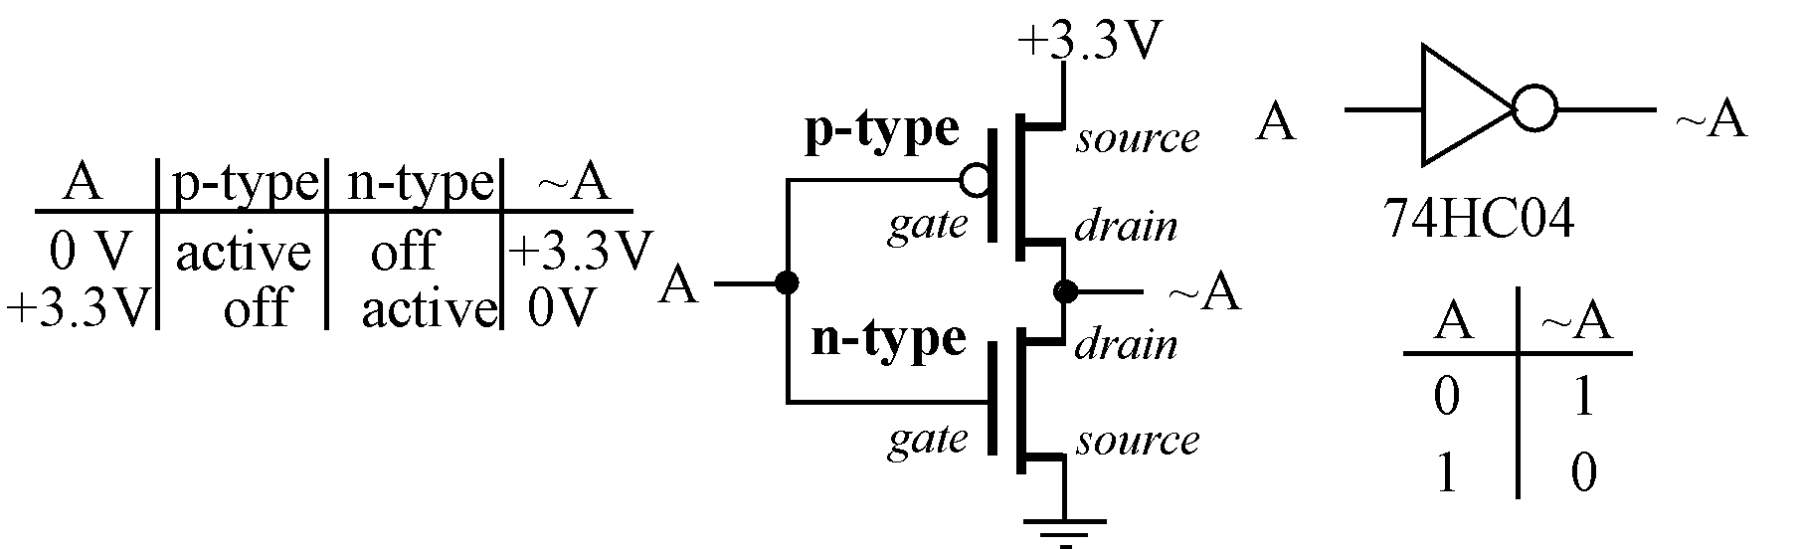
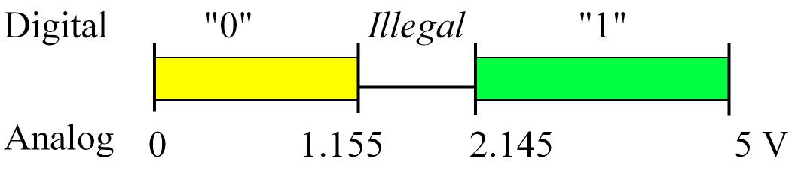
Review: Digital Logic
AND, OR, NOT
Flip flops
Registers
Positive logic: Negative logic :
True is higher voltage True is lower voltage
False is lower voltage False is higher voltage
Notes:
5

Slide 6
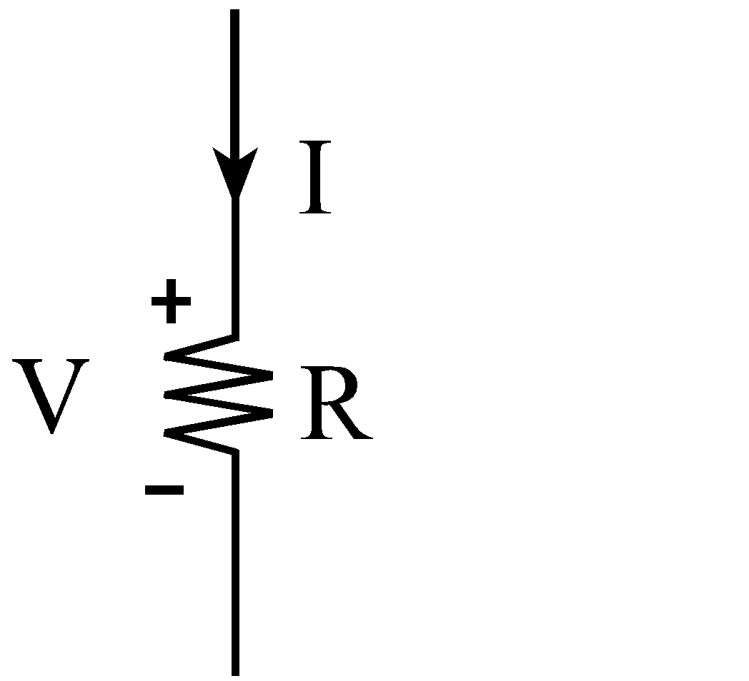
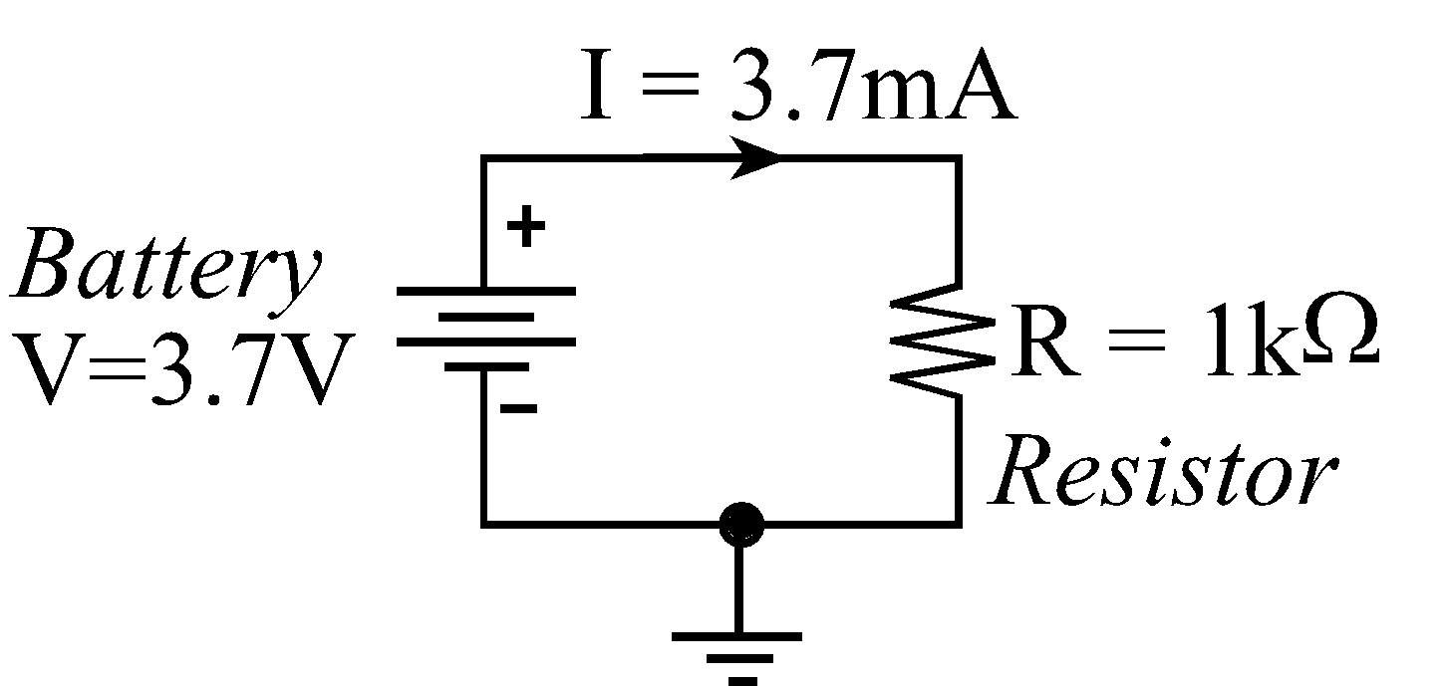
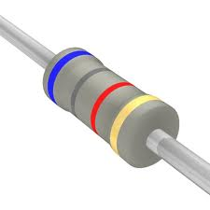
Review: Ohm’s Law
V = I * R Voltage = Current * Resistance
I = V / R Current = Voltage / Resistance
R = V / I Resistance = Voltage / Current
P = V * I Power = Voltage * Current
P = V² / R Power = Voltage² / Resistance
P = I² * R Power = Current² * Resistance
1 amp is 6.241×10¹⁸ electrons per second = 1 coulomb/sec

Slide 7
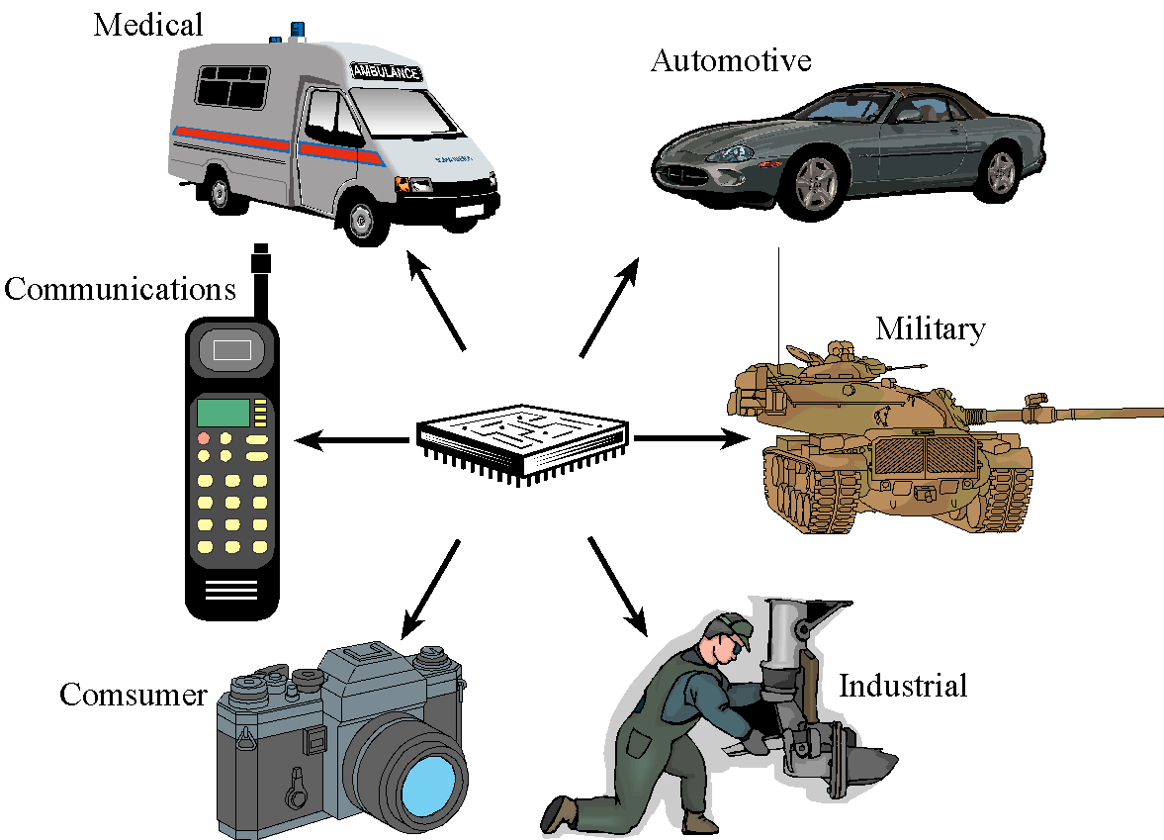
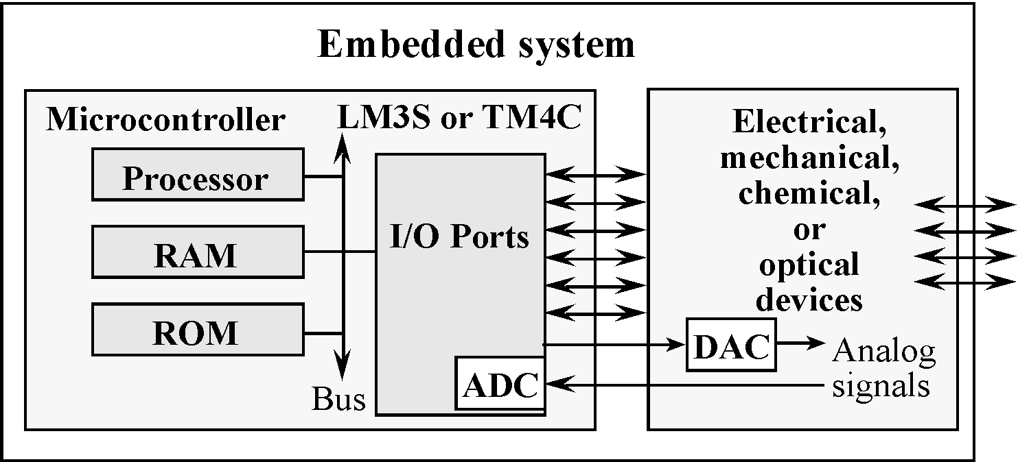
Embedded System
Embedded Systems are everywhere
Ubiquitous, invisible
Hidden (computer inside)
Dedicated purpose
Microprocessor
Intel: 4004, ..8080,.. x86
Freescale: 6800, .. 9S12,.. PowerPC
ARM, DEC, SPARC, MIPS, PowerPC, Natl. Semi.,…
Microcontroller
Processor+Memory+ I/O Ports (Interfaces)
Notes:
7
Consumer electronics: Washing machine, Exercise equipment, Remote controls, Clocks and watches, Games and toys, Audio/video electronics, Set-back thermostats, Camera, Camcorder, Television, VCR, cable box
Communication systems: Answering machines, Telephones, Fax machines, Radios, Cellular phones, pagers
Automotive systems: Automatic breaking, Noise cancellation, Locks, Electronic ignition, Power windows and seats, Cruise control, Collision avoidance, Climate control, Emission control, Instrumentation
Military hardware: Smart weapons, Missile guidance systems, Global positioning systems, Surveillance systems
Business applications: Cash registers, Vending machines, ATM machines, Traffic controllers, Industrial robots, Bar code readers and writers, Automatic sprinklers, Elevator controllers, RFID systems, Lighting and heating systems
Medical devices: Monitors, Drug delivery systems, Cancer treatments, Pacemakers, Prosthetic devices, Dialysis machines

Slide 8
Microcontroller
Processor – Instruction Set + memory + accelerators
Ecosystem
Memory
Non-Volatile
ROM
EPROM, EEPROM, Flash
Volatile
RAM (DRAM, SRAM)
Interfaces
H/W: Ports
S/W: Device Driver
Parallel, Serial, Analog, Time
I/O
Memory-mapped vs. I/O-instructions (I/O-mapped)

Slide 9
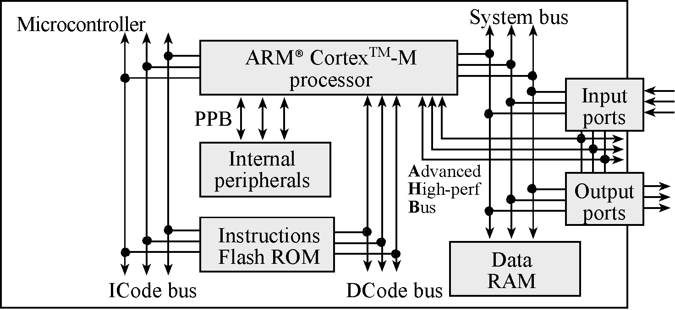
ARM Cortex M4-based System
ARM Cortex-M4 processor
Harvard architecture
Different busses for instructions and data

Slide 10
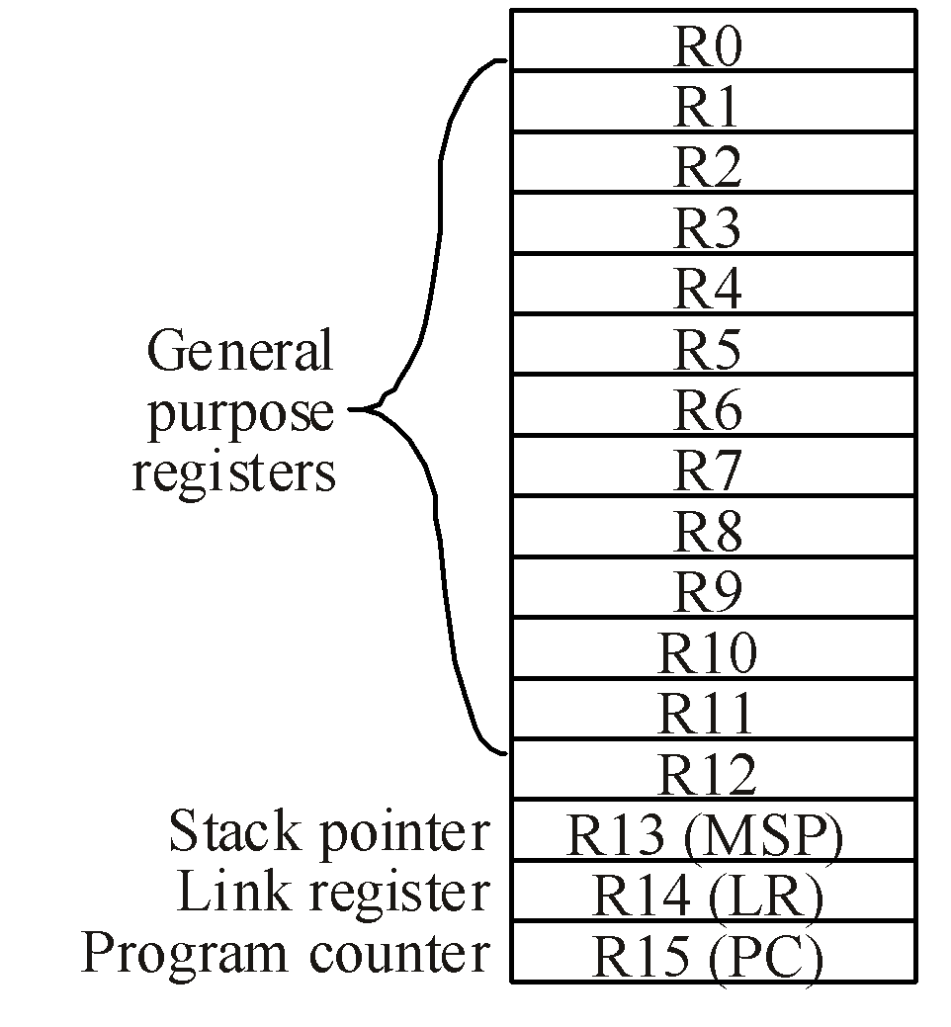
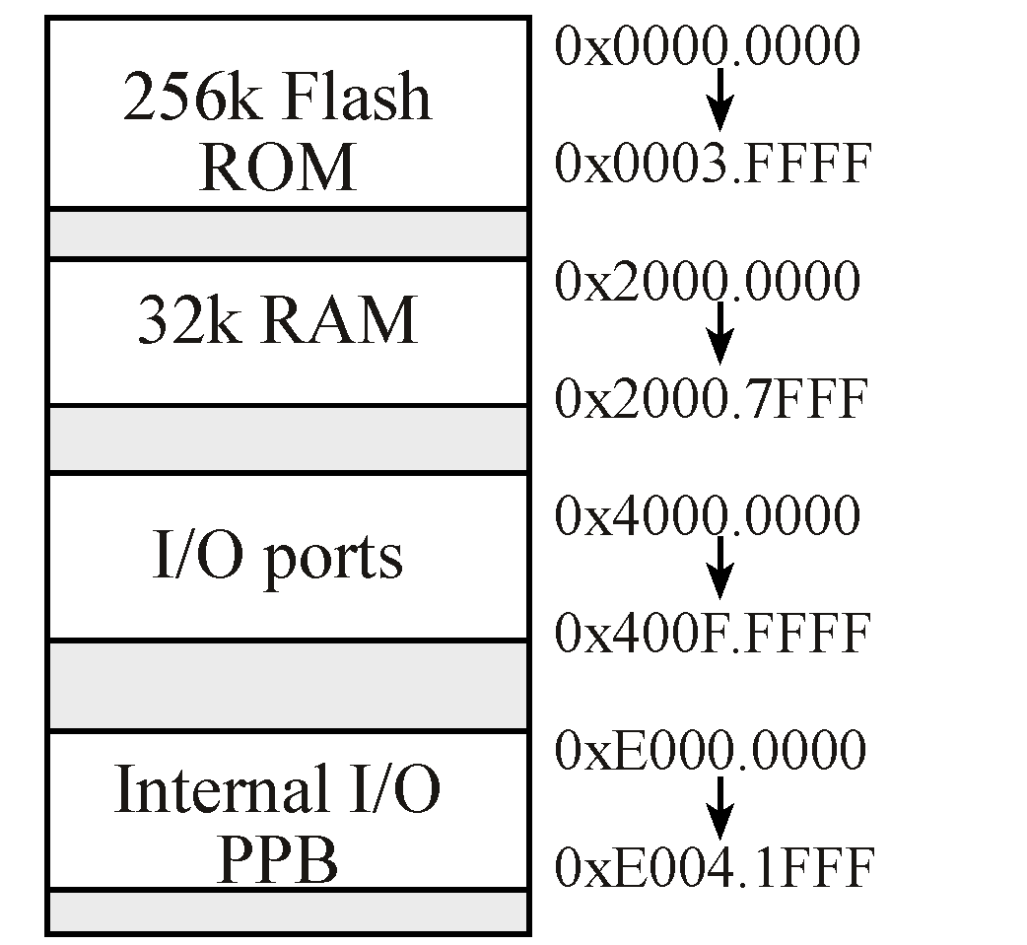
ARM ISA: Registers, Memory-map
Condition Code Bit s Indicates
N negative Result is negative
Z zero Result is zero
V overflow Signed overflow
C carry Unsigned overflow
TI TM4C123 Microcontroller
Notes:
10
The LC3 computer from EE 306 had an address space of 64Ki and an addressability of 16-bit for a total of 128KiB. The Memory Address Register (MAR) is 16 bits and the Memory Data Register (MDR) is also 16-bits.
Vs.
On the ARM, the MAR is 32-bits. Total addressable memory is 4GiB. It has flexible addressability (bit,byte-8bits,halfword-16bits,word-32bits)
The PC points to the address of the current instruction (Program Counter)
The Link Register is akin to Register R7 in LC3 used to store the return address on subroutine calls.
The stack is a temporary storage implemented in the RAM. We push and pop elements onto and off the stack as we desire. The stack pointer (SP) keeps track of the current location of the “top” of the stack.
The CC (condition-code) bits contain codes that reflect the results of the most recent instruction. Many “branch” type instructions “test” these bits for their operation. The Program Status Register (PSR) has them.

Slide 11
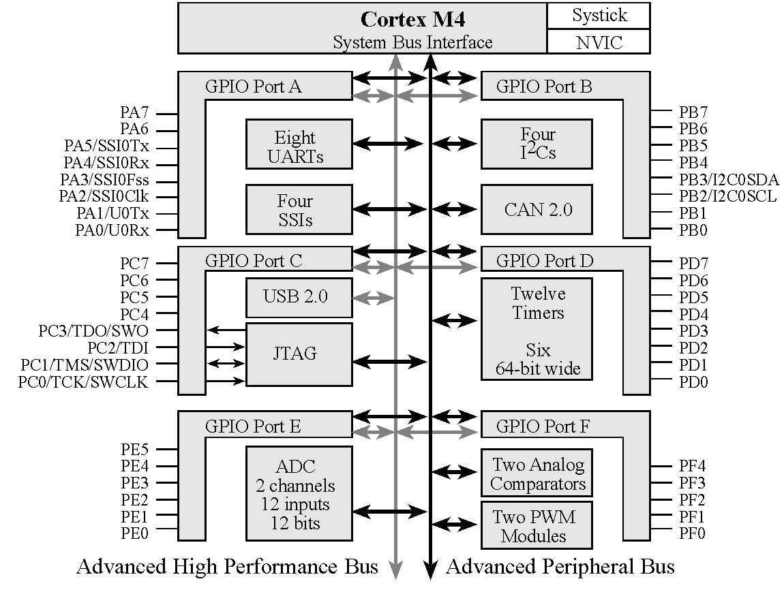
Texas Instruments TM4C123
ARM Cortex-M4
+ 256K EEPROM + 32K RAM
+ JTAG
+ Ports
+ SysTick
+ ADC
+ UART

Slide 12
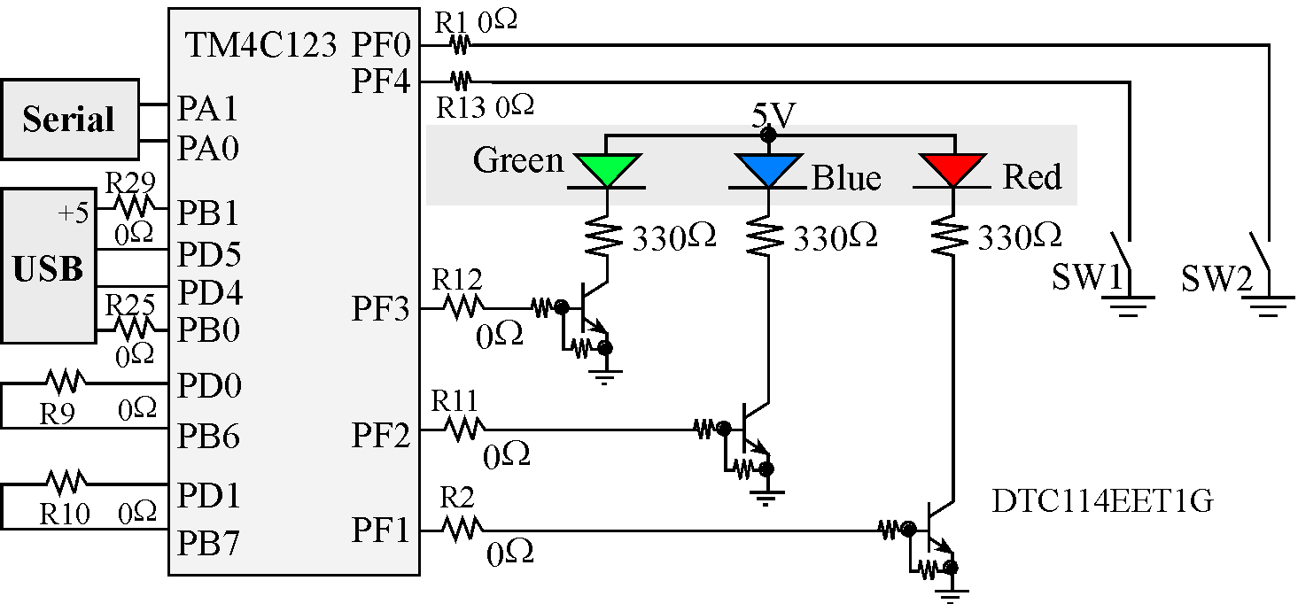
LaunchPad Switches and LEDs
The switches on the LaunchPad
Negative logic
Require internal pull-up (set bits in PUR)
The PF3-1 LEDs are positive logic

Slide 13
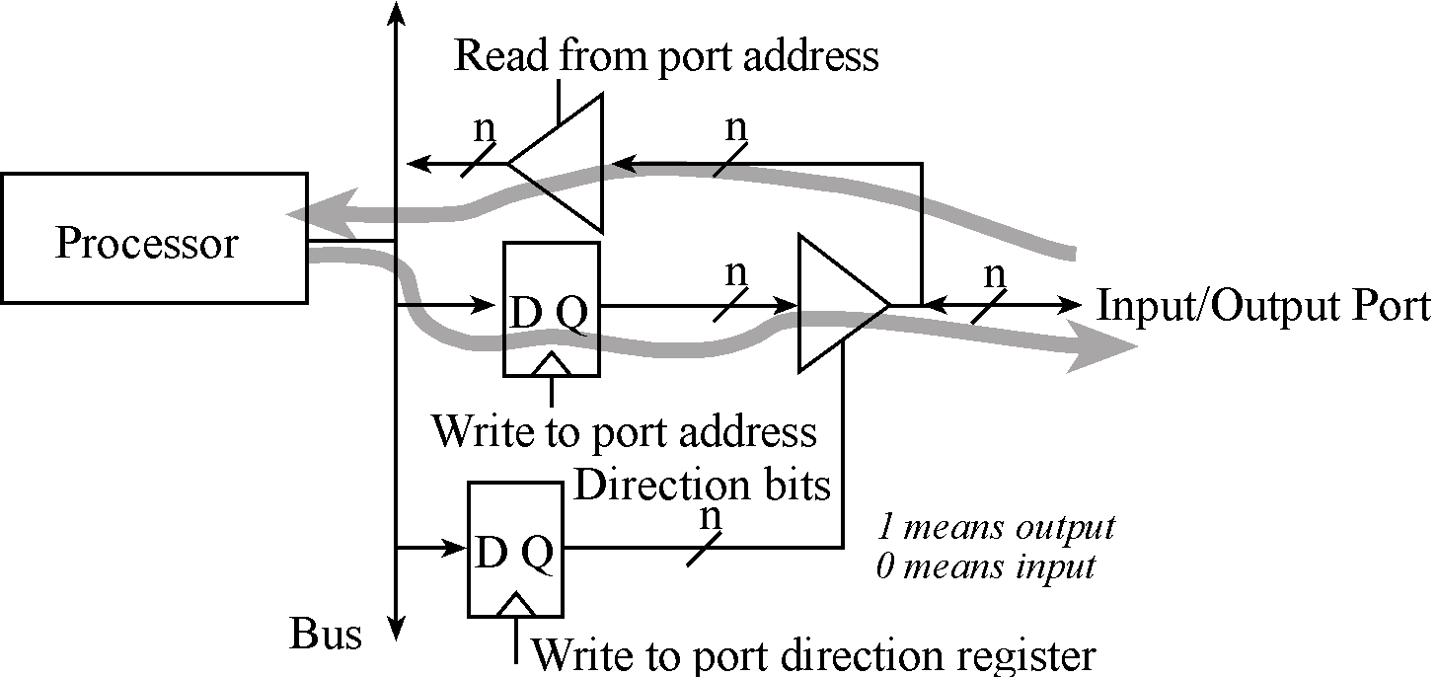
I/O Ports and Control Registers
GPIO_PORTF_DATA_R
GPIO_PORTF_DIR_R
The input/output direction of a bidirectional port is specified by its direction register.
GPIO_PORTF_DIR_R , specify if corresponding pin is input or output:
0 means input
1 means output

Slide 14
I/O Ports and Control Registers
Address | 7 | 6 | 5 | 4 | 3 | 2 | 1 | 0 | Name
400F.E608 | - | - | GPIOF | GPIOE | GPIOD | GPIOC | GPIOB | GPIOA | SYSCTL_RCGCGPIO_R
4002.53FC | - | - | - | DATA | DATA | DATA | DATA | DATA | GPIO_PORTF_DATA_R
4002.5400 | - | - | - | DIR | DIR | DIR | DIR | DIR | GPIO_PORTF_DIR_R
4002.551C | - | - | - | DEN | DEN | DEN | DEN | DEN | GPIO_PORTF_DEN_R
Initialization (executed once at beginning)
Turn on clock in SYSCTL_RCGCGPIO_R
Wait two bus cycles (two NOP instructions)
Write DIR bit, 1 for output or 0 for input
Set DEN bits to 1 to enable data pins
Input/output from pin
Input: Read from GPIO_PORTF_DATA_R
Output: Write GPIO_PORTF_DATA_R
Notes:
14
See example project InputOutput_4C123asm for a good example of how to initialize ports. Note that this example also disables analog functionality, but this is not necessary because done by default currently.

Slide 15
ARM is a Load-Store machine
Code to set (to 1) bit 5 of memory address 0x400FE608
SYSCTL_RCGCGPIO_R EQU 0x400FE608
; EQU pseudo-op allows use of
; symbolic name to represent a constant
LDR R1, =SYSCTL_RCGCGPIO_R ; R1 holds 0x400FE608
LDR R0, [R1] ; R0 holds contents of
; location 0x400FE608
ORR R0, R0, #0x20 ; bit5 of R0 is set to 1
STR R0, [R1] ; write R0 contents back to
; location 0x400FE608
Notes:
Notice the friendly coding and style

Slide 16
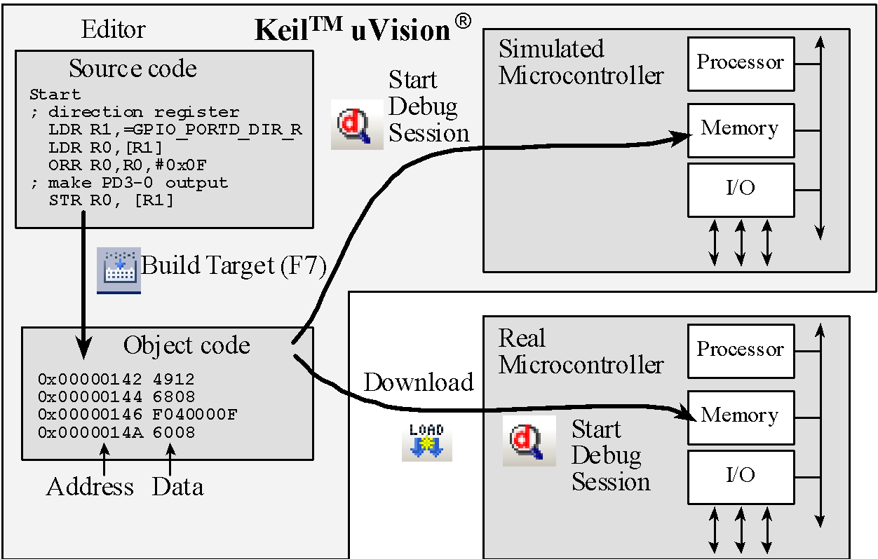
SW Development Environment

Slide 17
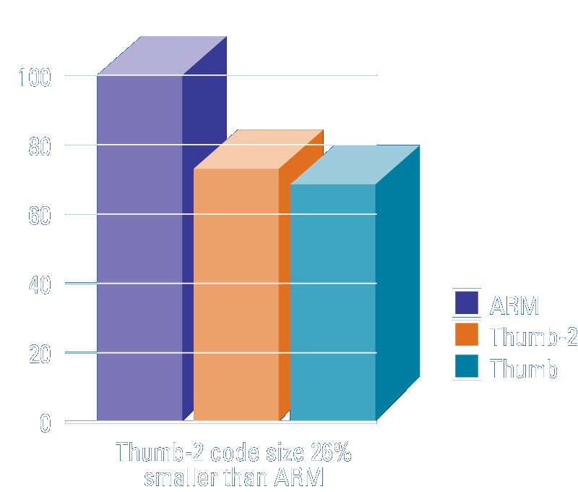
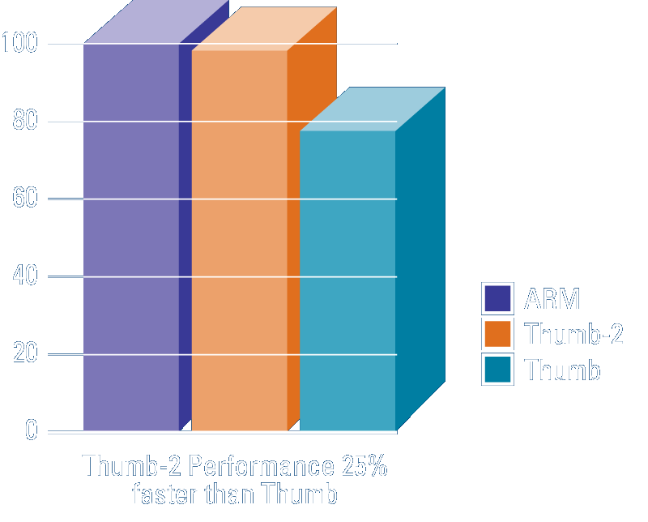
ARM ISA: Thumb2 Instruction Set
Variable-length instructions
ARM instructions are a fixed length of 32 bits
Thumb instructions are a fixed length of 16 bits
Thumb-2 instructions can be either 16-bit or 32-bit
Thumb-2 gives approximately 26% improvement in code density over ARM
Thumb-2 gives approximately 25% improvement in performance over Thumb

Slide 18
ARM Cortex M4-based System
“RISC” machine
Pipelining provides effectively single cycle operation for many instructions
Thumb-2 configuration employs both 16 and 32 bit instructions
CISC | RISC
Many instructions | Few instructions
Instructions execute in varying times | Instructions execute in varying times (in the past, just 1 or 2 cycles)
Many instructions access memory | Few memory instructions Load from memory to register Store from register to memory
Many instructions both read and write memory | A few special “atomic memory operations” can read and write memory in single inst.
Fewer and some specialized registers | Many identical general-purpose registers
Numerous address modes | Limited number of addressing modes: register, immediate, and indexed.

Slide 19
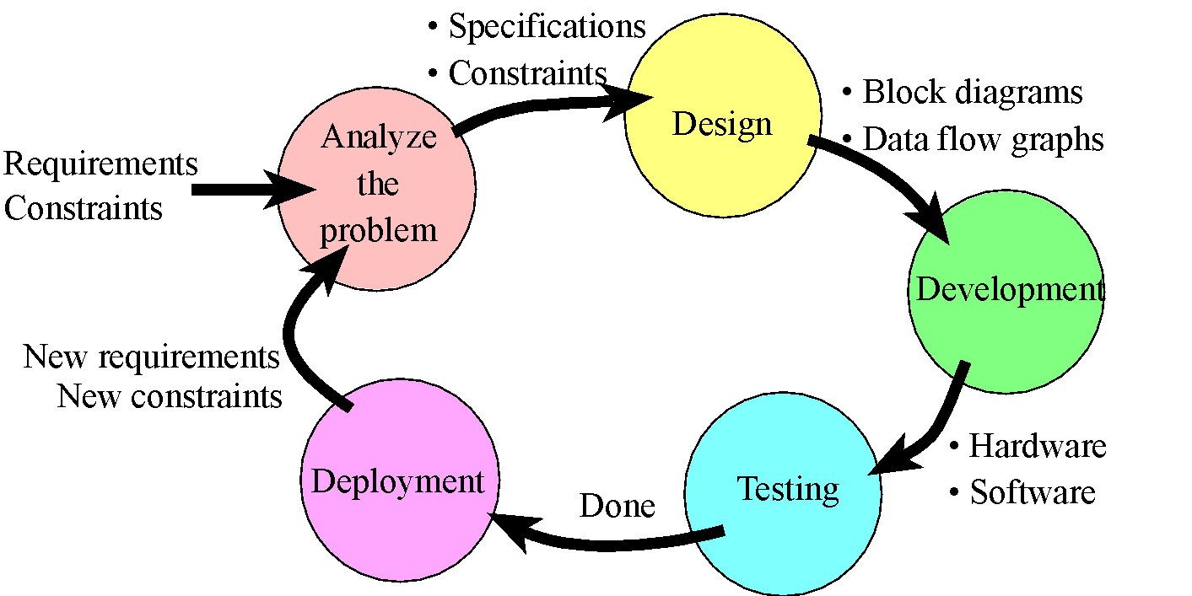
Product Life Cycle
Analysis (What?)
Requirements -> Specifications
Design (How?)
High-Level: Block Diagrams
Engineering: Algorithms, Data Structures, Interfacing
Implementation(Real)
Hardware, Software
Testing (Works?)
Validation:Correctness
Performance: Efficiency
Maintenance (Improve)
Notes:
19

Slide 20
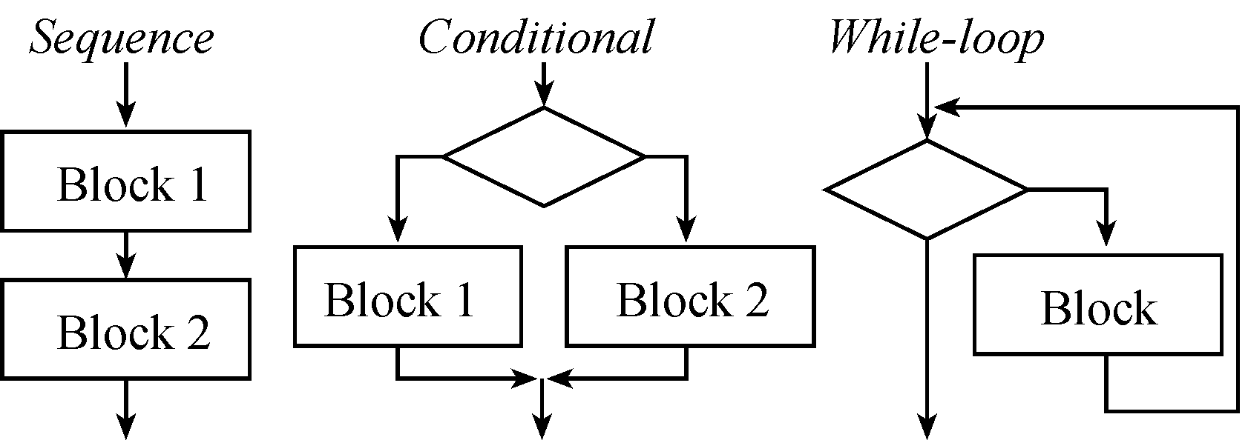
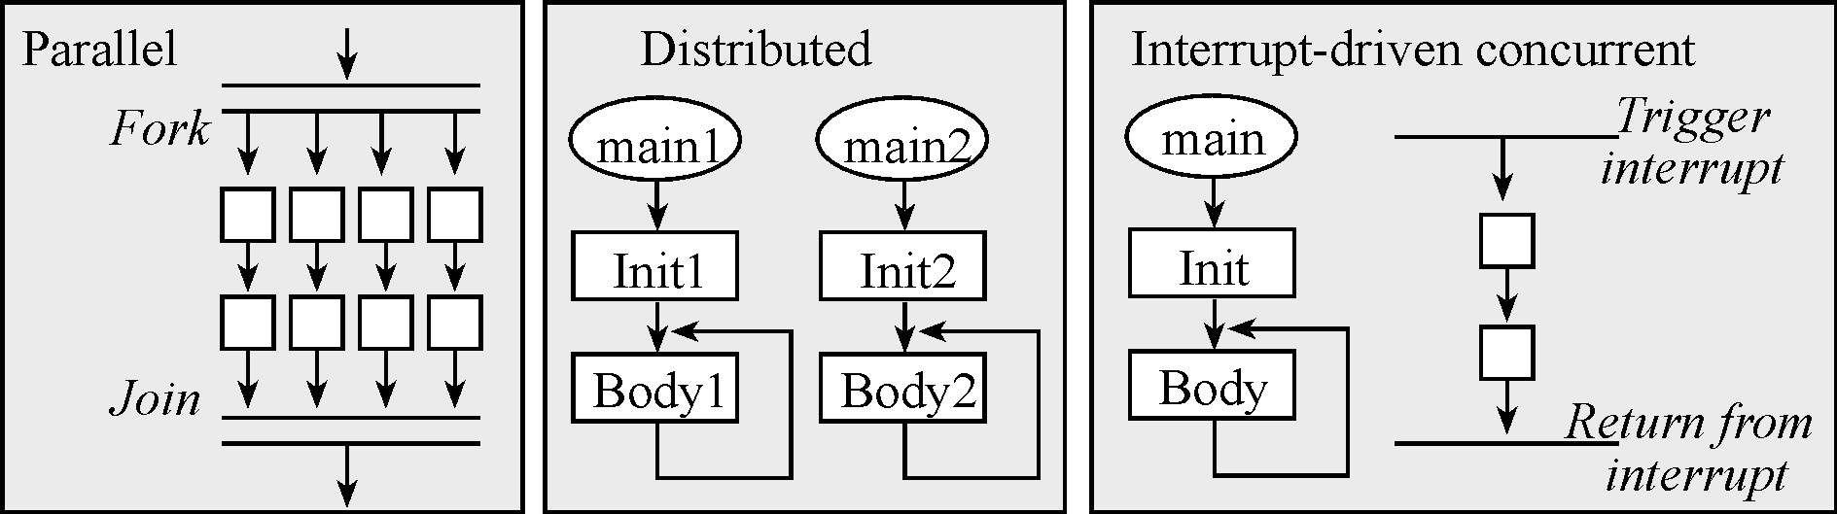
Structured Programming
Common Constructs (as Flowcharts, also pseudocode)
Notes:
20

Slide 21
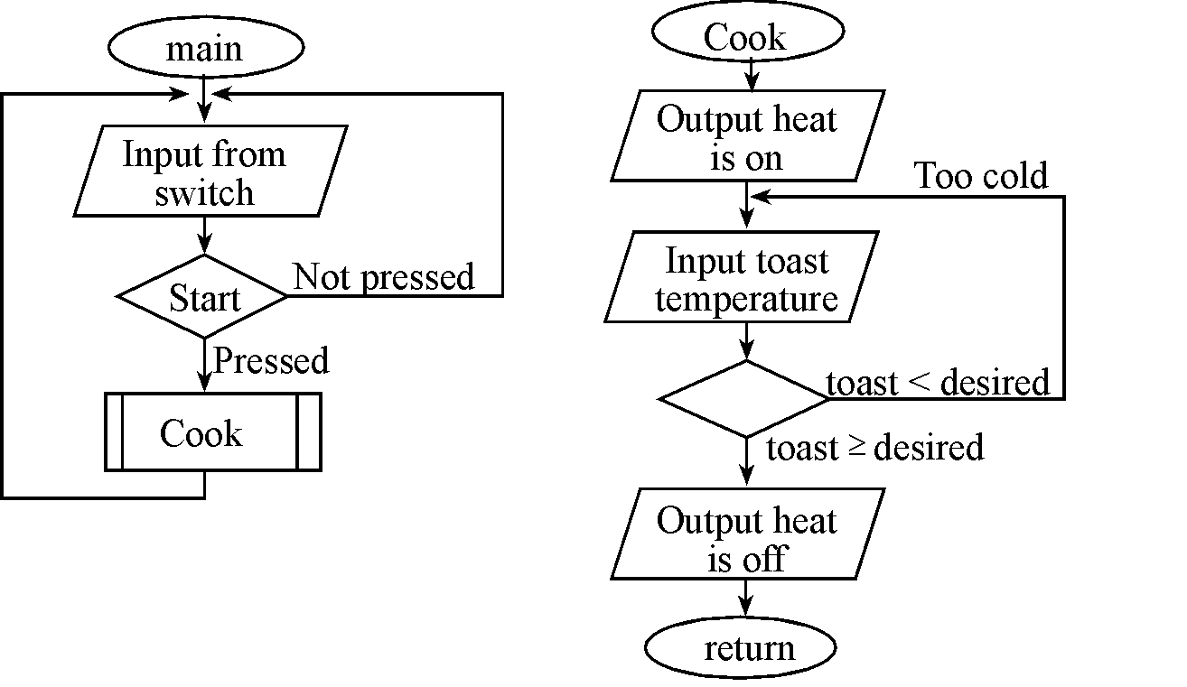
Flowchart
Toaster oven:
Coding in assembly and/or high-level language (C)

Slide 22
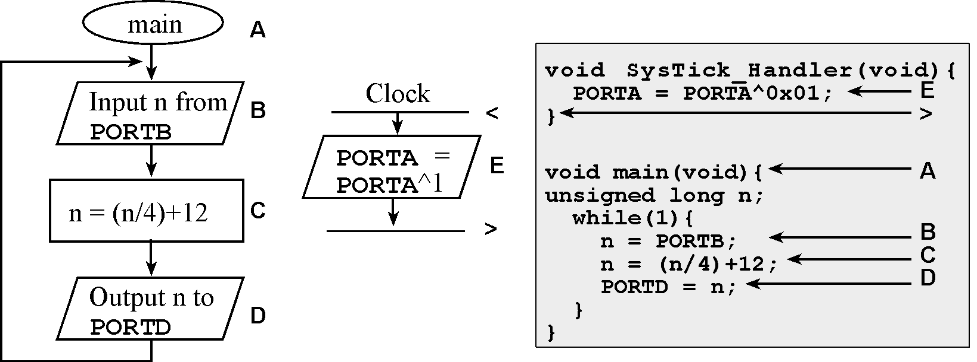
Flowchart
Example 1.3. Design a flowchart for a system that performs two independent tasks. The first task is to output a 20 kHz square wave on PORTA in real time (period is 50 ms). The second task is to read a value from PORTB, divide the value by 4, add 12, and output the result on PORTD. This second task is repeated over and over.
Notes:
22

