Slide 1
COMP-462 Embedded Systems
Lecture 2: I/O, Logic/Shift Operations, Addressing modes, Memory Operations, Subroutines, Introduction to C

Slide 2
Agenda
Recap
Embedded systems
Product life cycle
ARM programming
Outline
Input/output
Logical/shift operations
Addressing modes, memory operations
Stack and subroutines
Introduction to C
Structure of a C program
Variables, expressions and assignments

Slide 3
ARM Assembly Language
Assembly format
Label Opcode Operands Comment
init MOV R0, #100 ; set table size
BX LR
Comments
Comments should explain why or how
Comments should not explain the opcode and its operands
Comments are a major component of self-documenting code

Slide 4
Simple Addressing Modes
Second operand - <op2>
ADD Rd, Rn, <op2>
Constant
ADD Rd, Rn, #constant ; Rd = Rn+constant
Shift
ADD R0, R1, LSL #4 ; R0 = R0+(R1*16)
ADD R0, R1, R2, ASR #4 ; R0 = R1+(R2/16)
Memory accessed only with LDR STR
Constant in ROM: =Constant / [PC,#offs]
Variable on the stack: [SP,#offs]
Global variable in RAM: [Rx]
I/O port: [Rx]

Slide 5
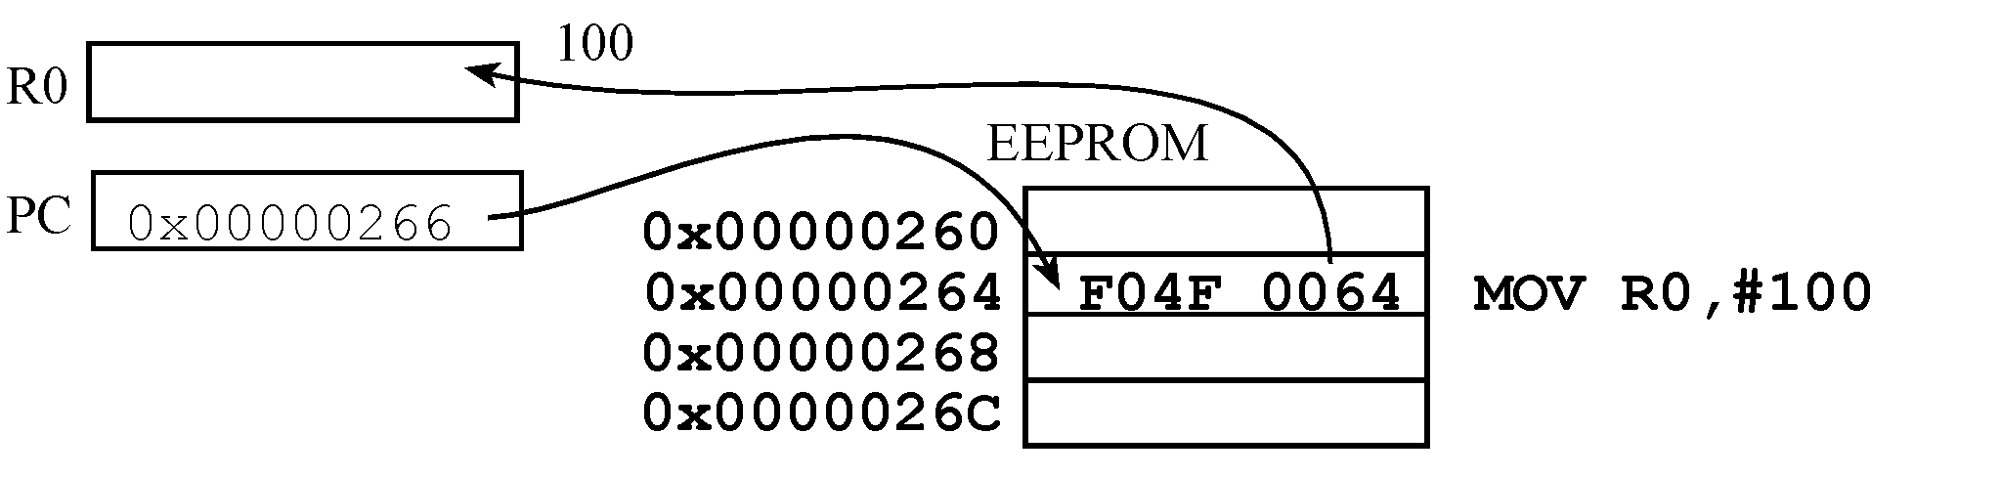
Addressing Modes
Immediate addressing
Data is contained in the instruction
MOV R0,#100 ; R0=100, immediate addressing

Slide 6
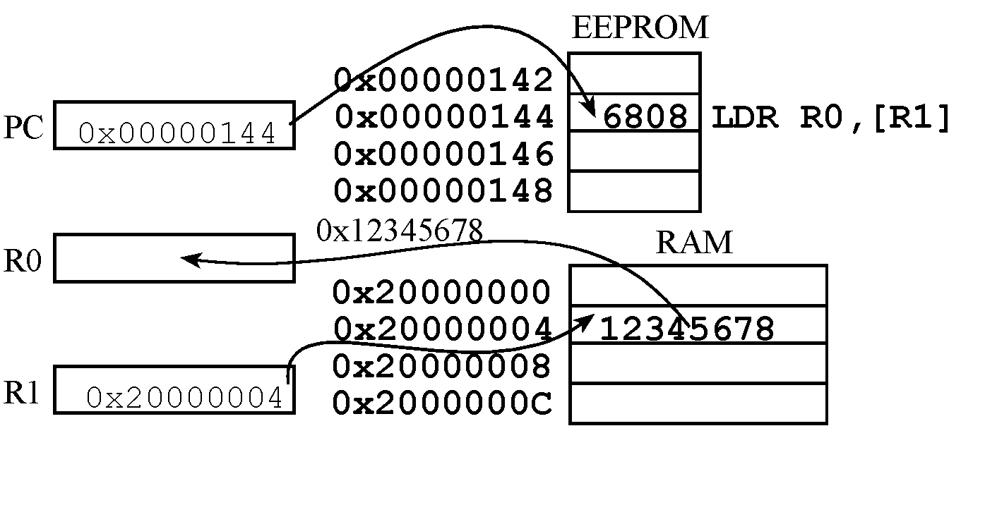
Addressing Modes
Indexed Addressing
Address of the data in memory is in a register
LDR R0,[R1] ; R0= value pointed to by R1

Slide 7
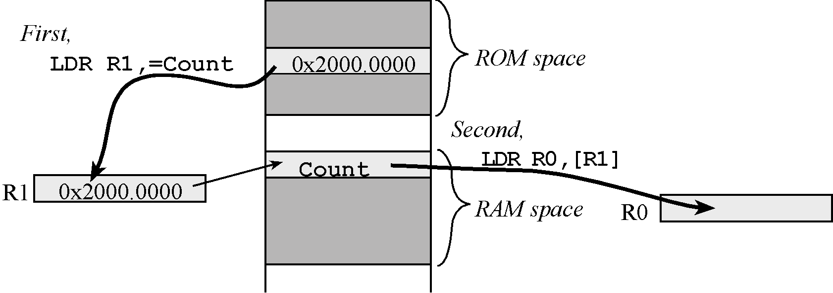
Addressing Modes
PC Relative Addressing
Address of data in EEPROM is indexed based upon the Program Counter

Slide 8
Memory Access Instructions
Loading a register with a constant, address, or data
LDR Rd, =number
LDR Rd, =label
LDR and STR used to load/store RAM using register-indexed addressing
Register [R0]
Base address plus offset [R0,#16]

Slide 9
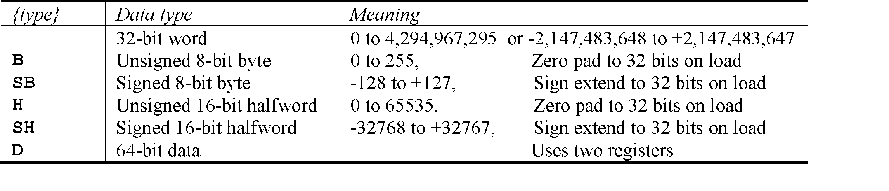
Load/Store Instructions
General load/store instruction format
LDR{type} Rd,[Rn] ;load memory at [Rn] to Rd
STR{type} Rt,[Rn] ;store Rt to memory at [Rn]
LDR{type} Rd,[Rn, #n] ;load memory at [Rn+n] to Rd
STR{type} Rt,[Rn, #n] ;store Rt to memory [Rn+n]
LDR{type} Rd,[Rn,Rm,LSL #n] ;load [Rn+Rm<<n] to Rd
STR{type} Rt,[Rn,Rm,LSL #n] ;store Rt to [Rn+Rm<<n]

Slide 10
Logic Operations
A Rn | B Operand2 | A&B AND | A|B ORR | A^B EOR | A&(~B) BIC | A|(~B) ORN
0 | 0 | 0 | 0 | 0 | 0 | 1
0 | 1 | 0 | 1 | 1 | 0 | 0
1 | 0 | 0 | 1 | 1 | 1 | 1
1 | 1 | 1 | 1 | 0 | 0 | 1
Logic Instructions
AND{S} {Rd,} Rn, <op2> ; Rd=Rn&op2
ORR{S} {Rd,} Rn, <op2> ; Rd=Rn|op2
EOR{S} {Rd,} Rn, <op2> ; Rd=Rn^op2
BIC{S} {Rd,} Rn, <op2> ; Rd=Rn&(~op2)
ORN{S} {Rd,} Rn, <op2> ; Rd=Rn|(~op2)

Slide 11
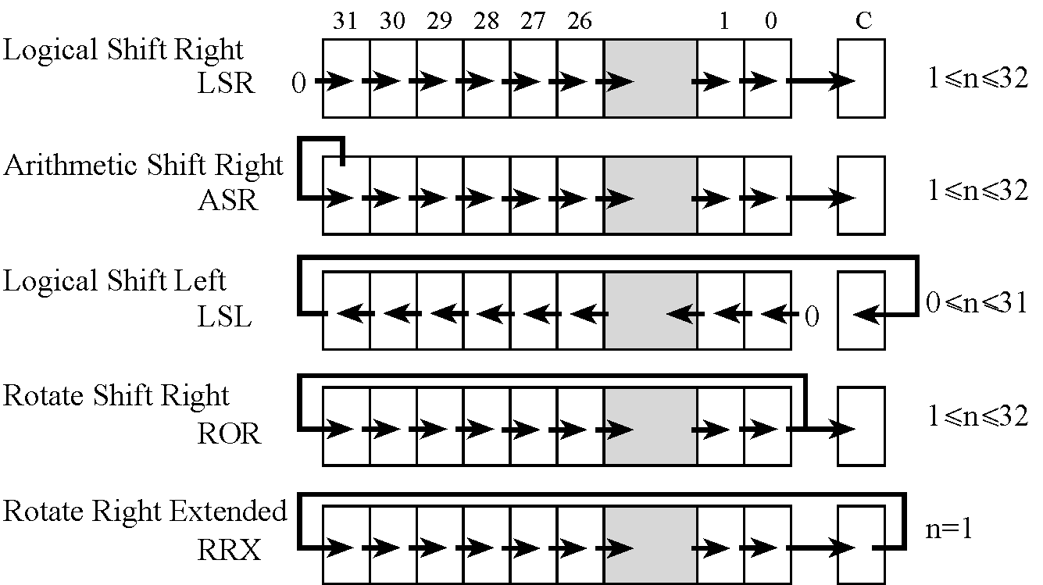
Shift Operations
Use the ASR instruction when manipulating signed numbers,
and use the LSR instruction when shifting unsigned numbers

Slide 12
The Stack
Stack is last-in-first-out (LIFO) storage
32-bit data
Stack pointer, SP or R13, points to top element of stack
Stack pointer decremented as data placed on stack
PUSH and POP instructions used to load and retrieve data

Slide 13
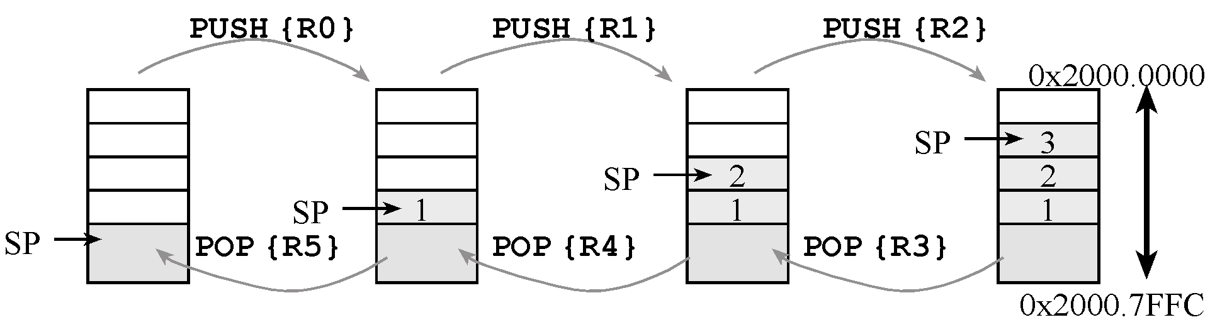
The Stack
Stack is last-in-first-out (LIFO) storage
32-bit data
Stack pointer, SP or R13, points to top element of stack
Stack pointer decremented as data placed on stack (incremented when data is removed)
PUSH and POP instructions used to load and retrieve data

Slide 14
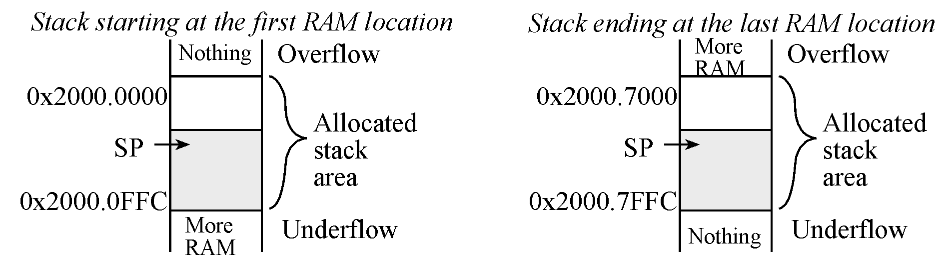
Stack Usage
Stack memory allocation
Rules for stack use
Stack should always be balanced, i.e. functions should have an equal number of pushes and pops
Stack accesses (push or pop) should not be performed outside the allocated area
Stack reads and writes should not be performed within the free area

Slide 15
To set
The or operation to set bits 1 and 0 of a register.
The other six bits remain constant.
Friendly software modifies just the bits that need to be. GPIO_PORTD_DIR_R |= 0x03; // PD1,PD0 outputs
Assembly:
LDR R0,=GPIO_PORTD_DIR_R
LDR R1,[R0] ; read previous value
ORR R1,R1,#0x03 ; set bits 0 and 1
STR R1,[R0] ; update
c₇ c₆ c₅ c₄ c₃ c₂ c₁ c₀ value of R1
0 0 0 0 0 0 1 1 0x03 constant
c₇ c₆ c₅ c₄ c₃ c₂ 1 1 result of the ORR

Slide 16
To toggle
The exclusive or operation can also be used to toggle bits.
EXA-1: Write a program to toggle PD7. Assume all register configuration all done to make PD7 an output pin.
C program:
GPIO_PORTD_DATA_R ^= 0x80; /* toggle PD7 */
Assembly:
LDR R0,=GPIO_PORTD_DATA_R
LDR R1,[R0] ; read port D
EOR R1,R1,#0x80 ; toggle bit 7
STR R1,[R0] ; update
b₇ b₆ b₅ b₄ b₃ b₂ b₁ b₀ value of R1
1 0 0 0 0 0 0 0 0x80 constant
~b₇ b₆ b₅ b₄ b₃ b₂ b₁ b₀ result of the EOR

Slide 17
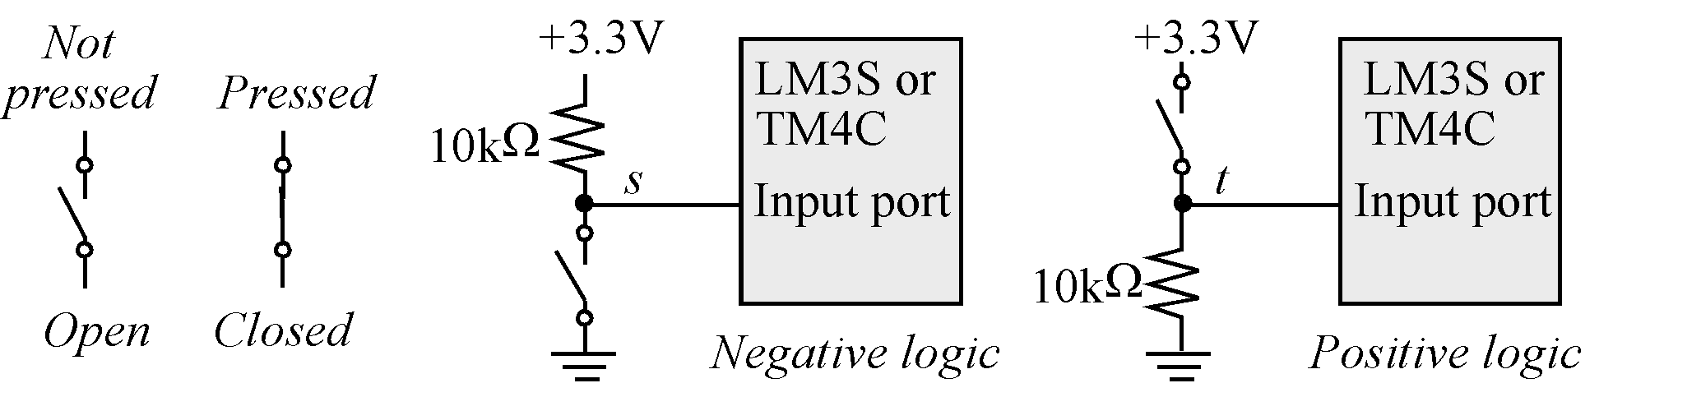
Switch Interfacing
EXA-2: Write an assembly program to read a switch and store it in a variable in the memory called “Pressed”.
The and operation to extract, or mask, individual bits: Pressed = GPIO_PORTA_DATA_R & 0x40;
//true if PA6 switch pressed
Assembly:
LDR R0,=GPIO_PORTA_DATA_R
LDR R1,[R0] ; read port A
AND R1,R1,#0x40 ; clear all bits except bit 6
LDR R0,=Pressed ; update variable
STR R1,[R0] ; true iff switch pressed
a₇ a₆ a₅ a₄ a₃ a₂ a₁ a₀ value of R1
0 1 0 0 0 0 0 0 0x40 constant
0 a₆ 0 0 0 0 0 0 result of the AND

Slide 18
Shift Example
EXA-3: Write an assembly program to combine unsigned 4-bit High and Low component into 8-bit Result variable.
C program:
Result = (High<<4)|Low;
Assembly:
LDR R0,=High
LDR R1,[R0] ; read value of High
LSL R1,R1,#4 ; shift into position
LDR R0,=Low
LDR R2,[R0] ; read value of Low
ORR R1,R1,R2 ; combine the two parts
LDR R0,=Result
STR R1,[R0] ; save the answer
0 0 0 0 h₃ h₂ h₁ h₀ value of High in R1
h₃ h₂ h₁ h₀ 0 0 0 0 after last LSL
0 0 0 0 l₃ l₂ l₁ l₀ value of Low in R2
h₃ h₂ h₁ h₀ l₃ l₂ l₁ l₀ result of the ORR instruction

Slide 19
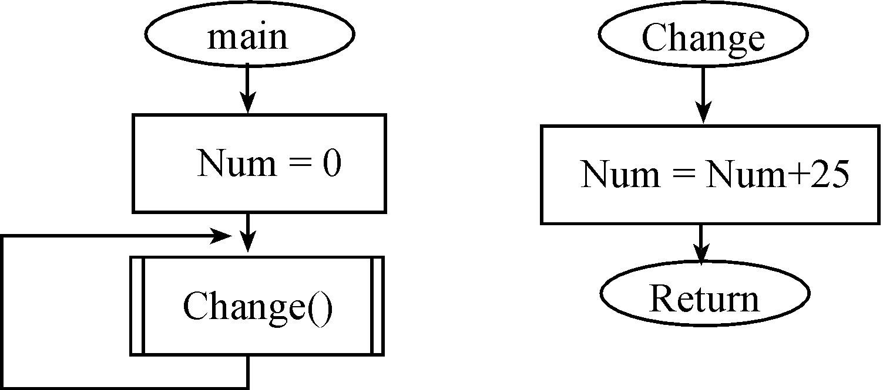
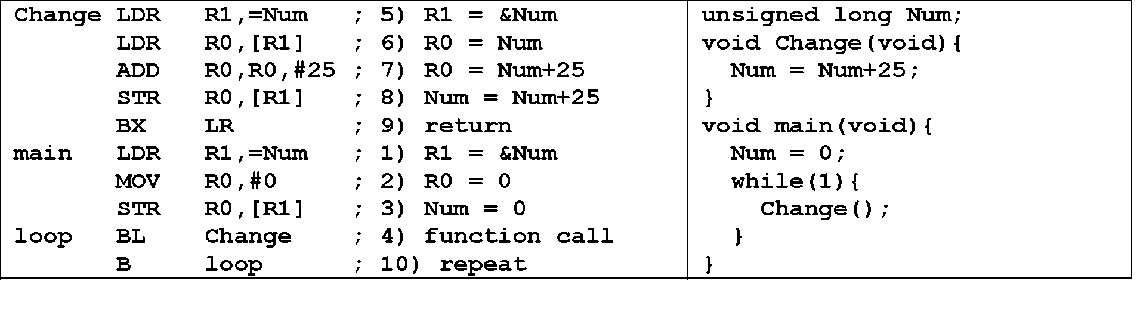
Functions

Slide 20

Design example
EXA-4: Design a not-gate using the Tiva Lauchpad. Steps are as follows:
a) Overall function, specifications
b) Data flow (test)
c) Flowchart (test)
d) Software (test)
c) Simulation, prototype (test)
e) Build (test)

Slide 21
Design
Function table (PE0 input, PE1 output)
How to test (switch input, LED output)
Draw a data flow graph
Draw a flowchart
Write pseudo code
Write assembly
Simulate

Slide 22
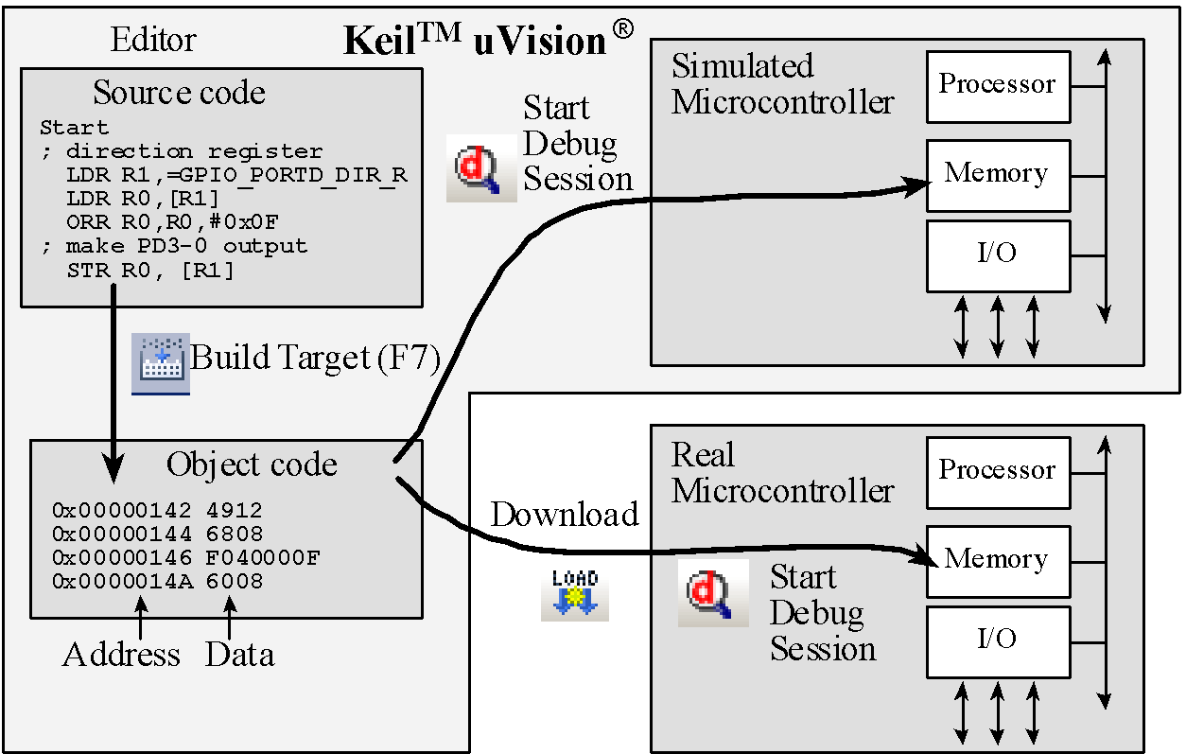
Process
Solution in NOTGate
Start Activate clock for port
Enable PE1, PE0 pins
Make PE0 (switch) pin an input
Make PE1 (LED) pin an output
Loop Read input from Switch (0 or 1)
PE1 = NOT(PE0)
Write output to LED
branch Loop
Build it, run it, test it.

Slide 23
Subroutines
;------------Rand100------------
; Return R0=a random number between
; 1 and 100. Call Random and then divide
; the generated number by 100
; return the remainder+1
Rand100
PUSH {LR} ; SAVE Link
BL Random
;R0 is a 32-bit random number
LDR R1,=100
BL Divide
ADD R0,R3,#1
POP {LR} ;Restore Link back
BX LR
;------------Divide------------
; find the unsigned quotient and remainder
; Inputs: dividend in R0
; divisor in R1
; Outputs: quotient in R2
; remainder in R3
;dividend = divisor*quotient + remainder
Divide
UDIV R2,R0,R1 ;R2=R0/R1,R2 is quotient
MUL R3,R2,R1 ;R3=(R0/R1)*R1
SUB R3,R0,R3 ;R3=R0%R1,
;R3 is remainder of R0/R1
BX LR ;return
ALIGN
END
POP {PC}
One function calls another, so LR must be saved

Slide 24
Reset, Subroutines and Stack
A Reset occurs immediately after power is applied and when the reset signal is asserted (Reset button pressed)
The Stack Pointer, SP (R13) is initialized at Reset to the 32-bit value at location 0 (Default: 0x20000408)
The Program Counter, PC (R15) is initialized at Reset to the 32-bit value at location 4 (Reset Vector)
The Link Register (R14) is initialized at Reset to 0xFFFFFFFF
Thumb bit is set at Reset
Processor automatically saves return address in LR when a subroutine call is invoked.
User can push and pull multiple registers on or from the Stack at subroutine entry and before subroutine return.

