Slide 1

Fuel Around
By Mason, Zachary, Patrick, and Matthew

Slide 2
Developer Setup
Android Studio
Virtual Box
Genymotion

Slide 3
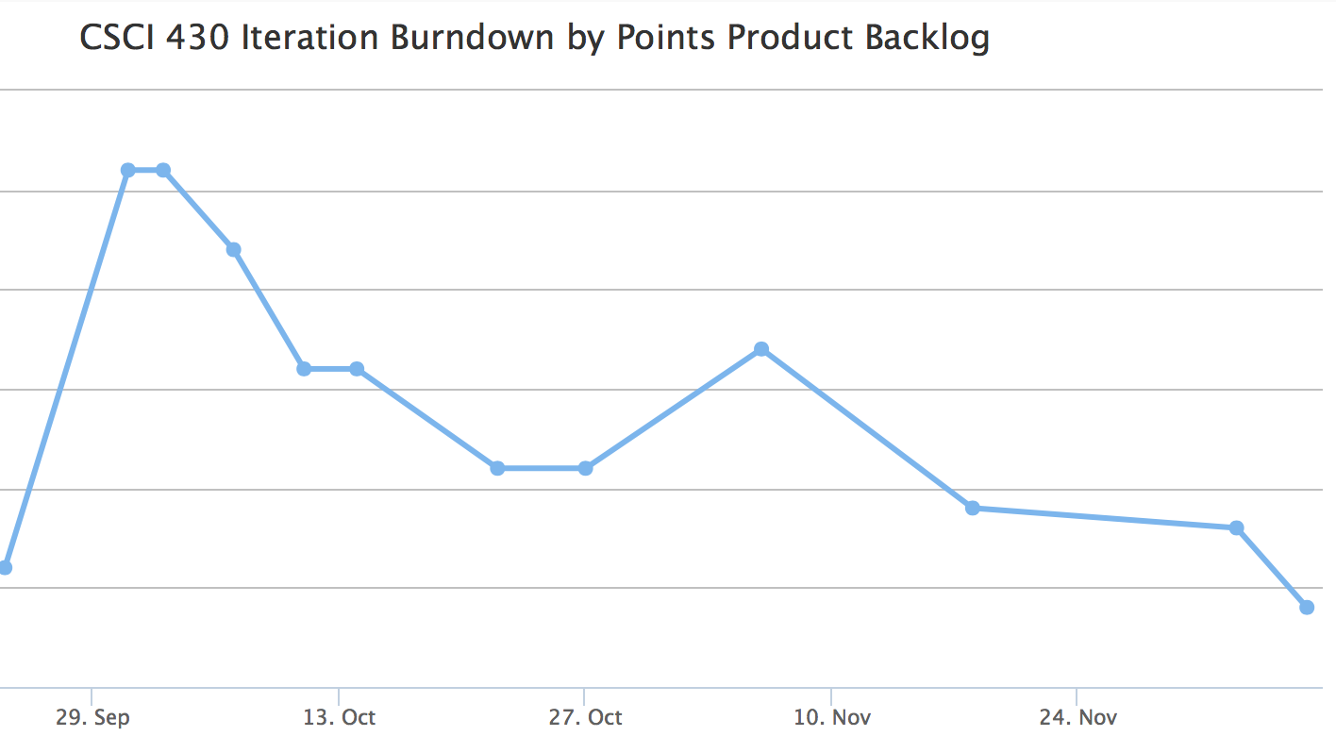

Slide 4
Architectural Design
MVA vs. MVC
Why did we choose MVA?
Fat model & skinny controller

Slide 5
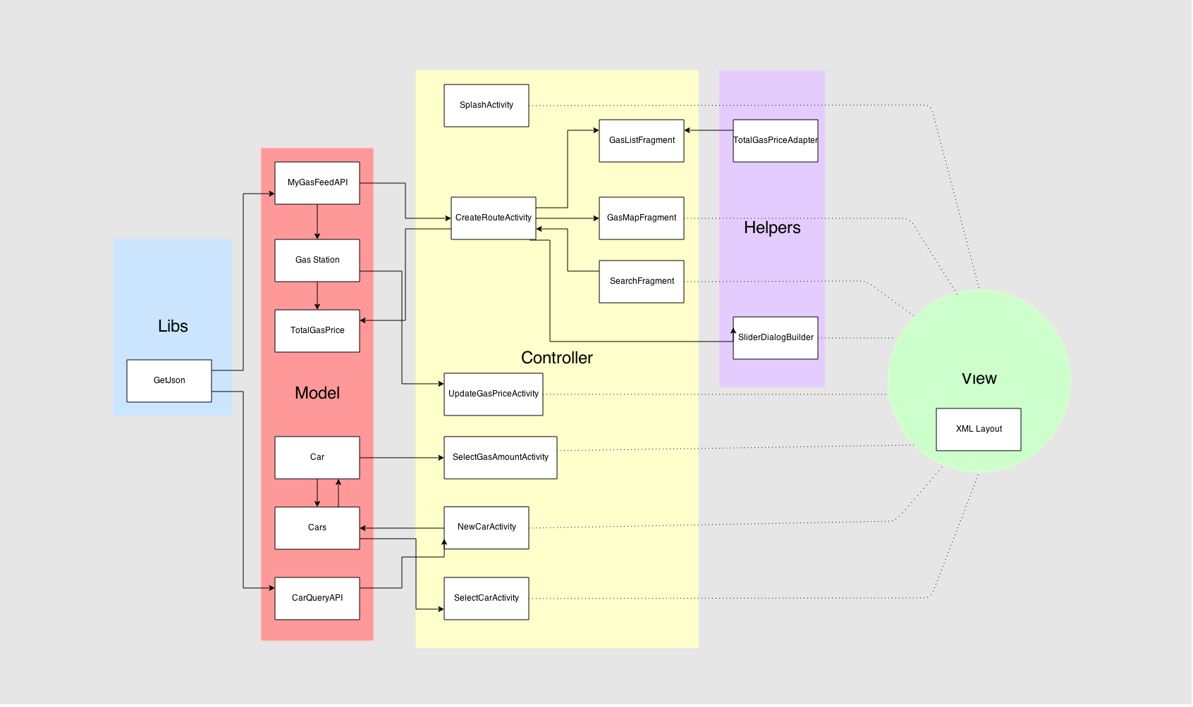

Slide 6
Project Overview

Slide 7
Antipatterns
God Class
Copy and Paste Programming
Reinventing the Wheel

Slide 8
Testing and complexity

Slide 9
If we had more time…
Add extended range for longer trips
User login
Updatable gas prices
Save location & search history

