Slide 1

Team Members:
Jason Boutte
Alejandro Velazquez
Darren Reitan

Slide 2
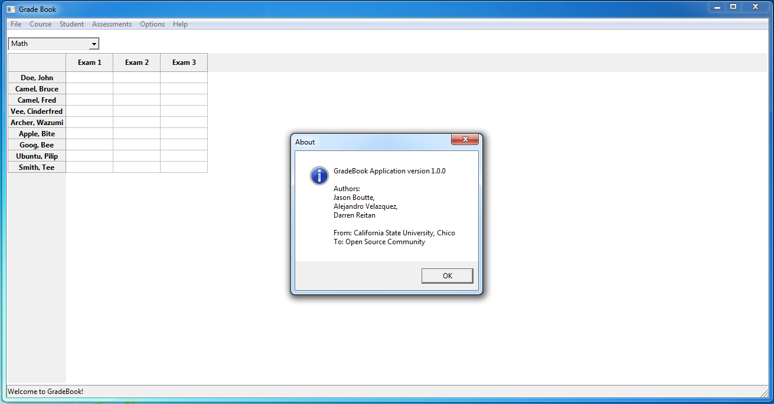
Welcome to Gradebook!

Slide 3
Overview
Gradebook targets …
Instructors at any educational institution.
Beginners to advance computer users.
Gradebook can …
Keeps track of students, their grades, and assessments.
Easily create graphs.
Imports students from either Blackboard Learn or Moodle.
Runs on a Windows or Unix based operating system.

Slide 4
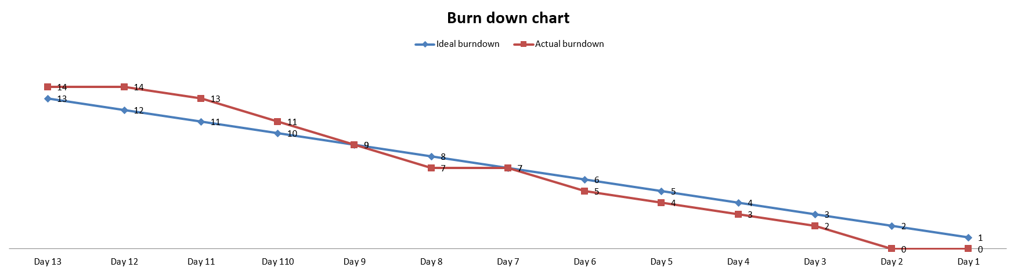
Sprint: September 8th – 24th “As a Teacher, I want to add multiple courses.”
Create File Menu GUI to add courses.
Create SQL interface for storing courses.
Connect SQL with GUI.

Slide 5
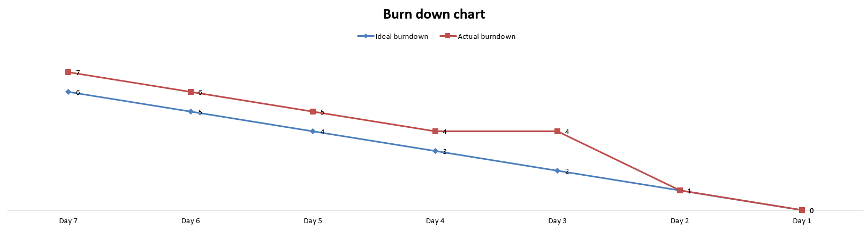
Sprint: September 25th – October 12th “As a Teacher, I want to add students to my course.”
Create GUI to add Students to Courses.
Add SQL interface for inserting Students into a Course.
Connect GUI and SQL code.
Add Students to Course.

Slide 6
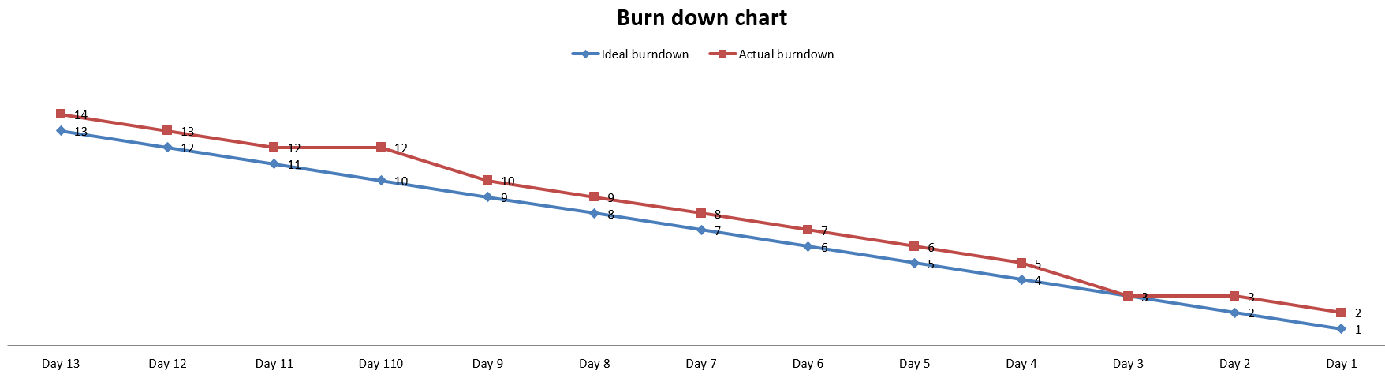
Sprint: October 13th – October 27th “As a Teacher, I want to add assessments.”
Create GUI to add Assessments.
Add SQL code for Assessments.
Connect GUI and SQL code for Assessments.
Add Assessments to class.

Slide 7
Design
Singleton Pattern
Observer Pattern
Model-View-Controller (MVC) Architecture

Slide 8
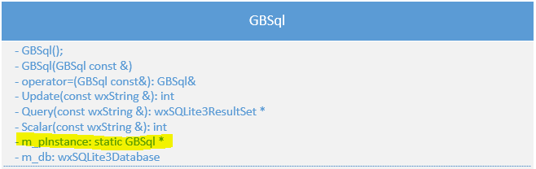
Sprint: October 28th – November 10th Implementing: Singleton, Observer, and MVC
Singleton Pattern
Why?

Slide 9
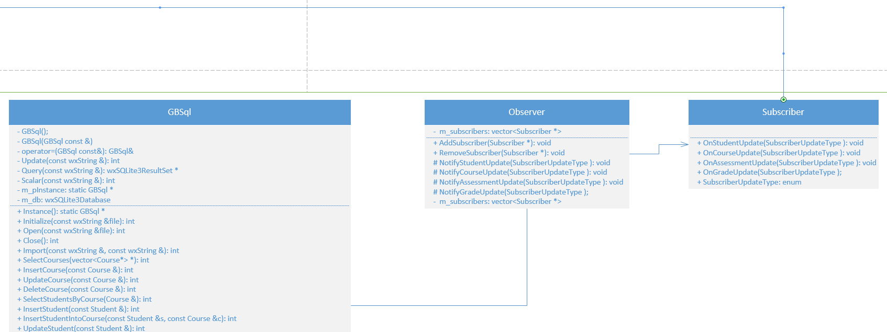
Sprint: October 28th – November 10th Implementing: Singleton, Observer, and MVC
Observer Pattern

Slide 10
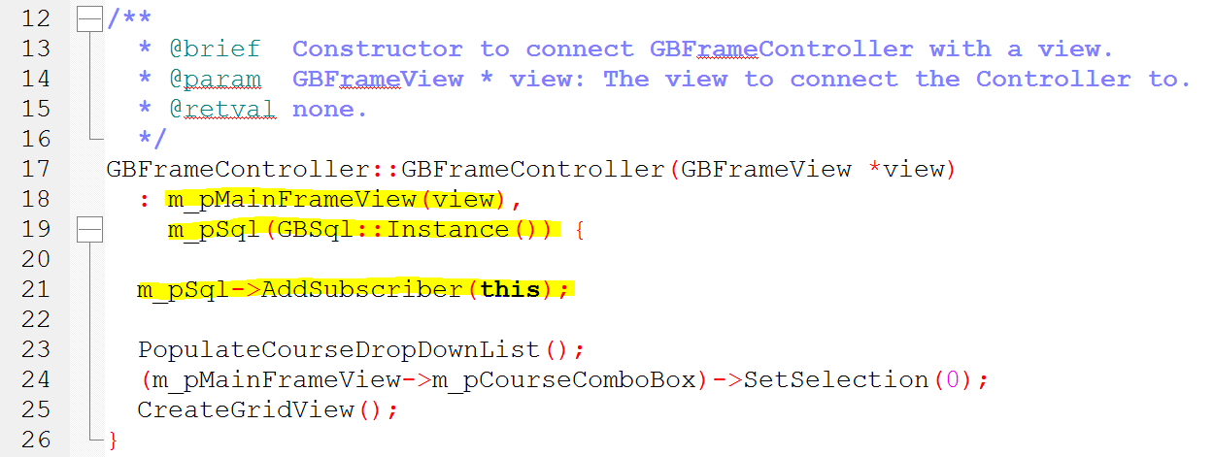
Sprint: October 28th – November 10th Implementing: Singleton, Observer, and MVC
Observer Pattern cont.

Slide 11
Sprint: October 28th – November 10th Implementing: Singleton, Observer, and MVC
Model-View-Controller (MVC)
View
GBDialogAssessmentView, GBFrameView,
Controller
GBDialogAssessmentController, GBFrameController,
Model
Subscriber, Course, Student
GBDialogCourseView, GBDialogStudentView,
GBDialogUserOptionsView
GBDialogCourseController, GBDialogStudentController,
GBDialogUserOptionsController
Observer, Grade, bbimporter
GBSql, Assessment

Slide 12
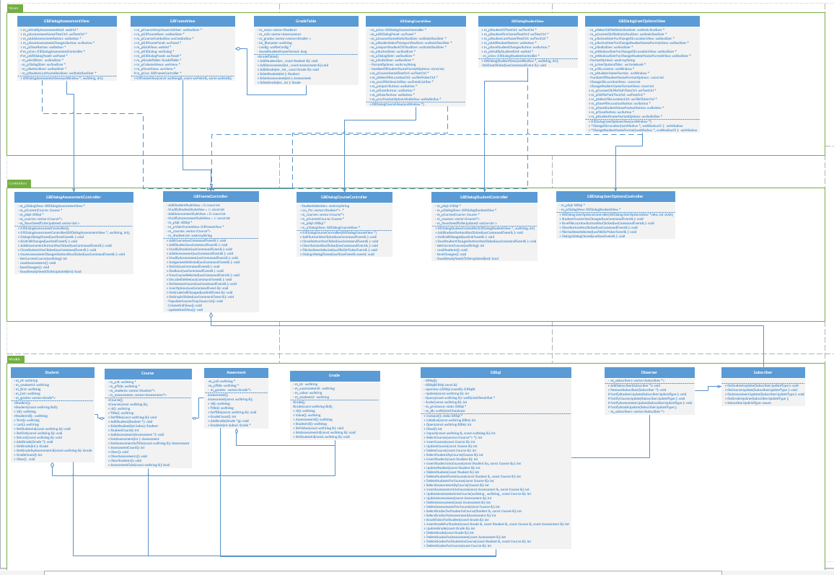

Slide 13
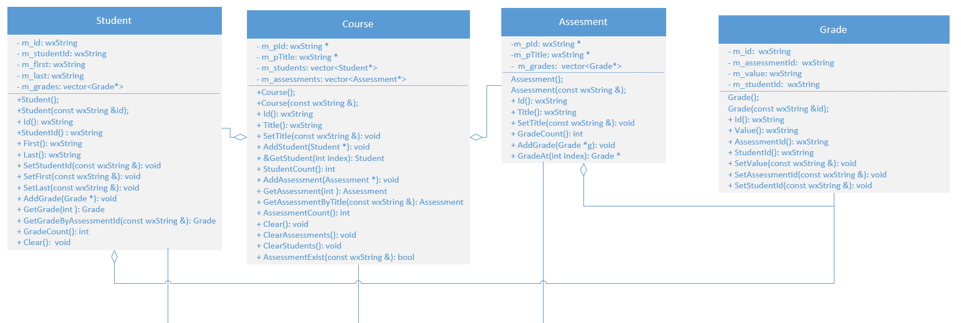
Model Relationships

Slide 14
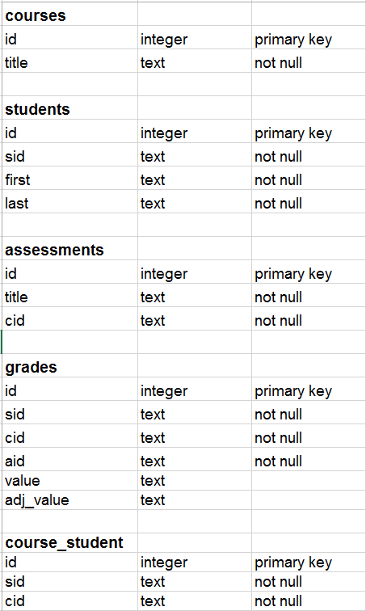
Database Schema

Slide 15
Testing and Verification
We have Unit Tests that will …
Verify that inserting, deleting, and updating information is always working accordingly.
Verify that no relationships in the Database are broken.

Slide 16
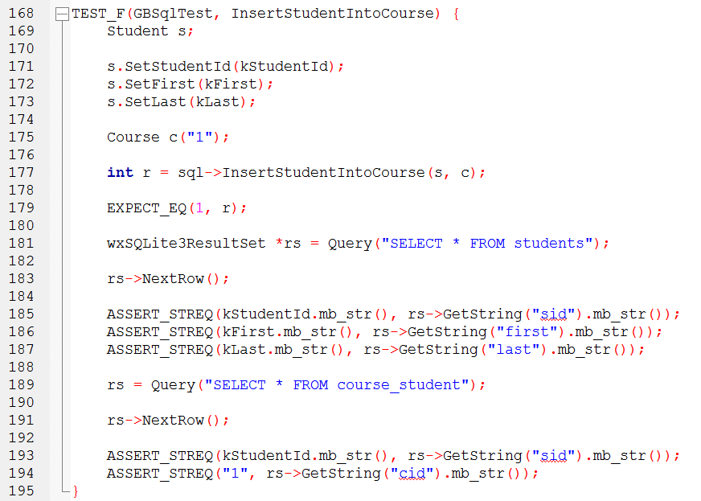

Slide 17
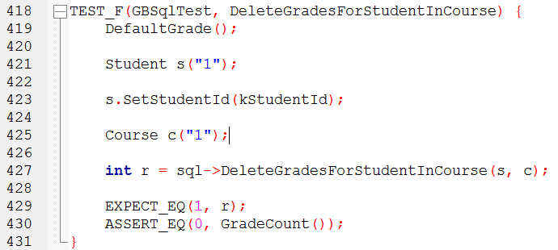

Slide 18
Metric++ checks for …
Architecture quality
Design quality
Code quality
Test quality
Cyclomatic Complexity Average = 0.830039526

Slide 19
Demo

