Slide 1
Effective Akka
Akka practice in building a real time streaming engine Gearpump
Scala Hangzhou Meetup 2015/12

Slide 2
About me
钟翔@Intel. Focus on stream processing. Storm committer.
Xiang.zhong@intel.com
http://weibo.com/clockfly
Previous working on Intel Hadoop distribution, MapReduce nativetask, HBase media object storage...

Slide 3
Why Akka?
Traditional Sequential Call
Lock
Scalability
Fault-tolerance
A
A
B
B
B
B
C
C

Slide 4
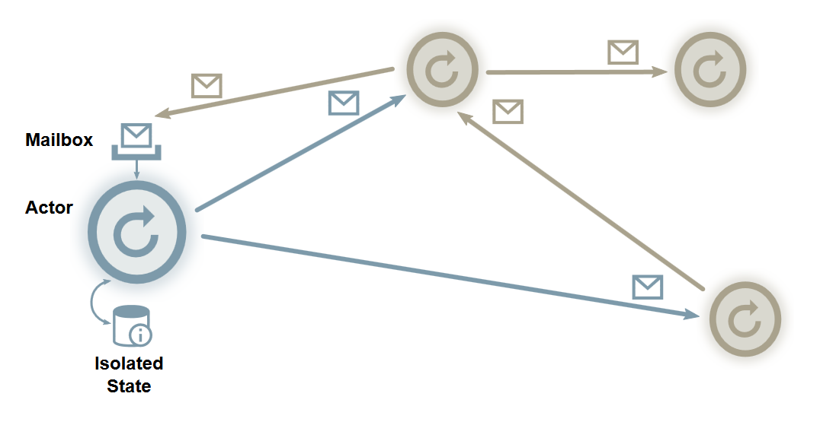
What is Akka? Micro-service oriented
Micro-service(Actor) oriented.
Message Driven
Lock-free
Location-transparent
It is like our human society, driven by message
Which can scale to 7 billion population!
Notes:
It is my belief that we need a higher abstraction, so that we can solve the problem in a simple and clean way.

Slide 5
What is build with Akka?
A real time streaming engine…
Milli-second latency,
Exactly-once
High throughput
Can scale to more than 10K tasks on my laptop
Fault-tolerance
Akka-stream

Slide 6
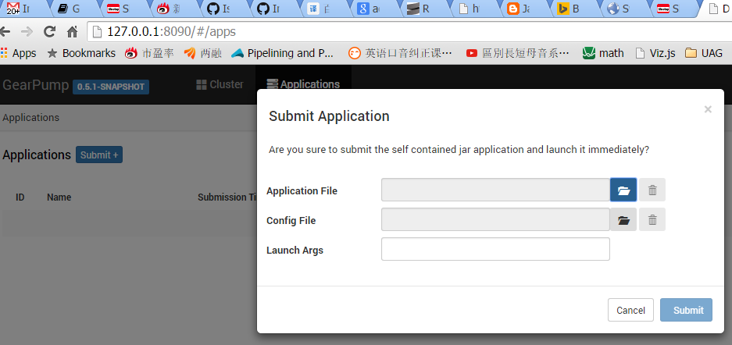
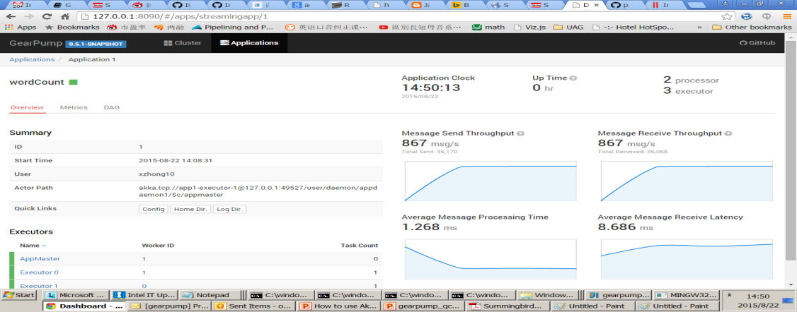
Three steps to use it
Download binary from http://gearpump.io
Submit jar by UI
Monitor Status

Slide 7
Low level Graph API - WordCount
val context = new ClientContext()
val split = Processor[Split](splitParallism)
val sum = Processor[Sum](sumParallism)
val app = StreamApplication("wordCount", Graph(split ~> sum), UserConfig.empty)
val appId = context.submit(app)
context.close()
class Split(taskContext : TaskContext, conf: UserConfig) extends Task(taskContext, conf) {
override def onNext(msg : Message) : Unit = { /* split the line */ }
}
class Sum (taskContext : TaskContext, conf: UserConfig) extends Task(taskContext, conf) {
val count = /**count of words **/ override def onNext(msg : Message) : Unit = {/* do aggregation on word*/}
}
Scala
Java
Notes:
How the API looks like?
Wordcount，first：split the words，then，count。
Split Message handle -> split lines into words.
Sum,

Slide 8
High Level DSL API - WordCount
val context = ClientContext()
val app = new StreamApp("dsl", context)
val data = "This is a good start, bingo!! bingo!!"
app.fromCollection(data.lines)
// word => (word, count = 1)
.flatMap(line => line.split("[\\s]+")).map((_, 1))
// (word, count1), (word, count2) => (word, count1 + count2)
.groupByKey().sum.log
val appId = context.submit(app)
context.close()
Notes:
这种DSL API怎么实现的呢？

Slide 9
Akka-stream API – WordCount
implicit val system = ActorSystem("akka-test") implicit val materializer = new GearpumpMaterializer(system) val echo = system.actorOf(Props(new Echo())) val sink = Sink.actorRef(echo, "COMPLETE") val source = GearSource.from[String](new CollectionDataSource(lines)) source.mapConcat{line => line.split(" ").toList}
.groupBy2(x=>x)
.map(word => (word, 1))
.reduce {(a, b) => (a._1, a._2 + b._2)}
.log("word-count").runWith(sink)
Available at branch https://github.com/gearpump/gearpump/tree/akkastream
Notes:
Express the same problem in akka-stream API,
Gearpump has defined a materializer, by using this, the app will be submited to remote Gearpump cluster.

Slide 10
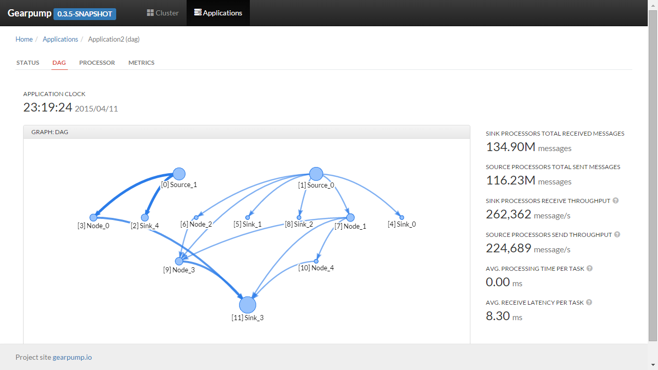
UI Portal - DAG Visualization
DAG Page
Track global min-Clock of all message
DAG:
Node size reflect throughput
Edge width represents flow rate
Red node means something goes wrong
Notes:
In the central parts, there is the DAG visualiton.
Size, means throughput.
Color: healthy status.
Clock ticking: track mean clock of all messages, on the right, overall metrics.
Each processor, has lots of distributed tasks(Actors),
Click through, we can see details of tasks.

Slide 11
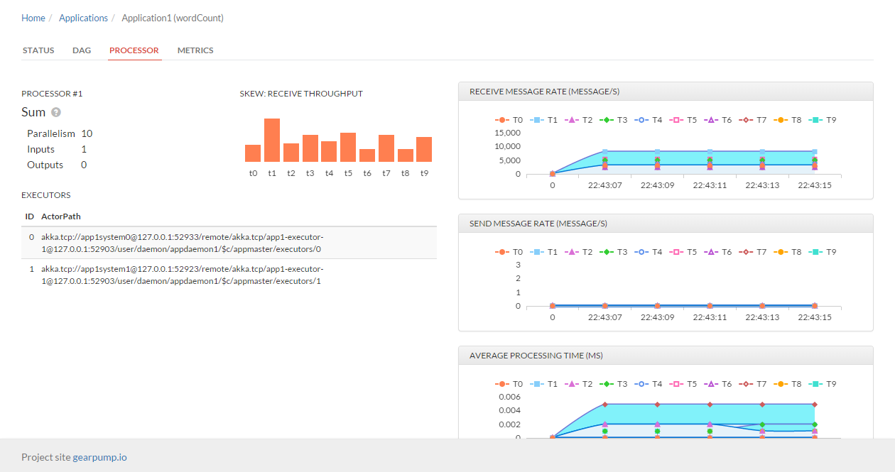
UI Portal – Processor Detail
Processor Page
Data skew distribution
Task throughput and latency
Notes:
Bar chat, show the data skew.
On the right, there are detail metrics show the status of a task, like throughput, transfer latency. User process time,

Slide 12
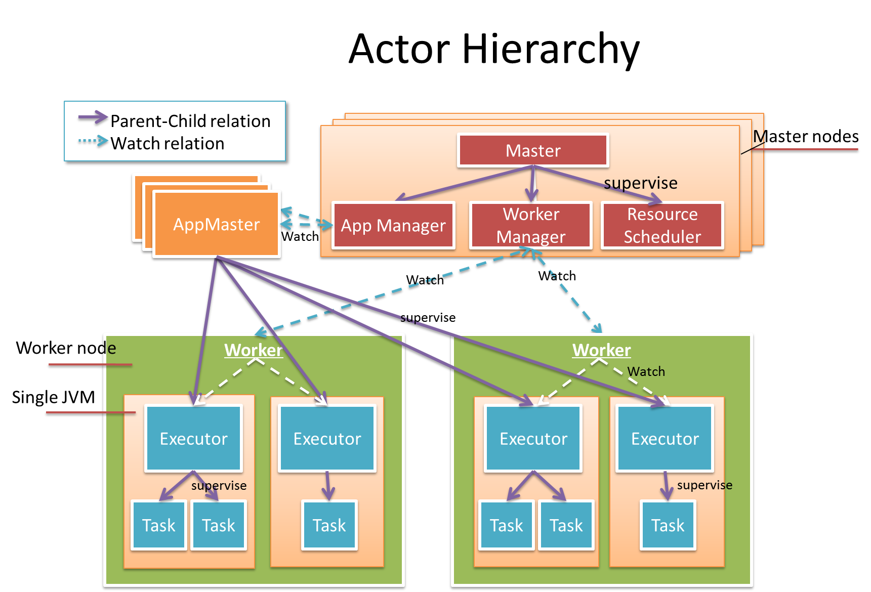
Architecture - Actor Hierarchy
Each App has one isolated AppMaster, and use Actor Supervision tree for error handling.
YARN
Master Cluster
HA Design
Client
Hook in and query state
As general service

Slide 13
What Akka cool feature is used?

Slide 14
Akka supervision for fault-tolerance

Slide 15
Akka-clustering for HA
Akka Cluster for a centerless HA system
Conflict free data types(CRDT) for consistency
leader
Master
Worker
Worker
Gossip
Worker
Gossip
State
standby Master
Standby Master
Gossip
Akka Cluster

Slide 16
Akka-Http for Web
Most intuitive web framework we ever used.
Demo

Slide 17
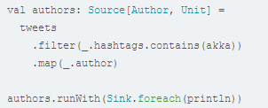
Akka Stream for local data flow
It tries to solve 99% problem of Akka usage.
A
B
C
pass data in a safe way.
Flow control
Error handling..

Slide 18
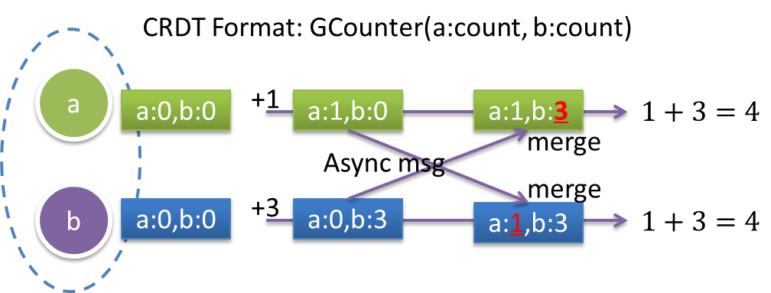
Akka data replication for shared consistent data
CRDT Data type example:

Slide 19
Other tools
Upickle for Json serialization
Sbt-pack for distribution and packaging.
…

Slide 20
Lesson learned?
Akka remoting performance challenges…
Configure Akka dispatcher pool carefully
Implicit for caution
How to maintain API compatibility
Know your collection performance characteristics.
Read-ability is more important, should leverage embedded method, and variable definition for documentation purpose.
While loop over for-each/map, when requiring high performance.
Notes:
Good for collection and monoad.

Slide 21
Demo for good/bad coding practice

Slide 22
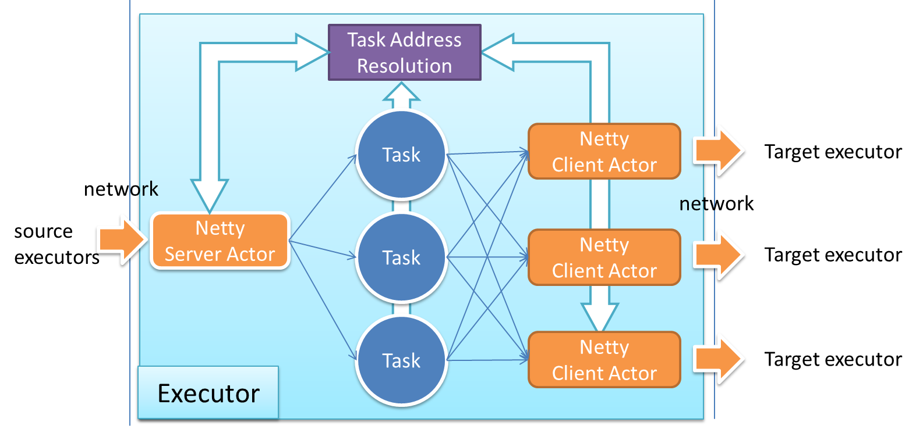
High performance Messaging Layer
Akka remote message has a big overhead, (sender + receiver address)
Reduce 95% overhead (400 bytes to ~20 bytes)
Effective batching
Sync with other executors
convert to short address
convert from short address
Notes:
Akka, addressing overhead.
Each message, it has a envlope, has a sender address, and receiver address, 400 bytes.
Address translation, 400 -> 20 bytes.

Slide 23
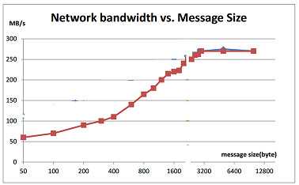
Effective batching
Network Idle: Flush as fast as we can
Network Busy: Smart batching until the network is open again.
Network Bandwidth
Doubled
For 100 byte per message
This feature is ported from Storm-297
Test environment: Same as storm-297
Notes:
看这张图，是batch的大小和网络带宽利用率的关系。
对小消息尤其有用。
Do small batching, (considering the latency)

Slide 24
Akka Design Patterns
See <<大数据的Reactive设计范式和Akka实践>>

Slide 25
Recruit committers for Gearpump
Welcome contribution!
Source code: http://github.com/gearpump
Document site: http://gearpump.io
Apache licensed

Slide 26
Resources
1. Why Gearpump?
http://www.gearpump.io/releases/latest/features.html
2. Gearpump site:
http://gearpump.io
Preparing for Apache incubation.
3. Gearpump source code:
http://github.com/gearpump
Scala get started:
http://www.scala-tour.com/

Slide 27
Thank you!

