Slide 1
Android Development Without Java

Slide 2
Android Development With Scala

Slide 3
Scala

Slide 4
Scala is

Slide 5
Scala is A Functional

Slide 6
Scala is A Functional Object Oriented

Slide 7
Scala is A Functional Object Oriented Statically Typed

Slide 8
Scala is A Functional Object Oriented Statically Typed Scalable

Slide 9
Scala is A Functional Object Oriented Statically Typed Scalable Language

Slide 10
Scala is A Functional Object Oriented Statically Typed Scalable Language Running on JVM

Slide 11
Scala is A Functional Object Oriented Statically Typed Scalable Language Running on JVM and DalvikVM

Slide 12
Why Scala

Slide 13
Java
public class MyActivity extends Activity {
ListView comments;
Button newComment;
@Override
void onCreate(Bundle bundle) { super.onCreate(bundle); comments = (ListView) findViewById(R.id.comments);
newComment = (Button) findViewById(R.id.new_comment);
//...
}
public void sayHello() {
Toast.makeText(this, “Hello”, Toast.LENGTH_LONG).show();
}
}
Initialize context and views

Slide 14
Java with RoboGuice
public class MyActivity extends RoboActivity {
@Inject Application context;
@Inject SessionManager sessionManager;
@Inject(R.id.comments) ListView comments;
@Inject(R.id.new_comment) Button newComment;
public void sayHello() {
Toast.makeText(this, “Hello”, Toast.LENGTH_LONG).show();
}
}
Inject views

Slide 15

GO HOME ANDROID. YOU ARE DRUNK.

Slide 16
Scala
class MyActivity extends ScalaActivity {
lazy val SessionManager
lazy val comments = findView(TR.comments)
lazy val newComment = findView(TR.new_comment)
def sayHello() = “Hello”.toast()
}
Implicit Context
Lazily load views
Toast using implicit conversion

Slide 17
A Sample Project

Slide 18

shadowsocks

Slide 19
shadowsocks
github/shadowsocks/shadowsocks-android
written in C/C++ and Scala
modules
shadowsocks-libev: secured socks5 proxy in pure C
shadowsocks-android: UI/Android interface in Scala
lwIP/tun2socks: user space TCP/IP stack in C++
pdnsd/iptables/redsocks: native porting for android

Slide 20
Project Structure
project/
Build.scala <SBT makefile>
plugins.sbt <SBT plugin config>
src/
main/
res/ <resource files>
assets/ <asset files>
jni/ <native codes>
libs/ <jar and native libraries>
scala/ <main Scala sources>
java/ <main Java sources>
AndroidManifest.xml <manifest template>
test/ <test sources>

Slide 21
SBT
Simple Build Tool for Scala / Java
Ant, Maven, Gradle like tool in Scala
github/jberkel/android-plugin
SBT plugin for Android
Dependency management, unit test, instrumentation, auto tasks, etc

Slide 22
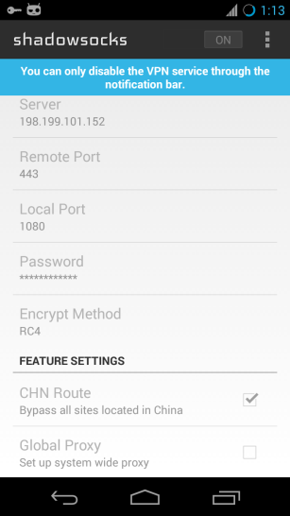
Components
UI
ActionBarSherlock
SwitchBackport
Crouton
UnifiedPreference
UniversalImageLoader
Libraries
DNSJava
Analytics
AdMob

Slide 23
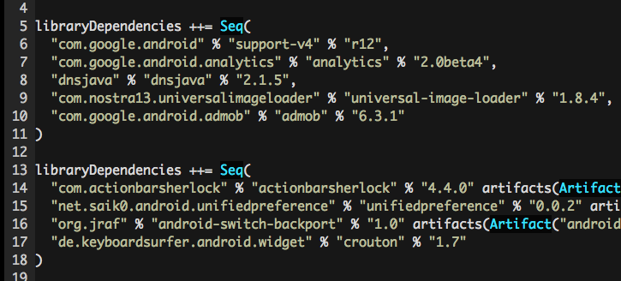
Components

Slide 24
Best Practices
Proguard
Aggressive default rules
IntelliJ IDEA
Best IDE for Scala and Android
Continuous Integration
Travis is best, Jenkins works well

Slide 25
Questions?

Slide 26
Thanks!

Slide 27
About Me
Max Lv
Member of Tangcha Project
字节社 for Android, http://zijieshe.com
Major Contributor of GoAgent Project
github/madeye/gaeproxy
Core maintainer of Shadowsocks Project
github/madeye/shadowsocks-libev
github/shadowsocks/shadowsocks-android

