Slide 1
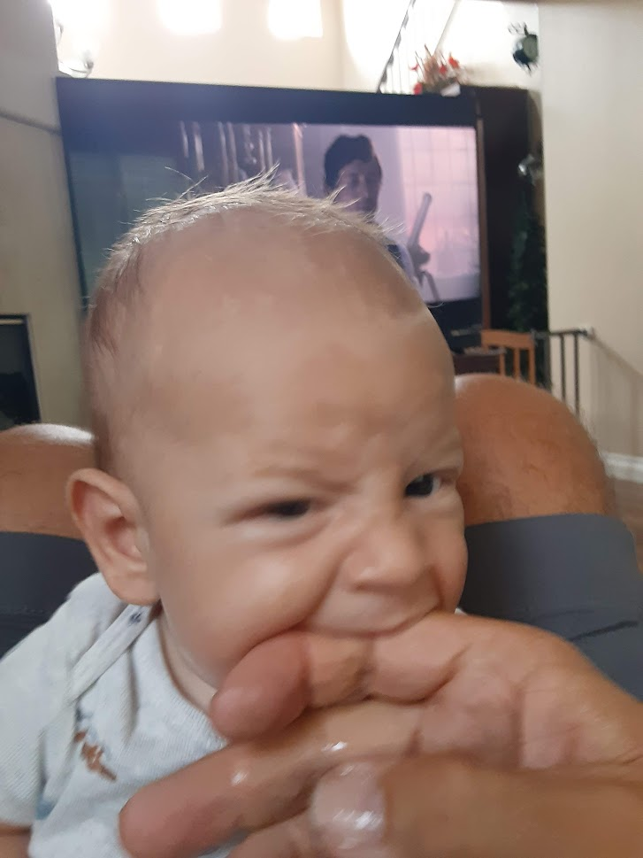
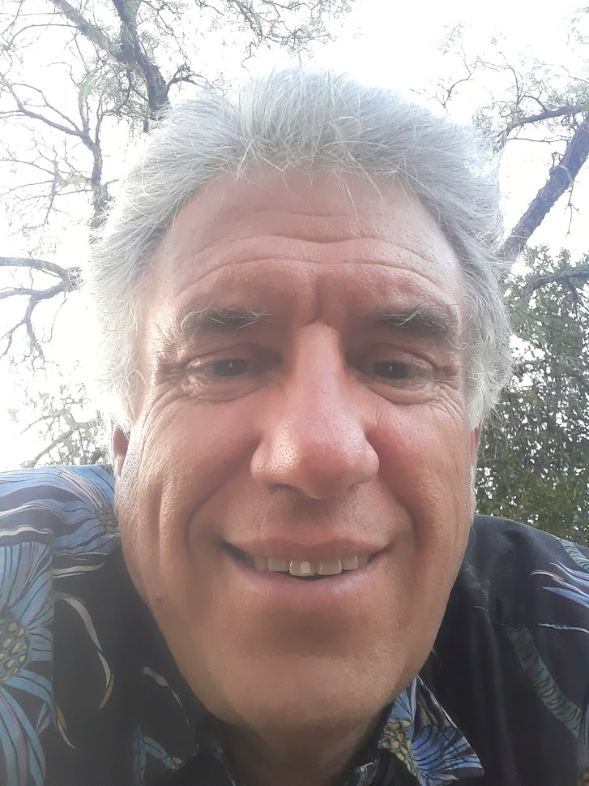
Women in Computing
December 5, 2023 - Master Gold
Steven.Gold@csulb.edu
Something to chew on…

Slide 2
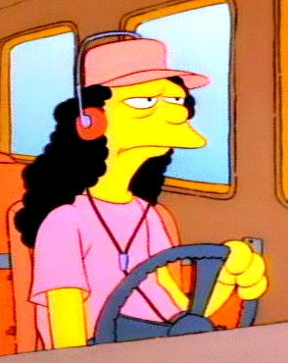
Bus Driver

Slide 3
Riddle Setup
Riddle: You are a bus driver at a station. 10 get on the bus and no one gets off. You drive 10 miles to another station where 3 people get on and 1 gets off. You drive another 10 miles only to get 25 people on and 5 people go off. Next you drive 3 miles while 12 people exit the bus. You drive back to the station knowing that there are a couple more stops along the way until the ride is done. At the 2nd to last station 5 people get on and 2 get off. And at the last station (5.5 miles) 25 people get on for no reason and 1 gets off.

Slide 4
Riddle Question
What is the bus driver’s eye color?

Slide 5
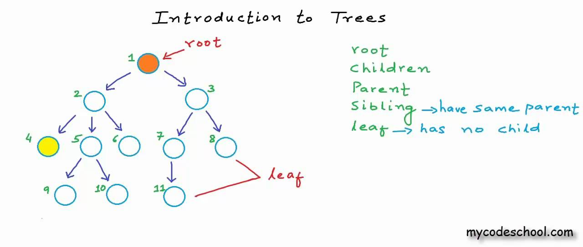
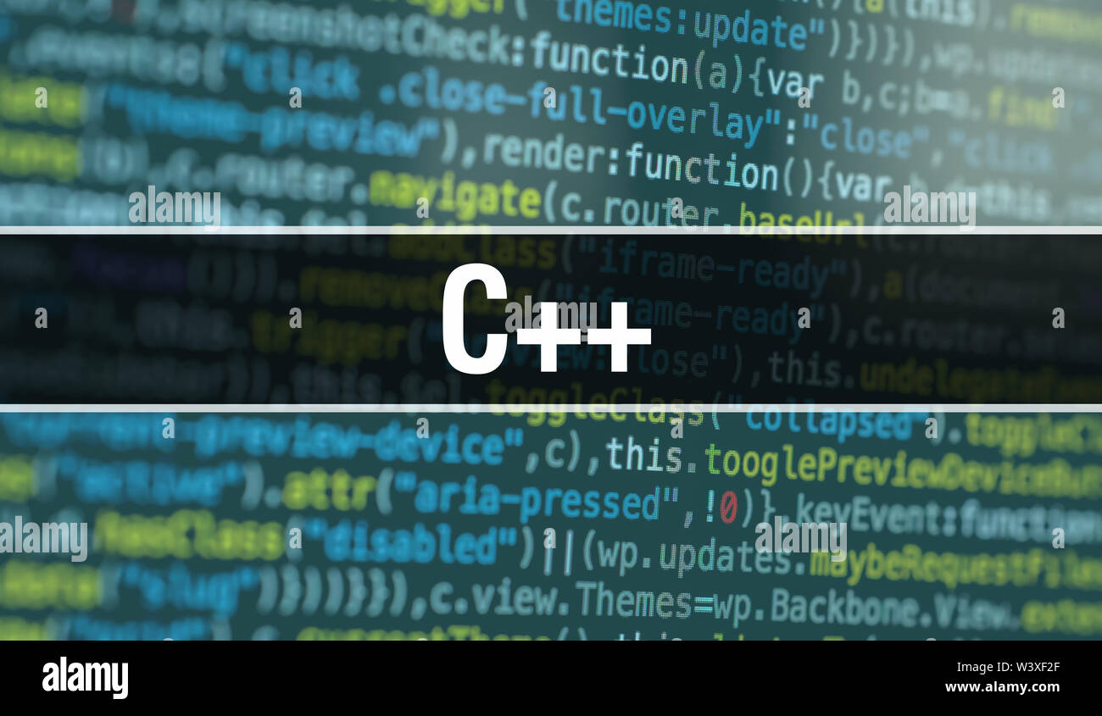

How to become a CSULB Programming Team Coach

Slide 6
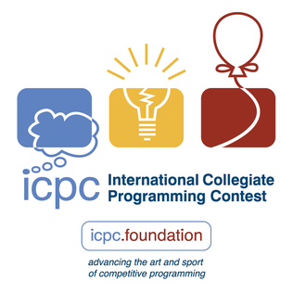
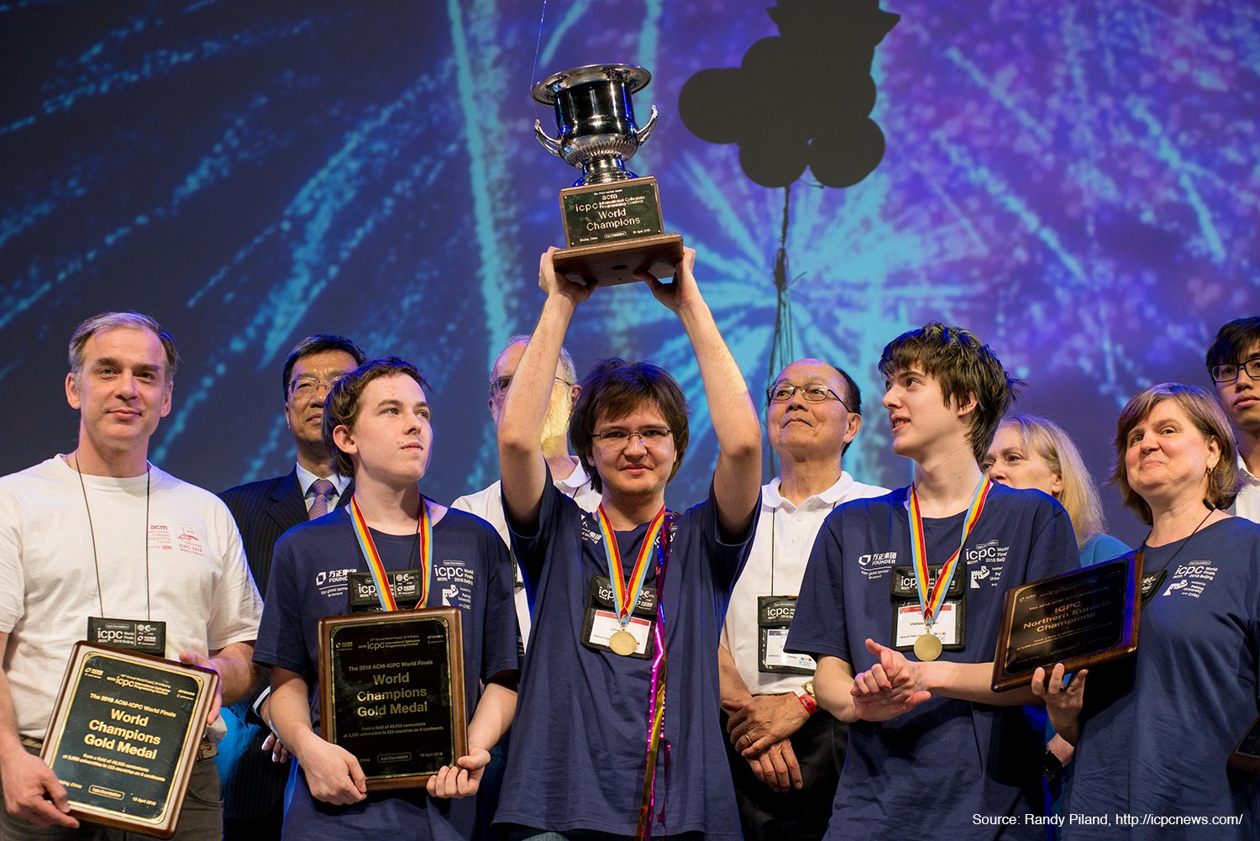
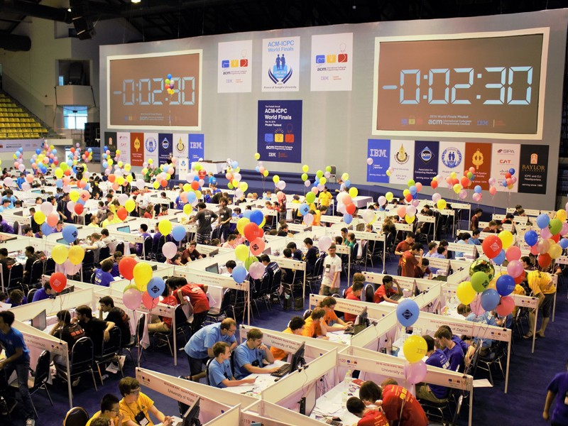
--ICPC -- International Collegiate Programming Contest

Slide 7
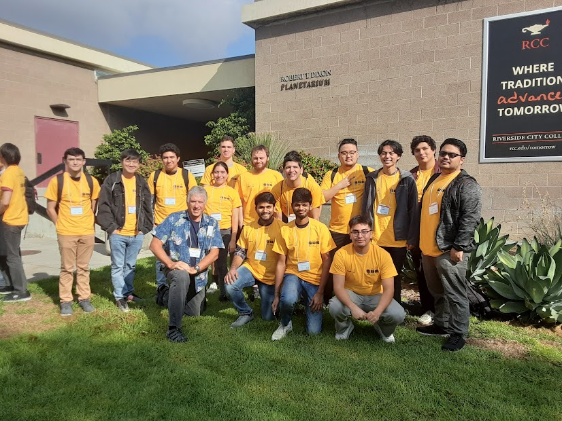
Southern California Regional Contest CSULB 2023

Slide 8
ICPC Regional Contest @ Riverside CC
All Day (9:00 AM to 9:00 PM)
Teams of three
Locked down environment
One Hundred Teams from So-Cal Region
Five Hour Contest
One computer per team
No electronics
Anything hardcopy is fine
Ten programming problems
Submit a wrong solution – 20 minute penalty
Team that solves most problems in least time WINNER!

Slide 9
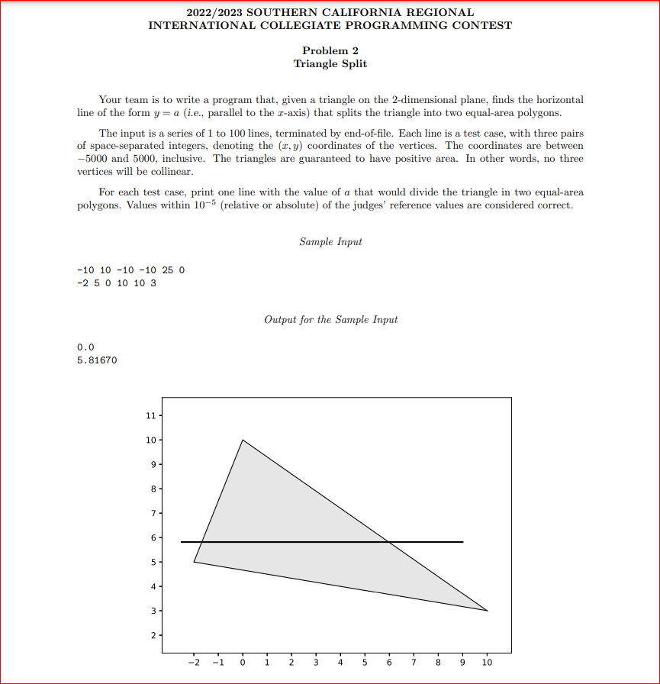
Problem 7

Slide 10
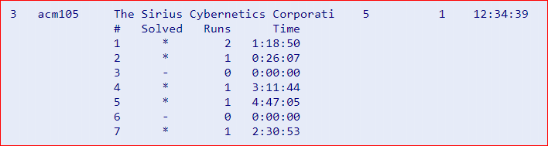
CSULB Performance http://socalcontest.org/current/index.shtml
2023 -> 84 teams: 33, 40, 47, 69, 70
2022-> 59 teams: 44, 46, 48
Best Performance – Third 2007

Slide 11
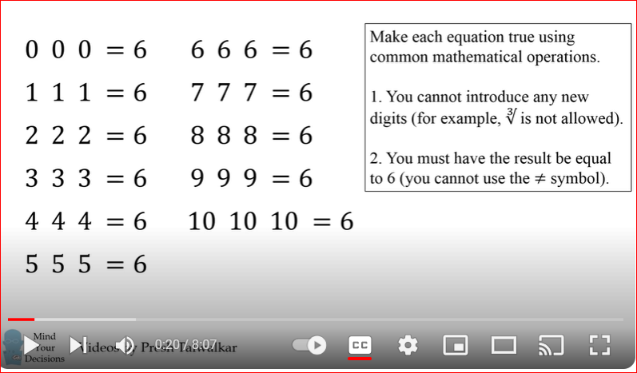
https://youtu.be/h2vkrxvh76c

Slide 12
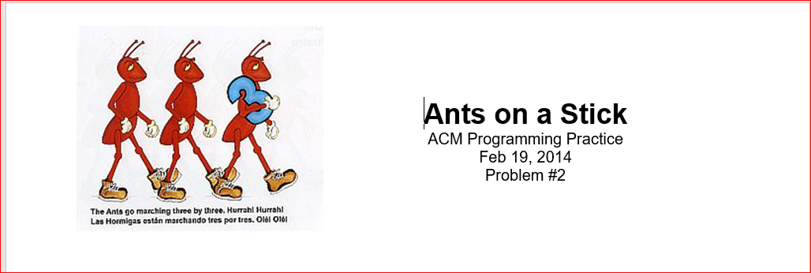
Ants on a Stick

