Slide 1

Python Fundamentals Workshop
ACM at CSUN Beginner Python Workshop
60–90 minute session

Slide 2
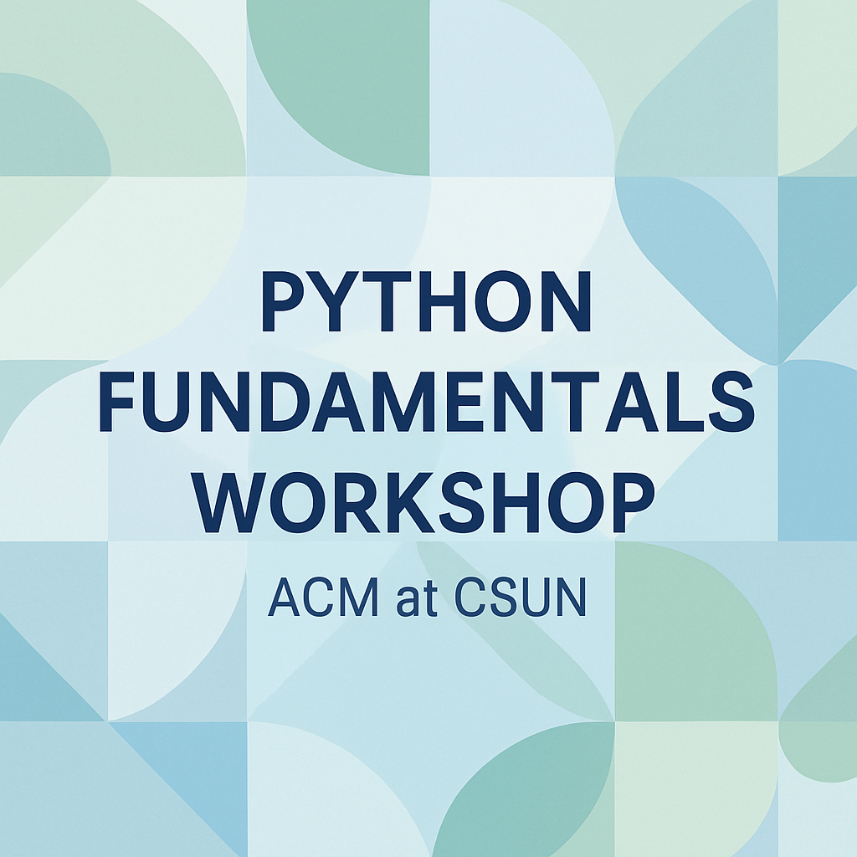
Agenda
1. Intro to Python
2. Variables & Data Types
3. Operators & Expressions
4. Control Flow
5. Functions
6. Lists & Dictionaries
7. Strings
8. Mini-project Example
9. Wrap-Up & Resources

Slide 3

Intro to Python
Versatile language used for web apps, workflows, database access and data analysis.
Cross‑platform and easy to learn with a readable syntax.
Ideal for quick prototyping or production‑ready software.
print("Hello, World!")
Exercise: Try printing your own name!
[1] [2]

Slide 4

Variables & Data Types
Variables are containers for storing data values.
Python’s built‑in types include numbers, strings, lists, tuples, ranges, dictionaries, sets, booleans and None.
Type is set when you assign a value; use type() to check.
x = 5
name = "Alice"
fruits = ["apple", "banana", "cherry"] print(type(x), type(name), type(fruits))
Exercise: Create variables of at least three different types and print their type.
[3]

Slide 5
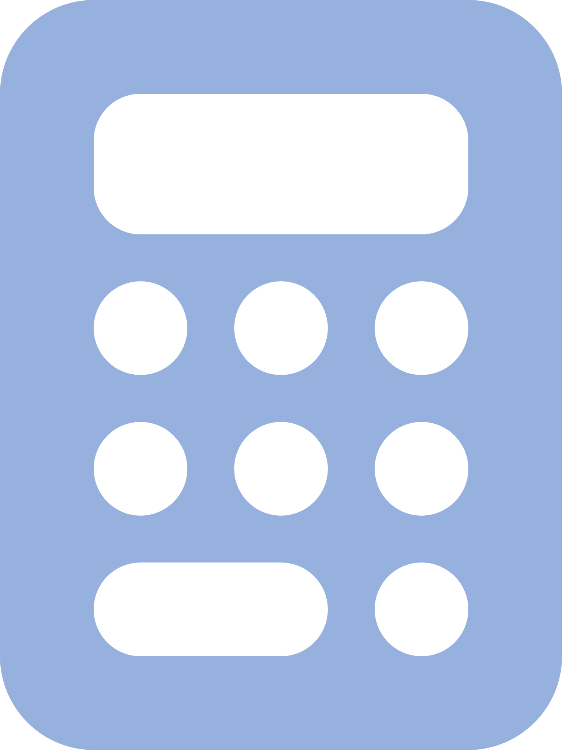
Operators & Expressions
Arithmetic: + - * / % ** //
Assignment: = += -= *= /= //= **= etc.
Comparison: == != > < >= <=
Logical: and or not; Membership: in not in; Identity: is is not
width, height = 5, 10
area = width * height print(area)
Exercise: Compute the area of a rectangle.
[4]

Slide 6

Control Flow
Use if/elif/else to perform actions based on conditions.
Indentation defines code blocks (no curly braces).
for loops iterate over sequences (lists, strings, ranges).
while loops repeat as long as a condition is true.
for fruit in ["apple", "banana", "cherry"]:
if fruit == "banana":
print("Found banana!")
else:
print("Fruit:", fruit)
Exercise: Write a loop to print numbers 1–5 and indicate which are even.
[5] [6]

Slide 7

Functions
Reusable blocks of code defined with def.
Can accept parameters and return values.
Call the function by its name followed by parentheses.
def greet(name):
print(f"Hello, {name}!")
greet("CSUN")
Exercise: Write a function that returns the square of a number.
[7]

Slide 8
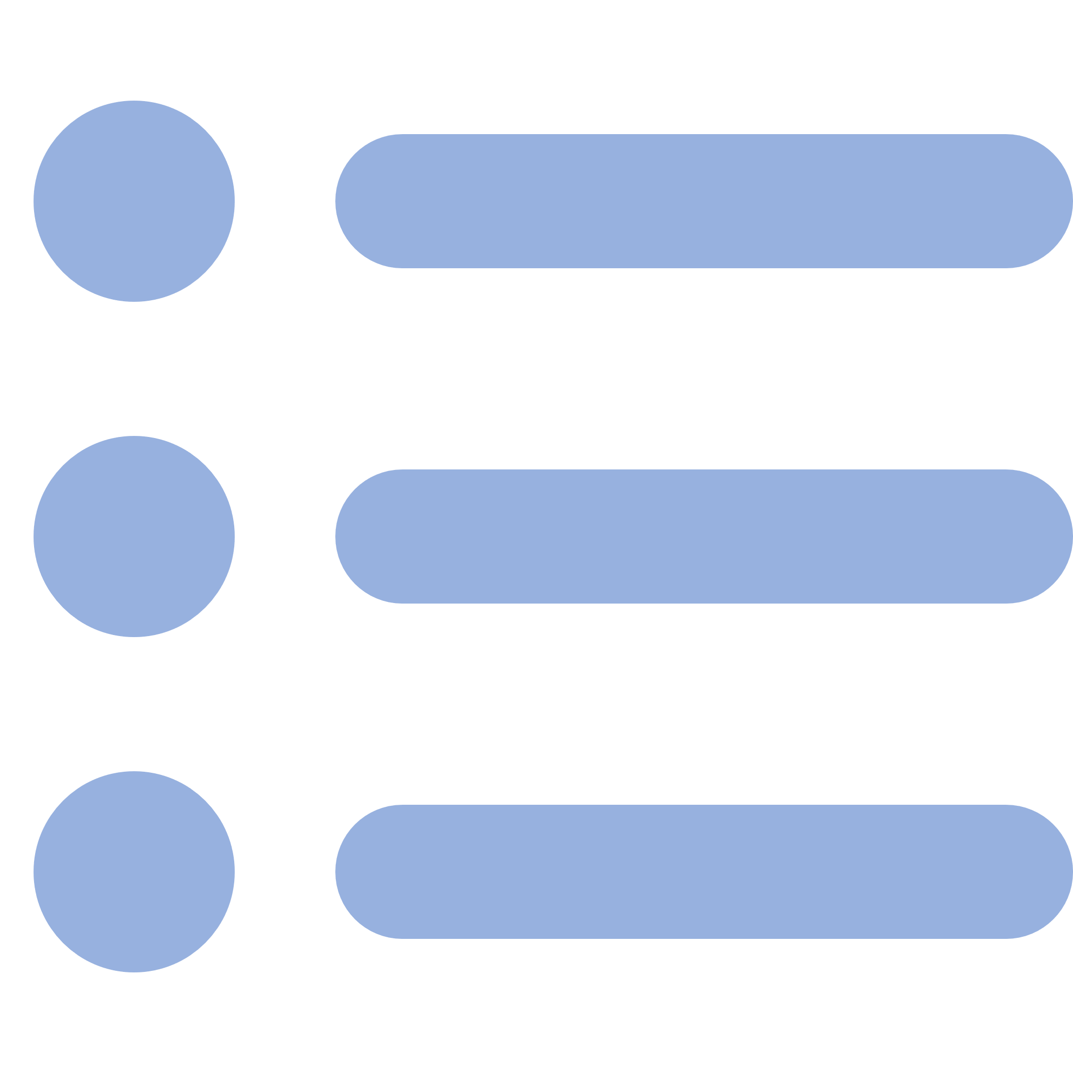
Lists & Dictionaries
Lists store multiple items in a single variable, ordered and changeable.
Allow duplicates and support indexing and slicing.
Dictionaries store data as key–value pairs, ordered (Python 3.7+) and mutable.
fruits = ["apple", "banana", "cherry"] print(fruits[1])
person = {"name": "Alice", "age": 21} print(person["name"])
Exercise: Create a list of your favourite fruits and a dictionary with personal info.
[8] [9]

Slide 9

Strings
Strings are sequences of unicode characters; individual characters accessed by index.
You can loop through characters using a for loop.
Use len() to find length and in/not in to test membership.
s = "Python" print(s[0], s[-1]) for ch in s:
print(ch)
Exercise: Ask for a word and print each letter on a new line.
[10] [11]

Slide 10
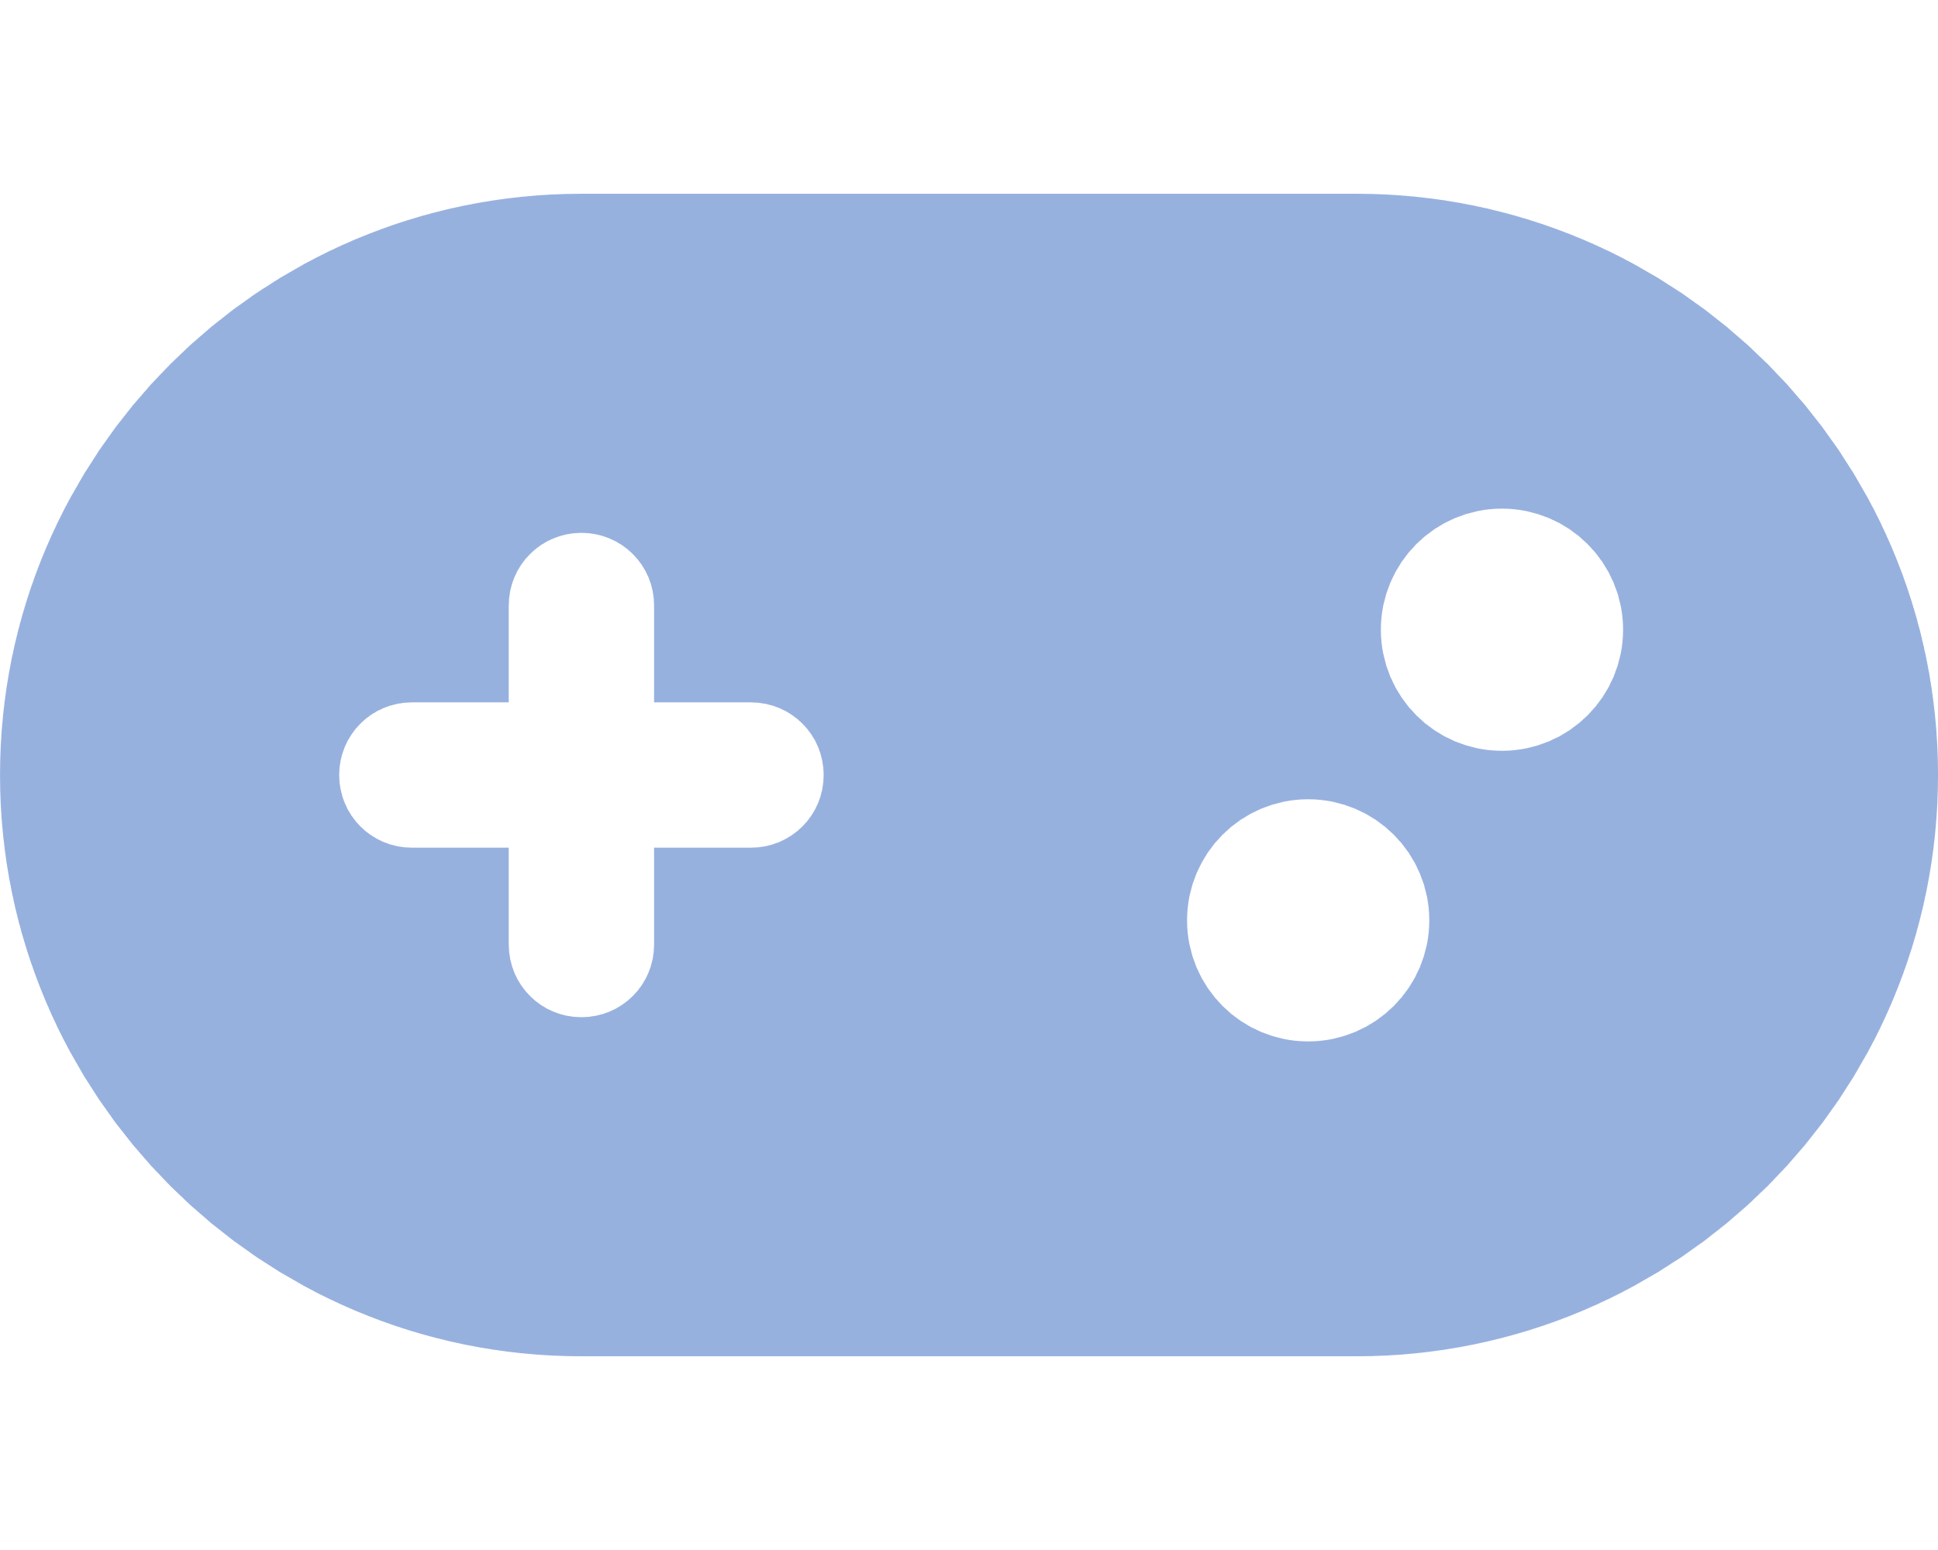
Mini‑Project: Guessing Game
The program picks a random number between 1 and 10.
The user guesses until the correct number is found.
Uses while loops, conditionals, and user input.
import random
secret = random.randint(1, 10)
guess = 0 while guess != secret:
guess = int(input("Guess a number (1–10): "))
if guess < secret:
print("Too low!")
elif guess > secret:
print("Too high!") print("Congratulations! You guessed it.")
Exercise: Add a counter to track guesses and give feedback.

Slide 11

Wrap‑Up & Resources
You learned about Python basics, variables, operators, control flow, functions, lists & dictionaries, and strings.
Keep practising: build small programs to reinforce these concepts.
Resources
Python Documentation
W3Schools Python Tutorial
freeCodeCamp Python Course
Thank you & happy coding!

