Slide 1
International Workshop on International workshop on Applied Computing in Agriculture Track A: Deep Learning in Agriculture
Day 2: Hands-on Tutorial: 10:30 – 12:00
March 5, 2022
Ngo Thi-Nha (Tina)

Slide 2
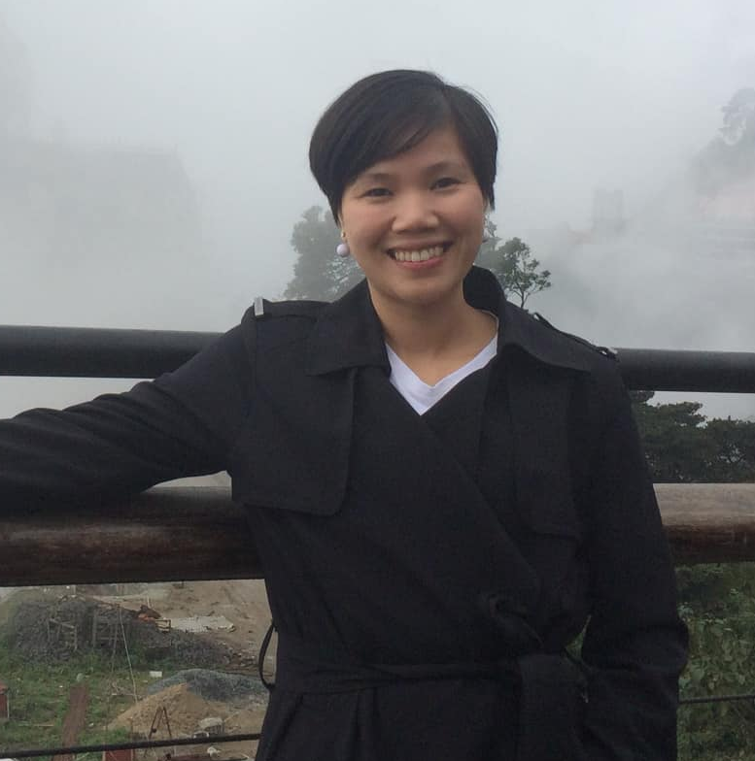
Facilitators
De La Salle University
1. Renzo Querol
2. William Dimaculangan
3. Eros Hacinas
National Taiwan University
1. Wu Yi-Ze
2. Chen Jing-Kuan
3. Huang Shao-Zheng
Tina Ngo
Pacific American School

Slide 3
Agenda
Create google colab project
Plant Village Dataset with Kaggle
Load Bell Pepper data from github
Data pre-processing
Constructing Convolutional Neural Network (CNN) model
Evaluating model
Classification of Bell Pepper Plants Diseases Using Convolutional Neural Network

Slide 4
Why Bell Pepper Leave Disease Classification?
Farmers who grow bell pepper are facing a lot of economical loss every year because of diseases.
One of the very common diseases in bell pepper is bacterial spot.
If farmer can detect the disease early and early apply appropriate treatment. It can prevent economically loss.
The treatment for different disease is different. So, it is important that we can accuracy identify what kind of disease in the bell pepper plant.

Slide 5
Why Convolutional Neural Network (CNN)?
Convolutional Neural Network (CNN) is a complex feed forward neural networks
CNN is good at image classification and recognition with High Accuracy
Image classification involves the extraction of features from the image to observe some patterns in the dataset

Slide 6
Q1 What is the main target object of today hackathon project?
A. Tomato leaf disease classification
B. Potato leaf disease classification
C. Bell Pepper leaf disease classification
D. Apple leaf disease classification

Slide 7
Q2 Which machine learning algorithm are we going to use for image classification?
A. Support Vector Machine
B. Convolutional Neural Network
C. K Nearest Neighbor
D. Logistic Regression

Slide 8
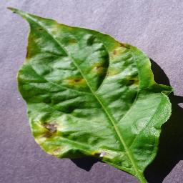
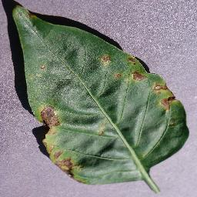
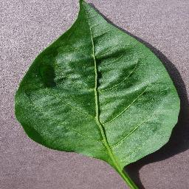
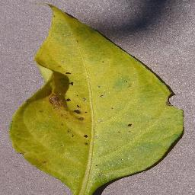
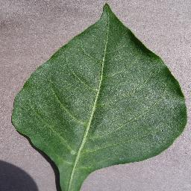
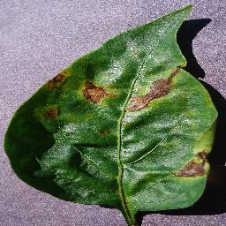
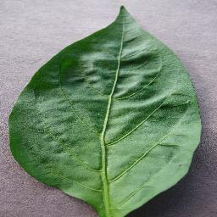
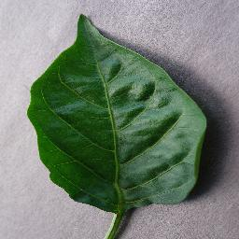
Data Cleaning and Preprocessing
Constructing Classification Model
Model Evaluation
2475 Input images
2 classes
tf dataset
CNN
Data augmentation
Heathy and Bacterial spot

Slide 9
Technologies/Concepts to be Learned
Technologies to be learned
Google Colab
Kaggle
Tensorflow and Keras
Convolutional Neural Network (CNN)
Objective:
Implement bell pepper classifier using CNN
Apply for different dataset for hackathon project

Slide 10
Google colab
Can write Python code over the browser and requires zero configuration and free access to GPUs (Graphical Processing Units)
Step 1. Go to Google colab website
https://colab.research.google.com/?utm_source=scs-index
Step 2. Select New notebook, rename the project
Step 3. Setup your colab project
Change the runtime type to GPU
Colab with others
Executed the code

Slide 11
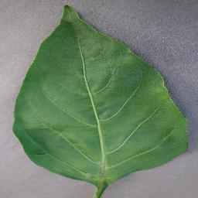
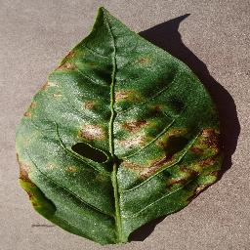
Plant Village Dataset with Kaggle
PlantVillage Dataset | Kaggle
Bell Pepper dataset:
2 classes
Pepper__bell___healthy (1478 images)
Pepper__bell___Bacterial_spot (997 images)
Image size 256x256 pixel
RGB images

Slide 12
Q3 How many classes do we want to classify?
A. 1
B. 2
C. 3
D. 4

Slide 13
Data Preprocessing – Batch, Epoch, Iteration
Batch – number of samples that will be passed through to the network at each epoch
Iterations is the number of batches needed to complete one epoch.
One Epoch is when an ENTIRE dataset is passed forward and backward through the neural network only ONCE.
If you have 1000 training examples, and your batch size is 500, then it will take 2 iterations to complete 1 epoch.

Slide 14
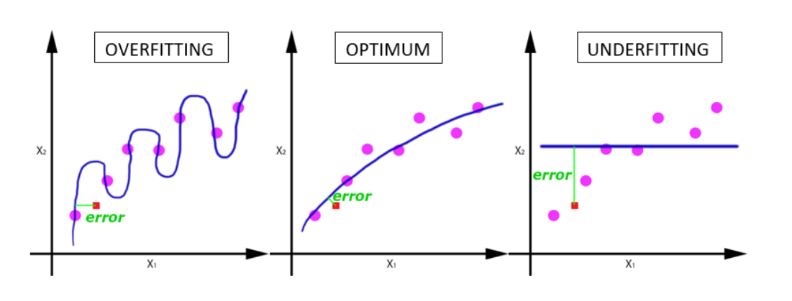
Overfitting and Underfitting

Slide 15
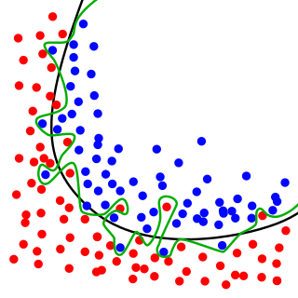
Overfitting in image classification
Model performs well on training dataset but not able to work on testing dataset and validating dataset.

Slide 16
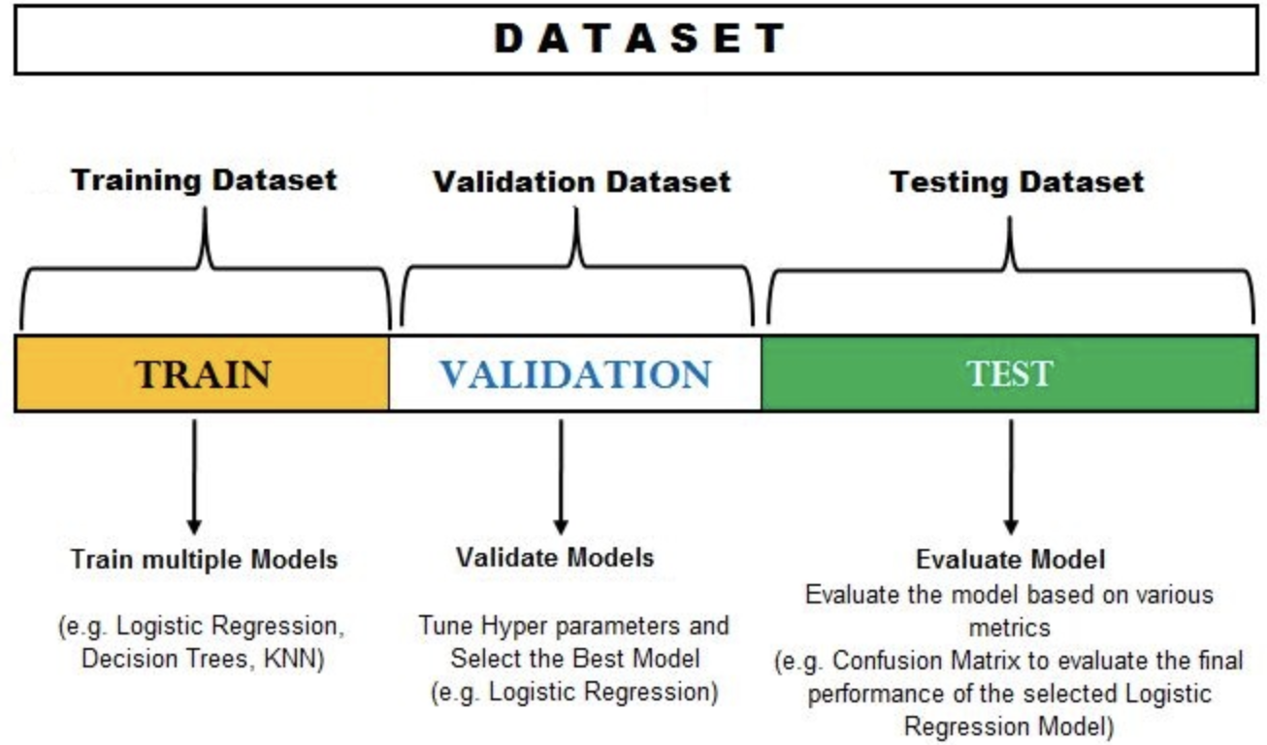
Training – Validating - Testing Dataset
Source

Slide 17
Data Preprocessing - Resize
Images gathered from the internet will be of different sizes.
The images being fed to CNN model will be required of a fixed size

Slide 18
Split Dataset (80% - 10% - 10% )
Training set:
It is the set of data that is used to train and make the model learn the hidden features/patterns in the data.
Validation set:
The validation set is a set of data, separate from the training set, that is used to validate our model performance during training.
Testing set:
The test set is a separate set of data used to test the model after completing the training.

Slide 19
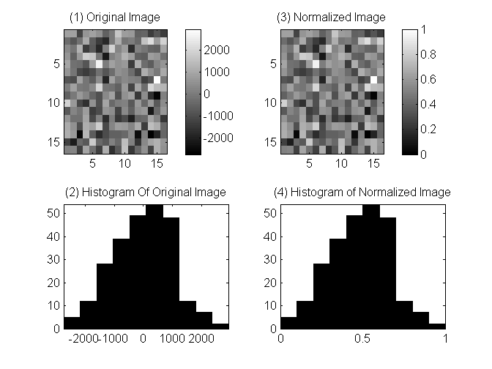
Data Preprocessing - Image Normalize

Slide 20
Data Preprocessing – Augmentation using tf.image
Data augmentation | TensorFlow Core
1.Resize Image
2.Crop Image
3.Crop and Resize
4.Crop to Bounding Box
5.Flipping
6.Rotate Image
7.Translation
8.Transform
9.Adding Salt and Pepper noise
10.Convert RGB to Grayscale
11.Change brightness
12.Adjust Contrast
13.Adjust Hue
14. Adjust Saturation
……..

Slide 21
Constructing CNN model
No human intervention in deep learning?
Humans are still in the loop
Grid search on all hyperparameters?
Too many hyperparameters
Infinitely many ways to design a network
Designed a deep neural network involves
Human expertise
Trials and errors

Slide 22
How to design a CNN network?
Working on old problems?
You don’t design
Pick something that works and use it
Working on novel problems?
Borrow ideas from successful models
Design your own model
Kernel size
3x3 or 5x5

Slide 23
How to choose number of layers and units
Start small
Gradually increase model size
Start from smallest model: linear regression
Model can goes deeper or wider

Slide 24
How to choose polling parameters?
A common setting
Max polling
Polling size: 2x2
Same padding
Global average pooling/ pooling to fixed size
Handles variables-sized inputs

Slide 25
How to choose activation functions?
Short answer: ReLU
How to choose batch size?
Image recognition tasks: 32
Noisy gradient: larger batches
Stuck in local minima or out of memory? Use smaller batches

Slide 26
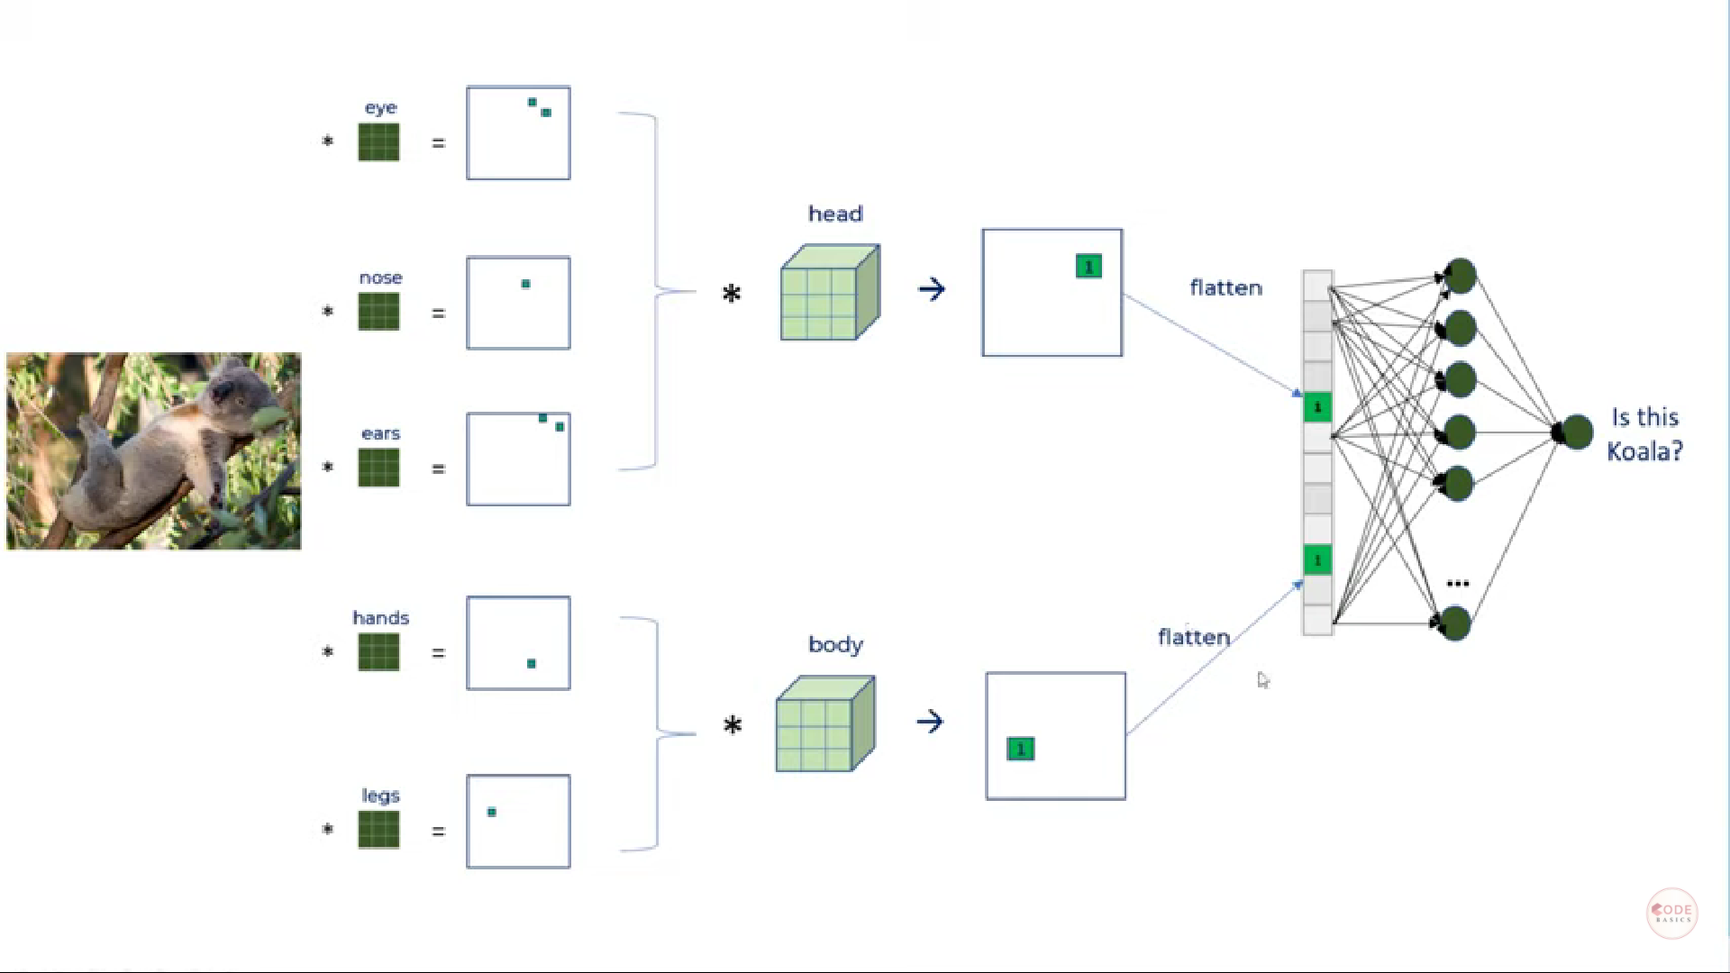
How many filters?

Slide 27
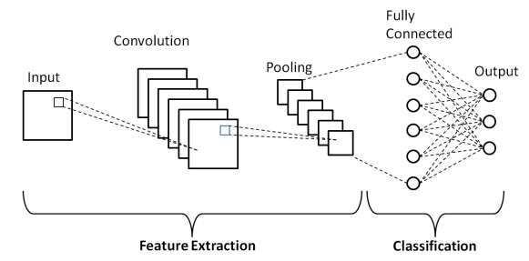
Structure of a simple CNN network
Source

Slide 28
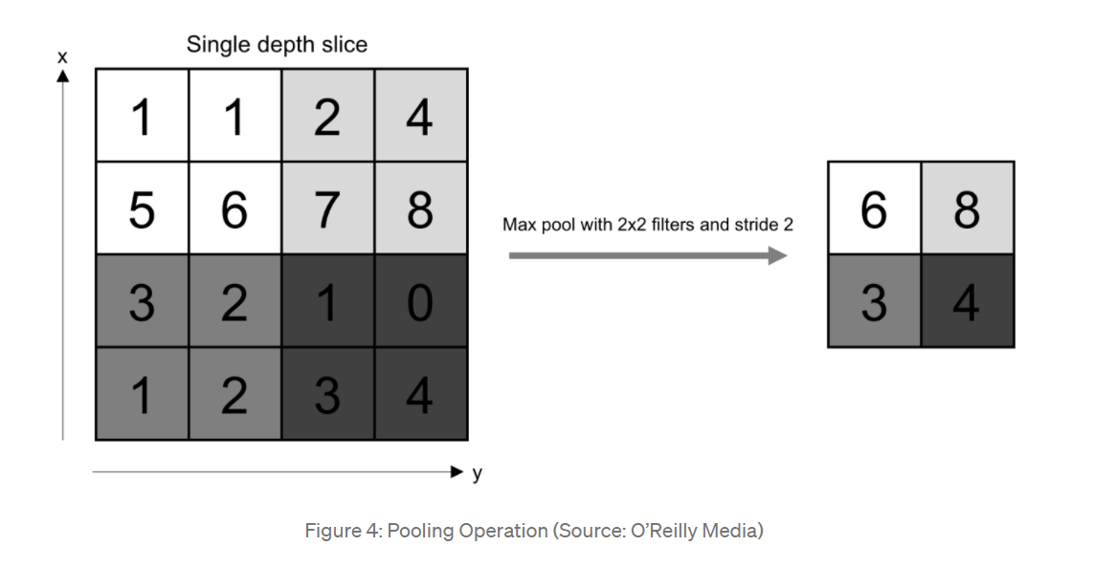
Max polling layer

Slide 29
How to improve the classification accuracy?
Increase the amount of data in the training set
Data augmentation
Hyper parameter optimizations
Number of epochs
Number of image inside the batch
Number of layers in CNN model

Slide 30
HACKATHON PROJECT - Statement
Tomato is affected by various diseases during its growth process.
Two most common disease in Tomato leaves are early blight and late bright cause by fungus. It affects all part of tomato plants and cause huge economical loss.
Accurately identify the diseases can help farmer to improve the yield of tomato.

Slide 31
HACKATHON PROJECT - RUBRIC
Please help Tomato farmer to build a model for classify tomato leave disease
Tomato leave disease classification
Class 1: Healthy
Class 2: Early blight
Class 3: Late blight

Slide 32
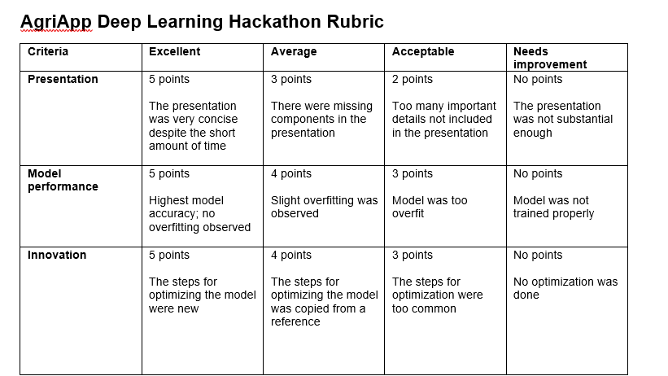
HACKATHON PROJECT - Objective

Slide 33
Conclusion
Getting familiar with Google Colab, Kaggle, Python
Implement Bell Pepper Leaf Disease Classification using CNN
Loading data
Preprocessing data
Constructing model
Training model
Evaluating model

Slide 34
THANK YOU!
Questions & Answer

