Slide 1

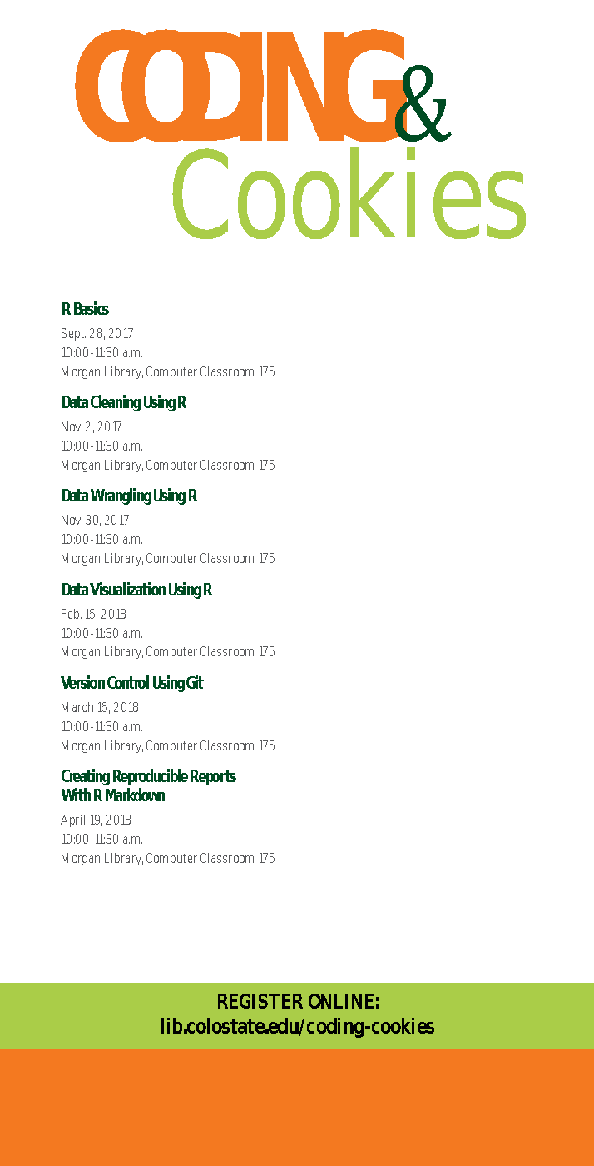
Version control using git
Notes:
Hi, and welcome to Coding and Cookies. My name is Ian, and today we’re going to be covering version control using git.

Slide 2
Outline
What is version control?
What is git?
How to use git with GitHub and Rstudio
Notes:
We’ll answer three main questions:
…,
…,
and we’ll see …
Throughout this video, feel free to pause and take as much time as you need on each slide.

Slide 3
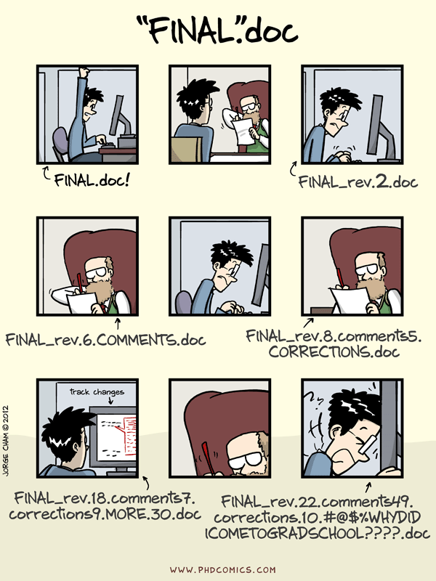
What is version control?
An answer to this fundamental question:
What is the most effective way for one or more people to organize and control revisions to a set of documents?
http://phdcomics.com/comics.php?f=1531
Notes:
First, what is version control? Version control is…
If you’ve ever experienced the situation in this cartoon to the right, then version control is for you.
Before we get into git, let’s first look at other forms of version control and their features.
->

Slide 4
Examples of Version Control Systems
 | Email files back and forth | MS Word “track changes” | Google Docs | Git
Track individual changes | ✕ | ✓ | ✓ | ✓
Allows concurrent editing | ✕ | ✕ | ✓ | ✓
Supports several file types | ✓ | ✕ | ✕ | ✓
Track who made what change when | ✕ | ✓/✕ | ✓ | ✓
Notes:
On the top of this grid we have different kinds of version control, even some you might not think of as version control.
Emailing files back and forth (like from the comic on the last slide), the “track changes” feature of MS word, Google Docs, and finally Git.
And on the left, we can see the different abilities of each of them. We want a version control system that can track individual changes, allow concurrent editing by multiple people, support different file types, and track who made what change and when.
All of these systems support one one of these features, but Git is the most flexible and powerful version control system of all of them.

Slide 5



Popular Version Control Systems
These generally all...
record changes to a file or set of files over time
Allow later recall of any prior versions
(EVERYTHING is saved)
Record who made what change when
Identify conflicting changes
Allow multiple versions of the same project
Notes:
There are, however, other version control systems besides git. For example, subversion and mercurial.
All of them have the desired properties from the last slide. But we are focusing on git because it is very popular and well-integrated with many tools.

Slide 6


Scope of this talk
Version control with git….
(A particular version control system)
… using GitHub….
(A website which stores git projects)
… and RStudio
(because we’ve been writing code in R)
Notes:
For the scope of this talk, we will be covering: …
… and Rstudio has nice integration with git.

Slide 7

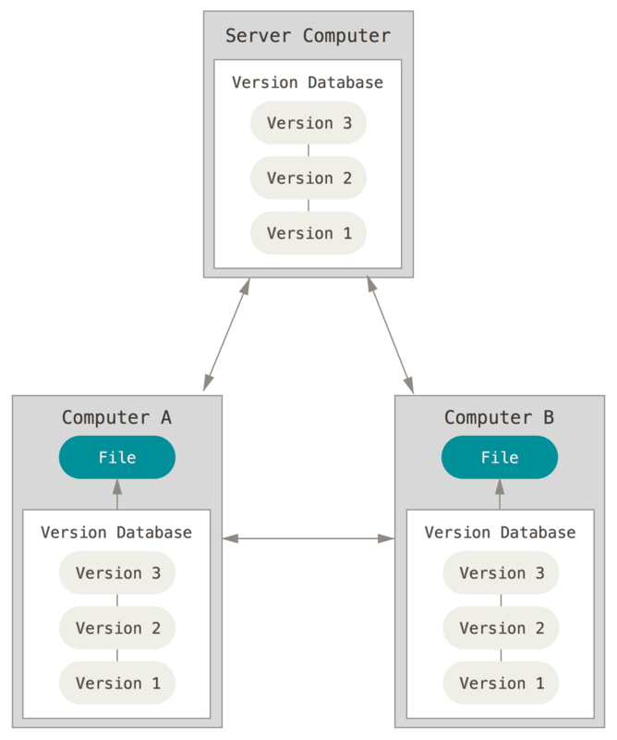
A particular version control system
Free, open source
Distributed
Copies on multiple computers
Copies on a central server
Hardware failure resistant
Notes:
Git is …
It is ...
And it’s distributed, which means …

Slide 8
A website that stores git projects for free (mostly)
Allows easy sharing of code with a wide audience
Augments git with
Project tasks
Bug/Issue tracking
Controlled access to projects
“Organization” accounts
Notes:
GitHub is …
*Mostly: GitHub charges for premium features like extra storage space on private respositories and 24/7 support.

Slide 9
A (Greatly) Simplified View
Your Computer
GitHub.com
Git repository (Local Copy)
“A folder on your computer with all your project files”
Git repository (Remote Copy)
“A page on github.com”
Unstaged Changes
“The default place for modified files”
Staging Area
“A place to gather several changes before updating the snapshot”
Master Branch
“A snapshot of all files in your project”
Master Branch
“A snapshot of all files in your project”
Notes:
To understand how Git works, let’s look at what is stored on your own computer, what is stored on a remote server like GitHub, and how they interact.
On your computer, you have a local copy of your git repository. This will look just like a folder on your computer where you do your work on the project and make changes to files.
Behind the scenes on your computer, there are three parts of your git repository:
Unstaged changes are any changes you have made to files recently and haven’t done anything else with yet. This is the default place for modified files.
The staging area is where you can gather together several changes before updating the snapshot.
And finally we have the master branch, which is a snapshot of all files in your project. Not only is it a snapshot of the current state of your project, but it has a history of all past states of your project.
All three of these places exist in the same folder on your computer. The differences between them are behind the scenes.
On GitHub.com, there will be a remote copy of your repository. It only has a copy of the branch, that is the snapshot of the files in your project. You can see this remote copy by logging into GitHub.com.
One note: You can have multiple branches, but we’ll just focus on the master branch, which is the main branch.

Slide 10
A (Greatly) Simplified View
Your Computer
GitHub.com
Git repository (Local Copy)
“A folder on your computer with all your project files”
Git repository (Remote Copy)
“A page on github.com”
Unstaged Changes
“The default place for modified files”
Staging Area
“A place to gather several changes before updating the snapshot”
Master Branch
“A snapshot of all files in your project”
Master Branch
“A snapshot of all files in your project”
Modify
Notes:
Now let’s imagine you have modified some files. When you do, they move into the unstaged changes. This happens automatically. In other words, git is not keeping track of the changes yet.

Slide 11
A (Greatly) Simplified View
Your Computer
GitHub.com
Git repository (Local Copy)
“A folder on your computer with all your project files”
Git repository (Remote Copy)
“A page on github.com”
Unstaged Changes
“The default place for modified files”
Staging Area
“A place to gather several changes before updating the snapshot”
Master Branch
“A snapshot of all files in your project”
Master Branch
“A snapshot of all files in your project”
Add
Notes:
But we can change that. We can tell git to “add” some (or all) of these changes to the staging area. This gets them ready to be made into a snapshot.
Notice that we haven’t added all of the changes yet. We may do this because if you’re working on more than one thing at once, all the changes you’ve made to a project may not be related to each other. Adding only some changes lets you keep them separate from others.

Slide 12
A (Greatly) Simplified View
Your Computer
GitHub.com
Git repository (Local Copy)
“A folder on your computer with all your project files”
Git repository (Remote Copy)
“A page on github.com”
Unstaged Changes
“The default place for modified files”
Staging Area
“A place to gather several changes before updating the snapshot”
Master Branch
“A snapshot of all files in your project”
Master Branch
“A snapshot of all files in your project”
Commit
Notes:
Once changes have been added to the staging area, you can commit them to the master branch. This takes the staged changes, and adds them to the snapshot, while keeping a history of all past snapshots.

Slide 13
A (Greatly) Simplified View
Your Computer
GitHub.com
Git repository (Local Copy)
“A folder on your computer with all your project files”
Git repository (Remote Copy)
“A page on github.com”
Unstaged Changes
“The default place for modified files”
Staging Area
“A place to gather several changes before updating the snapshot”
Master Branch
“A snapshot of all files in your project”
Master Branch
“A snapshot of all files in your project”
Push
Notes:
Lastly, we can push your local branch to GitHub.com. Pushing a branch updates the copy on GitHub.com and makes your latest changes available to your collaborators. It also makes your changes available to the world if your repository is public.
Until changes are pushed they are not visible to anyone else. So pushing is the last step in publishing your file changes.

Slide 14
A (Greatly) Simplified View
GitHub.com
Your Collaborator’s Computer
Git repository (Remote Copy)
“A page on github.com”
Git repository (Local Copy)
“A folder on their computer with all the project files”
Master Branch
“A snapshot of all files in your project”
Unstaged Changes
“The default place for modified files”
Staging Area
“A place to gather several changes before updating the snapshot”
Master Branch
“A snapshot of all files in your project”
Notes:
Now let’s see what happens when your collaborator needs to get a copy of your latest changes.
Your collaborator has their own copy of the repository. The only difference is they don’t have the most recent changes.

Slide 15
A (Greatly) Simplified View
GitHub.com
Your Collaborator’s Computer
Git repository (Remote Copy)
“A page on github.com”
Git repository (Local Copy)
“A folder on their computer with all the project files”
Master Branch
“A snapshot of all files in your project”
Unstaged Changes
“The default place for modified files”
Staging Area
“A place to gather several changes before updating the snapshot”
Master Branch
“A snapshot of all files in your project”
Pull
Notes:
To get them, they can pull the branch from GitHub.com, which will update their copy to the latest available state.
From here, they can make their own changes, commit to their snapshot, and push their branch back to GitHub.

Slide 16
A (Greatly) Simplified View
Your Computer
Git repository (Local Copy)
“A folder on your computer with all your project files”
Unstaged Changes
“The default place for modified files”
Staging Area
“A place to gather several changes before updating the snapshot”
Master Branch
“A snapshot of all files in your project”
New files show up as unstaged changes
Notes:
If you create a new file, it will show up as an unstaged change just like a modified file.
->

Slide 17
A (Greatly) Simplified View
Your Computer
Git repository (Local Copy)
“A folder on your computer with all your project files”
Unstaged Changes
“The default place for modified files”
Staging Area
“A place to gather several changes before updating the snapshot”
Master Branch
“A snapshot of all files in your project”
New files show up as unstaged changes
Notes:
From there the process is the same: add, commit, push, pull, etc.

Slide 18
Reverting changes (undoing changes)
Your Computer
GitHub.com
Git repository (Local Copy)
“A folder on your computer with all your project files”
Git repository (Remote Copy)
“A page on github.com”
Unstaged Changes
“The default place for modified files”
Staging Area
“A place to gather several changes before updating the snapshot”
Master Branch
“A snapshot of all files in your project”
Master Branch
“A snapshot of all files in your project”
Notes:
You may also change your mind and not want to commit your modified or added files.
->

Slide 19
Reverting changes (undoing changes)
Your Computer
GitHub.com
Git repository (Local Copy)
“A folder on your computer with all your project files”
Git repository (Remote Copy)
“A page on github.com”
Unstaged Changes
“The default place for modified files”
Staging Area
“A place to gather several changes before updating the snapshot”
Master Branch
“A snapshot of all files in your project”
Master Branch
“A snapshot of all files in your project”
Notes:
At any time, anything in the unstaged changes area or the staging area can be reverted to the most recent snapshot.

Slide 20
Types of files git works best with
Good formats
(more human readable)
“Bad” formats
(less human readable)
Documents (.txt, .tex, .rtf, .Rmd)
Tabular Data (.csv)
Source code (.R, .py, .c, .sh)
Documents (.docx, .pdf, .ppt)
Excel spreadsheets (.xlsx)
Media (.jpg, .mp3, .mp4)
Databases (.mdb, .sqlite)
Notes:
Git works best with text files, or files that are simply structured.
…
There are exceptions to these rules (xml, media may be okay as long as they aren’t too large and don’t change too much)

Slide 21
Prerequisites
Install/Upgrade R and R Studio http://happygitwithr.com/install-r-rstudio.html
Install git
http://happygitwithr.com/install-git.html
Create a github account: https://github.com/join?source=header-home
Notes:
Now let’s see git used in practice. We will walk through two exercises of basic git usage: how to set up a repository, how to import that repository to Rstudio, and how to make basic changes.
Please remember to pause as much as you need before moving to the next step.
For these next slides, you’ll need to…

Slide 22
Exercise 1: Setup
Make a new GitHub repository
Create a new R Studio Project
Link the repository to the project
“Clone” the remote
Notes:
In the first exercise, we’ll set up a new repository and project. We will …

Slide 23
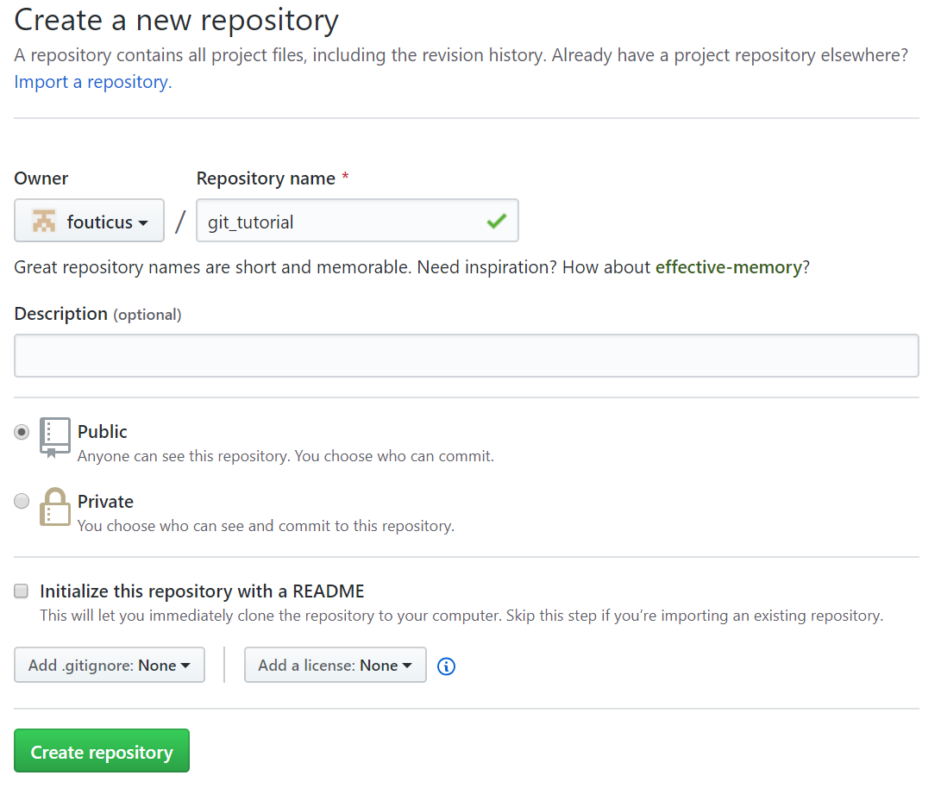
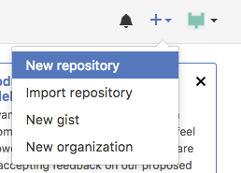
Make an empty GitHub Repository
Github.com
Upper right of screen
Notes:
Let’s make an empty GitHub Repository.
On the upper right of the screen on GitHub.com there is a button the create a new repository.
Name your repository then click “create”.

Slide 24
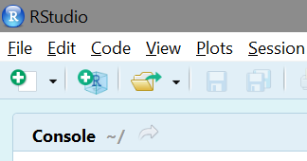
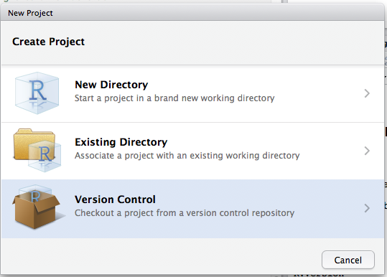
Make a new version control project
(no version control)
(auto-detects existing repository)
(creates a version controlled directory)
Notes:
Now, we’ll use this repository to create a new R project.
In Rstudio, click new project and select “Version Control”.

Slide 25
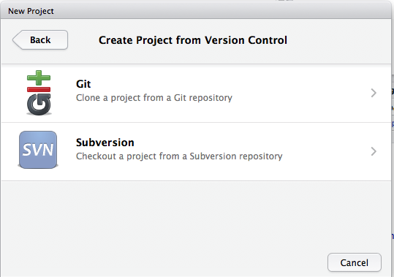
Select git
Notes:
Select “git” to clone a project from a Git repository.

Slide 26
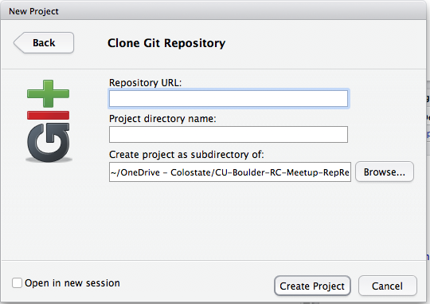
Link to GitHub Repository
URL from github
New dir name
Parent directory
Notes:
Rstudio needs the url from your newly created GitHub repository and the name of a folder to create on your computer.

Slide 27
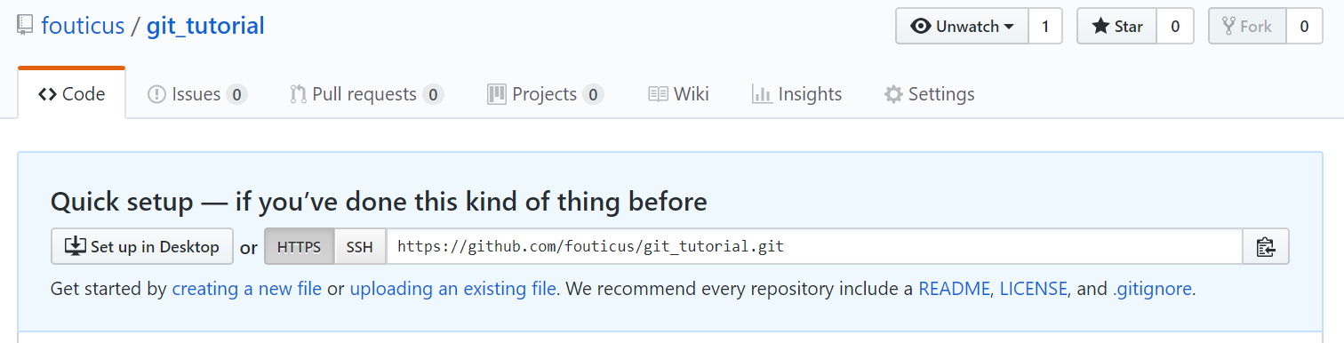
Get github URL
(copies)
Notes:
We can copy the URL from your new repository’s page. GitHub helpfully gives you this pop up in a new repository. Click the right-hand button to copy the URL.

Slide 28
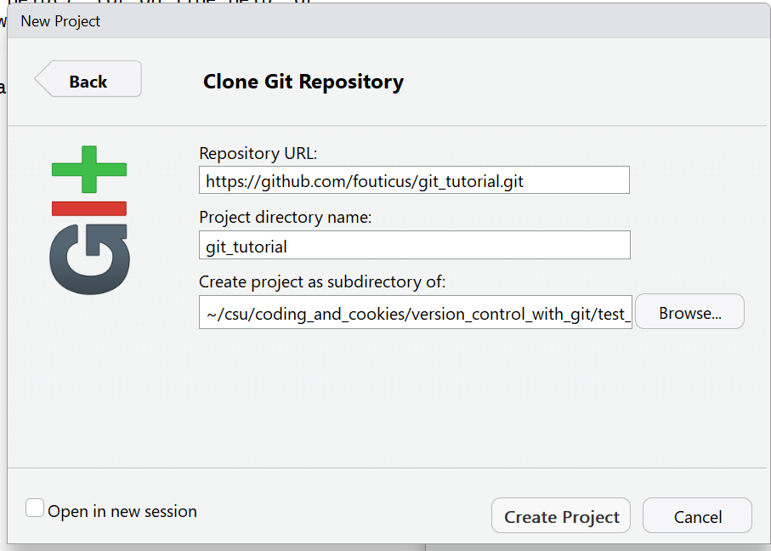
Select git, select options
Paste here
Pick location on D drive
Notes:
Paste the URL in Rstudio, choose a folder name and location to save your project. Then click “create project”

Slide 29
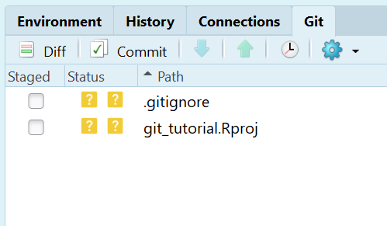
Results
New Tab!
unstaged changes
Notes:
You’ll notice a new tab in your upper-right-hand Rstudio Pane! This is where you’ll access git.

Slide 30
Exercise 1: Setup your repo
Make a github repository
Create a new RStudio version controlled project
Link the repository from GitHub
Verify that you have a git tab in the R studio upper right panel
Notes:
This is the end of exercise 1. Please feel free to go back, rewatch, and take as much time as you need.
You should have a repository on GitHub, an Rstudio project linked to this repository, and a new git tab in Rstudio showing git controls.

Slide 31
Exercise 2: The current picture
Your Computer
GitHub.com
Git repository (Local Copy)
“A folder on your computer with all your project files”
Git repository (Remote Copy)
“A page on github.com”
Unstaged Changes
“The default place for modified files”
Staging Area
“A place to gather several changes before updating the snapshot”
Master Branch
“A snapshot of all files in your project”
Master Branch
“A snapshot of all files in your project”
.gitignore
Notes:
In Exercise 2, we will make some basic changes to files and explore using git to track them.
Right now, we have some unstaged changes from Rstudio initializing the project, and a blank branch.

Slide 32
Let’s commit and push “.gitignore”
Your Computer
GitHub.com
Git repository (Local Copy)
“A folder on your computer with all your project files”
Git repository (Remote Copy)
“A page on github.com”
Unstaged Changes
“The default place for modified files”
Staging Area
“A place to gather several changes before updating the snapshot”
Master Branch
“A snapshot of all files in your project”
Master Branch
“A snapshot of all files in your project”
git_
tutorial
.Rproj
Add
Commit
.gitignore
Push
.gitignore
Notes:
Let’s add the “.gitignore”, commit it, and push to GitHub.

Slide 33
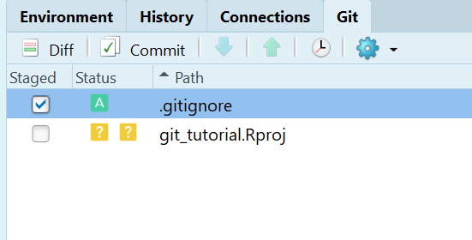
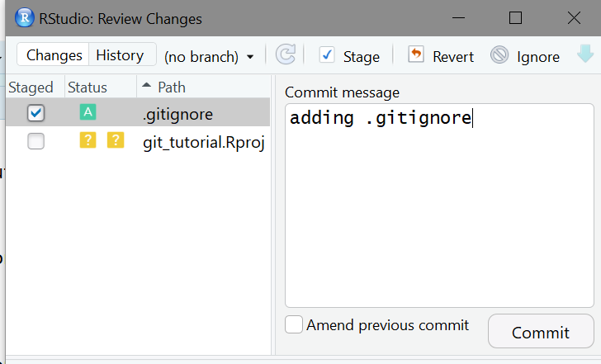
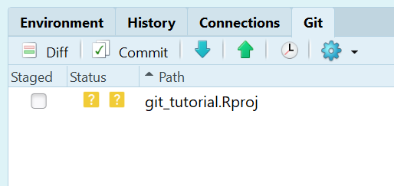
Add
2. Commit
3. Write an informative message
4. Push changes to GitHub
(updated unstaged changes)
Notes:
Add by clicking the checkbox next to “.gitignore” in the git tab. See how the checkboxes indicate whether changes have been staged.
Commit by clicking the “commit” button at the top of the pane.
Add a commit message. These messages appear when browsing the history of your project snapshots, so messages which are simple and informative are best.
Push your snapshot to GitHub by clicking the green up arrow to the right of the commit button.
With that, this new “.gitignore” file is visible to anyone with access to your github repository!

Slide 34
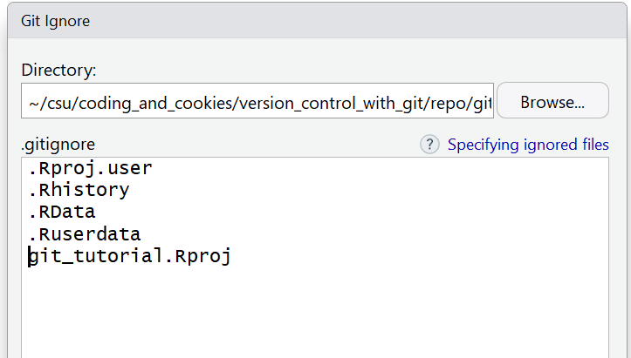
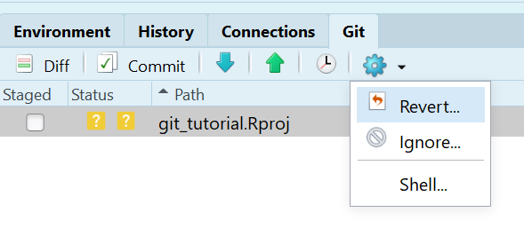
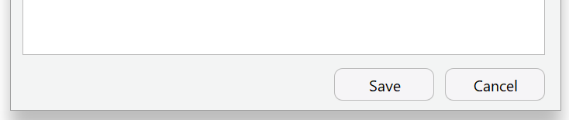
Ignoring files
Git by default “sees” all files in its directory unless you tell it not to
Add the filename to the .gitignore file to stop tracking
Notes:
The “.gitignore” file is one that is created by default in new repositories. It tells git which files to “ignore”. For example, you may want to have git track R markdown documents but not the PDFs they create, since those can be regenerated by anyone with the R markdown file.
Rproj files are also good ones to ignore. Let’s add the Rproj file to git’s ignore list by highlighting it, clicking the gear icon, and clicking ignore. Click save to finish.

Slide 35
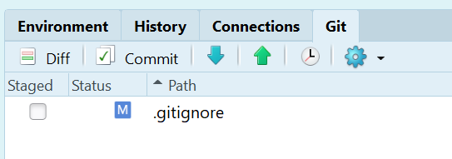
Ignoring files
Now the git ignore file is back
.Rproj is ignored
Status: Modified
Notes:
You’ll notice now that the Rproj file is missing from git’s list of unstaged changes. It’s ignoring it, just like we want.
But now there have been changes to the .gitignore file which we need to add, commit, and push.

Slide 36
What just happened
Your Computer
GitHub.com
Git repository (Local Copy)
“A folder on your computer with all your project files”
Git repository (Remote Copy)
“A page on github.com”
Unstaged Changes
“The default place for modified files”
Staging Area
“A place to gather several changes before updating the snapshot”
Master Branch
“A snapshot of all files in your project”
Master Branch
“A snapshot of all files in your project”
Ignore
.gitignore
Modify
.gitignore
.gitignore
Notes:
In our diagram, this is what happened.
The Rproj file is being ignored. But the .gitignore file now has unstaged changes.

Slide 37
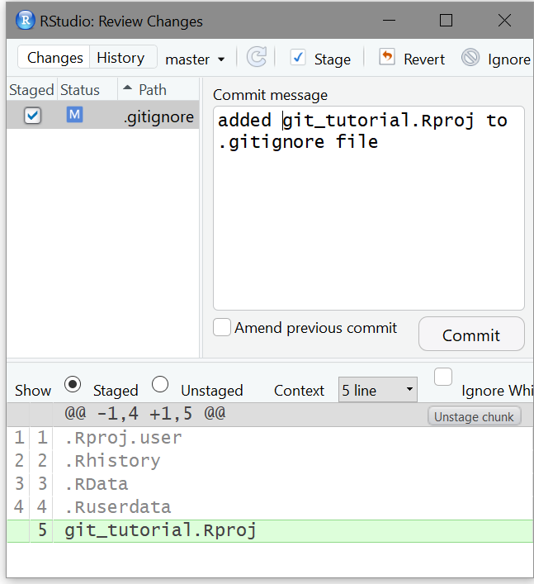
Exercise 2
Add the changes to the .gitignore file to the staging area
Commit the changes with an informative commit message
Look at what’s different (green) in the commit window
Notes:
Now, do the same things to the .gitignore file as we did when it was new.
Add the changes to the staging area, and commit the changes with an informative commit message.

Slide 38
What just happened
Your Computer
GitHub.com
Git repository (Local Copy)
“A folder on your computer with all your project files”
Git repository (Remote Copy)
“A page on github.com”
Unstaged Changes
“The default place for modified files”
Staging Area
“A place to gather several changes before updating the snapshot”
Master Branch
“A snapshot of all files in your project”
Master Branch
“A snapshot of all files in your project”
.gitignore
Add
.gitignore
Commit
.gitignore
.gitignore
Notes:
So far, our changes to .gitignore are saved in our local repository, but the remote repository needs to be updated.

Slide 39
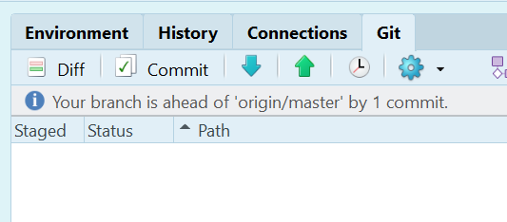
Push
Our repository has 1 commit that GitHub’s version doesn’t have
No one else has made changes on GitHub so we can push without any problems
Notes:
Rstudio helpfully notifies us that we have one commit that we need to push. Click the green up arrow to push.

Slide 40
What just happened
Your Computer
GitHub.com
Git repository (Local Copy)
“A folder on your computer with all your project files”
Git repository (Remote Copy)
“A page on github.com”
Unstaged Changes
“The default place for modified files”
Staging Area
“A place to gather several changes before updating the snapshot”
Master Branch
“A snapshot of all files in your project”
Master Branch
“A snapshot of all files in your project”
.gitignore
Push
.gitignore
Notes:
Now our changes to .gitignore have been synced to the copy of the repository on GitHub.com

Slide 41
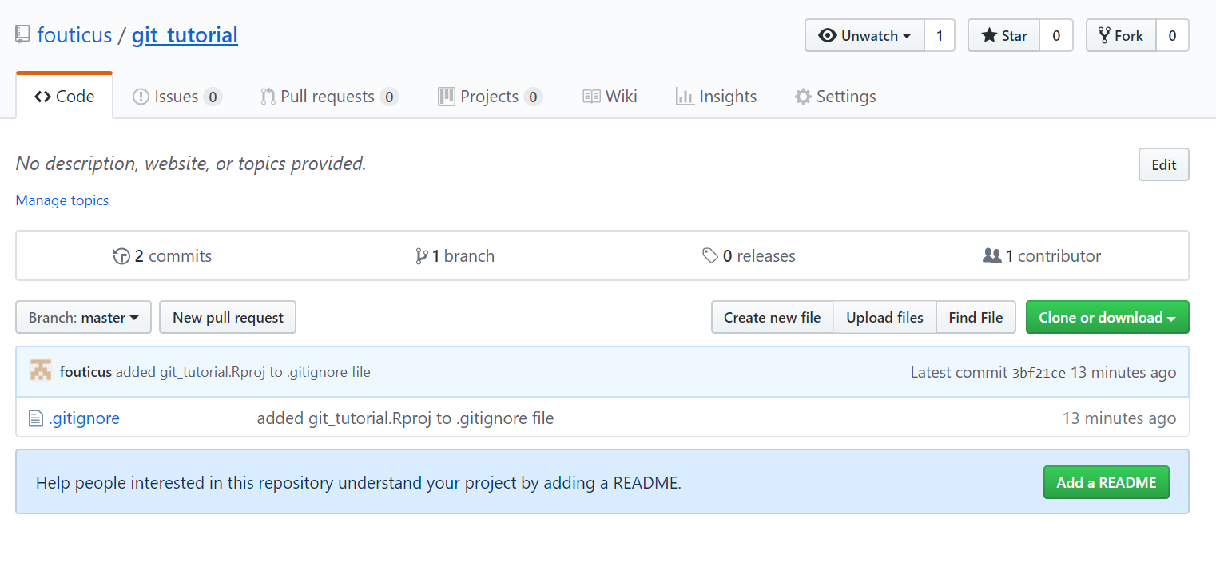
Files in remote (On Github)
Notes:
We can see these changes on the website, along with a last updated timestamp.

Slide 42
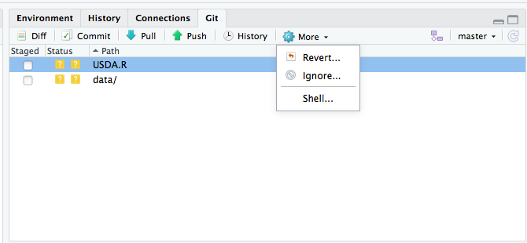
Reverting to the “snapshot”
Removes all uncommitted changes
includes staged changes
includes unstaged changes
Can’t revert to previous “snapshots”
We need the shell for that
Notes:
To revert changes, we can click the revert button under the gear menu in Rstudio.
To revert to previous snapshots requires more advanced git usage which we will see in the interactive session.

Slide 43
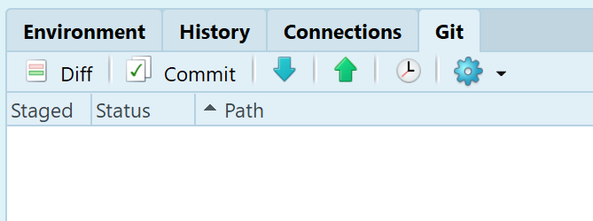
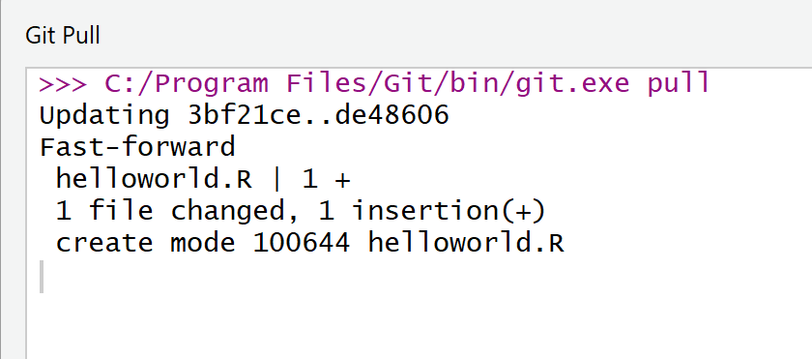
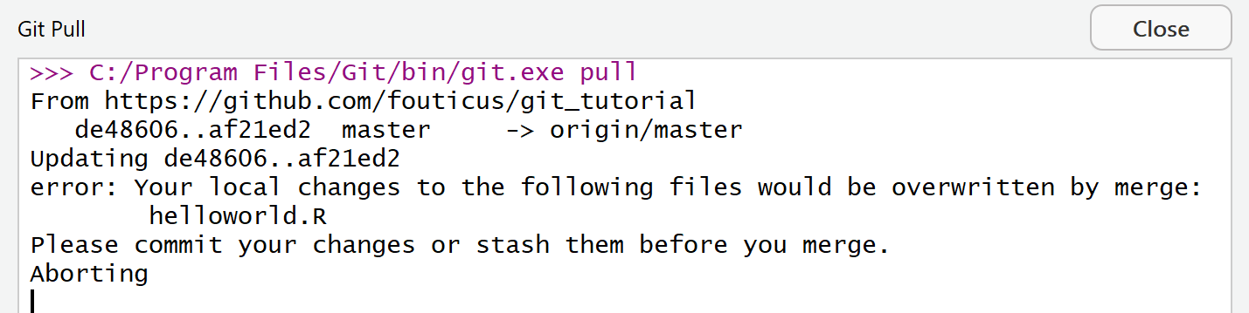
Pulling Changes from GitHub
Changes from GitHub are now in your local directory
If you have uncommitted changes, the pull will fail
Notes:
To pull changes from github, click the blue down arrow next to push.
If there are any conflicts that prevent your copy from being updated to the remote copy, git will notify you.

