Slide 1
COMP4913 Capstone Project
Simulation Game for Learning Algorithmic Trading
Programme-Stream Code: 61431-SYC
Supervisor: Dr YIU Man Lung Ken
Student Name: Cheung Sui Wing
Student ID: 21027547D
Notes:
Hello my name is Cheung Sui Wing
my topic of the capstone project is
Simulation game for learning algorithmic trading

Slide 2
Content
Project Overview
Development Details
Integration of the Game with course in PolyU
Demo
Q&A
Notes:
This is the structure of today's presentation
first is the overview of the project
second part is some development details
Then is Integration of the Game with course in PolyU
Final part is the demo and Q&A section

Slide 3
Project Overview
Algorithm trading
Complex field
Trading knowledge
Programming skill to execute
Challenging for beginner
Proposed solution
Web-base software
Provide user interface for user to interact with.
Purpose:
Allow users to learn about algorithm trading through the game play in a risk-free environment.
Target:
Beginner
Notes:
Let's talk about the project overview.
For algorithmic trading,
It is a complex field.
First, of course, people who want to trade using algorithm
need trading knowledge.
Not only that,
they also require computer programming skills
to execute their algorithm.
This makes it challenging for beginners to enter the field.
And the proposed solution in this project
is to create web-based software that
provides a user interface for the user to interact with.
The purpose is to let them
learn about algorithmic trading
through game play in a risk-free environment.

Slide 4
Development Details
Web-based software
Frontend (React)
Backend (RESTful APIs server usingNode.js)
Data
Using past market data
Polygon.io (getting updated data in daily)
Database
Store user data (e.g., rules set)
MongoDB

Slide 5
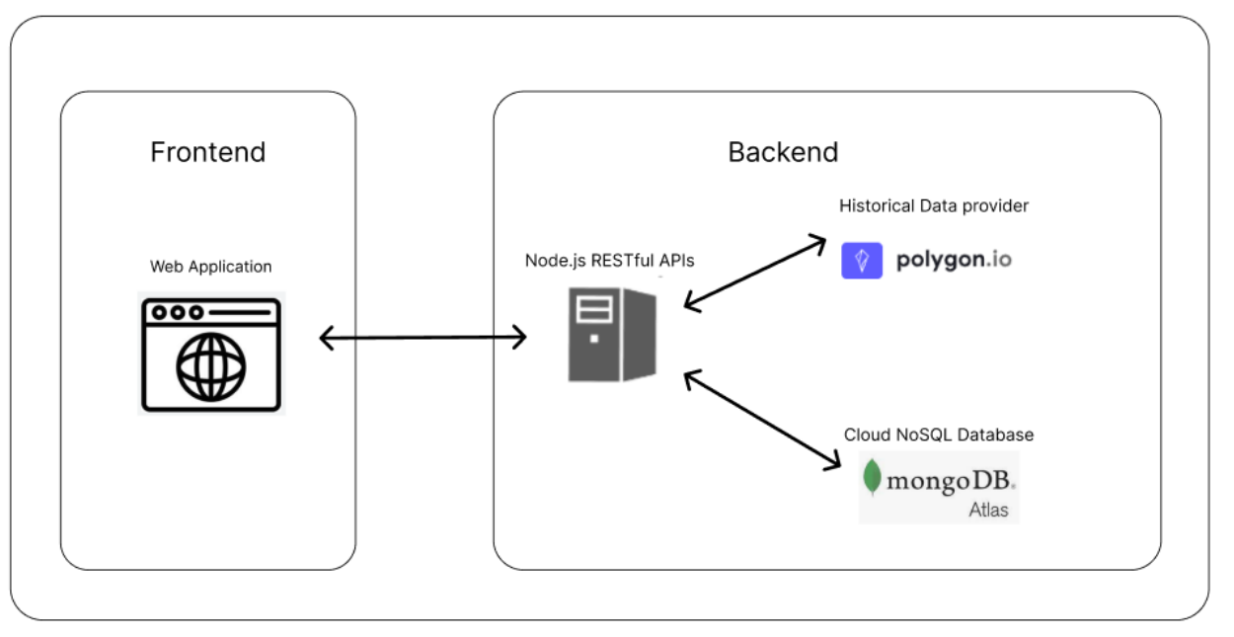
Development Details
System architecture

Slide 6
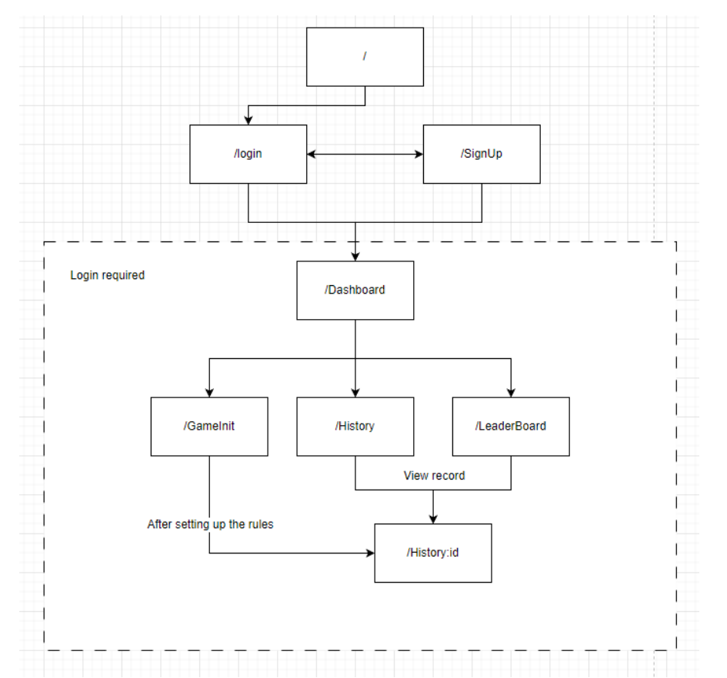
Development Details
Navigation map of the website
The system require login
After login (three main functions)
New game
History
Leader board

Slide 7
Game Level
Three game level
Dollar Cost Averaging (DCA)
Martingale
Custom rules set

Slide 8
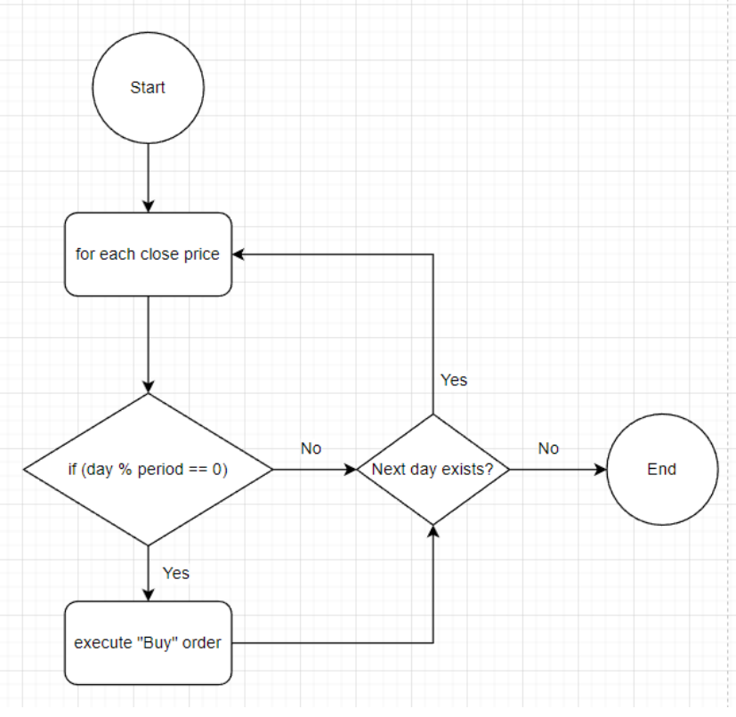
DCA
Good strategy for beginners who are just starting to invest
it is simple to understand
Parameters
Invest period
Invest amount
let them feel what it is

Slide 9
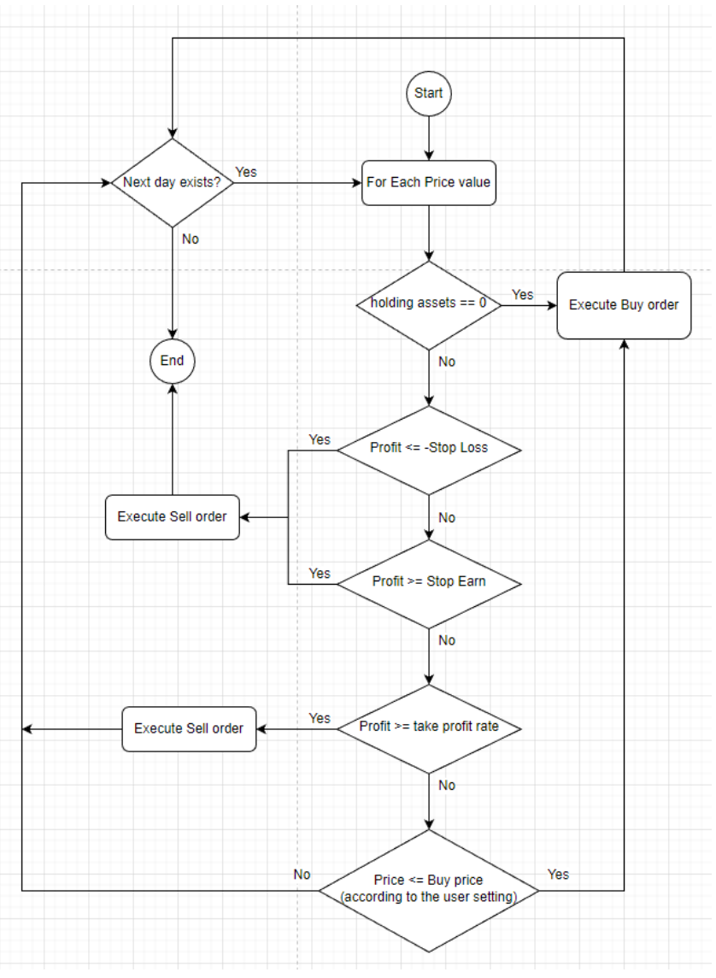
Martingale
Betting strategy
Logic:
When Lose
Increasing the amount of the next bet. E.g., double the investment
Then once win, it will recover all loss with some profit
High risk algorithm
Implementing some risk management concept here such as stop loss
to let user to learn this concept
Flow of Martingale Strategy

Slide 10
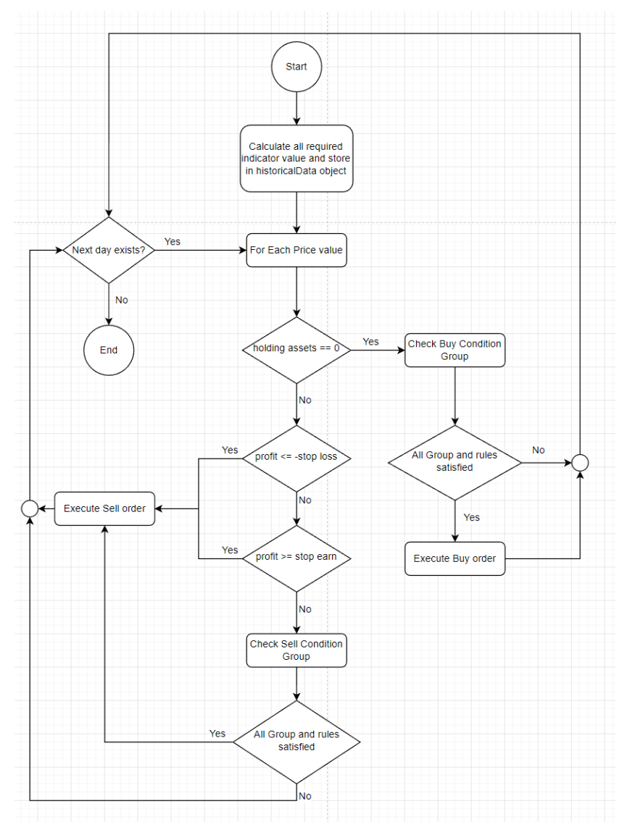
Custom Rules
Rule-setting options
current and previous
open,
high,
low,
close prices
and volume
Some technical indicators
SMA: Simple Moving Average
EMA: Exponential Moving Average
ADX: Average Directional Index
RSI
MACD
Stochastic Oscillator
Flow chart of Custom Rules

Slide 11
Custom Rules
User need to setup Buy and Sell Conditions
Each condition form with different groups
Each group contains different rules
Three group operation
And: all rules should pass
Not: all rules should not pass
Count: only number of rules need to pass

Slide 12
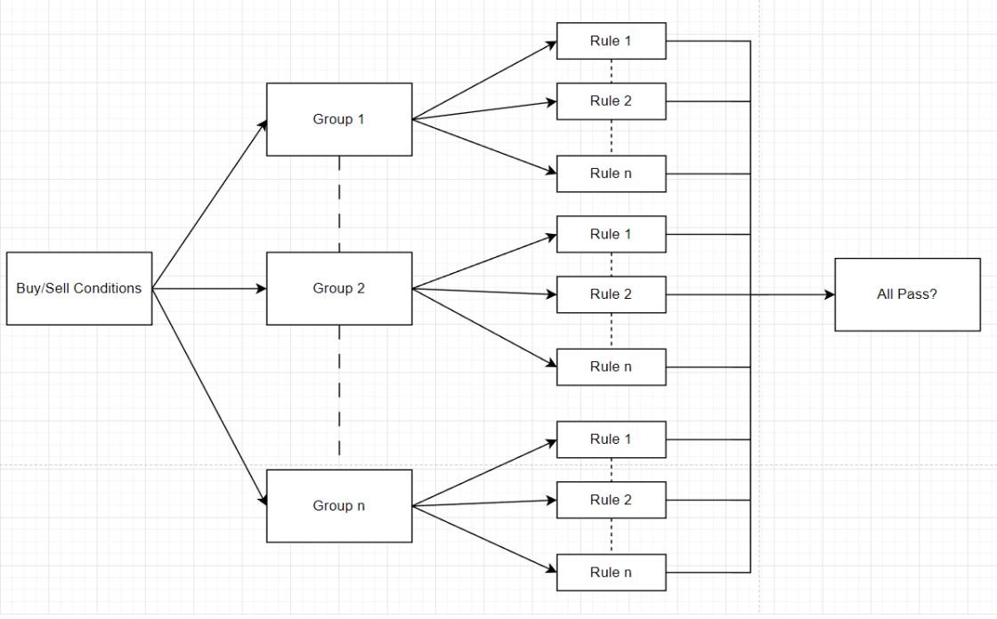
Custom Rules
structure of the condition

Slide 13
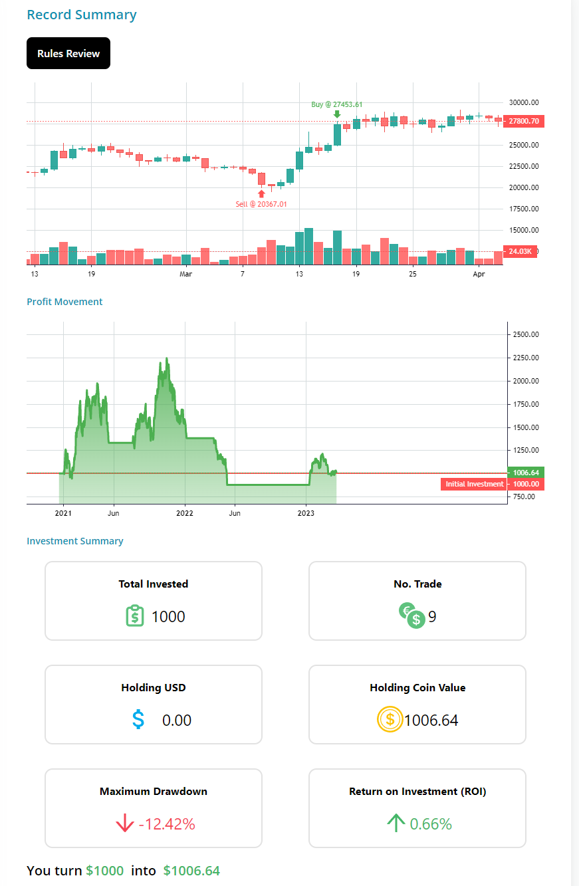
Record
After setting up the algorithm
Website will send the request to the server and ask for simulation.
The response data will show in here.
Generate buy/sell marker in the candle stick chart
Profit movement chart
Investment Summary
etc

Slide 14
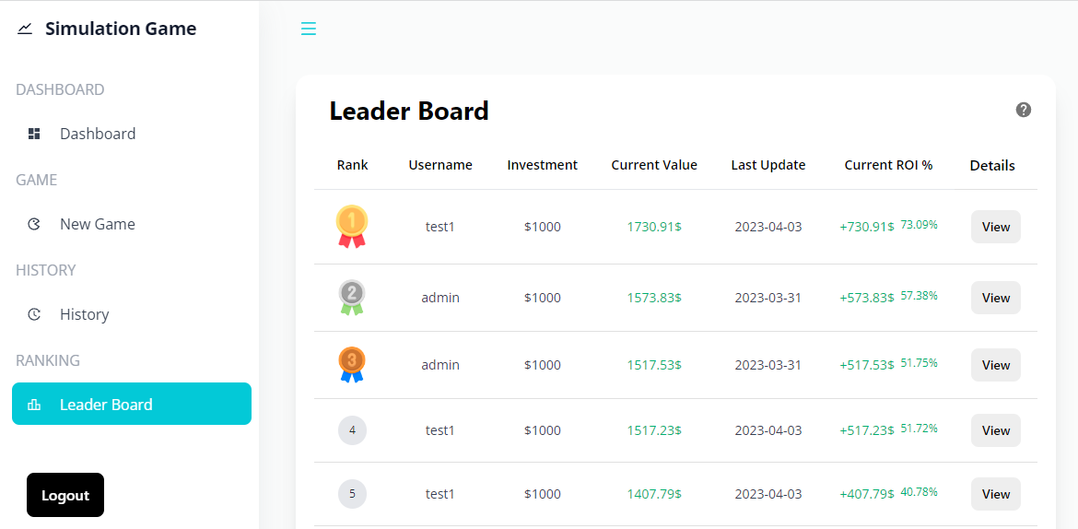
Leader Board
Allow the users to look at other people’s performance
Ranking according to the ROI (Return on Investment)
Only the Custom Rules will count
Updated daily
simulation the real time market

Slide 15
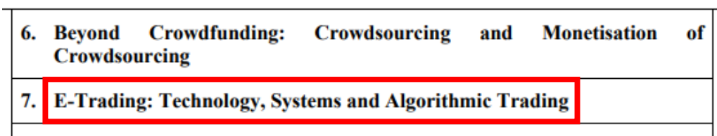
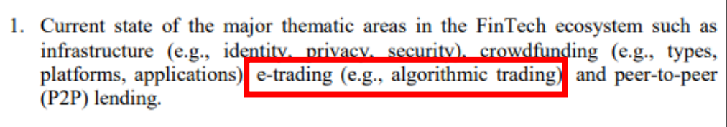
Integration with Course in PolyU
This game can be utilized in various courses at PolyU
Finance, technology, Fintech course
Such as COMP4141, COMP4531
Help them to gain hands-on experience in related topic
Syllabus of COMP4141
Syllabus of COMP4531

Slide 16
Demo

Slide 17
Q&A

