Slide 1
COMP4913 Capstone Project
Simulation Game for Learning Algorithmic Trading
Programme-Stream Code: 61431-SYC
Supervisor: Dr YIU Man Lung Ken
Student Name: Cheung Sui Wing
Student ID: 21027547D
Notes:
Hello my name is Cheung Sui Wing
my topic of the capstone project is
Simulation game for learning algorithmic trading

Slide 2
Content
Project Overview
Development Details
Integration of the Game with course in PolyU
Demo
Q&A
Notes:
This is the structure of today's presentation
first is the overview of the project
second part is some development details
Then is Integration of the Game with course in PolyU
Final part is the demo and Q&A section

Slide 3
Project Overview
Algorithm trading
Complex field
Trading knowledge
Programming skill to execute
Challenging for beginner
Proposed solution
Web-base software
Provide user interface for user to interact with.
Purpose:
Allow users to learn about algorithm trading through the game play in a risk-free environment.
Target:
Beginner
Notes:
Let's talk about the project overview.
For algorithmic trading,
It is a complex field.
First, of course, people who want to trade using algorithm
need trading knowledge.
Not only that,
they also require computer programming skills
to execute their algorithm.
This makes it challenging for beginners to enter the field.
And the proposed solution in this project
is to create web-based software that
provides a user interface for the user to interact with.
The purpose is to let them
learn about algorithmic trading
through game play in a risk-free environment.

Slide 4
Development Details
Web-based software
Frontend (React)
Backend (RESTful APIs server usingNode.js)
Data
Using past market data
Polygon.io (getting updated data in daily)
Database
Store user data (e.g., rules set)
MongoDB
Notes:
My web-based software for algorithmic trading
will consist of a
frontend developed using React,
and a backend built on a RESTful API server using Node.js.
To obtain relevant and up-to-date market data,
I am using Polygon.io.
This data will allow us to create a
realistic and dynamic environment
for users to learn and practice algorithmic trading.
In terms of storing user data,
I use MongoDB as my database solution.
This will enable us to securely store
user information and rule sets

Slide 5
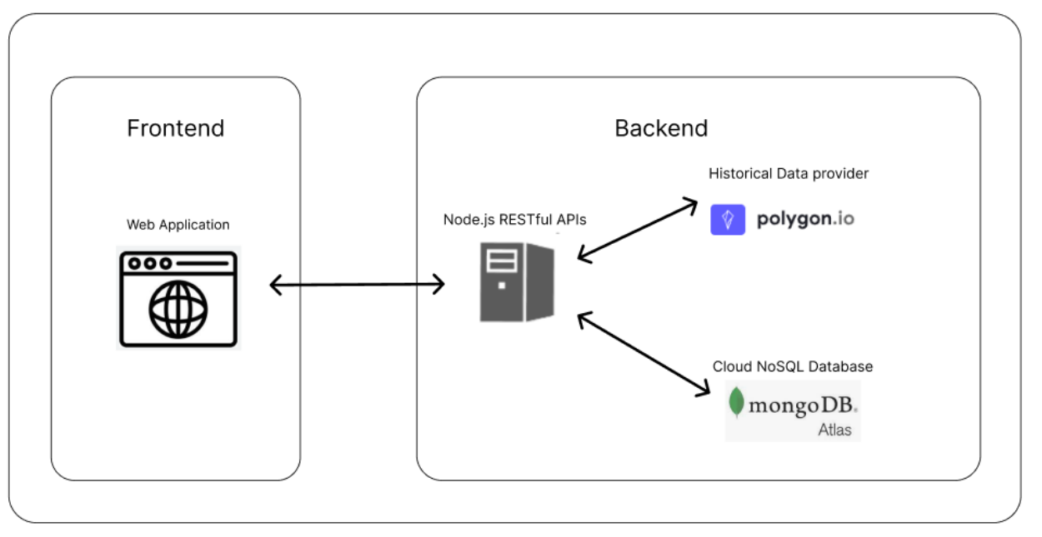
Development Details
System architecture
Notes:
This is a picture of the system architecture
The backend server will handle all the API connection
Such as updating the historical Data
or connecting to the database
It also do all the simulation
base on the user algorithm
and finally send back to the front end
To display the result to the user.

Slide 6
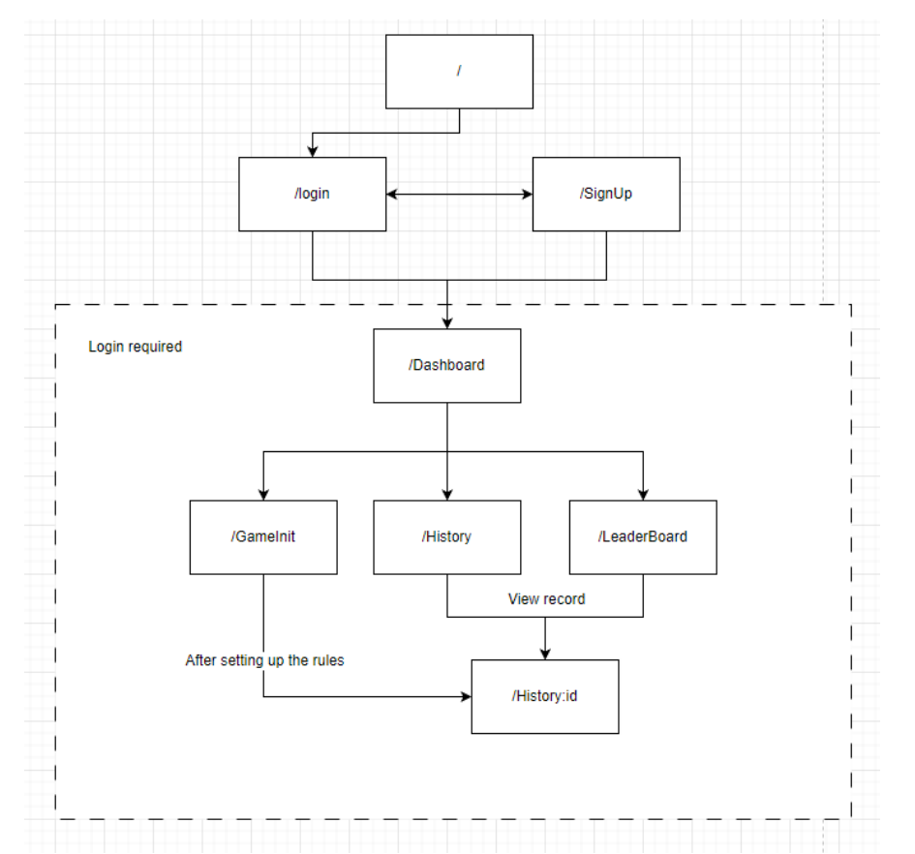
Development Details
Navigation map of the website
The system require login
After login (three main functions)
New game
History
Leader board
Notes:
This is a navigation map of my front end website
To access our web-based software,
users will need to log in to the system.
Once logged in,
they will have access to three main functions:
New Game, History, and Leaderboard.
The New Game function will allow users to start a new game session,
where they can practice
their algorithmic trading skills
in a simulated environment.
They will be able to select different
trading strategies,
set their own rules and parameters,
and execute the simulation
The History function will enable users to
review their past game sessions,
including the performance of their algorithms
and the results of their trades
This will allow users to track their progress
and identify areas where they may need to improve
Finally, the Leaderboard function
will display the rankings
of all users who have played the game.
This will provide a competitive element
to the learning experience,
and encourage users
to improve their skills to get a higher rankings.

Slide 7
Game Level
Three game level
Dollar Cost Averaging (DCA)
Martingale
Custom rules set
Notes:
This software will offer users
three game levels to choose from:
Dollar Cost Averaging (DCA),
Martingale,
and Custom Rules Set.

Slide 8
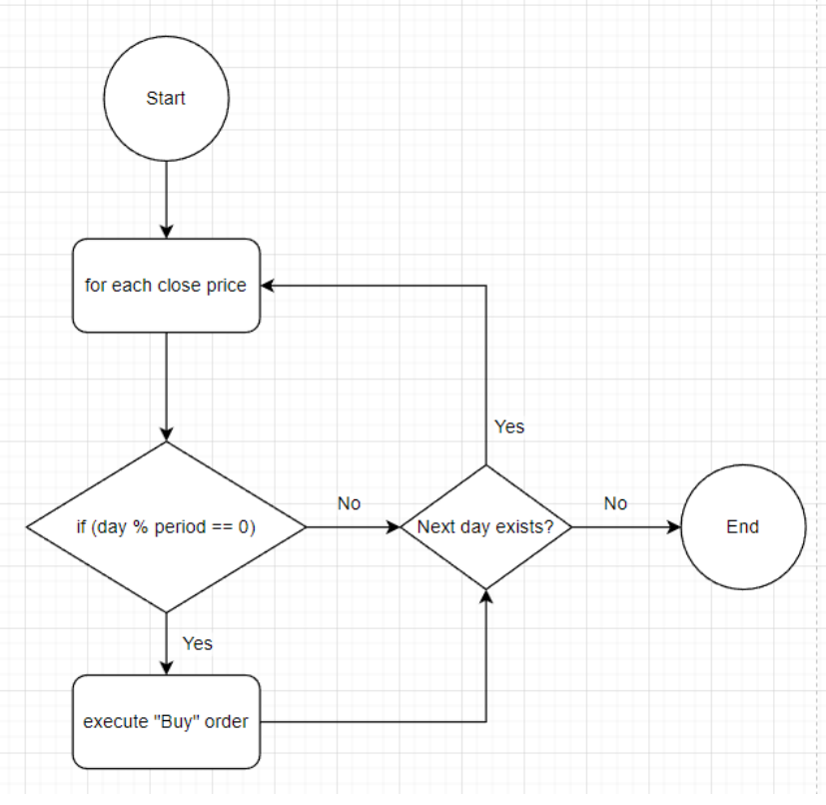
Level1: DCA
Good strategy for beginners who are just starting to invest
it is simple to understand
Parameters
Invest period
Invest amount
let them feel what it is
Notes:
The level 1 game is the DCA strategy
For beginners who are just starting to invest,
I recommend using this game level
in our algorithmic trading software.
This is a simple
and easy-to-understand
investment strategy
that involves
investing a fixed amount of money
at regular intervals,
regardless of market conditions.
In the DCA game level,
users will be able to select their investment period
and amount,
and see how their investment performs over time.
This will allow them to get a feel
for how the strategy works,
and how it can help them
build their investment portfolio over time.
The picture is the flowchart
of how the logic
will be executed in the backend

Slide 9
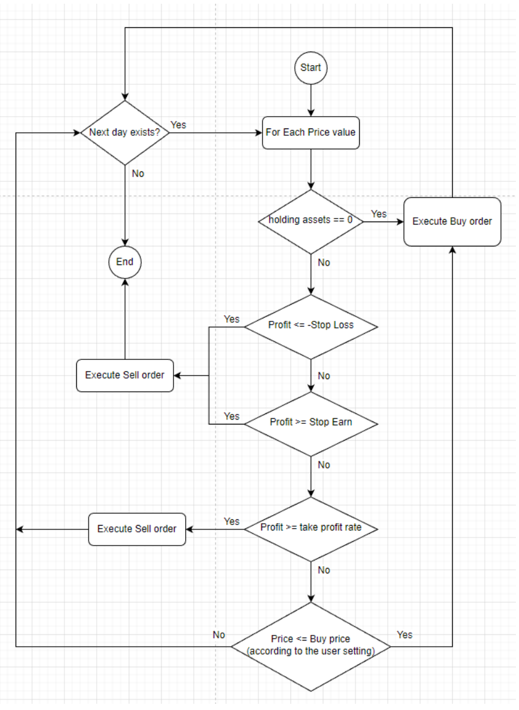
Level 2: Martingale
Betting strategy
Logic:
When Lose
Increasing the amount of the next bet. E.g., double the investment
Then once win, it will recover all loss with some profit
High risk algorithm
Implementing some risk management concept here such as stop loss
to let user to learn this concept
Flow of Martingale Strategy
Notes:
For users who are interested
in more advanced trading strategies,
I offer the Level 2 game, Martingale
This game level uses a
betting strategy that involves
increasing the amount
of the next bet after a loss,
with the aim of
recovering all losses with a single win.
While this strategy can be high-risk,
it can also be very profitable if executed correctly.
In the Martingale game level,
users will be able to experiment
with this strategy in a simulated environment,
without risking any real money.
To help users manage the
risks associated with this strategy,
The risk management concepts
such as stop loss is also implemented
This will allow users to set limits on their losses
and reduce the risk of large losses.
And By incorporating this concepts,
I hope to educate users about the
importance of risk management
in algorithmic trading.

Slide 10
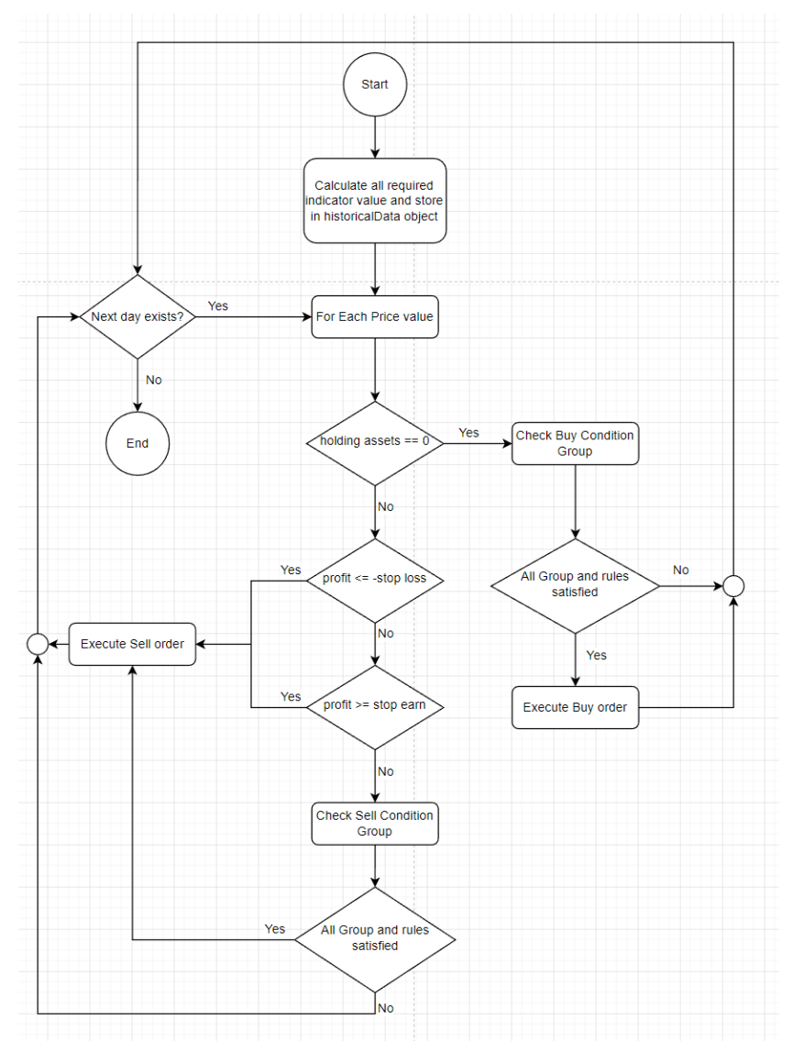
Level 3: Custom Rules
Rule-setting options
current and previous
open,
high,
low,
close prices
and volume
Some technical indicators
SMA: Simple Moving Average
EMA: Exponential Moving Average
ADX: Average Directional Index
RSI
MACD
Stochastic Oscillator
Flow chart of Custom Rules
Notes:
In the level 3 Custom Rules Set
users will have a range of rule-setting options
to choose from.
These include the basic
current and previous
open, high, low, and close prices,
as well as volume.
In addition to these basic rule-setting options,
I also offer some technical indicators
to help users create more so/phy/sit/cated trading strategies.
These include Simple Moving Average
Exponential Moving Average
Average Directional Index
Relative Strength Index
MACD etc
These technical indicators
can be used in a wide range
of trading strategies,
and can provide valuable insights
into market trends and price movements.
By incorporating these indicators into their trading rules,
users will be able to create more
complex and effective trading strategies,
and improve their chances of making profitable trades.

Slide 11
Custom Rules
User need to setup Buy and Sell Conditions
Each condition form with different groups
Each group contains different rules
Three group operation
And: all rules should pass
Not: all rules should not pass
Count: only number of rules need to pass
Purpose:
Set up more complex and flexible trading rules
greater degree of control
Notes:
In the Custom Rules Set game level,
users will be able to set up
Buy and Sell conditions
using different
groups and rules.
Each condition will be formed using different groups,
each of group will contain different rules.
There are three group operations
that users can choose from:
And, Not, Count.
The And operation requires that all rules in a group pass
The Not operation requires that
all rules in a group not pass
The Count operation
only requires a certain number
of rules in a group to pass
in order for the Group to be pass.
These different group operations allow users
to create more complex and flexible trading rules,
and provide a greater degree of control over their trading strategy.

Slide 12
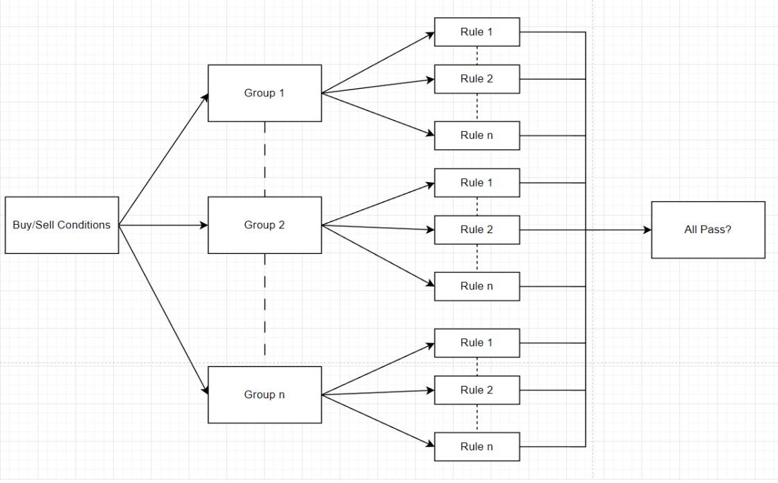
Custom Rules
structure of the condition
Notes:
This is a structure of the
condition group and rules
It show that how they combined
to one single object and
being executed by the program

Slide 13
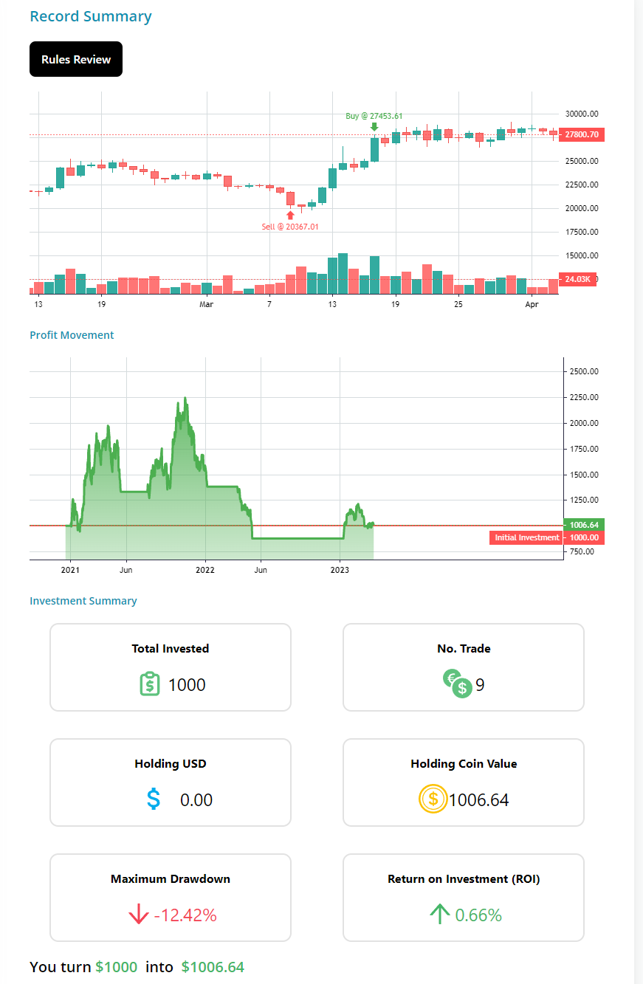
Record
After setting up the algorithm
Website will send the request to the server and ask for simulation.
The response data will show in here.
Generate buy/sell marker in the candle stick chart
Profit movement chart
Investment Summary
etc
Notes:
After setting up their algorithm in the different game level.
users will be able to request a simulation from the server.
The website will send the request
to the server,
and the response data
will be displayed on the user’s Record.
The response data will include
a range of information,
such as a candlestick chart
with buy and sell markers
generated by the algorithm.
This will allow users
to see how their algorithm
performed over time,
and which trades were executed
based on their trading rules.
In addition to the candlestick chart,
the response data will also
include a profit movement chart,
which will show the movement
of the user's investment over time.
This chart will provide a
clear visual representation
of the user's investment performance,
and help them identify areas where
they may need to adjust their trading rules.
Finally, the response data will
include an Investment Summary,
which will provide a detailed breakdown
of the user's investment performance,
including the total amount invested,
profits and losses,
and other key met/rics.
This summary will provide users
with a clear overview
of their investment performance,
and help them track their progress over time.

Slide 14
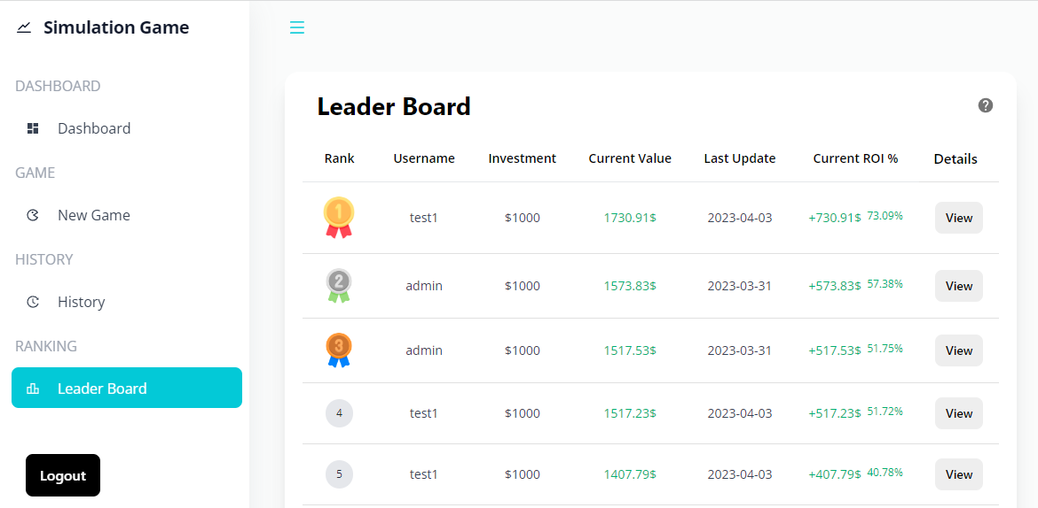
Leader Board
Allow the users to look at other people’s performance
Ranking according to the ROI (Return on Investment)
Only the Custom Rules will count
Updated daily
simulation the real time market
Notes:
I also offer a leader board function
that allows users to view other users’
performance and rankings.
The Leaderboard is ranked according to
ROI (Return on Investment),
and only the
Custom Rules Set game level
results are counted.
The Leaderboard is updated daily to reflect the most
recent trading performance of users.
This provides a competitive element to the learning experience,
To ensure that the Leaderboard
is a fair representation of users' performance,
The system simulate the real-time market
using up-to-date market data.
Daily market data
This ensures that users' performance
is accurately reflected,
and that the rankings are
a true reflection of users’
algorithmic trading skills.

Slide 15
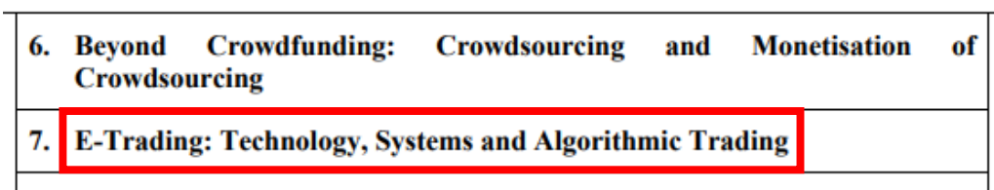
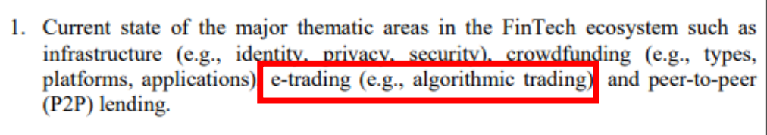
Integration with Course in PolyU
This game can be utilized in various courses at PolyU
Finance, technology, Fintech course
Such as COMP4141, COMP4531
Help them to gain hands-on experience in related topic
Syllabus of COMP4141
Syllabus of COMP4531
Notes:
This software has the potential to be integrated into various courses at PolyU,
such as Finance, Technology, and Fintech courses.
For example, it could be used in courses such as COMP4141
and COMP4531 to help students
gain hands-on experience in related topics.
And the two picture are the syllabus of the related Course.

Slide 16
Demo

Slide 17
Q&A
Notes:
Next is the demo section

