Slide 1
COMP4913 Capstone Project
Simulation Game for Learning Algorithmic Trading
Programme-Stream Code: 61431-SYC
Supervisor: Dr YIU Man Lung Ken
Student Name: Cheung Sui Wing
Student ID: 21027547D

Slide 2
Content
System review
Proposed solution
System design
Progress
Next stage
Demo

Slide 3
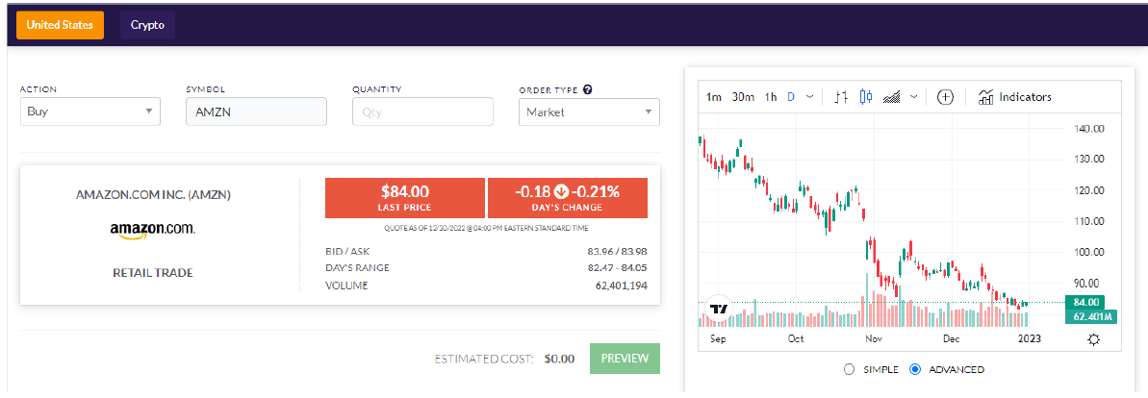
System review
Problems:
Only Buy/Sell options
Better one may contain a Stop-value
Too simple
Real-time trading UI (Wall Street Survivor)
Notes:
There are many simulation games that exist in the market.
I tried many of them during the review stage, and I found that all of them contain very few options for the user to execute. In most cases, only Buy/Sell.
A better one maybe contains a stop-loss value.
I think it is too simple and not that satisfying with my topic Algorithm trading.

Slide 4
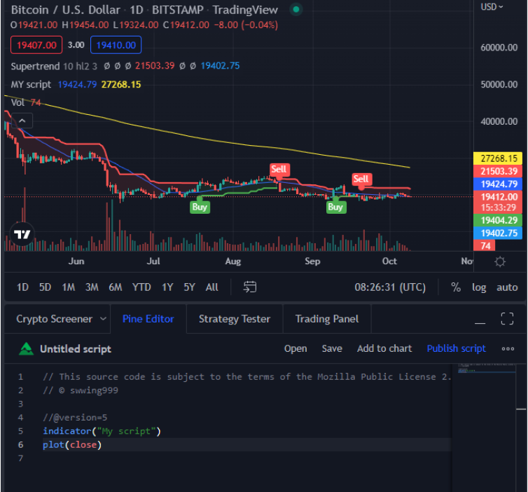
System review
Advanced or professional tool
Very complex
Require coding knowledge
not user friendly (new user)
Trading View
Notes:
Apart from these simple games. I also found some advance or professional tools related to algo trading.
Most of them require payment.
But through some youtube videos.
I know they all are very complex.
Of course, this is my point of view—a new person coming to this field.
And this Trading View is one of those tools that I found is free if you develop your strategy in code format.
That means users require coding knowledge before implementing the trading strategy.
Which is not user-friendly for people who come to learn in this field.

Slide 5
Proposed solution
Build the mirror world using historical data
Balance between too simple and too professional
Using GUI to lead the user to config
2 classic 1 flexible algorithms
Simulate the process
Animated the trading
Learn something during the process
Notes:
Learning from the previous examples, I come up with the following solution.
As usual, build the mirror world using the historical data
Then, I will take the balance between too simple and too professional.
Using user interface to lead the user to config the algorithm.
I hope that in the end, two traditional algorithms and one flexible algorithm can be provided for users to select
The game will also simulate the process and animate the trading
The purpose is to make it more dynamic.
The final goal is to let users learn something related to algo trading during the interactive process.

Slide 6
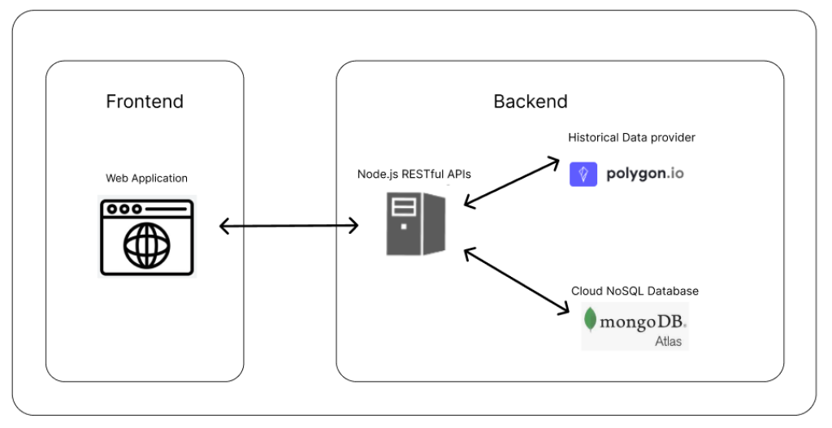
System design
Frontend web application
React.js
Backend server
Node.js + express.js + mongoose.js
Third party API
Polygon.io (Update everyday)
DB
MongoDB
System architecture
Notes:
This is my system architecture.
I will develop the frontend web application using Reactjs
A backend server using Nodejs, express.js, and mongoose.js
collect the historical from Polygon.io.
The purpose of using API calls to download data is that I can update the data every day.
And I also use MongoDB Altas as my database storage.

Slide 7
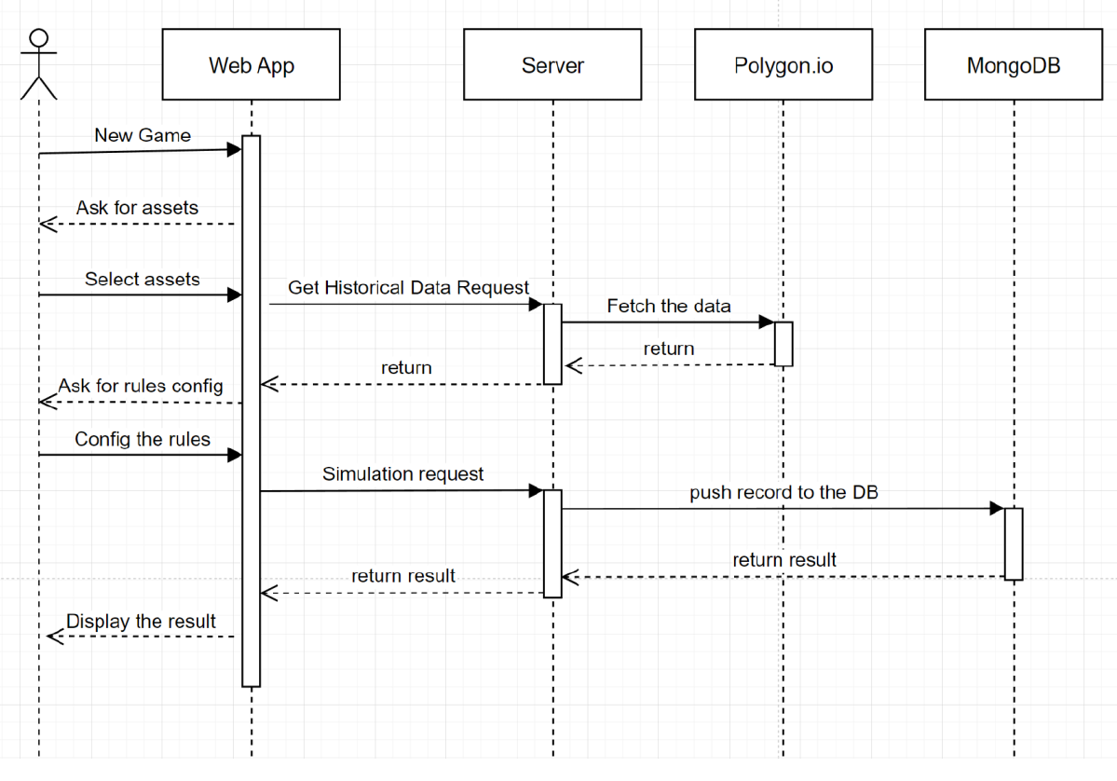
System design
Notes:
This is the sequence diagram of the main flow of the system.
The user interacts with the web application.
Then the web application will send requests accordingly to ask the server to do something
such as do the simulation task,
update the historical data,
or save user records, etc.

Slide 8
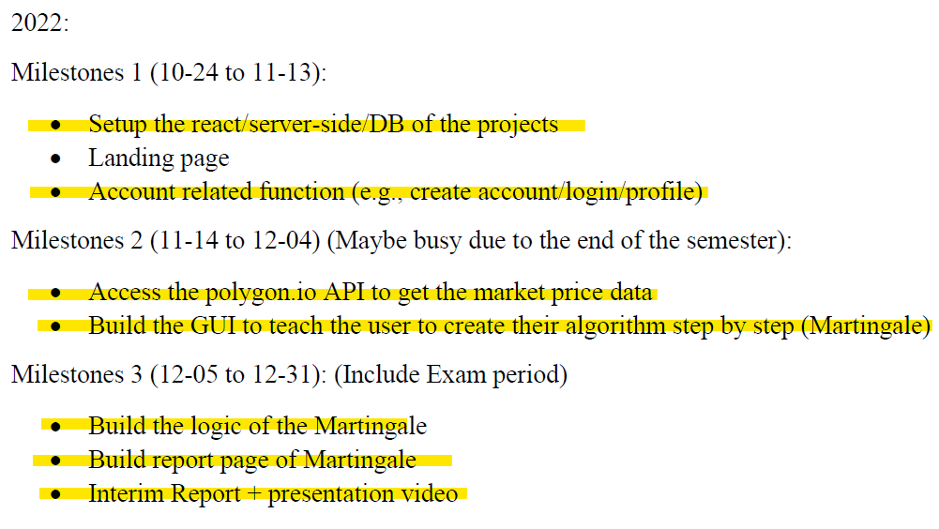
Progress
Notes:
This is the milestone I set in the proposal.
And most of the functions here been completed.
Such as learning and setting up the React and Server project.
Mange the route or navigation,
The connection between server and database
something like that, later you will see in the demo section
Also, One of the algorithm that allow user to play with is also be developed.
Which is the martingale strategy.
The basic logic of this algorithm is when you lose,
you double your amount of holding.
so that when you win,
you can recover all the loss.

Slide 9
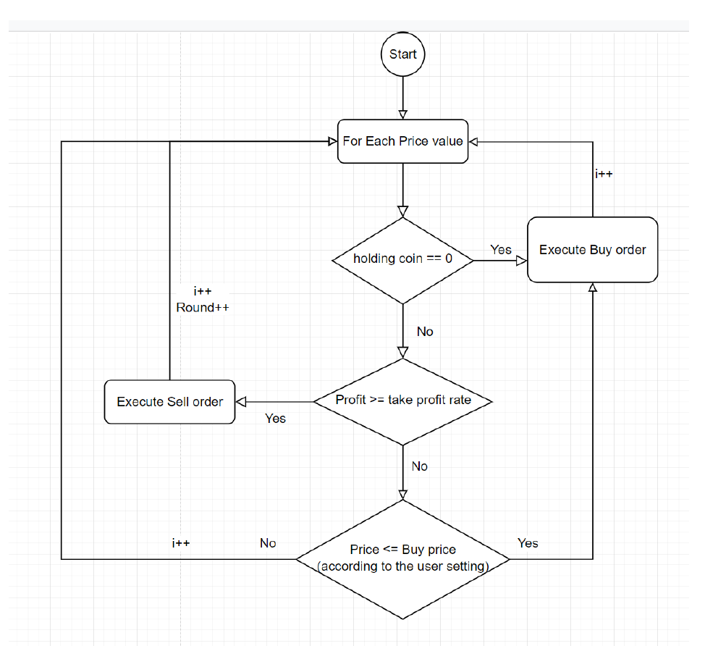
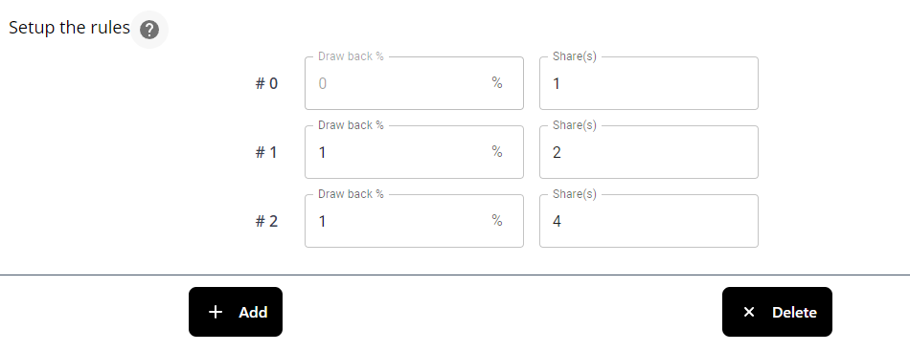

Progress
Flow chart of Martingale adjusted for trading
1
2
Notes:
However, when I apply the algorithm in trading market.
I found that I need do some change.
This is the flow chart of the basic logic of the adjust algorithm.
First you need to set up a set of buying order.
for example, every time the price go down 1 %, you willing to execute buy order.
And second, you need to set how many profit you get you will count as WIN and sell the holding assets.

Slide 10
Next Stage
Complete the remaining function
Dollar cost average
Custom Indicator
Leaderboard
Animation
Tooltip
Notes:
In the next stage
I will work on the remaining function one is the dollar cost average algorithm
and a more advance option custom indicator. User can create their algorithm by combining different indicator.
Also, I will add a leaderboard game play at the end for more interactive game play
more animation to make the website more dynamic
finally add the tooltip everywhere to let the user understand what is doing.

Slide 11
Demo

