Slide 1
Some Bash One-Liners: Explained
Apoorva
UMass Amherst
Notes:
Fun
banner -w 100 ’Unix 1 CSWOMEN’
sl – train
brew install sl
Glue that can bind any two programs using shell scripting. We will only learn how to use the shell commandline today.

Slide 2
UNIX 1
Pre-requisites
UNIX 0: Either Tian Guo’s session or codecademy or a screencast.

Slide 3
Why bother?
“The command line isn’t a crusty, old-fashioned way to interact with a computer, made obsolete by GUIs, but rather a fantastically flexible and powerful way to perform tasks.”
Notes:
Quote from an article featured in Wired discussing whether the CLI is obsolete
It’s still an essential tool for developers and system administrators who require access to guts of our machines
“People drive cars with steering wheels and gas pedals. Does that mean you don’t need wrenches?” says Rob Pike, who was part of the team at Bell Labs that developed the UNIX operating system and now works at Google, where he oversaw the creation of the Go programming language.

Slide 4
What are we going to talk about today?
Commands
unzip
env
grep
find
lsof
awk
sort
tail
xargs
alias
ssh
df
crontab
traceroute
ipconfig
nslookup
|,<,>,>>, ;, &&, ||
How to blow up your linux system
Notes:
Write this in the order that the commands will be presented
unzip
env
grep
find
lsof
awk
sort
tail
xargs
alias
ssh
df
crontab
traceroute
and maybe a few more?

Slide 5
UNZIP all files AT ONCE
unzip
Notes:
Cd to directory
unzip '*.zip'
Talk about a scenario

Slide 6
FIND the value of the PATH env Variable
env, grep
Notes:
env | grep “PATH”
Can you think of another way to do this?
echo $PATH
Is there a difference?
PATH=/some/path when you grep from env

Slide 7
Show the top 10 largest open files
lsof, pipe, awk, sort, tail
Notes:
http://www.bashoneliners.com/oneliners/oneliner/187/
lsof | more
lsof / | awk '{ if($7 > 1048576) print $7/1048576 "MB" " " $9 " " $1 }' | sort -n -u | tail
1,024^2 = 1048576 is 1MB
$7 File size
$9 File name
$1 Command
Sort numeric unique. Why numeric?
How would you get the smallest 10?
Make your own pipe?
mkfifo fifo_pipe
tail -f fifo_pipe

Slide 8
Find files ending in .JPG using regex and delete them
ls, find, regex, xargs, rm
Notes:
Apoorvas-MacBook-Pro:bash-one-liners Apoorva$ ls
README.md ata2358-at.jpg.zip bash_cheat_sheet.pdf.zip
# after unzip ‘*.zip’
$ find . -name '*.jpg' | xargs rm -rf
$ ls
<doesn’t exist anymore>

Slide 9
Make the cp, mv, and rm commands interactive
Cp, mv, rm, alias
Notes:
alias cp='cp -i'
alias mv='mv -i'
alias rm='rm -i'

Slide 10
SSH into a host at CS and report file system disk space usage
ssh, df
Notes:
ssh arb@blake.cs.umass.edu
or the mail server loki
df

Slide 11
SET UP A CRON JOB WITH the small shell script provided to you as the command
chmod, crontab
Notes:
whats in the trash folder? some old logs
Lets assume we don’t want to accumulate logs. So we will set up a cron job to delete whatever is in the trash folder periodically
crontab -e
* * * * * /Users/Apoorva/Downloads/NCWIT\ Talk/UNIX1/bash-one-liners/simple-cron-eg.sh
crontab -l
not system wide
Maybe you want to find and delete something specific? Use find inside the script.
You can also do this with logrotate. Sys admins use this often. We will not discuss this here for lack of time.

Slide 12
Crontab Fields and Allowed Ranges (Linux Crontab Syntax)
Field Description Allowed Value
MIN Minute field 0 to 59
HOUR Hour field 0 to 23
DOM Day of Month 1-31
MON Month field 1-12
DOW Day Of Week 0-6
CMD Command Any command

Slide 13
run traceroute, ifconfig, and nslookup for your website and write all the results into a single file
traceroute, ifconfig, nslookup, >, >>
Notes:
prints the route that packets take to a network host
ifconfig -- configure network interface parameters
DNS Lookup
traceroute www.google.com > googledotcominfo
ifconfig >> googledotcominfo
nslookup >> googledotcominfo

Slide 14
Which one is correct if you want to redirect both stdout and stderr into a logfile? a. somecmd >>logfile 2>&1 b. somecmd 2>&1 >>logfile
2>&1
Notes:
These are called file descriptors.
A is correct. Redirections are evaluated left to right before the command is executed.
In B, stderr will still show up on the terminal. This semantically incorrect code essentially means: "first redirect standard error to where standard out is currently pointing (the tty), then redirect standard out to append to a logfile".

Slide 15
What’s the difference between cd /backup/old; rm * -rf and cd /backup/old && rm * -rf ?
; and &&
Notes:
Besides it's a stupid way, the first one will remove your whole filesystem (or $HOME, depending how it's called) because it runs rm regardless wherever the cd succeeded or not.

Slide 16
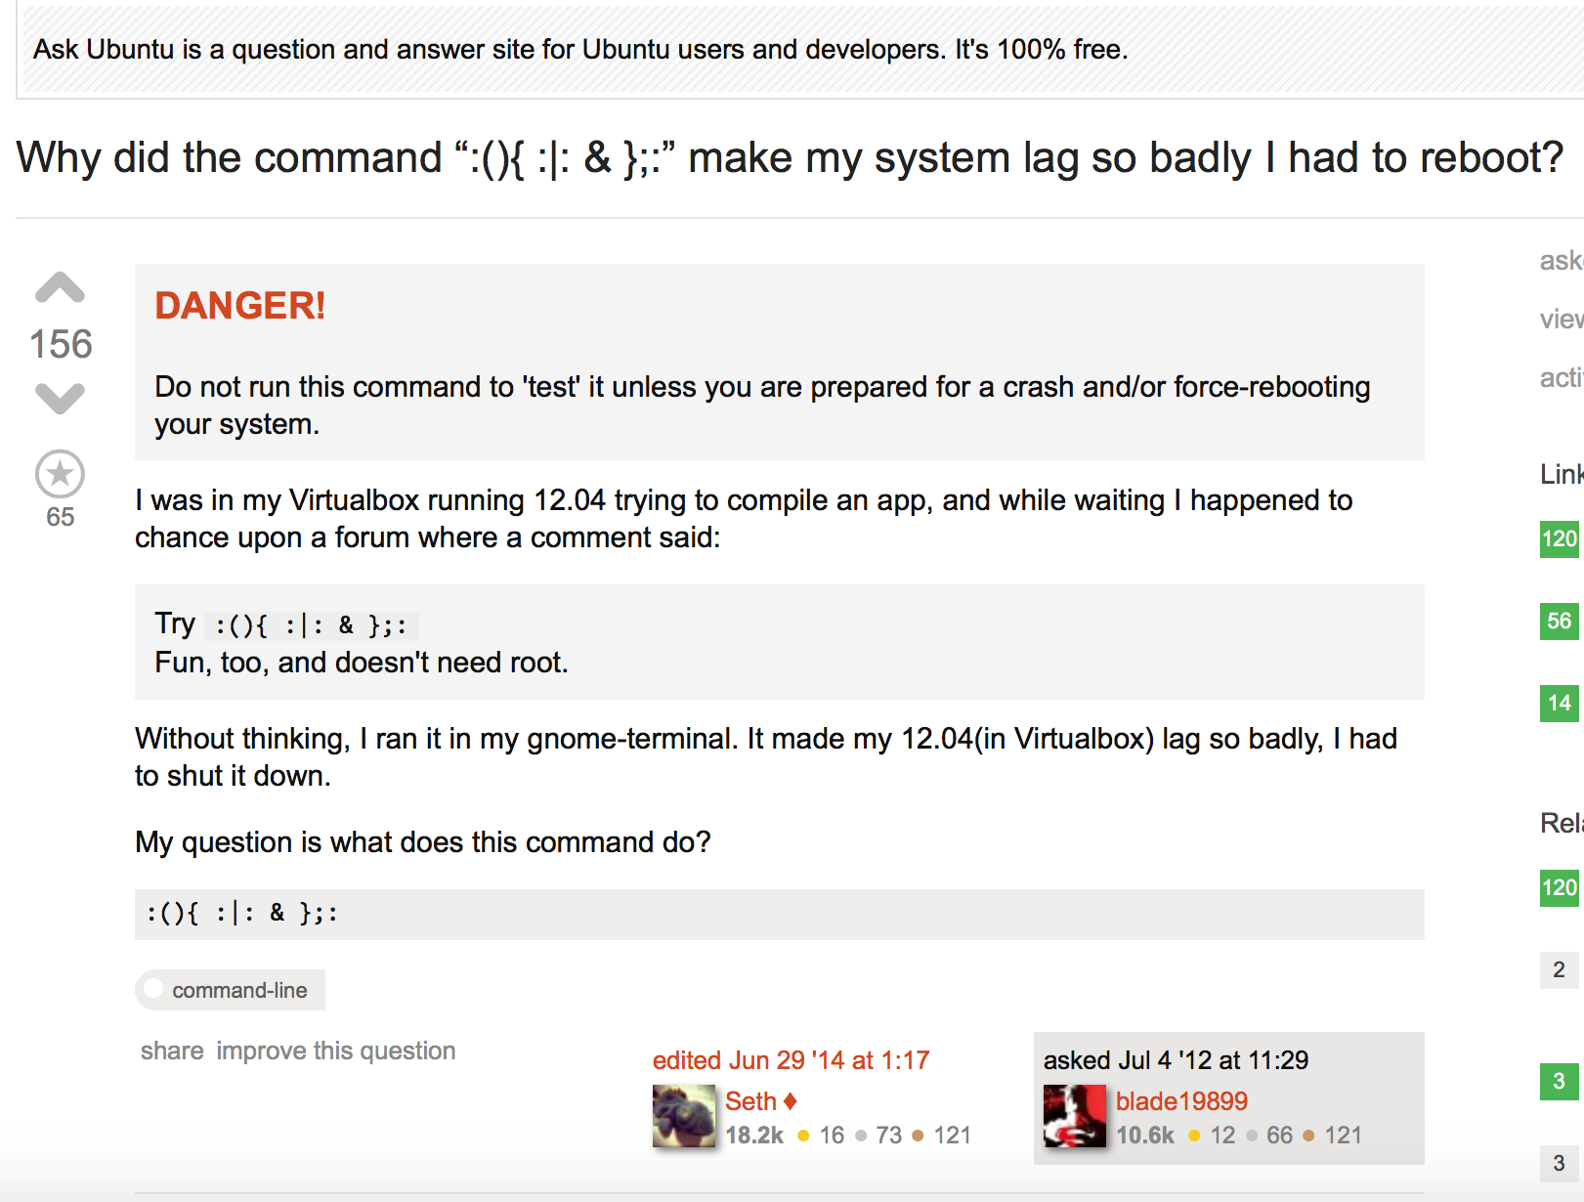

Slide 17

Try :(){ :|: & };: Fun and doesn't need root.
Why did it make his system lag so badly that he had to reboot?
Notes:
An Ubuntu user needed help compiling an app and posted a question on a forum.
The response he got was <in Bold>.
This is called the forkbomb.
:() means you are defining a function called :
{:|: &} means run the function : and send its output to the : function again and run that in the background.
The ; is a command separator, like &&.
: runs the function the first time.
Essentially you are creating a function that calls itself twice every call and doesn't have any way to terminate itself. It will keep doubling up until you run out of system resources.

Slide 18
Bash is an open source project
https://www.openhub.net/p/bash

Slide 19
Other topics you might want to explore
Rsync
Using screen
Parallel jobs with qsub

Slide 20
References
http://explainshell.com
http://www.bashoneliners.com/oneliners/oneliner/popular/
http://www.tuxradar.com/content/command-line-tricks-smart-geeks
http://www.cs.upc.edu/~padro/Unixforpoets.pdf

Slide 21

Thanks

Slide 22
Find all files with A specified SUBstring in the filename and write any lines found Matching another given string into another file.
Find with exec grep
Notes:
Add an additional file to the repo if using this slide
$ find . -name *conf* -exec grep -Hni 'matching_text' {} \; > matching_text.conf.list
Explanation
find . -name *conf* In current directory, recursively find all files with 'conf' in the filename.
-exec grep -Hni 'matching_text' {} \; When a file is found matching the find above, execute the grep command to find all lines within the file containing 'matching_text'.
Here are what each of the grep switches do:
grep -i ignore case.
grep -H print the filename
grep -n print the line number
> matching_text.conf.list Direct the grep output to a text file named 'matching_text.conf.list'

Slide 23
Print a flat list of dependencies of a Maven Project
Sed, sort, uniq
Notes:
http://www.bashoneliners.com/oneliners/oneliner/206/
mvn dependency:list | sed -ne s/..........// -e /patterntoexclude/d -e s/:compile//p -e s/:runtime//p | sort | uniq

