Slide 1
CSY2082 Introduction to Artificial Intelligence
Regression 1

Slide 2
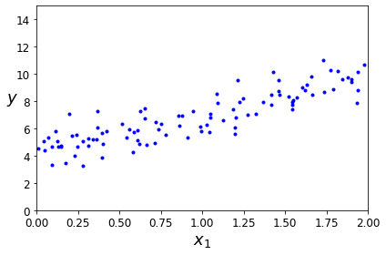
Regression
Relationship between one dependent variable and a series of other variables (independent variables)

Slide 3
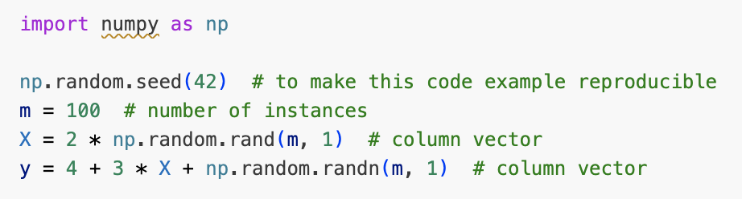
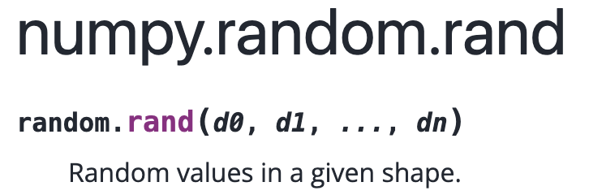
Regression
Create a dataset

Slide 4
Regression
Two very different ways to train it:
Using a direct “closed-form” equation that directly computes the model parameters that best fit the model to the training set (i.e., the model parameters that minimise the cost function over the training set). More details in the reference book.
Using an iterative optimization approach, called Gradient Descent (GD), that gradually tweaks the model parameters to minimize the cost function over the training set, eventually converging to the same set of parameters as the first method.

Slide 5
Regression
Linear Regression
Polynomial Regression
Logistic Regression
Softmax Regression

Slide 6
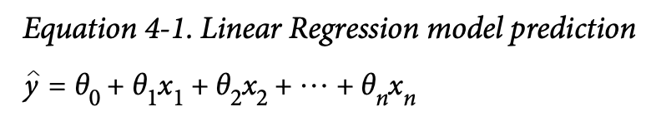
Linear Regression
a linear model makes a prediction by simply computing a weighted sum of the input features, plus a constant called the bias term (also called the intercept term)

Slide 7
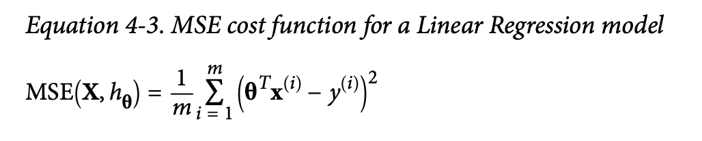

Slide 8
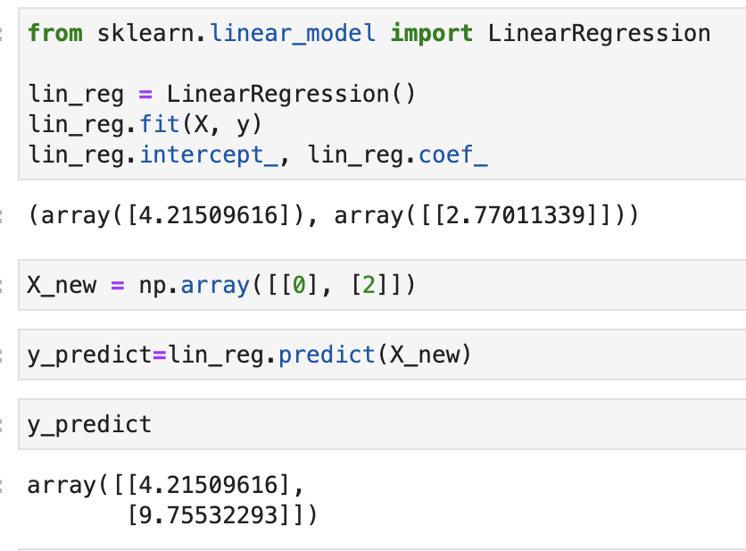
Using sklearn’s LinearRegression (when dataset is small)
The `LinearRegression` class is based on "least squares parameter approximation”:
https://www.youtube.com/watch?v=JvS2triCgOY

Slide 9
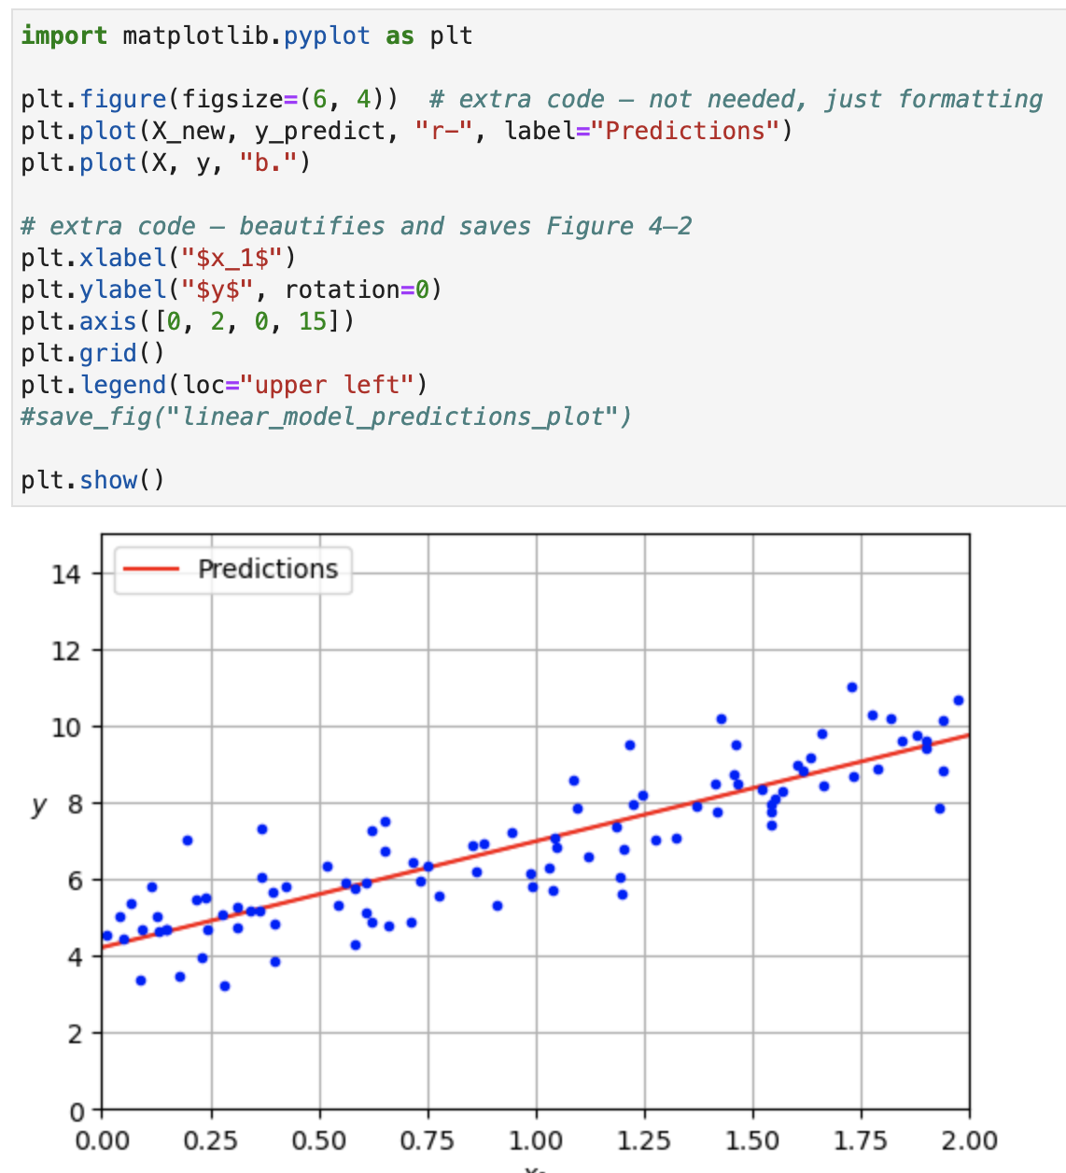

Slide 10
Gradient Descent

Slide 12
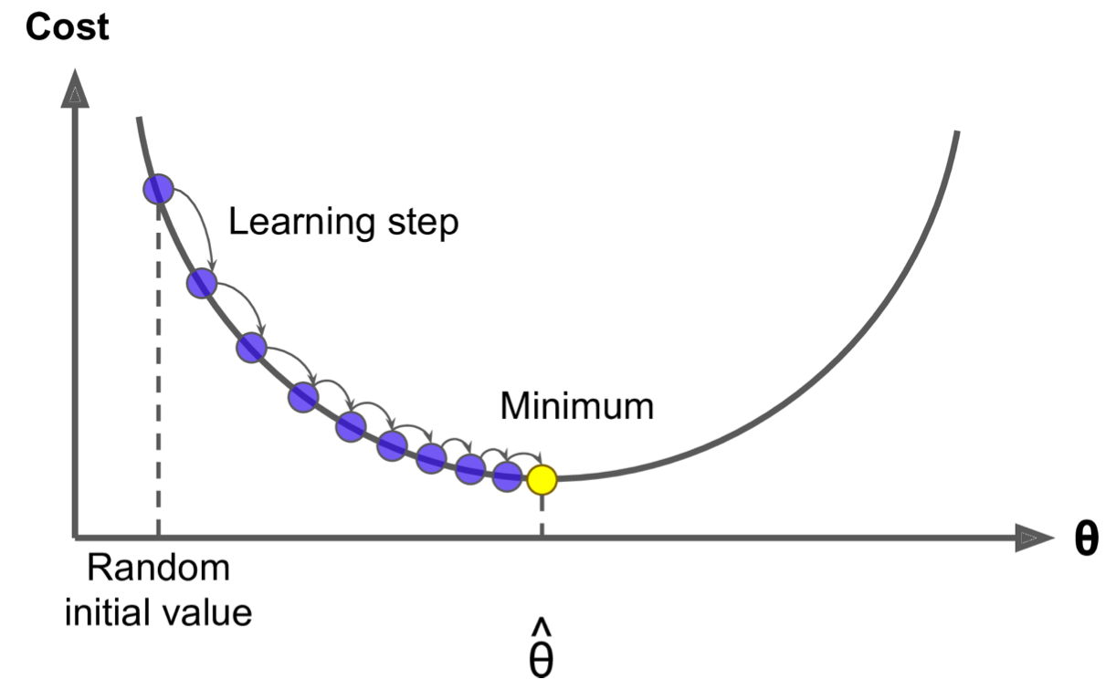
Gradient Descent
Gradient Descent is a very generic optimization algorithm capable of finding optimal solutions to a wide range of problems. The general idea of Gradient Descent is to tweak parameters iteratively in order to minimise a cost function.

Slide 13
Gradient Descent
Concretely, you start by filling θ with random values (this is called random initialization), and then you improve it gradually, taking one baby step at a time, each step attempting to decrease the cost function (e.g., the MSE), until the algorithm converges to a minimum

Slide 14
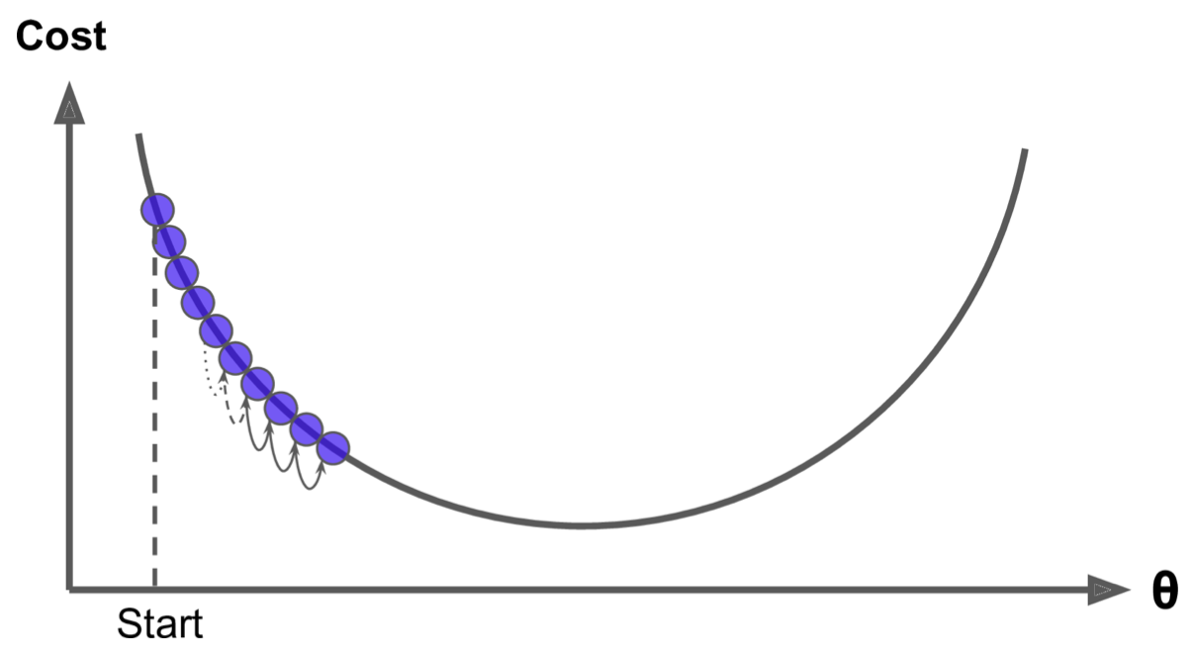
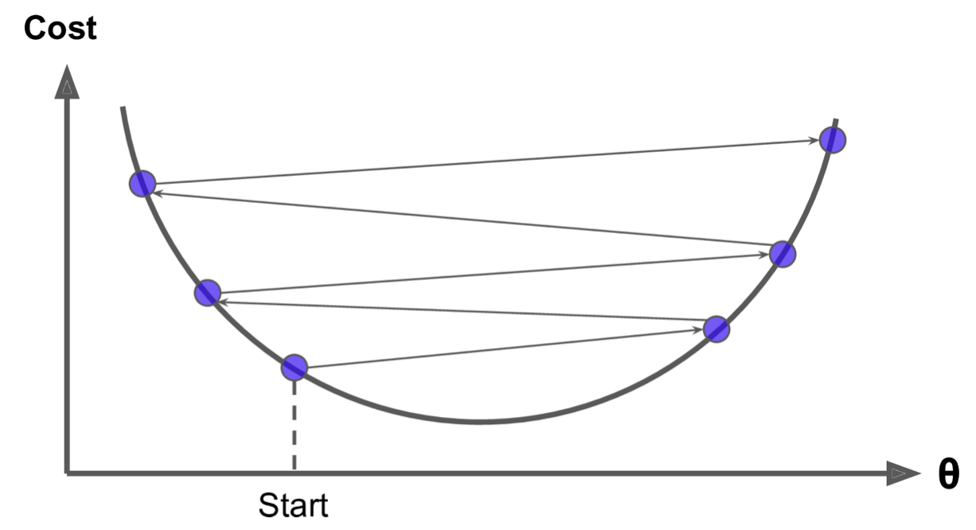
Gradient Descent
An important parameter in Gradient Descent is the size of the steps, determined by the learning rate hyperparameter.

Slide 15
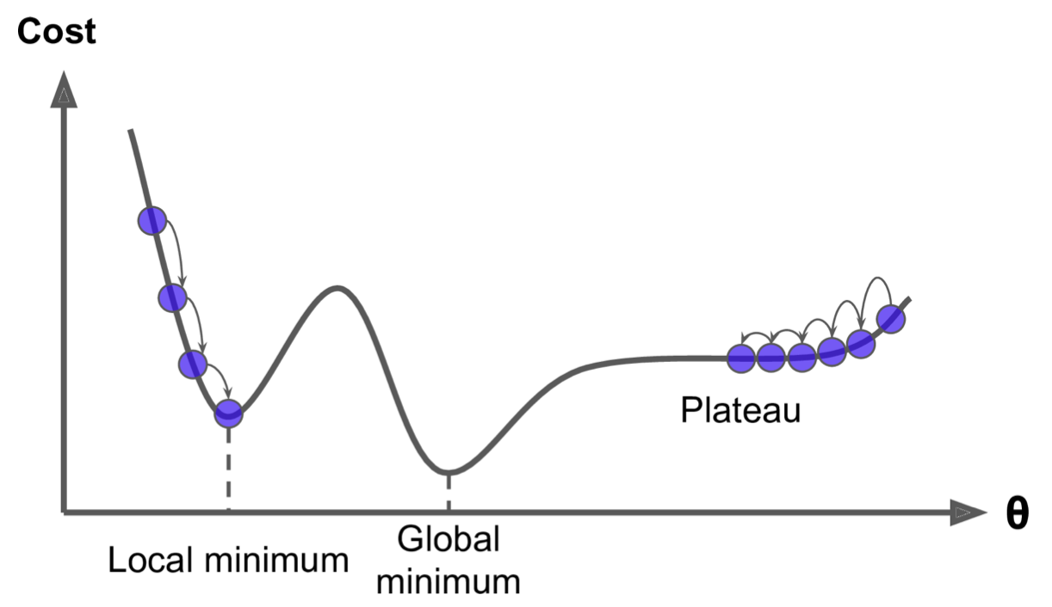
Gradient Descent
Two main challenges with Gradient Descent: if the random initialization starts the algorithm on the left, then it will converge to a local minimum, which is not as good as the global minimum. If it starts on the right, then it will take a very long time to cross the plateau, and if you stop too early you will never reach the global minimum.

Slide 16
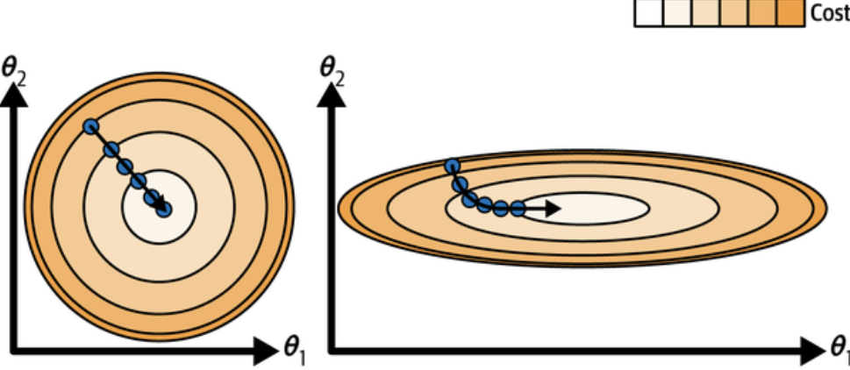
Feature scaling
“When using gradient descent, you should ensure that all features have a similar scale (e.g., using Scikit-Learn’s StandardScaler class), or else it will take much longer to converge.”

Slide 17
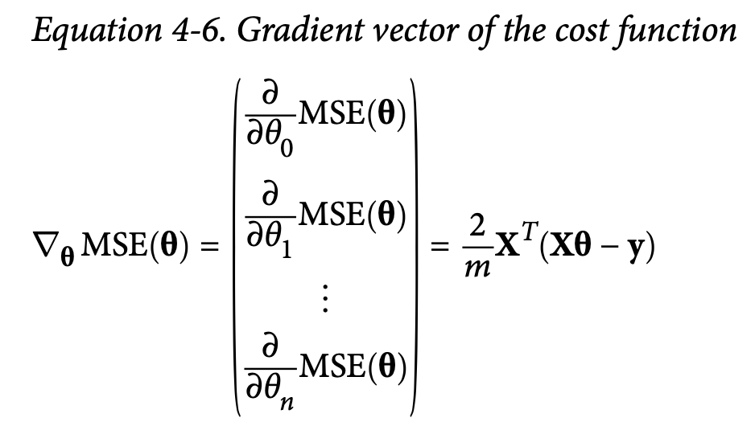
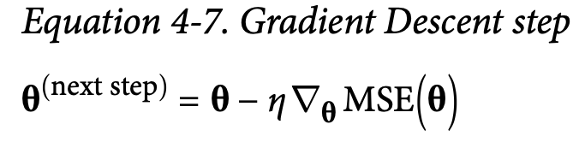
Batch Gradient Descent
To implement Gradient Descent, you need to compute the gradient of the cost function with regards to each model parameter θj. multiply the gradient vector by η to determine the size of the downhill step.
“Batch” means “use all training data at every step of the calculation”.

Slide 18
Batch Gradient Descent (manual calculation)
eta = 0.1 # learning rate
n_epochs = 1000
m = len(X_b) # number of instances
np.random.seed(42)
theta = np.random.randn(2, 1) # randomly initialized model parameters
for epoch in range(n_epochs):
gradients = 2 / m * X_b.T @ (X_b @ theta - y)
theta = theta - eta * gradients
print(epoch, gradients, theta)

Slide 19
Batch Gradient Descent
theta = np.random.randn(2, 1) # randomly initialized model parameters
[[0.49671415] [-0.1382643]]
print(epoch, gradients, theta)
0 [[-6.09276572] [-7.60024511]] [[1.10599072] [0.62176021]]
1 [[-3.44481702] [-4.57750006]] [[1.45047243] [1.07951022]]
2 [[-1.89495266] [-2.79922136]] [[1.63996769] [1.35943235]] …
5 [[-0.15667432] [-0.76622837]] [[1.80080402] [1.72450491]]
6 [[ 0.01876687] [-0.54754378]] [[1.79892734] [1.77925929]]
…

Slide 20
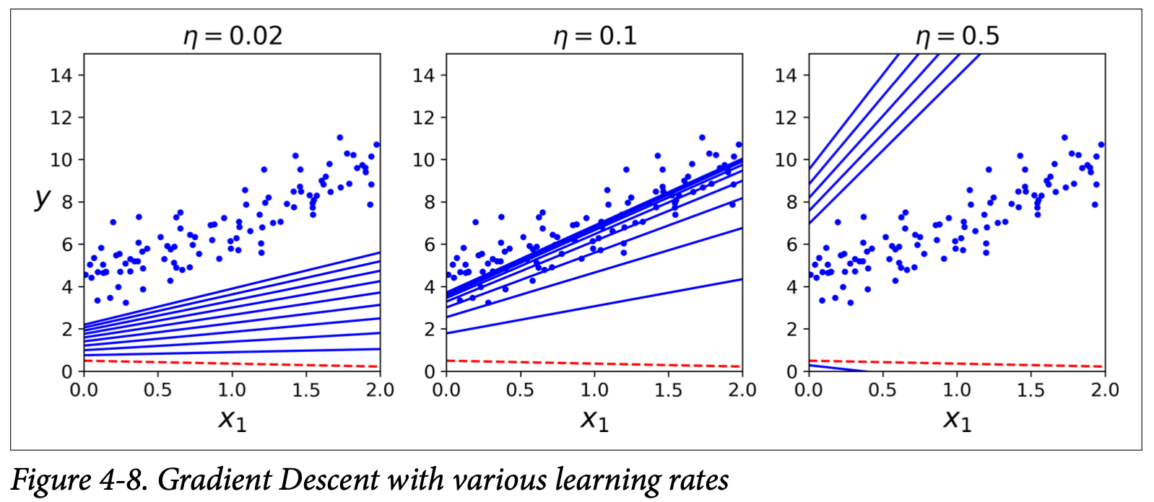

Slide 21
Weekly Practical 1
Edit the “Batch Gradient Descent” source code with adaptive epoch configuration, i.e., continue the learning process until a good solution is found.
Can you adjust the code to detect a learning rate that is set too high?

Slide 22
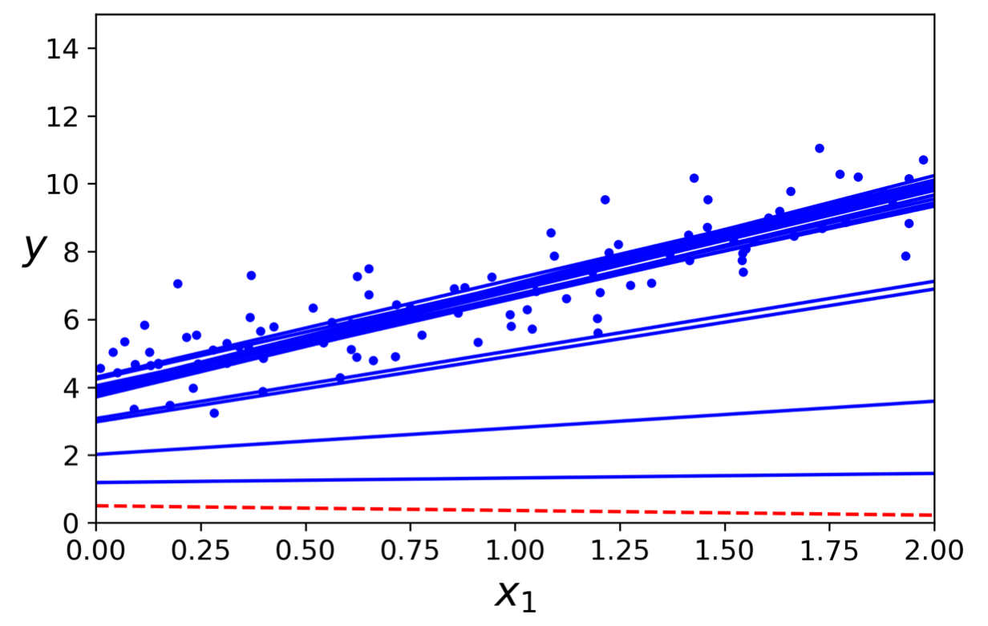
Stochastic Gradient Descent
The main problem with Gradient Descent is the fact that it uses the whole training set to compute the gradients at every step, which makes it very slow when the training set is large.
At the opposite extreme, Stochastic Gradient Descent just picks a random instance in the training set at every step and computes the gradients based only on that single instance. Obviously, this makes the algorithm much faster since it has very little data to manipulate at every iteration.

Slide 23
Stochastic Gradient Descent
On the other hand, due to its stochastic (i.e., random) nature, this algorithm is much less regular than Batch Gradient Descent: instead of gently decreasing until it reaches the minimum, the cost function will bounce up and down, decreasing only on average. Over time it will end up very close to the minimum, but once it gets there it will continue to bounce around, never settling down.
One solution to this dilemma is to gradually reduce the learning rate. The steps start out large (which helps make quick progress and escape local minima), then get smaller and smaller, allowing the algorithm to settle at the global minimum.

Slide 24
Stochastic Gradient Descent
for epoch in range(n_epochs):
for iteration in range(m):
random_index = np.random.randint(m)
xi = X_b[random_index : random_index + 1]
yi = y[random_index : random_index + 1]
gradients = 2 * xi.T @ (xi @ theta - yi)
eta = learning_schedule(epoch * m + iteration)
theta = theta - eta * gradients

Slide 25
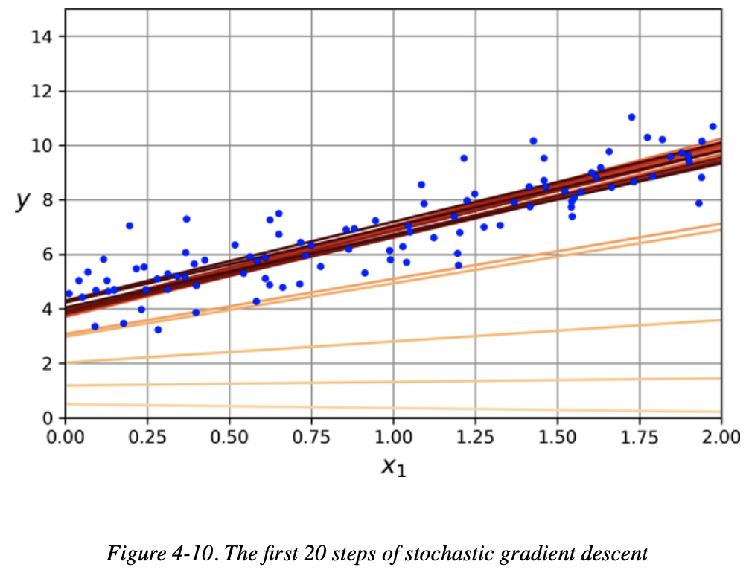
Stochastic Gradient Descent

Slide 26
Stochastic Gradient Descent using SGDGegressor
from sklearn.linear_model import SGDRegressor
sgd_reg = SGDRegressor(max_iter=1000, tol=1e-5, penalty=None, eta0=0.01,n_iter_no_change=100, random_state=42)
sgd_reg.fit(X, y.ravel()) # y.ravel() because fit() expects 1D targets
To perform Linear Regression using SGD with Scikit-Learn, you can use the SGDRegressor class, which defaults to optimising the squared error cost function.
The above code runs for maximum 1,000 epochs (max_iter) or until the loss drops by less than 10–5 (tol) during 100 epochs (n_iter_no_change). It starts with a learning rate of 0.01 (eta0), using the default learning schedule (different from the one we used). Lastly, it does not use any regularisation (penalty=None).

Slide 27
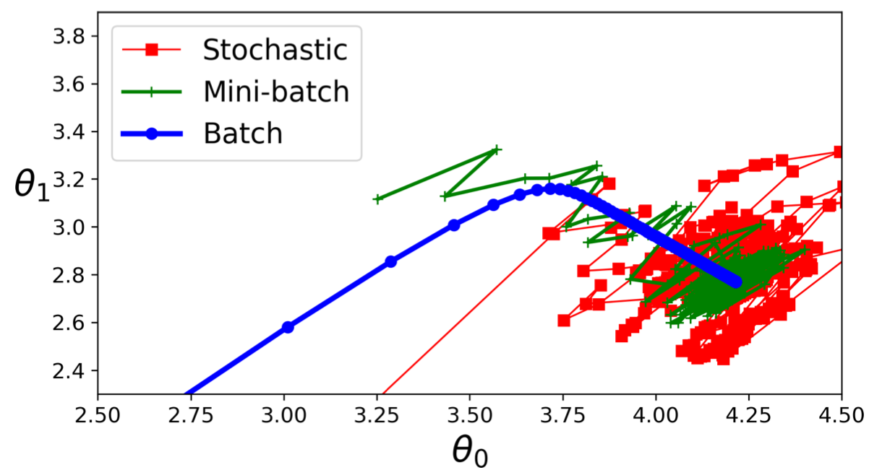
Mini-batch Gradient Descent
instead of computing the gradients based on the full training set (as in Batch GD) or based on just one instance (as in Stochastic GD), Mini-batch GD computes the gradients on small random sets of instances called mini-batches.
The main advantage of Mini-batch GD over Stochastic GD is that you can get a performance boost from hardware optimization of matrix operations, especially when using GPUs.

Slide 28
Mini-batch Gradient Descent
Or using:
random.sample() and
sgd_reg.partial_fit()
for epoch in range(n_epochs):
shuffled_indices = np.random.permutation(m)
X_b_shuffled = X_b[shuffled_indices]
y_shuffled = y[shuffled_indices]
for iteration in range(0, n_batches_per_epoch):
idx = iteration * minibatch_size
xi = X_b_shuffled[idx : idx + minibatch_size]
yi = y_shuffled[idx : idx + minibatch_size]
gradients = 2 / minibatch_size * xi.T @ (xi @ theta - yi)
eta = learning_schedule(iteration)
theta = theta - eta * gradients
theta_path_mgd.append(theta)

Slide 29
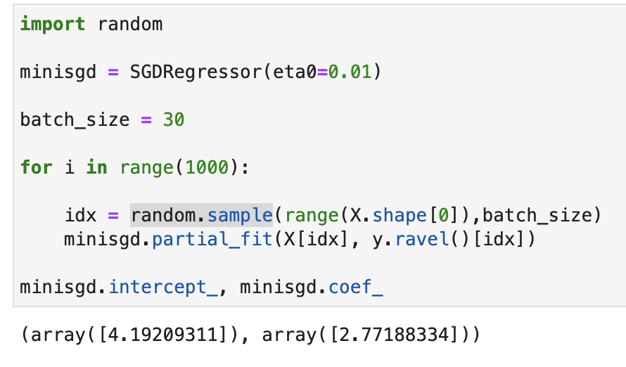
Mini-batch SGD using SGDRegressor and partial_fit (one step fitting)

Slide 30
Polynomial Regression

Slide 31
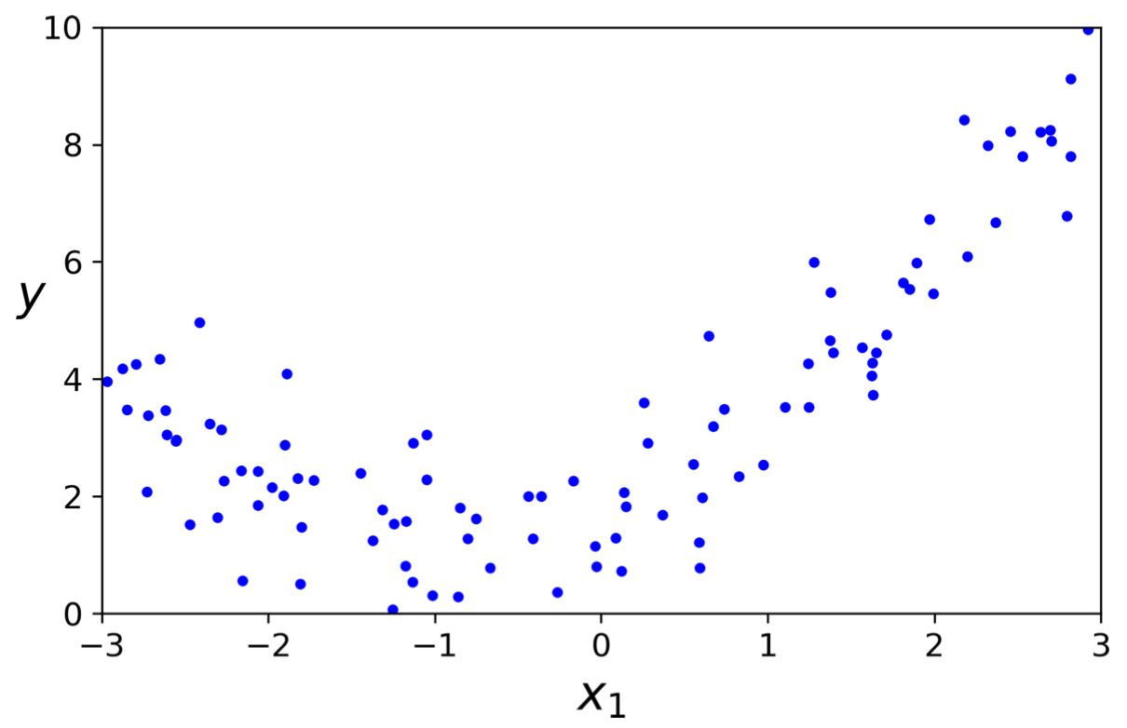
Polynomial Regression
Clearly, a straight line will never fit this data properly. So let’s use Scikit-Learn’s PolynomialFeatures class to transform our training data, adding the square (2nd-degree polynomial) of each feature in the training set as new features.

Slide 32
Polynomial Regression
>>> from sklearn.preprocessing import PolynomialFeatures
>>> poly_features = PolynomialFeatures(degree=2, include_bias=False)
>>> X_poly = poly_features.fit_transform(X)
>>> X[0]
array([-0.75275929])
>>> X_poly[0]
array([-0.75275929, 0.56664654])

Slide 33
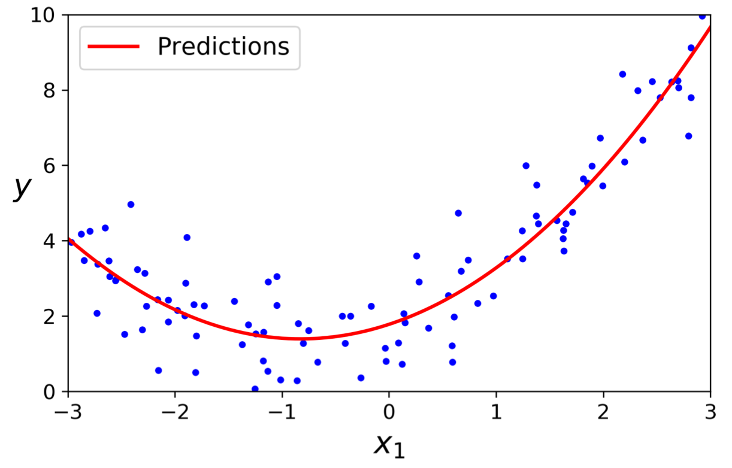

Polynomial Regression
>>> lin_reg = LinearRegression()
>>> lin_reg.fit(X_poly, y)
>>> lin_reg.intercept_, lin_reg.coef_
(array([1.78134581]), array([[0.93366893, 0.56456263]]))

Slide 34
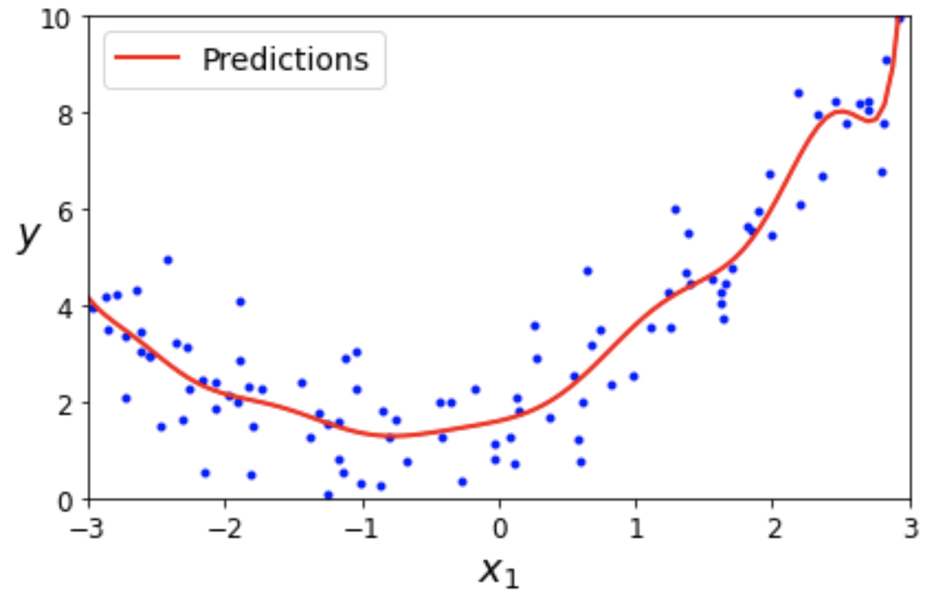
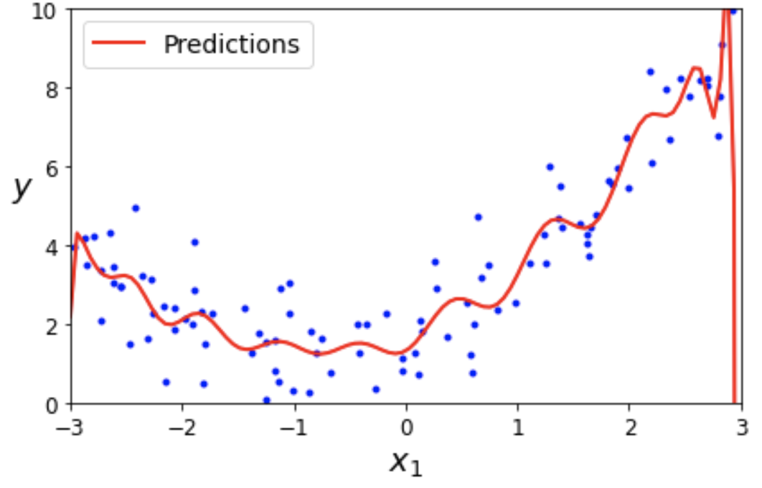
Polynomial Regression
If you perform high-degree Polynomial Regression, you will likely fit the training data much better than with plain Linear Regression.

Slide 35
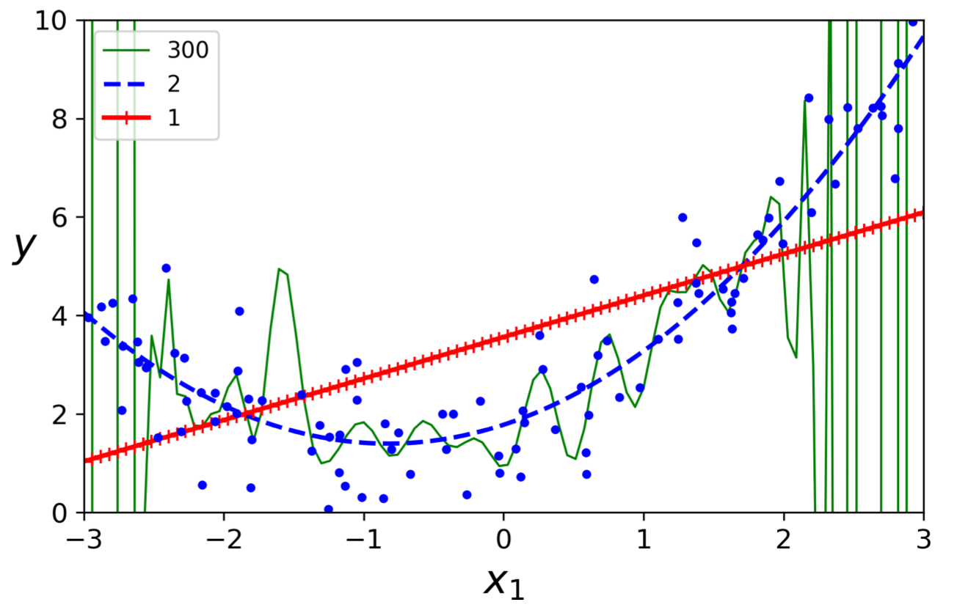

Slide 36
Weekly Practical
Download dataset file “Real estate dataset.csv” from Nile
Model the data to find the price based on the input features.

Slide 37
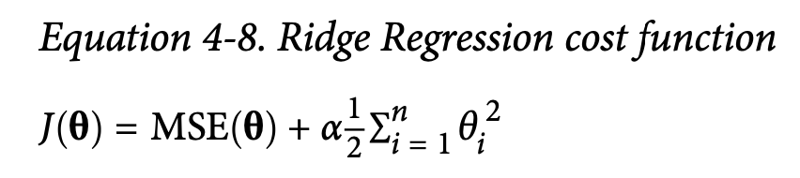
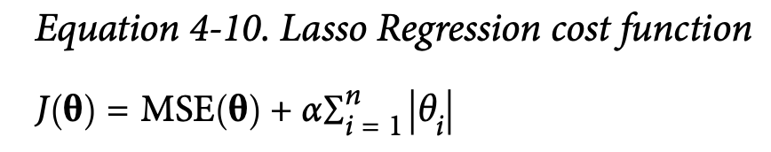
Further reading - Regularization
a good way to reduce overfitting is to regularize the model (i.e., to constrain it): the fewer degrees of freedom it has, the harder it will be for it to overfit the data.
A regularization term is added to the cost function. This forces the learning algorithm to not only fit the data but also keep the model weights as small as possible

