Slide 1

ECO-CRYPT
Environmental Day
Cipher Project’23
Open Source
Speaker: Darisi Priyatham

Slide 2
What is OPEN SOURCE
Open source is source code that is made freely available for possible modification and redistribution. Products include permission to use the source code,^{[1]} design documents,^{[2]} or content of the product. The open-source model is a decentralized software development model that encourages open collaboration.^{[3][4]} A main principle of open-source software development is peer production, with products such as source code, blueprints, and documentation freely available to the public. The open-source movement in software began as a response to the limitations of proprietary code.

Slide 3
Why to contribute OPEN SOURCE
1. Learn in a Practical Way
2. Learn to Look From Other Developers' Perspectives
3. Learn New Skills, Tools & Technologies
4. Build Confidence
5. Build Your Reputation
6. Learn to Understand Feedback
7. Meet New People

Slide 4
I am not good at Tech
Can I still Contibute?
GSOC,XROS,GSOD,LFX,OUTREACHY,SOB, Github Octernship …

Slide 5
YESSSSS!!!
28% of casual contributions to open source are documentation, such as a typo fix, reformatting, or writing a translation.
Reference: https://opensource.guide/how-to-contribute/

Slide 6
Stillll
I am not good at Github
What to do?
Reference: https://education.github.com/git-cheat-sheet-education.pdf

Slide 7
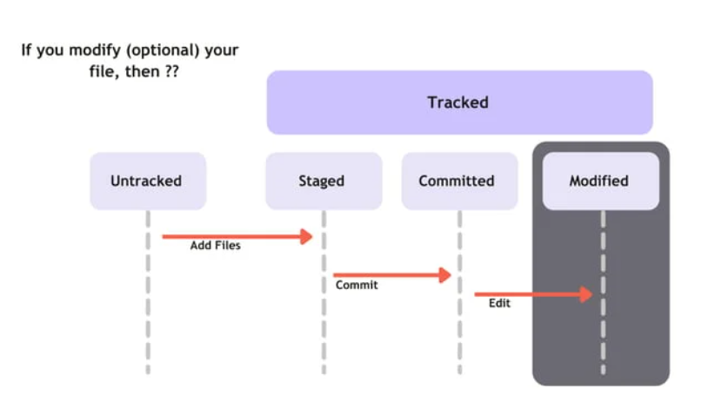
USING GITHUB FOR OPEN SOURCE
Credits: Ganesh Nathan
Reference: https://gdsc.community.dev/events/details/developer-student-clubs-indian-institute-of-information-technology-kottayam-presents-introduction-to-github-open-source-and-tech-article/

Slide 8
What is CIPHER
A cipher uses a system of fixed rules -- an encryption algorithm -- to transform plaintext, a legible message, into ciphertext, an apparently random string of characters. Ciphers can be designed to encrypt or decrypt bits in a stream, known as stream ciphers.

Slide 9
Less Gooo:
https://github.com/CSYClubIIITK/eco-crypt
Join Us: https://discord.gg/4znS588gX7

Slide 10
Thank you

