Slide 1
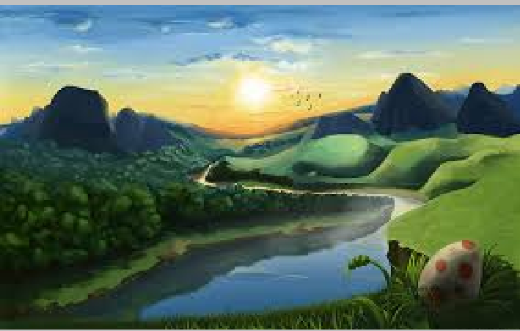
Image Processing with Swing
Team-9 Member: Ganta Karthik Sindhura Harika Chethana Rohith

Slide 2
Introduction
Purpose of the application: To demonstrate image processing capabilities using Java Swing.
Overview of key features: Image manipulation, color adjustment, and image effects.
Target audience: Developers, students, and educators interested in Java graphics programming
Tech Stack :
JAVA
Swing UI

Slide 3
Contributions and Functionalities Implemented:
Harika
Image Formatting
Ganta Karthik
Image Operations
Sindhura
Image Models
Chethana
Image Controller
Rohith
Image View

Slide 4
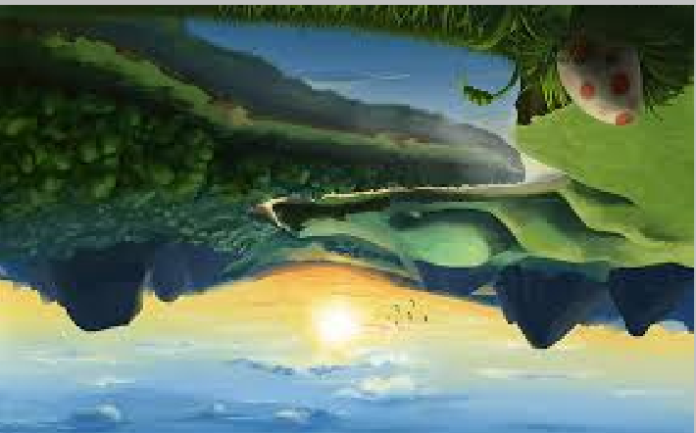
Vertical Flip
Flips the image vertically

Slide 5
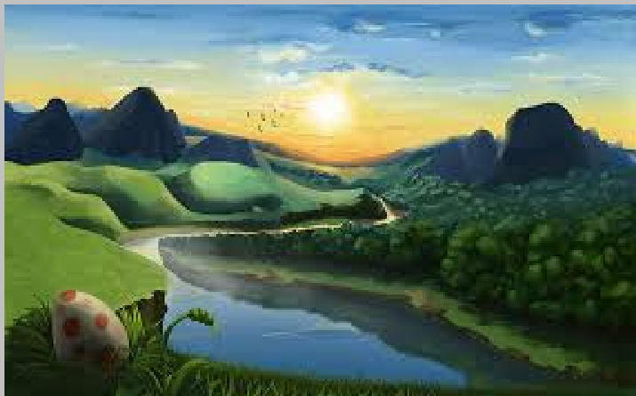
Horizontal Flip
Inverting the image along the Y-axis.

Slide 6
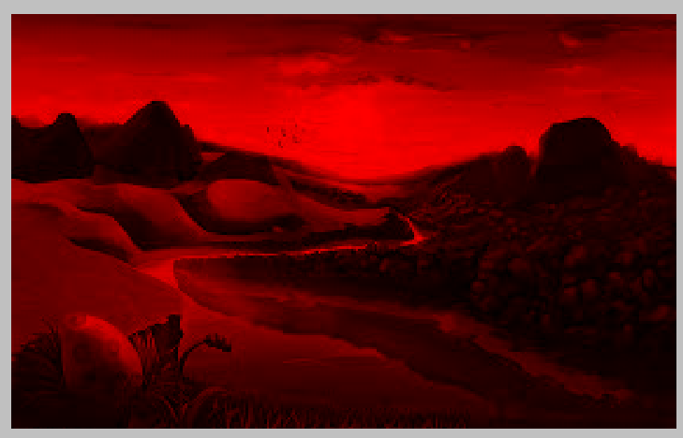
Red Color Changing
Transform your images by changing the Red color channel to create stunning visual effects.

Slide 7
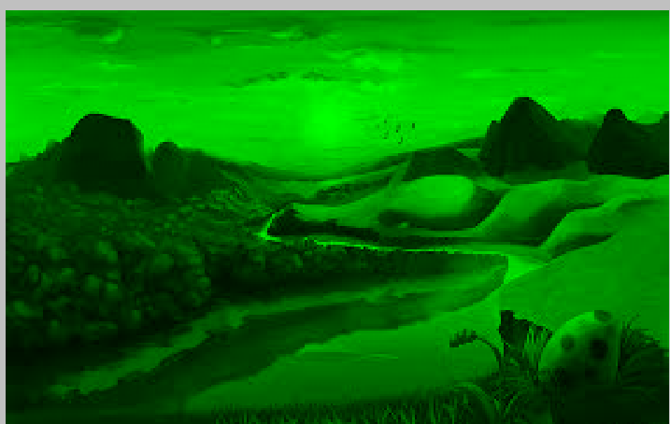
Green Color Changing
Transform your images by changing the Green color channel to create stunning visual effects.

Slide 8
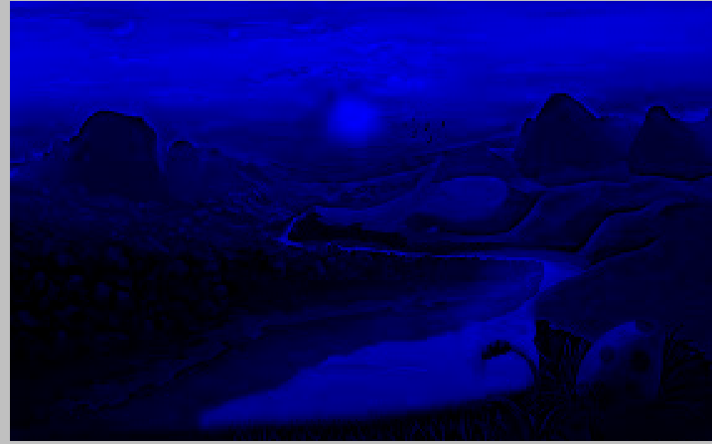
Blue Color Changing
Transform your images by changing the blue color channel to create stunning visual effects.

Slide 9
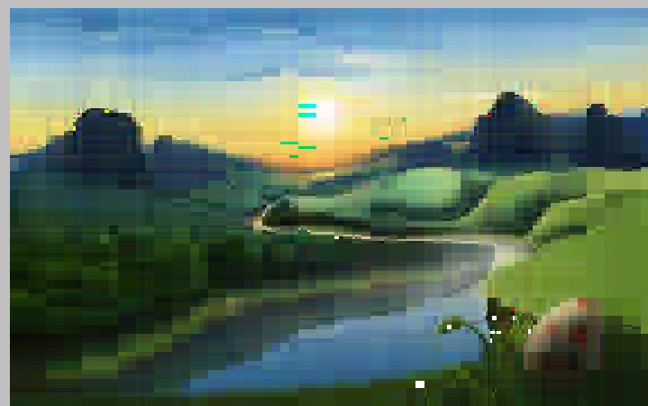
Compression
Compresses the image to reduce file size

Slide 10
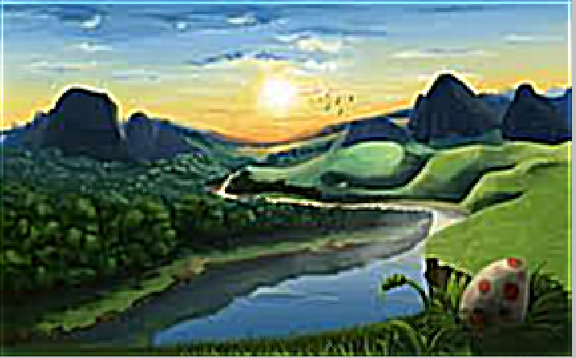
Sharpen
Enhances the sharpness of the image

Slide 11
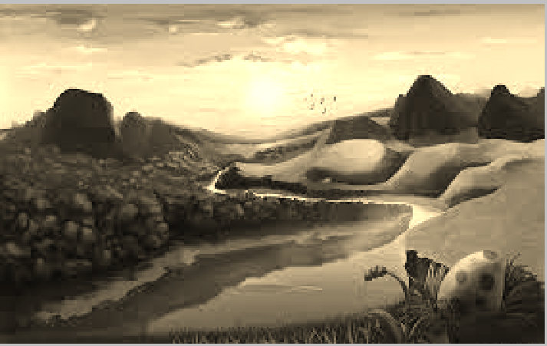
Sepia Tone
Apply a sepia tone effect to the image to give it an elegant vintage look. Sepia tone can evoke feelings of nostalgia and add a touch of class to your photos. With our image processing application using Swing, you can effortlessly transform your images into timeless masterpieces.

Slide 12
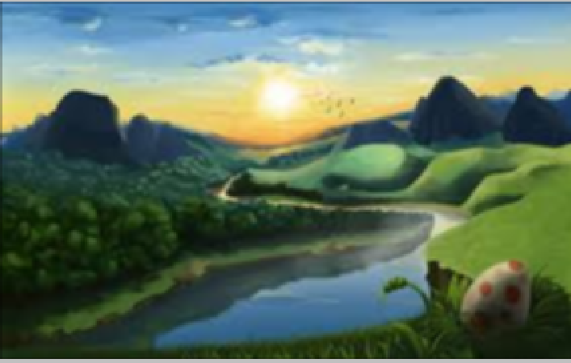
Blur
Applies a blur effect to the image. The blur feature is a powerful tool that can be used to add a sense of depth and create a soft, dreamy effect. By applying a blur effect, you can focus the viewer's attention on specific areas of the image while subtly blurring out the background. Whether you want to enhance the mood of a landscape photo or add a touch of mystery to a portrait, the blur feature is a versatile tool for any image processing application.

Slide 13
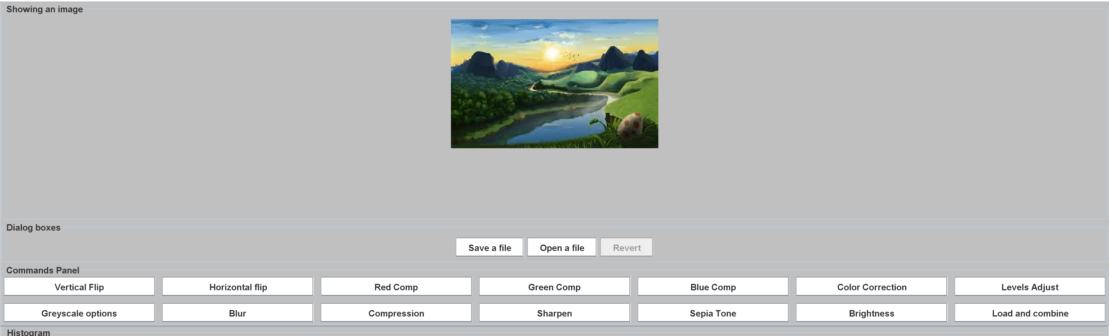
App View

Slide 14
Thank you

