Slide 1


Cloud Application with CI/CD pipeline automation
By -
Sai Dutt
Date –
12th August 2025

Slide 2
Project overview
Canvas-like application that does the following –
  Takes GitHub link from user and verifies the timeliness of submission.
  If valid, store the assignment zip in a GCP bucket. Log the details in RDS.
  Email the user the status and GCP bucket link.
  Ensure Load balancing and Auto Scaling.
  Ensure Continuous Deployment using GitHub Actions.

Slide 3
Project Role & Scope
Project can be divided into 4 categories:
  Backend application
  GitHub Actions CI/CD
  Infrastructure Code
  Serverless code
My contribution – Solo project with the help of my Professor and teaching assistants (weekly meetings)
Backend only.
Tech Stack: Express.js, Debian, AWS, GCP, Pulumi(Typescript)
Time Spent – 12-14 weeks, 20 hours per week

Slide 4
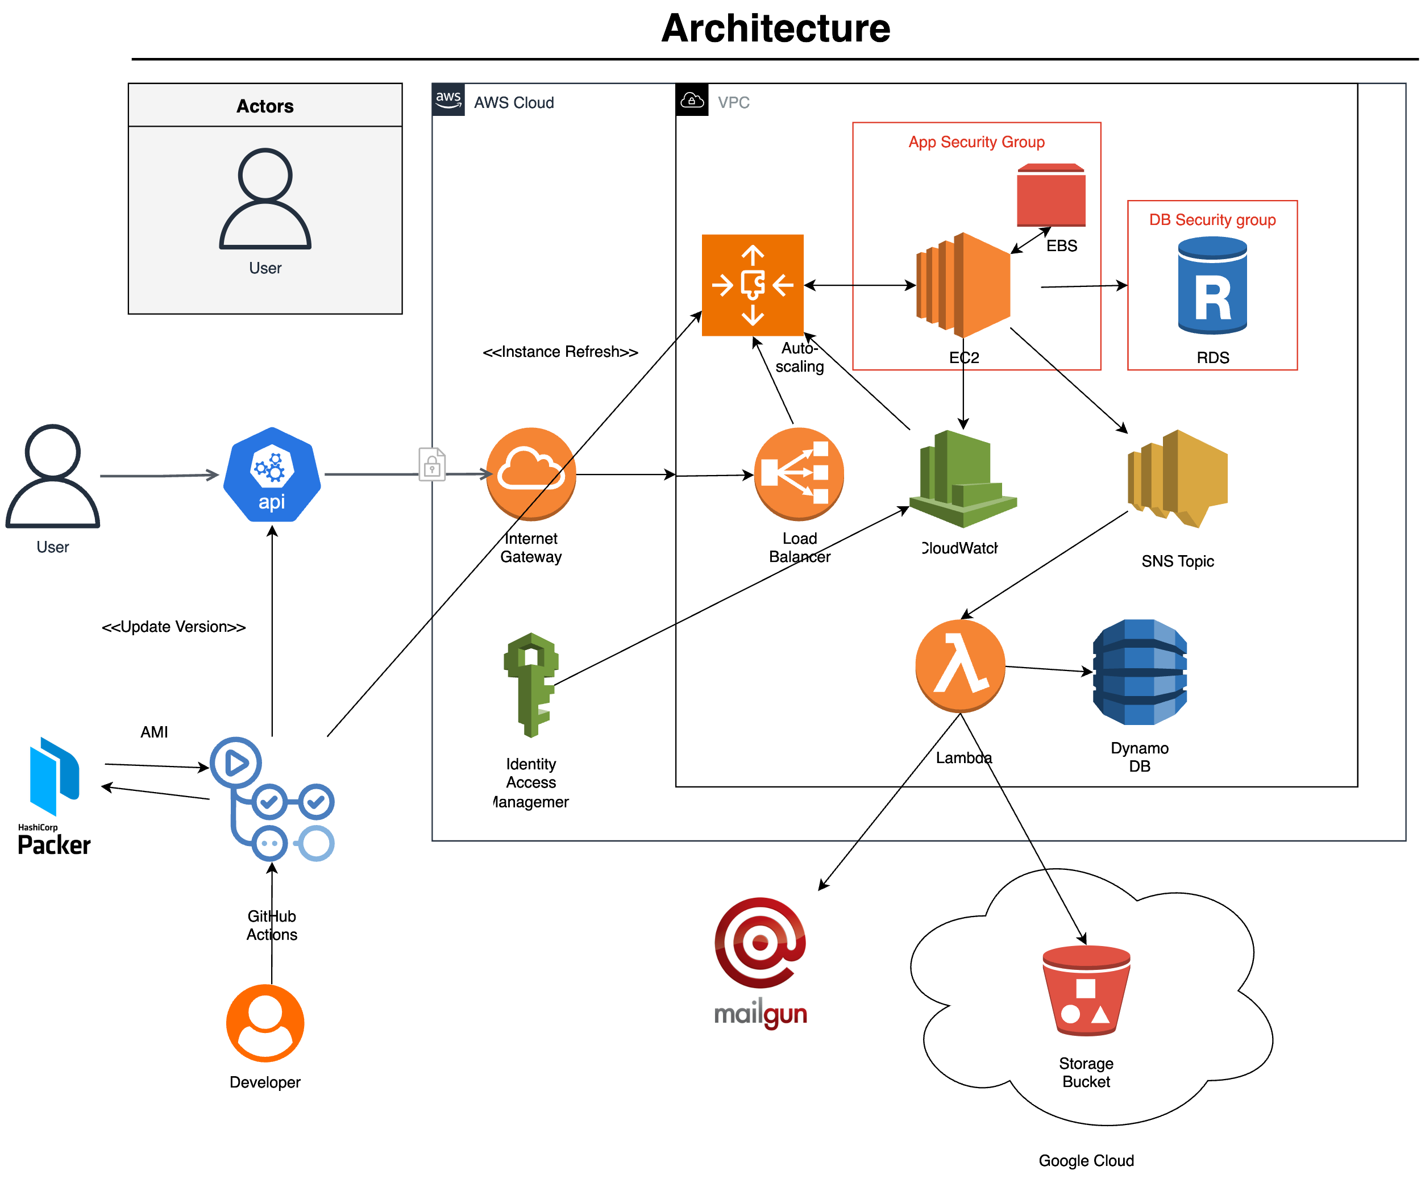
System Architecture

Slide 5
Web application
APIs include CRUD operations; Verified parameters like deadline, and valid GitHub link.
Robust API management with encryption and relevant error codes.
Submission sent a message to SNS which triggered the Lambda.
Sequelize ORM to communicate with MySQL database.
Integration testing using Chai framework.
API Load testing done with Postman to ensure 3-5% CPU utilization.

Slide 6
Deep Dive : Error codes
Condition | Code | Meaning
200 OK | Request succeeded | Getting data or performing an action that didn't create a new resource
201 Created | Request succeeded and created a new resource | Often includes a Location header to the new resource
400 Bad Request | Sent request was malformed | E.g., missing parameters or invalid fields—client error.
401 Unauthorized | Access requires authentication | Credentials are missing or invalid.
404 Not Found | Resource not found on the server | Request endpoint or data doesn’t exist.
500 Internal Server Error | Unknown server error | Used when the server encounters an unexpected condition
503 Service Unavailable | Server temporarily can't handle request | Used when service is down or overloaded; retry later.

Slide 7
Challenges faced & Lessons learned
Syncing instance usage details with Cloud Watch.
Fine-tuning error handling to ensure proper HTTP codes.
---
Principles like clean code, DRY, and YAGNI allowed for a smoother development process.
Strong input validation and error propagation improve maintainability and observability.

Slide 8
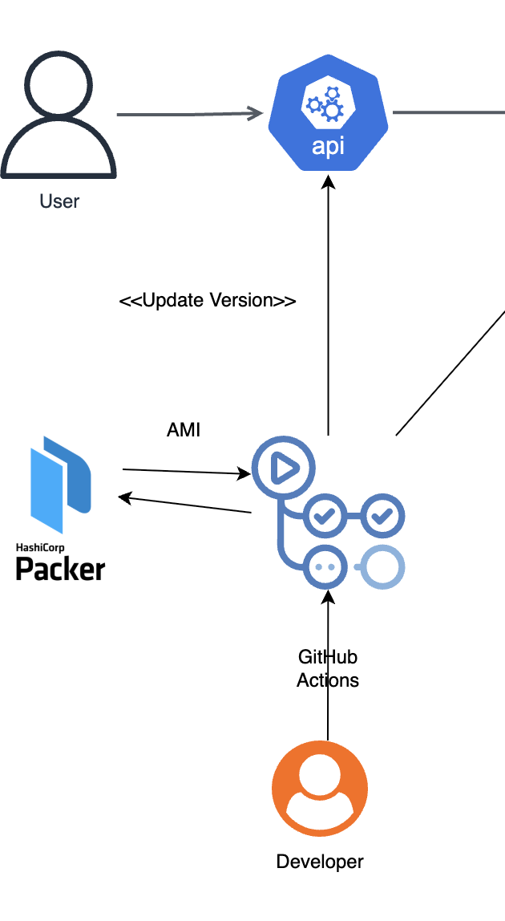
GitHub Actions CI/CD

Slide 9
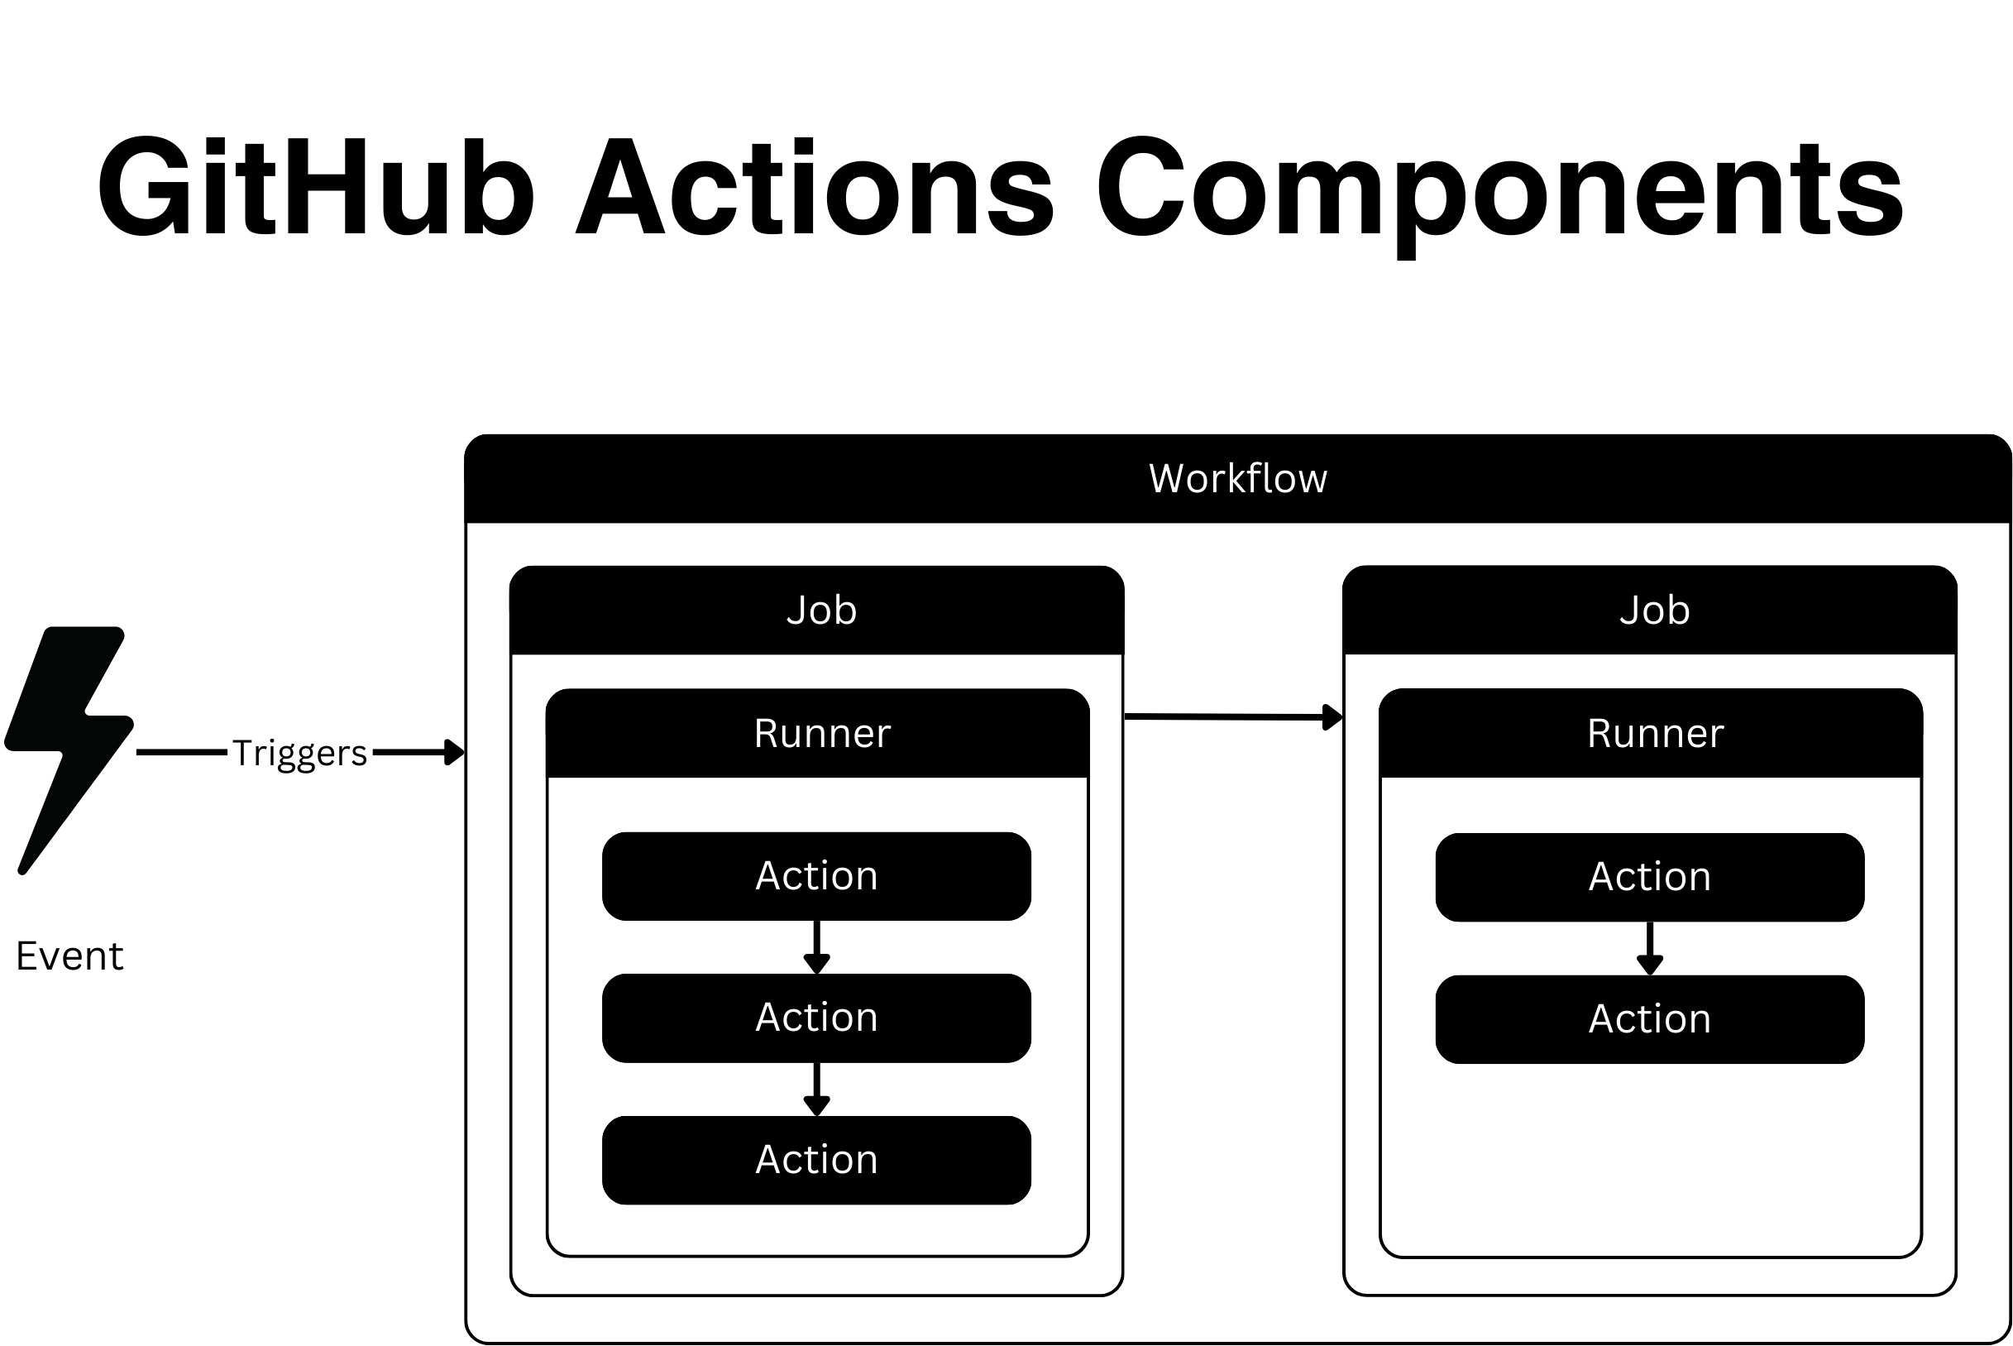
GitHub Actions CI/CD
Two workflows:
  CI – On push and pull request events
  AMI – On Pull request merged.
CI plan achieves Continuous Integration while AMI plan achieves Continuous Deployment.
It uses packer to build an Amazon Machine Image (AMI) and does an “instance refresh”.

Slide 10
Challenges faced & Lessons learned
Lack of local execution slowed down progress.
Managing sensitive details like API keys.
---
Enforce declarative validation and gating in CI (GitOps approach)
Use of GitHub secrets

Slide 11
Infrastructure as Code using Pulumi

Slide 12
Infrastructure as Code using Pulumi
Used Pulumi (Typescript) Async programming to construct AWS infrastructure.
Here is how the infrastructure is used –
  VPC is connected to the internet through the Internet Gateway.
  Load balancer distributes requests (HTTPS only) across EC2 instances.
  EC2 instance(s) are created with a launch template and AMI. It accepts requests only from Load balancer.
  An RDS instance is created. It accepts requests only from EC2.
  CloudWatch connects with Auto-scaling to scale based on 3-5% CPU utilization
  IAM roles allows CloudWatch to access EC2 metrics

Slide 13
Deep dive : Networking
Public subnet hosts the load balancer; private subnets host compute and database.
Load Balancer SG: allows inbound HTTPS (443) from the internet
App SG: allows HTTP (8080) only from ALB SG.
DB SG: permits DB port (3306) only from App SG.
EC2 and Lambda enforce IAM roles (e.g., CloudWatch write, DynamoDB access) to prevent misuse.

Slide 14
Deep dive : Networking
Choose a server location for the VPC, i.e. us-east-1.
Define an IPv4 CIDR (e.g., /16); all subnets exist within it.
Subnet sizes range /28 to /16.
Actual usable IPs = 2^(32-prefix) − 5
10.0.1.0/24 for public, 10.0.2.0/24 for private, per AZ—clear, scalable, and resilient.

Slide 15
Challenges faced & Lessons learned
Selecting from the various AWS services.
Connecting cloud details with the application.
Managing async script execution and complexity in debugging failed deployments.
---
Careful management of private keys and policy checks to catch misconfiguration and enforce secure defaults.
Version all infrastructure changes, enabling reproducible deployments.

Slide 16
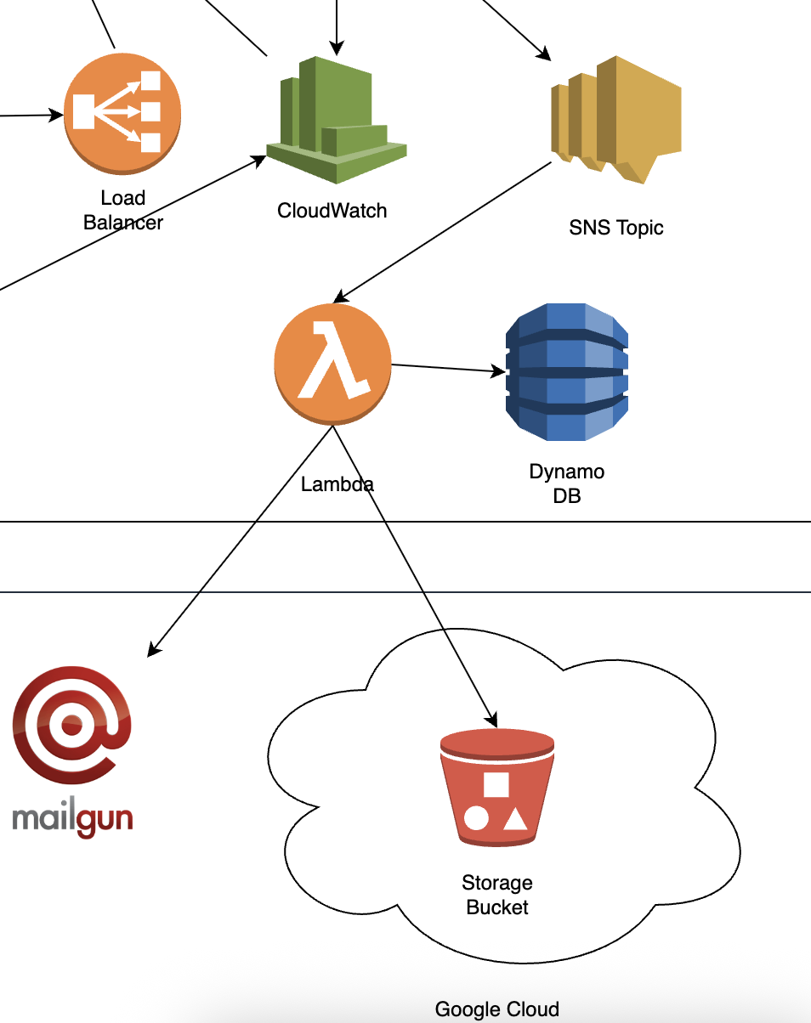
Lambda instance

Slide 17
Lambda instance
Fetches GitHub assignment in a Zip format.
Stores it in Google Storage Bucket.
Records successful storage or failure in DynamoDB.
Emails user with Google storage bucket link using Mailgun.

Slide 18
Challenges faced & Lessons learned
Mailgun and cross-vendor integration using Google Cloud Storage bucket.
Required setting up secure credentials and environment variables across platforms
---
Enforce declarative validation and gating in CI (GitOps approach)
Use of GitHub secrets

Slide 19
Why This Project is Relevant?
Robust application development with integration and load testing.
Experience with system management through Bash scripting and SystemD.
Hands-on experience with Cloud technologies like AWS, and GCP
Ensured security through security groups, encryption, and access management.
Gained familiarity with CI/CD code used in systems like GitHub Actions, Jenkins and Bamboo.

Slide 20


Thank you !
https://github.com/CSYE6225-002933709

