Slide 1
Yelp Review Data Analysis
Course: Big-Data Sys Engr Using Scala
Professor: Robin Hillyard
Team: Songzhe Zhang & Wanli Ma

Slide 2
Goals of the project
For each rate level(or star), we make a statistics of the most-frequent phrases(unigram, bigrams and trigrams).
Execute the machine learning algorithms, predict rate of the review data.

Slide 3
Data sources
The data we used comes from the following link: https://www.yelp.com/dataset_challenge.
Dataset:
2.2M reviews and 591K tips by 552K users for 77K businesses
566K business attributes, e.g., hours, parking availability, ambience.
Social network of 552K users for a total of 3.5M social edges.
Aggregated check-ins over time for each of the 77K businesses
200,000 pictures from the included businesses
Cities:
U.K.: Edinburgh
Germany: Karlsruhe
Canada: Montreal and Waterloo
U.S.: Pittsburgh, Charlotte, Urbana-Champaign, Phoenix, Las Vegas, Madison
The data is provided in the form of five JSON files. Each file is composed of a single object type, one json-object per-line. Respectively, these five files are businesses, check-ins, reviews, tips, and users. For example, objects in the review.json ant check-in.json files:

Slide 4
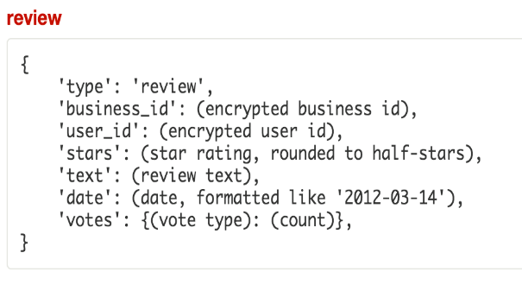
Data sources

Slide 5
Methodology
Data parser: Using Spark do some pre-process of the dataset, clean empty, miss format data from the dataset, and then extract data information that we need to use.
Statistic: Count the frequency of each words/phrases in different review level using MapReduce and Spark.
Data Analysis: Visualize statistic dataset and try to understand the dataset.Compare each review level data and exclude same words/phrases to get the feature words/phrases of each review level.
Machine Learning: according to the context of the review and the most frequency phrase, predict the stars of a certain business
Notes:
In detail, For goal 1, we can compare each word of review text against a lexicon of positive/negative words, and count the number of review words in the lexicon. For 2, we could use some query language to get the result.

Slide 6
Milestones
Time | Tasks
3/15 ~ 3/31 (16 days) | Statistics of the most-frequent phrases Using Scala.
4/01~ 4/03 (3 days) | Deploy on AWS
4/04 ~ 4/07 (4 days) | Visualization
4/08 ~ 4/17 (10 days) | Machine Learning (MLlib)
4/18 ~ 4/19 (2 days) | Integration all parts together and self-acceptance

Slide 7
Scala Programming
Functional Programing Language Scala (parser, word counter)
Spark (Map/Reduce)
Machine Learning (MLlib)
Cloud computing AWS

Slide 8
Acceptance criteria
Successfully make statistic of 2.2M review records for counting the frequency of each word/phrase in each level review.
Using 20% of the review data as the input of the machine learning model, check the output with the real stars. The correct rate reach more than 80%, then the goal is accomplished.

Slide 9
Thank you!

