Slide 1
Distributed Web
Crawler Framework
Team members: Stanley Li, Mayukh Sinha
Course: CSYE7200
Tech Stack: Scala, Apache Pekko, Apache Kafka
Date: October 2025

Slide 2
Motivation & Problem Statement
Challenges in Traditional Web Crawling:
- Limited scalability (single-machine or thread-based crawlers)
- Hard to handle millions of URLs dynamically
Goal:
- Build a distributed, event-driven, and resilient crawling system

Slide 3
Use cases
1. Large-Scale Data Collection
  A data engineer needs to collect millions of web pages daily from multiple domains for downstream analytics or NLP model training.
  Unlike single-machine crawlers, our system scales horizontally , simply add more worker nodes to increase throughput without downtime.
2. Real-Time Web Monitoring
  A business analyst needs to monitor competitors’ websites for price or content changes in real time.
  It provides faster insights, helping businesses respond to market changes immediately.
  Real-time competitive intelligence drives quicker decision-making and better business agility.

Slide 4
Why Use Pekko
Pekko = The Distributed Brain of the Crawler
Web crawling is a highly concurrent and I/O-intensive workload that requires managing thousands of parallel tasks.
Traditional multithreading models are hard to scale and difficult to coordinate across multiple nodes.
Pekko’s Actor Model abstracts each crawling task into an independent, message-driven actor, replacing shared state with asynchronous message passing.

Slide 5
Master–Worker Architecture (using Pekko Actors)
MasterActor:
- Generates and publishes new URLs or crawl tasks into the Kafka task topic.
WorkerActors:
- Consume tasks (URLs) from Kafka
- Perform the actual web fetching and HTML parsing
- Send parsed results or extracted links back to Kafka for further processing

Slide 6
Why Use Kafka
High-throughput message queue for distributed systems.
Decouples producer (Master) and consumer (Workers).

Slide 7
Kafka In Web Crawler Framework
The Master publishes pending URLs into the Kafka topic crawl_tasks.
Workers consume tasks from Kafka, execute the crawl, and send the results to the crawl_results topic.
Kafka provides task buffering, and flow control across the entire pipeline.

Slide 8
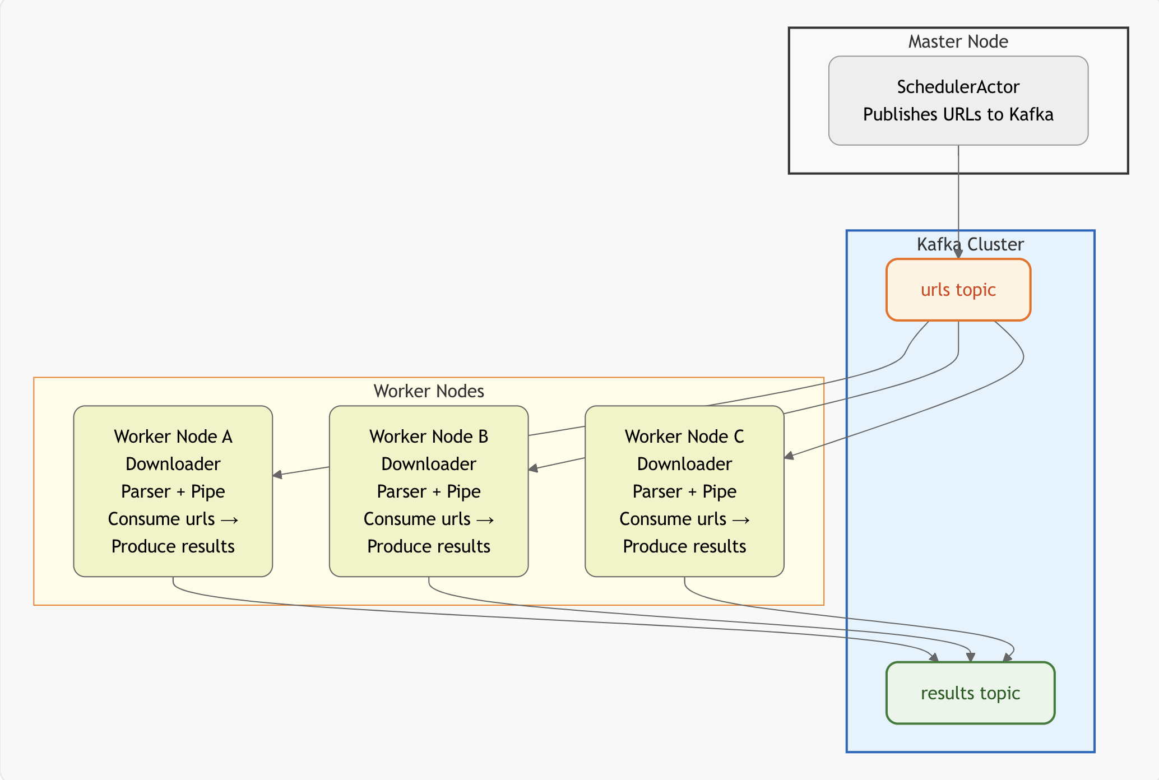
Framework Architecture Overview

Slide 9
Next Steps & Timeline
For the next few weeks, here’s how we plan to proceed:
Week 1: Set up the Kafka and Pekko environments, and define the basic Master–Worker actor communication.
Week 2: Implement the crawling logic and integrate HTML parsing.
Week 3: Add result collection and metrics monitoring.
Week 4: Run scalability tests and prepare our final report and demo.
By the end, we’ll have a distributed web crawler that can be extended for real-world use — like news aggregation or web indexing.

Slide 10
Acceptance Criteria
Metric | Criterion (Quantitative Target) | Purpose
Throughput (pages/sec) | The system should crawl between 300 and 600 pages per second under a 10-worker configuration | Measure overall system capacity.
Average Latency (ms) | The average time from task dispatch to completion should remain below 900 ms when the system sustains 300–500 pages per second. | Evaluate system responsiveness.
Speed-up Ratio | When scaling from 5 to 20 workers, throughput should increase by at least 3× (Speed-up ≥ 3.0). | Measure horizontal scalability.

