Slide 1
Student Attendance and
Leave Management System
Chandra Sai (B150744CS)
Bhanu Prakash(B150593CS)
Giridhar (B150970CS)
Sai Manoj (B150610CS)

Slide 2
Introduction
Student Attendance and Leave Management System is software developed for daily student attendance in National Institute of Technology Calicut. It facilitates to access the attendance information of a particular student in a particular class.

Slide 3
Introduction(cont)
It generates the attendance of the student on basis of his/her presence in class. The faculty will login to the system and marks the attendance of students on daily basis. Students can check their attendance percentage and absent dates of a particular course.

Slide 4
Tools and Technologies used
Front – end: HTML, CSS, and JavaScript
Back – end: PHP and MySQL
Web Server: LAMPP

Slide 5
Objectives :
The intention of developing Attendance Management System is to computerize the tradition way of taking attendance. Another purpose for developing this software is to simplify the leave management system.

Slide 6
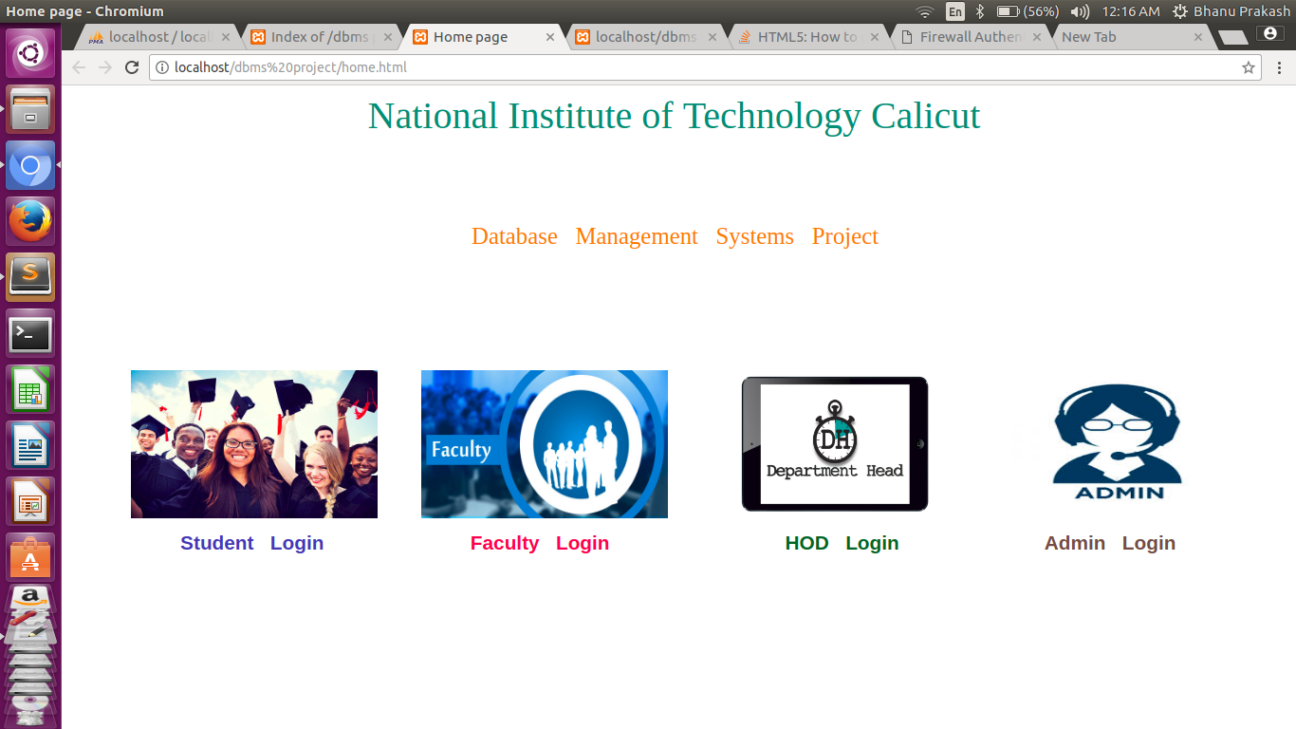
Home Page :

Slide 7
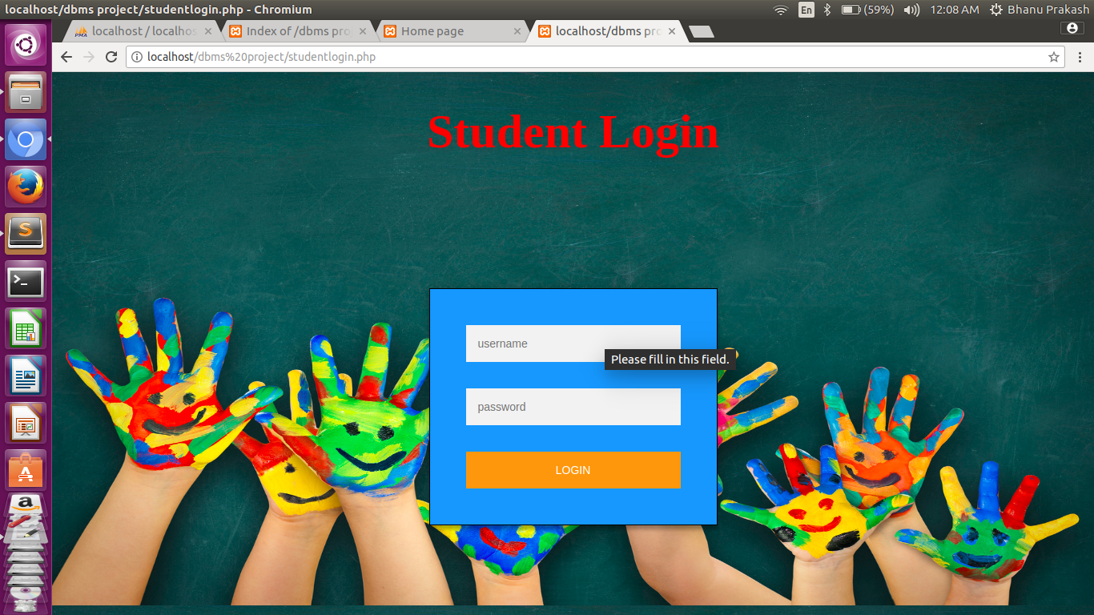
Student Login :

Slide 8
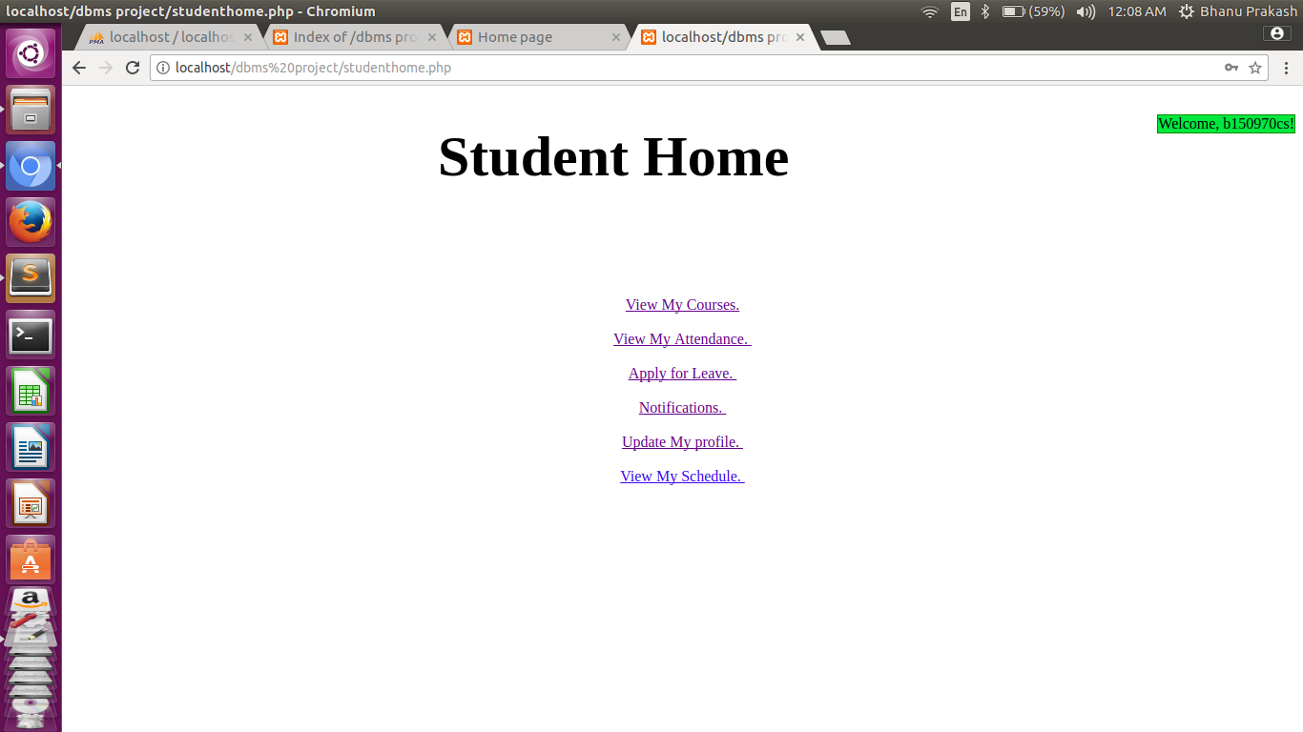
Home Page - Student
The functions of the student can view on his account.

Slide 9
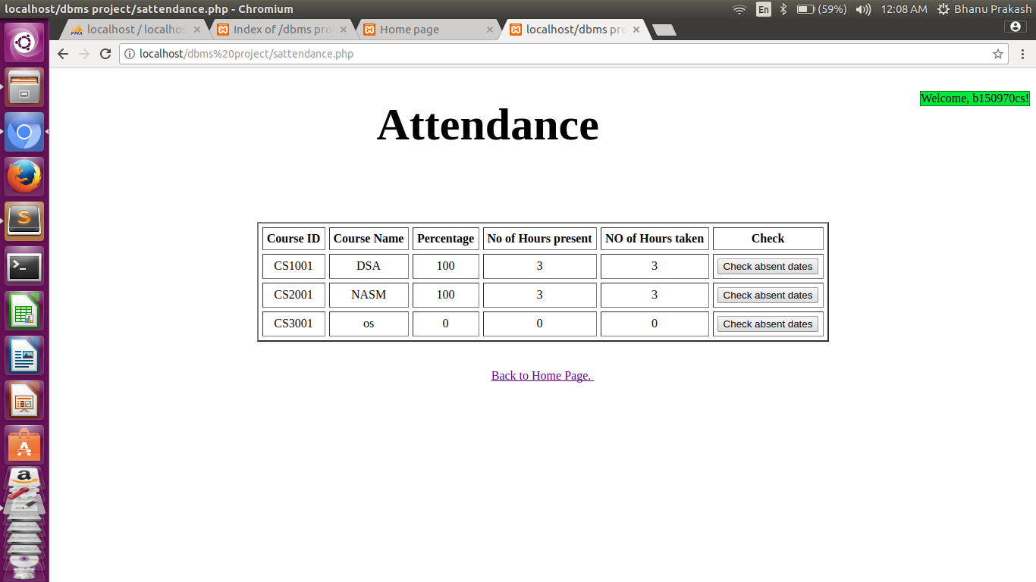
His/her attendance:

Slide 10
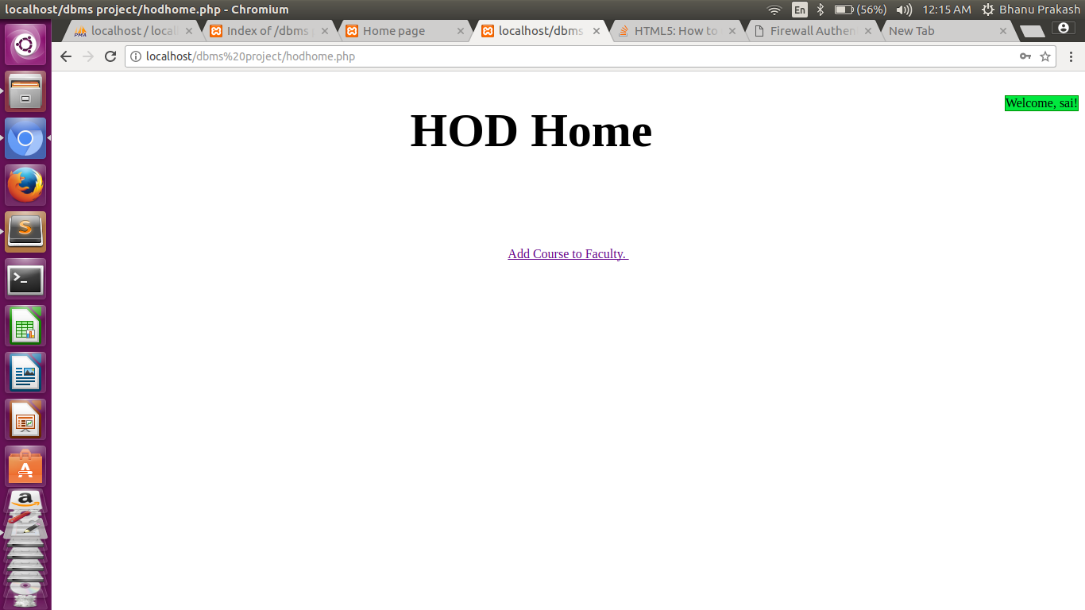
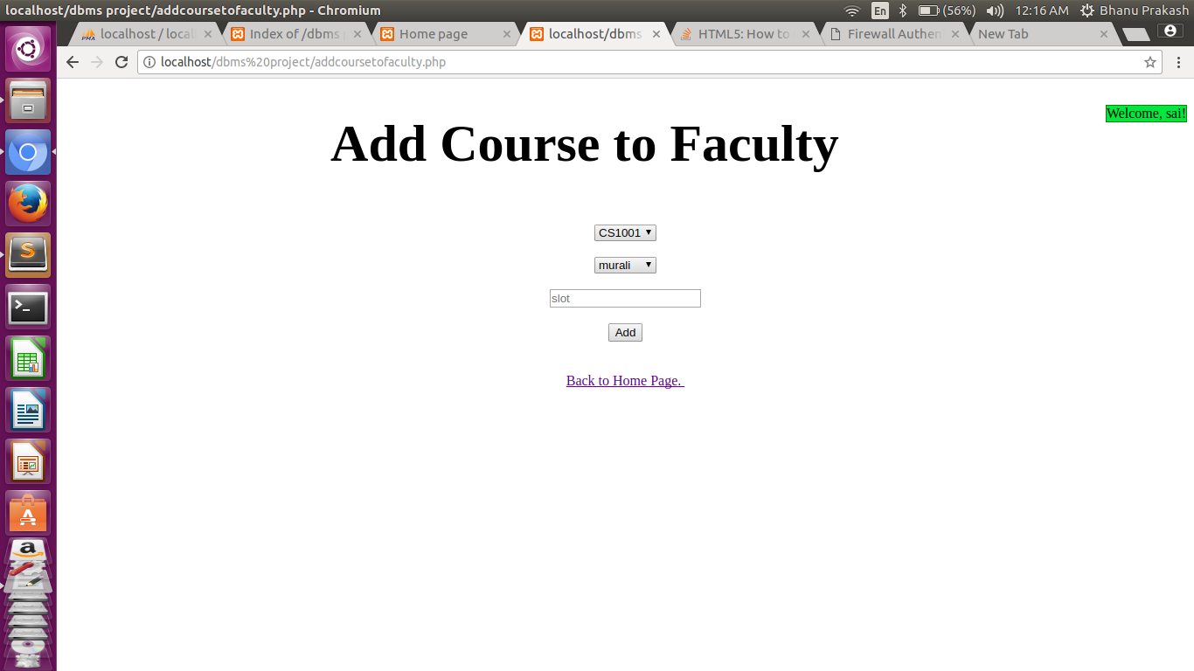
HOD section :

Slide 11
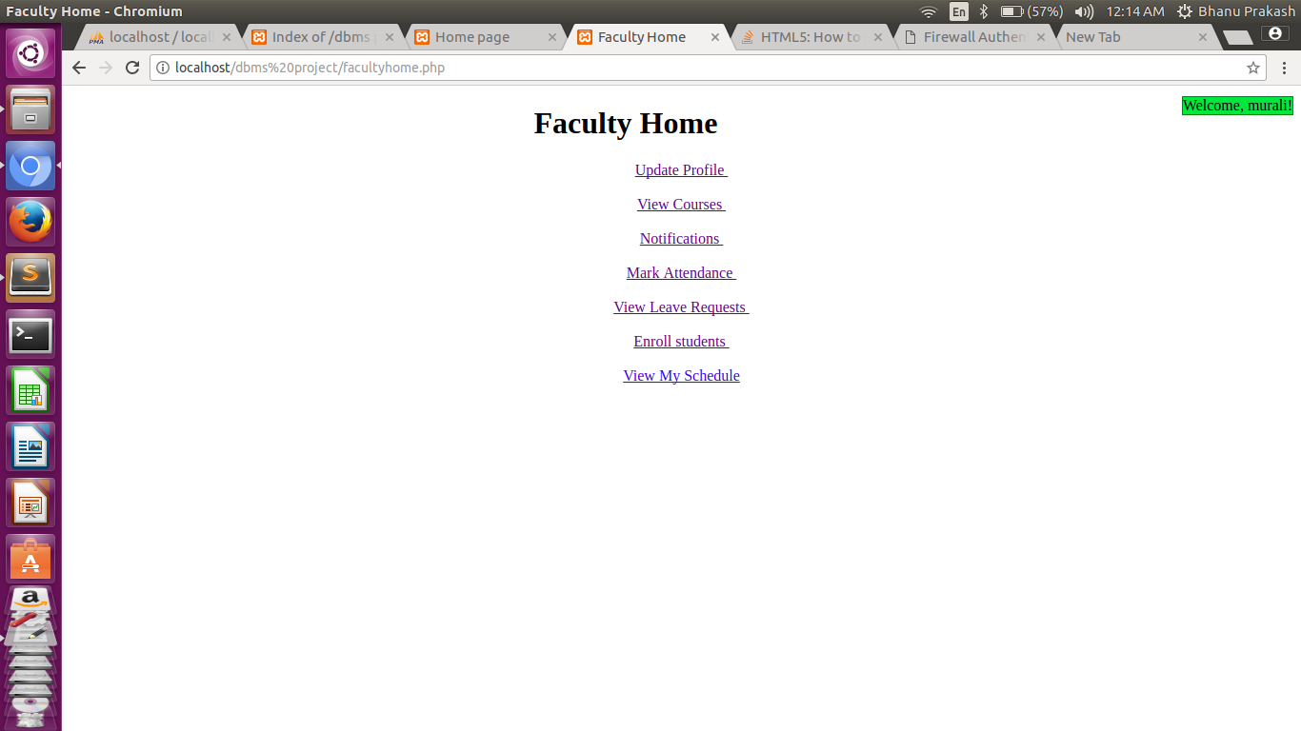
Home Page – Faculty:

Slide 12
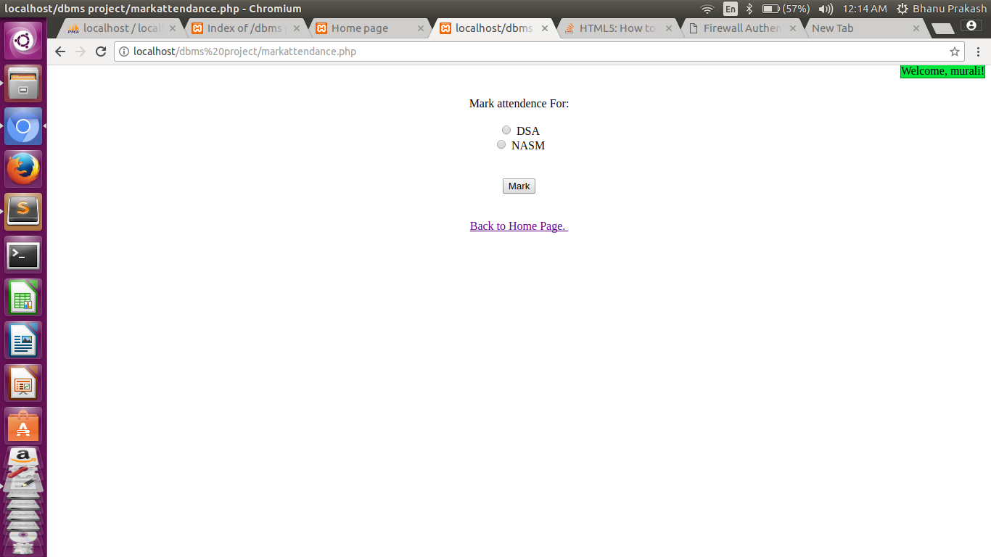
Marking Attendance:

Slide 13
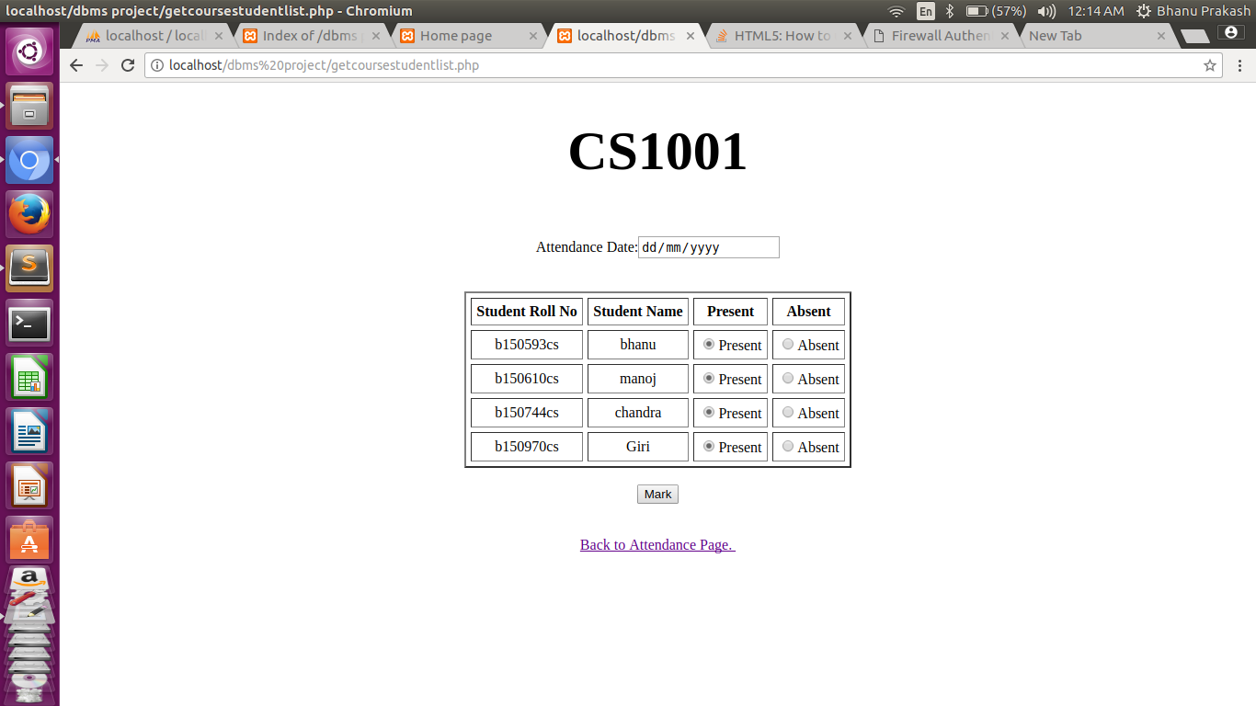
Enrolled Students of his course:

Slide 14
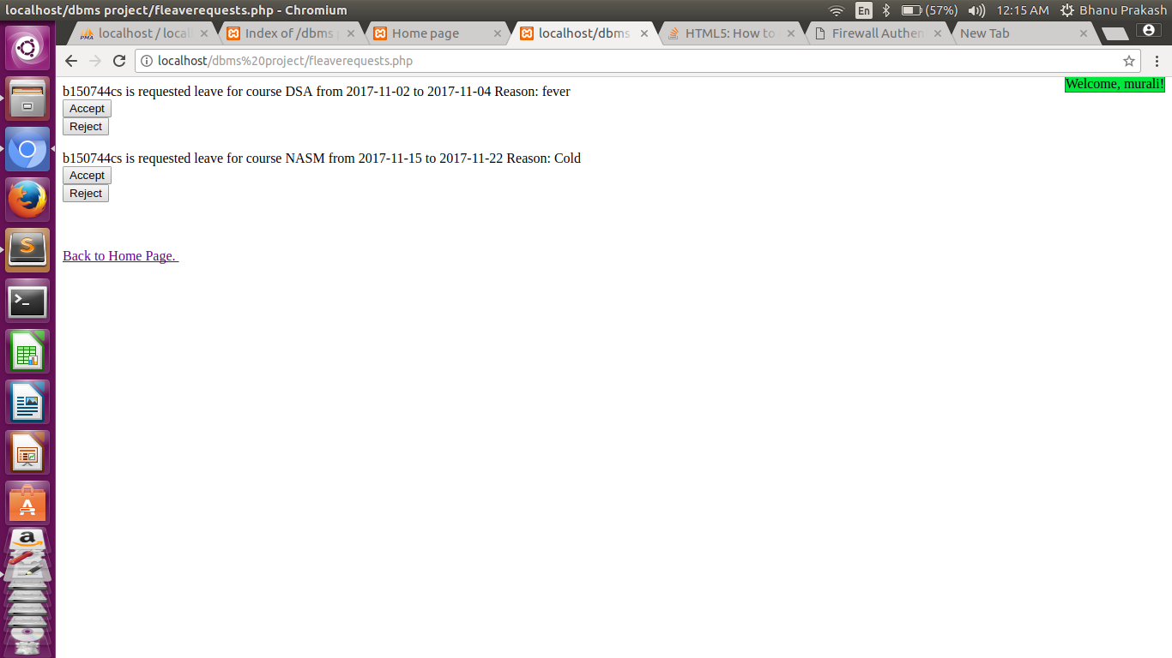
Leave requests :

Slide 15
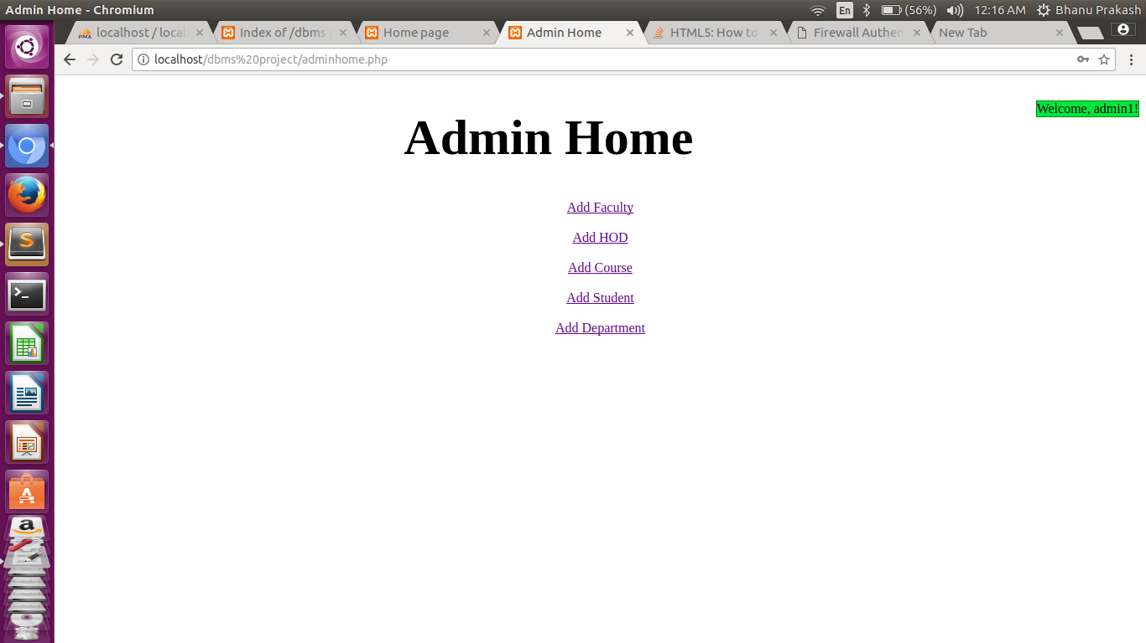
Admin Functionalities:

Slide 16

Renewal Request by Admin(cont..)

Slide 17
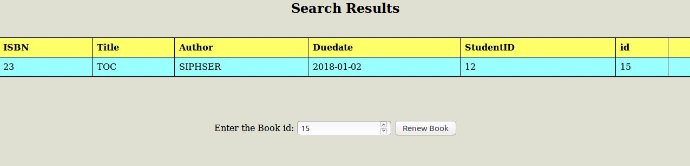

Request approval by admin

Slide 18
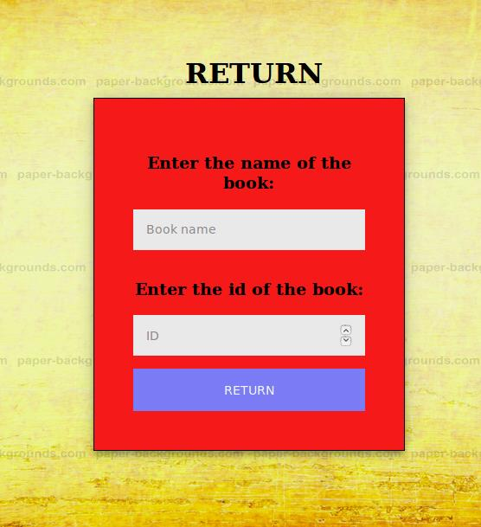
Book Return

Slide 19

Book Return(cont....)

Slide 20
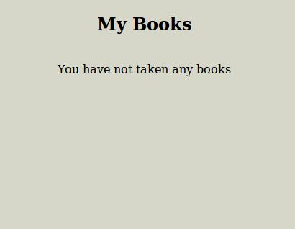
View Books

Slide 21
THANK YOU

