Slide 1
IBM SKILLS BUILD DATA ANALYTICS

Slide 2
Name : Chakkera Sai Prasanna email : prasannachakkera2004@gmail.com College name : Madanapalle institute of technology and science(MITS) Course:B.tech 3nd year Branch:Computer science & Engineering(Data Science) College state : Andhra Pradesh Internship Domain : Data Analytics Internship start date : 12-06-2023 Internship end date : 24-07-2023

Slide 3
Data analytics
Data analytics is the science of analysing raw data to make conclusions about that information.
Data analytics help a business optimize its performance, perform more efficiently, maximize profit, or make more strategically-guided decisions.
The techniques and processes of data analytics have been automated into mechanical processes and algorithms that work over raw data for human consumption.
Various approaches to data analytics include looking at what happened (descriptive analytics), why something happened (diagnostic analytics), what is going to happen (predictive analytics), or what should be done next (prescriptive analytics).
Data analytics relies on a variety of software tools including spreadsheets, data visualization, reporting tools, data mining programs, and open-source languages for the greatest data manipulation.

Slide 4
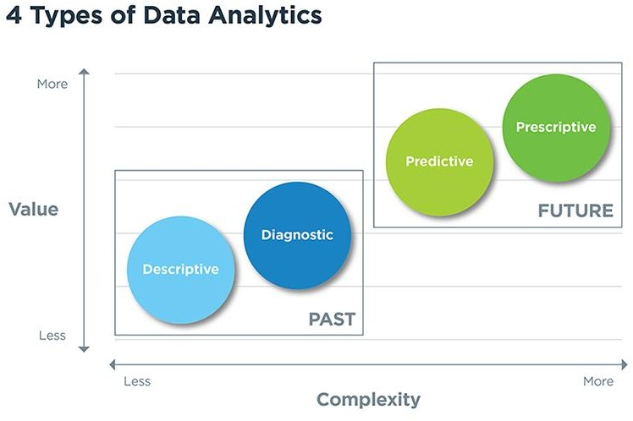

Slide 5
PROJECT TOPIC
Analyzing the data for understanding the trends and patterns associated with profits and sales of superstore with the help of data visualization.
The trends and patterns desired will give insight and insights will lead to recommendations help in business to strategies for growth.

Slide 6
Analysis of superstore dataset
Introduction
Working with dataset
Visualization
Overall Analysis

Slide 7
Introduction
In this dataset we have many features like ship mode, Segment, country, city, state, postal code, region, category, sub-category, sales, quantity, discount, and the dependent variable is profit. The remaining are Independent variables.

Slide 8
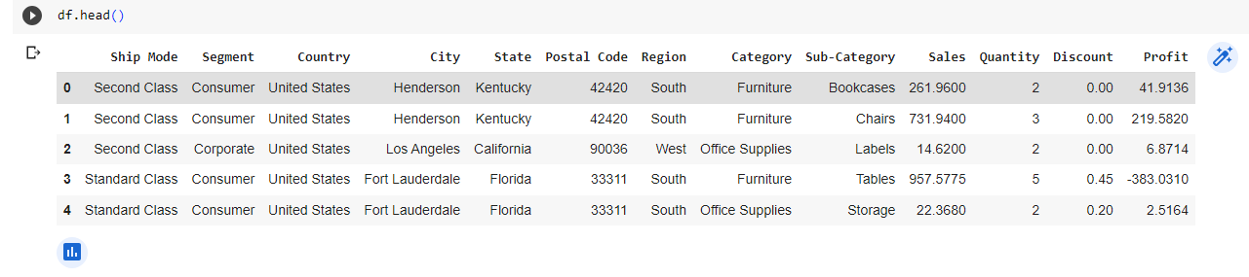
Working with superstore dataset

Slide 9
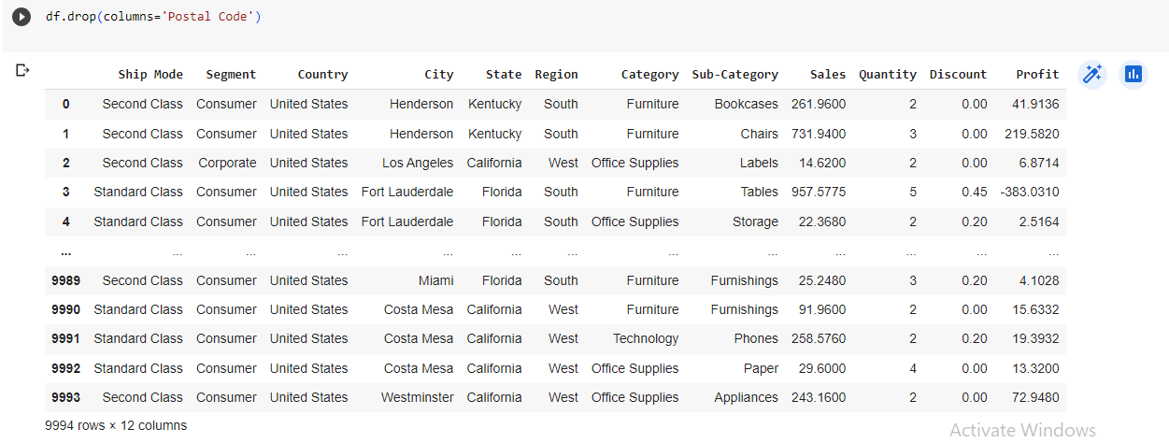
In this we don’t need postal code for analyzing the superstore dataset. So we will drop that column.

Slide 10
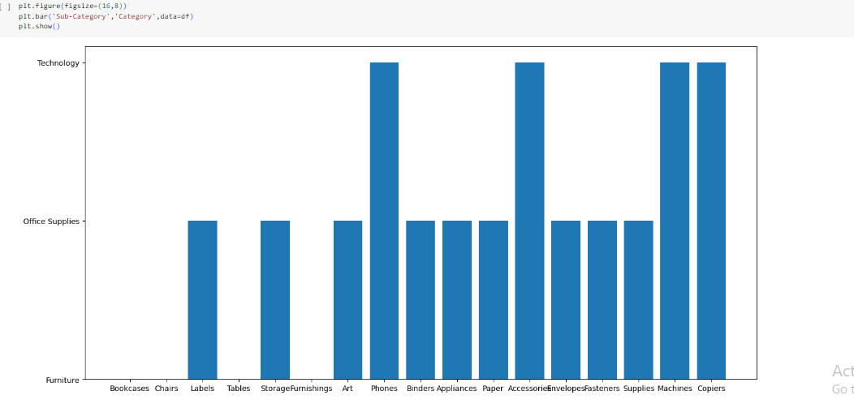
Visualizing the superstore dataset
Bar plot between category and sub-category
In this we can see the frequency of the item

Slide 11
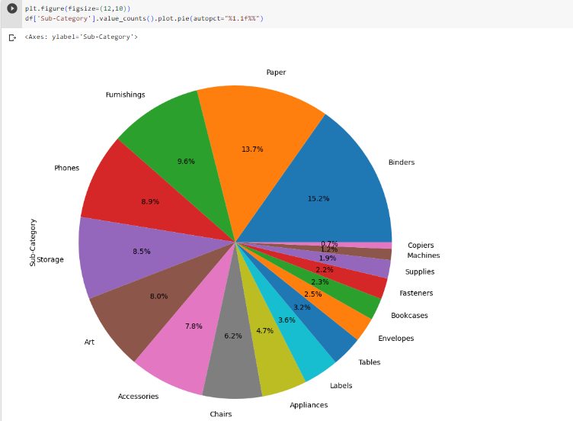
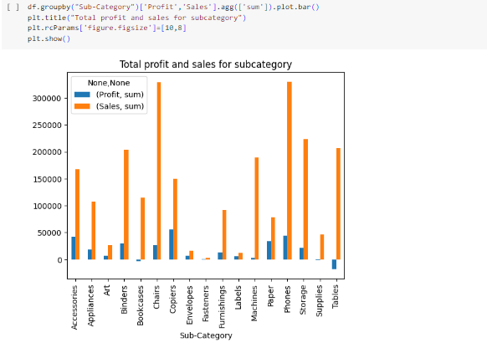

Slide 12
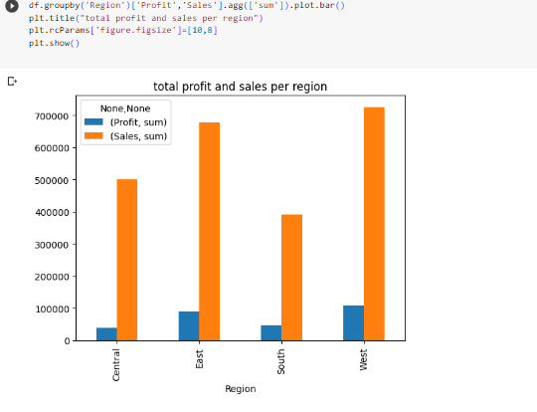
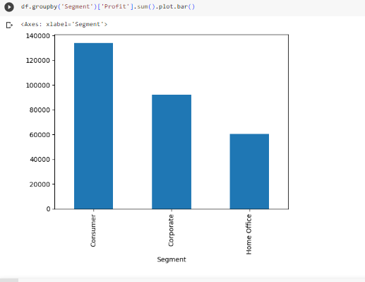

Slide 13
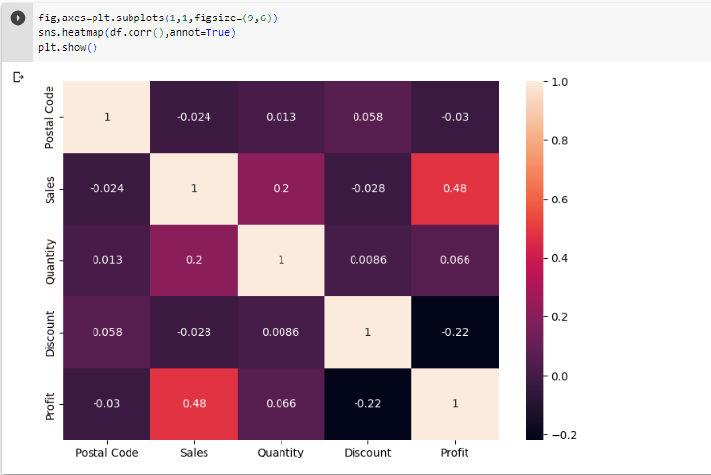
HEAT MAP FOR VISUALIZING DATASET

Slide 14
Conclusion
We have visualized and analyzed various use cases in the superstore dataset. We have got some insightful results about the Profits and Sales that can be used to improve future results.
This is what I understood from the superstore dataset and I analyzed the dataset accordingly.

