Slide 1
The COMPLEX relationship between HARMONY AND LYRICS
Digital Musicology, EPFL

Slide 2
To what extent harmonic complexity links to lexical complexity in lyrics in modern music?

Slide 3
Overview
Data scraping and cleaning
Pre-processing and extraction of the features
Lexical complexity
Harmonic complexity
Results and analysis
Further work

Slide 4
I. The dataset
Web-scraping and cleaning

Slide 5
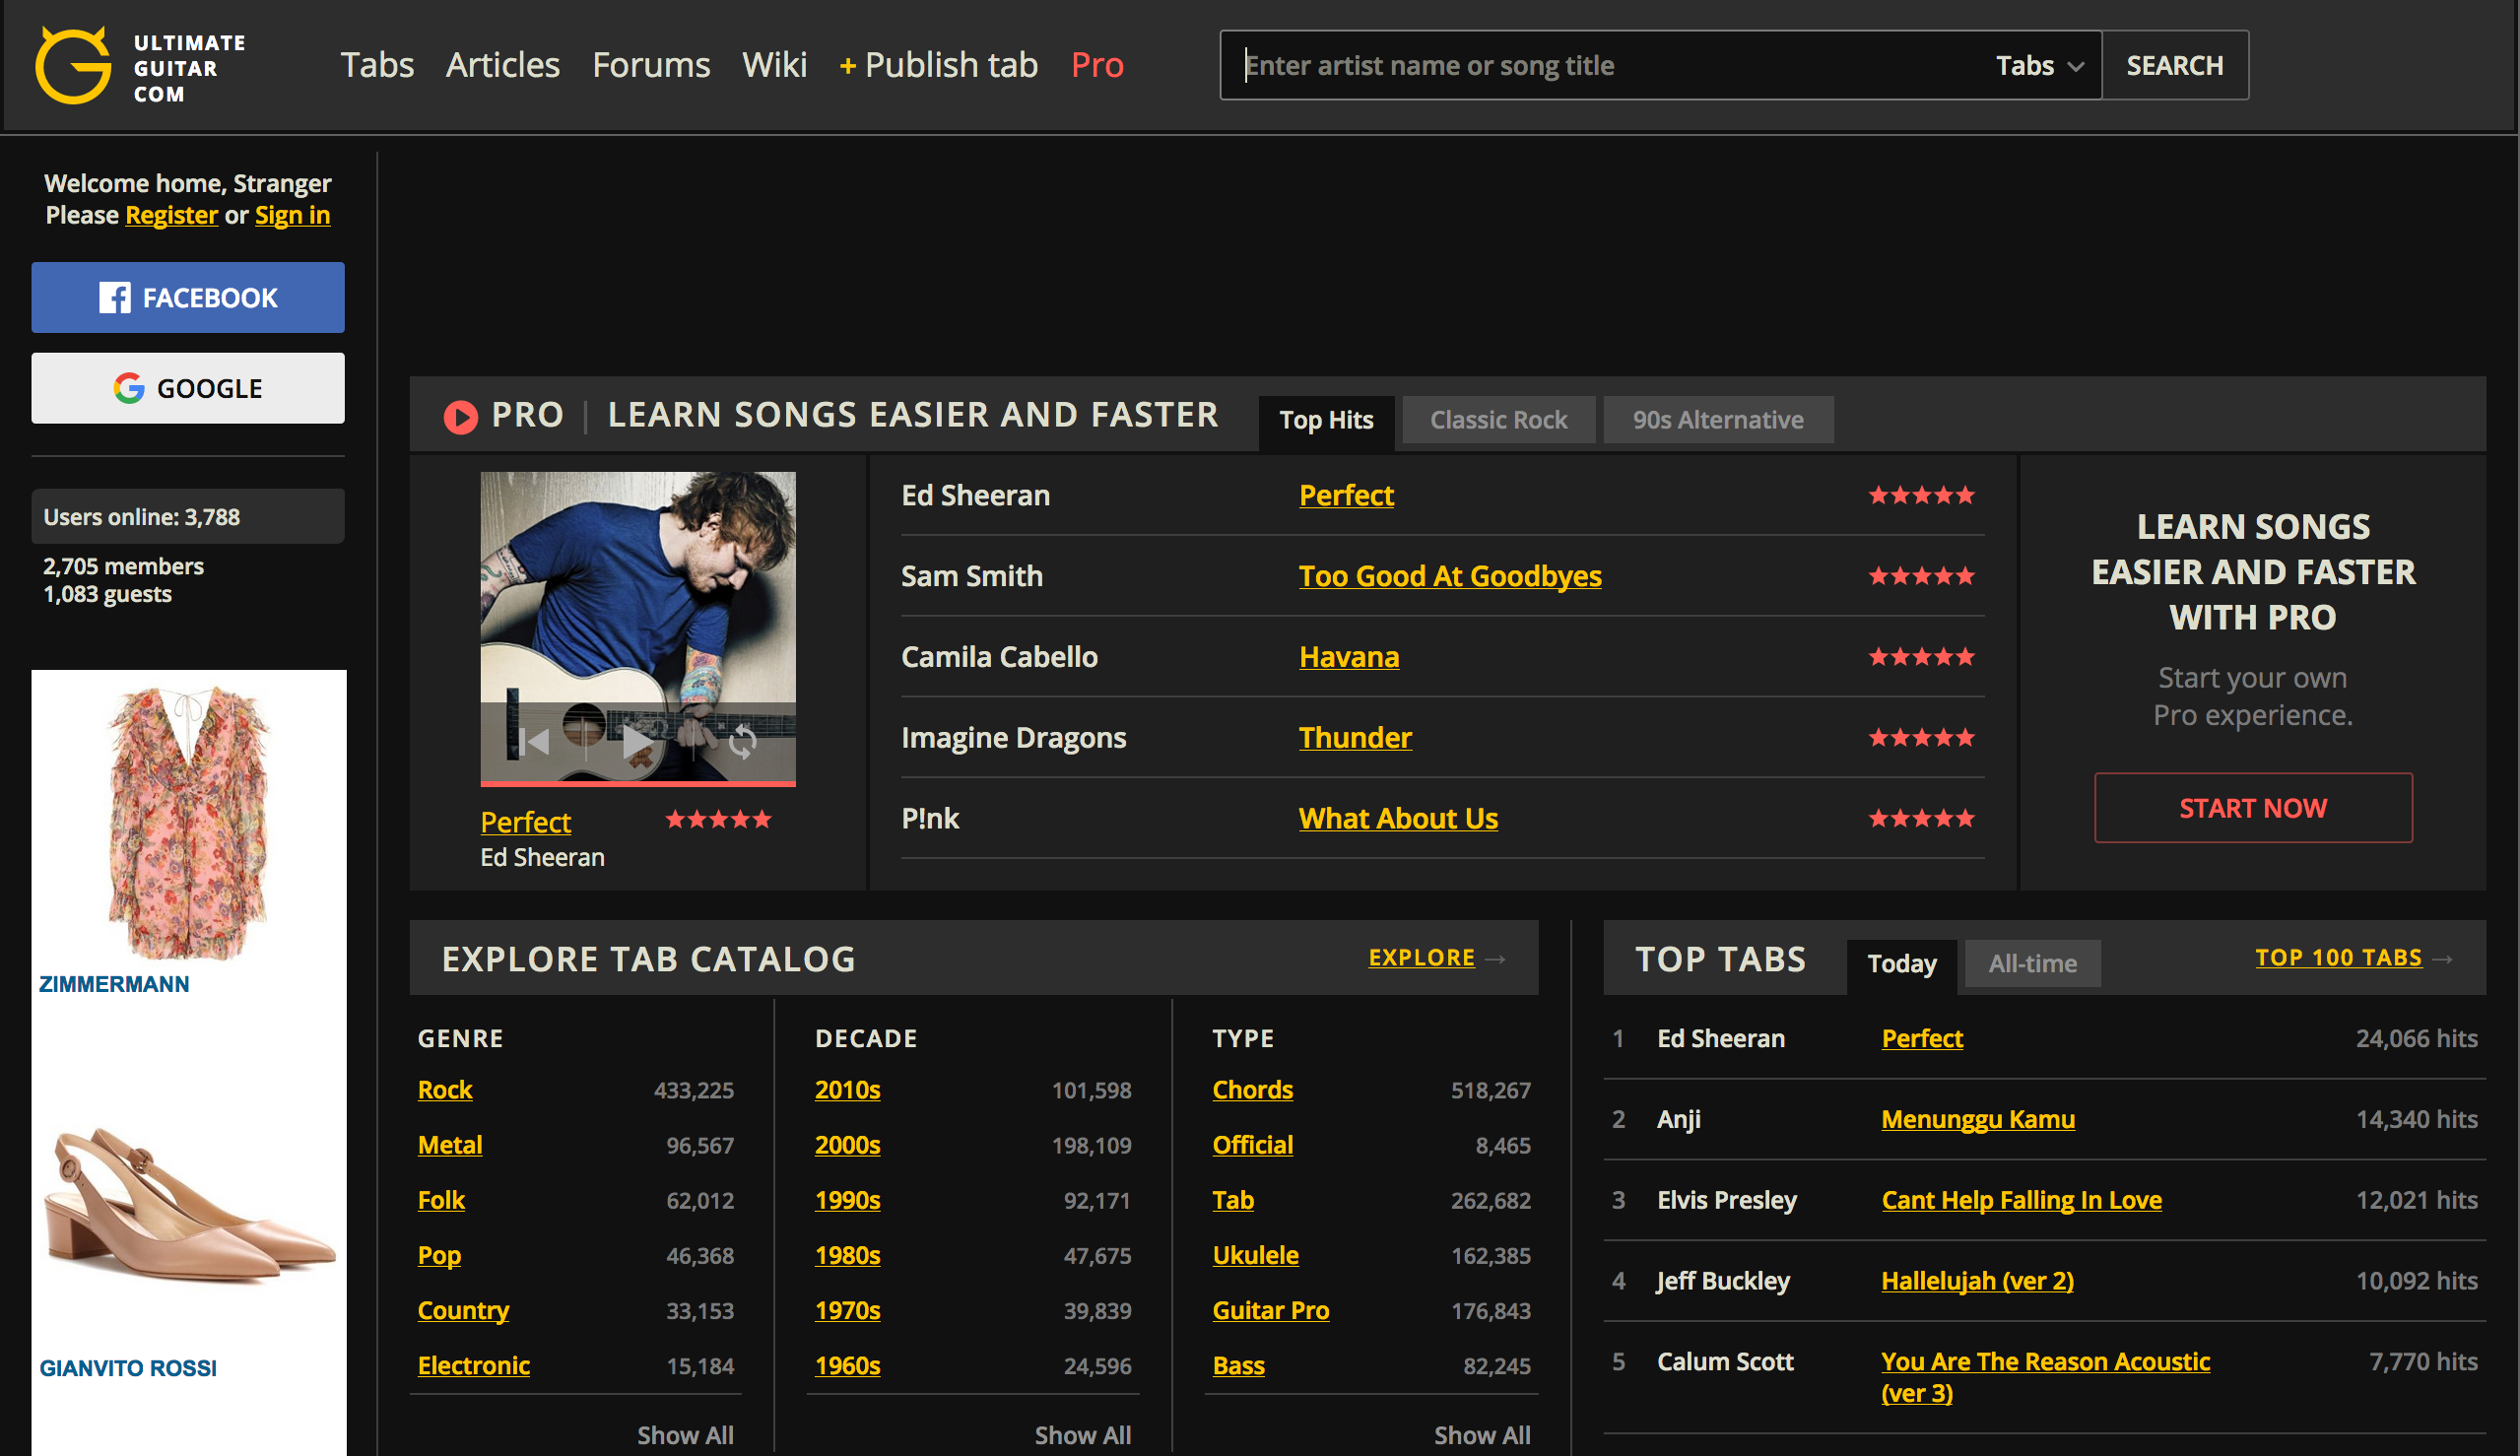
Ultimate Guitar

Slide 6
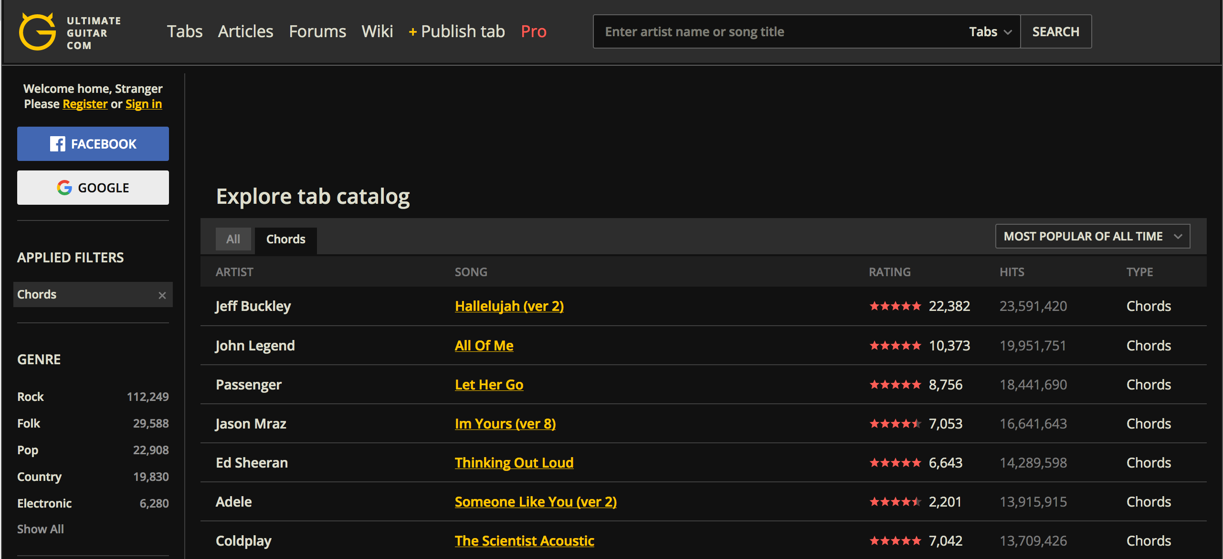
Ultimate Guitar

Slide 7
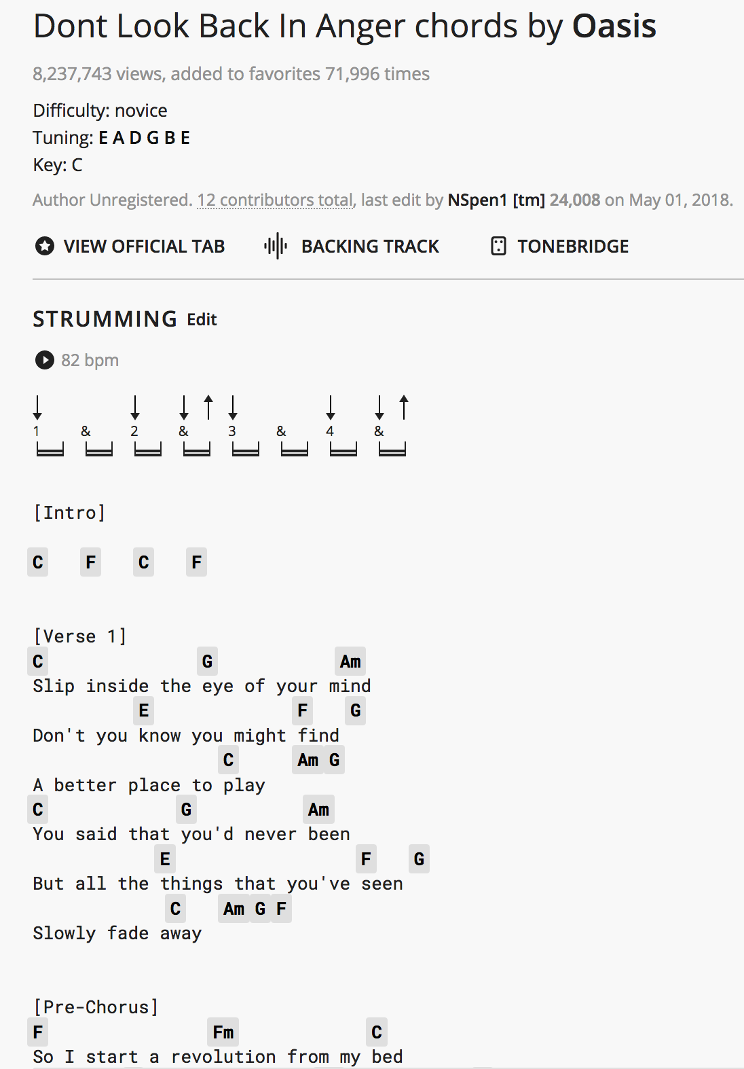
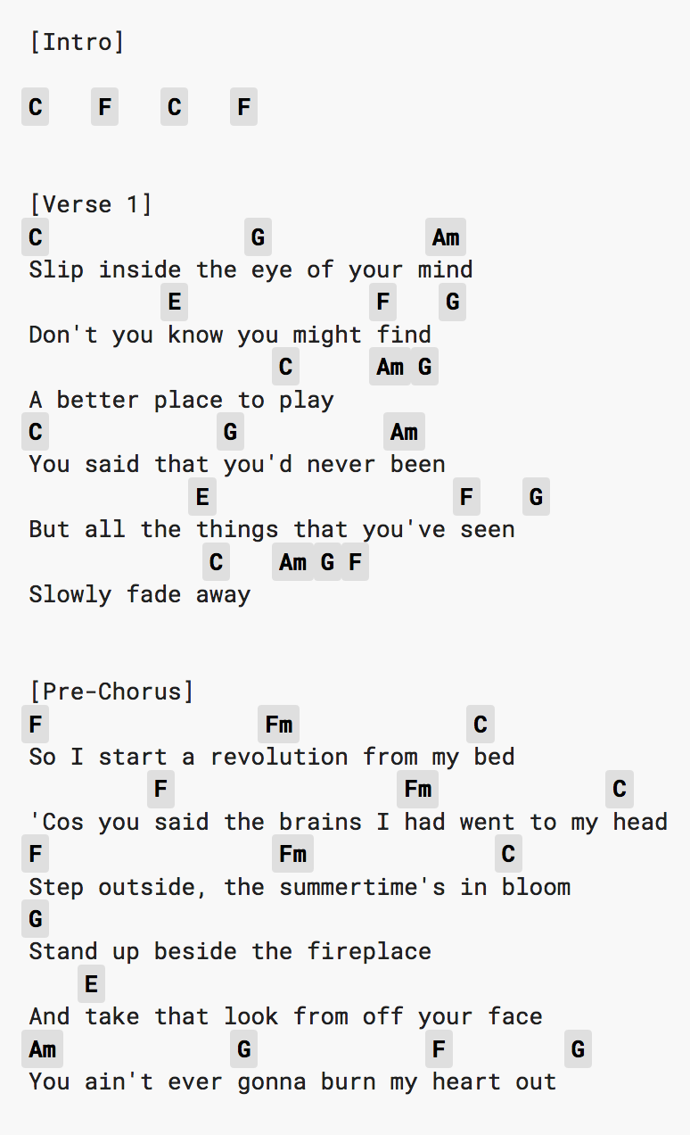
Ultimate Guitar

Slide 8
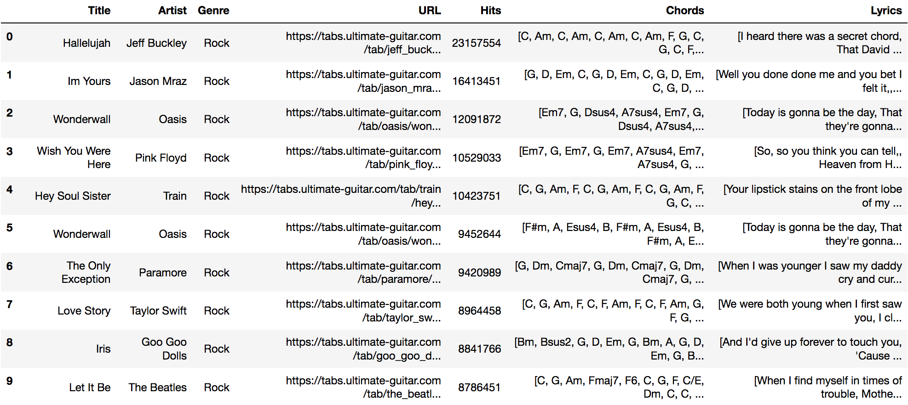
The dataset
Total size : 13 genre X top 400 = 5200 songs

Slide 9
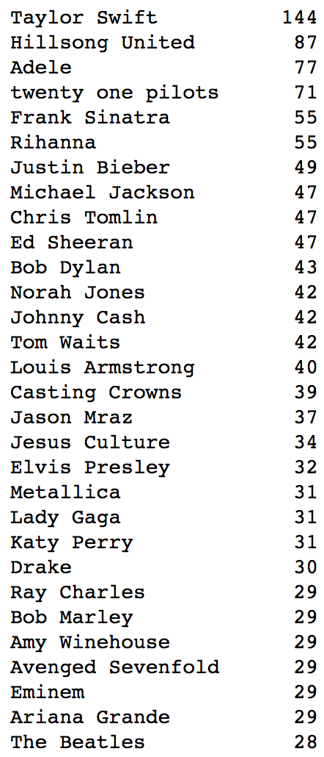
Artists repartition
Total = 914 artists

Slide 10
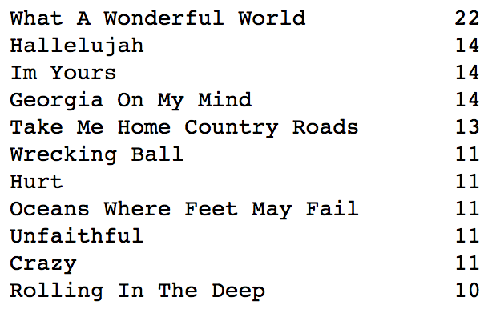
Songs repartition
Total = 2969 songs

Slide 11
II. Pre-processing
How we extracted the necessary features
for our complexity analysis

Slide 12
Lyrics tokenization
All lowercase
Remove punctuation and special characters
Remove stopwords (articles, pronouns, conjunctions...)
Avoid stemming to keep vocabulary diversity

Slide 13
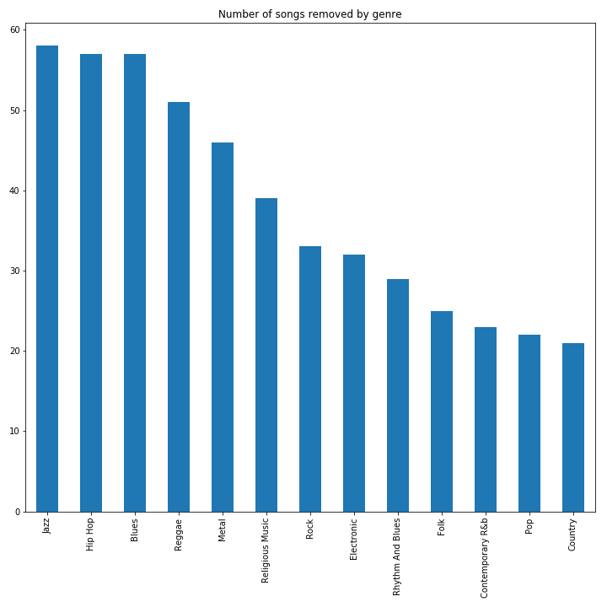
Data pruning
Remove songs with :
Lyrics with less than 40 tokenized words (487)
Chord sequences with less than 4 chords (22)
Total = 493 songs

Slide 14
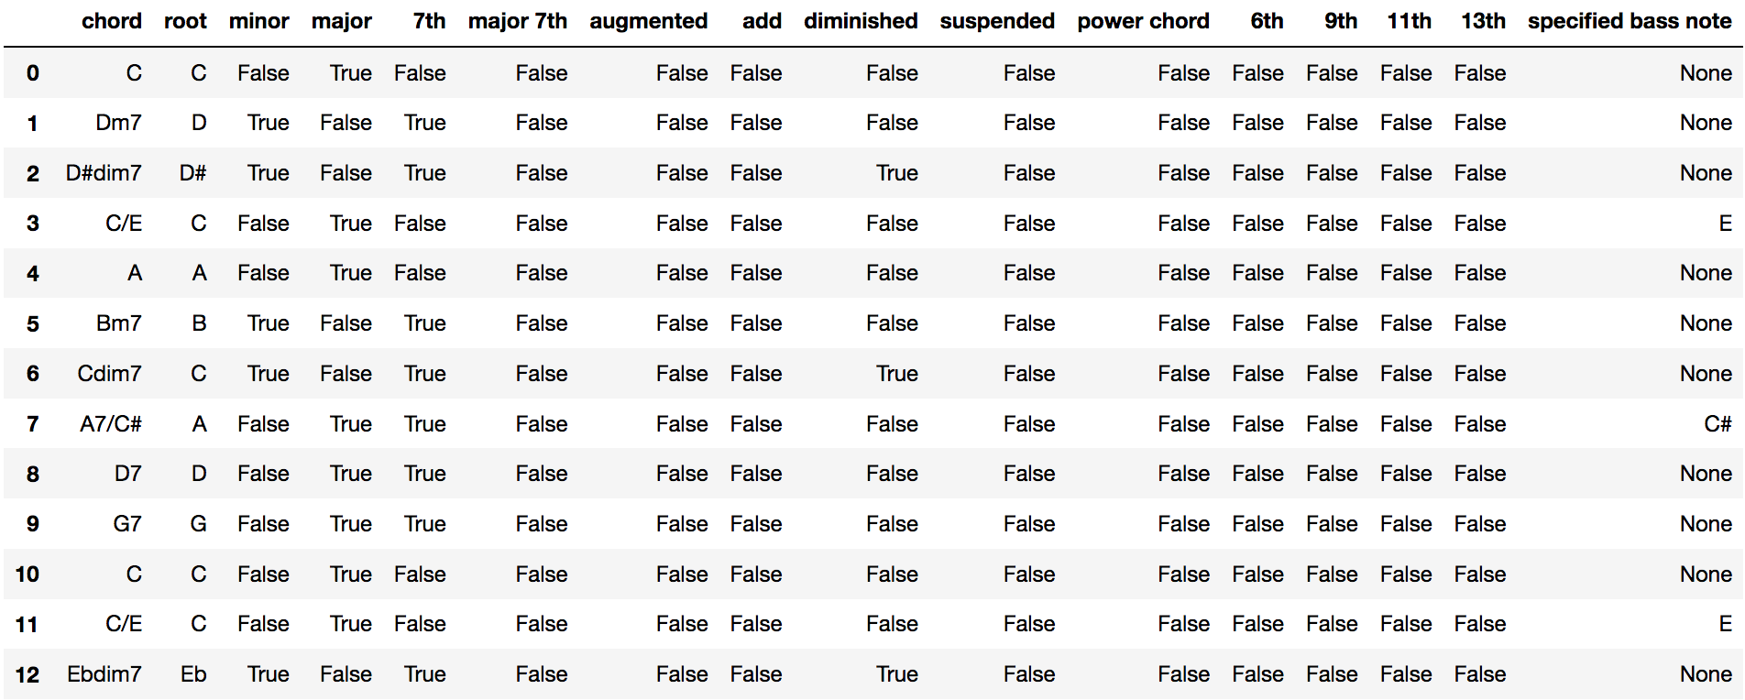
Chords sequence
Don’t Get Around Much Anymore, Duke Ellington, 1940 :

Slide 15
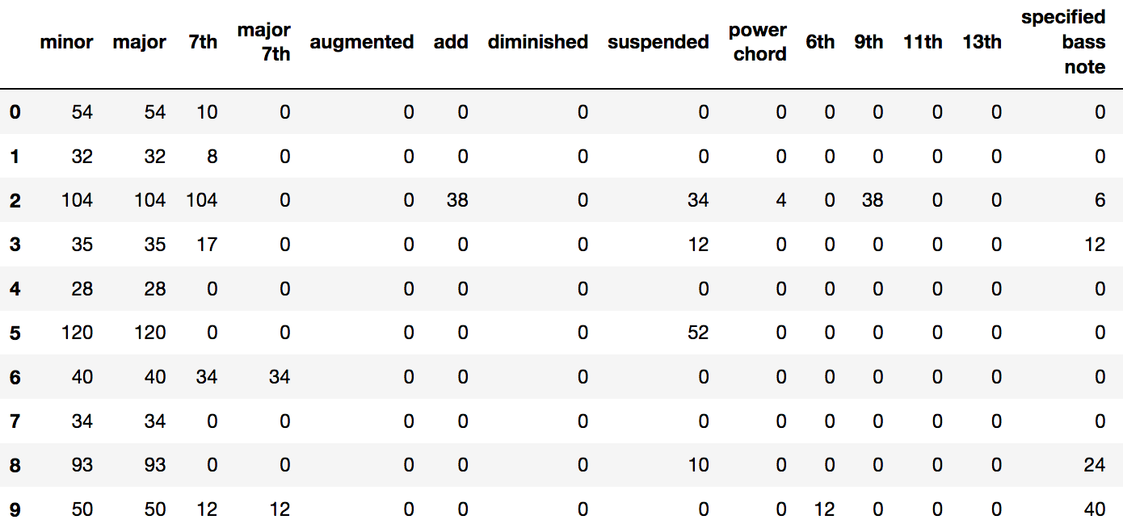
Transitions data

Slide 16
Transitions features
Dimension (number of non-zero columns, i.e. number of different chord qualities present in the song)
Number of variations (sum of all those columns)
Number of distinct chords
Total number of chords

Slide 17
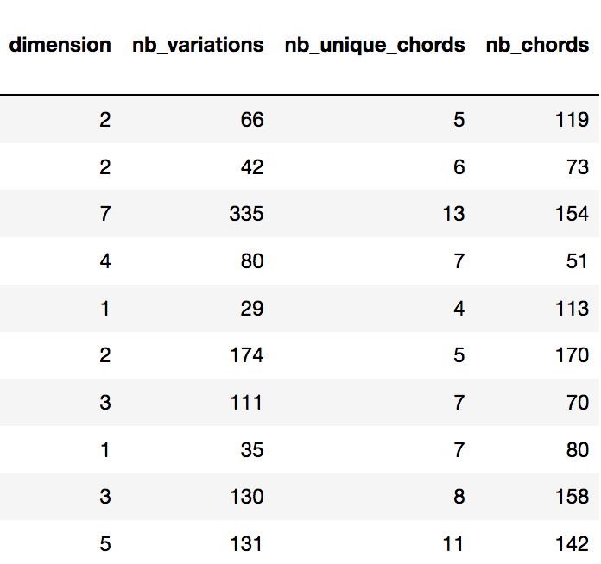
Transitions data

Slide 18
Bi-grams
Chords sequences Interval bigrams
[ C, G, F, C ] [ (C,G), (G,F), (F,C) ]
TOP 10:
(C,G)
(G,D)
(G,C)
(F,C)
(D,G)
(G,Am)
(Am,F)
(Em,C)
(D,A)
(D,Em)

Slide 19
Bi-grams

Slide 20
Bi-grams

Slide 21
III. Lexical Complexity

Slide 22
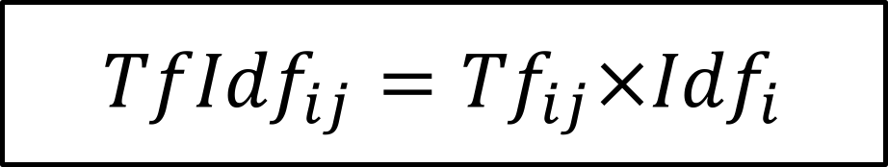
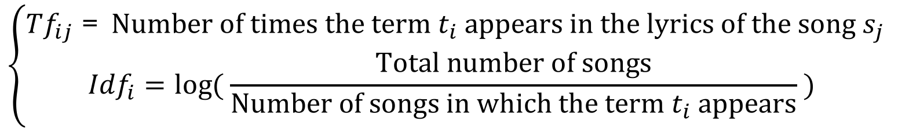
TF-IDF
$${TfIdf}_{ij}={Tf}_{ij}×{Idf}_{i}$$
$$\left\{\begin{aligned}{Tf}_{ij}\text{ =} \text{Number} \text{of} \text{times} \text{the} \text{term} t_{i} \text{appears} \text{in} \text{the} \text{lyrics} \text{of} \text{the} \text{song} s_{j} \\ {Idf}_{i}=log⁡( \frac{\text{Total} \text{number} \text{of} \text{songs}}{\text{Number} \text{of} \text{songs} \text{in} \text{which} \text{the} \text{term} t_{i} \text{appears}} ) \end{aligned}\right.$$

Slide 23
Lexical complexity distribution

Slide 24
Lexical complexity by genre

Slide 25
Readability Scores
Flesch-Kincaid
Coleman-Liau
Dale-Chall
SMOG
Automated Readability Index

Slide 26
IV. Harmonic Complexity

Slide 27
Difficulties
970 different chords
Unconsistent notations
No key information
Notes:
Towards a Harmonic Complexity of Musical Pieces

Slide 28
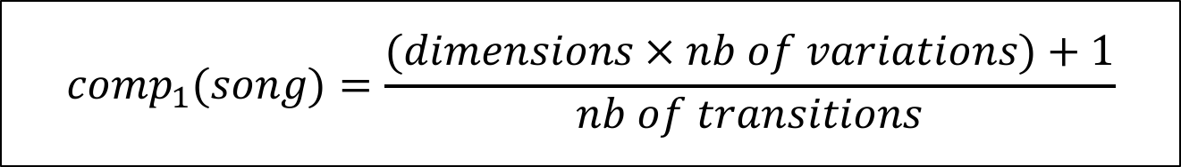
Complexity factor 1
$${comp}_{1}(song)=\frac{(dimensions × nb of variations)+1}{nb of transitions}$$
Notes:
The dimension feature counts the number of different qualities in the song, which allows us to weight the total number of "quality transitions". Major and minor only count as one column, as they are complementary (and not really complex), but more complex qualities like augmentation or addition count double because they are usually followed by a 6th or a 9th or any other additional tone, hence counting twice in our column representation.

Slide 29
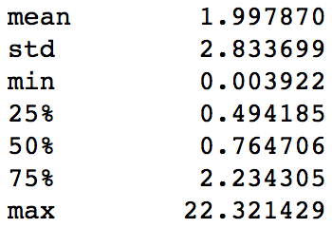
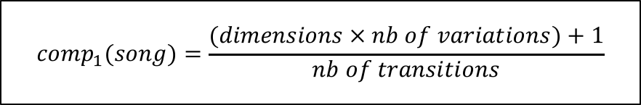
Results for the first metric
$${comp}_{1}(song)=\frac{(dimensions × nb of variations)+1}{nb of transitions}$$

Slide 30
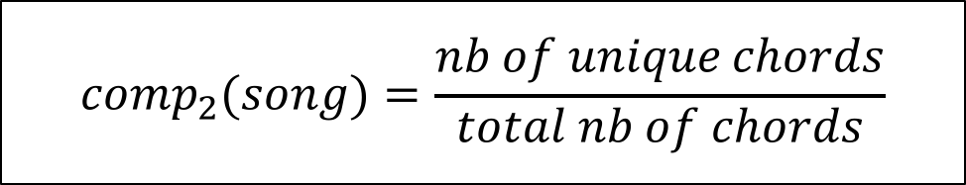
Complexity factor 2
$${comp}_{2}(song)=\frac{nb of unique chords}{total nb of chords}$$

Slide 31
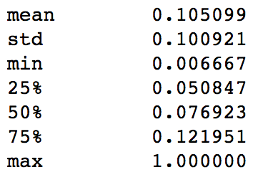
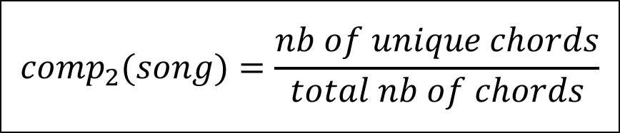
Results for the second metric
$${comp}_{2}(song)=\frac{nb of unique chords}{total nb of chords}$$

Slide 32
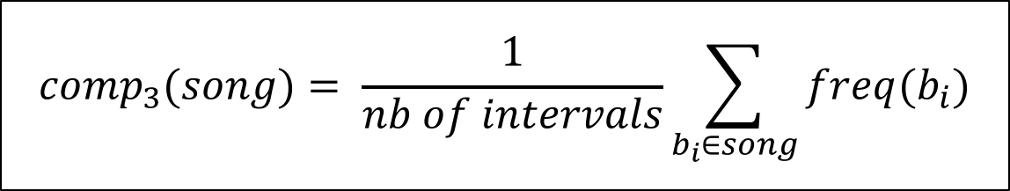
Complexity factor 3
$${comp}_{3}(song)= \frac{1}{nb of intervals}\sum_{b_{i}∈song}{freq(b_{i})}$$

Slide 33
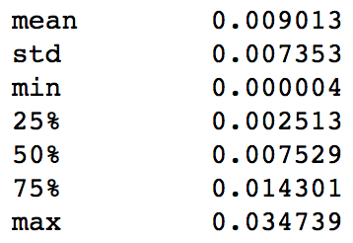
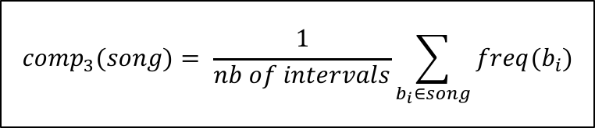
Results for the third metric
$${comp}_{3}(song)= \frac{1}{nb of intervals}\sum_{b_{i}∈song}{freq(b_{i})}$$

Slide 34
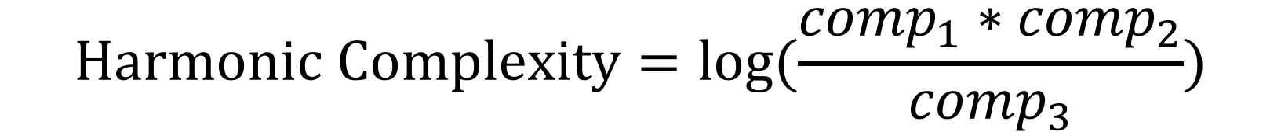
Harmonic Complexity
$$\text{Harmonic} \text{Complexity}=\log{(\frac{{comp}_{1}∗{comp}_{2}}{{comp}_{3}})}$$

Slide 35
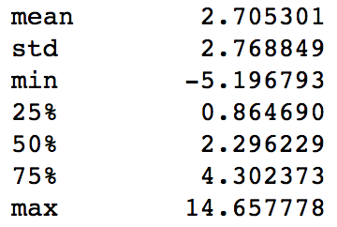

Harmonic complexity distribution
$$\text{Harmonic} \text{Complexity}=\log{(\frac{{comp}_{1}∗{comp}_{2}}{{comp}_{3}})}$$

Slide 36
Harmonic complexity by genre

Slide 37
V. Results and analysis

Slide 38
Baseline

Slide 39
Baseline
33680 unique words
970 distinct chords

Slide 40
Scatterplot

Slide 41
Scatterplot by genre

Slide 42
Scatterplot by genre (zoomed)

Slide 43
Conclusion

Slide 44
VI. Further work

Slide 45
Rhyme patterns and complexity
“Now this looks like a job for me
So everybody, just follow me!
‘Cause we need a little controversy
‘Cause it feels so empty without me
I said this looks like a job for me
So everybody, just follow me!
‘Cause we need a little controversy
‘Cause it feels so empty without me”
Eminem – Without Me
“Yo! His palms are sweaty, knees weak, arms are heavy
There's vomit on his sweater already: Mom's spaghetti
He's nervous, but on the surface he looks calm and ready
To drop bombs, but he keeps on forgetting
What he wrote down, the whole crowd goes so loud
He opens his mouth, but the words won't come out
He's choking, how? Everybody's joking now
The clock's run out, time's up, over—blaow!”
Eminem – Lose Yourself

Slide 46
Other possible leads
Improve harmonic complexity with more features and weights for coefficients
Larger less-specific dataset
Theoritical complexity ≠ performing difficulty

Slide 47
Thank you for your attention. Any questions ?

