Slide 1

Drasil Geometric Algebra Extension
Christopher Schankula
CAS-741
April 1st, 2025

Slide 2
Recap
Drasil is a platform to capture knowledge and create artifacts from this knowledge.
Project goal: Add better support for vectors and matrices to Drasil
Including: checking validity of operations (e.g. sizes of vectors when adding, sizes of matrices when multiplying)
Original idea: use tensors to represent vectors and matrices
Switched to geometric algebra as we learned more about it

Slide 3
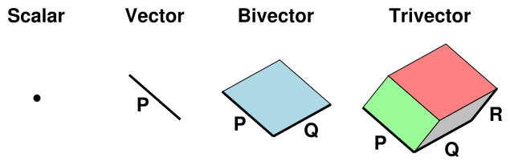
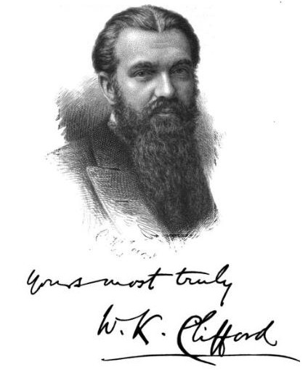
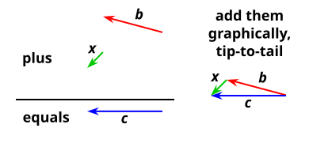
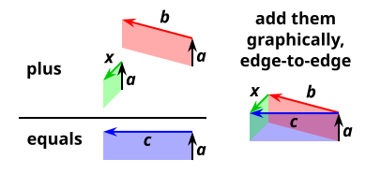
Recap: Geometric Algebra
[2]
William Kingdon Clifford (1845-1879)
Right-side graphics from [1]

Slide 4
Geometric Algebra Cont’d
object |  | visualized as |  | geometric extent |  | grade
scalar |  | point |  | no geometric extent |  | 0
vector |  | line segment |  | extent in 1 direction |  | 1
bivector |  | patch of surface |  | extent in 2 directions |  | 2
trivector |  | piece of space |  | extent in 3 directions |  | 3
etc.
[1]

Slide 5
Why Geometric Algebra?
Real numbers embedded: grade 0 clifs are just real numbers (not super interesting by itself)
Vectors embedded: grade 1 clifs are just vectors of real numbers (same)
Complex numbers can be represented as a subalgebra using scalars and bivectors in two dimensions. → More interesting! Allow us to describe 2D rotations.
Quaternions as well: subalgebra containing scalars and bivectors in three dimensions. → Even more interesting! Allows describing 3D rotations.
Operations do not care about their basis
[1]

Slide 6
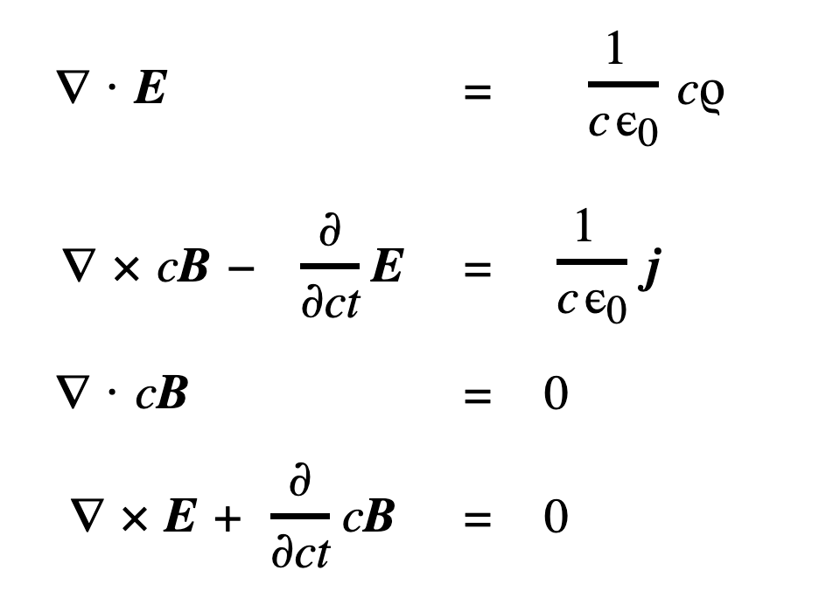
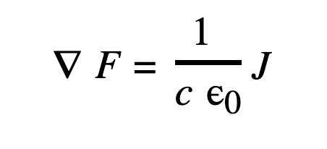
“Help stamp out cross products!”
Geometric algebra defines the wedge product, a generalization of cross product.
Any calculation involving cross products can be generalized / simplified using a wedge product.
Example: Maxwell’s equations
[1]

Slide 7
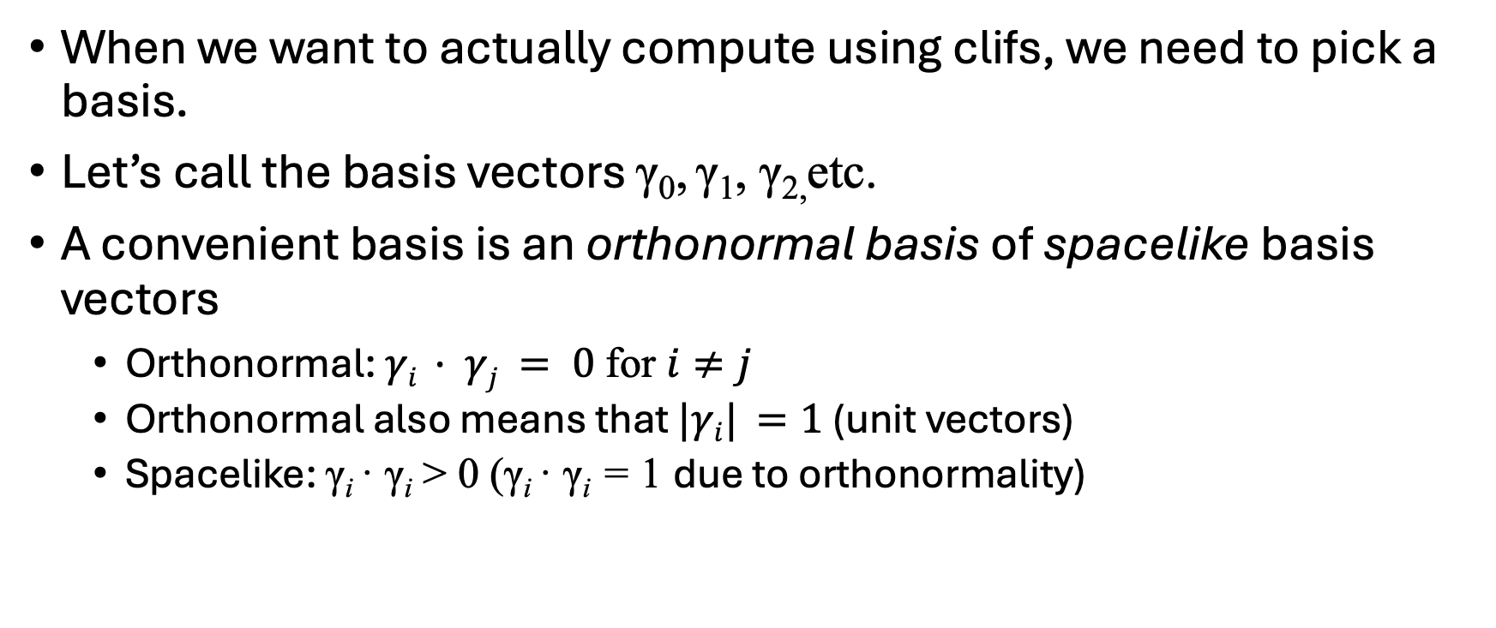
Representing Clifs Component-Wise
When we want to actually compute using clifs, we need to pick a basis.
Let’s call the basis vectors γ₀, γ₁, γ_{2,}etc.
A convenient basis is an orthonormal basis of spacelike basis vectors
Orthonormal: $γi · γj = 0$for $i≠j$
Orthonormal also means that $|γi| =1$(unit vectors)
Spacelike: γ_{i} · γ_{i} > 0 (γ_{i} · γ_{i} = 1 due to orthonormality)
[1]

Slide 8
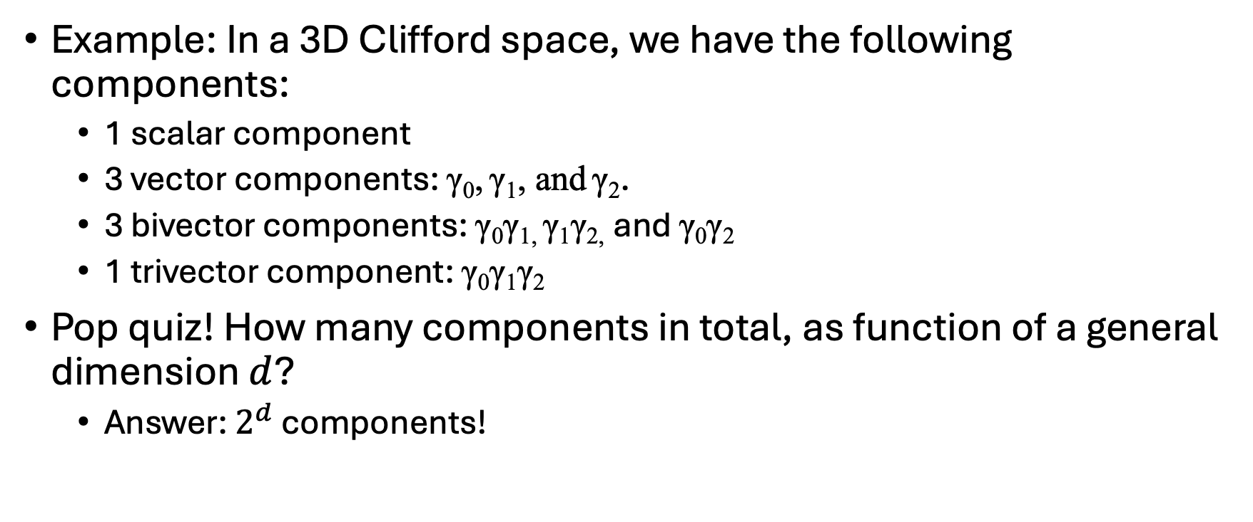
Representing Clifs Cont’d
Example: In a 3D Clifford space, we have the following components:
1 scalar component
3 vector components: γ₀, γ₁, and γ₂.
3 bivector components: γ₀γ_{1,} γ₁γ_{2,} and γ₀γ₂
1 trivector component: γ₀γ₁γ₂
Pop quiz! How many components in total, as function of a general dimension $d$?
Answer: $2^{d}$ components!
[1]

Slide 9
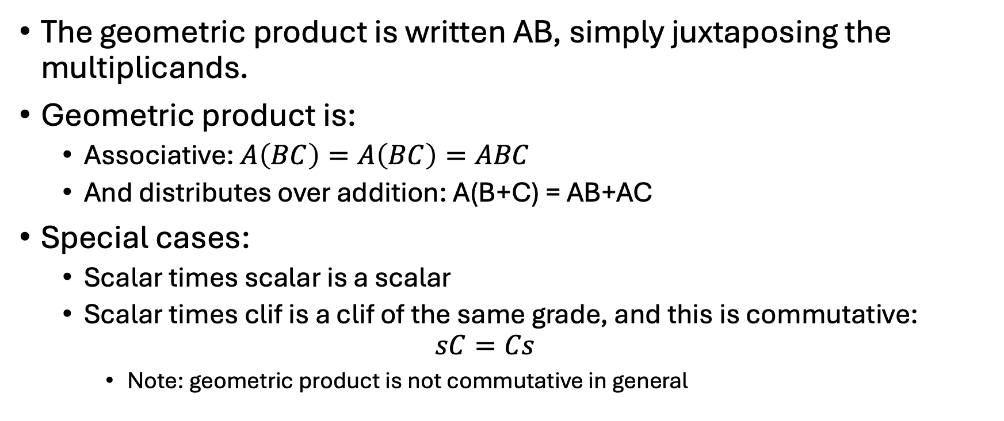
Geometric Product
The geometric product is written AB, simply juxtaposing the multiplicands.
Geometric product is:
Associative: $A\left(BC\right)=A\left(BC\right)=ABC$
And distributes over addition: A(B+C) = AB+AC
Special cases:
Scalar times scalar is a scalar
Scalar times clif is a clif of the same grade, and this is commutative: $sC=Cs$
Note: geometric product is not commutative in general
[1]

Slide 10

Computing the Geometric Product
To compute a geometric product, first pick a basis, project into that basis, then multiply out term-by-term and simplify
Simplification rules:
γ_{i} γ_{j} = - γ_{j} γ_{i} for $i≠j$
γ_{i} γ_{i} = 1 (spacelike)
[1]

Slide 11
Computing the Geometric Product
Example: AB where A = γ₁ + 2γ₁γ₂ and B = 3γ₃ + 5γ₁γ₂γ₃
Step 1: (Pairwise mult.)
Step 2: (Rearrange)
Step 3: (Simplify)
 | γ₁ | 2γ₁γ₂
3γ₃ | 3γ₃γ₁ | 6γ₃γ₁γ₂
5γ₁γ₂γ₃ | 5γ₁γ₂γ₃γ₁ | 10γ₁γ₂γ₃γ₁γ₂
 | γ₁ | 2γ₁γ₂
3γ₃ | -3γ₁γ₃ | 6γ₁γ₂γ₃
5γ₁γ₂γ₃ | 5γ₁γ₁γ₂γ₃ | -10γ₁γ₁γ₂γ₂γ₃
 | γ₁ | 2γ₁γ₂
3γ₃ | -3γ₁γ₃ | 6γ₁γ₂γ₃
5γ₁γ₂γ₃ | 5γ₂γ₃ | -10γ₃
[1]

Slide 12
Computing the Geometric Product
Therefore, (γ₁ + 2γ₁γ₂)(3γ₃ + 5γ₁γ₂γ₃) = -3γ₁γ₃ + 5γ₂γ₃ + 5γ₂γ₃ + -10γ₃
 | γ₁ | 2γ₁γ₂
3γ₃ | -3γ₁γ₃ | 6γ₁γ₂γ₃
5γ₁γ₂γ₃ | 5γ₂γ₃ | -10γ₃
[1]

Slide 13

Representing Clifs Cont’d
Pop quiz 2: What is the “shape” of these $2^{d}$ components?
Anyone recognize this?
 |  |  |  |  |  |  |  |  |  | d = | Tot.
 |  |  |  | 1s |  |  |  |  |  | 0 | 1
 |  |  | 1s |  | 1v |  |  |  |  | 1 | 2
 |  | 1s |  | 2v |  | 1b |  |  |  | 2 | 4
 | 1s |  | 3v |  | 3b |  | 1t |  |  | 3 | 8
1s |  | 4v |  | 6b |  | 4t |  | 1q |  | 4 | 16

Slide 14
How to represent dimensions
From my original SRS: 4. The system shall allow the specification of vector and matrix operations with fixed or variable sizes at specification time.
To do so, created this data type:
Allows fixed dimensions of any non-negative size, or named dimensions such as “n”
data Dimension where
-- | Fixed dimension
Fixed :: Natural -> Dimension
-- | Variable dimension
VDim :: String -> Dimension

Slide 15
Representing Clifs in Haskell (Old)
First iteration: Clif :: Natural -> S.Dimension -> Expr -> Expr
Had no representation for the space/components
Good for computing with basis-free, but could not be applied to a particular basis (the single Expr argument makes no sense)
Next try: Clif :: S.Dimension -> Maybe [Expr] -> Expr
Removed the grade, represents a clif of any grade in the given dimension
Allows basis-free or particular-basis computations
Problem?

Slide 16

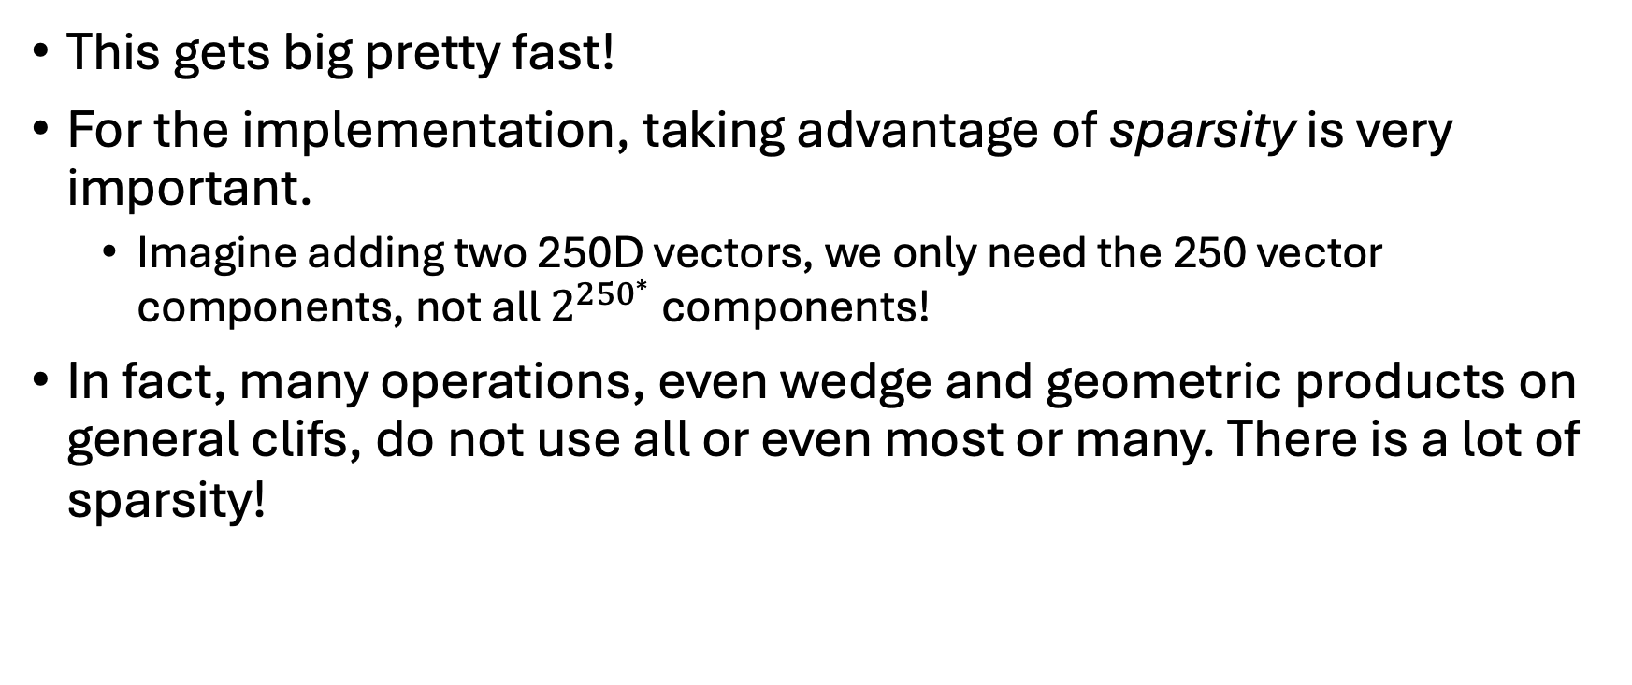
Problem?
This gets big pretty fast!
For the implementation, taking advantage of sparsity is very important.
Imagine adding two 250D vectors, we only need the 250 vector components, not all $2^{{250}^{∗}}$ components!
In fact, many operations, even wedge and geometric products on general clifs, do not use all or even most or many. There is a lot of sparsity!
*$2^{250}=\text{1.8092513943×10⁷⁵}$

Slide 17
Solution
Lindsay et al [3].’s solution: use dictionaries!
Instead of a list of all components, use a dictionary indexed by the component and containing the value, symbol or expression in that component.
Sort components first by grade, then lexicographically, and index them using a binary number:
Component | 1 | γ₀ | γ₁ | γ₂ | γ₀γ₁ | γ₀γ₂ | γ₁γ₂ | γ₀γ₁γ₂
Key | 000 | 001 | 010 | 100 | 011 | 101 | 110 | 111

Slide 18
Solution
In Haskell code: Clif :: S.Dimension -> BasisBlades Expr -> Expr type BasisBlades e =
Map BasisKey e -- Map is a dict in Haskell data BasisKey =
Y BasisKey
| N BasisKey
| E
Example: γ₁γ₂ is represented as Y (Y (N E))

Slide 19
What about other bases?
As mentioned, all the basis vectors so far have been spacelike, meaning a vector γ_{i} such that γ_{i} · γ_{i} > 0.
There are two other kinds:
Timelike: a vector γ_{i} such that γ_{i} · γ_{i} < 0.
Useful for solving problems in general relativity! [1]
Null, or “lightlike”: a vector γ_{i} such that γ_{i} · γ_{i} = 0
Also useful in special relativity [4]
Future work includes allowing you to change the types of basis vectors to create a more generalized Clifford space

Slide 20
Conclusion
Have a representation of Clifford algebra in Drasil!
Currently supports spacelike vectors of any dimension
Must take advantage of sparsity to make the generalization worth it
Still no idea how to represent matrices!
Documentation (LaTeX) generation of vectors works

Slide 21
Next Steps
Short-term: Getcode generation working, generated code should take advantage of sparsity too
Short/medium-term: Create an program to compute the trajectory of a projectile in 2D, and use these new components (representing vectors as clifs, using clif addition, etc) to generate documentation and code
Medium-term: Implement more operations on dimensions (e.g. concatenating vector of size m and n should yield a vector of size m+n, currently not possible)
Medium-term: support timelike and lightlike basis vectors
Long-term: create examples with advanced scientific computations (e.g. gyroscopic procession, Maxwell’s equations, special relativity)

Slide 22
References
[1] J. S. Denker, "Clifford Algebra: A Visual Introduction," AV8N, [Online]. Available: https://www.av8n.com/physics/clifford-intro.htm. . [Accessed: Mar. 2025].
[2] Wikimedia Foundation, "William Kingdon Clifford," Wikipedia. [Online]. Available: https://en.wikipedia.org/wiki/William_Kingdon_Clifford. . [Accessed: 01-Apr-2025].
[3] J. M. Lindsay and A. Soreni-Harari, "Beyond the Limits of Propulsion: Exploring Interstellar Spaceflight," arXiv, 2503.10451, Mar. 2025. [Online]. Available: https://arxiv.org/abs/2503.10451.
[4] E. W. Weisstein, "Lightlike," MathWorld, Wolfram Research, Inc., [Online]. Available: https://mathworld.wolfram.com/Lightlike.html. . [Accessed: Mar. 2025].

Slide 23

Thank you! Questions? PR: https://github.com/JacquesCarette/Drasil/pull/4009 Documentation: https://github.com/CSchank/GeometricCodeGen

