Slide 1
Irrigation Control System - ICS
Daniel Cefaratti 001212130 Matthew D’Cruz 001216450 Sophia Tao 400019596 Chris Schankula 400026650

Slide 2

QR Code
Instructions
Install Expo Client from App Store
Scan QR Code from Expo App
Interact with our front-end mock-up

Slide 3
Scope
Program is designed to assist farmers with irrigation
Meant to reduce water waste by taking into account soil moisture and water outflow
Goal is to make irrigation as efficient as possible

Slide 4
ICS Overview
Uses server to node communication to maintain proper water and moisture levels.
Each node uses a separate but equivalent control system to ensure equal treatment across nodes and crops.

Slide 5
Assumptions
The crop is the same throughout the node.
Water is equally distributed within each node.
Nodes are independent from one another.
All water units are millimeters of rain equivalent in each node.
Each node represents a single sprinkler.
All nodes start at midnight.

Slide 6
Control system
System utilizes PID controllers.
Node-by-node PID controllers allow for each crop to be watered equally within its own node.

Slide 7
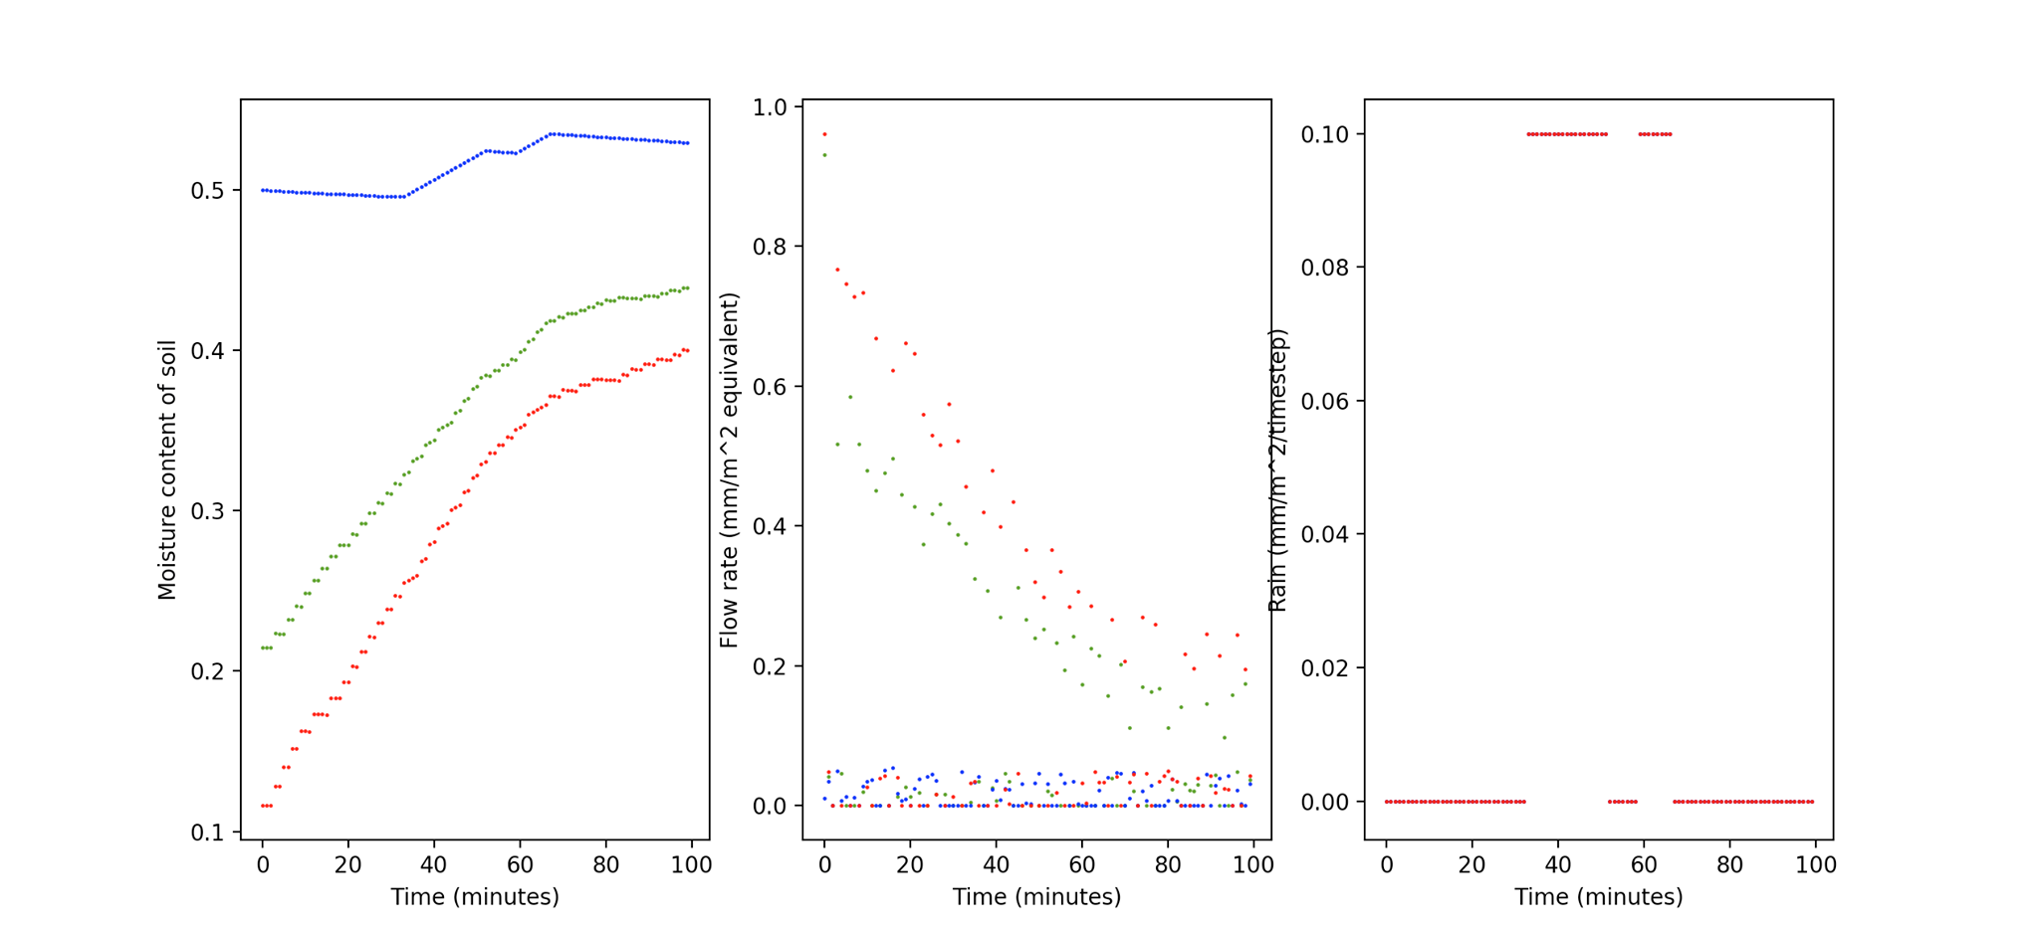

Slide 8
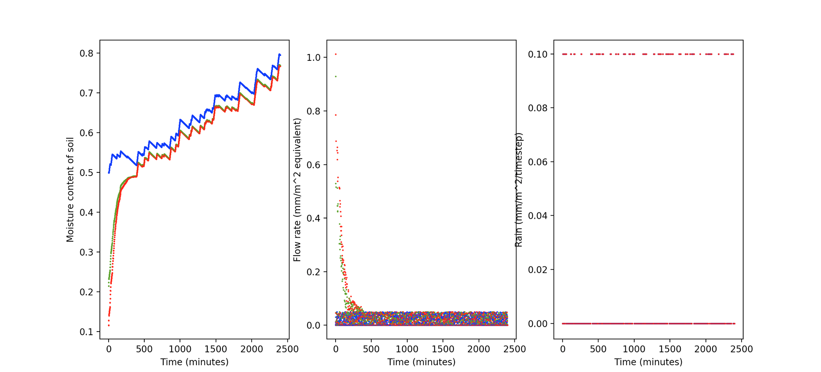

Slide 9
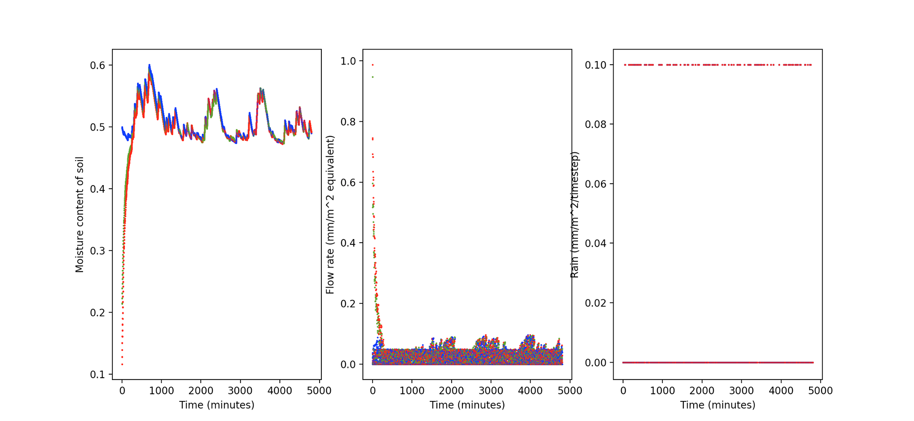

Slide 10
QR Code
Instructions
Install Expo Client from App Store
Scan QR Code from Expo App
Interact with our front-end mock-up

Slide 11
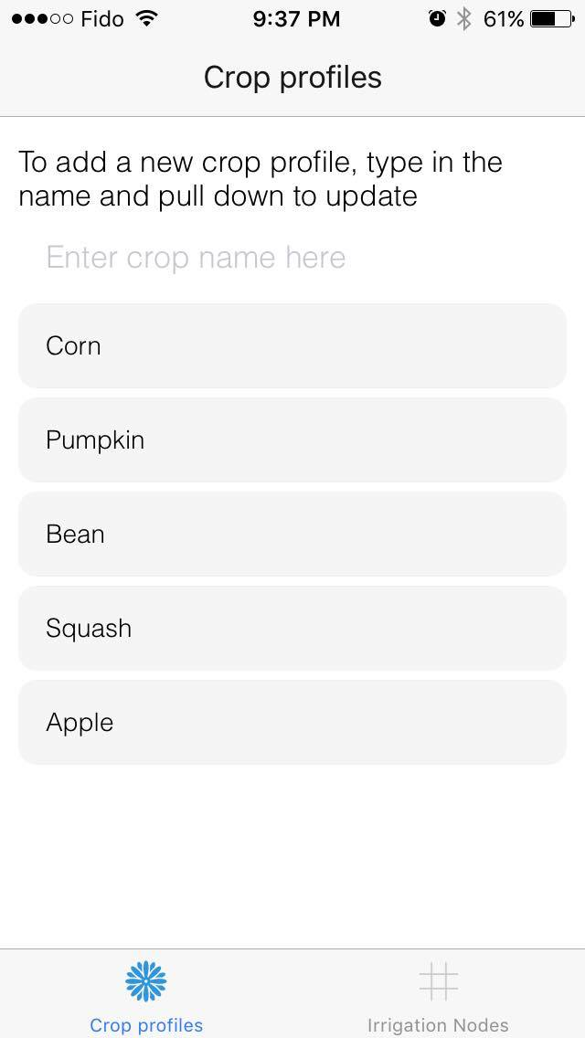
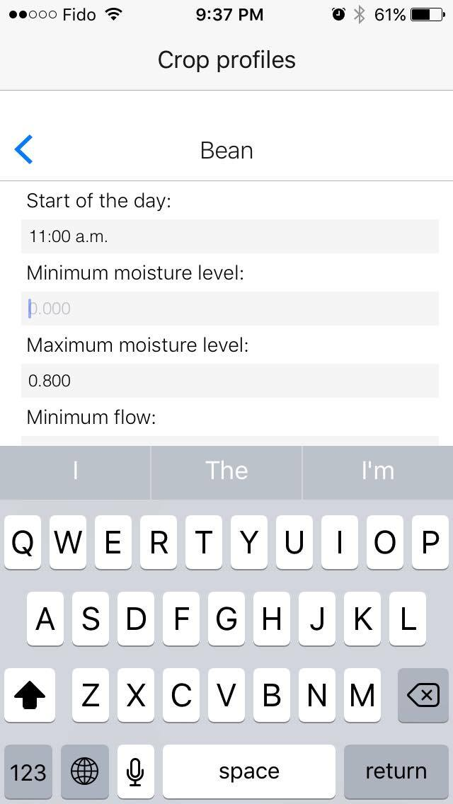
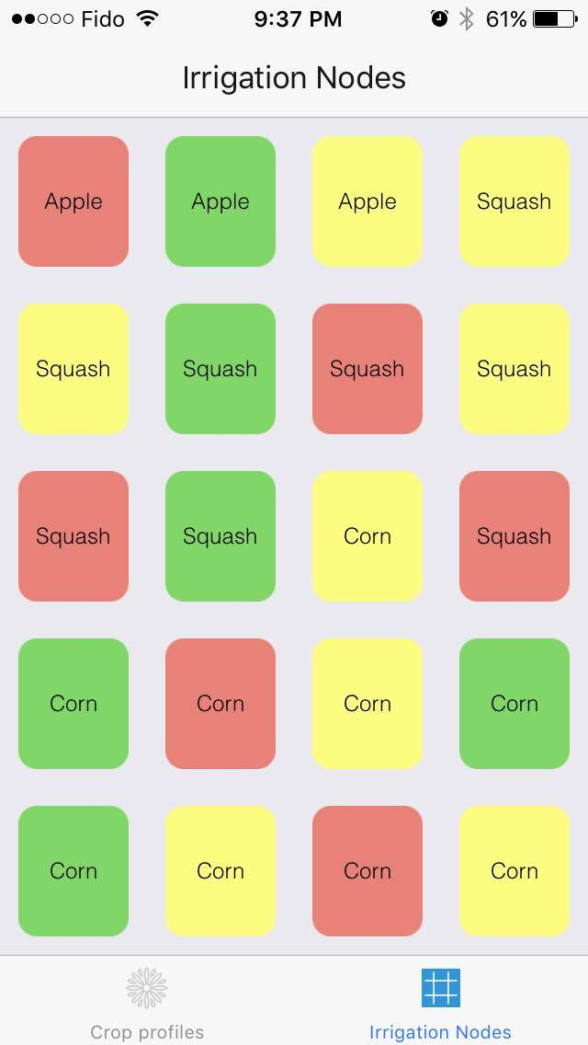

Slide 12
Thank you for your attention!

