Slide 1
National Park Biodiversity
Caitlin Schlagal
Capstone Two
21 April 2021

Slide 2
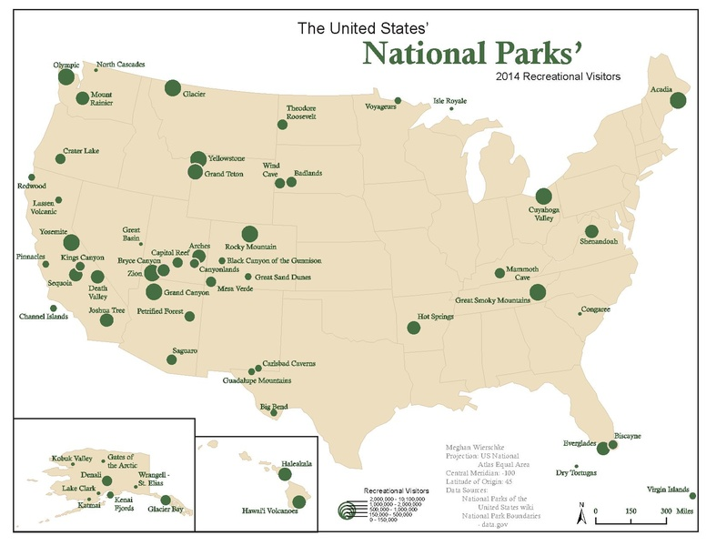
National Parks Background
Created for conservation
62 unique sites
Notes:
National parks in the United States were created for conservation purposes and include 62 unique sites. Out of these spectacular 63 parks, however it may be challenging to narrow down just which to see first. This project aims at investigating and characterizing the different national parks by biological diversity, focusing on mammals, birds, reptiles/amphibians, fish and vascular plants.

Slide 3
Project Proposal
Diversity - “the state of variety; the condition of having or being composed of different elements”
US National Parks Species Database
Project Aim: investigate and characterize the national parks by biological diversity
Notes:
Diversity is defined as, “the state of variety; the condition of having or being composed of different elements”. By identifying the national park with most diverse ecosystem, this information can be used to determine the best park to see larger mammals, or perhaps you are a budding birder, or a fan of fauna? Additionally, this database contains entries of animals and plants that were once located in the park but are gone now (historic), whether this be due to migration or perhaps extinction. Therefore, we will also investigate species that are currently endangered or threatened and could impact future sightings at the park.

Slide 4
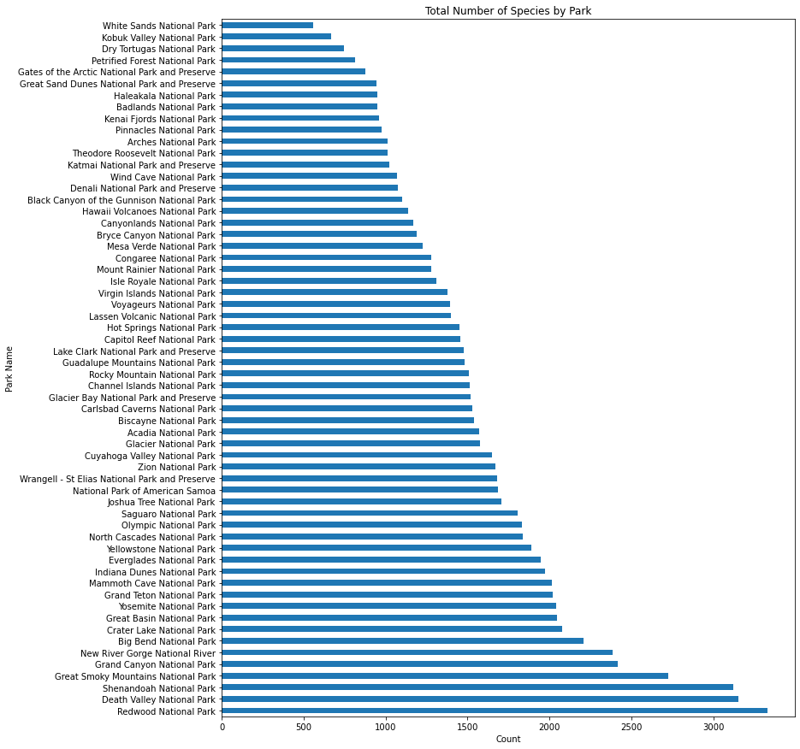
Total Species Count by Park

Slide 5
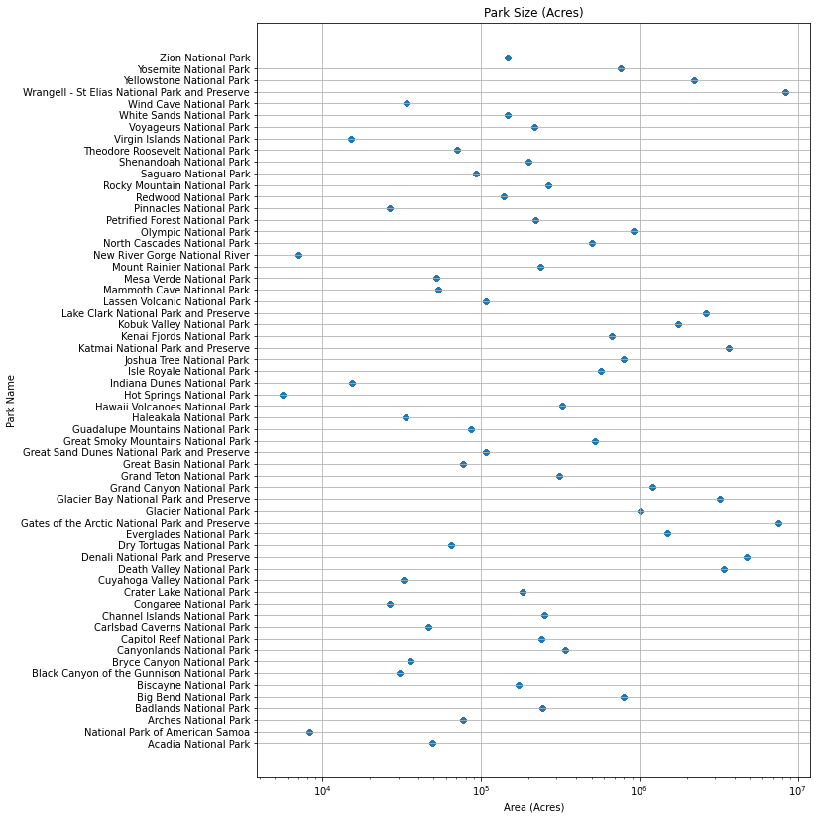
Park Size in Acres

Slide 6
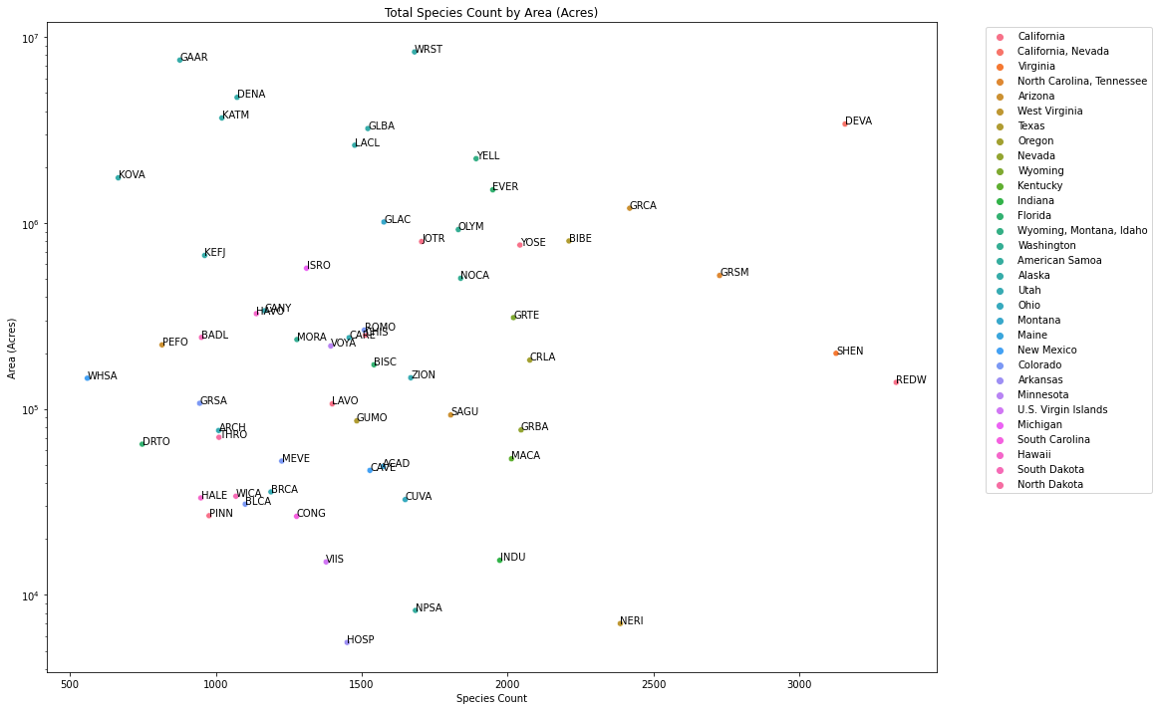
Correlation between Area and Species Count

Slide 7
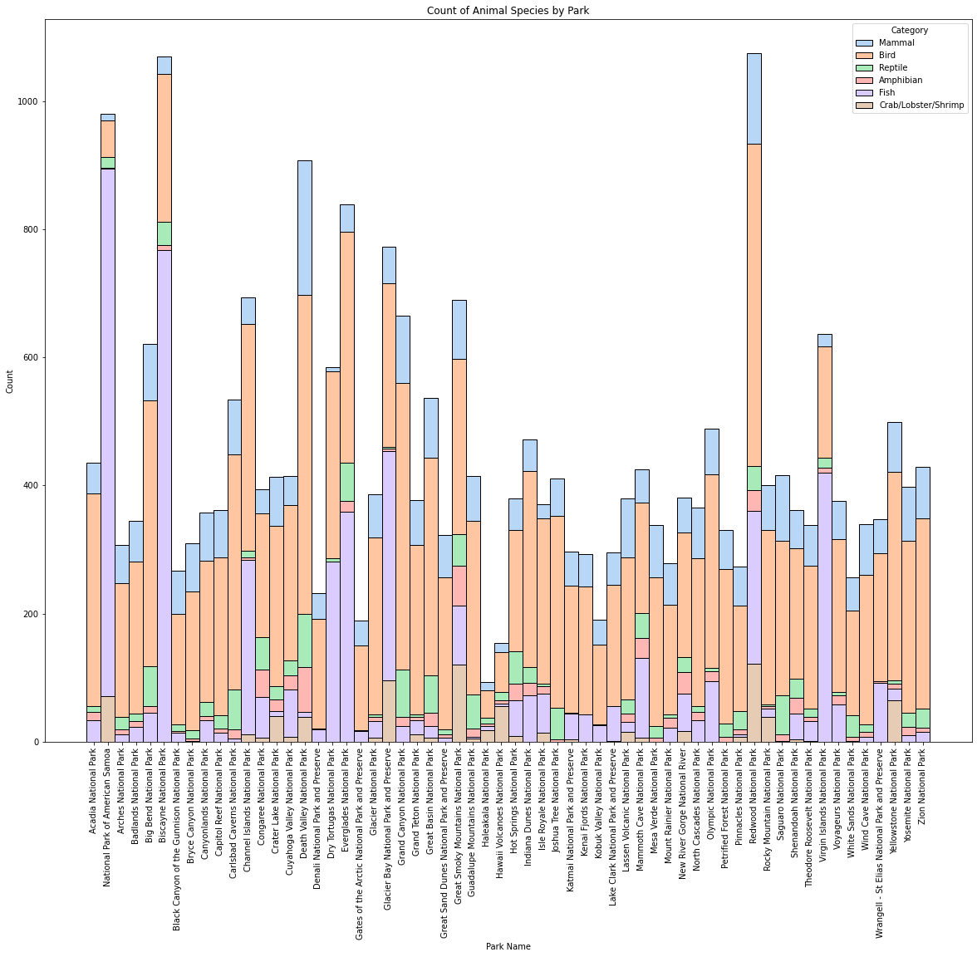
Distribution by Species Category

Slide 8
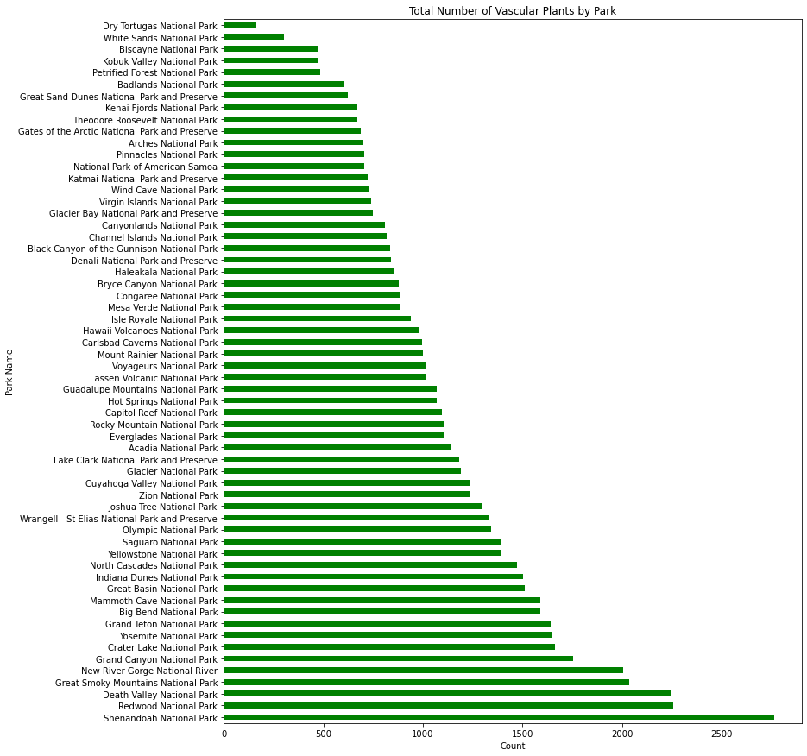
Vascular Plants

Slide 9
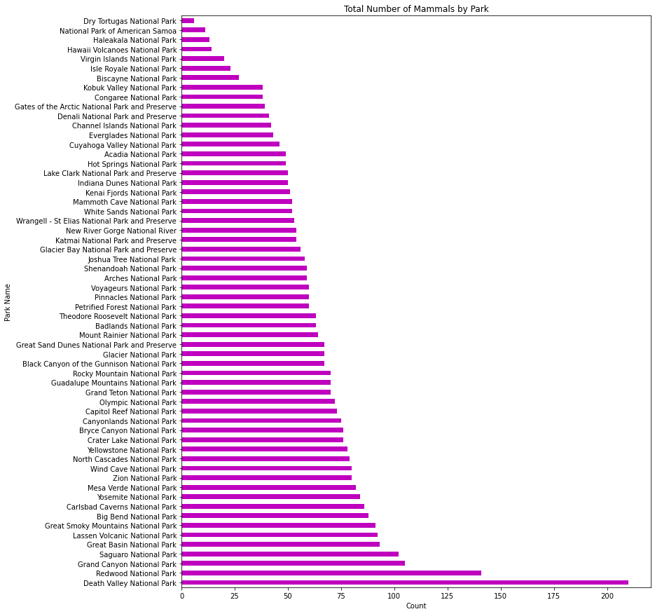
Mammals

Slide 10
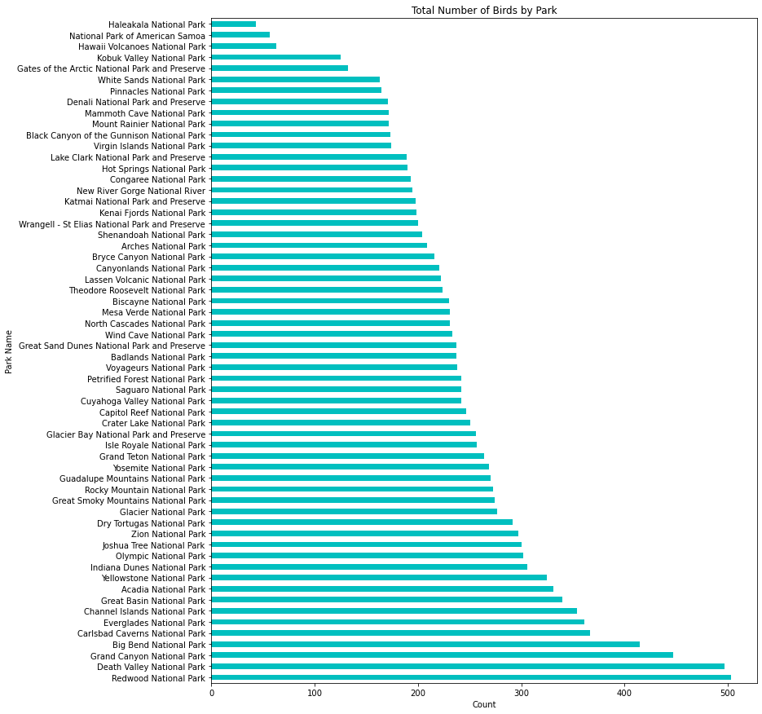
Birds

Slide 11
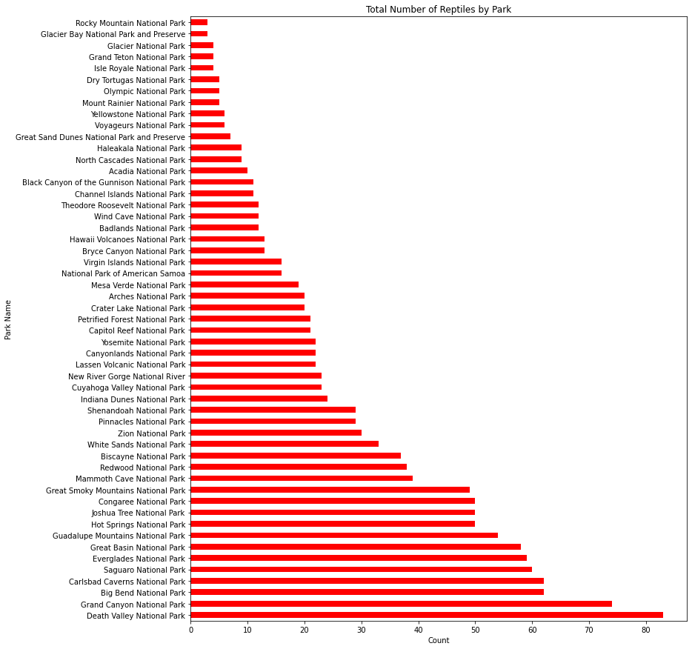
Reptiles

Slide 12
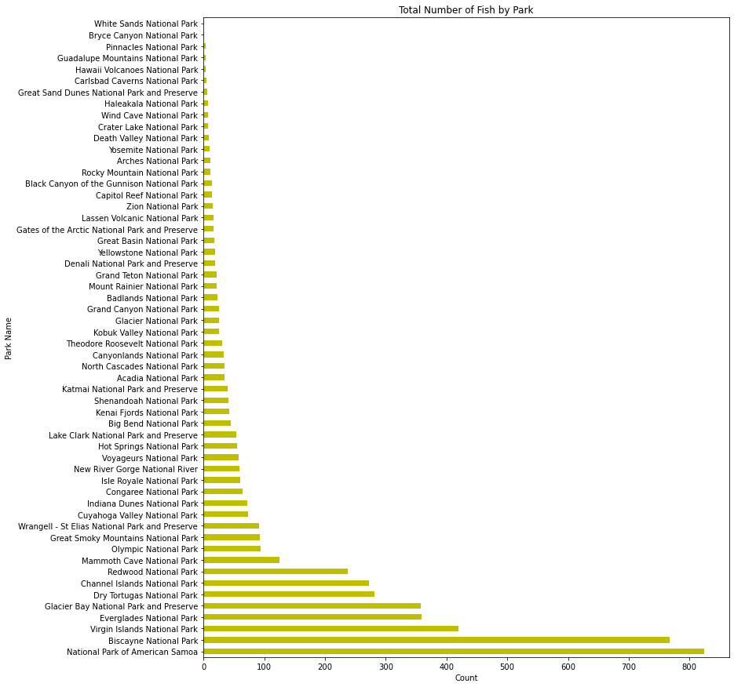
Aquatic Species

Slide 13
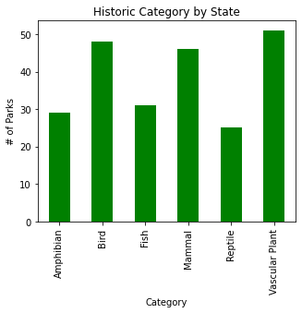
Total Number of Historic Species Over All Parks

Slide 14
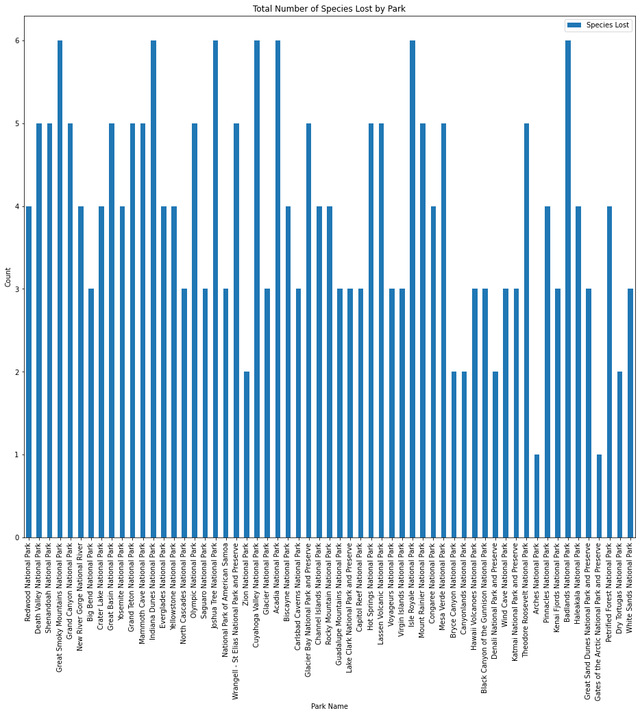
Species Lost by Park

Slide 15
Conclusions
California national parks had some of the highest diversity based on total number of animals and species density
Redwood and Death Valley National Parks had the greatest number of animal species overall
Shenandoah Nation Park had the greatest plant diversity
National Park of American Samoa had the greatest diversity in aquatic species

