Slide 1
Michael Backes
IBM Research GmbH, Rüschlikon, Switzerland
joint work with Birgit Pfitzmann and Michael Waidner
Justifying a Dolev-Yao Model under Active Attacks, and Limitations Thereof
ARSPA Workshop
07/16/05
Notes:
1

Slide 2


Building Systems on Open Networks
E-Government
Bank
Hospital

Slide 3
Cryptography: The Details
Crypto-Toolbox
Fact(p*q)
DL(g^{x})
Encryption
Hashfunction
Prob[
Attack
] ≤ …
Signature
Key establishment

Slide 4

Cryptography: The Details
Crypto-Toolbox
Encryption
Hashfunction
Signature
Key establishment
Proof

Slide 5
Formal Methods: The Big Picture
But can we justify
?
Idealized Crypto
Signature
Encryption
Hashfunction
Key establishment
Designed by CAD
Verified by CAV

Slide 6
Overview of our Approach (since 2000)
Precise system model allowing cryptographic and abstract operations
Reactive simulatability (“≥”) with composition theorem
Preservation theorems for security properties
  In particular integrity, liveness, non-interference, recently (strong) secrecy
Concrete pairs of idealizations and secure realizations
  In particular: Dolev-Yao style cryptographic library
Sound security proofs of NSL, Otway-Rees, iKP, etc.
Mainly Today:
  The Dolev-Yao style cryptographic library
  Limitations of Soundness: XOR and (partly) hashing

Slide 7
PART 1
Justifying a Dolev-Yao Model under Active Attacks
Notes:
1

Slide 8
Sound Abstract Protocol Proofs
The Big Picture
Formalize with given interface
Prove for NLS
Ideal DY-style library
NLS-PK protocol
Entity authentication
Abstract primitives
uses
Abstract protocol
fulfils
Abstract goals
replace primitives
Comp/ theorem
General defs
BPW03
BP04, ..
“≥”
“≥”
Concrete primitives
uses
Concrete protocol
fulfils
Concrete goals
Clear
Pres/ theorem
Real DY-style library
Notes:
4

Slide 9
Automating Security Protocol Proofs
Even simple protocol classes & properties undecidable
  Robust protocol design helps
Full arithmetic is out
Probability theory just developing
So how do current tools handle cryptography?

Slide 10
Dolev-Yao Model
Idea [DY81]
  Abstraction as term algebras, e.g., D_{x}(E_{x}(E_{x}(m)))
  Cancelation Rules, e.g., D_{x}E_{x} = ε
Well-developed proof theories
  Abstract data types
  Equational 1st-order logic
Important for security proofs
  Inequalities! (Everything that cannot be derived.)
  Known as “initial model”
Important goal: Justify or replace

Slide 11
Dolev-Yao Model – Variants [Ours]
Operators and equations
  sym enc, pub enc, nonce, payload, pairing, sigs, MACs, ...
  Inequalities assumed across operators!
Untyped or typed
Destructors explicit or implicit
Abstraction from probabilism
  Finite selection, counting, …
Surrounding protocol language
  Special-purpose, CSP, pi-calculus, ... [any]
sign
pk’
E
pk
( , )
N
m

Slide 12
Cryptography
Notes:
1

Slide 13
Example: Encryption, passive
∀A₁, A₂ ∈ PPT:
P(b* = b :: (Attacker success)
(sk, pk) ← gen(k); (Keys)
(m₀, m₁, v) ← A₁(k , pk); (Message choice)
b ∈_{R} {0, 1};
c := enc(pk, m_{b}); (Encrypt)
b* ← A₂(v, c) ) (Guess)
≤ 1/2 + 1/poly(k) (Negligible)

Slide 14
Reactive Simulatability
(“as secure as”)
Notes:
1

Slide 15
Reactive Simulatability
  ∀
H
  ∀
H
  ∃
A
A’
≥
M₁
M₂
TH
Real system
Ideal system
Idea: Whatever happens with real system could also happen with ideal system.
view_{real}(H) ≈ view_{ideal}(H)
Indistinguishability of random variables

Slide 16
Reactive Simulatability: Blackbox Case
  ∀
H
  ∀
H
  ∃
A
≥
Sim
A
M₁
M₂
TH
Real system
Ideal system
Idea: Whatever happens with real system could also happen with ideal system.
view_{real}(H) ≈ view_{ideal}(H)
Indistinguishability of random variables

Slide 17
Ideal Dolev-Yao Style Library
Notes:
1

Slide 18
Dolev-Yao-style Crypto Abstractions
Recall: Term algebra, inequalities
Major tasks:
  Represent ideal and real library in the same way to higher protocols
  Prevent honest users from stupidity with real crypto objects, but don’t restrict adversary
    E.g., sending a bitstring that’s almost a signature
  What imperfections are tolerable / must be allowed?

Slide 19


Ideal Cryptographic Library
U
V
No crypto outputs! Deterministic!
Commands,
payloads,
terms?
Payloads / test results,
terms?
handles
handles
Term 1
Term 2
Term 3
Not globally known
For U:
For V:
For A:
T_{u,1}
-
-
T_{u,2}
T_{v,1}
T_{a,1}
T_{u,3}
-
-
A
E
E
pk
pk
m
pk
m
TH

Slide 20
Ideal Cryptographic Library (2)
U
V
T_{u,4} ← encrypt(T_{u,1}, T_{u,3})
get_type(T_{v,2})
T_{v,3} := decrypt(...)
send(V, T_{u,4})
received(U, T_{v,2})
Term 1
Term 2
Term 3
Term 4
...
For U:
For V:
For A:
T_{u,1}
-
-
T_{u,2}
T_{v,1}
T_{a,1}
T_{u,3}
-
-
E
A
E
E
pk
E
pk
pk
m
pk
m
pk
m
TH

Slide 21
Main Differences to Dolev-Yao
Tolerable imperfections:
  Lengths of encrypted messages cannot be kept secret
  Adversary may include incorrect messages inside encryptions
  Signature schemes can have memory
  Slightly restricted key usage for symmetric encryption
Most imperfections avoidable
for more restricted cases

Slide 22
Real Dolev-Yao Style Library
Notes:
1

Slide 23
Real Cryptographic Library
U
V
No crypto outputs!
Commands,
payloads,
handles
Payloads / test results,
handles
pk
c₁ ← E(pk, m)
c₂ ← E(pk, m)
c₁
A
Bitstrings
Real system

Slide 24
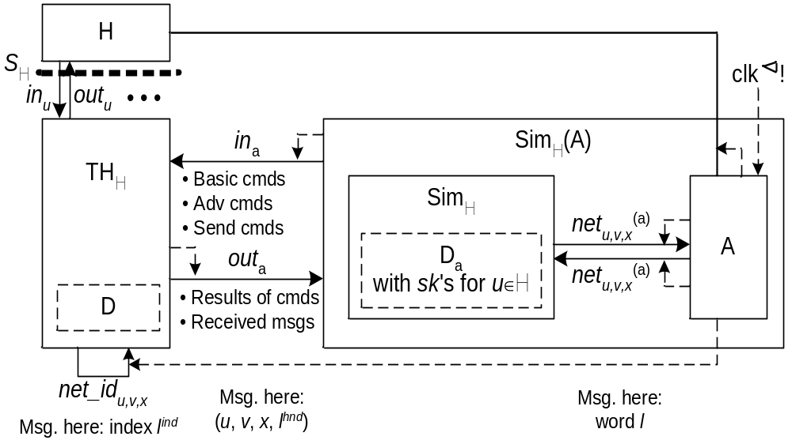
The Simulator (sketch)

Slide 25
PART 2
Impossibility Results: (Un-)soundness of Symbolic XOR and Symbolic Hash functions
Notes:
1

Slide 26
(Un-)Soundness of DY-Hashes and DY-XOR
Extensions of DY have become popular
XOR as the most common extension
    symbolically defined via equational theories
    strong secrecy properties intuitively justified by the hiding property of XOR (one-time pad)
    Abstract XOR not cryptographically correct with wrt. blackbox simulatability!
Soundness of DY Hashes complicated
    Symbolically functions w/o inverse
    Already in crypto often abstracted into random oracles
    Cryptograpic correctness of abstract hashes depends on the desired security properties / the allowed surrounding protocols
XOR
N
E
pk
m
Hash
m
N

Slide 27
Impossibility Results: Symbolic XOR
Symbolic XOR not sound under active attacks with respect to blackbox simulatability:
XORs of sufficiently many nonces span the whole message space
→ simulator cannot meaningfully decompose real messages to mount an equivalent attack on the Dolev-Yao model
“No Dolev-Yao style XOR can be soundly realized wrt blackbox simulatability by any (moderately natural) implementation of XOR”
“Meta-theorem”, hard to prove:
  “Dolev-Yao style” can hardly be captured formally
Solution by reduction proof: refined statement
“If a Dolev-Yao style XOR existed, it signs messages cryptographically or tests the validity of signatures”
Symbolic XOR sound under passive attacks

Slide 28
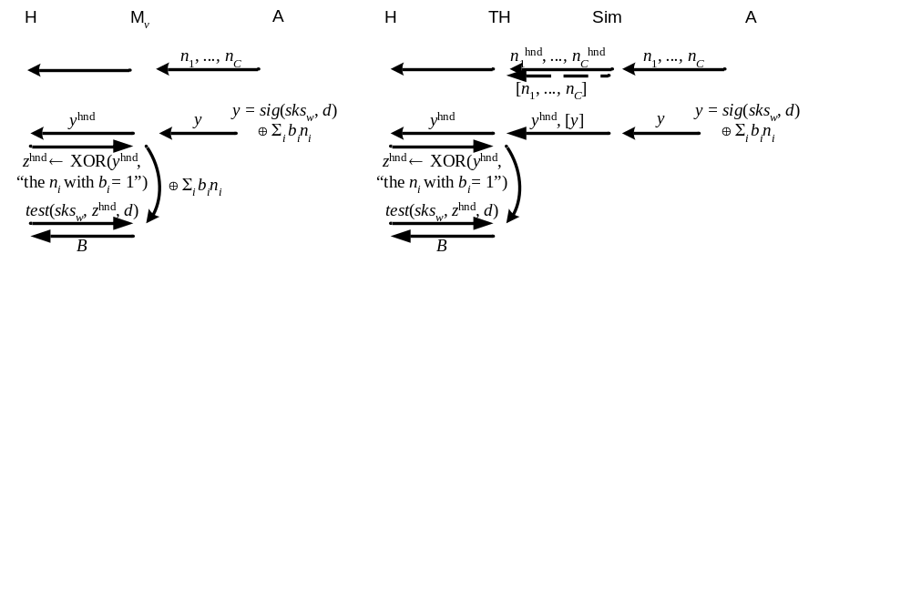
Counterexample (sketch)
√
Correct simulation requires TH to
compute a valid signature on d
(without the help of Sim)

Slide 29
(Un-)Soundness Results: Symbolic Hashes
Soundness of symbolic hashes depends on the generality of their usage in the considered protocol. Simplified results for most common cases:
Arbitrary usage: H(m)
→ Not even sound in the random oracle model
(commitment problem)
Usage with secret randomness: H(m,N)
→ Sound in the random oracle model
(commitment problem for standard model)
Hashing of (specific) payload-free terms: H(N)
→ Sound in the standard model

Slide 30
Summary
Proofs of soundness of a DY model under active attacks
(pubenc+sig 2002/03, MAC+symenc 2003)
Strong preservation theorems for security properties: Integrity, liveness, non-interference;
More recently: Preservation theorems for nonce, key and payload secrecy
but there now also exist limitations:
  XOR not justifiable in general under blackbox simulatability
  Soundness of Hashes depends on the generality of use / the allowed surrounding protocols / the desired security property
Soundness of (classes of) algebraic/equational extension in Dolev-Yao models: An interesting direction for future work?

Slide 31
More Information
mbc@zurich.ibm.com
http://www.zurich.ibm.com/security/models/
Read just one paper? ACM CCS 2003.
Read more? Oakland 2005, Info & Comp 2005, CSFW 2004, IEEE JSAC 2004, ESORICS 2003,

