Slide 1
Design and Analysis of Diffie-Hellman-Based Key Exchange Using One-time ID by SVO Logic
ARSPA’05
Kenji Imamoto, Kouichi Sakurai
Kyushu University, Japan

Slide 2
Outline
Introduction
  Background
  Idea of One-time ID
  Key exchange in three-party model
Preliminaries of SVO Logic
Proposed Protocol
  Propose a three-party key exchange using One-time ID
  Analyze the proposed protocol by SVO Logic
  Propose One-time ID generation method
Conclusion

Slide 3





Main focus of our study is …
Authenticated key exchange protocol
based on pre-shared key
In most previous works,
Leakage of user’s Identity, DoS attack
Denial of Service attack
Pre-shared key model
Shared secret
Shared secret

Slide 4
Threat: Leakage of user’s identity
Bob
Bob
E_{KB}(M)
Responder
User’s ID | Secret key
Alice | K_{A}
Bob | K_{B}
Charlie | K_{C}
Public
network
K_{B}: secret key
M: message
K_{B}: secret key
Decrypt E_{KB}(M) using K_{B}
➔ Hot problem (Privacy)
  Bluetooth, RFID, Mobile
  phone, Wireless LAN, …
Adversary can eavesdrop on user’s identity.

Slide 5


Threat: DoS attack
Point
Attack cost is small,
But response cost is big.
Requests
Adversary
Responder
He cannot respond requests.
(even for legitimate users !)

Slide 6

To prevent leakage of user’s identity, we need an identity that cannot be specified by eavesdropper.
  By substituting shared secret for user’s identity
Leakage of user's identity
Legitimate user can specify his partner.
Adversary cannot specify who is communicating.
To prevent DoS attack, we need an identity that is one-time and adversary cannot guess the next valid identity.
DoS attack
Responder checks validity of identity before he responds. (the cost of checking is small.)
One-time ID
  Encrypted communication, Key
  establishment protocol, Authentication …

Slide 7
Effect of One-time ID (1):
➔ Protection of user’s identity
Bob
Responder
One-time ID_{B}
E_{KB}(M)
User’s ID | One-time ID | Secret key
Alice | One-time ID_{A} | K_{A}
Bob | One-time ID_{B} | K_{B}
Charlie | One-time ID_{C} | K_{C}
Public
network
K_{B}: secret key
One-time ID_{B}
M: message
K_{B}: secret key
One-time ID_{B}
Decrypt E_{KB}(M) using K_{B}
Adversary cannot specify who is communicating.
Protection of user’s identity

Slide 8
Effect of One-time ID (2):
➔ Protection from DoS attack
Adversary
Responder
User’s ID | One-time ID | Secret key
Alice | One-time ID_{A} | K_{A}
Bob | One-time ID_{B} | K_{B}
Charlie | One-time ID_{C} | K_{C}
Requests
Request needs a valid One-time ID.
Adversary cannot guess any valid One-time ID.
Protection from DoS attack
  The cost of checking validity of received One-time ID is equal to only searching in responder’s One-time ID list.

Slide 9
One-time ID model
Two-party Model
  If a user wants to communicate with n persons, then he needs to share n long-term secrets beforehand.
➔ Low Scalability
H. Krawczyk, The IKE-SIGMA Protocol, Internet Draft, Nov 2001.
K. Imamoto, K. Sakurai, Notes on Dynamic Information Management
for Authenticated Key Exchange, 2003.
Three-party Model
  If a user wants to communicate with n persons, then he needs to prepare one long-term secret with TTP beforehand.
➔ High Scalability

Slide 10
Comparison with Existing Protocols
 | Nonce | TTP | One-time ID | Rounds
Signal [2] | RN,SN,PN | No | Yes | 2
P-SIGMA [3] | RN | No | Yes | 3 or 4
Kerberos [4] | TS, RN | Yes | No | 4
Otway-Rees [5] | RN | Yes | No | 4
3PAK [6] | RN | Yes | No | 5
Proposal | RN,SN,PN | Yes | Yes | 5
(TS: time-stamp, RN: random number, SN: sequence number, PN: Pre-chosen number)

Slide 11
Model of our proposed system
All users share a distinct long-term secret with TTP beforehand.
  Then, a user can perform key exchange with any users by using TTP as mediator.
k_{AT}
k_{BT}
A
B
TTP
k_{AT}, k_{BT}

Slide 12
Proposed Protocol in Three-party Model
A
(1) S, O_{AS}, {B, g^{x}, O_{AS}}_{kAS}
B
S
(2) O_{AS}, {B,g^{x},O_{AS}}_{kAS}, {g^{y},O_{AS}}_{kBS}
(3) S, {A,g^{x},g^{y}, {g^{x},g^{y}}_{kAS} }_{kBS}
(4) g^{x}, {g^{x},g^{y}}_{kAS}, {g^{x},N_{b}}_{kAB}
(5) {N_{b}-1}_{kAB}
g: generator
{Y}_{X}: encryption of Y using X
N_{b}: random value generated by B
k_{AB}: = g^{xy}

Slide 13
Preliminaries of SVO Logic
SVO Logic [7,8]
  A formal method for authentication protocols
    Based on modal logic
    Especially, applicable to authenticated key exchange protocol including Diffie-Hellman-based protocol
SVO logic can clarify
  which assumptions are necessary
  which authentication goals are achievable

Slide 14
Preliminaries of SVO Logic
SVO notations
SVO rules
SVO axioms
Authentication goals

Slide 15
SVO Notations (1/2)
P believes X
  The principle P may act as though X is true
Notion of Time
Past
By using SVO Logic, we confirm what belief a principle can obtain by a protocol execution
Begging of a session
said, says (transmit)
Current
Principle
fresh
has (own)
controls (jurisdiction)
received (reception)

Slide 16
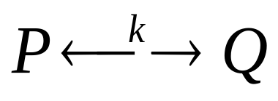
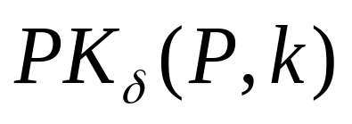
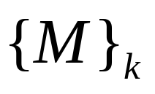
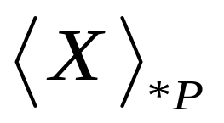
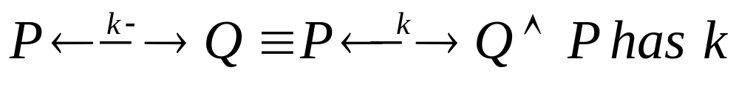
SVO Notations (2/2)
  : P and Q may use k as a shared
  secret key
  : k is a public key-agreement key
  of P (e.g. Diffie-Hellman public key of P: g^{x})
  : Encryption of M using k
  : P doesn’t know or recognize X

Slide 17



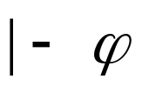
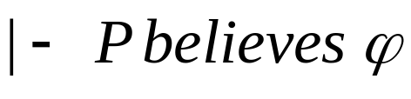
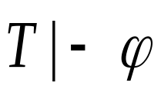

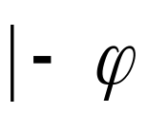
SVO Rules
Modus Ponens
  From and infer
Necessitation
  From infer
: is derivable from the set of formula T
: is a theorem (derivable from axioms)

Slide 18
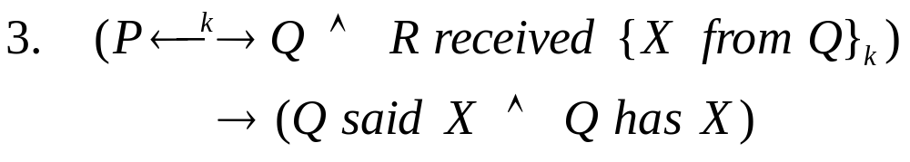
Belief Axioms
Source Association Axioms
i.e., origin-authentication based on symmetric key
Key Agreement Axioms
F₀(k, k’) implicitly names the (Diffie-Hellman) function that combines k with k⁻¹ (or, k’ with k⁻¹) to form a shared key

Slide 19



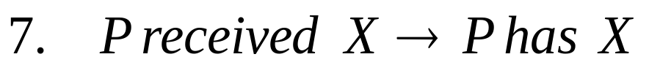
Receiving Axioms
Symmetric key system:
Asymmetric key systetm:
is a public key, and
is the
associated private key
Possession Axioms
F is a meta-notation for any function computable in practice by P

Slide 20
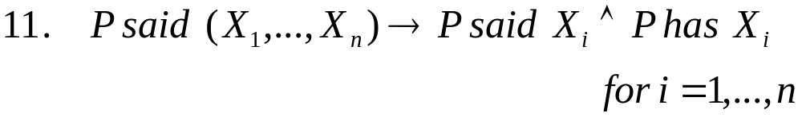
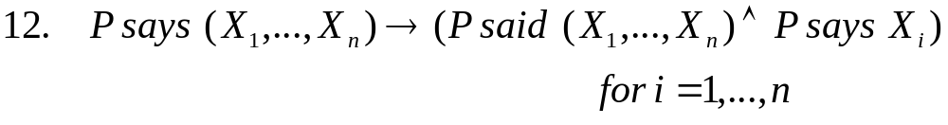
Comprehension Axiom
F is a meta-notation for any function computable in practice by P
Saying Axioms

Slide 21
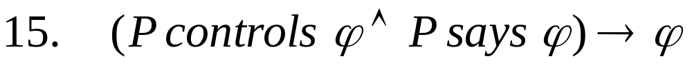
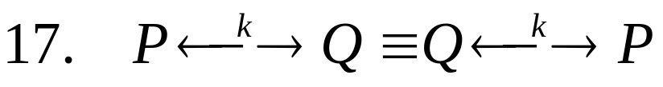
Freshness Axioms
If a message is fresh, a message including the message is also fresh
It is infeasible to compute value of F without values of all the X_{i}
Jurisdiction and Nonce-Verification Axioms
Symmetric Goodness Axiom

Slide 22
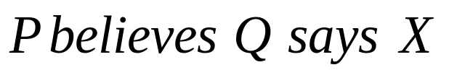
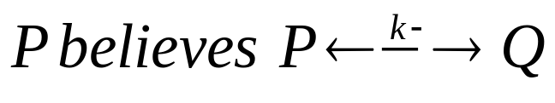

Authentication Goals (1/2)
G1. Ping Authentication P knows whether an interlocutor Q is alive
G2. Entity Authentication Q said something relevant to their present conversation
G3. Secure key establishment P believes that he has a good key to communicate with Q

Slide 23
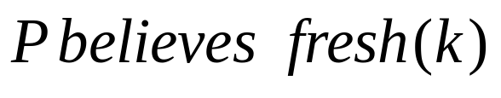
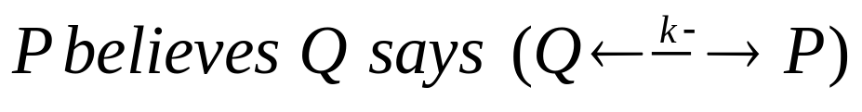
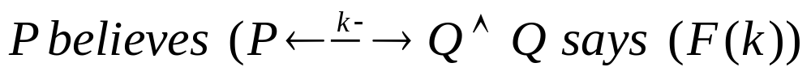
Authentication Goals (2/2)
G4. Key freshness P believes a key to be fresh
G5. Mutual understanding of shared keys P can establish that Q has sent a key as an unconfirmed secret between the two of them
G6. Key confirmation P believes that Q proved to receive a previously unconfirmed secret key between the two of them

Slide 24
Procedure of Analysis by SVO Logic
  Initial state assumptions
    Write assumptions about initial status (eg. Pre-shared key, PKI)
  Received message assumptions
    Write assumptions about messages each party receives in case that a protocol completes faithfully
  Comprehension assumptions
    Write assumptions about each party’s comprehension of received messages
  Interpretation assumptions
    Write assumptions about how each party interprets received messages
  Derivation
    Derive the beliefs each party obtains by above assumptions, and check which authentication goals are derived

Slide 25
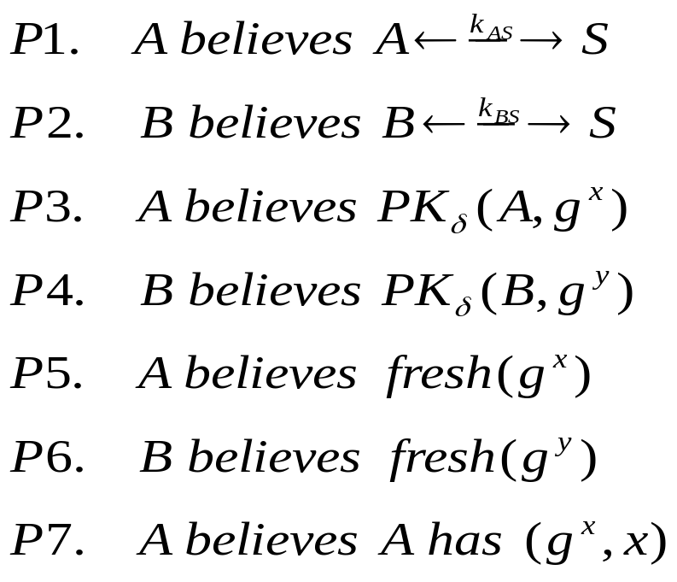
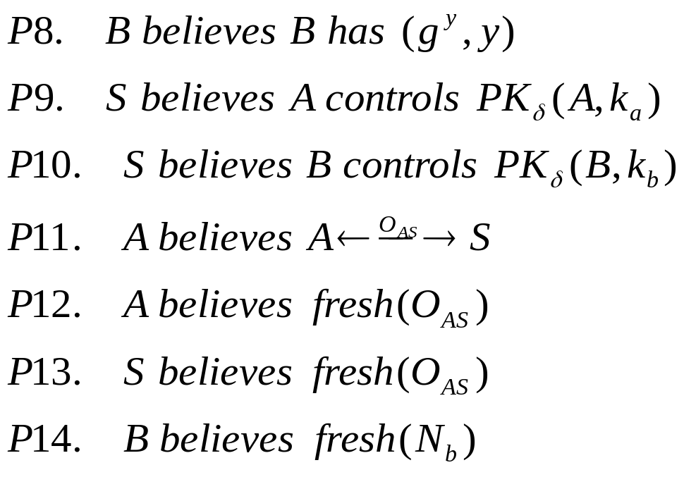
Initial State Assumptions
Help
Use of pre-shared key
  - User shares key with server
Server
Initiate a session
Respond to A’s request
Based on Diffie-Hellman
k_{AB}
Alice
Bob
Use of One-time ID
  - A shares OID with server (O_{AS})
Authenticated key exchange

Slide 26
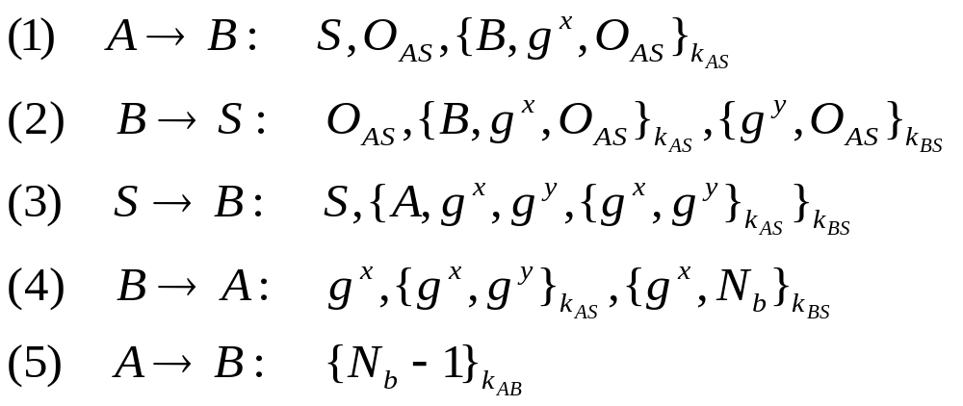
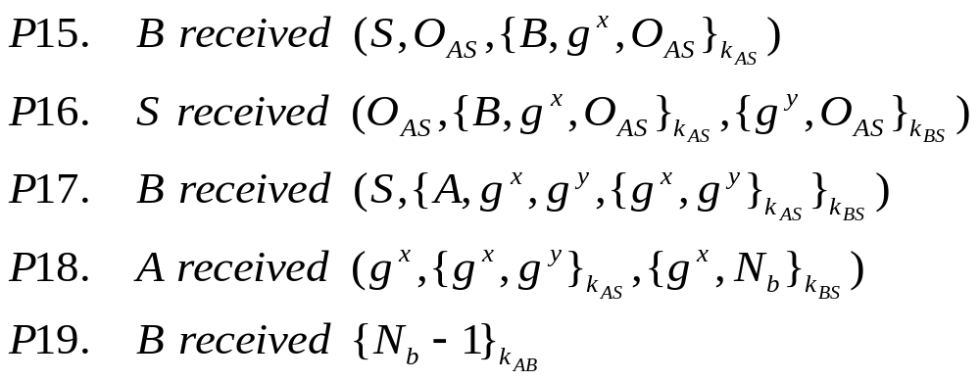
Received Message Assumptions
If the protocol completes faithfully, …

Slide 27
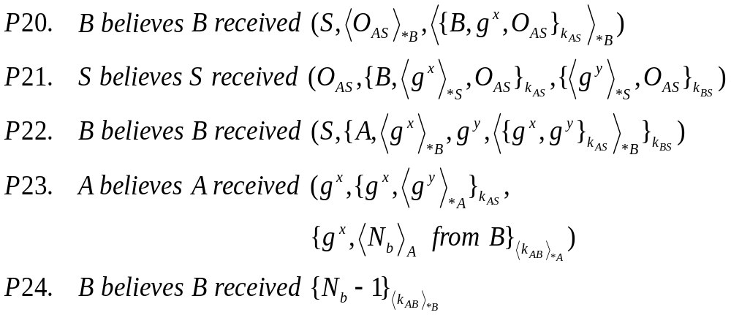
Comprehension Assumptions
Append “believes” and
check unrecognized messages
Transform P15 - P19

Slide 28
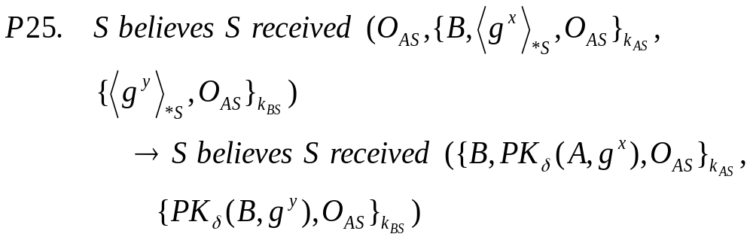
Interpretation Assumptions (1/2)
S recognizes each party’s Diffie-Hellman public key
A and B recognize the partner’s Diffie-Hellman public key
Assumptions about how each party interprets if it receives a message

Slide 29
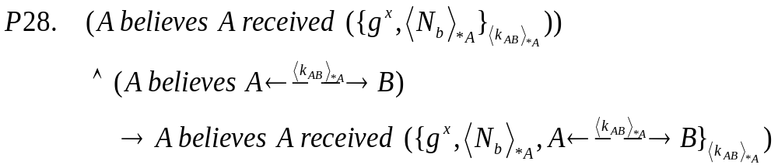
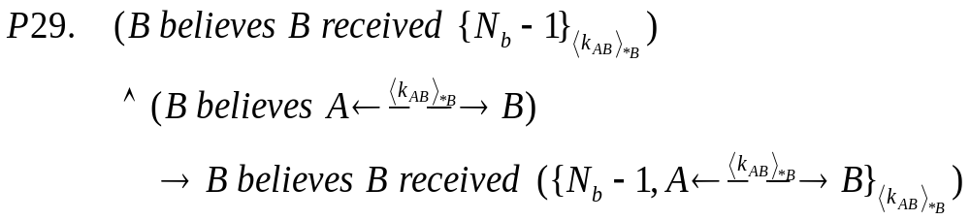
Interpretation Assumptions (2/2)
A recognizes <k_{AB}>_{*A} as a session key
B recognizes <k_{AB}>_{*B} as a session key
Assumptions about how each party interprets if it receives a message

Slide 30
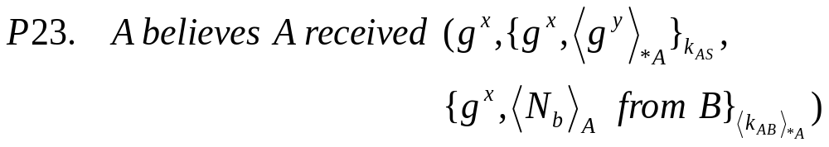
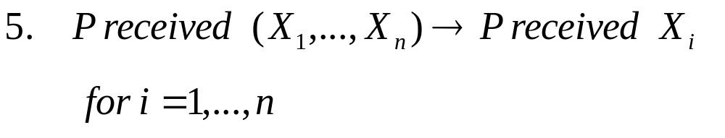
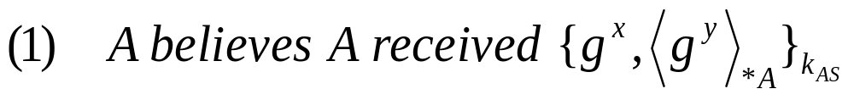
Derivation (w.r.t Alice) (1/2)
Receiving Axioms
Derive

Slide 31
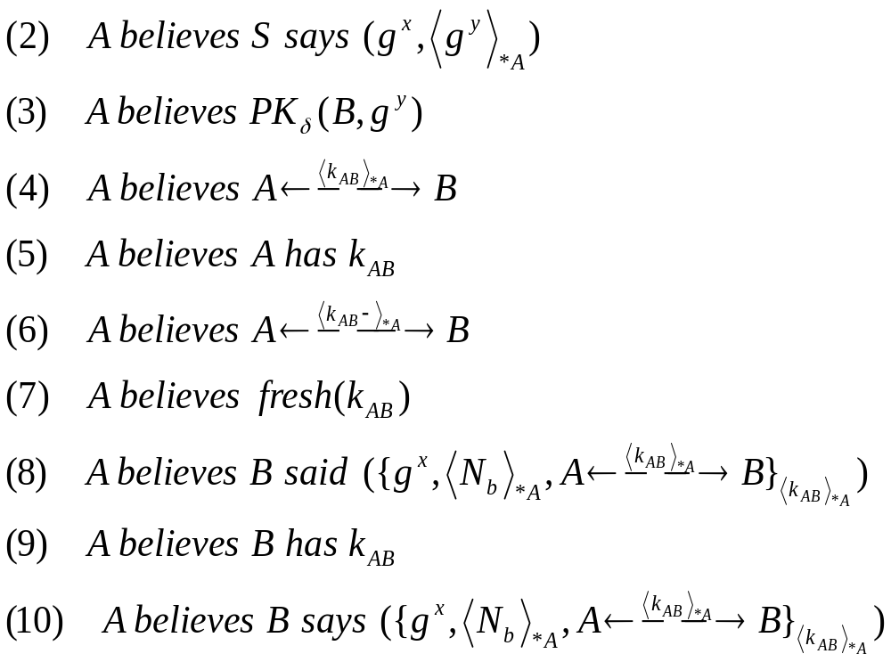
Derivation (w.r.t Alice) (2/2)
Confirm Bob actually participates the session
  ➔ Prevent impersonation
Confirm freshness of messages
  ➔ Detect replay attacks
Confirm the other party completes a session faithfully
For Bob
  G1, G2 (10)
  G3 (6)
  G4 (7)
  G5 (9,10)
  G6 (6,10)
For the server
  G1, G2 (2)
The trusted server actually participates the session
  ➔ Prevent impersonation
Confirm freshness of messages
  ➔ Detect replay attacks
Same goals are derivable w.r.t. Bob

Slide 32
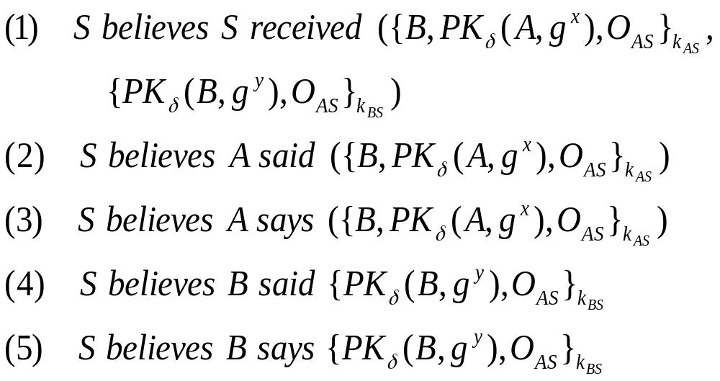
Derivation (w.r.t Server)
Confirm each party actually participates the session
  ➔ Prevent impersonation
Confirm freshness of messages
  ➔ Detect replay attacks
For Alice
  G1, G2 (3)
For Bob
  G1, G2 (5)
Other authentication goals are unnecessary
  Because each user does not share a session key with the server

Slide 33
Analysis on Generation of One-time ID
Use of pre-shared key
  - User shares key with server
Server
Help
Based on Diffie-Hellman
k_{AB}
Use of One-time ID
  - A shares OID with server (O_{AS})
Alice
Bob
Authenticated key exchange

Slide 34
Derivation (w.r.t. Server)
For Alice
  G1, G2 (3)
For Bob
  G1, G2 (5)
Replay attacks against the server are available
➔ An attacker can impersonate
anyone to the server

Slide 35
How to make fresh One-time ID ?
Sequence number & Hash function [2,3]
O_{ASi}=h(SO_{AS}, i ) (SO_{AS} : shared secret, i : session number)
Synchronization problem of One-time ID
If One-time ID is not shared correctly, then receiver cannot understand One-time ID.
Sequence number & Public key encryption
O_{ASi}={A,SO_{AS},i}_{ks} (SO_{S}: shared secret, k_{s}: server’s
public key)
Even if One-time ID is not shared correctly, the server can obtain the sender’s ID by decrypting O_{AS}

Slide 36
Analysis of our proposed protocol: Anonymity
Eavesdropper can obtain …
  Plaintexts : S, O_{AS}, and g^{x}
  Encrypted messages : {B, g^{x},O_{AS}}_{kAS}, {g^{y}, O_{AS}}_{kBS}, {A,g^{x},g^{y}, {g^{x},g^{y}}_{kAS}}_{kBS}, {g^{x}, g^{y}}_{kAS}, {g^{x}, N_{B}}_{kAB}, and {N_{B}-1}_{kAB}
➔ Eavesdropper cannot know users’ identities.
(The server’s identity is revealed)
Any users’ IDs are concealed from any eavesdropper

Slide 37
Conclusion
Propose
  a key exchange using One-time ID with TTP
    Can achieve mutual entity authentication, key confirmation, key freshness, and PFS of session key.
  a generation method of One-time ID
    Can solve synchronization problem of One-time ID
Analyze
  The proposed protocol by SVO Logic
    Our protocol provides all authentication goals

