Slide 1

Static Validation of a Voting Protocol
Christoffer Rosenkilde Nielsen
with Esben Heltoft Andersen and Hanne Riis Nielson
Language-Based Technologies,
Safe and Secure IT-Systems,
Informatics and Mathematical Modelling,
Technical University of Denmark

Slide 2
Electronic Voting Protocols
Convenient and inexpensive.
Several cryptographic approaches.
Introduces new ways to disrupt or falsify votings.
Must upheld the security properties of the classical paper vote.
Need for provably correct systems.
Notes:
Compare with paper-ballot voting

Slide 3
Security Properties
Verifiability: Voters can verify that their votes have been counted.
Accuracy:
  No votes can be altered
  Validated votes count in the final tally
  Invalid votes cannot be counted in the final tally.
Democracy:
  Only eligible voters can vote
  Eligible voters can only vote once.
Fairness: No early results from the voting can be obtained.
Privacy: Voters and their votes cannot be linked together.
Notes:
Different from ordinary security properties for protocols
Compare with paper-ballot voting

Slide 4
Case Study: FOO92
Voter
1
5
1. V → A : V, sign_{V}(blind_{b}(commit_{r}(v)))
3
4
2. A → V : sign_{A}(blind_{b}(commit_{r}(v)))
2
3. (V) → C : sign_{A}(commit_{r}(v))
4. C → : l, sign_{A}(commit_{r}(v))
Admin
Counter
5. (V) → C : l, r
Blinding:
unblind_{b}(blind_{b}(msg)) = msg
unblind_{b}(sign_{s}(blind_{b}(msg))) = sign_{s}(msg)
Notes:
3 principals
5 phases
Blinding construct
Anonymous Channel

Slide 5
Framework
Annotations
OK
Protocol
Narration
LySa
Analysis
Not OK?
Notes:
Annotations = intention of the protocol
Static analysis

Slide 6
LySa-Calculus
A process calculus in the π-calculus tradition.
The original LySa incorporates the usual cryptographic operations; symmetric and asymmetric encryption.
Messages sent on Ether.
An extension to the LySa-calculus with the blinding construct was needed in order to analyse the FOO92 protocol.
All encryptions/decryptions are annotated with a destination/origin
Annotations
Protocol
Narration
OK
LySa
Analysis
Not OK?

Slide 7
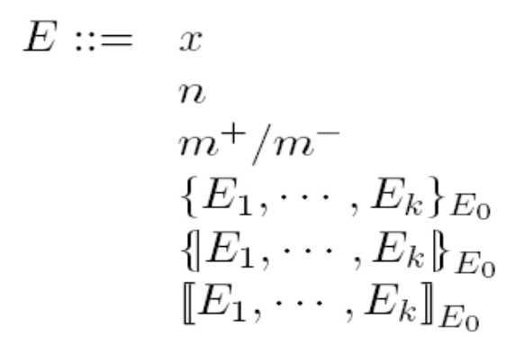
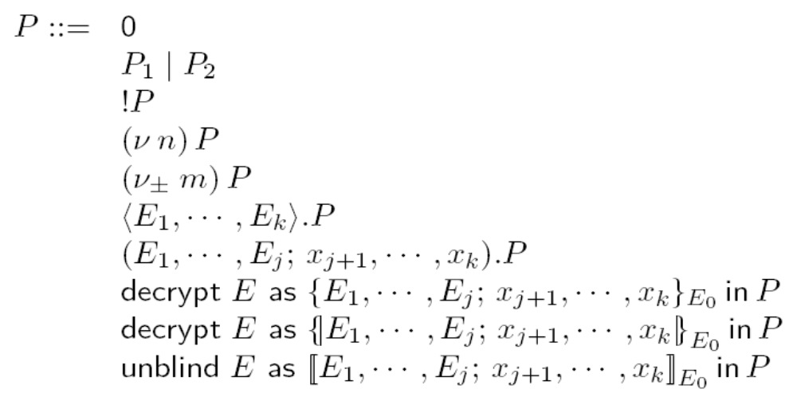
LySa-Calculus
Annotations
Protocol
Narration
OK
LySa
Analysis
Not OK?
Notes:
Terms + Processes

Slide 8
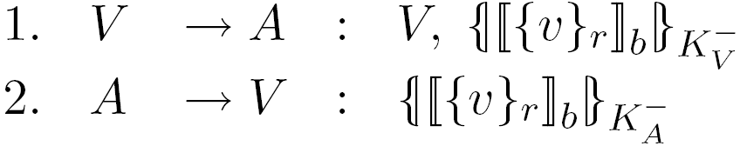
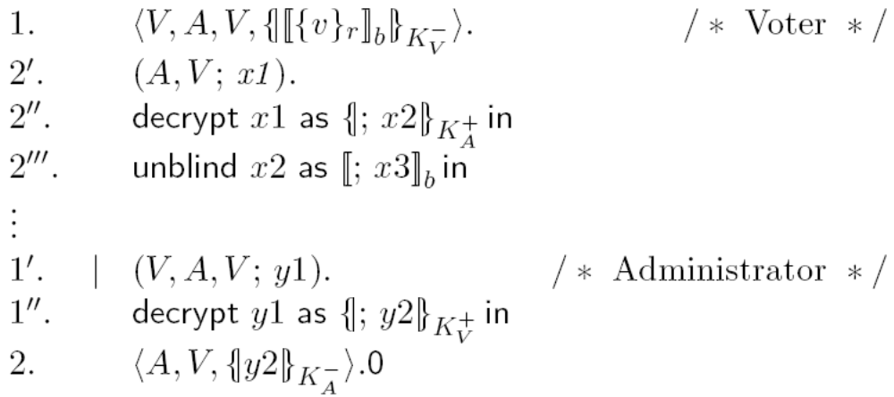
FOO92 in LySa
1. V → A : V, sign_{V}(blind_{b}(commit_{r}(v)))
2. A → V : sign_{A}(blind_{b}(commit_{r}(v)))
3. (V) → C : sign_{A}(commit_{r}(v))
4. C → : l, sign_{A}(commit_{r}(v))
5. (V) → C : l, r
Annotations
Protocol
Narration
OK
LySa
Analysis
Not OK?
Notes:
Focus on message 1+2 where blinding is used
Use LySa notation
Sender/Receipt of messages as in IP

Slide 9
Analysis
Control flow analysis to safely approximate the behavior of the protocol.
Dolev-Yao attacker.
LySaTool: An automated tool for verifying security properties of protocols written in the LySa-calculus.
Reports any possible violation to the destination/origin annotations.
Annotations
Protocol
Narration
OK
LySa
Analysis
Not OK?
Notes:
Analysis of the design of a protocol
Attacker in parallel

Slide 10
Security Properties
Verifiability: Voters can verify that their votes have been counted.
Accuracy:
  No votes can be altered
  Validated votes count in the final tally
  Invalid votes cannot be counted in the final tally.
Democracy:
  Only eligible voters can vote
  Eligible voters can only vote once.
Fairness: No early results from the voting can be obtained.
Privacy: Voters and their votes cannot be linked together.
Annotations
Protocol
Narration
OK
LySa
Analysis
Not OK?
Notes:
Not analysing Privacy.

Slide 11
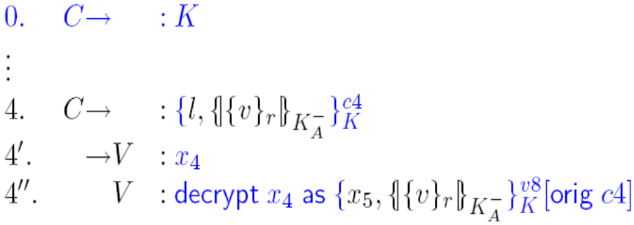
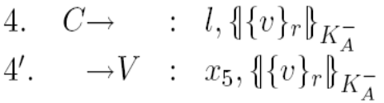
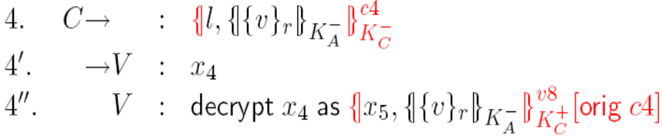
Results: Verifiability
The voters can independently verify that their vote has been counted correctly.
1. V → A : V, sign_{V} (blind_{b}(commit_{r}(v)))
2. A → V : sign_{A}(blind_{b}(commit_{r}(v)))
3. (V) → C : sign_{A}(commit_{r}(v))
4. C → : l, sign_{A}(commit_{r}(v))
5. (V) → C : l, r
Problem: The publication can originate from the attacker.
Solution: The counter signs the publication.
Annotations
Protocol
Narration
OK
LySa
Analysis
Not OK?
Notes:
Verifiability = The voters can be sure that the counter has the ballot.
Destination/Origin not on plain-text messages.

Slide 12
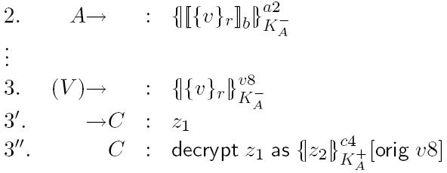
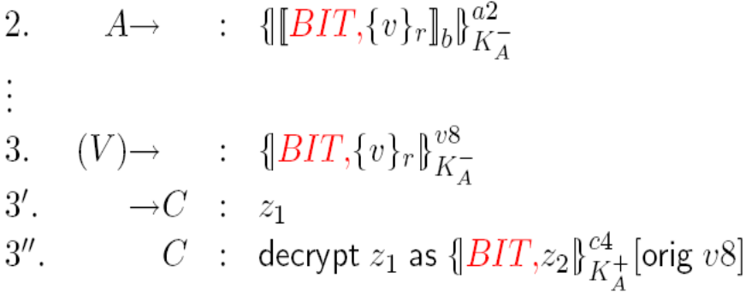
Results: Accuracy (2)
Invalid votes are not counted in the final tally.
1. V → A : V, sign_{V} (blind_{b}(commit_{r}(v)))
2. A → V : sign_{A}(blind_{b}(commit_{r}(v)))
3. (V) → C : sign_{A}(commit_{r}(v))
4. C → : l, sign_{A}(commit_{r}(v))
5. (V) → C : l, r
Problem: Blinded ballots can be accepted as valid ballots.
Solution: Distinguishing between committed values and blinded values.
Annotations
Protocol
Narration
OK
LySa
Analysis
Not OK?
Notes:
Accuracy = getting a ballot accepted by the counter.

Slide 13
Results: Accuracy (1 and 3)
(1) It is not possible for a vote to be altered (3) All validated votes must count in the final tally.
1. V → A : V, sign_{V} (blind_{b}(commit_{r}(v)))
2. A → V : sign_{A}(blind_{b}(commit_{r}(v)))
3. (V) → C : sign_{A}(commit_{r}(v))
4. C → : l, sign_{A}(commit_{r}(v))
5. (V) → C : l, r
Result: Accuracy (1): Perfect cryptography, voter checks his vote in message 2.
Accuracy (3): The counter must receive as many votes as the administrator has signed.
Annotations
Protocol
Narration
OK
LySa
Analysis
Not OK?

Slide 14
Results: Democracy
(1) Only eligible voters can vote and (2) they can only vote once.
1. V → A : V, sign_{V} (blind_{b}(commit_{r}(v)))
2. A → V : sign_{A}(blind_{b}(commit_{r}(v)))
3. (V) → C : sign_{A}(commit_{r}(v))
4. C → : l, sign_{A}(commit_{r}(v))
5. (V) → C : l, r
Result: Democracy (1): The administrator only signs ballots that originates from eligible voters.
Democracy (2): Any eligible voter can only have one ballot validated and the counter will not accept the same ballot twice.
Annotations
Protocol
Narration
OK
LySa
Analysis
Not OK?

Slide 15
Results: Fairness
No early results from the voting can be obtained.
1. V → A : V, sign_{V} (blind_{b}(commit_{r}(v)))
2. A → V : sign_{A}(blind_{b}(commit_{r}(v)))
3. (V) → C : sign_{A}(commit_{r}(v))
4. C → : l, sign_{A}(commit_{r}(v))
5. (V) → C : l, r
Result: The attacker cannot learn the votes before the opening phase.
Annotations
Protocol
Narration
OK
LySa
Analysis
Not OK?
Notes:
Fairness before the opening phase.
Integrity on the value v.

Slide 16
Summary
Previous work has shown that LySa can analyse protocols for confidentiality and authentication.
Voting protocols has different properties:
  Verifyability
  Accuracy
  Democracy
  Fairness
  Privacy
Using the extended LySa we sucessfully validated four of these properties for FOO92.
Framework also applies to other voting protocols: Sensus, E-Vox.

Slide 17
Related Work
[FOO92] A. Fujioka, T. Okamoto and K. Ohta, A Practical Secret Voting Scheme for Large Scale Elections, (AUSCRYPT '92)
[CC96] L. F. Cranor and R. K. Cytron, Design and Implementation of a Practical Security-Conscious Electronic Polling System, (WUCS-96-02)
[BBDNN04] C. Bodei, M. Buchholtz, P. Degano, H. Riis Nielson and F. Nielson, Static Validation of Security Protocols, (JCS’04)
[KR05] S. Kremer and M. D. Ryan, Analysis of an Electronic Voting Protocol in the Applied Pi Calculus, (ESOP'05)

Slide 18
Assumptions
Perfect Cryptography;
Bit-committed votes are unique;
The administrator only signs one vote for each eligible voter;
The counter is a trusted party;
The counter must have received all votes before publishing;
The number of votes counted by the counter equals the number of votes signed by the administrator; and
All the commitment keys must be received by the counter.
Annotations
Protocol
Narration
OK
LySa
Analysis
Not OK?

