Slide 1
Internet Security Protocols:
Specification and Modeling
Tutorial T6
International Conference on
SOFTWARE ENGINEERING AND FORMAL METHODS
Brisbane – Australia, 22nd - 27th September, 2003

Slide 2
Contents
Internet Layers, Basics
Management, Implementation or Design Errors
Designing Correct Protocols: The Avispa contribution
IETF Groups and Activities
Sec Protocols: Kerberos, AAA,
IPsec, IKE, IKEv2, Wlan,
PKI, TLS
High-level Protocol Spec. Language (hlpsl): Syntax,
Semantics, Goals, Examples
Outlook: MobileIP, HIP, Pana

Slide 3
Conclusions
Internet offers agent many identities
  user, ip, mac, tcp port, ... What is “A”, “ID_A”?
Many types of attackers (or channels)
  over the air, authentic channels, connection channels
  safer routes
Many types of DoS attacks
  flodding, bombing, starving, disrupting
Many types of properties
  besides authentication and secrecy
  “Incomplete protocols” (need to add extra messages to prove authentication goals)
  key control, perferct forward secrecy, ...
  layered properties
    if attacker ... then ..., if attacker ... then ...

Slide 4









Internet
Protocols define
Format and order of msgs sent and received among network entities, and
actions taken on msg transmission, receipt
  Examples: TCP, IP,
  HTTP, FTP,PPP
Internet: “network of networks”
Standards
  RFC: Request for Comments
  IETF: Internet
  Engineering Task Force
administration
domains
access
router
local ISP
server
core
router
host
company
network
mobile

Slide 5
Protocol layering in Internet
Appl.
http
http
HTTP-Protocol
„Indepentdent“
Layers
Headers
Tunneling
Trans.
tcp
tcp
TCP-Protocol
Netw.
ip
IP-Protocol
ip
ip
IP-Protocol
Link /
MAC
ppp
ppp
PPP-Protocol
Ethernet
Ethernet
Eth.-Protocol
PHY
hdlc
HDLC-Protocol
hdlc
ISDN
802.3
Mobile Node
(MN)
Server
Access-Router

Slide 6


Internet Network Architecture
Internet
Peer
(Client)
Peer
(Server)
Internet/Web Applications
www
www
http
http
tcp
tcp
ip
ip
ip
ip
ip
ip
ip
ip
link
link
link
link
link
link
link
link
phy
phy
phy
phy
phy
phy
phy
phy

Slide 7
Encapsulation
HTML
user data
http
appl. hdr
tcp
tcp hdr
application data
TCP segment
ip
ip hdr
IP datagramm
802.2
Ethernet
ip hdr
tcp hdr
appl. hdr
user data
14 bytes
20 bytes
20 bytes
Ethernet frame
64 - 1500 bytes

Slide 8
At which layer security?
http
http
Application
Layer
Kerberos, CMS,
custom token protocols
tcp
tcp
Transport
Layer
TLS, WTLS
ip
ip
Network
Layer
IPsec
Ethernet
Ethernet
Data Link
Layer
Wep
Physical
Layer
Host
Access Point
or Gateway

Slide 9
Separation of Concerns
Most security protocols today are separated into two parts:
1) Authentication and key exchange protocols
2) Protection of data traffic
Step (1) is usually the most difficult one. Sometimes this step is again separated into sub-steps for performance reasons.

Slide 10

Internet protocol architecture
W3C
html
xml
xsl
smil
www
HTTP
FTP
SMTP
M3UA
NFS
DNS
SNMP
TCP
SCTP
UDP
IP
IETF
PPP
ARP
encap
Internet
ITU
ETSI
ATMF
802.2
ISDN
ATM
SDH
GSM
802.3
802.4
802.5
802.11

Slide 11
Some protocols in the TCP/IP Suite
BGP
FTP
HTTP
SMTP
Telnet
SNMP
DIAMETER
TCP
UDP
SCTP
IGMP
ICMP
OSPF
RSVP
IP
BGP = Border Gateway Protocol
DIAMETER = (2 x RADIUS) = New AAA Protoc
FTP = File Transfer Protocol
HTTP = Hypertext Transfer Protocol
ICMP = Internet Control Message Protocol
IGMP = Internet Group Management Protocol
IP = Internet Protocol
MIME = Multi-Purpose Internet Mail Extension
OSPF = Open Shortest Path First
RSVP = Resource ReSerVation Protocol
SMTP = Simple Mail Transfer Protocol
SNMP = Simple Network Management Protocol
TCP = Transmission Control Protocol
TCP = Transmission Control Protocol
UDP = User Datagram Protocol

Slide 12
Securing the Infrastructure
Applications need complex, reliable protocols for service discovery, session control, guaranteeing QoS, etc.
Network control mechanisms and routing protocols have minimal or no authentication at all
Infrastructure mechanisms often may not use IPSec or TLS to secure their operations

Slide 13
AAA Definitions
Authentication
Verifying an identity (distinguishing identifier) claimed by or for a system entity. This is done presenting authentication information (credentials) that corroborates the binding between the entity and the identifier. (2828)
Entity authentication
Assuring one party (through acquisition evidence) of the identity of a second party involved in a protocol, and that the second has actually participated (i.e., is active at, or immediately prior to, the time the evidence is acquired).

Slide 14
AAA Definitions
Message authentication
A party is corroborated as the source of specified data created at some (typically unspecified) time in the past, and data integrity, but no uniqueness or timeliness guarantees.
Methods for providing data origin authentication include:
  1. message authentication codes (MACs)
  2. digital signature schemes
  3. appending (prior to encryption) a secret authenticator value to encrypted text.
A difference btw. entity and msg authentication:
  message authentication provides no time-liness guarantee
  entity authentication implies actual communications with verifier during execution of the protocol

Slide 15
AAA Definitions
Authorization
An "authorization" is a right or a permission granted to an entity to access a system resource. An "authorization process" is a procedure for granting such rights. (2828) Here: Policy-based. Others: ACL, capability tokens.
Accounting
The collection of resource consumption data for the purposes of capacity and trend analysis, cost allocation, auditing, and billing. Accounting management requires that resource consumption be measured, rated, assigned, and communicated between appropriate parties.

Slide 16
AAAA Definitions
Accountability
The property of a system (including all of its system resources) that ensures that the actions of a system entity may be traced uniquely to that entity, which can be held responsible for its actions. (2828)

Slide 17


Authentication
This makes no sense.
Credentials belong to
claimed-ID, so what?
(Probably I knew that before)
(Claimed-ID, Credential)
This, alone, makes no sense.
Claimed-ID is now
at port xyz,so what?
In the next message?
(Claimed-ID, Credential
[Port | IP-Address] )
This makes sense.
Claimed-ID is requesting this
or telling that.
( {Port | IP-Address | Claimed-ID} , Credential, {Req | Msg} )
In connectionless communication, entity authentication without a meaningful message other than the claim of being a particular entity makes no sense.

Slide 18
Security Relations
(Claimed-ID, Credential, Req)
How can the router verify the
Credentials and check that
the Req is forn Claimed-ID?
The router has to know
something special about the
Claimed-ID: he has to have a
Security Relation
(pre-established) or obtain one.
Examples:
Knowledge of the validity of a Public Key (Digital certificates, PKI)
Shared secret (password, key) Note: in this case the SR is bidirectional

Slide 19
Authentication Credentials
Examples:
  Digital certificates (PKI)
  f(secret key, time-stamp)
  rsp := f(secret key, chall), i.e. responses to Challenges
(Claimed-ID , Credential, Req )
(Claimed-ID, Req )
(chall )
(resp)

Slide 20
Key Establishment
Protocol whereby a shared secret becomes available to two or more parties, for subsequent cryptographic use.
Subdivided into
  key transport and
  key agreement
Key transport: one party creates or otherwise obtains a secret value, and securely transfers it to the other(s).
Key agreement: a shared secret is derived by two (or more) parties as a function of information contributed by, or associated with, each of these

Slide 21
Key Establishment
Authentication term | Central focus
authentication | depends on context of usage
entity authentication | identity of a party, and aliveness at a given instant
data origin (=msg) authentication | identity of the source of data (+integrity)
(implicit) key authentication | identity of party which may possibly share a key
key confirmation | evidence that a key is possessed by some party
explicit key authentication | evidence an identified party possesses a given key

Slide 22
Key Agreement -- Properties
(Implicit) Key authentication:
  one party is assured that no other party aside from a specifically identified second party (and possibly additional identified trusted parties) may gain access to a particular secret key.
  independent of the actual possession of such key by the second party.
Key confirmation:
  One party is assured that a second (possibly unidentified) party actually has possession of a particular secret key.
Explicit key authentication: both
  (implicit) key authentication and
  key confirmation hold.

Slide 23
Key Agreement -- Properties
Authenticated key establishment
  key establishment protocol which provides key authentication.
Identity-based key establishment
  identity information (e.g., name and address, or an identifying index) of the party involved is used as the party’s public key.
Identity-based authentication protocols may be defined similarly.

Slide 24
Session Keys
An ephemeral secret, i.e., restricted to a short time period, after which all trace of it is eliminated. Reasons:
  1. to limit available ciphertext (under a fixed key) for cryptanalytic attack;
  2. to limit exposure, with respect to both time period and quantity of data, in the event of (session) key compromise;
  3. to avoid long-term storage of a large number of distinct secret keys (in the case where one terminal communicates with a large number of others), by creating keys only when actually required;
  4. to create independence across communications sessions or applications

Slide 25
Key Agreement -Classification
1. Nature of the authentication:
  a. entity authentication,
  b. key authentication, and
  c. key confirmation.
2. Reciprocity of authentication. If provided, entity authentication, key authentication, and key confirmation may be unilateral or mutual
3. Key freshness. A key is fresh (from the viewpoint of one party) if it can be guaranteed to be new, as opposed to possibly an old key being reused through actions of either an intruder or authorized party. This is related to key control

Slide 26
Key Agreement - Classification
4. Key control:
the key is derived from joint information, and neither party is able to control or predict the value of the key
5. Efficiency.
(a) number of message exchanges
(b) bandwidth (total number of bits)
  (c) complexity of computations
  (d) precomputation to reduce on-line computational complexity

Slide 27
Key Agreement - Classification
6. Third party requirements
(a) on-line (real-time),
  (b) off-line, or
  (c) no third party;
  (d) degree of trust required in third party (e.g., trusted to certify public keys vs. trusted not to disclose long-term secret keys).
7. Type of certificate used and manner by which initial keying material is distributed
8. Non-repudiation
some type of receipt that keying material has been exchanged.

Slide 28
Perfect forward secrecy and known-key attacks
Perfect forward secrecy
  compromise of long-term keys does not compromise past session keys.
    Previous traffic is locked securely in the past.
    It may be provided by a Diffie-Hellman procedure.
  If long-term secret keys are compromised, future sessions are subject to impersonation by an active intruder
Immunity to known-key attack: When past session keys are compromised, do not allow
  Passive attacker to compromise future session keys
  impersonation by an active attacker in the future
  (Known-key attacks on key establishment protocols are analogous to known-plaintext attacks on encryption)

Slide 29
Many types of keys
Sealing key: a shared secret key used for computing cryptographic checkvalues (MACs)
Signature key: a private key used for signing,
Verification key: a public key used for checking signatures, or a secret key used for checking MACs
Encipherment key: either secret or public key,
Decipherment key: either secret or private key.
Keys shold be used only for one purpose

Slide 30
Contents
Internet Layers, Basics
Management, Implementation or Design Errors
Designing Correct Protocols: The Avispa contribution
IETF Groups and Activities
Sec Protocols: Kerberos, AAA,
IPsec, IKE, IKEv2, Wlan,
PKI, TLS
High-level Protocol Spec. Language (hlpsl): Syntax,
Semantics, Goals, Examples
Outlook: MobileIP, HIP, Pana

Slide 31
Management Problems: Passwords, Cards, Tokens
Passwords are
  often shared
  guessable
  written down on pieces of paper
Smart cards and hand-held tokens are
  expensive
  People forget them
  Card readers draw too much power from hand-helds

Slide 32
Management Problems: WLAN/WEP
WEP is optional,
  many real installations never even turn on encryption
    irrelevant how good the cryptography is if it is never used.
By default, WEP uses a single shared key for all users
  often stored in software-accessible storage on each device
  If any device is stolen or compromised, change the shared secret in all of the remaining devices
  WEP does not include a key management protocol

Slide 33
Is PKI secure? More
Management Problems
Most users don’t know what certificates are.
Most certificates’ real-world identities aren’t checked by users.
Meaningless Certificates:
  Why should Dow, Jones own the www.wsj.com certificate?
  Is that certificate good for interactive.wsj.com?
Is it NASA.COM or NASA.GOV?
  MICROSOFT.COM or MICR0S0FT.COM?
  What about MICROSОFT.COM? (Cyrillic “O”, do you see it?)
Effectively, we have no PKI for the Web.

Slide 34
DoS Attacks against Authentication Protocols
Flooding attacks: Spoofed messages cause target to perform expensive cryptographic operations:
Attacker gets the nodes to perform PK operations. It may spoof a large number of “signed messages” with random numbers instead of signatures
    Target will verify the signatures before rejecting the messages.
    Symmetric encryption, hash functions and non-cryptographic computation are rarely the performance bottleneck (unless the cryptographic library is optimized only for bulk data)
If a node creates a state during protocol execution, the attacker may start an excessive number of protocol runs and never finish them
The stronger the authentication, the easier it may be for an attacker to use the protocol features to exhaust target’s resources.

Slide 35
SYN Flooding: Implementation Issues
Host accepts TCP open requests, from spoofed locations
Half-open connection queue fills up
Legitimate open requests are dropped
Implementation issues
Mostly solved:
  use cheaper data structure for queue,
  random drop when queue is full

Slide 36
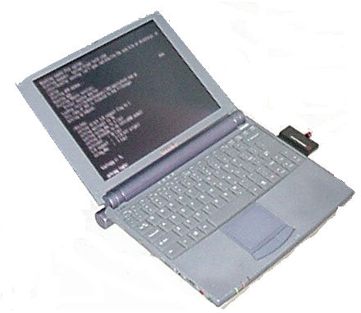
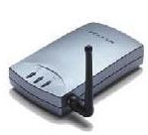

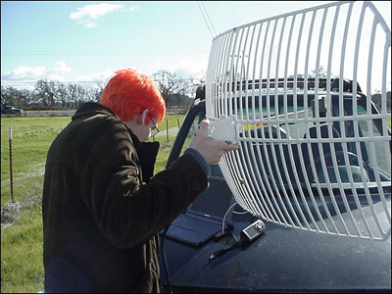
Design Problems: WLAN/WEP
m
E(m)
E(m)
D(E(m))
Internet
m

Slide 37
No perfect Security
Many different types of Attacks
Many different types of Security Mechanisms
  at different SW layers
  with different strength
Management, Implementation or Design Errors
  Design errors affect more people
Some risks
  may be acceptable (low damage or very low risk)
  too expensive to fully prevent

Slide 38
Authentication Levels
None (no authentication)
  SASL Anonymous [RFC2245]
  Authentication based on source IP address
  Diffie-Hellman
Weak (vulnerable against eavesdroppers)
  FTP USER/PASS
  POP3 USER/PASS
Limited (vulnerable against active attacks)
  One-time Passwords
  HTTP Digest Authentication
  IMAP/POP Challenge/Response
Strong (protection against active attacks)
  Kerberos
  SRP Telnet Authentication
  Public Key Authentication

Slide 39
Variable Security
Different security mechanisms
  variable levels of guarantees
  variable security properties
  variable cost
Challenge:
  find an acceptable level of protection
  at affordable price
Find:
  most inexpensive security mechanisms
    even if they are weak!
  that solve your problem

Slide 40
Attackers
Most are joy hackers.
Soon also Terrorists?
Spies? Governments? Industrial spies?
For profit?
Some businesses report targeted attempts:
  Vendor prices changed on a Web page
  ISP hacked by a competitor
  Customers on pay-per-packet nets targets of packet storms

Slide 41
Well known Attacks: DOS
Denial of Service Attacks
Attacker doesn’t break in
  he denies you access to your own resources.
Many incidents reported, more are likely.
You lose:
  if it’s cheaper for the attacker to send a message
  than for you to process it
Denial of Service Attacks are hard to prevent
  in particular using security measures at higher layers only
Thumbrules:
  Try to be stateless – allocate resources as late as possible.
  Do expensive computations as late as possible.
  Move heavy computation to the initiator of the protocol run.

Slide 42
DOS Example: “Smurf” Attack
Attacker sends “ping” to intermediate network’s broadcast address.
Forged return address is target machine.
All machines on intermediate network receive the “ping”, and reply, clogging their outgoing net and the target’s incoming net.
Firewalls at target don’t help -- the line is clogged before it reaches there.

Slide 43
Well known Attacks: Sniffers
Password collection
Credit card numbers
NFS file handle collection
DNS spoofing

Slide 44
Attacks to the infrastructure: Routing Attacks
Routers advertise
  own local nets,
  what they’ve learned from neighbors
Routers trust dishonest neighbors
Routers further away must believe everything they hear
First solutions in the literature

Slide 45
GSM Today
LUR
ADR
SN
HE
MS
UAR(chall)
ADS(AV_{1,..} AV_{n})
UAS(resp)
AV = (chall, resp, C), C = Cipher Key
AV generation is not so fast => batch generation
MS is able to calculate: C = C_{k}(chall)
  Therefore MS and SN share C.
MS authenticates to SN, but SN does not authenticate to MS

Slide 46
GSM Today: Problem
C
C’
MS
SN’
MS’
SN
If attacker gets hold of one (for instance, used) AV:
  he may create false base station SN’
  force MS to communicate to SN’ (using C)
  decipher/encipher
  use another (legal) user MS’ (with key C’)
Possible:
  says(A,B,m) /\ notes(C,A,m) /\ C != B
  notes(A,B,m) /\ says(B,A,m’) /\ m != m’

Slide 47
UMTS: Idee
LUR
ADR
SN
HE
MS
UAR(chall)
ADS(AV_{1,..} AV_{n})
UAS(resp)
SynchronFailure
MS is able to check that challenge is consistent: cons_{k}(chall)
AV_{i} also contain a sequence number, that may be reconstructed by the MS: seq = seq_{k}(chall)
MS accepts AV_{i} only if
    seq_{MS} < seq_{k}(chall) < = seq_{MS} + Δ

Slide 48
UMTS: Idee
LUR
ADR
SN
HE
MS
UAR(chall)
ADS(AV_{1,..} AV_{n})
UAS(resp)
SynchronFailure
    seq_{MS} < seq_{k}(chall) < = seq_{MS} + Δ
Is there no MiM Attack?
Is there no deadlock?
Such design errors would be very expensive:
Replace firmware in many towers
and in millions of Cellular Phones

Slide 49
Contents
Internet Layers, Basics
Management, Implementation or Design Errors
Designing Correct Protoc.: The Avispa contribution
IETF Groups and Activities
Sec Protocols: Kerberos, AAA,
IPsec, IKE, IKEv2, Wlan,
PKI, TLS
High-level Protocol Spec. Language (hlpsl): Syntax,
Semantics, Goals, Examples
Outlook: MobileIP, HIP, Pana

Slide 50
Avispa
http://www.avispa-project.org
U. of Genova,
LORIA-Lorraine,
ETHZ,
Siemens AG
Shared-cost RTD (FET Open) Project IST-2001-39252
Started on Jan 1, 2003

Slide 51
PBK Construction
Alice sends m1, m2, …, mN,
Bob is able to recognize they have same source
Alice constructs a public/private key pair PBK = (p,s)
Alice disclosed the public key p to Bob along with the initial packet
Bob verifies messages signed with the private key s=inv(p)
Bob knows the messages were sent by one node
If replay protection: sequence number or timestamp
Is there a cheaper way?

Slide 52
Generalized PBK: Requirements
Bob receives m1, m2, …, mN,
authentically generated by one source
If the first message A → B arrives without modification,
all other messages shall be protected in a way that B recognizes alteration
MiM attack in the first message:
A → E → B : B is receiving messages from E
But if first message is OK, the system should protect against MiM
DoS:
If attacker can only insert messages: DoS resilience

Slide 53
1. Hash Construction
If Alice knows in advance which messages she wants to send:
m1, m2, …, mN:
{mi} := <mi , H(mi+1)> (Send mi together with H(mi+1)).
1. Quiz: OK?
No. An attacker can replace {m_{i}} := <m_{i} , H(m_{i+1})> by {m_{i}} := <m_{i} , H(μ_{i+1})>
And then replace {m_{i+1}} := <m_{i+1} , H(m_{i+2})> by {μ_{i+1}} := < μ_{i+1} , H(μ_{i+2})> etc.
{m_{i}} := <m_{i} , H(m_{i+1}, m_{i+2}, …, m_{N})> 2. Quiz: OK?
I think, yes, this seems easy to prove.

Slide 54
2. Hash Construction
Alice chooses a hash sequence:
h1= H(h2)= H(H(h3))= H^{i}(hi+1) =.. = H^{N-1}(hN):
{mi} := <mi , H(mi , hi)>
What is wrong? (Too trivial for a quiz!)
Bob has no means to check HAshes.
{m_{i}} := <m_{i} , H(m_{i} , h_{i}), h_{i} > 3. Quiz: OK?
No. Attacker replaces {m_{i}} := <m_{i} , H(m_{i} , h_{i}), h_{i} > by < μ_{i} , H(μ_{i} , h_{i}), h_{i} >

Slide 55
3. Hash Construction
Hash sequence: h1= H(h2)= H(H(h3)) =… = H^{i}(hi+1) =.. = H^{N-1}(hN)
{mi} := <mi , H(mi , hi), hi-1 >
4. Quiz: OK?
No. Attacker intercepts 2 consecutive messages
{m_{i}} := < m_{i} , H(m_{i} , h_{i}), h_{i-1} > {m_{i+1}} := <m_{i+1} , H(m_{i+1} , h_{i}), h_{i} > replaces
{m_{i}} by < μ_{i} , H(μ_{i} , h_{i}), h_{i-1} >
Idea: Alice waits for an Acknowledge {ack_{i}} := <H(m_{i} , ĥ_{i}), ĥ_{i} >
(Bob uses seq: ĥ₁= H(ĥ₂)= H(H(ĥ₃)) =… = H^{i}(ĥ_{i+1}) =.. = H^{N-1}(ĥ_{N}) )
5. Quiz: OK?
I think, yes. Is somebody sure? What is not nice about the solution?
That B is forced to use a hash series, one for each peer. (DoS)

Slide 56
4. Hash Construction
Hash sequence: h1= H(h2)= H(H(h3)) =… = Hi(hi+1) =.. = HN-1(hN)
{mi} := <mi , H(mi , hi), hi-1 >
Alice waits for an Acknowledge {acki} := <H(mi , ĥi), ĥi , H(ĥi+1)>
6. Quiz: OK?
I think, yes. Is somebody sure?
Another idea: instead of acknowledgments, use time frames. This will work for multimedia. Both A and B divide their time in intervals: A sends at the beginning of his intervals, B discards messages that arrive too late.
7. Quiz: Dos that work?
I think, yes. Is somebody sure?

Slide 57
Motivation for the project
There are many techniques for the automatic analysis of security protocols, BUT
  tools usually come with specific working assumptions (specification language, security Goals, modelling assumptions, bounds, . . . )
This makes it very difficult
  to use the tools productively (for the non-expert user) and
  to assess and compare the potential of the proposed techniques.

Slide 58
Objectives of the AVISPA Project
Build a open architecture supporting
  design of security protocols using a comfortable notation and web-based user-friendly interface
  seamless integration and systematic assessment of new automated techniques for the validation of security protocols.
Build and make publicly available a library of formalized IETF protocols and associated security problems.
Develop and tune three promising and complementary state-of-the-art technologies for automatic formal analysis:
  On-the-fly Model-Checking
  Constraint Theorem-Proving
  SAT-based Model-Checking

Slide 59
Architecture of the AVISPA Tool
High-Level Protocol Specification Language
Intermediate Format
SAT-based Model-Checker
CL-based Theorem-Prover
On-the-fly Model-Checker
Open to other technologies

Slide 60
On-the-fly Model-Checking
Context: On-the-fly model checking supports the incremental exploration of very large or infinite state systems. Lazy evaluation in languages like Haskell provides a powerful platform for building flexible, efficient search engines.
Approach: Lazy evaluation is combined with symbolic (unification-based) methods to build on demand, and explore, the protocol search space.
Advantages:
  Declarative specification of infinite data structures, reduction methods, and heuristics.
  Modular design, easy integration of heuristics/improvements.

Slide 61
Constraint Theorem-Proving
Context: Rewrite-based, first-order theorem provers have recently appeared as very effective tools for equational reasoning. daTac combines rewriting with constraints to handle properties such as associativity/commutativity.
Approach: Messages exchanges and intruder activities can be directly translated into rewrite rules. Searching for an attack amounts to deducing a contradiction.
Advantages:
  Protocol representation is simple and intuitive.
  Advancements in deduction can be easily incorporated.
  Fast prototyping of model enhancements (e.g. algebraic properties of operators).

Slide 62
SAT-based Model-Checking
Context: Dramatic speed-up of SAT solvers in the last decade:
  Problems with thousands of variables are now solved routinely in milliseconds.
Approach: Bounded model-checking of security protocols based on a constructive translation of the IF into SAT with iterative deepening on the number of steps.
Advantages:
  Most of the generated SAT instances are solved in milliseconds.
  Declarative.
  Plug and play integration of different SAT solvers ⇒
  Improvements of SAT technology can be readily exploited.

Slide 63
Contents
Internet Layers, Basics
Management, Implementation or Design Errors
Designing Correct Protocols: The Avispa contribution
IETF Groups and Activities
Sec Protocols: Kerberos, AAA,
IPsec, IKE, IKEv2, Wlan,
PKI, TLS
High-level Protocol Spec. Language (hlpsl): Syntax,
Semantics, Goals, Examples
Outlook: MobileIP, HIP, Pana

Slide 64
Internet History
1961-1972: Early packet-switching principles
1961: Kleinrock - queueing theory shows effectiveness of packet-switching
1964: Baran - packet-switching in military nets
1967: ARPAnet conceived by Advanced Research Projects Agency
1969: first ARPAnet node operational
1972:
  ARPAnet demonstrated publicly
  NCP (Network Control Protocol) first host-host protocol
  first e-mail program
  ARPAnet has 15 nodes

Slide 65
Internet History
1972-80: Internetworking, new and proprietary nets
1970: ALOHAnet satellite network in Hawaii
1973: Metcalfe’s PhD thesis proposes Ethernet
1974: Cerf and Kahn - architecture for interconnecting networks
late70’s: proprietary architectures: DECnet, SNA, XNA
late 70’s: switching fixed length packets (pre ATM)
1979: ARPAnet 200 nodes
Cerf and Kahn’s internetworking principles:
  minimalism, autonomy - no internal changes required to interconnect networks
  best effort service model
  stateless routers
  decentralized control
define today’s Internet architecture

Slide 66
Internet History
1980-1990: new protocols, a proliferation of networks
1983: deployment of TCP/IP
1982: SMTP e-mail
1983: DNS name-to-IP-address translation
1985: FTP
1986, Jan: first IETF meeting 21 attendees
1986, Oct: 4th IETF, first IETF with non-government vendors
1987, Feb: 5th IETF: Working Groups were introduced
1987, Jul: 7th IETF, > 100 attendees
1988: TCP congestion control
New national networks: Csnet, BITnet, NSFnet, Minitel
100,000 hosts connected to confederation of networks
1993 July: IETF met in Amsterdam, first IETF meeting in Europe
US/non-US attendee split was (+is) nearly 50/50.

Slide 67
Internet Organizations
ISOC (Internet Society)
political, social, technical aspects of the Internet
http://www.isoc.org/
IAB (Internet Architecture Board)
oversight of Internet architecture and standards process;
liaisons with e.g. ITU-T, ISO
http://www.iab.org/iab/
IETF
(Internet Engineering Task Force)
standardizes Internet protocols;
open community for engineers,
scientists, vendors, operators
http://www.ietf.org/
IRTF
(Internet Research
Task Force)
pre-standards R&D
http://www.irtf.org/

Slide 68

IETF
3 meetings a year.
  working group sessions,
  technical presentations,
  network status reports,
  working group reporting, and
  open IESG meeting.
Proceedings of each IETF plenary
Meeting minutes,
working group charters (which include the working group mailing lists),
are available on-line see www.ietf.org.

Slide 69
IETF Overview
Forum for working groups to coordinate technical developments of new protocols.
Development and selection of standards within the Internet protocol suite.

Slide 70
IETF mission
Identify and propose solutions to pressing operational and technical problems in the Internet
Specify the development or usage of protocols and the near-term architecture, to solve technical problems for the Internet;
Facilitate technology transfer from the Internet Research Task Force (IRTF) to the wider Internet community
Provide a forum for the exchange of relevant information within the Internet community

Slide 71

Internet Society
Financial and legal support of the IETF.
Provides insurance coverage for many of the people in the IETF process
Acts as a public relations channel for the IETF

Slide 72
IAB (Internet Architecture Board)
Long-range planning + coordination of various areas of IETF
Discuss long-term and emerging issues in the Internet
Review the charter of new WGs
  architectural consistency and integrity
Sponsor and organize the IRTF
Organize workshops
  in-depth reviews of specific architectural issues.
  recommendations to the IETF and IESG
Board for appeals against IESG actions
Oversees IETF liaisons with other standards bodies

Slide 73

IANA (Internet Assigned Numbers Authority)
Core registrar for the IETF's activities is the IANA.
Examples
  TCP port numbers
  MIME types.
Nowadays the IETF is generally no longer involved in the IANA's domain name and IP address assignment functions, which are overseen by ICANN.

Slide 74
IESG
Technical management of IETF activities and the Internet standards process
Get WGs started and finished
Ratify or correct the output from the IETF's WGs
  ADs are review the drafts coming out of areas other than their own
Make sure that non-WG drafts that are about to become RFCs are correct.
Vote on each Internet Draft that is becoming an RFC,
  2 IESG members block a draft from moving forward
Decide if WG’s result has real consensus
Prevent IETF WG are at odds with other WG

Slide 75
IETF Current Areas
Applications (APP) - Protocols seen by user programs, such as e-mail and the Web
Internet (INT) - Different ways of moving IP packets and DNS information
Operations and Management (OPS) Administration and monitoring
Routing (RTG) - Getting packets to their destinations
Security (SEC) - Authentication and privacy
Transport (TSV) - Special services for special packets
User Services (USV) - Support for end users and user support organizations
General (GEN) - Catch-all for WGs that don't fit in other areas (which is very few)

Slide 76
IETF procedures
The IETF is a group of individual volunteers (~ 4 000 woldwide)
Work is being done on mailing lists (plus 3 meetings/year)
No formal membership, no formal delegates
Participation is free and open
>110 working groups with well defined tasks and milestones
Major US vendors dominate the IETF
IETF does not decide about the market, but:
the approval of the IETF is required for global market success.

Slide 77
Protocol design is done in working groups
Basic Principles
  Small focused efforts preferred to larger comprehensive ones
  Preference for a limited number of options
Charter
  Group created with a narrow focus
  Published Goals and milestones
  Mailing list and chairs' addresses
"Rough consensus (and running code!)"
  No formal voting (IESG decides)
  Disputes resolved by discussion and demonstration
  Mailing list and face-to-face meetings
Consensus made via e-mail
  (no "final" decisions made at meetings)

Slide 78
Contents
Internet Layers, Basics
Management, Implementation or Design Errors
Designing Correct Protocols: The Avispa contribution
IETF Groups and Activities
Sec Protocols: Kerberos, AAA,
IPsec, IKE, IKEv2, Wlan,
PKI, TLS
High-level Protocol Spec. Language (hlpsl): Syntax,
Semantics, Goals, Examples
Outlook: MobileIP, HIP, Pana

Slide 79

Kerberos
An authentication system for distributed systems

Slide 80
Introduction
Based on Needham - Schroeder
Three-Party Protocol
Extensions according to Denning - Sacco.
Developed at MIT as part of the project Athena
Versions 1 - 3 internal
Currently the following Kerberos Version are published:
  Kerberos v4
  Kerberos v5
Kerberos v5 Clarifications/Revisions (not finished)

Slide 81
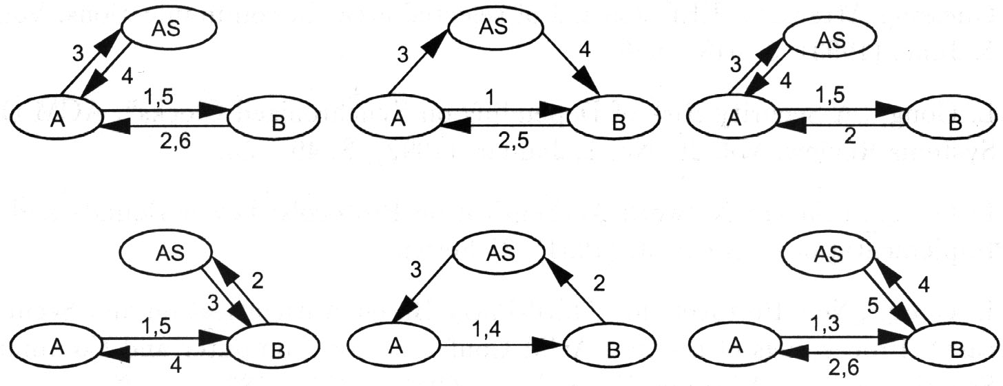

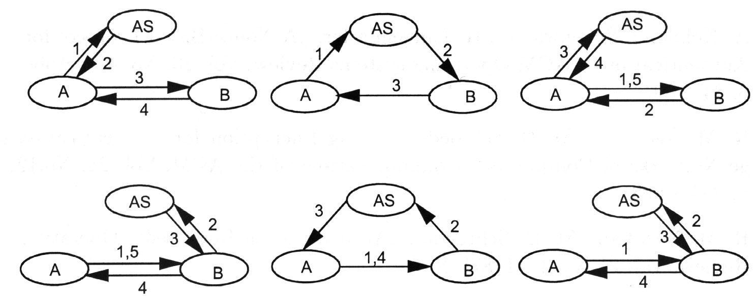
Three Party Protocols
Nonce-based Protocol
Kerberos
Timestamp-based Protocol
Y. Ding and H. Petersen: "Eine Klassifikation von Authentifikationsmodellen",
Proc. Trust Center'95, DuD Fachbeiträge, 292 - 302, 1995.

Slide 82
Kerberos in three Acts
AS+
KDC
AReq(A,B)
ARsp({k}_{A}, {k}_{B})
SrvReq
( {k}_{B} )
AS+
KDC
A
B
({tt}_{k}, {k}_{B})
AuthRsp({k}_{A}, {A,B,tt_{max},k}_{B})
Drawback: User has to re-type password for every new service ticket request
Solution: Ticket Granting Ticket
AS
KDC
TGS
SrvReq
({tt}_{k}, {A,B,tt_{max},k}_{B})
A
B

Slide 83
Kerberos Single-Sign-On
Obtaining additional tickets
  Don't want to present user's password each time the user performs authentication with a new service
  Caching the user's password on the workstation is dangerous
  Cache only tickets and encryption keys (collectively called credentials) for a limited period, typically ~8 hours
When the user first logs in, an authentication request is issued and a ticket and session key for the ticket granting service is returned by the authentication server
A special ticket, called a ticket granting ticket, is used to subsequently request a session key with a new verifier
The TGT may be cached
Notes:
Subsequently, when the user wishes to prove its identity to a new verifier, a new ticket is requested from the authentication server using the ticket granting exchange. The ticket granting exchange is identical to the authentication exchange except that the ticket granting request has embedded within it an application request, authenticating the client to the authentication server, and the ticket granting response is encrypted using the session key from the ticket granting ticket, rather than the user's password.

Slide 84
Complete Kerberos
(from: B. C. Neuman + T. Ts’o: IEEE Communications Magazine SEP. 1994)
KDC
Protocol
< client communicate with AS to obtains a ticket for access to TGS >
1. Client requests AS of KDC to supply a ticket in order to
communicate with TGS.
- request (C, TGS) C : client id
2. AS returns a ticket encrypted with TGS key(Kt) along with a session
key Kct.
- return = ( {ticket}Kt, {Kct}Kc Kct : TGS session key
- ticket = ( C, TGS, start-time, end-time, Kct ) Kc : client key
AS
TGS
2
3
1
4
Client
5
Server
6
< client communicate with TGS to obtain a ticket for access to other server >
3. Client requests TGS of KDC to supply a ticket in order to communicate with order server.
- request = ( {C, timestamp}Kct, {ticket}Kt, S ) S: server key
4. TGS checks the ticket, If it is valid TGS generate a new random session key Kcs.
TGS returns a ticket for S encrypted by Ks along with a session key Kcs.
- return = ( {ticket}Ks, {Kcs}Kct ) ticket = ( C, S, start-time, end-time, Kcs )
< client communicate with the server to access an application >
client decrypt {Kcs}Kct with Kct to get Kcs.
client generate authenticator A with the information from ticket.
- A = ( {C, S, start-time, end-time, address}Kcs )
5 . Client sends the service request to the server along with the ticket and A.
- ( {ticket}Ks, {C, S, start-time, end-time, address}Kcs, request
6. The server decrypt ticket using Ks and check if C, S, start, end times are valid
If service request is valid, use Kcs in the ticket to decrypt authenticator
Server compares information in the ticket and in the authenticator. If agreement, the service request accepted.

Slide 85
Kerberos Entities
Kerberos Key Distribution Center (KDC) consists of
  Kerberos Authentication Server (AS)
  Kerberos Ticket Granting Server (TGS)
  KDC supplies tickets and session keys
Realm
  Kerberos Administrative Domain that represents a group of principals
  A single KDC may be responsible for one or more realms
Principal
  Name of a user or service
  Principal Identifier: Unique identity for a principal (service/host@realm_name)
  Example: krbtgt/SYSSEC.UNI-KLU@SYSSEC.UNI-KLU

Slide 86
The Kerberos Ticket
A Kerberos Ticket contains of two parts:
  Unencrypted part
  Encrypted part
Fields of the unencrypted part:
  Version number for the ticket format
  Realm that issued a ticket
  Server identity
Fields of the encrypted part:
  Flags
  Key
  Client name/Client realm
  Transited
  Start-time, End-time, Renew-till
  Host addresses and authorization data

Slide 87
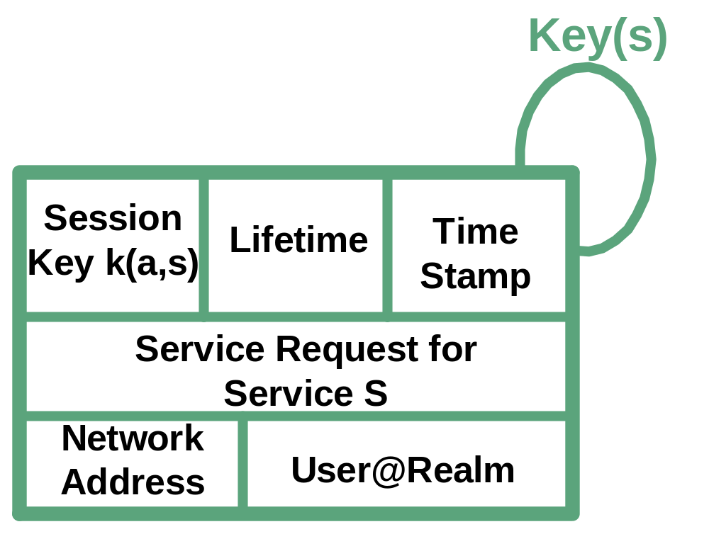
Example: Service Ticket
Service Ticket is encrypted with the secret key of the service S.
The ticket itself does not provide authentication. This is the responsibility of the Authenticator.

Slide 88
Comparison Kerberos V4/V5 (1/3)
Limitations with V4 | Improvements with V5
Weak Timestamp mechanism | Nonce-based replay protection with KRB_PRIV and KRB_SAFE. Replay protection for the client in the AS and TGS msgs.
No authentication forwarding | Right delegation via forwardable and proxiable tickets
Reuse of “session keys” possible | No reuse possible, real session keys for KRB_PRIV and KRB_SAFE messages with sub-keys in AP_REQ
Flawed DES in cipher-block chaining mode | Standard DES in CBC mode
The AS and TGS response msgs are not double-encrypted in Krb V5 => U2U Auth.

Slide 89
Comparison Kerberos V4/V5 (2/3)
Limitations with V4 | Improvements with V5
Limitations with principal naming | Less restrictions with a multi-component principal naming
Available for IP only | Multi-protocol support introduced
Cross-realm authentication requires n*(n-1)/2 keys between communicating realms | Hierarchy of realms introduced.
Only DES encryption algorithm available (export restrictions) | Generic interface supports several algorithms, still limitations exist
Problems with the Kerberos V4 pseudo-random number generator used for the session key generation (2^56 -> 2^20) | Problems fixed in Kerberos V5

Slide 90
Comparison Kerberos V4/V5 (3/3)
Limitations with V4 | Improvements with V5
Sender encodes messages in his native format. | Messages are described and encoded with the ASN.1 syntax.
No batch processing support for tickets available. | Batch processing available with the help of postdated tickets.
Limited ticket lifetime(~21h) | Time format based on NTP -> very long lifetime
Weak message digest/checksum routines (CRC-32) | Several message digest routines available
No support for handheld authenticators (One-time Passwords) | Support added via the pre-authentication data field
Limitations with V4
Improvements with V5

Slide 91
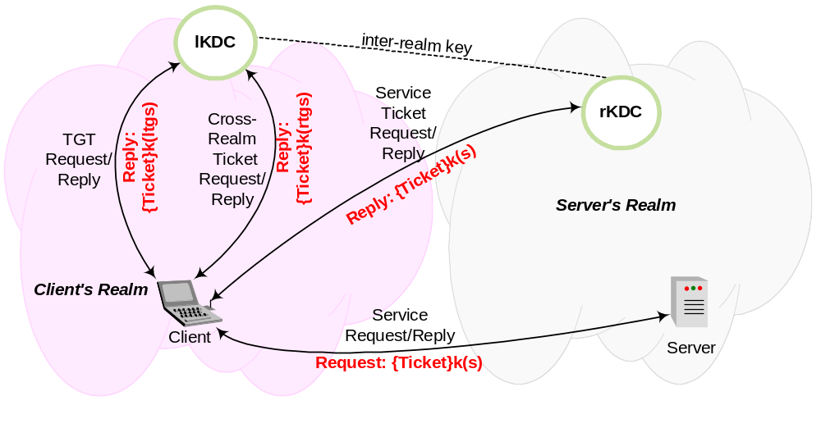
Kerberos V4 Cross-Realm Authentication
Ticket Flow

Slide 92
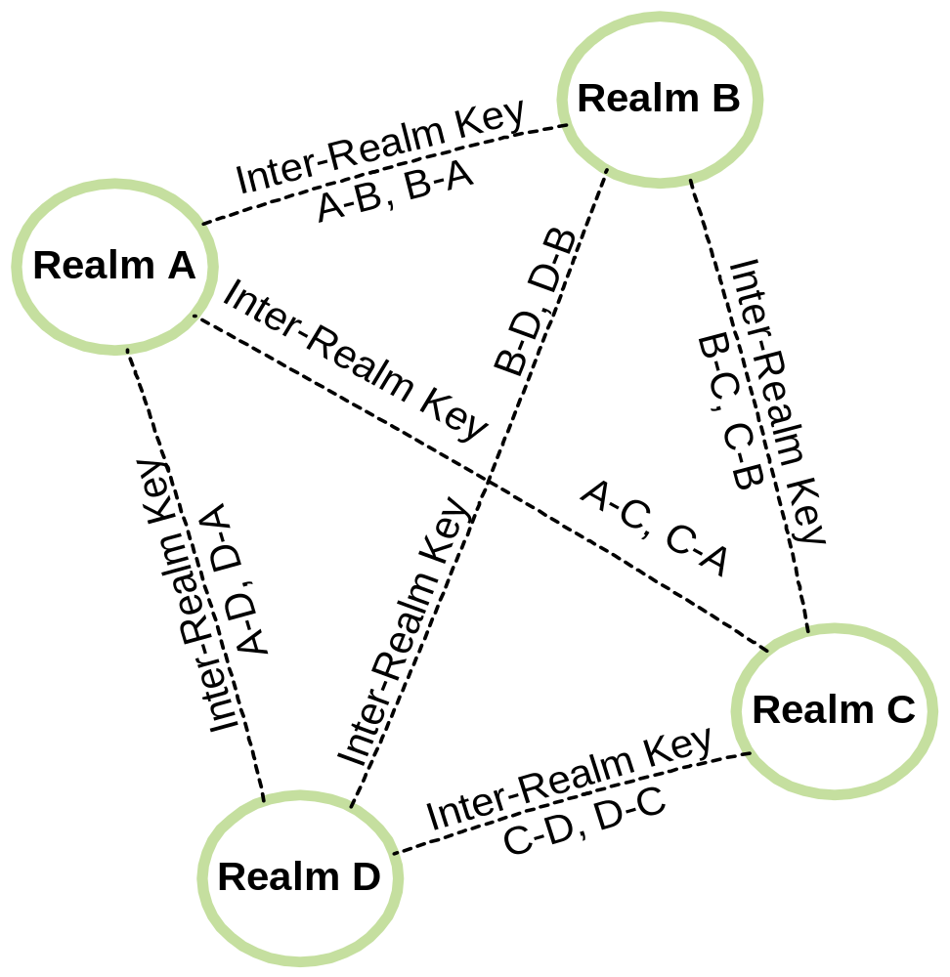
Kerberos V4 Cross-Realm
Realm navigation does not assume a realm-structure.
KDC must share a inter-realm key with all neighboring realms it wants to communicate with.
Scalability problems due to the complex key distribution.

Slide 93
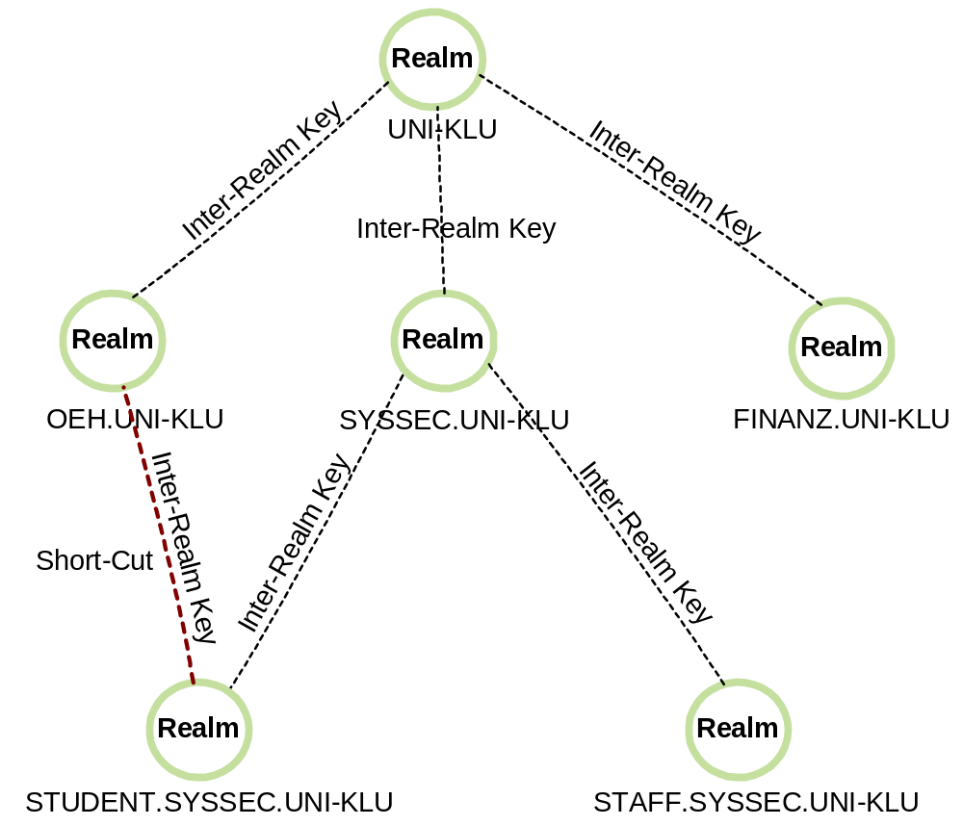
Kerberos V5 Cross-Realm Improvement
Hierarchical structure may be used.
Consulting a database is an alternative
The client and the KDC run the same algorithm to determine the authentication path.
Short-cuts limit the number of requests.

Slide 94
Kerberos V5 Cross-Realm Authentication
The sequence of realms used in the authentication process is referred as the authentication path.
The client determines the authentication path by using a realm-naming convention similar to the DNS naming convention. The server runs the same algorithm but he may return a TGT that is closer to the final realm (if available).
Example:
  Client located at STUDENT.SYSSEC.UNI-KLU
  Server located at FINANZ.UNI-KLU
  Required TGTs:
    krbtgt/STUDENT.SYSSEC.UNI-KLU@STUDENT.SYSSEC.UNI-KLU
    krbtgt/SYSSEC.UNI-KLU@STUDENT.SYSSEC.UNI-KLU
    krbtgt/UNI-KLU@SYSSEC.UNI-KLU
    krbtgt/FINANZ.UNI-KLU@UNI-KLU
The transited path is the list of realms that were actually used to obtain the current ticket.

Slide 95
Kerberos V5 Ticket Types
Initial Ticket
  Indicates that this ticket is the result of a initial authentication.
  Used for ticket issued by the KDC and not by the TGS.
  Required by some programs (e.g. password changing programs)
  Gives the assurance that the user has typed in his password recently.
Invalid Ticket
  Validated by the KDC in a TGS request.
  Often used with postdated tickets
Postdated Ticket
  Purpose: Request a ticket for later use I.e. batch jobs
  Invalid until the start ticket has been reached
  Ticket must be sent to the KDC to convert it to a valid one.

Slide 96
Kerberos V5 Ticket Types
Renewable Ticket
  Used for batch jobs.
  Ticket has two expiration dates.
  Ticket must be sent to the KDC prior the first expiration to renew it.
  The KDC checks a “hot list” and then sends a new ticket with a new session key back.
Proxiable Ticket
  Makes it possible for a server to act on behalf of the client to perform a specific operation. (e.g. print service)
  Purpose: granting limited rights only
Forwardable Ticket
  Similar to proxiable ticket but not bound to a specific operation
  Mechanism to delegate user identity to a different machine/service
  Sample application: telnet

Slide 97
Where is Kerberos used?
Architecture:
PacketCable
Operating Systems:
Unix
Windows 2000 for all authentication procedures
Windows CE .NET
Protocols (examples):
Resource Reservation Protocol (RSVP)
Telnet; NFS; FTP; SNMP; TLS; KINK; DNS
APIs / Carriers for Authentication Protocols
GSS-API; SASL; EAP;

Slide 98
AAA (Diameter) for MobIP V4
Visited Domain
Home Domain
AAA-V
AAA-H
FA
HA
MN
5. Home-Agent-MobileIP-Answer
1. Agent advertisement + Challenge
6. AA-Mobile-Node-Answer
2. Registration Request
7. Registration Reply
3. AA-Mobile-Node-Request
8. Registration Request
4. Home-Agent-MobileIP-Request
9. Registration Reply
7‘. Now there are SA:
MN-FA, MN-HA, FA-HA
(8. + 9. Auth. with extensions:
MN-FA-, MN-HA-,FA-HA-Auth)
Notes:
After 3.: The AAA-H generates 3 registration keys:
MN-FA-K, MN-HA-K, FA-HA-K
And encrypts each of them twice.
In 4 sends these encrypted keys

Slide 99
What is IPSec?
IPSec is the standard suite of protocols for network-layer confidentiality and authentication of IP packets.
IPSec = AH + ESP + IPComp + IKE
In particular the following features are provided:
  Connectionless integrity
  Data origin authentication
  Replay Protection (window-based mechanism)
  Confidentiality
  Traffic flow confidentiality (limited)
An IPv6 standard compliant implementation must support IPsec.

Slide 100
Insecured Messages vs. Secured Messages
IPHdr
Payload
IPHdr
Fields
Source
IPAdd
Dest
IPAdd
TCP
Hdr
Appl
Hdr
Appl
Payload
IP Spoofing
Session hijacking
Man-in-the-middle
Eavesdropping
Message modification
IPHdr
Payload
Tunnel mode:
the whole package is being encapsulated
in a new package
Neuer
IPHdr
IPSec
Hd
IPHdr
Payload
IPSec
Trailer
encrypted
Transport mode (less expensive)
new IPSec Header (+ evtl Trailer)
provides somewhat less security
IPHdr
IPSec
Hd
Payload
IPSec
Trailer
encrypted

Slide 101




Use of IPSec: Tunnel Mode
Neuer
IPHdr
IPSec
Hd
IPHdr
Payload
IPSec
Trailer
encrypted
IPHdr
Payload
Secured messages
in an insecure
environment
IPHdr
Payload
Insecured messages
in an secure
environment

Slide 102
Why IPSec?
Users want a secure, private network by
  disallowing communication to untrusted sites,
  encrypting packets that leave a site,
  authenticating packets that enter a site.
By implementing security at the IP level, all distributed applications can be secured (including many security-ignorant, legacy applications).
Typically, the following threats are prevented:
  Impersonation (IP Spoofing);
  Session hijacking;
  Man-in-the-middle Attacks;
  Injecting or re-ordering of IP packets
  Eavesdropping;
  Message modification

Slide 103




Tunnel Mode
IPHdr
Payload
Tunnel Mode
Tunnel mode has an
“outer IP header” and
“inner IP header”
  AH protects part of
  the outer header as well
Authentication is between remote host and firewall (or Security Gateway), or between two firewalls
User has access to entire internal network (VPN)
Neuer
IPHdr
IPSec
Hd
IPHdr
Payload
IPSec
Trailer
encrypted
Corporate
Network
Firewall /
Security Gateway
Internet
Roaming
User
IPsec Tunnel
IPsec Tunnel
Site A
Site B
Internet

Slide 104
Transport vs. Tunnel Mode
Transport Mode
no additional header to the IP packet.
Authentication Header (AH) offers no confidentiality protection but protects parts of the IP header.
Encapsulating Security Payload (ESP) provides confidentiality protection.
Transport mode must be host to host
  adequate for upper layer protocols
  Gateways cannot handle fragmentation or multiple routes
Hosts share a secret key
IPHdr
IPSec
Hd
Payload
IPSec
Trailer
encrypted

Slide 105
IPSec SA
A Security Association (SA) is a data structure. The SA provides the necessary parameters to secure data. SAs can be established manually or dynamically (e.g. IKE).
An IPsec SA is uniquely identified by:
  Security Parameter Index, SPI (32 bit)
  Destination IP Address
  Protocol (AH or ESP)
IPsec SAs can support:
  Transport mode
  Tunnel mode

Slide 106
How to establish IPSec Security Associations?
Default Key Management Protocol:
The Internet Key Exchange Protocol (IKE)
Alternatives:
  Kerberized Internet Negotiation of Keys (KINK)
  (see http://www.ietf.org/html.charters/kink-charter.html)
  IKEv2 (SON-of-IKE)
  Host Identity Payload (HIP)
  (http://homebase.htt-consult.com/HIP.html;
  http://homebase.htt-consult.com/draft-moskowitz-hip-05.txt)
    HIP adds new namespace and provides a protocol for
    IPsec ESP SA establishment – not fully conformant to IPsec

Slide 107
Internet Key Exchange (IKE)
ISAKMP Phases and Oakley Modes
  Phase 1 establishes an ISAKMP SA
    Main Mode or Aggressive Mode
  Phase 2 uses the ISAKMP SA to establish other SAs
    Quick Mode
    New Group Mode
Authentication with
  Signatures
  Public key encryption
    Two versions
    Based on ability to decrypt, extract a nonce, and compute a hash
  Pre-shared keys
Four of the five Oakley groups
No SA
Ph 1
Main
Aggressive
Ph 2
Quick
New Group
IKE states (simplified)
modes and phases

Slide 108
Diffie-Hellman
A
B
choose g,p
generate x
compute
X=g^{x} mod p
X [,g,p]
generate y
compute
Y=g^{y} mod p
Y
k = Y^{x} mod p = (g^{x})^{y} mod p = (g^{y})^{x} mod p = X^{y} mod p =k
The parameters g and p are typically known to all communication partners.

Slide 109
Denial of Service (Flodding)
A
B
choose g,p
generate
random numbers:
X_{i} , i =1.. n
X_{i} [,g,p]
generate y_{i}
compute Y_{i} = g^{yi} (p)
Y_{i}
DOS:
  Exponentiation: computationally expensive
  B: Memory allocation
  A: IP spoofing to prevent traceability.

Slide 110
Dos Protection (Cookies)
A
B
C_{A}
choose C_{A}
choose C_{B}
C_{B}
X=g^{x} mod p
C_{A,} C_{B,} X [,g,p]
Y=g^{y} mod p
C_{A,} C_{B,} Y
Return routability proof:
  A has to have seen C_{B} to send the next msg
  If A spoofs Addi it has to sit on path Addi --B
Close to Addi : not many active addresses
Close to B

Slide 111
IKE: Cookies
A
B
C_{A}
choose C_{A}
choose C_{B}
C_{B}
X=g^{x} mod p
C_{A,} C_{B,} X [,g,p]
Y=g^{y} mod p
C_{A,} C_{B,} Y
If A uses repeatedly same Address:
  Same cookie: B discards
  Different cookies: A must wait
Problem remains:
  Unauthenticated key-exchange:
    man-in-the-middle

Slide 112
Authenticated Key Exchange
A
B
C_{A}
choose C_{A}
choose C_{B}
C_{B}
X=g^{x} mod p
C_{A,} C_{B,} X [,g,p]
Y=g^{y} mod p
C_{A,} C_{B,} Y
C_{A,} C_{B,} {ID_{A}, …}_{PSKey,k}
C_{A,} C_{B,} {ID_{B}, …}_{PSKey,k}
If A and B share a key PSKey then they may use it, together with k
(the D-H result) to encrypt and authenticate the ID (and other param).

Slide 113
Main Mode for shared key: Negotiation, Key Derivation
A
B
C_{A,} ISA_{A}
SKey = h_{PSKey}( N_{A} | N_{B})
C_{B,} ISA_{B}
SKey_{d} = h_{SKey}( k | C_{A} | C_{B} | 0 )
C_{A,} C_{B,} X [,g,p], N_{A}
SKey_{a} = h_{SKey}( SKey_{d} | k | C_{A} | C_{B} | 1 )
C_{A,} C_{B,} Y, N_{B}
SKey_{e} = h_{SKey}( SKey_{d} | k | C_{A} | C_{B} | 2 )
C_{A,} C_{B,} {ID_{A}}_{PSKey,k}
Hash_{A} = h_{SKeya}( X | Y | C_{A} | C_{B} | ISA_{A} | ID_{A} )
C_{A,} C_{B,} {ID_{B}}_{PSKey,k}
{ID_{A}}_{PSKey,k} = ( ID_{A} | Hash_{A} )
ISA_{A}, ISA_{B} are ISAKMP SA Data, used by IKE to negotiate:
  encryption algorithm
  hash algorithm
  authentication method
The negotiated parameters pertain only to the ISAKMP SA
  and not to any SA that ISAKMP may be negotiating
  on behalf of other services.

Slide 114
IKE (5): Key Derivation
Derived Key DK :=
T1
||
T2
||
...
||
Tn
T1
T2
Tn
Parameters
PRF
PRF
PRF
Layer 0
Key
Key
Key
Properties:
IKE uses a key derivation procedure without a hierarchy.
Key derivation provides key material of arbitrary length for the individual keys
(encryption keys, integrity keys, IVs, etc. for different directions).
The same key derivation routine is used to create an ISAKMP and an IPsec SA.

Slide 115
Internet Key Exchange (IKE) Summary (1/2)
Phase I
  The two peers establish a secure channel for further communication by negotiating ISAKMP SAs.
Phase II
  Protected by the SA negotiated in Phase I, the peers negotiate SAs that can be used to protect real communication; that is, the IPsec SA.

Slide 116
Internet Key Exchange (IKE) Summary (2/2)
IKE defines two Phase I modes:
  MAIN MODE gives authenticated key exchange with identity protection.
  AGRESSIVE MODE gives quicker authenticated key exchange without identity protection.
For Phase I, IKE defines (for main and aggressive modes) four different authentication methods:
  1. authentication with digital signatures;
  2. authentication with public key encryption;
  3. authentication with a revised mode of public key encryption; and
  4. authentication with a pre-shared key.

Slide 117
IKEv2 – What’s new? (1/2)
Number of authentication modes reduced : Only one public key based and a pre-shared secret based method
Establishes two types of SAs (IKE-SA and Child-SAs)
User identity confidentiality supported
  Active protection for responder
  Passive protection for initiator
Number of roundtrips are reduced (piggy-packing SA establishing during initial IKE exchange)
Better (optional) DoS protection
NAT handling covered in the core document

Slide 118
IKEv2 – What’s new? (2/2)
Legacy authentication and IPSRA results have been added to the core document.
This allows OTP and other password based authentication mechanisms to be used
To support legacy authentication a two-step authentication procedure is used.
Traffic Selector negotiation improved
IPComp still supported
Configuration exchange included which allows clients to learn configuration parameters similar to those provided by DHCP.
EC-groups supported

Slide 119
IPsec: Firewall to Firewall
Implement VPNs over the Internet.
Deployment already in progress; may some day largely replace private lines.
Caution: still vulnerable to denial of service attacks.

Slide 120
IPsec: Host to Firewall
Primary use: telecommuters dialing in.
Also usable for joint venture partners, clients, customers, etc.
But today’s firewalls grant permissions based on IP addresses; they should use certificate names.

Slide 121
IPsec: Host to Host
Can we manage that many certificates?
Can servers afford it?
Can today’s hosts protect their keys?

Slide 122
Limits to IPsec
Encryption is not authentication; we must still control access.
  Firewalls can’t peek inside encrypted packets
Traffic engineers want to look inside packets, too.
New techniques for handling unusual links -- satellite hops, wireless LANs, constant bit rate ATM, etc. -- require examining, replaying, and tinkering with packets.
NAT boxes incompatible with end-to-end IPsec.
Use key recovery technology?

Slide 123
IPsec: IP security
Issues for IKE update (only minor corrections):
  NAT/Firewall traversal
  SCTP
Proposals for IKEv2 features/simplifications (new version):
  remote access
  dead-peer detection
  client puzzles for DoS protection
  remove most of the authentication methods
  remove perfect forward secrecy
  only one phase
  backwards compatibility
  …
Much discussion and several sets of proposals related to IKEv2

Slide 124
Network Access Example
PAP
User
NAS
Authenticate-Request
(ID, Password)
Password =? Pwd(ID)
Auth-Ack / Auth-Nak
CHAP
Generate random
Challenge
(ID, response)
response = h(Challenge, Pwd(ID)
Auth-Ack / Auth-Nak
User
Challenge
Random number
Shared secret
h
h
Shared secret
Response
=?
Server

Slide 125
Wireless Environments
Traditional network access procedures are not well suited for wireless environments.
Hence wireless network have to use different mechanism.
What about the security of IEEE 802.11?

Slide 126
IEEE 802.11 Background
WEP (Wired Equivalent Privacy)
  Goal was: protection equivalent to the protection granted by wired LAN
  Secret key is shared between AP and all stations (40 or 104 Bit)
  Authentication based on Chall/Resp, but not mandatory
  No key distribution mechanisms
  WEP was developed behind closed doors
    as opposed to widespread practice today
Link layer security
  WEP key consists of Initialisation Vector (IV) concatenated with shared key
  IV is 24 Bit long, no rules about usage
  Encryption is based on RC4 (a stream cipher)
    Generates an "endless" key stream
    Key stream is bit-wise XORed with plaintext
    General Rule: never use key stream twice, but: 24 Bit revolves quickly

Slide 127


Wireless Equivalence Privacy (WEP) Authentication
MN
Shared secret distributed out of band
AP
Challenge (Nonce)
Response (Nonce RC4 encrypted under shared key)
Decrypted nonce OK?
802.11 Authentication Summary:
Authentication key distributed out-of-band
Access Point generates a “randomly generated” challenge
Station encrypts challenge using pre-shared secret

Slide 128
WEP Encryption
IV
Initialization Vector (IV)
seed
RC4 PRNG
Key Sequence
| |
Secret Key
⊕
Ciphertext
Plaintext PDU Data
| |
Message
CRC-32
Integrity Check Value (ICV)

Slide 129
WEP in brief:
Sender and receiver share a secret key k.
m
c(m)
To transmit m:
Compute a checksum c(m), append to m:
    M = ( m | c(m) )
K (keystream)
Pick iv, and generate a keystream
K := rc4(iv,k)
iv
C (ciphertext)
ciphertext = C := M ⊕ K
Transmit (iv | ciphertext )
Recipient:
Use the transmitted iv and k to generate K = rc4(iv,k)
<m',c'> := C ⊕ K =^{ifOK}= (M ⊕ K) ⊕ K = M
If c' = c(m'), accept m' as the message transmitted

Slide 130
Attacks involving keystream reuse (collision)
If m1 and m2 are both encrypted with K,
⇒ C1 ⊕ C2 = m1 ⊕ K ⊕ m2 ⊕ K
= m1 ⊕ m2
⇒ intruder knows ⊕ of two plaintexts!
Pattern recognition methods:
know m1 ⊕ m2 ⇒ recover m1, m2.
K = rc4(iv,k).
k changes rarely and shared by all users
Same iv ⇒ same K ⇒ collision
iv cleartext ⇒ intruder can tell when collision happens.
There are 2^24, (16 million) possible values of iv.
50% chance of collision after only 4823 packets!
Cards reset iv to 0 on each activation (then iv++): low iv values get reused often
m
c(m)
K (keystream)
iv
C (ciphertext)

Slide 131
Decryption Dictionaries
pings, mail ⇒ intruder knows one pair ciphertext and the plaintext for some iv.
C := M ⊕ K ⇒ he knows K = M ⊕ C .
    Note that he does not learn the value of the shared secret k.
He stores (iv, K) in a table (dictionary).
This table is 1500 * 2^24 bytes = 24 GB
The next time he sees a packet with iv in the table, he can just look up the K and calculate M = C ⊕ K
size of the table depends only on the number of different iv you see.
It doesn't matter if you're using 40-bit keys or 104-bit keys
If the cards reset iv to 0, the dictionary will be small!

Slide 132
Message “Authentication” in WEP
The checksum algorithm used is CRC-32
CRC's detect random errors; useless against malicious errors:
  It is independent of k and iv
  It is linear: c(m ⊕ D) = c(m) ⊕ c(D)

Slide 133
Message Modification
Assume IV and C are known to intruder .
Intruder wants the
receiver to accept fake message
  F = m ⊕ d
  for some chosen d
  ($$ in a funds transfer)
D := ( d | c(d) ), then (C ⊕ D) = K ⊕ (M ⊕ D)
C' := C ⊕ D transmit (iv,C') to the receiver.
Receiver checks:
C' ⊕ K = C ⊕ D ⊕ K = M ⊕ D = <F, c(F)>
OK!
m
c(m)
K (keystream)
iv
C (ciphertext)

Slide 134
Message Injection
Assume: Intruder
knows a plaintext,
and corresponding encryption
(pings or spam provide this)
The encrypted packet is (iv,C),
plaintext is ( m | c(m) ),
intruder computes
K = C ⊕ ( m | c(m) ).
Now he can take any message F, compute c(F), and compute
C' = <F,c(F)> ⊕ K .
Transmits (iv,C').
m
c(m)
K (keystream)
iv
C (ciphertext)

Slide 135
Message Injection
Note that we only used that the CRC does not depend on the key. The attack would work just as well if the CRC were replaced by, say, SHA-1.

Slide 136
The Authentication Protocol
AP sends challenge
The client sends back the challenge, WEP-encrypted with the shared secret k
AP checks if the challenge is correctly encrypted
Intruder: has now both the plaintext and the ciphertext of this challenge!

Slide 137
Authentication Spoofing
Once intruder sees a
challenge/response pair for a
given key k, he can extract iv and K .
Now he connects to the
network himself:
  AP sends
  a challenge m' to intruder
  Intruder replies with iv, <m',c(m')> ⊕ K
  This is in fact the correct response, so AP accepts intruder
  Without knowing k
m
c(m)
K (keystream)
iv
C (ciphertext)

Slide 138
Message Decryption
m
c(m)
K (keystream)
iv
C (ciphertext)
Intruder can trick AP into decrypting the packet, and telling him the result :
Double-encryption
IP Redirection
Reaction attacks

Slide 139
Double-encryption
Encryption = Decryption, same key. If intruder wants a certain packet decrypted, he can:
Join the network (authentication spoofing)
Use a second Internet connection to send the packet to his laptop over the wireless network
AP will encrypt this packet a second time
Need right timing: access point uses the same IV
  Easy if access point is using sequential IV's

Slide 140
IP Redirection
Intruder joins the network
He takes the packet to be decrypted, modifies it so that the IP address of a machine he controls is the destination
Sends modified packet to AP, which will decrypt it and send the plaintext to intruder 's machine
Issue: get the IP header checksum correct, easy to solve
Firewall: not too difficult

Slide 141
Reaction Attacks
Assume the packet to be decrypted is a TCP packet
Do not need connection to the Internet
Use the fact: TCP checksum invalid => silently dropped
But if the TCP checksum on the modified packet is correct, ACK
We can iteratively modify a packet and check if the TCP checksum valid
Possible to make the TCP checksum valid or invalid exactly when any given bit of the plaintext message is 0 or 1
So each time we check the reaction of the recipient to a modified packet, we learn one more bit of the plaintext

Slide 142
Attacking the WEP Algorithm
Passive attacks
  Eavesdropping packets with same IV ⇒ yields XOR of two (or more) plaintexts and allows conclusions about plaintext
  Eavesdropping packets with "special IVs" ⇒ allows to reconstruct the WEP key (=> Airsnort attack)
Active attacks
  Injecting know plaintext packets from the Internet
  (packet sent with selected IV for a known key stream) ⇒
    Allows to decrypt all packets with same IV
    Allows to encrypt own plaintext with same IV
    Allows to built a lookup table for many (all) IVs (space required for all IVs ~15GB)
  Authentication possible without knowledge of the key
  (Known plaintext attack - challenge / response)

Slide 143
IEEE 802.11 Security weaknesses
The properties provided by IEEE 802.11 do not meet today’s security objectives
The missing user identification and the non-existing appropriate key management makes it difficult to detect unusual activity.
Authentication is based on the MAC address and not on the user identity.
Mutual authentication not provided (false base-station attacks possible)
No keyed message digest used
40-bit RC4 key length too short for today's application (because of US export restriction)
Too short Initialization Vector (24 bits)
Known (and partially known) plain-text attacks possible

Slide 144
Current Status of WLAN Security
802.11 Task Group i deals with enhanced security for 802.11 WLANs
Standard expected for end 2003
Short-term solution: TKIP (Temporal Key Integrity Protocol)
  Idea: reuse existing hardware by software-/firmware-update only
  128 bit key, 48 bit Extended IV, IV sequencing rules (~10^10 years)
  Key mixing function (creates new seed for RC4 for each packet)
  New Message Integrity Code
Authentication and key management: 802.1X "Port-based access control"
  Mutual authentication between STA and backend authentication server
  Establishment of individual per-session keys between STA and AP
Long-term solution: AES-CCMP (AES-Counter-Mode/CBC-MAC protocol)
  Robust security solution
  Requires new hardware

Slide 145
TKIP: IEEE 802.11i Short-Term Solution
Temporal Key Integrity Protocol (TKIP) constraints:
  Allow deployed systems to be software or firmware upgradeable (most systems implement WEP in HW);
  Allow the current WEP hardware implementation to remain unchanged
  Minimize performance degradation imposed by the fixes.
TKIP wraps WEP in three new elements:
  A message integrity code (MIC), called Michael, to defeat forgeries;
  A packet sequencing discipline, to defeat replay attacks;
  A per-packet key mixing function, to prevent FMS attacks.
TKIP mandates fresh keys. The IEEE 802.1X key management scheme provides fresh keys.

Slide 146
WEP Security: Lessons
WEP designers selected well-regarded algorithms, such as RC4
But used them in insecure ways
The lesson is that security protocol design is very difficult
  best performed with an abundance of caution,
  supported by experienced cryptographers and security protocol designers
  and tools!

Slide 147
IEEE 802.1X Security Properties
Support flexible security framework based on EAP (RFC 2284) and RADIUS
Enable plug-in of new authentication, key management methods without changing NIC or Access Point
Enables customers to choose their own security solution
Can implement the latest, most sophisticated authentication and key management techniques with modest hardware
Enables rapid response to security issues
Per-session key distribution

Slide 148
IEEE 802.1X Security Properties
Enables use of Kerberos v5 for authentication
Allows fine-grain authorization:
  Authorization can include bandwidth limits, Virtual LAN, QoS, etc.
User-based identification
  Identification based on NAI (Network Access Identifier, RFC 2486)
  Allows cross-realm access in public places
Receives wide support in the industry
  3Com, Intel, HP, MERIT, Microsoft, Nortel, Cisco

Slide 149
EAP Architecture
Kerberos V5 IAKERB, SPNEGO, SPKM, SRPGM, …
TLS
SRP
UMTS
AKA
OTP
GSS-API
The Extensible Authentication Protocol
Application Layer
SIP / HTTP
Radius/ Diameter
Transport Layer
UDP
ICMP
PPP
802.*
Link Layer

Slide 150

IEEE 802.1X EAP/Radius Conversation
Port connect
Access blocked
EAPOL-Start
EAPOL
RADIUS
EAP-Request/Identity
EAP-Response/Identity
Radius-Access-Request
EAP-Request
Radius-Access-Challenge
EAP-Response
Radius-Access-Request
EAP-Success
Radius-Access-Accept

Slide 151
Purpose of Digital Certificates
Scalability
Trusted validation of parties
Transmission and storage of public keys can be insecure
Can provide permissions (Authorizations)
X.509 is part of the ITU-T Directory series of recommendations (= ISO/IEC 9594).

Slide 152

The minimal Public Key Certificate
PKCertificate :: =
A data structure that binds
  a subject
  a public key
{
Subject Name
Subject Public Key
---------------------------
Signature
Binding done by trusted CA:
  verifies the subject’s identity
  signs the certificate
}

Slide 153
X.509 Public Key Cert V.1
PKCertificate :: =
Version 1 from 1988
{
Version = 0 (“1”)
Serial Number
Signature AlgorithmID
Issuer
Validity (Lifetime)
Not Before
Not After
Subject Name
Subject Public Key
AlgorithmID
Key value
---------------------------
Signature
To uniquely identify cert. Never reused
X.500 DN of CA, e.g., {C=de, S=.., O=Comp}
YYMMDD; HHMM{SS}: “Y2K problem”
AlgorithmID is a pair:
encrypt + hash (+ opt. parameters)
}
Format of certificate is ASN.1
DER (Direct Encoding Rules) produces octets for transmission

Slide 154
(Single) Certificate Validation
Check the Certificate Integrity
Validity Period
Key Usage and Applicability according to policies
Certificate Status

Slide 155
How do I Verify this Certificate?
Alice wants me to believe that she owns a certain public key PK.
For that, she presents me a Certificate, issued by her company “CA₁”.
But who is that company, “CA₁”?
Is CA₁ trustworthy?
Is “Signature of CA1” really the signature of CA1?
Issuer
Subject Name
Subject PubKey
Signature
CA₁
Alice
PK
of CA₁

Slide 156
Path Construction and Path Discovery
Issuer
Subject Name
Subject PubKey
Signature
CA_{T}
CA_{T}
of CA_{T}
Issuer
Subject Name
Subject PubKey
Signature
CA_{T}
CA₂
of CA_{T}
Issuer
Subject Name
Subject PubKey
Signature
CA₂
CA₁
of CA₂
Issuer
Subject Name
Subject PubKey
Signature
CA₁
Alice
of CA₁
Easy, in hierarchical PKIs, If not: may need construct several paths

Slide 157
CA Hierarchy and Cross-Certification
CA
CA
CA
CA
CA
CA
CA
Alice
Certificate
CA
Certificate Authority
Cross Certificate
Certificate User
Notes:
Hierarchical CA’s require the support of one root CA which can verify all entities public keys. So if a CA down the chain is queried for a key, it will pass the query to the next level up the chain, this will continue until the query can be answered. This model is based on the concept of trusting those CA’s higher up the chain. The downside is that if the root CA is compromised then the whole hierarchy is compromised. If the root issues a new key or advises a change to it’s subordinates, there is no way to know if this information is coming from the actual root CA or from an attacker that may have compromised that CA.
The other approach is cross-certification. This allows devices in one administrative domain to communicate with hosts in another domain. A cross-certificate is a certificate issued by one CA to another CA that implies that the information issued by one is trusted by the other. For example host A trusts CAA, which in-turn trusts CAB. If host B is using a cert issued by CAB, host A will communicate with host B knowing that host B is using a valid certificate. The trust may not necessarily be two way, such that host B may not trust the cert used by host A unless it was issued by CAB.

Slide 158
Verify the Certificate: Path Validation
Issuer
Subject Name
Subject PubKey
Signature
CA_{T}
CA_{T}
of CA_{T}
Issuer
Subject Name
Subject PubKey
Signature
CA_{T}
CA₂
of CA_{T}
Issuer
Subject Name
Subject PubKey
Signature
CA₂
CA₁
of CA₂
Issuer
Subject Name
Subject PubKey
Signature
CA₁
Alice
of CA₁
Relying on a trusted/local copy of the root certificate:
prove by induction : Issuer owns the claimed PubKey,
  CA₂ , CA₁ trustworthy.
Check Lifetime, Policies and Revocation Lists

Slide 159
X.509 Public Key Cert V.2
Version 2 from 1992
PKCertificate :: =
There may be several “Trustme-Cert Inc.” worldwide,
or several “Bob Hope” in our company
{
Version = 1
Serial Number
Signature AlgorithmID
Issuer
Validity (Lifetime)
Not Before
Not After
Subject Name
Subject Public Key
AlgorithmID
Key value
Issuer Unique ID
Subject Unique ID
----------------------
Signature
If “Bob Hope” leaves our company and a new “Bob Hope” is hired,
how to make sure that the new one does not inherit the old authorizations?
To uniquely identify Issuer
To uniquely identify Subject
}
Nobody uses that. There are better solutions.

Slide 160
X.509 Public Key Cert V.3
Version 3 from 1998
PKCertificate :: =
{
Version = 2
Serial Number
Signature AlgorithmID
Issuer
Validity (Lifetime)
Not Before
Not After
Subject Name
Subject Public Key
AlgorithmID
Key value
Extensions
Extension₁
Extension₂
--------------------
Signature
UCTTime: YYMMDD: If YY < 50 then add 2000
else add 1900
OR
Generalized Time: YYYYMMDD
Standard extensions for: KeyID,
Key usage intention / restriction,
subject/issuer alternate names or attributes
(DNS name, email addr., URL, IP addr.)
policies
certification path
Private Extensions also possible
}

Slide 161
Key Usage
  KeyUsage ::= BIT STRING {
    digitalSignature (0),
    nonRepudiation (1),
    keyEncipherment (2),
    dataEncipherment (3),
    keyAgreement (4),
    keyCertSign (5),
    cRLSign (6),
    encipherOnly (7),
    decipherOnly (8) }
Notes:
There are many types of key which may need to be managed. One way of classifying keys is by first dividing all cryptographic techniques into two general categories (authentication systems and encipherment systems) and then considering the keys required for each of these categories.
Authentication systems include: integrity mechanisms (MACs, etc.) and digital signatures. The operations permitted by such mechanisms are:
seal - compute a (symmetric) cryptographic checkvalue (MAC),
sign - compute an (asymmetric) digital signature,
verify a seal - recompute a cryptographic checkvalue (MAC),
verify a signature - verify an (asymmetric) digital signature.
Thus authentication systems use three main types of key:
sealing key - a shared secret key,
signature key - a private key,
verification key - either a public key or a shared secret key.
Encipherment systems include symmetric and asymmetric cipher systems and the main types of key are:
encipherment key - either a secret key or a public key,
decipherment key - either a secret key or a private key.

Slide 162
X.509 Public Key Certificate V.3
PKCertificate :: =
{
Version = 2 (“3”)
Serial Number
Signature AlgorithmID
Issuer
Validity (Lifetime)
Not Before
Not After
Subject Name
Subject Public Key
AlgorithmID
Key value
Extensions
Extension₁
Extension₂
------------------
Signature
Fields: Type
(critical | non critical)
value
Problems:
Issuer does not only check your identity,
it also checks what you are allowed
Size of cert (say, in wireless applications)
Do not need all extensions always
More extensions => faster to revocate
}

Slide 163
X.509 Attribute Cert V.1 (current)
AttrCertificate :: =
{
Version = 0 (“1”)
Serial Number
Signature AlgoID
Issuer + IssuerID
Validity (Lifetime)
Subject
  Subject Name
  or
  Base Certificate
  Issuer
    Serial Nr.
Attributes
Extensions
---------------------------
Signature
Generalized Time: YYYYMMDD
No field for a public Key
May have different CA from PKCert
    different lifetime (shorter)
    authorization information
    role, etc.
}
Not (yet?) in wide use

Slide 164
Other Extensions
Basic constraints
  Identifies whether the certificate subject is a CA;
  how deep a certification path may exist through that CA.
Name constraints (only for CA certificates)
  Indicates name space within which all subject names in subsequent certificates in a certification path must be located.
Notes:
Other important CA-related extensions include the following.
Basic constraints. The basic constraints extension identifies whether the subject of the certificate is a CA and how deep a certification path may exist through that CA.
Name constraints. The name constraints extension, which can only be used in a CA certificate, indicates a name space within which all subject names in subsequent certificates in a certification path shall be located. Restrictions may apply to the subject distinguished name or subject alternative names. Restrictions apply only when the specified name form is present. If no name of the type is in the certificate, then the certificate is acceptable.

Slide 165
Certificate management
Certificate management covers:
  the responsibilities and actions of the Certification Authority,
  the ‘certification process’,
  distribution and use of certificates,
  certification paths,
  certificate revocation.
Two parallel sets of standards cover interactions between users and a CA:
  IETF RFCs 2510/2511
  ISO/IEC 15945.
IETF leads the way - ISO/IEC has adopted proposals of RFCs.
Notes:
Annex D of ISO/IEC 11770-2 contains a detailed discussion of certificate lifecycle management. This discussion covers the following main topics:
the role of the Certification Authority (CA),
the ‘certification process’ (covering the relationships between the main entities involved in the generation and management of certificates),
distribution and use of certificates,
certification paths, and
certificate revocation.

Slide 166
The Certification Authority
The CA is responsible for:
  identifying entities before certificate generation
  ensuring the quality of its own key pair,
  keeping its private key secret.
The CA, before generating a certificate, checks that a user
  knows the corresponding private key to its claimed public key.
On keeping those commitments depends the notion of trust
Notes:
The CA is trusted by its subscribers for the purposes of certificate generation. The CA is responsible for :
identifying the entities whose public key information is to be incorporated into a certificate,
ensuring the quality of the the CA’s own key pair used for generating certificates, and
securing the certificate generation process and the private key used in the certificate generation process.
One issue of major importance not addressed in ISO/IEC 11770-1 concerns the situation where a user generates his/her own asymmetric key pair, and then requests the CA to generate a certificate for his/her public key. It is generally considered good practice for the CA to ask the user to provide assurance that the user possesses the private key corresponding to the public key offered for signature (e.g. in the case of a signature key by signing a date-stamped statement to this effect, which the CA can then verify using the offered public key). Such a procedure can avoid one user claiming to possess another user’s key pair, with undesirable consequences in certain situations.

Slide 167
What is an End Entity?
X.509v3 certificates are used by protocols such as S/MIME, TLS and IKE, when authentication requires public keys.
(End Entity = Natural Person)
When two routers or security gateways or servers, etc. wish to communicate, they exchange certificates to prove their identity
  thus removing the need to manually exchange public keys or shared keys with each peer
  End Entity = Router, Printer, Gateway, Server, Device
  The certificate provides the equivalent of a digital ID card to each device.

Slide 168






Basic model: basic protocols -- Simplified User‘s View
"out-of-band„ loading
Registration
Authority
initial registration certification
key pair recovery
certificate update
key
enrolment
Certification
Authority
key
enrolment
cross-certification
cross-certificate update
Company XYZ
ID: 12 34 56 78
Name ABCDEFG
certification
revocation request
Smart card
stores keys
Certification
Authority
cert. publish
"out-of-band„ publication
CRL publish
Directory server
stores public keys as
X.509 certificates
Notes:
The diagram illustrates the information flows between the main entities who may be involved in the certification process.

Slide 169
Recall: Purpose of Digital Certificates
Scalability: get public keys only when really needed
Trusted validation of parties: by induction, I believe party is who he claims to be (erroneously: "trust is transitive")
Transmission and storage of public keys can be insecure:
replace storing securely many keys with:
  store insecurely many certificates
  store securely the root certificate
  store securely the private key
Can provide permissions (Authorizations): later

Slide 170
Basic model: basic protocols -- Simplified User‘s View
Secured applications client e.g.
■ Encrypted e-mail
■ Encrypted web-access
■ E-commerce using certificates
■ VPN authentication using certificates
Company XYZ
ID: 12 34 56 78
Need all:
Secure
networks,
services,
applications, and
devices
Name ABCDEFG
Secured application servers, e.g.
■ Encrypted e-mail
■ Encrypted web-access
■ E-commerce using certificates
■ VPN authentication using certificates
Notes:
The diagram illustrates the information flows between the main entities who may be involved in the certification process.

Slide 171
PKIX and the IETF
Handles interoperability issues
Profiles for X.509 v3 certificates to be used by security protocols like IPSec, new extensions
Operational protocols for certificate and CRL distribution, e.g. LDAP, HTTP, FTP
Management protocols for the support of interactions between a CA and client system,
i.e. register, revoke via standard messages and exchange protocols (CRMF, CMMF, CMP, CMC)

Slide 172
Reasons for Revocation
Compromise of subject’s private key
Change in subject name
Change in Authorizations in Cert
Change of subject’s affiliation
Violation of CAs policies
Compromise of CAs private key
Termination of entity, etc.
Need to inform all users by some means.
Note: Revocation before expiry!
Notes:
Why revoke a certificate?
Change of User data (e.g., Name)
Key compromise
Employee leaves organization
Certificate is revoked by placing the certificate serial number in a Certificate Revocation List (CRL)
CRL must be consulted by anyone using a cert to make sure it is still valid
CRLs are also signed the CA and are released (posted to directory) periodically or on demand
CRLs also have a validity period

Slide 173
Certificate Revocation List, Version 2 (current)
Time-stamped
and frequently updated
Rate may vary according to security
of the transaction (say, 4 times a day)
Must be scheduled regardless of
change in status
CRL :: =
{
Version = 1 (“2”)
Serial Number
Signature AlgoID
Issuer
Date (+Time)
NextUpdate (Time)
Revoked Certificates
  Certificate
    Serial Nr.
  RevocationDate
  Extensions
CRL Extensions
---------------------------
Signature
List of revoked certificate’s serial numbers
Signed by CA
Stored on CA,
directory service or
OSCP (Online Cert Status Prot) server
}
Notes:
Why revoke a certificate?
Change of User data (e.g., Name)
Key compromise
Employee leaves organization
Certificate is revoked by placing the certificate serial number in a Certificate Revocation List (CRL)
CRL must be consulted by anyone using a cert to make sure it is still valid
CRLs are also signed the CA and are released (posted to directory) periodically or on demand
CRLs also have a validity period

Slide 174



Distribution of CRLs
Polling
  Client polls according to advertised interval
  CA or directory server can be polled
  Black hole between revocation and next scheduled update
CRL :: =
{
Version = 1 (“2”)
Serial Number
Signature AlgoID
Issuer
Date (+Time)
NextUpdate (Time)
Revoked Certificates
Certificate
Serial Nr.
RevocationDate
Extensions
CRL Extensions
---------------------------
Signature
}
Push
  Broadcast
  Reliable transport
  Bandwidth Intensive
Who needs them?
CRL :: =
{
Version = 1 (“2”)
Serial Number
Signature AlgoID
Issuer
Date (+Time)
NextUpdate (Time)
Revoked Certificates
Certificate
Serial Nr.
RevocationDate
Extensions
CRL Extensions
---------------------------
Signature
On-line status checking
  Client initiated
  On-line query
  Info available 24 x 7
}
?
CRL :: =
{
Version = 1 (“2”)
Serial Number
Signature AlgoID
Issuer
Date (+Time)
NextUpdate (Time)
Revoked Certificates
Certificate
Serial Nr.
RevocationDate
Extensions
CRL Extensions
---------------------------
Signature
}
Notes:
Why revoke a certificate?
Change of User data (e.g., Name)
Key compromise
Employee leaves organization
Certificate is revoked by placing the certificate serial number in a Certificate Revocation List (CRL)
CRL must be consulted by anyone using a cert to make sure it is still valid
CRLs are also signed the CA and are released (posted to directory) periodically or on demand
CRLs also have a validity period

Slide 175
Problems
PDAs, Cellular Phones, Laptops:
  Intermittent Network Access
  Low communication Bandwidth
  Low Computational Power
Ideally:
  Connect for a short time, download messages, SW, etc
  Validate Certificates
  Proceed with off-line operations
  But:
  Need Public Keys
  Path Discovery, Verification

Slide 176
How to check revocation status?
Options from PKIX
  OCSP (Online certificate status protocol)
  OCSP with extensions:
    Delegated Path Validation (DPV)
    Delegated Path Discovery (DPD)
  DPD or DPV are also possible without OCSP
  Simple Certificate Verification Protocol (SCVP)

Slide 177
Online certificate status protocol
OCSP, RFC 2560, enables certificate status to be queried.
  The protocol specifies data exchanged between entity checking certificate status and the T3P providing that status.
OCSP may provide more timely revocation information than is possible with CRLs.
Entity issues status request to T3P and suspends acceptance of certificate until T3P gives response. (Some seconds, not real-time)
Client sends list of cert ids to a responder
Responder returns status for each:
  Good (simply means that responder has no record of the cert’s revocation)
  Revoked
  Unknown (responder has no knowledge of the cert)
(Version 2 fixes the way cert ids are sent)
Notes:
The Online Certificate Status Protocol (OCSP), defined in both Internet RFC 2560 and ISO/IEC 15945, enables applications to determine the state of an identified certificate. OCSP may be used to satisfy some of the operational requirements of providing more timely revocation information than is possible with CRLs and may also be used to obtain additional status information. An end entity using OCSP services issues a status request to an OCSP T3P and suspends acceptance of the certificate in question until the T3P provides a response.
This protocol specifies the data that needs to be exchanged between an end entity checking the status of a certificate and the T3P providing that status.

Slide 178
DPD: Delegated Path Discovery
For clients that don’t want to do build a complete cert chain
  Memory or bandwidth constraints
Client request parameters:
  On the path construction
    Trust anchors
    Name constraints
    Name forms
  Validation Parameters
    Type of revocation status info (CRL or OCSP)
Responder builds a chain for the client:
  Client sends cert id
  Responder builds and returns chain - does not validate
Why DPD but no DPV? Client does not trust the responder

Slide 179
DPV: Delegated Path Validation
For clients that don’t want to do validate a complete cert chain
  CPU, memory or bandwidth constraints
  Central policy management
Responder builds chain (but does not return) and gives status of cert sent as for OCSP
Client can specify trust points through which chain must be built
Client completely trusts the responder, but
  Can use signed response for non-revocation
Issue: trust delegation

Slide 180
SCVP
The amount that the responder does can be varied
  Client can offload all processing to the SCVP server
  Client can just use SCVP for chain building
Client sends up complete certs and what it expects:
  TypesOfCheck
    tells the server what types of checking the client expects the server to perform on the on the query item(s).
  WantBack
    tells the server what the client wants to know about the query item(s).

Slide 181
TLS Protocol
TLS itself has two layers:
  TLS Record protocol
    Built on top of reliable transport, such as TCP
    Encapsulates higher-level protocols, such as TLS Handshake protocol
  TLS Handshake provides for
    Negotiation of encryption algorithm and keys
    Mutual authentication between client and server
Other features of TLS
  This is a stateful protocol
  Compression is done via some negotiated technique

Slide 182
TLS Sub-Protocols
Application
Handshake
Alert
CCS
Record
TLS
TCP

Slide 183
TLS
Secure message passing protocol
Developed by Netscape, now an IETF RFC (TLS: Jan '99)
Protocol for using one or two public/private keys
  to authenticate a sever to a client
  and by requiring a client key to authenticates the client to the server
  establish a shared symetric key (the session key)
  uses the session key to encypt all data over the secure channel
Gives you authentication, message integrity and confidentiality
  Everything except authorizaton

Slide 184
TLS Handshake
Negotiate the cipher suite
Establish a shared session key
Authenticate the server (optional)
Authenticate the client (optional)
Authenticate previously exhanged data

Slide 185
TLS Overview
A sends to B a session identifier and nonce.
B sends another nonce and his public-key certificate (there are other possibilities).
A generates a pre-master-secret ( = 48-byte random string).
A sends it to B encrypted with his public key and optionally a signed message to authenticate herself.
Both parties calculate the master-secret M from the nonces and the pre-master-secret, using a secure pseudo-random-number function (PRF). They calculate session keys and MAC secrets from the nonces and master-secret. Each session involves a pair of symmetric keys; A encrypts using one and B encrypts using the other. Similarly, A and B protect message integrity using separate MAC secrets.

Slide 186
TLS Overview
Before sending application data, both parties exchange finished messages to confirm all details of HAndshake and to check that cleartext parts of messages have not been altered.
A full handshake is not always necessary. At some later time, A can resume a session by quoting an old session identifier along with a fresh nonce. If B is willing to resume the designated session, then he replies with a fresh nonce. Both parties compute fresh session keys from these nonces and the stored master-secret, M.
Both sides confirm this shorter run using finished messages.

Slide 187
TLS Handshake Overview
Ciphers:
  RSA, DSS, and DH
  Elliptic curves, Kerberos, and Fortezza
  RC4, DES, 3DES, IDEA
RC4 is the default encryption algorithm
  Lots of old 40-bit software around
  Very weak.
HMAC MD5 or HMAC SHA-1 are the common MAC

Slide 188
The TLS Handshake Protocol
hello request B → A : ()
  sent by the server at any time, simple notification that the client should begin the negotiation process anew by sending a client hello
  This message should not be included in the message hashes which are used in the finished messages and the certificate verify message.
client hello A → B : A; Na; Sid; Pa
  nonce Na, called client random,
  session identifier Sid. The model makes no assumptions about the structure of agent names such as A and B.
  Pa is A's set of preferences for encryption and compression;
  both parties can detect if Pa has been altered during transmission (using the message hashes in finished messages and the certificate verify message).

Slide 189
The TLS Handshake Protocol
server hello B → A : Nb; Sid; Pb
  nonce Nb (called server random).
  Same session identifier
  Pb his cryptographic chice, selected from Pa.
server certificate B → A : certificate(B;Kb)
  The server's public key, Kb, in a cert signed by a trusted CA
Server key exchange message B → A : g^{y}
  sent by the server only when the server certificate message does not contain enough data to allow the client to send a PMS. This message (may) contain the DH parameter of B "g^{y}", for calculating the PMS. (Another variant, not discussed here)

Slide 190
The TLS Handshake Protocol
certificate request B → A : certificate_types,
certificate_authorities
server hello done B → A : ()
client certificate* A → B : certificate(A; Ka)
either client key exchange A → B : g^{x}
or encrypted premaster secret A → B : {PMS}_{Kb}
certificate verify* A → B : Sig_{Ka} (Hash {Nb; B; PMS})
Optional messages are starred (*)
In certificate verify, A authenticates herself to B by signing HAsh of some relevant messages to the current session.
Paulson: Important only to hash Nb, B and PMS.

Slide 191
The TLS Handshake Protocol
M = PRF(pre_master_secret, "master secret",
Client_random + Server_random)
Both parties compute the master-secret M from PMS, Na and Nb
finished A → B : PRF(M, "client finished" ,
hash(handshake_messages))
finished B → A : PRF(M, "server finished" ,
hash(handshake_messages))

Slide 192
The TLS Handshake Protocol
According to the TLS specification, client hello does not mention the client's name. But server needs to know where the request comes from; in practice gets this information from TCP. That it is not protected and could be altered by an intruder.
The master secret is hashed into a sequence of bytes, which are assigned to the MAC secrets, keys, and non-export IVs required by the current connection state:
  a client write MAC secret,
  a server write MAC secret,
  a client write key,
  a server write key,
  a client write IV, and
  a server write IV

Slide 193
The TLS Handshake Protocol
The symmetric client write key is intended for client encryption, while server write key is for server encryption; each party decrypts using the other's key.
Once a party has received the other's finished message and compared it with her own, she is assured that both sides agree on all critical parameters, including M and the preferences Pa and Pb.
Only now she may begin sending confidential data.

Slide 194
The TLS Handshake Protocol
The TLS specification erroneously states that she can send data immediately after sending her own finished message, before confirming these parameters;
  An attacker may have changed the preferences to request weak encryption.
  This is exactly the cipher-suite rollback attack, which the finished messages are intended to prevent.
  TLS corrects this error.

Slide 195
The TLS Handshake Protocol
For session resumption, the hello messages are the same.
After checking that the session identifier is recent enough, the parties exchange finished messages and start sending application data.
Each party has to store the session parameters after a successful handshake and look them up when resuming a session.
Session resumption does not involve any new message types.

Slide 196
Certificates, CAs, Browsers, and Servers
Many CAs’ certificates pre-loaded with the browser:
  ATT, VeriSign, …
  Can be viewed in the browser, e.g.,
    Navigator 6: tasks, security and privacy, security manager
User surfs to https://www.mystockbroker.com/
Browser connects to port 443, sends nonce and gets back servers’ cert & nonce

Slide 197
Certificates, CAs, Browsers, and Servers
Browser verifies cert; encrypts a pre-master secret with server’s public key
  Process works if everyone is careful
    Some browsers come with 100+ CAs’ certs; easy to mistake the name
    Some CAs may be unreliable
    Pre-master secret may be predictable
    Certificates expire and signatures may not check
    Virus may corrupt either party
Rest of the communications are protected
  Server asks for password, credit card #, tax ID #, etc.
    Sometimes servers get hacked and all customers’ secrets get published
  And there’s a lot of old “40-bit” software around

Slide 198
Personal Certificates and Client-Side Authentication
Clients (browsers) can have certificates too
  CA signs client’s public key
  Obtained from well-known CAs:
    VeriSign, ATT, MCI, …
    Costs and policies vary
  Can be viewed in the browser, e.g.,
    options, security, personal certificates
  Two-way strong security
    No server access to user’s secret
    Good security but not widely used
    Most secure web sites ask client for a simple password (encrypted)
    Worse, most secure Web sites only secure the “payment screen”

Slide 199
TLS Limitations
In all cases, have to trust other party’s CA
  Usually not even aware of the choice
  How can you trust 115 CAs?
Password or credit card authentication allows unlimited guessing
Systems on both sides may get hacked or infiltrated with untrusted code
For efficiency reasons, most screens are not protected
Inherent back-end security target
  Many exposures, examples
No non-repudiation and huge dispute rates
  Netscape introduced “form signing” on navigator 4.04
  Not supported by Explorer
No convenient “wallet” software

Slide 200
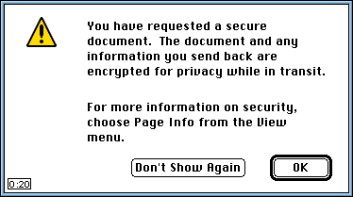
Using TLS
Warning screen from a secure page:
https://www.somewheresecure.com

Slide 201
TLS Architecture
Reliable Transport
Application
The Change Cipher Spec protocol consists of a single message that is sent by both the client and server to notify the receiving party that subsequent data will be protected under the newly negotiated Ciphersuite and keys.
The Alert protocol specifies the TLS alert messages.
Handshake
Change Cipher Spec
Alert
Record Layer
Reliable Transport
The Record Layer provides the encapsulation of the upper layer data. The data is fragmented, optionally compressed, a MAC is appended, and data and MAC are encrypted. Each transport connection is assigned to a unique TLS session.

Slide 202
Contents
Internet Layers, Basics
Management, Implementation or Design Errors
Designing Correct Protocols: The Avispa contribution
IETF Groups and Activities
Sec Protocols: Kerberos, AAA,
IPsec, IKE, IKEv2, Wlan,
PKI, TLS
High-level Protocol Spec. Language (hlpsl): Syntax, Semantics, Goals, Examples
Outlook: MobileIP, HIP, Pana

Slide 203
The basic Model: Alice, Bob, Intruder
Well-known in network security world
Alice + Bob want to communicate securely (privately, without modifications)
Alice and Bob are “roles”
Intruder may intercept, delete, add messages
Alice
channel
data, control messages
Bob
data
secure
sender
secure
receiver
data
Intruder

Slide 204
Syntax: Roles as trace Predicates
Think of a module or “role” as a formula Alice(n;x,y)
Analogy: think of p(n,x,y) a FOL formula, like (x > y+n)
Alice(n;x,y) is not talking about single values of variables, (like p does), but about traces (sequences of values).
As you may write ξ sat p(n,x,y) (sat is usually written “ |= ”),
for instance (2,10,4) sat (x > y+n)
You can also write τ sat Alice(n;x,y) for instance
((1,0,0), (1,1,0), (1,1,0), (1,1,8), (1,8,8), …)
sat (x=y=0 ∧ □ (x’ ≠ x ⇒ y ≤ x’ ≤ y’ +1) )

Slide 205
Syntax: Variables, Predicates
Set of vars V={x,x1,x2,x3,y,y1, …} called state variables (each of a determined type),
construct a copy of them called primed variables
{x',x1',y', …}
FOL predicates with free vars in V are called state predicates
and predicates with free vars in V united V' are called
transition predicates
st_pred, tr_pred
(x=y=0) is a state predicate
(x’ ≠ x ⇒ y ≤ x’ ≤ y’ +1) ) is a transition predicate

Slide 206
Syntax: Events, Stuttering
Transition predicates of the form
( t(x) ≠ t(x') ) ∧ N(x,x') where x is a tuple of variables
are called events. Events exclude stuttering (x=x')
x'=x+1 is not an event (syntactical criteria) but it excludes stuttering. It is equivalent to the event
x'≠x ∧ x'=x+1
Note that the disjunction of events is wlog also an event rewirting:
( t(x) ≠ t(x') ) ∧ N(x,x') ) ∨ ( s(x) ≠ s(x') ) ∧ M(x,x') )
( (t,s)(x) ≠ (t,s)(x') ) ∧ (N ∨ M)(x,x') )

Slide 207
Syntax: TLA Normal Form
A TLA formula in normal form is:
∃… st_pred ∧ □ ((event ⇒ tr_pred) ∧ (event ⇒ tr_pred) ∧ …)
Our hlpsl is close to this TLA form
Note: conjunction of TLA normal forms is (wlog) normal form
Conjuction is parallel composition of modules (roles)!
Two types of variables:
  flexible variables (state of the system)
  rigid variables (parameters, constants, may be instantiated at some point later)

Slide 208
TLA Example
V={x,y}
Let Prg(x) = (x=0) ∧ □ (x'≠x ⇒ x'=x+1)
Then the following traces are in Tr(Prg):
    (0,3), (0,4), (0,5), (0,6), (0,7), …
    (0,3), (1,4), (2,5), (3,6), (4,7), …
    (0,0), (1,1), (2,2), (3,3), (4,4), …
    (0,0), (0,1), (1,2), (1,3), (2,4), …
If a TLA program talks about variable x only, it does not say anything about variable y.
All traces of Prg are generated by the following "symbolic trace":
    (0,*), (1,*), (2,*), (3,*), (4,*), …
  by:
    take a prefix (including all)
    introduce any number of x-stuttering steps,
    repeat (x0,*) any number of times (even infinite)
    replace the do-not-cares "*" by any values of y

Slide 209
hlpsl Example
Prg(x) = (x=0) ∧ □ (x'≠x ⇒ x'=x+1)
Using a signal “Trigg”:
  Role Prg(Trigg,x) :=
    Owns x
    Init x = 0
    Trans
    Trigg ⇒ x’ = x +1
The var x is modified only by Prg, but it may seen outside.
Trigg
Prg
x

Slide 210
TLA Example
V={x,y}
Let Prg(x) = (x=0) ∧ □ (x'≠x ⇒ x'=x+1)
Let New(x,y) := Prg(x) ∧ Prg(y)
Exercise: What are the traces of this program?

Slide 211
TLA Example, modelling channels
Sec
A
Min
B
Hr
C
sec
min
hr
V={sec:{0,…59} ,min :{0,…59},hr :{0,…11} }
Sec := (sec'≠sec), etc. Events
Clock: = A ∧ B ∧ C
A := (sec = 0) ∧ □ (∧ Sec ⇒ sec’ = sec +1 (mod 60)
∧ Sec ∧ sec’ = 0 ⇒ Min)
B := (min = 0) ∧ □ (∧ Min ⇒ min’ = min +1 (mod 60)
∧ Min ∧ min’ = 0 ⇒ Hr)
C := (hr = 0) ∧ □ ( Hr ⇒ hr’ = hr +1 (mod 12))

Slide 212
hlspl Example, the clock
Sec
A
Min
B
Hr
C
sec
min
hr
Clock: = A ∧ B ∧ C
Role A(Sec,sec,Min) :=
Init sec = 0
Trans Sec ⇒ sec’ = sec +1 (mod 60)
Sec ∧ sec’ = 0 ⇒ Min

Slide 213
Implementing the clock with local variables
Sec
A
Min
B
Hr
C
sec
min
hr
Who owns the minutes?
Separate Min + min, etc
Redefine Min := v_Min’ ≠v_Min
Role A(Sec,sec,Min) :=
Owns sec, Min
Init sec = 0
Trans Sec ⇒ sec’ = sec +1
Sec ∧ sec’ = 0 ⇒ Min
A = (sec = 0) ∧ □ (∧ Sec ⇒ sec’ = sec +1
∧ Sec ∧ sec’ = 0 ⇒ Min
∧ sec ≠ sec’ = 0 ⇒ Sec
∧ Min ⇒ Sec ∧ sec’ = 0 )

Slide 214
Types of Channels
role A (p; v, channels: channel (dy|secure|ota|…) ) :=
…
end role

Slide 215
Basic Roles: Semantics
role Basic_Role (…) :=
owns {θ: Θ}
local {ε}
init Init
accepts Accept
transition
event1 ⇒ action1
event2 ⇒ action2
…
end role
Trigg(Basic_Role) := event1 ∨ event2 ∨ … %% This is also an event!
Init(Basic_Role) := Init
Accept(Basic_Role):= Accept(A) ∧ Accept(B) ∧ Accept
Mod(x,Basic_Role) := ∨ {eventi | x’ ocurrs in actioni (or in a LHS channel val)}
Step(Basic_Role) := Trigg(Basic_Role) ∧ (event1 ⇒ action1) ∧ (event2 ⇒ action2) ∧ ...
TLA(Basic_Role) := ∃ ε { Init ∧ □ [ (event1 ⇒ action1) ∧ (event2 ⇒ action2) ∧ ...
∧ (∧ _(θ∈Θ) θ‘≠ θ ⇒ Mod(θ,Basic_Role)) ] }

Slide 216
Basic Roles: Semantics
role A (…) :=
owns {θ: Θ}
local {ε}
init Init
accepts Accept
transition
event1 ⇒ action1
event2 ⇒ action2
…
end role
Trigg(A) := event1 ∨ event2 ∨ … %% This is also an event!
Init(A) := Init
Accept(A):= Accept
Mod(x,A) := ∨ {eventi | x’ ocurrs in actioni (or in a LHS channel val)}
Step(A) := Trigg(A) ∧ (event1 ⇒ action1) ∧ (event2 ⇒ action2) ∧ ...
TLA(A) := ∃ ε { Init ∧ □ [ (event1 ⇒ action1) ∧ (event2 ⇒ action2) ∧ ...
∧ (∧ _(θ∈Θ) θ‘≠ θ ⇒ Mod(θ,A)) ] }

Slide 217
Basic Roles: Semantics
role A (…) :=
owns {θ: Θ}
local {ε}
init Init
accepts Accept
transition
event1 ⇒ action1
event2 ⇒ action2
…
end role
Trigg(A) := event1 ∨ event2 ∨ … %% Also event!
Init(A) := Init
Accept(A):= Accept
Mod(x,A) := ∨ {eventi | x’ ocurrs in actioni
(or in a LHS channel val)}
Step(A) := Trigg(A) ∧
(event1 ⇒ action1) ∧ (event2 ⇒ action2) ∧ …
TLA(A) := ∃ ε { Init ∧ □ [
Trigg(A) ⇒ Step(A)
∧ (∧ _(θ∈Θ) θ‘≠ θ ⇒ Mod(θ,A)) ] }
Note:
Step(A) ⇒ (event1 ∧ action1) ∨ (event2 ∧ action2) ∨ …
TLA(A) = ∃ ε { Init ∧ □ [
(event1 ⇒ action1) ∧ (event2 ⇒ action2) ∧ …
∧ (∧ _(θ∈Θ) θ‘≠ θ ⇒ Mod(θ,A)) ] }

Slide 218
Semantic of Composed Roles: modular approach
A ⊗ B = Composition(A,B):
Parallel, Sequential (+taking ownership, hiding)
IF-Programs ← hlpsl-Programs → TLA-Formulas
IF(A) , IF (B) ← A , B → TLA(A) , TLA(B)
↓ ↓ ↓
IF(A) ⊕ IF (B) ← A ⊗ B → TLA(A) • TLA(B)
For Parallel composition:
TLA(A) • TLA(B) = TLA(A) ∧ TLA(B) ∧ extra_glue (for ownnership)

Slide 219
Semantic of Composed Roles: flattening approach
A ⊗ B = Composition(A,B):
Parallel, Sequential (+taking ownership, hiding)
flatten: hlpsl-Programs → hlpsl-Programs
For basic roles: flatten(A) = A
For composed roles: flatten(A ⊗ B) = arrange(flatten(A),flatten(B))

Slide 220
Composed Roles: Parallel
role Par_Role ( parameters; variables, channels) := % Parallel Composition of A and B
owns {θ:Θ}
local {ε}
init Init
accepts Accept
A ∧ B
end role
Trigg(Par_Role) := Trigg(A) ∨ Trigg(B)
Init(Par_Role) := Init(A) ∧ Init(B) ∧ Init
Accept(Par_Role) := Accept(A) ∧ Accept(B) ∧ Accept
Mod(x,Par_Role) := Mod(x,A) ∨ Mod(x,B)
TLA(Par_Role) := ∃ ε { Init ∧ A ∧ B
∧ □ [ (∧ _(θ∈Θ) θ‘≠ θ ⇒ Mod(θ, Par_Role)) ] }

Slide 221
Composed Roles: Seq
role Seq_Role ( parameters; variables, channels) := %Sequential Composition of A and B
owns {θ:Θ}
local {ε}
init Init
accepts Accept
A ; B
end role
Trigg(Seq_Role) := (flag = 0 ∧ Trigg(A)) ∨ (flag = 1 ∧ Trigg(B))
Init(Seq_Role) := flag = 0 ∧ Init(A) ∧ Init
Accept(Seq_Role) := Accept(B) ∧ Accept
Mod(x,Seq_Role) := (flag = 0 ∧ Mod(x,A)) ∨ (flag = 1 ∧ Mod(x,B))
TLA(Seq_Role) := ∃ ε,flag {Init(Seq_Role)
∧ □ [(Trigg(A) ⇒flag=0) ∧ (Trigg(B) ⇒flag=1)
(flag' ≠ flag => flag' = 1
∧ Accept_A’
∧ Init_B')

Slide 222
Example: Share protocol
A
B
choose Na
sent it encrypted
withPK of B
{Na}PK(B)
choose Nb
sent it encrypted
withPK of A
{Nb}PK(A)
k = hash(Na.Nb)

Slide 223
hlpsl: Share: basic roles
role Initiator(A,B, PK: agent -> public_key; SND, RCV: channel (dy)) :=
exists St:{0,1,2}, Na:text (fresh), Nb:text
init St=0
transition
St=0 ∧ RCV(start) ⇒ St'=1 ∧ SND({Na'}PK(B))
St=1 ∧ RCV({Nb'}PK(A)) ⇒ St'=2 ∧ secret(hash(Na,Nb’))
goal
secrecy % of hash(Na,Nb)
end goal
end role
role Responder(A,B, PK: agent -> public_key; SND, RCV: channel (dy)) :=
exists St:{0,1,2}, Na:text, Nb:text (fresh)
init St=0
transition
St=0 ∧ RCV({Na'}PK(B)) ⇒ St'=1 ∧ SND({Nb'}PK(A)) ∧ secret(hash(Na’,Nb’))
goal secrecy end goal
end role
Explicit secrecy goals

Slide 224
Needham-Schroeder Public Key Protocol (NSPK): Alice
role Alice (A,B: agent,
Ka, Kb: public_key,
SND,RCV: channel (dy)) played_by A def=
exists State : nat, Na : text (fresh), Nb: text
init State=0
knowledge(A) = { inv(Ka) }
transition
step1. State=0 /\ RCV(start) =|> State'=1 /\ SND({Na'.A}Kb)
step2. State=1 /\ RCV({Na.Nb'}Ka) =|> State'=2 /\ SND({Nb'}Kb)
end role
played_by
knowledge
start message to signal an initiator that he should start
step1 and step2 are merely labels

Slide 225
NSPK: Bob
role Bob(A: agent,
Ka, Kb: public_key,
SND,RCV: channel (dy)) played_by B def=
exists State : nat, Na: text, Nb: text (fresh)
init State=0
knowledge(B) = { inv(Kb) }
transition
step1. State=0 /\ RCV({Na'.A}Kb)
=|> State'=1 /\ SND({Na.Nb'}Ka)
step2. State=1 /\ RCV({Nb}Ka)
=|> State'=2
end role

Slide 226
NSPK: Composing the roles
role NSPK(S,R: agent -> channel (dy),
Instances: (agent,agent, public_key,public_key) set) def=
exists A, B: agent, Ka, Kb: public_key
composition
/\_{in((A,B,Ka,Kb),Instances)}
Alice(A,B,Ka,Kb,S(A),R(A))
/\ Bob(A,B,Ka,Kb,S(B),R(B))
end role

Slide 227
NSPK: Sessions and Goals
role Environment() def=
composition
NSPK([(a,s_a),(b,s_b)], % S
[(a,r_a),(b,r_b)], % R
[(a,b,ka,kb),(a,i,ka,ki)]) % Instances
end role
goal
Alice weakly authenticates Bob on Nb
Bob weakly authenticates Alice on Na
secrecy of Na, Nb
end goal

Slide 228
Share: goals
A->B: {NA}k(B)
B->A: {NB}k(A)
Agents will use h(NA,NB) as shared key.
The authentication goals
A authenticates B on NB (or on (NA,NB))
and
B authenticates A on NA (or on (NA,NB))
are trivially violated:
i(a) -> B: {X}k(B)
B -> i(a): {nb}k(A)
Now B believes (X,nb) is the shared key between a and him, while a is not even present.
Not a "real" attack:
  intruder does not find out the nonce nb
  and can never use the shared key

Slide 229
Share
Also execution of B is stuck: nobody except B knows the shared key, nobody can send messages with this key.
Same problem with the first-phase of IKE: intruder can play a MiM, but can not find out the key and the protocol execution is stuck, no second-phase protocol can be executed.
Protocol does not satisfy the authenticate goal:
when B receives the first message of the protocol, he can not be sure that it actually comes from A.
A must prove her presence by sending a message encrypted with the key h(NA,NB).

Slide 230
Share
See this part of protocol as a challenge, add the response:
  A->B: {NA}k(B)
  B->A: {NB}k(A)
  A->B: {0,..}h(NA,NB)
  B->A: {1,..}h(NA,NB)
“0”, “1” inserted to distinguish the two messages
then intruder can not simply reflect this message 3 from A back to A
New goals:
A authenticates B on NA,NB,MA
B authenticates A on NA,NB,MB
secrecy of NA,NB,MA,MB

Slide 231
“Incomplete Protocols”
"the key-exchange phase of the protocol does not YET provide the authenticate itself, but rather after the first use of the key the agents authenticate each other."
We found no further attacks on SHARE.
We have taken SHARE (with the additional messages 3 and 4) as an example and could verify (within seconds!) secrecy and weak authentication (in a typed model for an unbounded number of sessions and agents).

Slide 232
List of Protocols
SHARE
UMTS-AKA 3GPP
ISO Pub Key wout T3 Party
ChapV2 AAA
EKE cat,sasl,NWWG
SRP cat,sasl,NWWG
EKE2
SPEKE
ASW
AAA-MobileIP mobileip
IKEv2 main mode ipsec
Two-Party RSA Sig Schemes
TLS
TWSS Liberty
Kerberos krb-wg
HIP HIP
Mut Auth for low-power dev
TESLA MSEC
sucv mobileip
BU in IPv6 mobileip
TLS tls
SSH secsh
Key-Priv in Pub-Key Encr PKIX
Payment in UMTS 3GPP
CMS Symmetric Key Mang smime
SET
FairZG

Slide 233
Contents
Internet Layers, Basics
Management, Implementation or Design Errors
Designing Correct Protocols: The Avispa contribution
IETF Groups and Activities
Sec Protocols: Kerberos, AAA,
IPsec, IKE, IKEv2, Wlan,
PKI, TLS
High-level Protocol Spec. Language (hlpsl): Syntax, Semantics, Goals, Examples
Outlook: MobileIP, HIP, Pana

Slide 234
IP mobility
MN moves from one IP address to another
  moves between network coverage areas or media types,
  its logical point of network access changes, or
  a whole subnetwork moves (not covered in MobileIP).
Mobility protocols
  maintain existing connections over location changes
  ensure that MN can be reached at its new location.
Location management = mechanism for informing other nodes about MN's current address. Approaches:
  a directory service where MN's location is maintained or
  direct notifications to the nodes that need to know about the new location.

Slide 235
Mobility Management
Correspondent Node
CN
Visited Domain
Home Domain
Leaf
Router
LR
HA
Home Agent
Two addresses:
HoA: home address (fixed: to identify MN)
CoA: care-of address (to locate MN)
  that changes at each new pt of attachment.
How are such „Bindings“ created / modified?
Notes:
The triplet that contains the HoA , CoA, and registration lifetime is called a binding for the mobile node.
One MN may have several CoA, that is several bindings.
How are bindings created?
How are they updated?
A registration request can be considered a binding update sent by the mobile node

Slide 236
Mobility Management
CN
LR
HA
Triangular Routing
Binding Update (BU):
Route optimization
Notes:
The triplet that contains the HoA , CoA, and registration lifetime is called a binding for the mobile node.
One MN may have several CoA, that is several bindings.
How are bindings created?
How are they updated?
A registration request can be considered a binding update sent by the mobile node

Slide 237
Security Problems
CN
X
LR
HA
Attacker may redirect the traffic:
MiM
DoS (starving, flodding, boming)
Notes:
The triplet that contains the HoA , CoA, and registration lifetime is called a binding for the mobile node.
One MN may have several CoA, that is several bindings.
How are bindings created?
How are they updated?
A registration request can be considered a binding update sent by the mobile node

Slide 238
IP V6
Adress size increased from 32 to 128 bits.
Auto-configuration to generate locally CoA:
Routing prefix
MAC Address
64-bit routing prefix, which is used for
  routing the packets to the right network
64-bit interface identifier,
  which identifies the specific node
  can essentially be a random number.

Slide 239
Mobile IPv6
MN is identified by a home IP address (HoA)
IP addresses in MIPv6 can identify either a node or a location on the network, or both.
Home agent (HA, a router)
  acts as MN's trusted agent and
  forwards IP packets between MN's correspondent nodes (CN) and its current location, the care-of address (CoA)
The MIPv6 protocol also includes a location management mechanism called binding update (BU).
MN can send BUs to CN and HA to notify them about the new location so that they can communicate directly
MN may also be triggered to sending a BU when it receives a packet from a new CN via HA.

Slide 240
Binding Update
MN and HA have a permanent trust relationship and a preconfigured security association for encrypted and authenticated communication.
MN informs HA about its location via this secure tunnel.
MN and its HA can cooperate to send BUs to CNs, with which they often have no preexisting relationship.
CN stores the location information in a binding cache entry, which needs to be refreshed regularly by sending a new BU.

Slide 241
Threats
Misinform CN about MN’s location
  Redirect packets intended for MN
    compromise of secrecy and integrity
    denial-of service (MN unable to communicate).
Attacker sending bogus BUs may use own address as CoA, impersonating MN.
  highjack connections between MN and its CNs or
  open new ones.
Or redirect packets to a random or non-existent CoA (DOS).
  MN has to send a new BU every few minutes to refresh the binding cache entry at CN.
the attacker can make any node believe that any other node, even a non-MN one, is MN and has moved to the false CoA.
  Side effect of making mobility transparent.

Slide 242
Replay Attacks
Time stamps would be problematic because MNs may not be able to maintain sufficiently accurate clocks.
Sequence-numbered BUs, on the other hand, could be intercepted and delayed for later attacks.
A nonce-based freshness mechanism seems practical because many related authentication and DoS protection mechanisms use nonces anyway.

Slide 243
Why not IPSec, IKE, and PKI?
BU authentication: could use strong generic authentication mechanisms and infrastructure: IPSec, IKE, and PKI.
Overhead too high for low-end mobile devices and for a network-layer signaling protocol.
Internet mobility protocol should allow anyone to become MN and it must allow all Internet nodes as CNs.
  A single PKI must cover the entire Internet.

Slide 244
Cryptographically Generated Addresses (CGAs)
Take last 64 bits of the IP address (interface identifier) as one-way hash of a PK. MN signs its location information with the corresponding private key and sends the PK along with the data.
The recipient hashes the public key and compares HAsh to the address before verifying the signature on the location data.
Used without any trusted third parties, PKI, or other global infrastructure.
Weakness: at most 64 bits of the IP address can be used for Hash. Perhaps brute force attack will become possible during the lifetime of MobIPv6.

Slide 245
CGAs
Strong signature key generation expensive, but weak signature keys may be used.
Advances in storage technology may enable the attacker to create a large enough database for finding matching keys at high probability.
CGA do not stop the attacker from inventing new false addresses with an arbitrary routing prefix. The attacker can generate a public key and a matching IP address in any network. Thus CGA addresses prevent some packet-flooding attacks against individual addresses but not against entire networks.
Public-key protocols (including CGA) are computationally intensive and expose the participants to DoS.

Slide 246
Routing-based authentication
Idea: send 1st message through a relatively safe route (hope it is not intercepted).
  Here: Route between CN and HA.
  CN can send a secret key to HA (plaintext).
HA forwards key to MN (secure tunnel),
MN uses key for authenticating a BU to CN:
  MN → CN: BU with MAC (computed with secret key).
CN
HA

Slide 247
Routing-based authentication
Reasonable: very few Internet nodes can listen to or modify packets on the right routers to mount an attack against a given connection.
  At most 10-20 routers see the secret keys for a specific connection
Not secure in the classical sense
  But much better than unauthenticated situation.
HA and CN are typically located on the wired network and communication is relatively secure compared to the packets to and from a wireless MN.
  An attacker between MN at home and a CN can mount equally damaging attacks
  Recall that the goal is to address the additional threats created by mobility
Weaker than CGA

Slide 248
Sending 2 Pieces of Authentication Data
Other proposals for BU authentication:
Send 2 pieces of authentication data between CN and MN via 2 independent routes and hoping that most attackers are unable to capture both of them.
CN
HA

Slide 249
Leap-of-faith authentication
MN sends a session key insecurely to CN at the beginning of their correspondence and the key is used to authenticate subsequent BUs, no safe route.
  Attacker can send false key before the MN sends the key
  Need a recovery mechanism for situations where MN or CN loses its state; attacker can exploit this mechanism
  Attacker can trigger the BU protocol at any time by sending to MN's home address a spoofed packet that appears to come from CN

Slide 250
Ingress Filtering
A way of limiting the number of potential attackers.
A gateway router or firewall
  checks the source addresses of outgoing packets
  drops ones that do not originate from the network
    Prevents nodes on the network from sending spoofed packets that claim to come from other networks
Since MN's new address in a MIPv6 BU is usually sent in the source address field of the IP packet header, ingress filtering limits the choice of false addresses.
There are, however, two well-known weaknesses:
  Ingress filtering must be applied on the attacker's local network; on the target network it makes no difference.
  MIPv6 specifies an alternative mechanism (Alternative CoA sub-option) that can be used for sending a false CoA without source spoofing.

Slide 251
Another DoS
Authentication does not prevent the attacker from lying about its own location.
Attacker acts as MN, sends false location data to CNs and get them to send traffic to an arbitrary IP address.
It first subscribes to a data stream (e.g. a video stream from a public web site) and then redirects this to the target address.
Bomb any Internet node or network with excessive amounts of data.
  Attack an entire network by redirecting data to a nonexistent address and congesting the link toward the network.
The attacker may even be able to spoof the (say TCP) acknowledgements

Slide 252
Another DoS (cont)
The attacker performs the TCP handshake itself and thus knows the initial sequence numbers. After redirecting the data to the target, it suffices to send one spoofed ack per TCP window to CN.
TCP provides some protection against this attack:
  If the target address belongs to a real node, it will respond with TCP Reset, which prompts CN to close the connection.
  If target is a non-existent address, the target network may send ICMP Destination Unreachable messages. Not all networks send this latter kind of error messages.
The attack is not specific to MIPv6:
  Dynamic updates are made to Secure DNS, there is no requirement or mechanism for verifying that the registered IP addresses are true.
  ICMP Redirect messages enable a similar attack on the scale of a local network. We expect there to be other protocols with the same type of vulnerability.

Slide 253
Variation: Bombing HoA
Im MIPv6 the MN has a default address, to which data will be sent when its current location is unknown.
Attacker claims to have a HoA in the target network. It starts downloading a data stream and either sends a request to delete the binding cache entry or allows it to expire. This redirects the data stream to the false HoA .
CGA prevents bombing individual addresses but not whole networks
  generate a new address with its routing prefix.

Slide 254
Bombing HoA
The target itself cannot do anything to prevent the attack.
  it does not help if the target stops sending or accepting BUs.
The attacker needs to find a CN that is willing to send data streams to unauthenticated recipients.
  Many popular web sites provide such streams.
A firewall on the border of the target network may be able to filter out packets to nonexistent addresses.
  However, IPv6 addressing privacy features can make such filtering difficult.

Slide 255
Limiting bombing attacks: Return Routability
Test the return routability (RR) of MN's new address
  CN sends a packet with a secret value to the new location and accepts the BU only if MN is able to return the value (or hash)
  Thus MN can receive packets at the claimed address
  Number of potential attackers is strongly reduced
Figure shows how a BU is authenticated using two secrets, which CN sends to MN's home and CoAs. The secret sent directly to the CoA forms the RR test.
The RR test can be seen as a variation of the cookie exchange, used in TCP, Photuris, and IKE
CN
HA

Slide 256
RR
Expiry of a binding cache
  Deleting the cache entry means that MN's new address defaults to the HoA , but since MN may have become unreachable, it is not always possible to test RR for the new address.
One solution:
  mark the cache entry as invalid and
  stop sending data to MN until the RR test succeeds
    Then some cache entries are never deleted.
Alternative: additional RR test for the HoA during every BU
  Invariant: a successful RR test for the HoA has been performed recently
  When the cache entry needs to be deleted, it can be deleted immediately
    BU cancellation, expiring cache entry, or failing BU authentication
  This limits bombing-attack targets to networks where attacker has recently visited.

Slide 257
RR
In routing-based authentication (CN sends a plaintext key to MN via its HoA), the same secret key can also serve as the RR test for the HoA .
Thus CN tests return routability of both HoA and CoA.
RR is complementary to CGA-based BU authentication, which does not prevent bombing of the home network.

Slide 258
Transport layer: Flow Control
When sending a data flow into a new route, CN could first verify that this route accepts the data
Send first a single packet and increase the transmission rate gradually.
TCP: reset the TCP window size to one packet when MN moves. This would, in effect, test return routability of the new route before sending large amounts of data into it.
Adding a secure RR test to all transport protocols and changing existing implementations is not be possible in practice.
Some transport-layer protocols either do not practice TCP compatible congestion control or allow spoofing of acknowledgments.
Therefore: return routability test in the IP layer.

Slide 259
DoS Attacks against unnecessary BU Authentication
When a MIPv6 MN receives an IP packet from a new CN via its home network, it may automatically send a BU to CN.
The attacker can exploit this by sending MN spoofed IP packets (e.g. ping or TCP SYN packets) that appear to come from different CN addresses.
The attacker will automatically start the BU protocol with all these CNs.
If CN addresses are real addresses of existing IP nodes, most instances of the BU protocol will complete successfully. The entries created into the binding caches are useless.
This way, the attacker can induce MN or CN to execute the BU protocol unnecessarily, which will drain host's resources.
A strong cryptographic authentication protocol is more vulnerable than a weak or unauthenticated.

Slide 260
Reflection and Amplification
Reflection: Attacker sends data to other nodes and tricks them into sending the same number, or more (amplification), packets to the target.
  Possible even when ingress filtering prevents source address spoofing.
The location management protocols could also be used for reflection. For example, CN in Figure responds to the initial packet by sending two packets to MN (one to the HoA and one to the new address).
  If public-key authentication is used, the packets sent by CN may be significantly larger than the one that triggers them.

Slide 261
Preventing Resource Exhaustion: Delaying Commitment
Idea: delay committing one's resources until other party has shown its honesty
Require first a weaker authentication, such as a RR, before expensive computation.
Making the protocol parties stateless:
  usually only the responder can be stateless,
  not clear which party initiates the BU process and which one responds.
    MN normally initiates the authentication,
    this may be triggered by a packet belonging to another protocol that arrived from CN via HA.
    Moreover, if a packet sent by CN triggers a BU, CN's IP layer does not know that this was the case because the IP layer is stateless and does not maintain a history of sent packets.
  Make CN stateless until the BU has been authenticated.
One way in which CN can remain stateless is to derive a values Ka using a one-way function from a secret value N known only by CN and a value dependent on the MN:
  CN uses the same value of N for all MNs.
  It can discard Ka because it can recompute the values after receiving the final message.
CN generates a new secret Ni periodically.

Slide 262
Cryptographic puzzles
Used to protect against resource-exhaustion attacks.
A server requires its clients to solve a puzzle, e.g. bruteforce search for some input bits of a one-way function, before committing its own resources to the protocol.
The server can adjust the difficulty of the puzzles according to its load.
Solving the puzzle creates a small cost for each protocol invocation, which makes flooding attacks expensive but has little effect on honest nodes.
Drawbacks:
  IP layer does not know which node is the server (i.e. the respondent)
  MNs often have limited processor and battery capacity while an attacker pretending to be a MN is likely to have much more computational resources
The puzzle protocols work well only when all clients have approximately equal processing power

Slide 263
Setting a limit on the amount of resources
Processor time, memory and communications bandwidth, used for location management.
When the limit is exceeded, communication needs to be prioritized.
A node that exceeds the limit should stop sending or accepting BUs and allow binding cache entries to expire.
Although communication can continue via MN's home network, it is suboptimal.
Node should try to resume normal operation when attack may be over.
Ingress filtering at the attacker's local network mitigates the resource exhaustion attacks by making it easier to trace the attacker and to filter out the unwanted packets.

Slide 264
Favoring Regular Customers
CN's local security policy: allow BUs with some
  high-priority MNs or
  those with which it has a long-term relationship or
  recent meaningful communication.
The decision may violate the layering principle: a Web server could accept BUs from its clients after it has successfully executed the TCP handshake.

Slide 265
How does MN obtain its CoA?
IPv6 stateless address autoconfiguration used to obtain an IPv6 address for MN.
Host combines tentative interface identifier with link-local address prefix and probes address with a Neighbor Solicitation message.
If another host is already using this address then he sends a Neighbor Advertisement message.
An intruder can use this protocol exchange for a DoS attack.
IETF Send WG tries to solve this problem.
Stateful address autoconfiguration (DHCP)

Slide 266
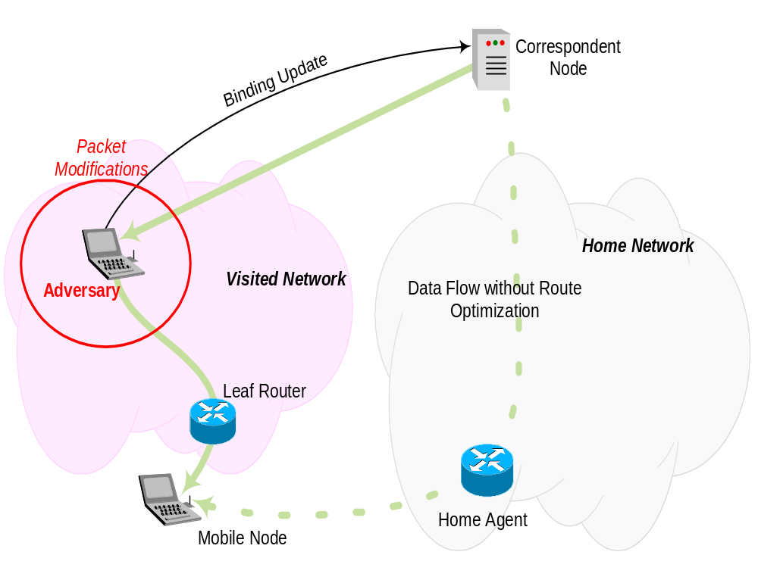
Security Problems?
Binding Updates (BU) are
security relevant.
⇒ BU enables
source routing
Unprotected BUs:
- Denial of Service attacks
- Man-in-the-Middle attacks
Binding Updates between HA<->MN and between CN<-> MN experience different protection.

Slide 267
The Home Address
The home address (HoA) must be unique for each MN (global reachable IP address).
Functionality:
  Connection endpoint identifier for long-lived connection
  Is used to reach MN
  (HoA,CoA) pair used to create profile for personalization
  Can used to identify MN for billing and charging
  (additionally to NAI)

Slide 268
Selected Problem 1: Privacy [RFC2462]
Hosts selects interface identifier
Interface identifier is based on the link layer address
Since the link layer address rarely changes MN is uniquely identified
CoA Prefix reveals location of MN (source address)
HoA
  represents long-lived endpoint identifier
  is unencrypted
  revealed to CN (Route Optimization)
CoA and/or HoA enable profiling

Slide 269
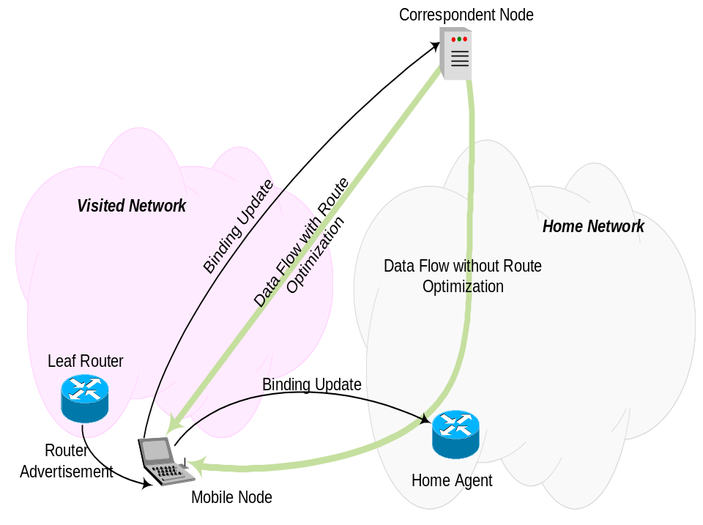
Solutions for Privacy Problem
Bi-directional IPSec tunnel from MN to HA
  Very expensive communication
HA option encryption
  Requires modification to IPSec
IPv6 Privacy Extension
  Changing stateless address
  autoconfiguration
Disable Route Optimization
  Performance degradation
Castelluccia Mobile IPv6 Privacy Proposal
  Uses Temporal Mobile Identifier
  TMI changed temporarily, HoA encrypted

Slide 270
Standard Sec Infrastructure cannot be used
To enable route optimization
⇒ BU must be sent to CN
Consequences:
  Security Association between MN-CN required
  Previously suggested: IPsec (together with IKE)
  IPsec does not address mobility specific problems; IKE is computationally expensive;
  Public key infrastructure not available
  Protection of BU difficult
  ⇒ IPSec policies too coarse grained
  CN has to run many IKE exchanges
  CN has to store a large number of SAs
  Vulnerability against active attackers may be acceptable
  ⇒ Unauthenticated key agreement/key transport

Slide 271
Selected Problem 2: Address Ownership
Authorization Problem
  MN must show that it is owner of an IP address
Is this MN allowed to set the (CoA,HoA)-binding?
First proposal to address this mobility & security problem:
  Purpose Built Keys
  Proposal does not require a PKI or similar security infrastructure
  Does not provide “perfect” security (i.e. protection against all attacks)
After this proposal was published similar proposals have been submitted.

Slide 272
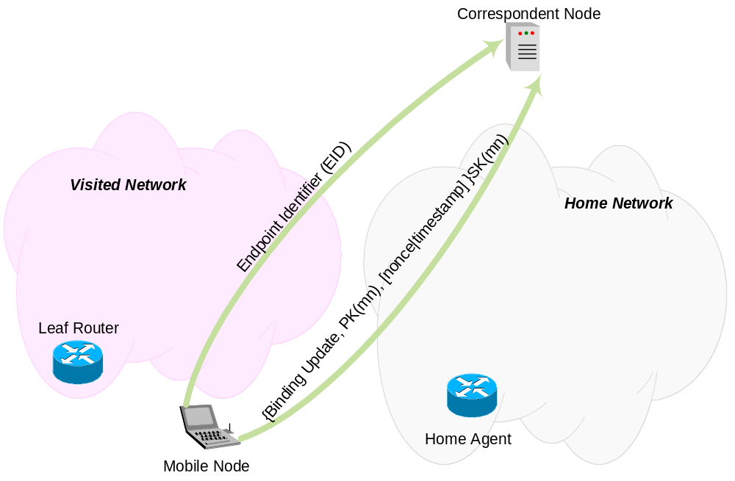
Purpose Built Keys

Slide 273
Mobile IPv6 Security
MN ⇔ CN Binding Update
Home Test Init
CN
Binding
Update
HA
Care-of Test Init
Home Test
Care-of
Test
Home Test
Home
Network
Home Test Init
MN
Security Property: Return Routability
Verifies that a node is able to respond to packets sent to a given address
Assumption: Routing infrastructure is secure

Slide 274
HIP (Host Identity Payload + Protocol) Overview
Protocol proposal submitted by Bob Moskowitz.
HIP is developed independently (not within an IETF working group).
Protocol proposal contains:
A new namespace / new identity
An authentication and key exchange protocol
Architecture

Slide 275
HIP: A new namespace / new identity
Basic Idea: Cryptographic identity for a host
An IP address to identify a host is not the best idea
(see multi-homed hosts, virtual interfaces)
Used Identities:
  Host Identity (=Public Key)
  Host Identity Tag (=hash of the public key, 128 bit)
  SPI (same as in IPSec)
  LSI (32-bit Local Scope Identity)
Security Association indexed by Host Identity Tag (HIT)
32 bit value (LSI) is used to support IPv4 applications
Host Identities can be well-known or anonymous
Higher layers only see identities, not addresses

Slide 276
HIP Architecture
An additional Identifier
Application-specific identifiers
Application Layer
Pairs <IP address, Port#> + Transport Protocol ID
Transport Layer
Host Identity (HI)
Host Identity
IP address
Network Layer
Link layer address
Data Link Layer

Slide 277
HIP: Authentication and key exchange
The HIP protocol is used to create an IPSec ESP security association
The protocol has the following properties:
  DoS protection with the client-puzzle mechanism
  Re-keying provided by a separate protocol
  Digital signatures and certificates are exchanged in a DNS like data structure.
  The DNS protocol is strongly integrated with HIP
  Identities are stored into the DNS (DNS Binary Labels allow reverse mapping).
Including the HIP identity in every packet would be difficult. Therefore HIP is always combined with IPSec ESP where the HIP Identity is “compressed” into IPsec ESP SPI.

Slide 278
HIP Properties
IP addresses still used for routing packets.
Bandwidth conservative
Each host must have at least one key pair
A 128 bit hash or tag to be used in system calls
End-to-end use but integration of intermediate devices planned.
HIT replaces IP address as the ‘name’ of a host
Enables mobility and allows simpler multi-homing
Addressing realm friendliness
Support for different addressing schemes, end-to-end => IPv4/IPv6 migration

Slide 279
What about PKI and HIP?
HIP assumes interaction with DNS
  Identity in KEY records
  DNSSEC required for trustable as the 3rd party authentication
Payload uses DNS RR formats
  Reuse existing code
  KEY, SIG, OPT, and A records
  Subject to change to reduce packet size

Slide 280
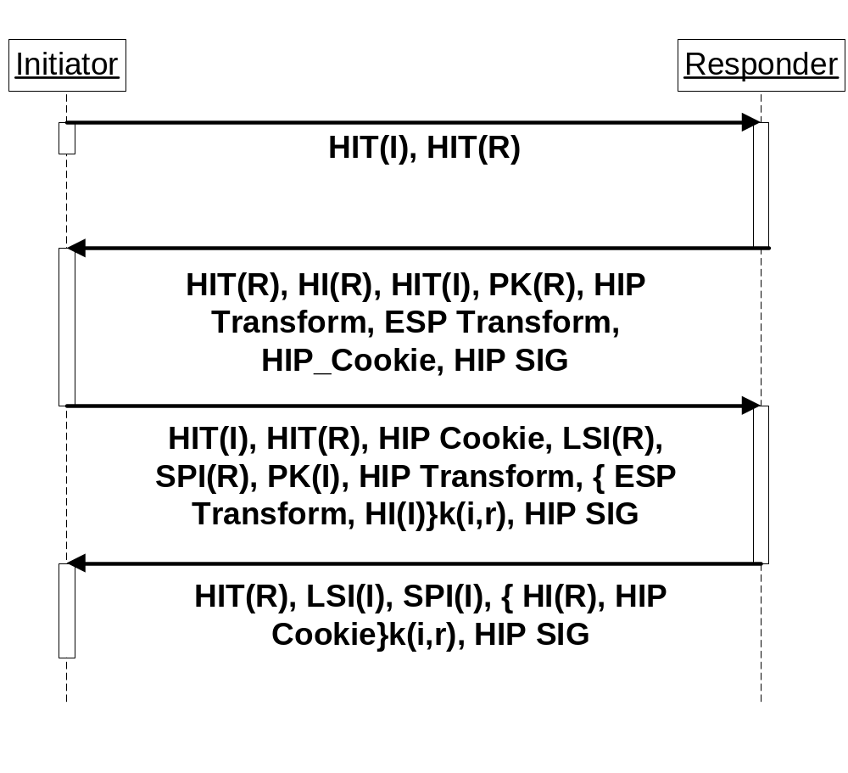
HIP Protocol Exchange

Slide 281
HIP Protocol Exchange
Legend
Host Identity Tag – HIT
Host Identity – HI
I – Initiator
R – Responder
PK(R), PK(I) – Diffie-Hellman Public Key of Responder (Initiator)
k(i,r) – session key computed between I and R
HIP SIG – Digital Signature computed over the entire packet
HIP (ESP) Transport – List of algorithm to be negotiated (used)
HIP Cookie – Values required for the Client Puzzle
LSI – Local Scope Identity
SPI – Security Parameter Index

Slide 282
Special HIP Packets
Message for rekeying
Bootstrapping for the case where the initiator does not possess the HIT of the responder.
Packet to announce readdressing
  Readdressing required because of:
    PPP reconnect
    DHCP new lease, IPv6 address prefix change
    Mobility related readdressing
    IPv6 privacy related IP address change

Slide 283
Summary
HIP introduces new and interesting concepts.
The introduction of a new address space based on a cryptographic identity makes a lot of things easier:
  Mobility
  Multi-Homing
  IPv4/IPv6 Transition
Solutions are already there for these problems;
HIP solves the problems in a different way.
Additionally HIP has security integrated into the protocol.
Open Source implementations might create an interesting alternative.

Slide 284
Authentication, Authorization and Accounting (AAA)
Authorization: Is a particular entity able to pay for the requested resources?
Which resource?
  Certain services
  Specific QoS
  Amount of time being online
  Data volume transmitted/received
Goal:
  1) Establishing a financial settlement
  2) Prevent unauthorized nodes from gaining access to resources
Two basic models for (1):
  Subscription-based Architecture
  Alternative Access Architecture

Slide 285
Subscription-based Architecture
AAA
Access Network
AAAL
AAAH
AAA
Home
Network
AR
EAP over PANA, IEEE 802.1x, ICMP, etc.
Terms:
AAAL - Local AAA server
AAAH - Home AAA server
MN
MN is registered at home network (typically secret key based).
Several protocol proposals exist for transport of AKA information between MN and the AAA attendant.

Slide 286
Alternative Access Architecture
Payment Protocol
Charging
AAA
CCS
CCC
Background
Payment System
Access Network
AR
Charging
EAP over PANA, IEEE 802.1x, ICMP, etc.
Background
Payment System
Terms:
CCS – Credit Control Server
CCC – Cost Charging Centre
MN

Slide 287
PANA
Protocol for carrying Authentication for Network Access (pana)
Provides carrier for EAP messages over IP (UDP)
Provides in-order delivery of packets
PANA is a protocol for heterogeneous network access (link layer agnostic).
PANA provides a mechanism for the PAC to discover the PAA on the link
Provides different mechanisms to prevent unauthorized nodes from accessing the network (interaction with other protocols)

Slide 288
PANA Framework
PaC
EP
PAA
AAA
PAA Discovery
PANA Request
AAA Interaction
PANA Response
PANA SA
PANA SA
Filter information
installation
Access control SA establishment
Protected PANA Messages
Note that some protocol interactions are optional.
Terminology: http://www.ietf.org/internet-drafts/draft-ietf-pana-requirements-05.txt

Slide 289
PANA Security Association Establishment
PaC
PAA
AAA
PAA Discovery
EAP Authentication (PaC ⇔ AAA[L|H] Authentication)
AAA Session
Key Transport
PANA SA
PANA SA
Protected PANA Messages
PANA relies on EAP methods to produce keying material for PANA SA.

Slide 290
Literature
PANA IETF WG:
  http://www.ietf.org/html.charters/pana-charter.html
WLAN Security:
  Fluhrer, Mantin, Shamir: "Weaknesses in the Key Scheduling Algorithm of RC4"
  (see http://citeseer.nj.nec.com/fluhrer01weaknesses.html)
EAP IETF WG:
  http://www.ietf.org/html.charters/eap-charter.html
AAA IETF WG:
  http://www.ietf.org/html.charters/aaa-charter.html
PPPEXT IETF WG:
  http://www.ietf.org/html.charters/pppext-charter.html
Airsnort Software:
  http://airsnort.shmoo.com/
Open Source IEEE 802.1X (EAP) Implementation:
  http://www.open1x.org

Slide 291
Literature
Linux (FreeS/Wan: http://www.freeswan.org/)
Contains AH, ESP (Klips) and IKE (Pluto)
IETF IPsec WG: http://www.ietf.org/html.charters/ipsec-charter.html
AES Support: http://www.irrigacion.gov.ar/juanjo/ipsec/
IPv6 and IPSec: http://www.ipv6.iabg.de
BSD (e.g. http://www.netbsd.org/Documentation/network/ipsec/)
IKE Daemon: Racoon
Provides Traffic Selectors at a fine-grain granularity and “policy” management
PF_KEY: RFC 2367
API for the communication with the kernel-based key engine (Security Association Database (SADB) and Security Policy Database (SPD))

Slide 292
Literature
Kerberos IETF WG:
  http://www.ietf.org/html.charters/krb-wg-charter.html
Kerberos V4
  Steiner, B., Neuman, C., Schiller, J.: "Kerberos: An Authentication Service for Open Network Systems", USENIX Conference, (Dallas, TX), pp. 191-201, 1988.
KINK
  http://www.ietf.org/html.charters/kink-charter.html
Kerberos V5
  http://www.ietf.org/rfc/rfc1510.txt
MIT Kerberos Software implementation:
  http://web.mit.edu/kerberos/www/

Slide 293
Literature
IETF Mobile IP WG:
  http://www.ietf.org/html.charters/mobileip-charter.html
  Particularly interesting are the following drafts:
    MIPv4, MIPv6; Hierarchical Mobile IPv6 mobility management
    Fast Handovers for Mobile IPv6
IETF AAA WG:
  http://www.ietf.org/html.charters/aaa-charter.html
IETF Context Transfer, Handoff Candidate Discovery, and Dormant Mode Host Alerting (seamoby):
  http://www.ietf.org/html.charters/seamoby-charter.html
IRTF Routing Research Group (Micromobility)
  http://www-nrc.nokia.com/sua/irtf-mm-rr/IRTF-mm-rr.htm

Slide 294
Literature
Host Identity Payload and Protocol
  http://homebase.htt-consult.com/~hip/draft-moskowitz-hip-05.txt
Host Identity Payload Implementation Issues
  http://homebase.htt-consult.com/~hip/draft-moskowitz-hip-impl-01.txt
Host Identity Payload Architecture
  http://homebase.htt-consult.com/~hip/draft-moskowitz-hip-arch-02.txt
Implementations:
  HIPL: HIP for Linux http://gaijin.iki.fi/hipl/

