Slide 1
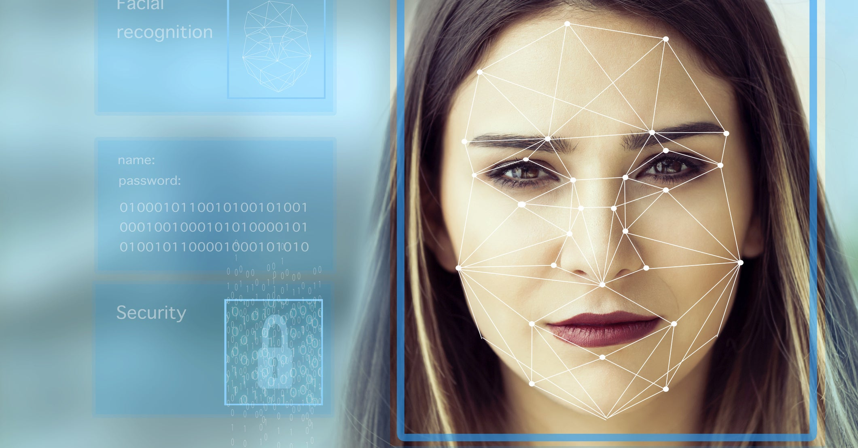
AUTOMATIC ATTENDENCE SYSTEM USING FACE RECOGNITION
PRESENTED BY:- ANMOL AHUJA(1816653)
Chirag Sharma (1816659)
ROHIT KUMAR(1816685)
AYUSH DUBEY(1816657)

Slide 2
ABOUT OUR PROJECT..
SOFTWARE AND HARDWARE USED :
VS Code python IDE
Inbuilt camera
SQLite database.
DURATION :
4Weeks(approx.)

Slide 3
WHAT EXACTLY IS FACE RECOGNITION?
A Facial recognition is a computer application for automatically identifying or verifying the person from an image or video source or video frame.
It will work by identifying some of the points
Distance b/w eyes.
Width of nose.
Length of jawline.
Depth of eye sockets

Slide 4
Implementation of face recognition....
The implementation technology include the following steps:
Image acquisition
Image processing
Extraction of facial features
Comparisions with database
Face image classification and marking the attendance.

Slide 5
BLOCK DIAGRAM:
Image acquisition
Image processing
Extraction of facial features
Marking the attendance
Comparing with database

Slide 6
Applications....
Used in classroom for attendance of students.
It decrease the false attendance.
In security/counterterrorism.
In ATM
Healthcare : minimize the fraud by verifying identity

Slide 7


