Slide 1
PINBALL
BY - Deepesh Tank - 18075017
Divyansh Chaturvedi - 18074005

Slide 2
3D Models Used
Desk
Slingshots
Flippers
Bumpers
Targets
Ramp
Ball
Plunger
Cylindrical surfaces
Cubical structures for obstacles
Collider Objects

Slide 3
Colliding objects
The colliding objects are used to register collision. They are not rendered in the final images. They are mainly used to trigger events that will be used in completing game missions. We don’t use displayed graphical model as after collision the ball may get deviated in unwanted directions.

Slide 4
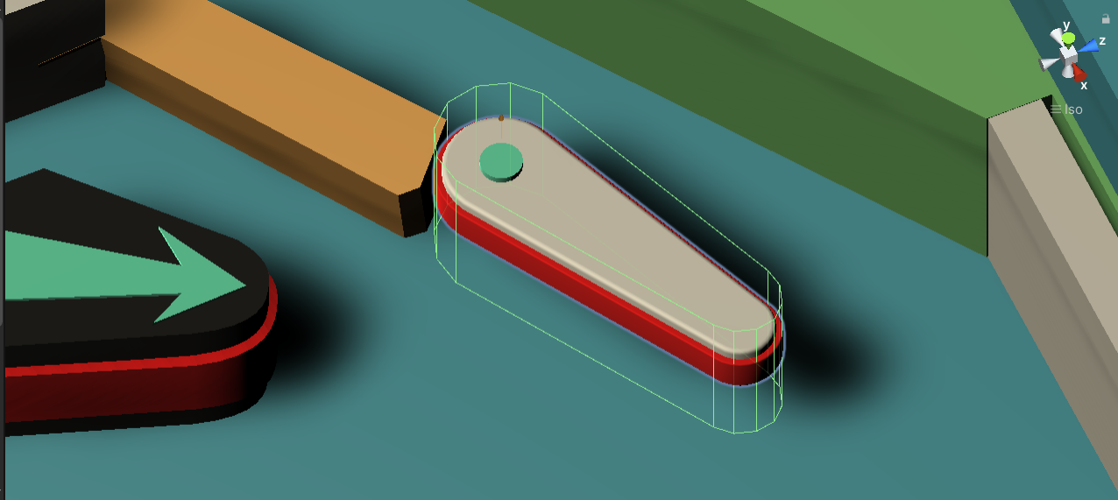
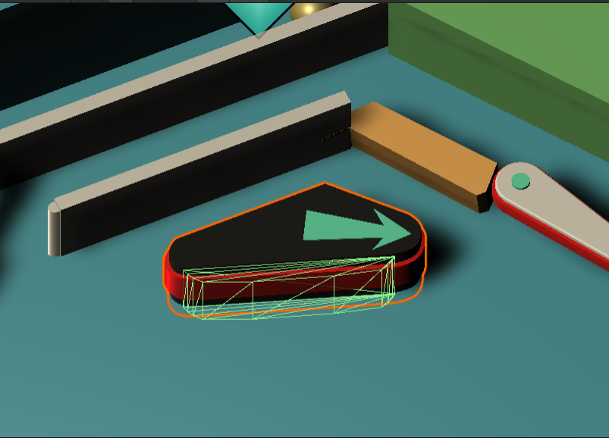
Colliding Objects
Here, The green outline represents the colliding object and is hidden in final game. Similarly there are colliding objects for other 3D models like Bumpers, Targets , Plunger , Ramp etc.

Slide 5
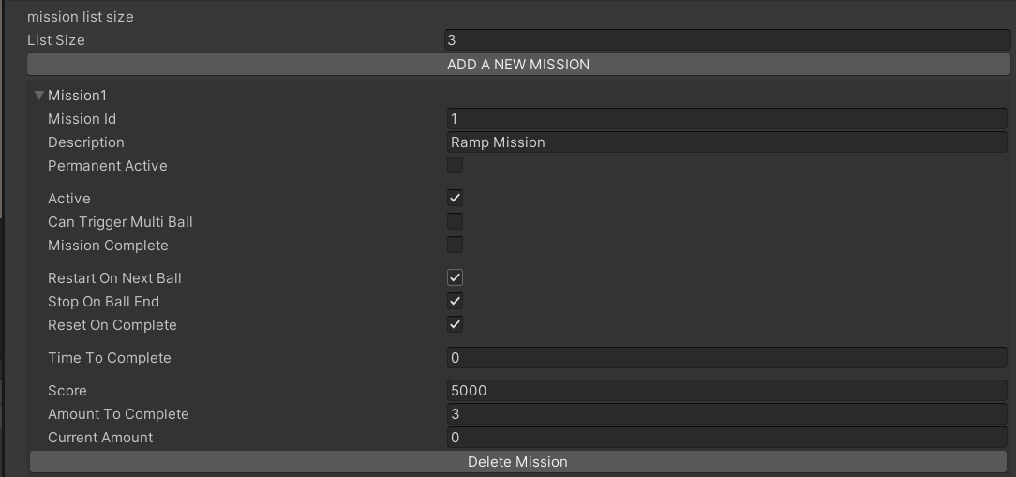
Missions
CUSTOM MISSION PANEL CREATED BY US

Slide 6
Missions
We can create mission (game objectives) to get score.A mission has following components:
Mission Id: will be similar to triggerId of the related mission object.
Mission Description: Information about mission.
Active: Checks if mission active or not. Set to true on starting of mission.
Score: Score earned after the mission is completed.
Amount To Complete: Number of triggers require to complete mission.
Current Amount: Display the number of triggers happened during runtime. If amount to complete become equal to current amount, then the mission is completed and no more active.
Mission Complete: Set to true after mission is completed.
Permanent Active: always active mission no trigger required to activate them.
Can trigger Multiple: An optional reward of spawning multiple balls on completing specified mission.

Slide 7
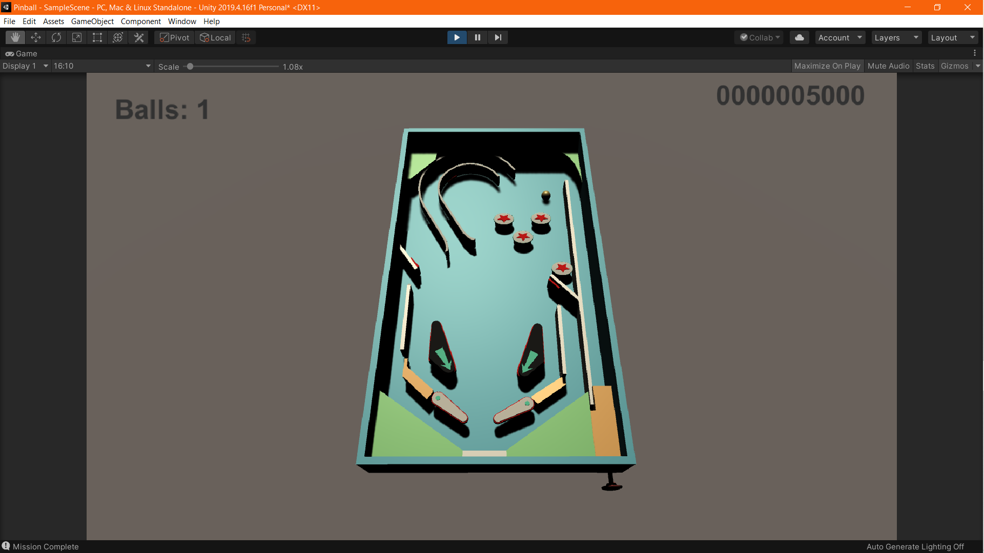
User Interface Panel
During Gameplay:
Shows Number of ball remaining and Total Score gained.

Slide 8
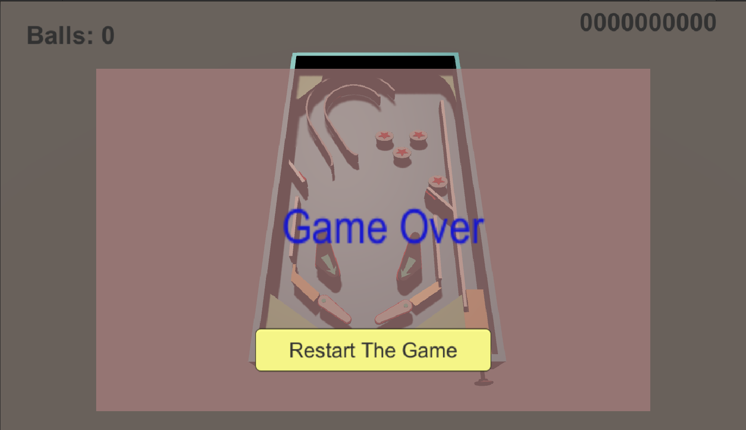
User Interface Panel
After game is Over:
Shows final score along with a restart button to restart the game.

Slide 9
Animation Used
On hitting the bumper , it will go up and down slightly.
On hitting the Target , the target will go down and if all the the targets are hit mission will be completed and all the targets will return back to the their original positions.
Plungers will go back on holding down key the amount of time of holding will then determine the power transferred to the ball.
Flippers will be used to prevent ball from falling in the pit area and on hitting flipper ball will go back with extra power in direction normal to the plane of the flipper.left and right keys are used to for triggering flippers.

Slide 10
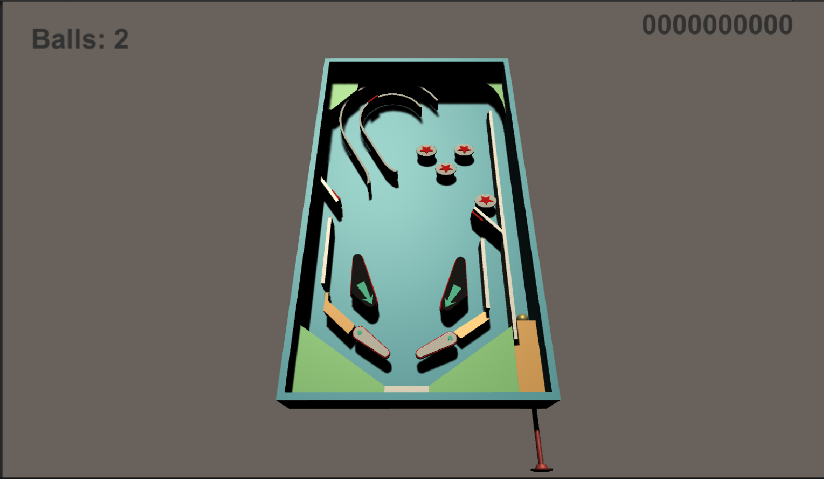
Animation Used
On hitting target , it will go down as shown

Slide 11
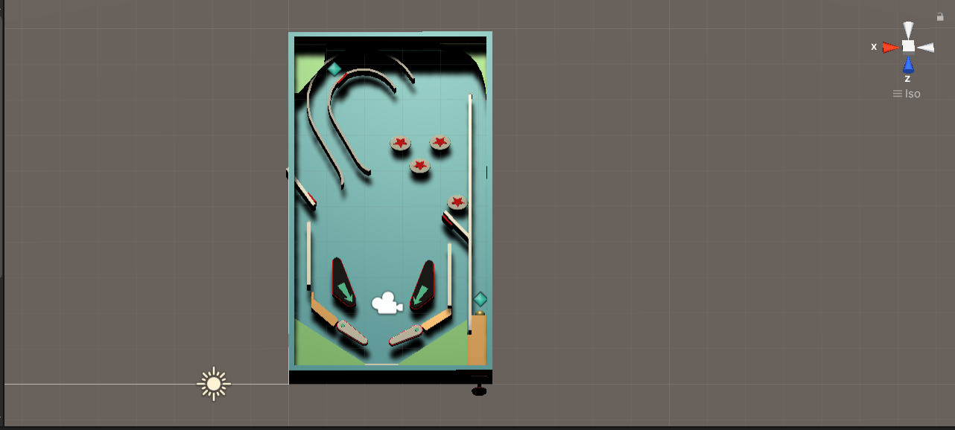
Spawning Points
Upper Blue Star represent points to multiple ball spawning.
Lower blue star represent point of default ball spawning.

Slide 12
Physics Used
There is no gravity in x direction and -9.81 in y direction and +5 in the z direction.
Fixed Timestep is 0.01 which determine framerate-independent interval that dictates when physics calculations are performed.
Increasing mass of ball will make it slower to move and vice versa.
Surfaces are slippery with both value of dynamic and static coefficient is set to zero to make the ball movement faster.

Slide 13
C# Scripts Used
Flipper, bumpers , targets , plunger will have added C# script having code to activate triggers and associated animations.
ScoreManager C# script will keep records to the score.
GameManager C# script will used to have game related functionality like resetting game , updating Mission , creating balls , keeping track of active balls on the desk etc.
MissionManager C# script will used to have mission related functionality like activating a mission , keeping trigger counts , adding/updating/deleting mission etc.
UIManager C# scripts will used to display the score , remaining ball and restart button option on the gameover.

Slide 14
Thank You

