Slide 1




Code Contracts
C# DEV/CONNECT
May 17, 2015
Todd Lang
Hosted by
@CSDevConnect #CSDevConnect https://github.com/CSharpDevConnect/

Slide 2
What are Code Contracts?
Code Contracts help
Make your assumptions explicit
Contract.Requires<ArgumentNullException>(parameter != null, “parameter”);
Contract.Assume(someInternalVariable == null);
Contract.Ensures(Contract.Result<int>() > 0);
Static analysis to prove your code is correct
The caller expects the postcondition Contract.Ensures(Contract.Result<int>() > 0); to hold for the interface member GetFoo. Consider adding such postcondition to enforce all implementations to guarantee it

Slide 3
How do we write Code Contracts?
Contracts consist primarily of 3 parts
Pre-Conditions
Contract.Requires(someValue == someCondition, “message”);
Post-Conditions
Contract.Ensures(returnValue == someCondition);
Invariants
Contract.Invariant(_internalValue == alwaysTrueCondition);
Notes:
We will not be covering Pex

Slide 4
Contract.Requires
Represents a pre-condition your code requires.
Checked at the start of every execution of your method.
Consists of a boolean condition you want to be true and a message.
Commonly used wherever “sanity checking” was done.
public IFoo GetFooByValue(IIdentifier identifier, string value)
{
Contract.Requires<ArgumentNullException>(identifier != null, “identifier”);
Contract.Requires<ArgumentException>(!String.IsNullOrWhiteSpace(value), “value”);
Exception is thrown when any condition fails.

Slide 5
Contract.Ensures
Represents a post-condition your code ensures.
Checked at the end of every execution of your method.
Consists of a boolean condition you will make true.
public IFoo GetFooByValue(IIdentifier identifier, string value)
{
Contract.Requires<ArgumentNullException>(identifier != null, “identifier”);
Contract.Requires<ArgumentException>(!String.IsNullOrWhiteSpace(value), “value”);
Contract.Ensures(Contract.Result<IFoo> != null);
Exception is thrown when any condition fails.

Slide 6
Contract.Invariant
Represents a condition that will never change.
Checked at the end of every public method execution.
Consists of a boolean condition must always be true.
[ContractInvariantMethod]
private void ObjectInvariant()
{
Contract.Invariant(_fooFactory != null);
}
Exception is thrown when any condition fails.

Slide 7
What can be used in Contract methods?
Only methods declared as Pure can be used in contracts.
A pure method is, basically, a method that has no visible side effects or modifies internal state.
Property getters are implicitly pure, as are operators.
Anything in System.Diagnostics.Contracts.Contract, System.String, System.IO.Path, or System.Type is assumed pure.
You may use private fields in a public method contract if you mark up the private field using ContractPublicPropertyName.

Slide 8
Contracts and Inheritance
Contract.Requires must be declared on the root method (first virtual or abstract method declaration)
All sub-classes inherit the same restrictions imposed by the ancestor.
Sub-classes MAY NOT add additional restrictions via Requires.
Sub-classes MAY add additional guarantees via Ensures.
Invariants are checked for all instances of the class and its descendants.

Slide 9
A SOLID Digression
The 5 basic principles of object-oriented programming.
S – Single responsibility principle.
O – Open/Closed principle.
L – Liskov substitution principle.
I – Interface segregation principle.
D – Dependency inversion principle.
See Wikipedia for more

Slide 10
Liskov Substitution Principle
“Objects in a program should be replaceable with instances of their subtypes without altering the correctness of that program”
Any implementation of an object API must adhere to the same restrictions as all other implementations.
Object1 and Object2 are descendants of Object. Object1 must not impose any different restrictions on its usage than those of Object2, or the substitution principle is violated.

Slide 11
Contracts and Interfaces
C# doesn’t allow code for interfaces! What do we do?
Create a hidden abstract implementation of the class.
[ContractClass(typeof(FooFactoryContract))]
public interface IFooFactory
{
[ContractClassFor(typeof(IFooFactory))]
internal abstract class FooFactoryContract : IFooFactory
{
All contracts are imposed all implementations of the interface.
Like inheritance, implementers may not impose additional Requires.
This is the same procedure to use for abstract classes.

Slide 12
Contracts and Constructors
Invariants are enforced at the end of the outermost constructor.
Contract.Requires are necessary for constructors of interfaces.
Otherwise, nothing special.

Slide 13
Contracts and Existing Code
No, they didn’t forget code existed before Code Contracts.
Leave all your condition checking code in place.
Add Contract.EndContractBlock()
Profit?

Slide 14
Contracts and Existing Code
What to do when dealing with code that does not have contracts?
Contract.Assume to the rescue.
Used only by the static verification.
Creates a fact that cannot be otherwise proven.

Slide 15
Advanced Concepts
Contract.EnsuresOnThrow<T>()
Whenever an exception of type T is thrown, this condition will be true.
Contract.ForAll()
Ensures the condition holds true for all enumerable elements.
Contract.ValueAtReturn()
Allows for contracts on out parameters.

Slide 16
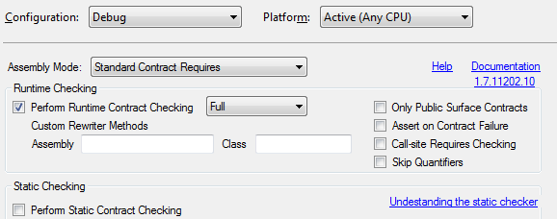
Configuring Code Contracts
Create a new mode “Static Analysis”
Static analysis is SLOOOOOOO…wait for it...OOOOOOOW.
Debug mode, full checking, but no analysis.

Slide 17
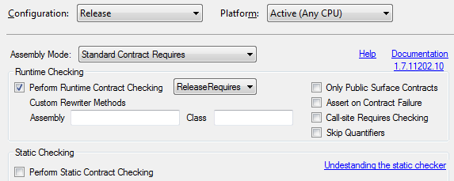
Configuring Code Contracts
Release mode, less stringent checking, no analysis.

Slide 18
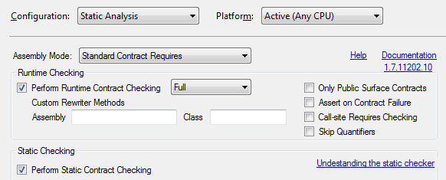
Configuring Code Contracts
Full checking with analysis.

Slide 19
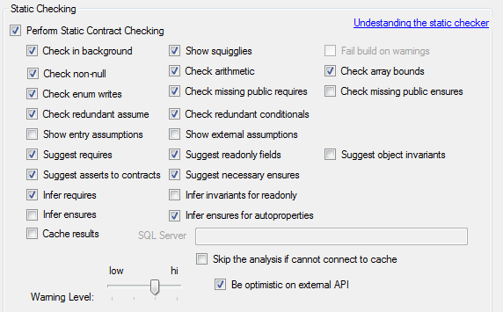
Configuring Static Analysis
These are only suggestions, but they work well for us.
Fear this, but aspire higher

Slide 20

Static Analysis
Performed after a build.
For a small amount of code, expect this to take minutes.
It just saved you from a potential NullReferenceException.
Were you aware this was never modified? Is it meant to be invariant?
Did you know your callers were expecting you to never return null?
Notes:
A note about the leap second.
What is the result of March 30th – one month?

Slide 21
Required Tools
Code Contracts for .Net
Includes ccrewriter.exe
Code Contracts Editor Extensions
Adds contracts to Intellisense and project properties page.
Code Contracts User Guide
Covers all usages of Code Contracts and common patterns.

Slide 22


C# DEV/CONNECT
: @CSDevConnect #CSDevConnect
: csharpdevconnect@gmail.com
: https://github.com/CSharpDevConnect/
Todd Lang
: todd.lang@magnetforensics.com

