Slide 1
Why Roslyn is a BigDeal™

Slide 2
What is Roslyn?

Slide 3
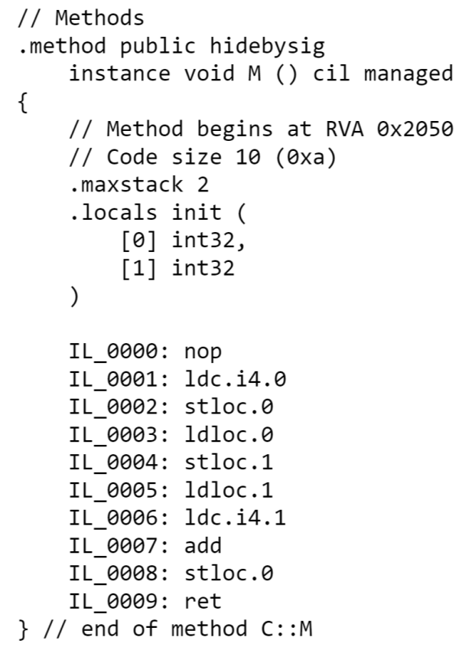
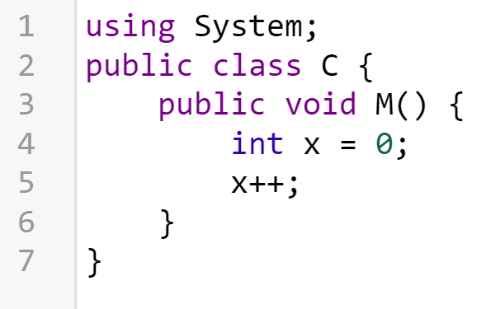
Compiler

Slide 4
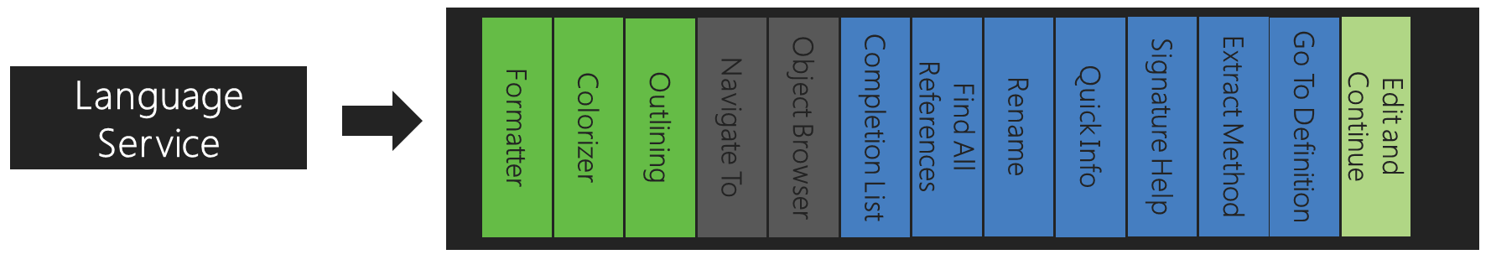
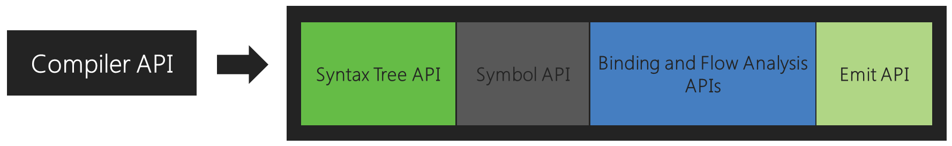
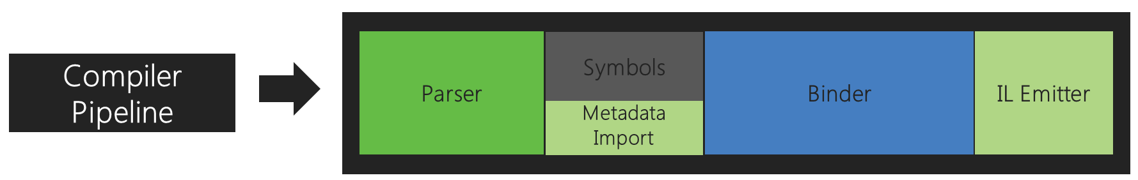

Slide 5
Some Numbers
Projects: 134
Documents: 9,522
Lines of Code: 3,489,071
Developers: 35
Years: 6

Slide 6
They did it by making the single worst strategic mistake that any software company can make: They decided to rewrite the code from scratch.
Joel Spolsky, Stack Overflow, FogBugz, Twilio

Slide 7
Why is Roslyn?

Slide 8
Reasons to be excited
Open source/Cross platform
Analyzers
ASP .Net vNext
Developer tools

Slide 9
Omnisharp
Cross platform development
Open source
Supports five editors
Language Services
Intellisense
Goto definition
Code fixes
http://omnisharp.net

Slide 10
Demo

Slide 11
ScriptCS
C# Scripting
Read Evaluate Print Loop
Future integration with Visual Studio
http://scriptcs.net/

Slide 12
Demo

Slide 13
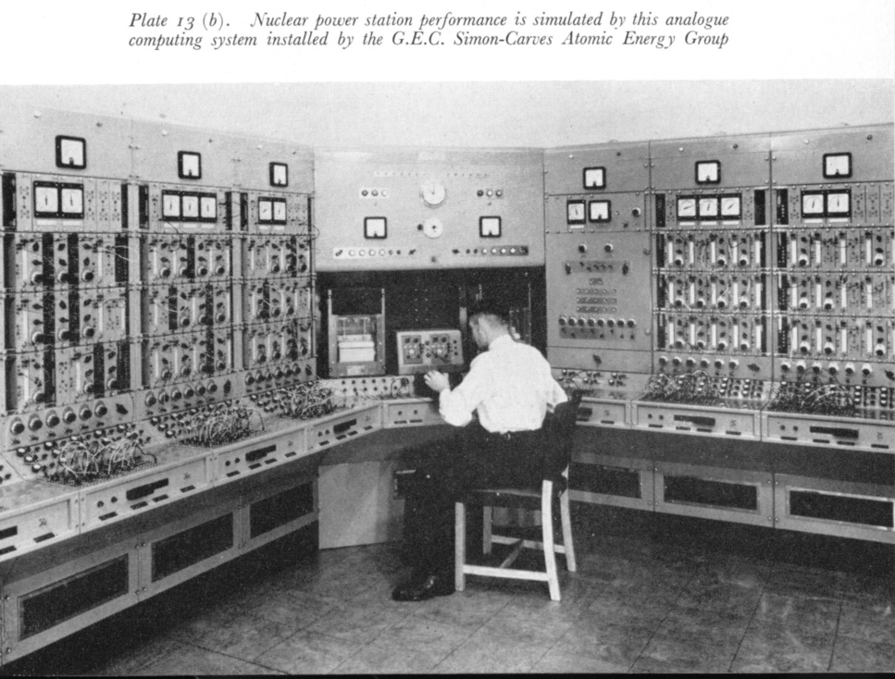
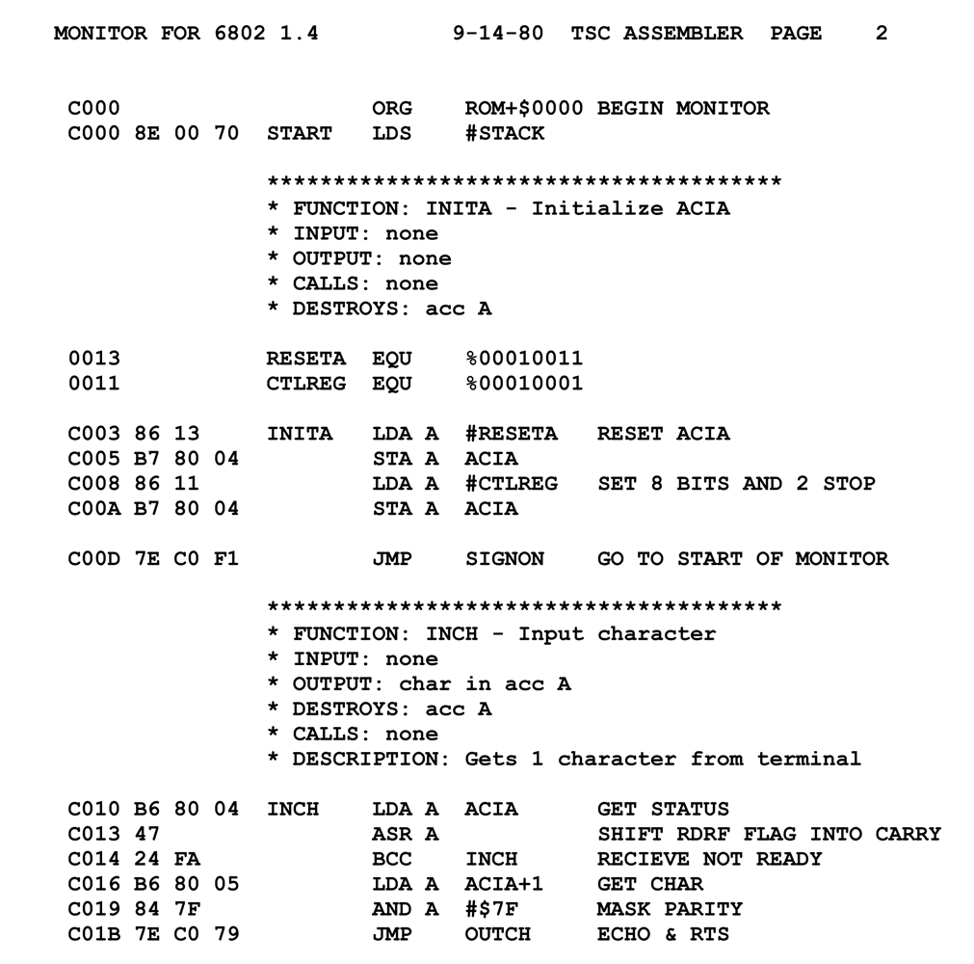
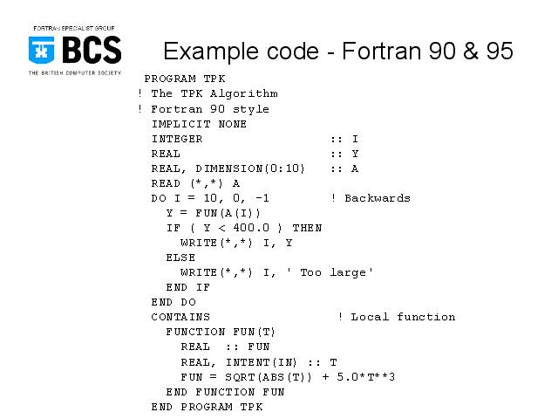
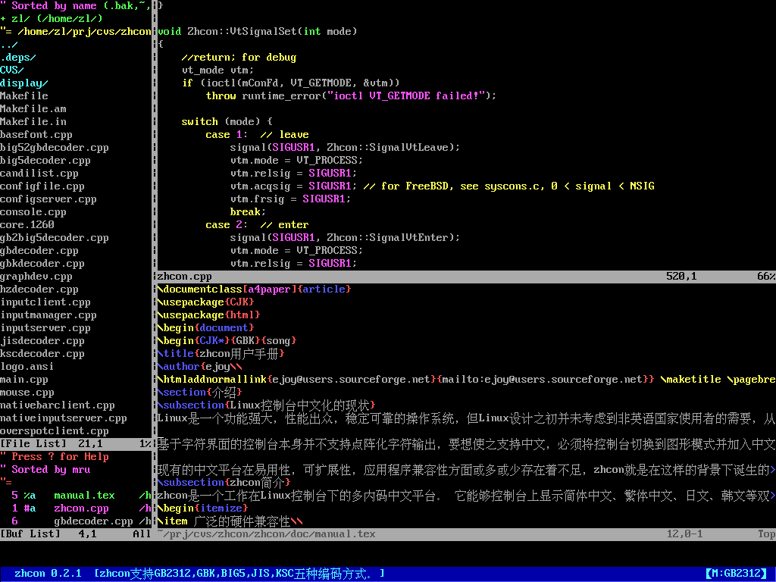
An aside on programming

Slide 14
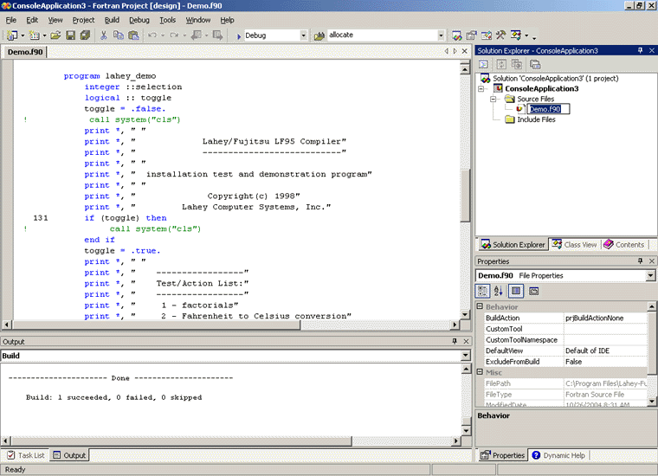
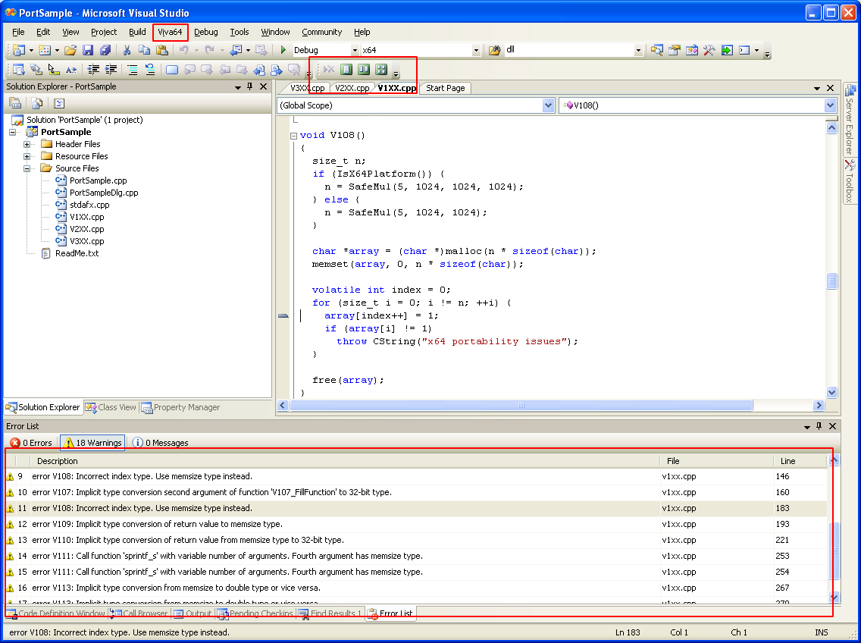
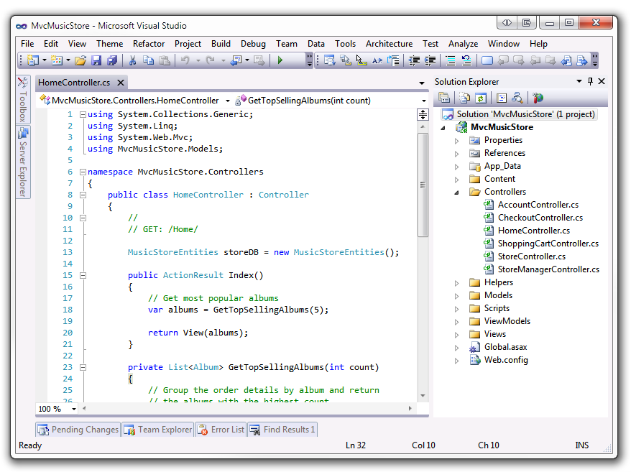
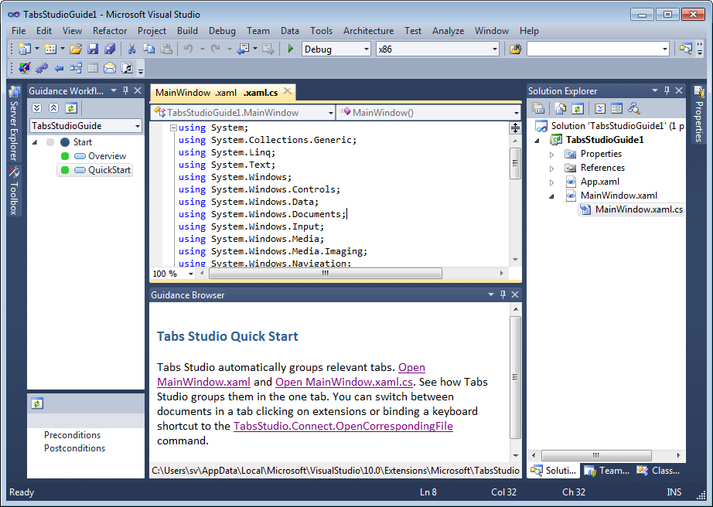
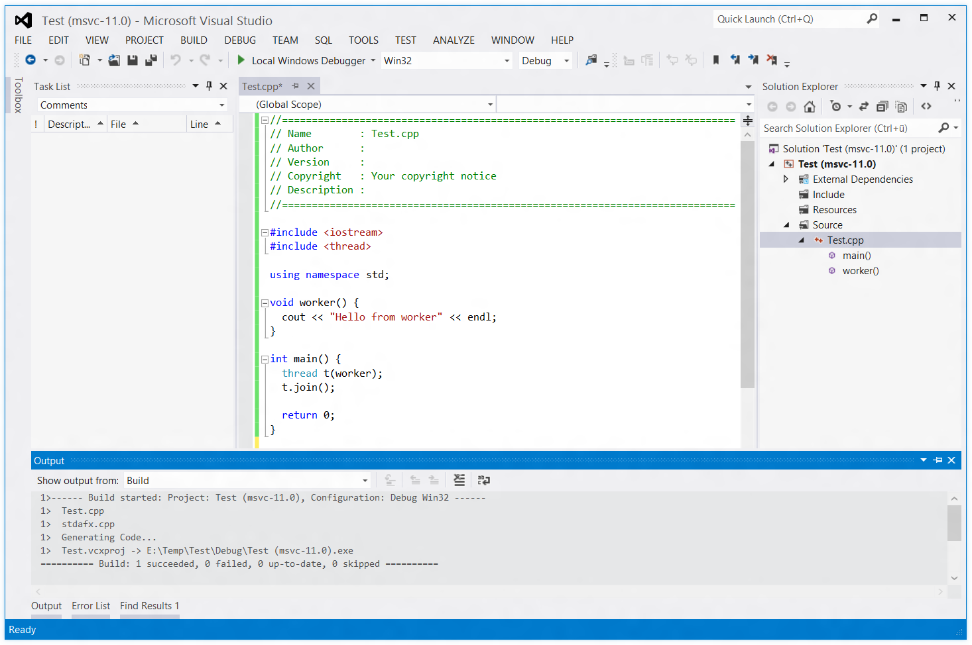
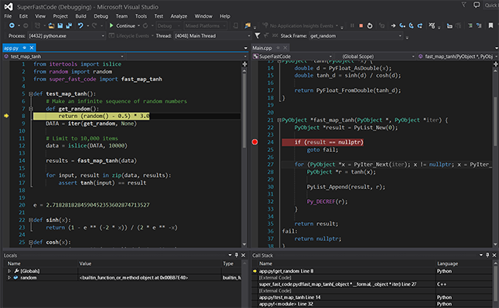
An aside on programming

Slide 15
Why Roslyn is a BigDeal™
(to me)
Intelligent tooling

Slide 16
Demo

Slide 17
Contact Info
Email: joshvarty@gmail.com
Twitter: @ThisIsJoshVarty
Websites:
http://joshvarty.com
http://codeconnect.io

