Slide 1

Intro to Unity
Dan Currie

Slide 2
Agenda
What is Unity?
Make a game
Animations
Collisions
Multi-platform controls
More!
Where to go from here
Questions

Slide 3
Unity
All your platforms belong to us
iOS
Android
Windows
Tizen
OSX
Linux
Xbox 360
Xbox One
PS 3
PS4
PS Vita
PS VR
Wii U
Oculus Rift
Gear VR
Microsoft Hololens
Web Player
And more!
Build once deploy anywhere

Slide 4
Other Unity Facts
Develop in C# or Javascript
So many tutorials
Drag and drop
Free to develop for and deploy to all platforms
With limitations…
a

Slide 5


Some Games Made With Unity

Slide 6
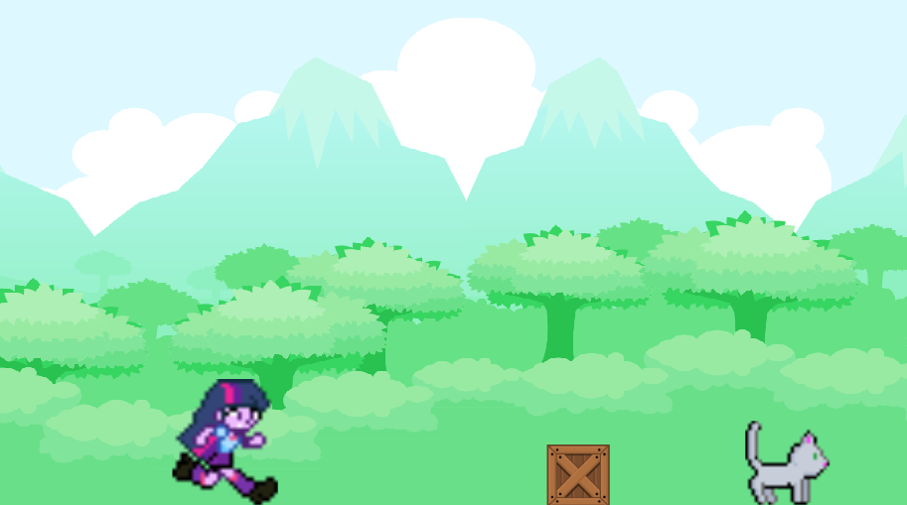
Let’s Make a Game
Game Art from:
http://ikuntyphoon.deviantart.com/art/Custom-EqG-Twilight-Sparkle-sprite-sheet-430115680
http://sukitehkitty.deviantart.com/art/Old-Cat-sprite-sheet-268693686
http://www.gameart2d.com/free-platformer-game-tileset.html

Slide 7
Where to go from here
Unity3d.com
More info
Tutorials
Unity3d.com
Raywenderlich.com
YouTube.com
Udemy.com

Slide 8

Questions?
@_DanCurrie
danjc_15@hotmail.com

