Slide 1
Impacts of Literacy on World Fertility Rates
Team Members:
Henry Deane
Cindy Jones
Sandy Goodell
Mathew Miller
This presentation has been designed using resources from PoweredTemplate.com

Slide 2
Motivation and Summary Slide
Population
Define the core message or hypothesis of your project.
Tracking fertility rates can allow for more beneficial planning and resource allocation in a particular region. The Total Fertility Rate is the most widely used fertility measurement. Our problem was to determine if fertility rates were higher due to a lower levels of literacy in the Country. We also wanted to explore other factors that affect fertility, such as age and income.
Describe the questions you asked, and why you asked them
Do literacy rates effect fertility rates?
While this is a broad question, we wanted to understand how literacy in a country impacts the fertility rate. We also wanted to understand how fertility rates impact population and where is a Replacement level of fertility?
What is the ranking of factors that affect fertility?
We wanted to know what data factors where important in determining their impact on fertility. We needed to see if literacy plays a part in affecting fertility.
Where are fertility rates increasing and decreasing in comparison to literacy rates?
This gives us a better understanding if we know the relationship between literacy rates and fertility rates.
How has the age of childbearing changed over time?
Our assumption was see if this would help us rank the factors affecting fertility.

Slide 3
Motivation and Summary Slide
Describe whether you were able to answer these questions to your satisfaction, and briefly summarize your findings

Slide 4
Questions and Data
Elaborate on the questions you asked, describing what kinds of data you needed to answer them, and where you found it.

Slide 5
Data Cleanup and Exploration
Describe the exploration and cleanup process
Age-specific fertility rates, Total fertility and .csv – this was our first data file that we started exploring.
Headers had to be removed and the grouping by age columns had to be put in place
Final Data frame was created – fertility_clean
For sharing this main file was written to a csv file (add file name)
Sorting and retrieving only the most recent year was done – (DataFrame: last_year
csv_files/literacy-rate-adults.csv – this was our literacy rates that was merged
We did not anticipate a mismatch between countries and data. There was a lot of variability between the number of years and what years were listed for each country
Discuss any problems that arose after exploring the data, and how you resolved them
Our first literacy rates data did not produce enough matching years to our fertility data, we found another source
We found that we need some additional data to bring information together in small groups than country, so we added continent into the data
Present and discuss interesting figures developed during exploration with the help of Jupyter Notebook
Outliers information
Country Data points for above and below the population sustainability rate of 2.1
Mappings of
Scatterplots of
Statistics and Graphs of

Slide 6
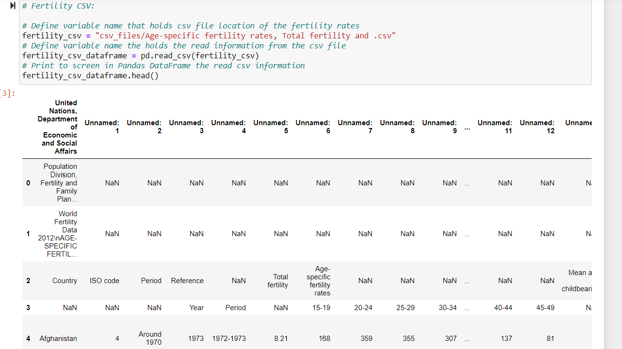
Data Cleanup and Exploration
Describe the exploration and cleanup process
Age-specific fertility rates, Total fertility and .csv – this was our first data file that we started exploring.
Notes:
Headers had to be removed and the grouping by age columns had to be put in place
Final Data frame was created – fertility_clean
For sharing this main file was written to a csv file (add file name)
Sorting and retrieving only the most recent year was done – (DataFrame: last_year

Slide 7
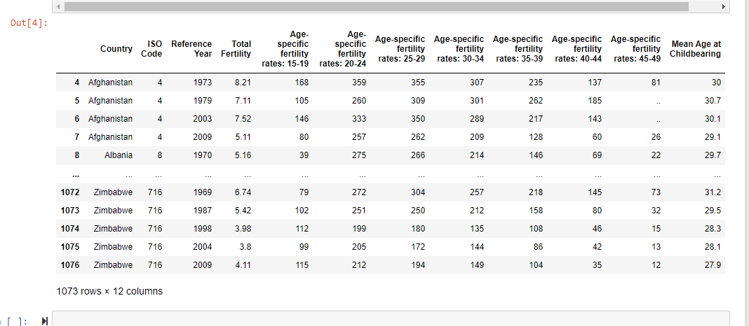
Data Cleanup and Exploration
Discuss any problems that arose after exploring the data, and how you resolved them

Slide 8
Data Cleanup and Exploration
Present and discuss interesting figures developed during exploration with the help of Jupyter Notebook
Outliers information
Country Data points for above and below the population sustainability rate of 2.1
Mappings of
Scatterplots of
Statistics and Graphs of

Slide 9
Data Cleanup and Exploration
Describe the exploration and cleanup process
Age-specific fertility rates, Total fertility and .csv – this was our first data file that we started exploring.
Headers had to be removed and the grouping by age columns had to be put in place
Final Data frame was created – fertility_clean
For sharing this main file was written to a csv file (add file name)
Sorting and retrieving only the most recent year was done – (DataFrame: last_year
csv_files/literacy-rate-adults.csv – this was our literacy rates that was merged
We did not anticipate a mismatch between countries and data. There was a lot of variability between the number of years and what years were listed for each country
Discuss any problems that arose after exploring the data, and how you resolved them
Our first literacy rates data did not produce enough matching years to our fertility data, we found another source
We found that we need some additional data to bring information together in small groups than country, so we added continent into the data
Present and discuss interesting figures developed during exploration with the help of Jupyter Notebook
Outliers information
Country Data points for above and below the population sustainability rate of 2.1
Mappings of
Scatterplots of
Statistics and Graphs of

Slide 10
Data Analysis and Discussion
What impact does literacy have on fertility rates in a Nation?
For all the box is above the 80%
Are there any difference in Countries that are above or below Replacement-level fertility?
Mean age age of childbearing for countries that are above replacement
Henry’s

Slide 11
Data Analysis and Discussion
What is the ranking of factors that affect fertility?
Literacy
Age
Female participation in work force
Discuss the steps you took to analyze the data and answer each question you asked in your proposal
Present and discuss interesting figures developed during analysis with the help of Jupyter Notebook
Discuss your findings. Did you find what you expected to find? If not, why not? What inferences or general conclusions can you draw from your analysis?

Slide 12
Data Analysis and Discussion
Where are fertility rates increasing and decreasing in comparison to literacy rates?
Discuss the steps you took to analyze the data and answer each question you asked in your proposal
Present and discuss interesting figures developed during analysis with the help of Jupyter Notebook
Discuss your findings. Did you find what you expected to find? If not, why not? What inferences or general conclusions can you draw from your analysis?

Slide 13
Data Analysis and Discussion
How has the age of childbearing changed over time?
Discuss the steps you took to analyze the data and answer each question you asked in your proposal
Present and discuss interesting figures developed during analysis with the help of Jupyter Notebook
Discuss your findings. Did you find what you expected to find? If not, why not? What inferences or general conclusions can you draw from your analysis?

Slide 14

Post Mortem
Discuss any difficulties that arose, and how you dealt with them
Discuss any additional questions that came up, but which you didn't have time to answer:
What would you research next, if you had two more weeks?

