Slide 1
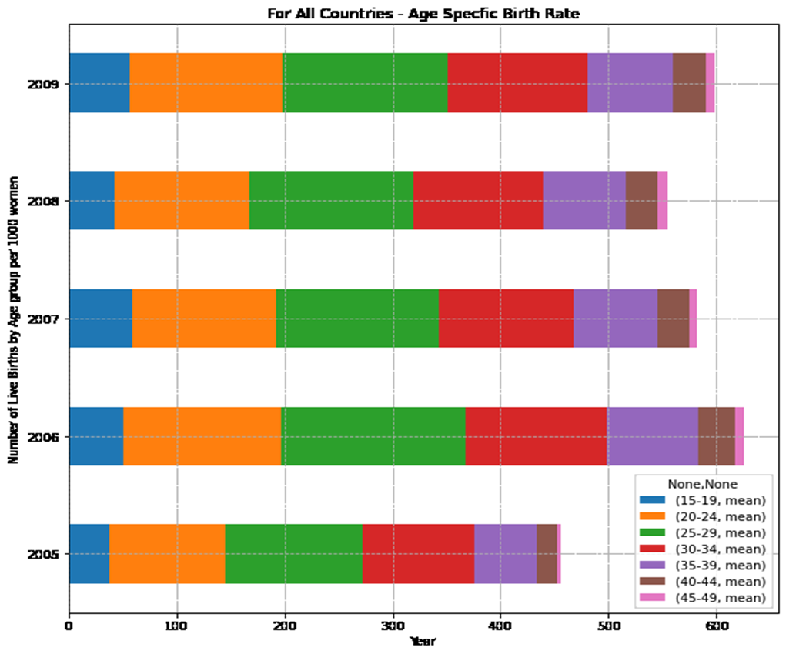
Questions and Data
Age-specific birth rate measures the annual number of births to women of a specified age or age group per 1,000 women in that age group.
Notes:
Data we needed to answer our questions. The age specific fertility rate is the measurement that we use to calculate the total fertility Childbearing years are from 15-49 - From this we can calculate the Total Fertility.

Slide 2
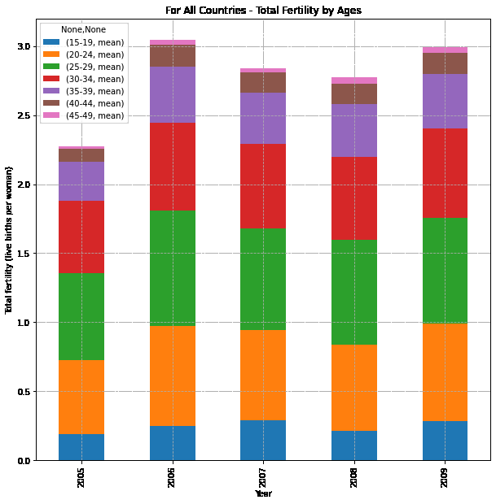
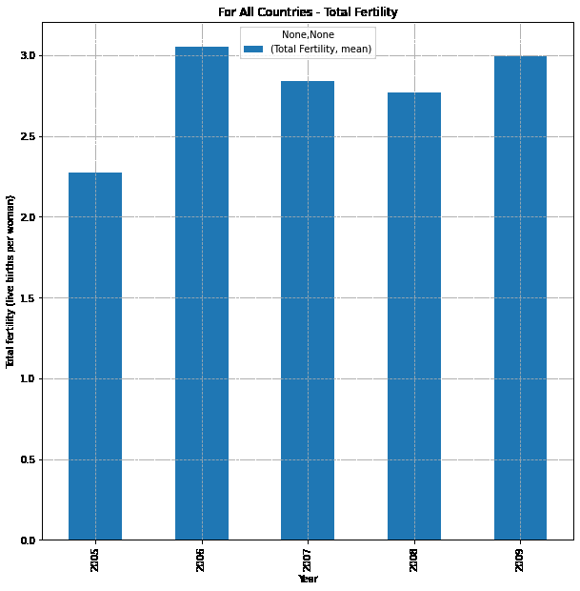
Questions and Data
Total fertility rate is the average number of children a woman would have if a she survives all her childbearing years (15-49)
Notes:
Data we needed to answer our questions. Total Fertility will be the one of the main data that we present tonight. The total fertility rate can be calculated using age-specific birth rates. We will be talking about the fertility rate threshold. sub-replacement fertility as any rate below approximately 2.1 children born per woman of childbearing age, but the threshold can be as high as 3.4 in some developing countries because of higher mortality rates.

