Slide 1

TITLE: TOLL PLAZA COLLECTION
FACULTY: UMA MAHESWARI
COURSE NAME: TECHNICAL ANSWERS FOR REAL WORD PROBLEMS
COURSE CODE: SWE1901
TEAM NUMBER: 1
TEAM MEMBERS
S.NO | NAME | REGISTER NUMBER
1. | A.MOHITH | 19MIS1007
2. | B. RAJESH | 19MIS1019
3. | K. MANISH KUMAR | 19MIS1022
4. | C. SIVA | 19MIS1075

Slide 2
MOTIVATION
The motivation for this project is that as we can see that so many people are traveling in their vehicles. As we traveling, we can find the number of toll gates on the way.
We find it very difficult to wait in the queue for such a long time.
At present, manual toll collection is the most widely used collection method in the world. Due to manual intervention, the processing time at toll plazas is highest.
Traffic congestion at Toll plazas leads to a huge economical loss in terms of fuel wastage and also causes pollution.

Slide 3
OBJECTIVE
This system reduces cash handling which aids in enhanced audit control by user account.
It will help to reduce the waiting time at the tolls.
It provides users the flexibility of paying their toll amounts with both rfid and from account.
User can pay amount to the tolls before head for the journey
User can pay amount to the tolls from one destination to another destination.
User will get refund if they did not crossed the toll within 24 hours.

Slide 4
INTRODUCTION
The toll plaza collection system will be useful to the user who travel through the tolls by paying the amount to the tolls before head for the journey for a particular toll or for all tolls from one place to destination.
First the user will give the travelling details of vehicle number, vehicle type and the destination. After the travelling details the user will give toll details of for which toll the user want to pay or for all tolls and the user can pay amount for single trip or return trip also available.
If the user paid for the tolls then at the tolls the payment will be verified using rfid scanner(qr code)

Slide 5
LITERATURE SURVEY
Online toll gate payment system using RFID
This Online Toll Gate Payment system provides online payment for tollgates and detecting theft vehicles using the RFID technology along with micro controller and GSM modem.
Once the source and destination is selected the number of tollgates is listed and the payment is done.
In all the tollgates where the user has made the payment, the number plate of the vehicle is detected automatically and is allowed to travel further.

Slide 6
LITERATURE SURVEY
Online Toll Payment System
It is used to find the position of the vehicle as well as toll plazas accurately.
When the destination toll is near to the user, an alert message is sent to the user. 1-2 km before the toll plaza, a notification will be sent to the mobile phone of the approaching user with Toll Name and applicable Toll Fee.
Payment can be facilitated through mobile wallets.
An electronic receipt is generated, with QR code which can be scanned by the QR readers at Toll Booth.

Slide 7
LITERATURE SURVEY
GPS Based Toll Collection System
This project aims in designing a system, which automatically identifies the vehicle that advance towards the toll plazas and observes the vehicle number and the time of arrival.
If matches exist between vehicle data and GPS data, then predetermined amount is automatically taken from the user account.

Slide 8
LITERATURE SURVEY
Toll Booth Collection using Li-Fi
At the toll plaza, once the vehicle’s Li-Fi transmitter is paired with the Li-Fi receiver, the system at toll plaza automatically identifies the vehicle details.
The Li-Fi system uses Li-Fi which collects information of vehicle passing through the toll plaza and automatically debits the toll amount from prepaid account of vehicle owner

Slide 9
LITERATURE SURVEY
TOLLZ-E (Online toll system)
RFID tags provided to the users are scanned through RFID reader fixed at toll booths in specific positions and online transactions are carried out regarding the specific RFID tag number of user

Slide 10
REQUIREMENTS
Hardware requirements
Computer
Software requirements
Operating system(windows)
Xampp server
NetBeans ide

Slide 11
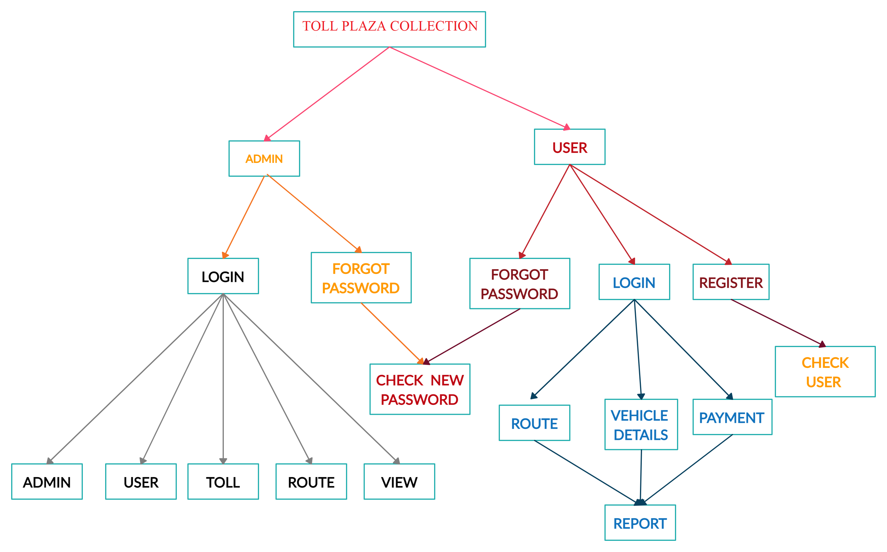
DESIGN

Slide 12
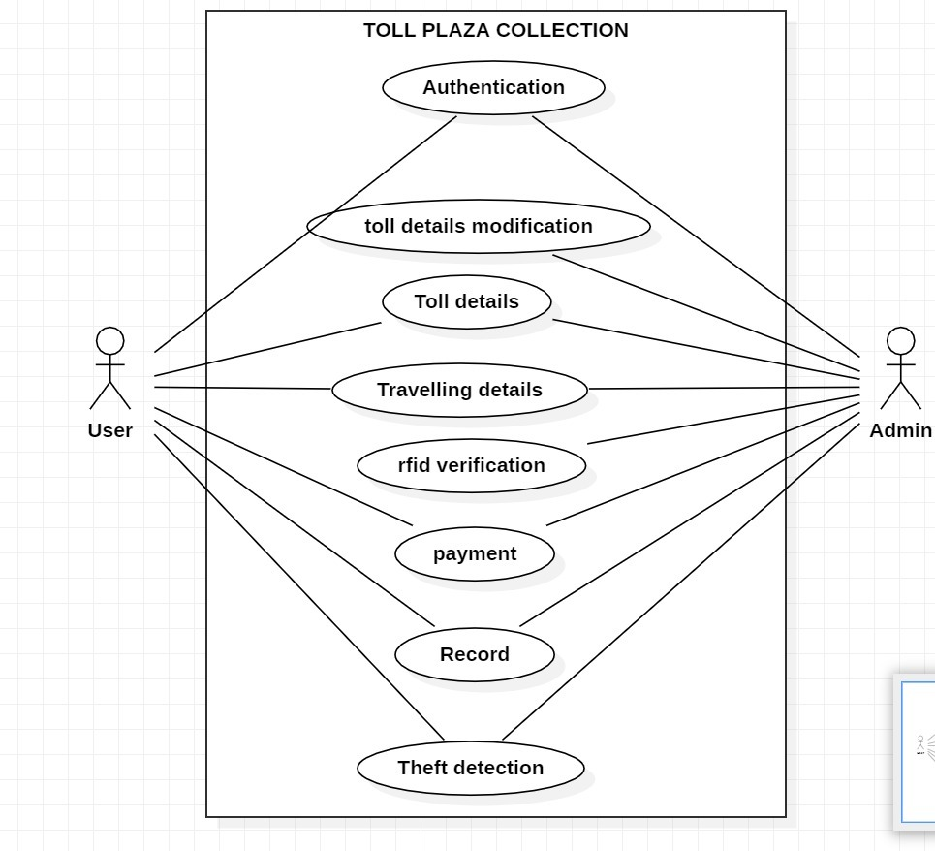
DESIGN

Slide 13
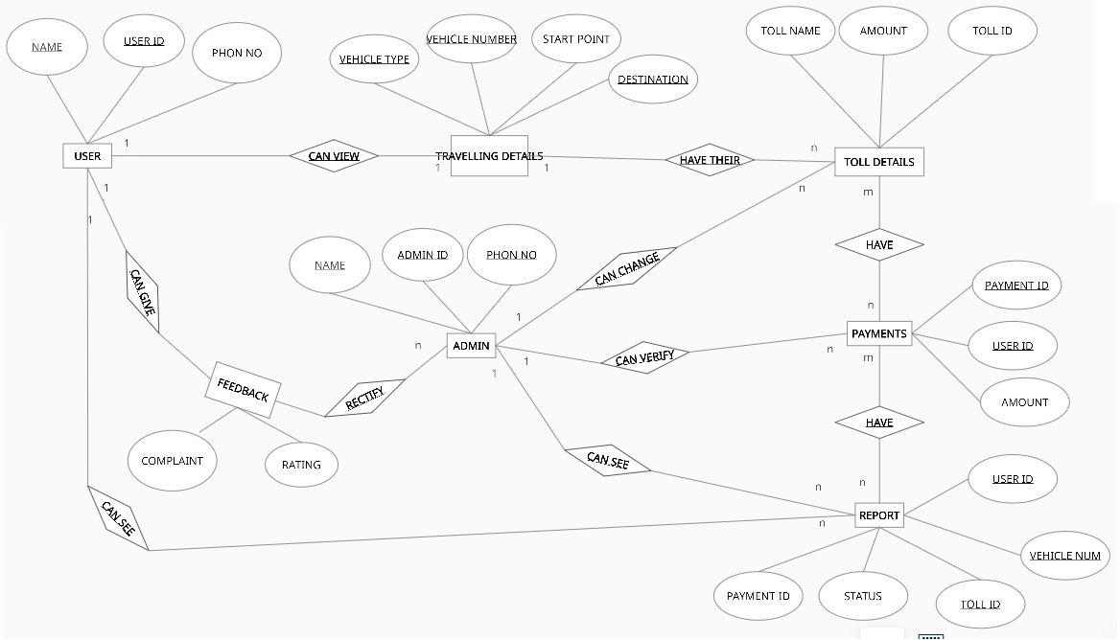
DESIGN

Slide 14
MODULES
ADMIN
Authentication
Toll details modification
Rfid verification
USER
Travelling details
Toll details
Payment
Record
Theft detection

Slide 15
MODULES
Authentication
Authentication is to validate the users credentials and create the user and admin.
Toll modification
The admin will be having the function to change the change details of tolls.
Rfid verification
The admin will scan the qrcode and verify the users payment.

Slide 16
MODULES
Travelling details
The user will give the vehicle, start and destination places with which type of details.
Toll details
After giving the travelling details here the details of the tolls.
Payment
The payment will be done using the wallet or through the online mode.

Slide 17
MODULES
Record
Records will store the details of the users, tolls and payment details.
Theft detection
If the users vehicle was thefted, if the user raised the complaint then if that vehicle crossed the toll then the vehicle detected and notified the user.

Slide 18
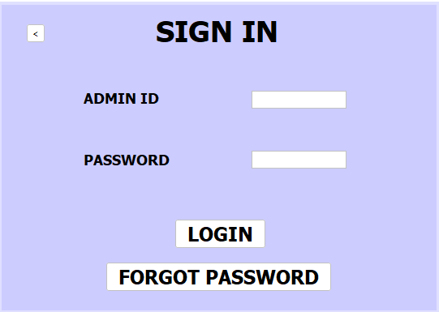
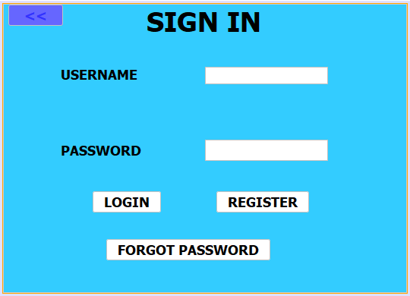
IMPLEMENTATION

Slide 19
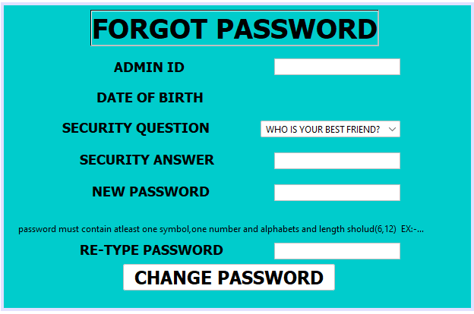
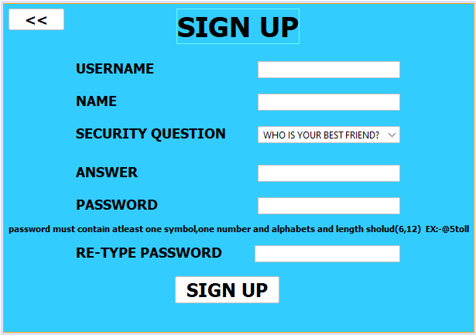
IMPLEMENTATION

Slide 20
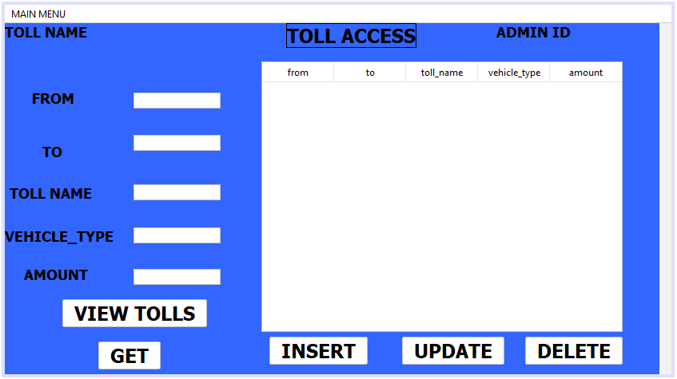
IMPLEMENTATION

Slide 21
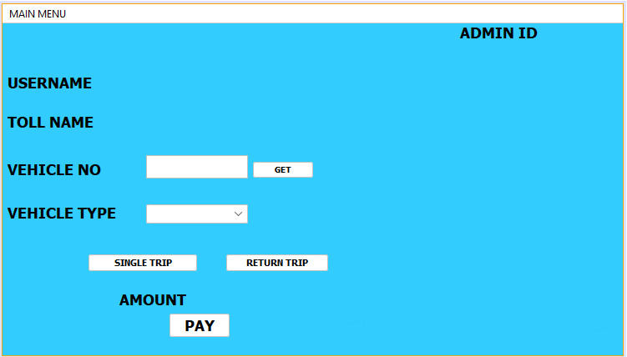
IMPLEMENTATION

Slide 22
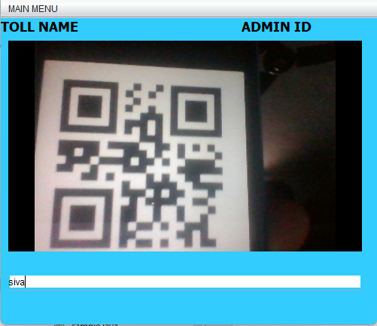
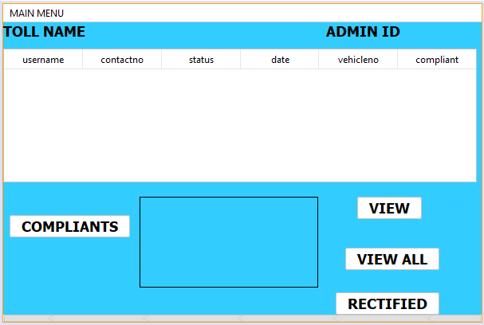
IMPLEMENTATION

Slide 23
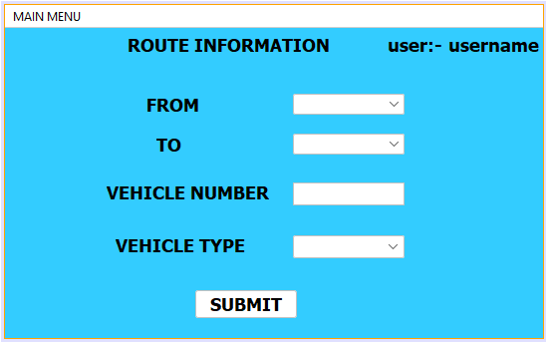
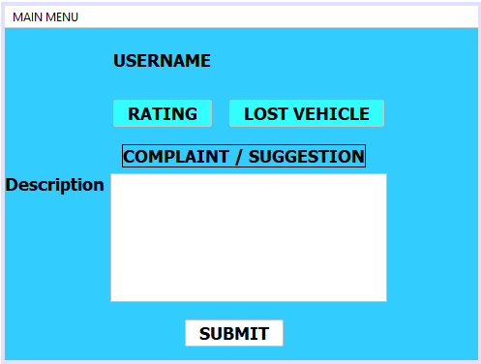
IMPLEMENTATION

Slide 24
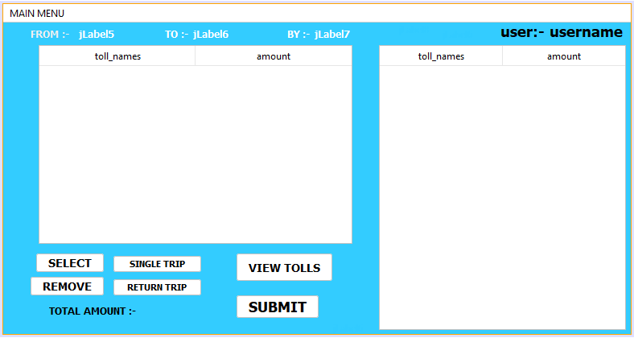
IMPLEMENTATION

Slide 25
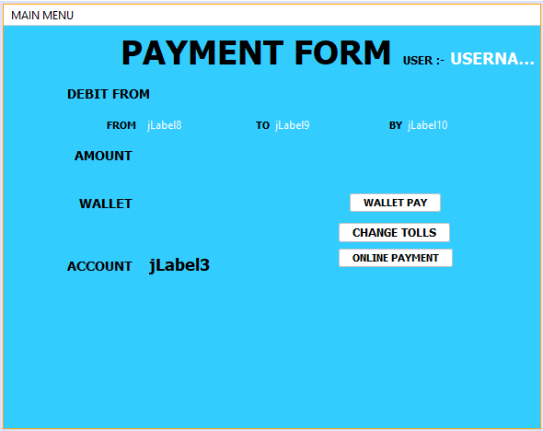
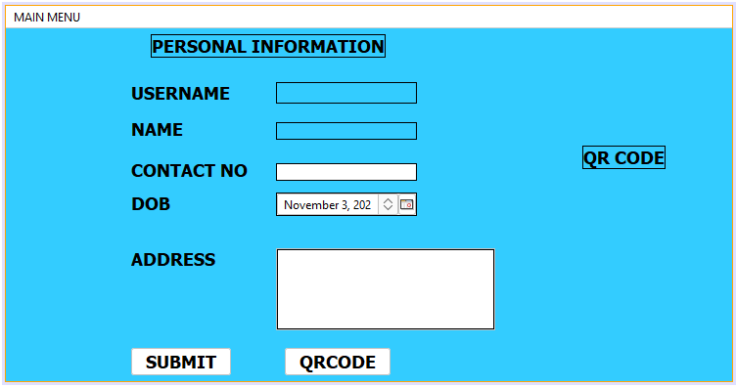
IMPLEMENTATION

Slide 26
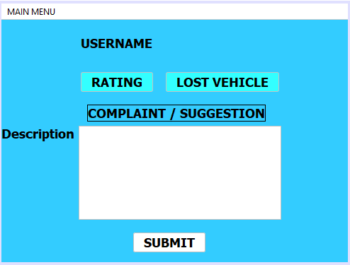
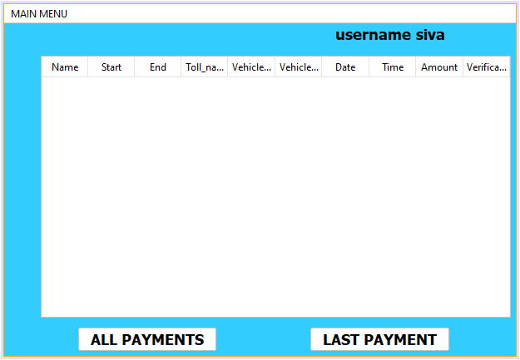
IMPLEMENTATION

Slide 27


