Slide 1

Exploratory Data Analysis
Taxi Industry Investment Analysis
Carl Somers 21/08/22

Slide 2
Breakdown
Basic Analysis
Data
Cleaning and Variable Insights
Exploring Entire Taxi Industry
Location
Time Period
Consumer
Taxi Industry Comparison
Variable Comparison
Profitability Analysis
Hypothesis Testing

Slide 3
Data
4 datasets providing a total of 17 features.
Cab_Data.csv – this file includes details of transaction for 2 cab companies
Customer_ID.csv – this is a mapping table that contains a unique identifier which links the customer’s demographic details
Transaction_ID.csv – this is a mapping table that contains transaction to customer mapping and payment mode
City.csv – this file contains list of US cities, their population and number of cab users

Slide 4
Feature Insights
Feature extraction providing profitability, cost per km and price per km.
Correlation between commonly understood variables (price charged and profit, or distance travelled, and price charged).
Notable moderate correlations exist between city population and price charged.

Slide 5
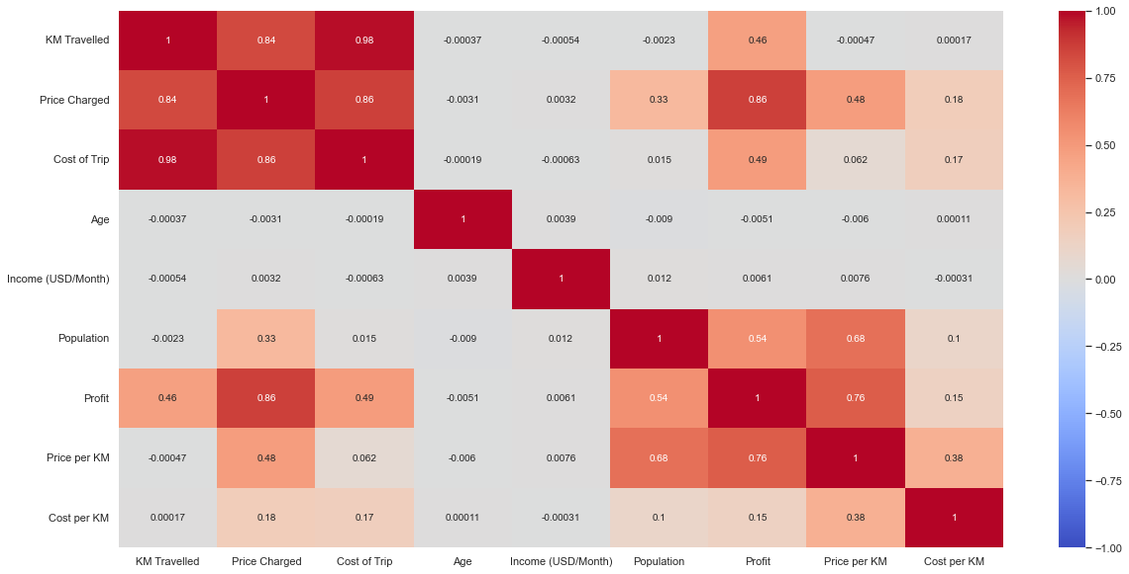

Slide 6
Industry – Location
New York accounts for over 25% of all taxi trips taken across the 3 years.
Top 5 cities make up over 95% of total taxi trips
Top 5 cities:
New York, NY
Chicago, IL
Los Angeles, CA
Washington, DC
Boston, MA
New York makes up almost 60% of the total profit within the taxi industry.

Slide 7
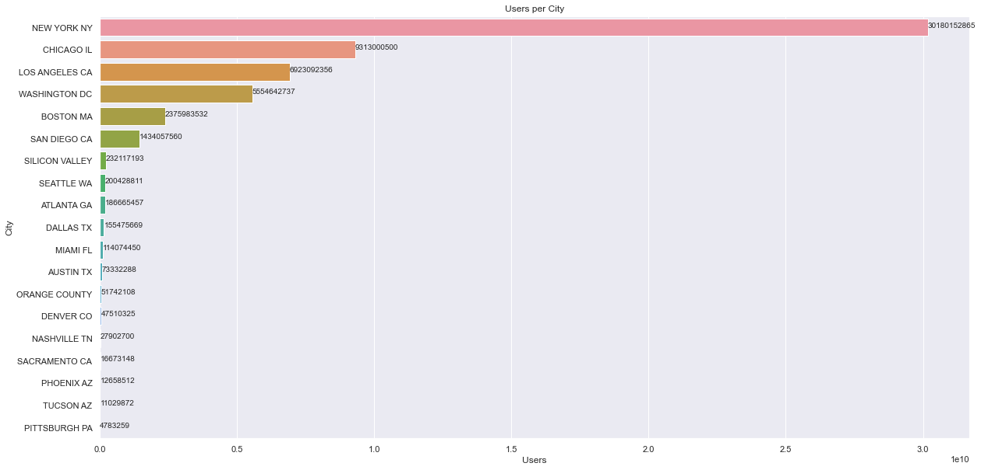

Slide 8
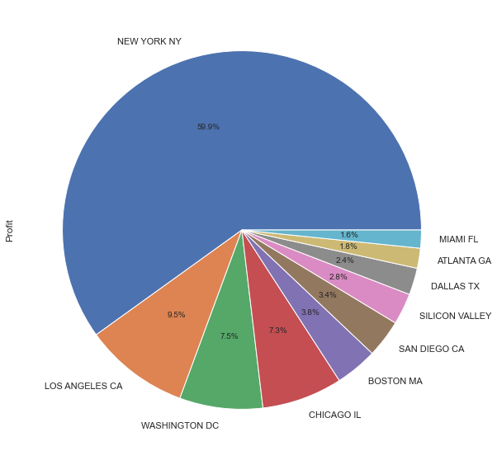
Total Profit by City

Slide 9
Industry – Time Period
On average, least profitable months are the late summer months (July & August)
Most profitable in February & May for the taxi industry.
Poor indication for taxi industry – dipping profit levels in 2018 despite consistent users (thinning margins!).

Slide 10
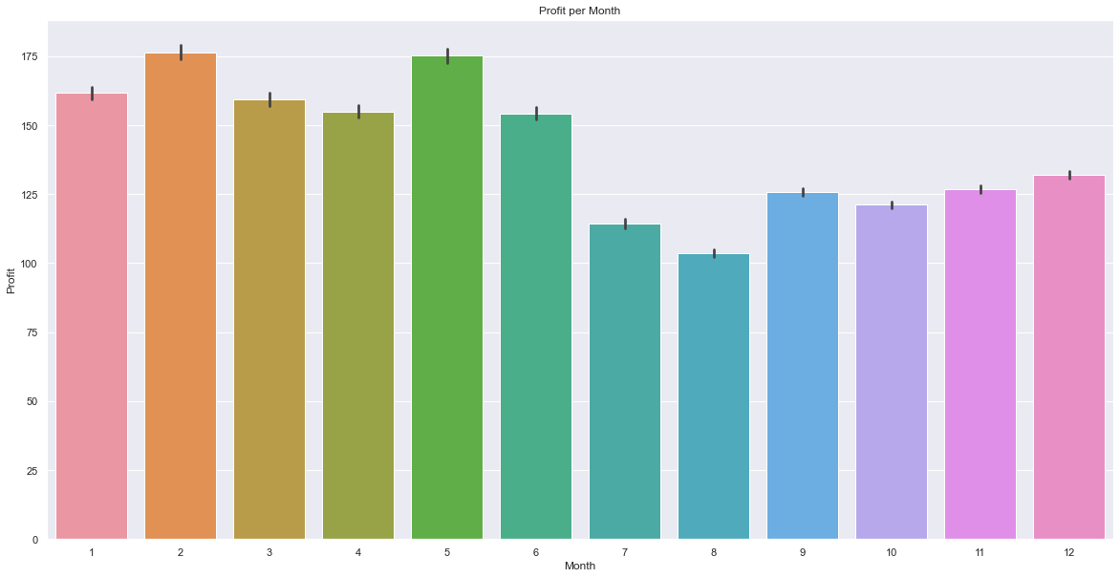

Slide 11
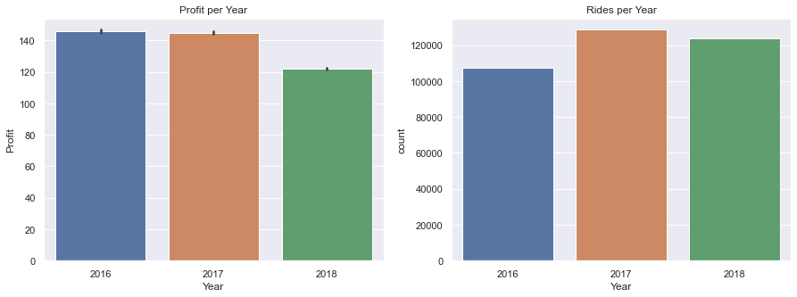

Slide 12
Industry – Customer
Larger userbase and profit margins from male customers in the taxi industry.
Though there is an even split along almost all ages.
10–40-year-old customers use taxis more often (almost twice as often as other brackets).

Slide 13
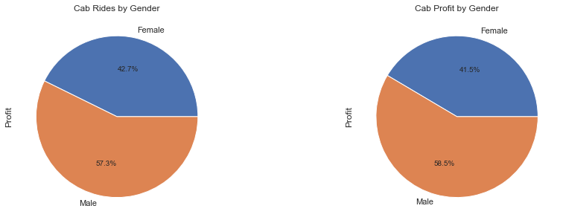

Slide 14
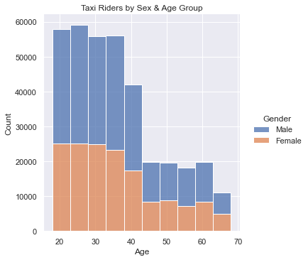

Slide 15
Taxi Industry Comparison
Comparing Yellow and Pink Taxis.
Yellow charges higher price per KM across all cities.
Yellow holds a dominant market share in all cities.
Customer ages hold true to industry insights and market share, large proportion of customers in 10-40-year-old age bracket.

Slide 16
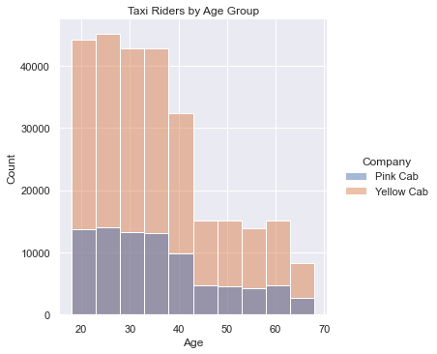

Slide 17
Taxi Industry Comparison – Profit Analysis
Pink has steadier profits.
Yellow has trended down in recent years.
Clear seasonality within data (see industry – time period).

Slide 18
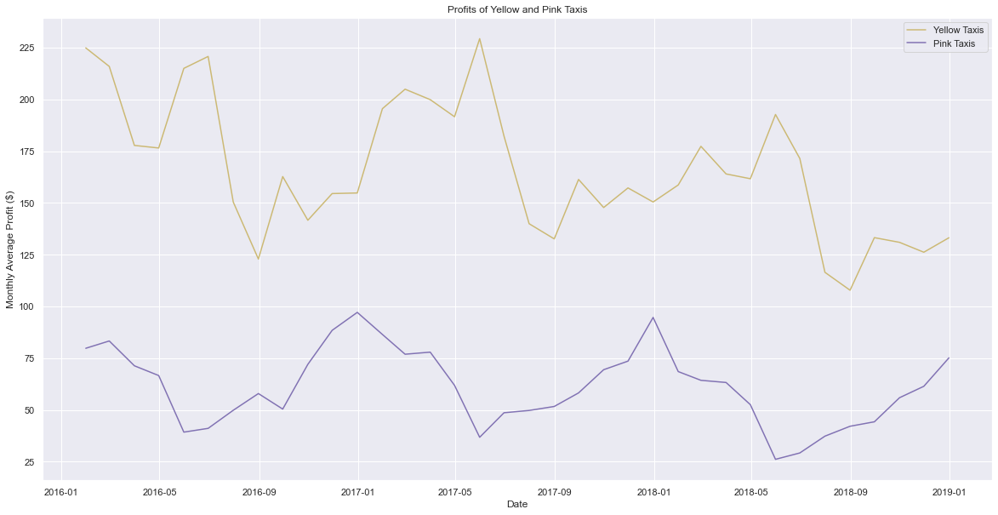

Slide 19
Hypothesis Testing
Is there seasonality within the data?
True, each year has had an element of seasonality, it is to be expected therefore that late summer months continue to be poor performing months for the taxi industry.
Is there a relationship between certain cities and “their” taxi company?
True, different companies have a higher proportion in certain cities. For example, Yellow largely exceeds the userbase of Pink taxis in New York and other large cities.
Is there a company preference by age group?
True, certain ages prefer different taxi companies. The younger age group is more inclined towards the more developed Yellow Taxi company.

Slide 20

Thank you!

