Slide 1
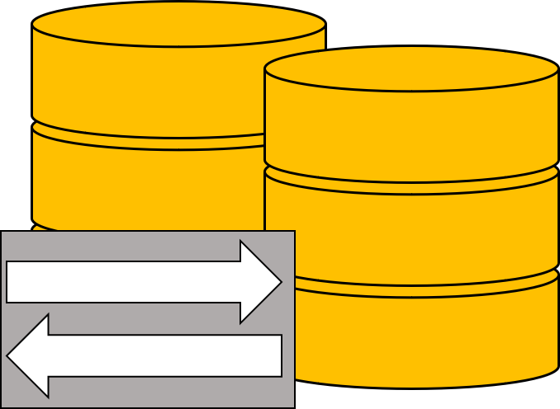
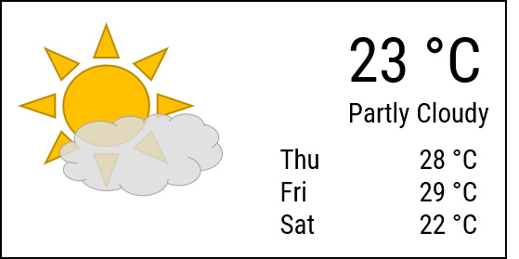
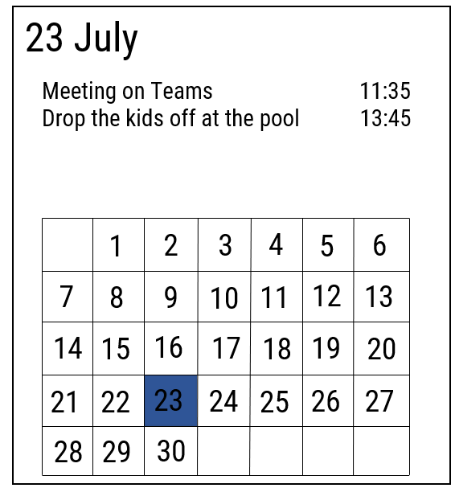
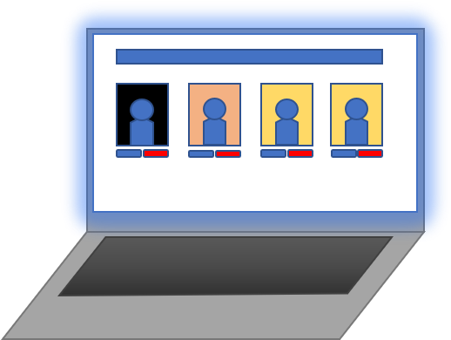

Database and Webserver
Responses
Requests
HTTP
HTTP
Requests
Responses
Registration and Management website
Smart Mirror

Slide 2

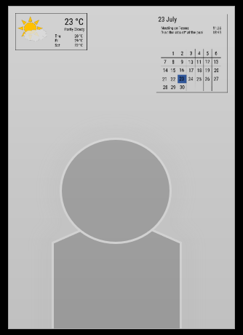
Database and Webserver
HTTP
Requests
And
Responses
Smart Mirror
Management
website

Slide 3
23 °C
Partly Cloudy
Thu 28 °C
Fri 29 °C
Sat 22 °C
23 July
Meeting on Teams 11:35
Drop the kids off at the pool 13:45
1
2
3
4
5
6
7
8
9
10
11
12
13
14
15
16
17
18
19
20
21
22
23
24
25
26
27
28
29
30

Slide 4
ORM

