Slide 1

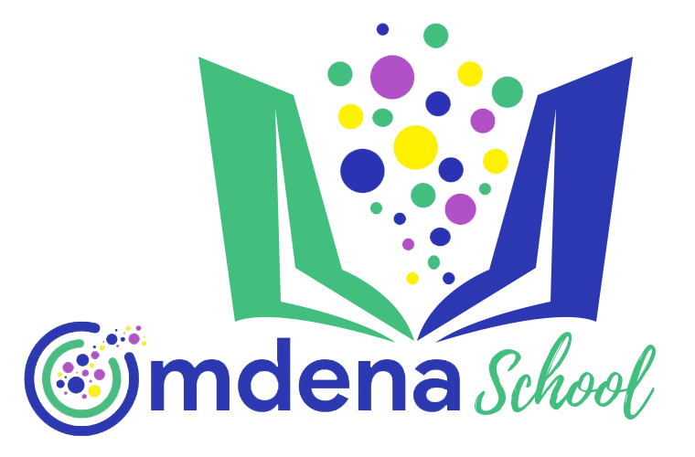

Solving Business Problems with NLP
Instructor: Juber Rahman

Slide 2
Limitations of Bag of Words (Countvectorizer)
Does not consider the context
Does not account for semantic order
new sentences contain new words, thus increasing vocabulary size and thereby, the length of the vectors.
the vectors would also contain many 0s, thereby resulting in a sparse matrix (not good for an model for learning)
retains no information on the grammar of the sentences nor on the ordering of the words in the text.
Introduces curse of dimensionality

Slide 3
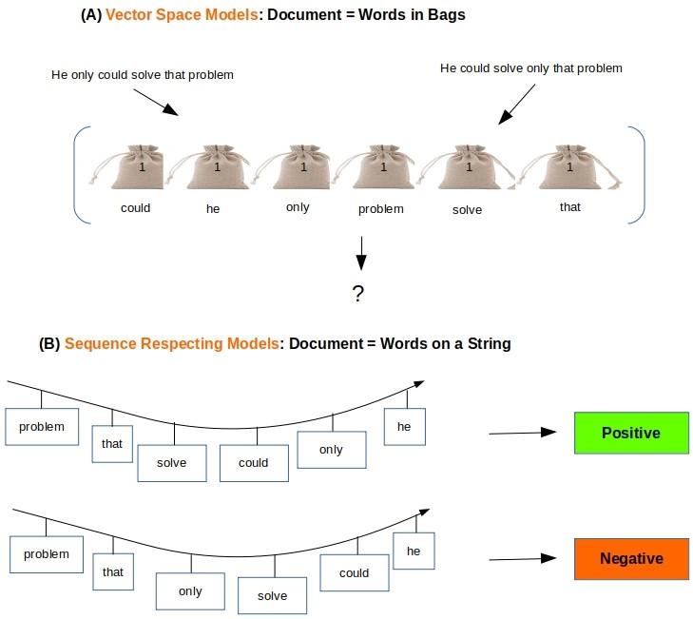
Some examples
“Eat to Live” and “Live to Eat“
Eat -1, To- stopword, Live- 1
“You like him” and “You are like him”
You -1, like -1, he -1

Slide 4
Limitations of Bag of Words TF-IDF
It computes document similarity directly in the word-count space, which may be slow for large vocabularies.
It assumes that the counts of different words provide independent evidence of similarity.
It makes no use of semantic similarities (meaning and relationship) between words.
Okay for information retrieval but not good for search engine optimization
e.g. searching for information related to the word “king”. In such a case, the TF-IDF will only consider the word “king”. Synonyms like “ruler” or “monarch” would be treated as completely different entities
Ref: https://towardsdatascience.com/whats-in-a-word-da7373a8ccb

Slide 5
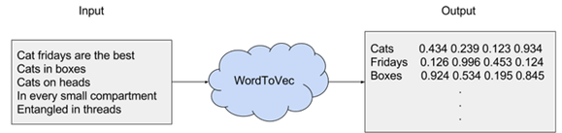
Alternatives- Word2Vec method
an algorithm that accepts text corpus as an input and outputs a vector representation for each word in the document.
retains the semantic meaning of different words in a document.
2 different techniques can be used - CBOW and Skip-Gram
Neural network classifiers are used

Slide 6
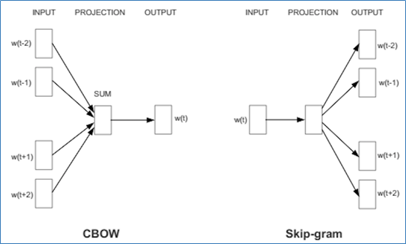
Continuous Bag-Of-Words and Skip gram
Skip gram - tries to use the current word w in order to predict its neighbors (i.e., its context)
CBOW- uses each of these contexts to predict the current word

Slide 7
N-gram Illustrated
Scikit-learn-
CountVectorizer(ngram_range = (1, 1))
CountVectorizer(ngram_range = (2, 2), stop_words='english')
“Medium blog” is a 2-gram (a bigram)
“Write on Medium” is a 3-gram (trigram)
“A Medium blog post” is a 4-gram
Another example-
“I love this article” has four words and n=4.
if n=2, i.e bigram, then the columns would be — [“I love”, “love this”, ‘this article”]
if n=3, i.e trigram, then the columns would be — [“I love this”, ”love this article”]
if n=4,i.e four-gram, then the column would be -[‘“I love this article”]

Slide 8
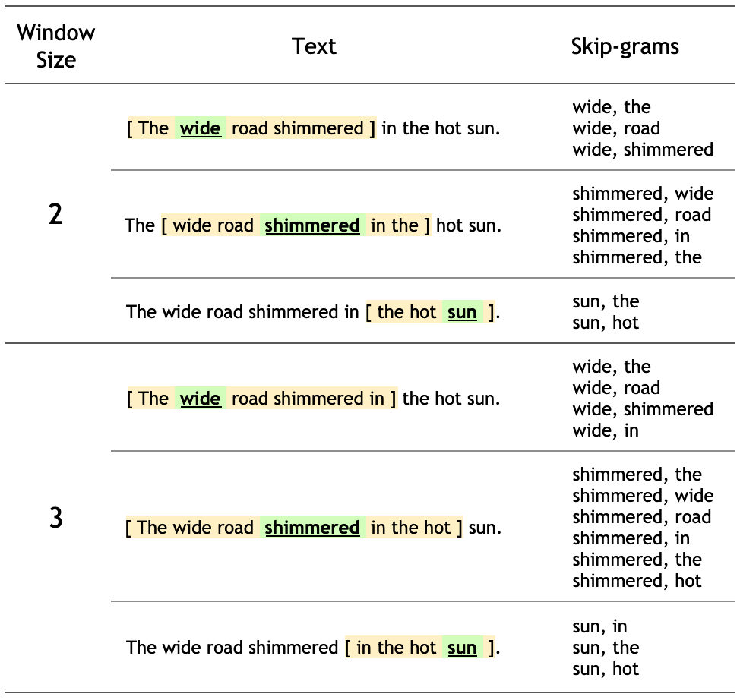
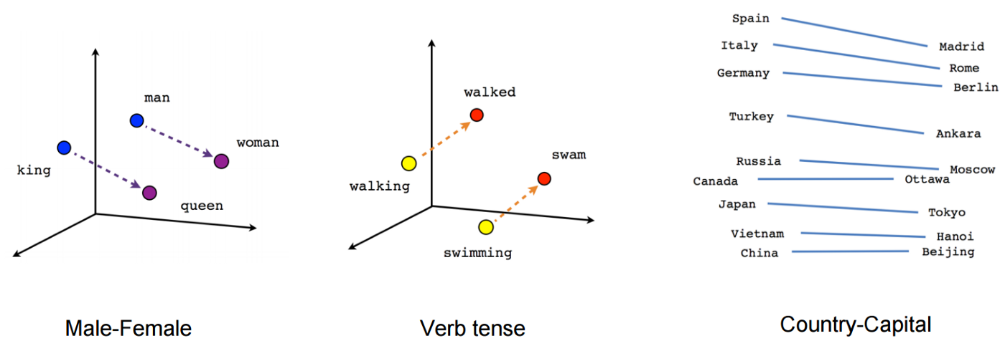
Skip gram- Illustrated

Slide 9
Python packages
Spacy
Gensim
FastText
GloVe
Further Readings:
https://nlp.stanford.edu/projects/glove/
https://fasttext.cc/docs/en/crawl-vectors.html

Slide 10
Semi-Supervised Learning

