Slide 1
FUZZY LOGIC
Shane Warren
Brittney Ballard

Slide 2
OVERVIEW
What is Fuzzy Logic?
Where did it begin?
Fuzzy Logic vs. Neural Networks
Fuzzy Logic in Control Systems
Fuzzy Logic in Other Fields
Future

Slide 3
WHAT IS FUZZY LOGIC?
Definition of fuzzy
  Fuzzy – “not clear, distinct, or precise; blurred”
Definition of fuzzy logic
  A form of knowledge representation suitable for notions that cannot be defined precisely, but which depend upon their contexts.

Slide 4


TRADITIONAL REPRESENTATION OF LOGIC
Slow
Fast
Speed = 0
Speed = 1
bool speed;
get the speed
if ( speed == 0) {
// speed is slow
}
else {
// speed is fast
}

Slide 5


FUZZY LOGIC REPRESENTATION
Slowest
For every problem must represent in terms of fuzzy sets.
What are fuzzy sets?
[ 0.0 – 0.25 ]
Slow
[ 0.25 – 0.50 ]
Fast
[ 0.50 – 0.75 ]
Fastest
[ 0.75 – 1.00 ]

Slide 6
FUZZY LOGIC REPRESENTATION CONT.
Slowest
Slow
Fast
Fastest
float speed;
get the speed
if ((speed >= 0.0)&&(speed < 0.25)) {
// speed is slowest
}
else if ((speed >= 0.25)&&(speed < 0.5))
{
// speed is slow
}
else if ((speed >= 0.5)&&(speed < 0.75))
{
// speed is fast
}
else // speed >= 0.75 && speed < 1.0
{
// speed is fastest
}

Slide 7
ORIGINS OF FUZZY LOGIC
Traces back to Ancient Greece
Lotfi Asker Zadeh ( 1965 )
  First to publish ideas of fuzzy logic.
Professor Toshire Terano ( 1972 )
  Organized the world's first working group on fuzzy systems.
F.L. Smidth & Co. ( 1980 )
  First to market fuzzy expert systems.

Slide 8
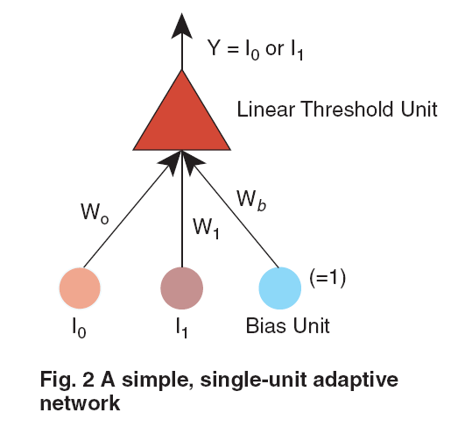
FUZZY LOGIC VS. NEURAL NETWORKS
How does a Neural Network work?
Both model the human brain.
  Fuzzy Logic
  Neural Networks
Both used to create behavioral
systems.

Slide 9
FUZZY LOGIC IN CONTROL SYSTEMS
Fuzzy Logic provides a more efficient and resourceful way to solve Control Systems.
Some Examples
  Temperature Controller
  Anti – Lock Break System ( ABS )

Slide 10
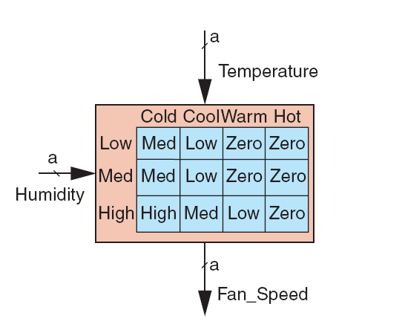
TEMPERATURE CONTROLLER
The problem
  Change the speed of a heater fan, based off the room temperature and humidity.
A temperature control system has four settings
  Cold, Cool, Warm, and Hot
Humidity can be defined by:
  Low, Medium, and High
Using this we can define
the fuzzy set.

Slide 11
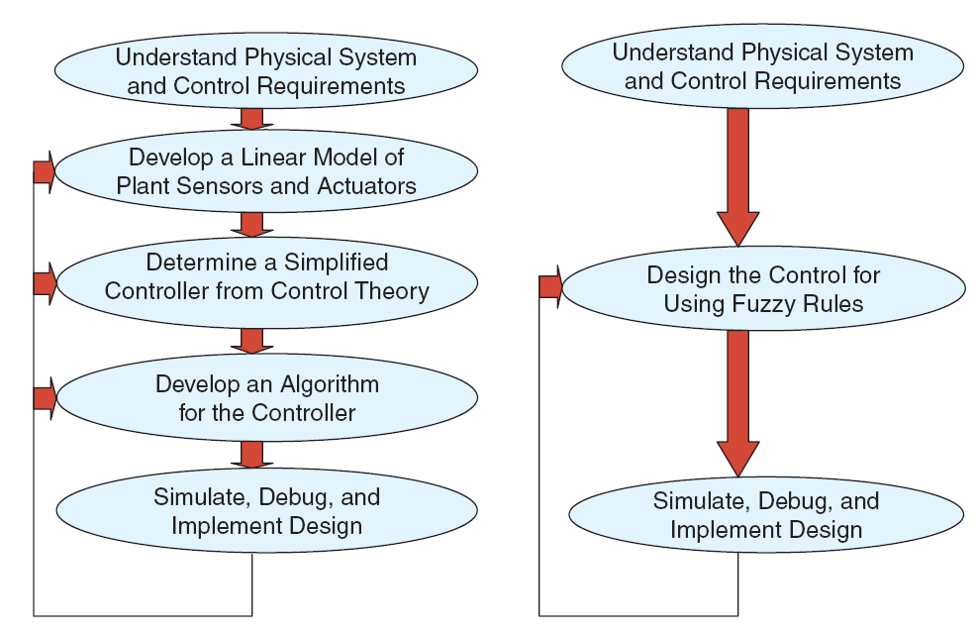
BENEFITS OF USING FUZZY LOGIC

Slide 12
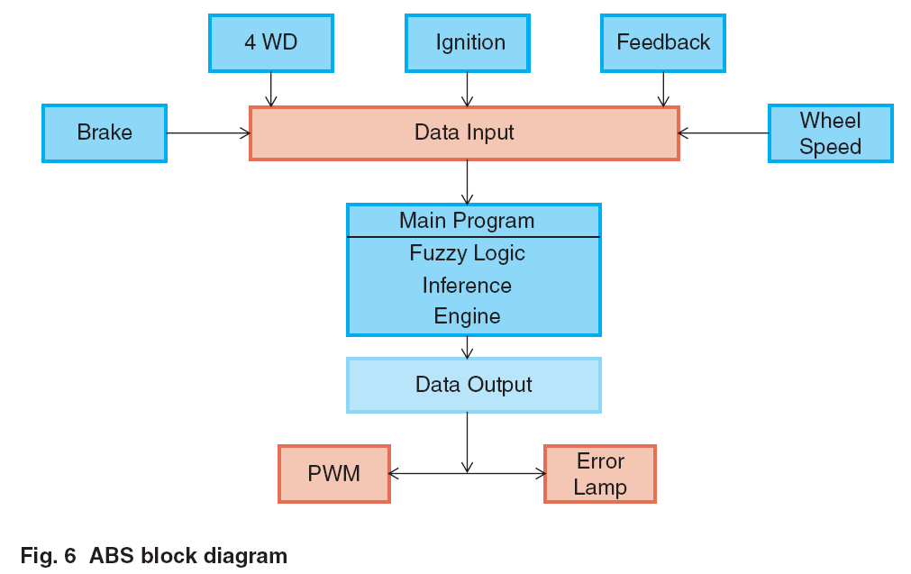
ANTI LOCK BREAK SYSTEM ( ABS )
Nonlinear and dynamic in nature
Inputs for Intel Fuzzy ABS are derived from
  Brake
  4 WD
  Feedback
  Wheel speed
  Ignition
Outputs
  Pulsewidth
  Error lamp

Slide 13
FUZZY LOGIC IN OTHER FIELDS
Business
Hybrid Modeling
Expert Systems

Slide 14
CONCLUSION
Fuzzy logic provides an alternative way to represent linguistic and subjective attributes of the real world in computing.
It is able to be applied to control systems and other applications in order to improve the efficiency and simplicity of the design process.

Slide 15


