Slide 1
What is the most valuable OS you will ever come across?

Slide 2

YOU!!!

Slide 3
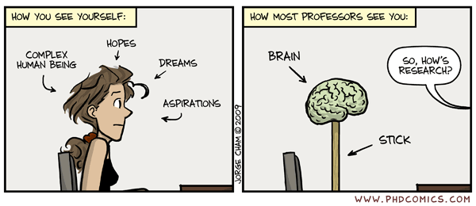

Slide 4
Sitting in a comfy chair all day
What could possibly go wrong?

Slide 5
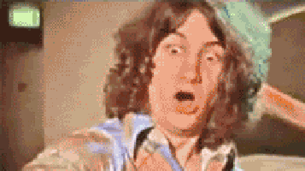
Health issues in IT
Thrombosis
Heart disease
Cancer
Carpel tunnel syndrome
Vit D deficiency
Anxiety, stress, depression
Insomnia
Lower back pain
Neck and eye strain

Slide 6

Oh dear!

Slide 7

Prevention!

Slide 8
3 categories:
Trombosis
Heart disease
Cancer
Anxiety
Depression
Vit. D deficiancy
Cardinal tunnel syndrome
Back pain
Neck pain
Insomnia
Eye strain

Slide 9

Lack of movement:

Slide 10
Move!
“Sport elke dag een half uur, behalve als je het druk hebt dan beter een uur!” UGhent sport
Move at least once in 1h
Catch some sunlight!

Slide 11
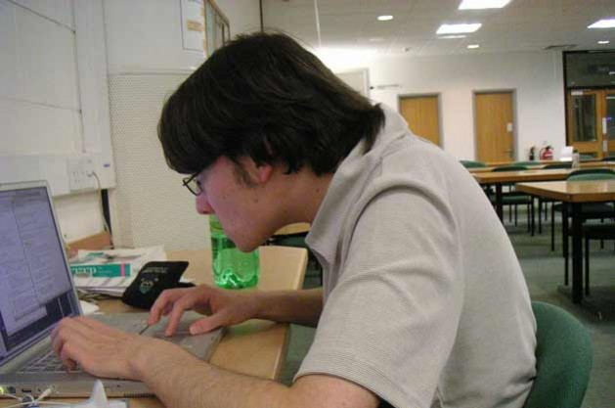
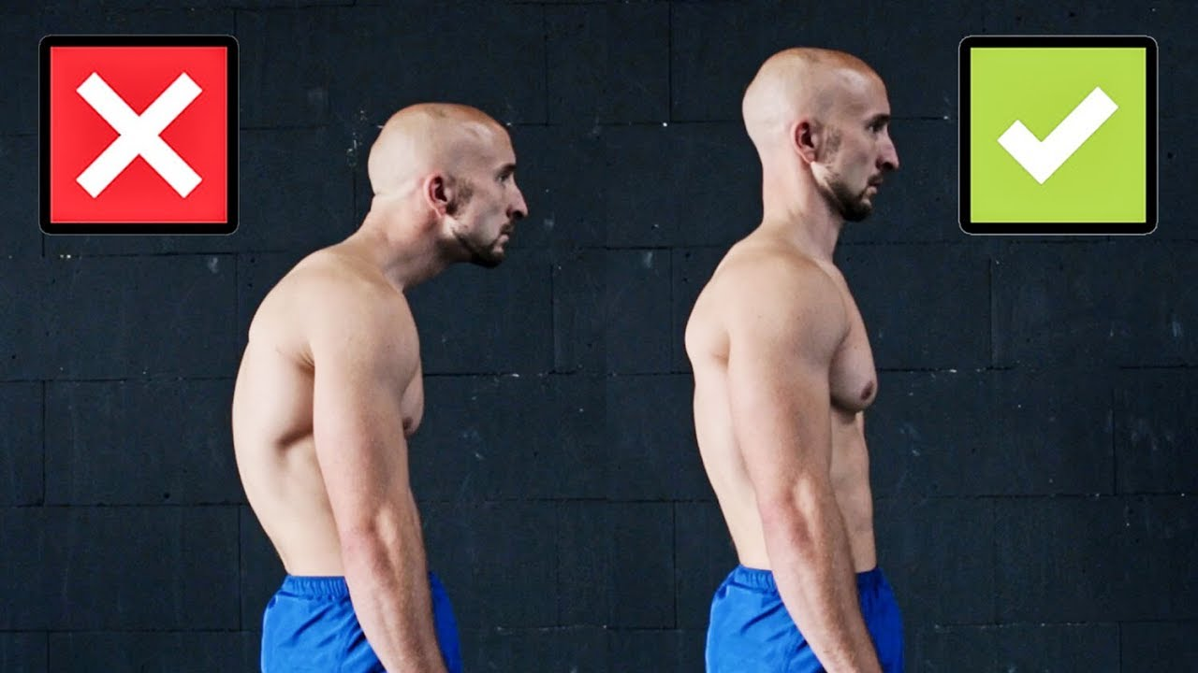
Posture and ergonomics
Awareness and exercise!

Slide 12
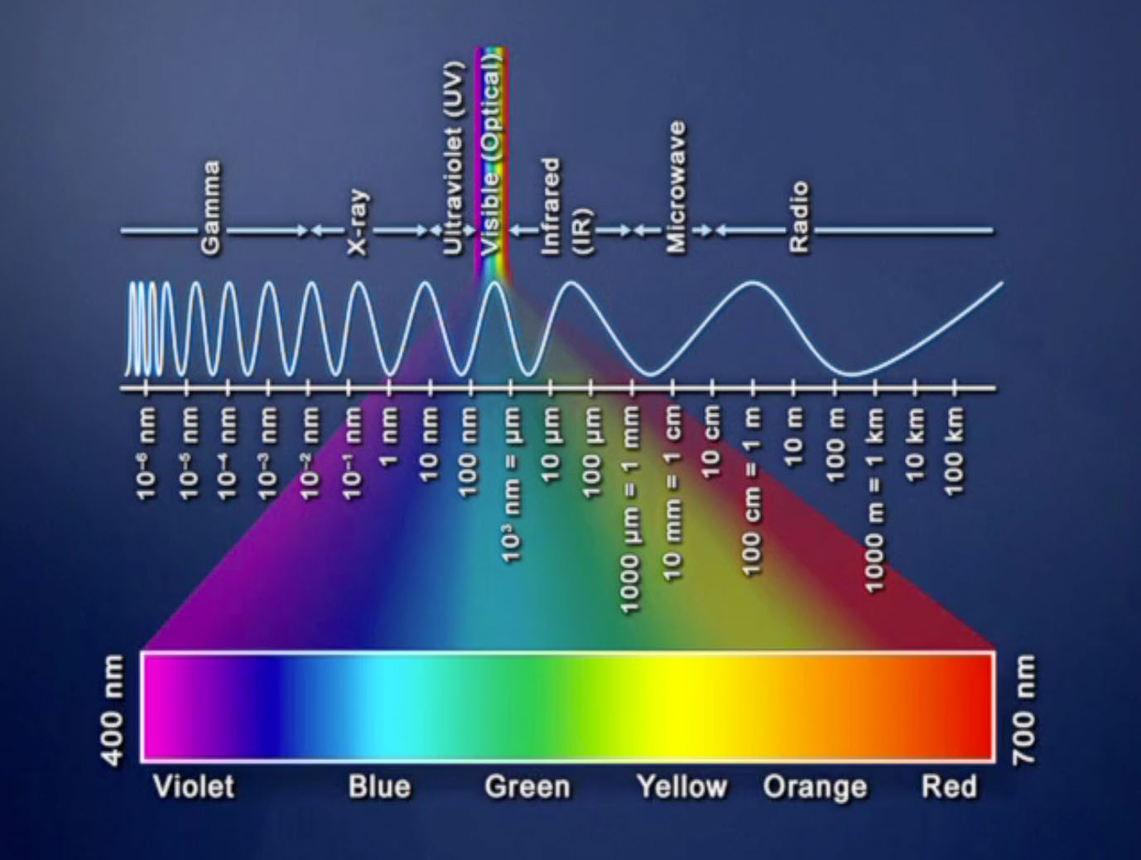
Blue light:

Slide 13

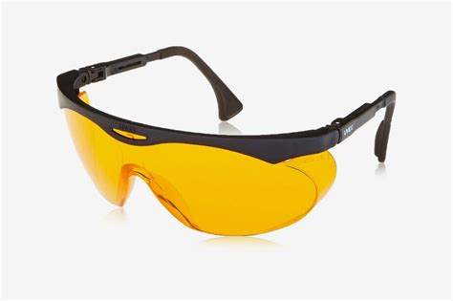
Blue light protection:
Limit screen time after work
Use protective software (flux)
Use Blue light filtering glasses

Slide 14
Questions?

