Slide 1
Smart India Hackathon 2026 - Internal Hackathon
INCOIS 3D Ocean Data Visualization System
Problem Statement ID: SIH26067
Problem Statement Title: Develop a web-based interactive 3D visualization platform that
integrates numerical ocean model outputs and in-situ observations
Theme: Disaster Management
PS Category: Software
Team Name: Astra
Idea Reference ID: SIH_CU_080
Team Members:
1. Subham Rai
2. Sumeghna Banerjee
3. Nabeeha Kappan
4. Niroop H
5. Aaron John Dev
6. Prabhjot

Slide 2
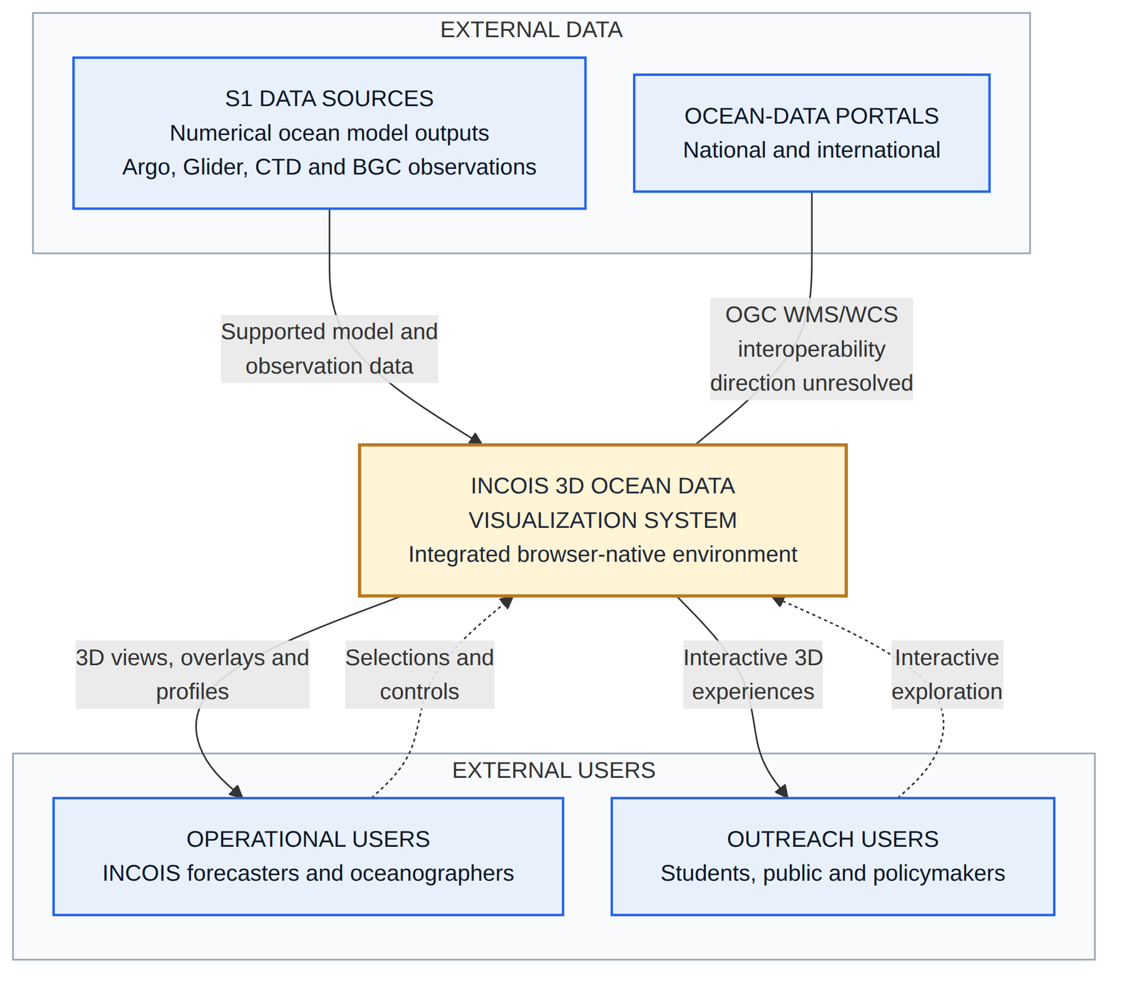
System Context
Who interacts with the system, what information enters it, and what crosses its external boundary
External participants
S1 Data Sources supplies numerical ocean model outputs and Argo, Glider, CTD and BGC observations. National and international ocean-data portals sit outside the system.
What crosses the boundary
Supported model and observation data enters. 3D views, overlays and profiles leave. OGC WMS/WCS interoperability is shown undirected because its direction is unresolved.
Users
Operational users are INCOIS forecasters and oceanographers. Outreach users are students, the public and policymakers.
SRS basis: DIR-001 to DIR-007 · MOI-001 to MOI-003 · WEB-001 · STD-003.

Slide 3
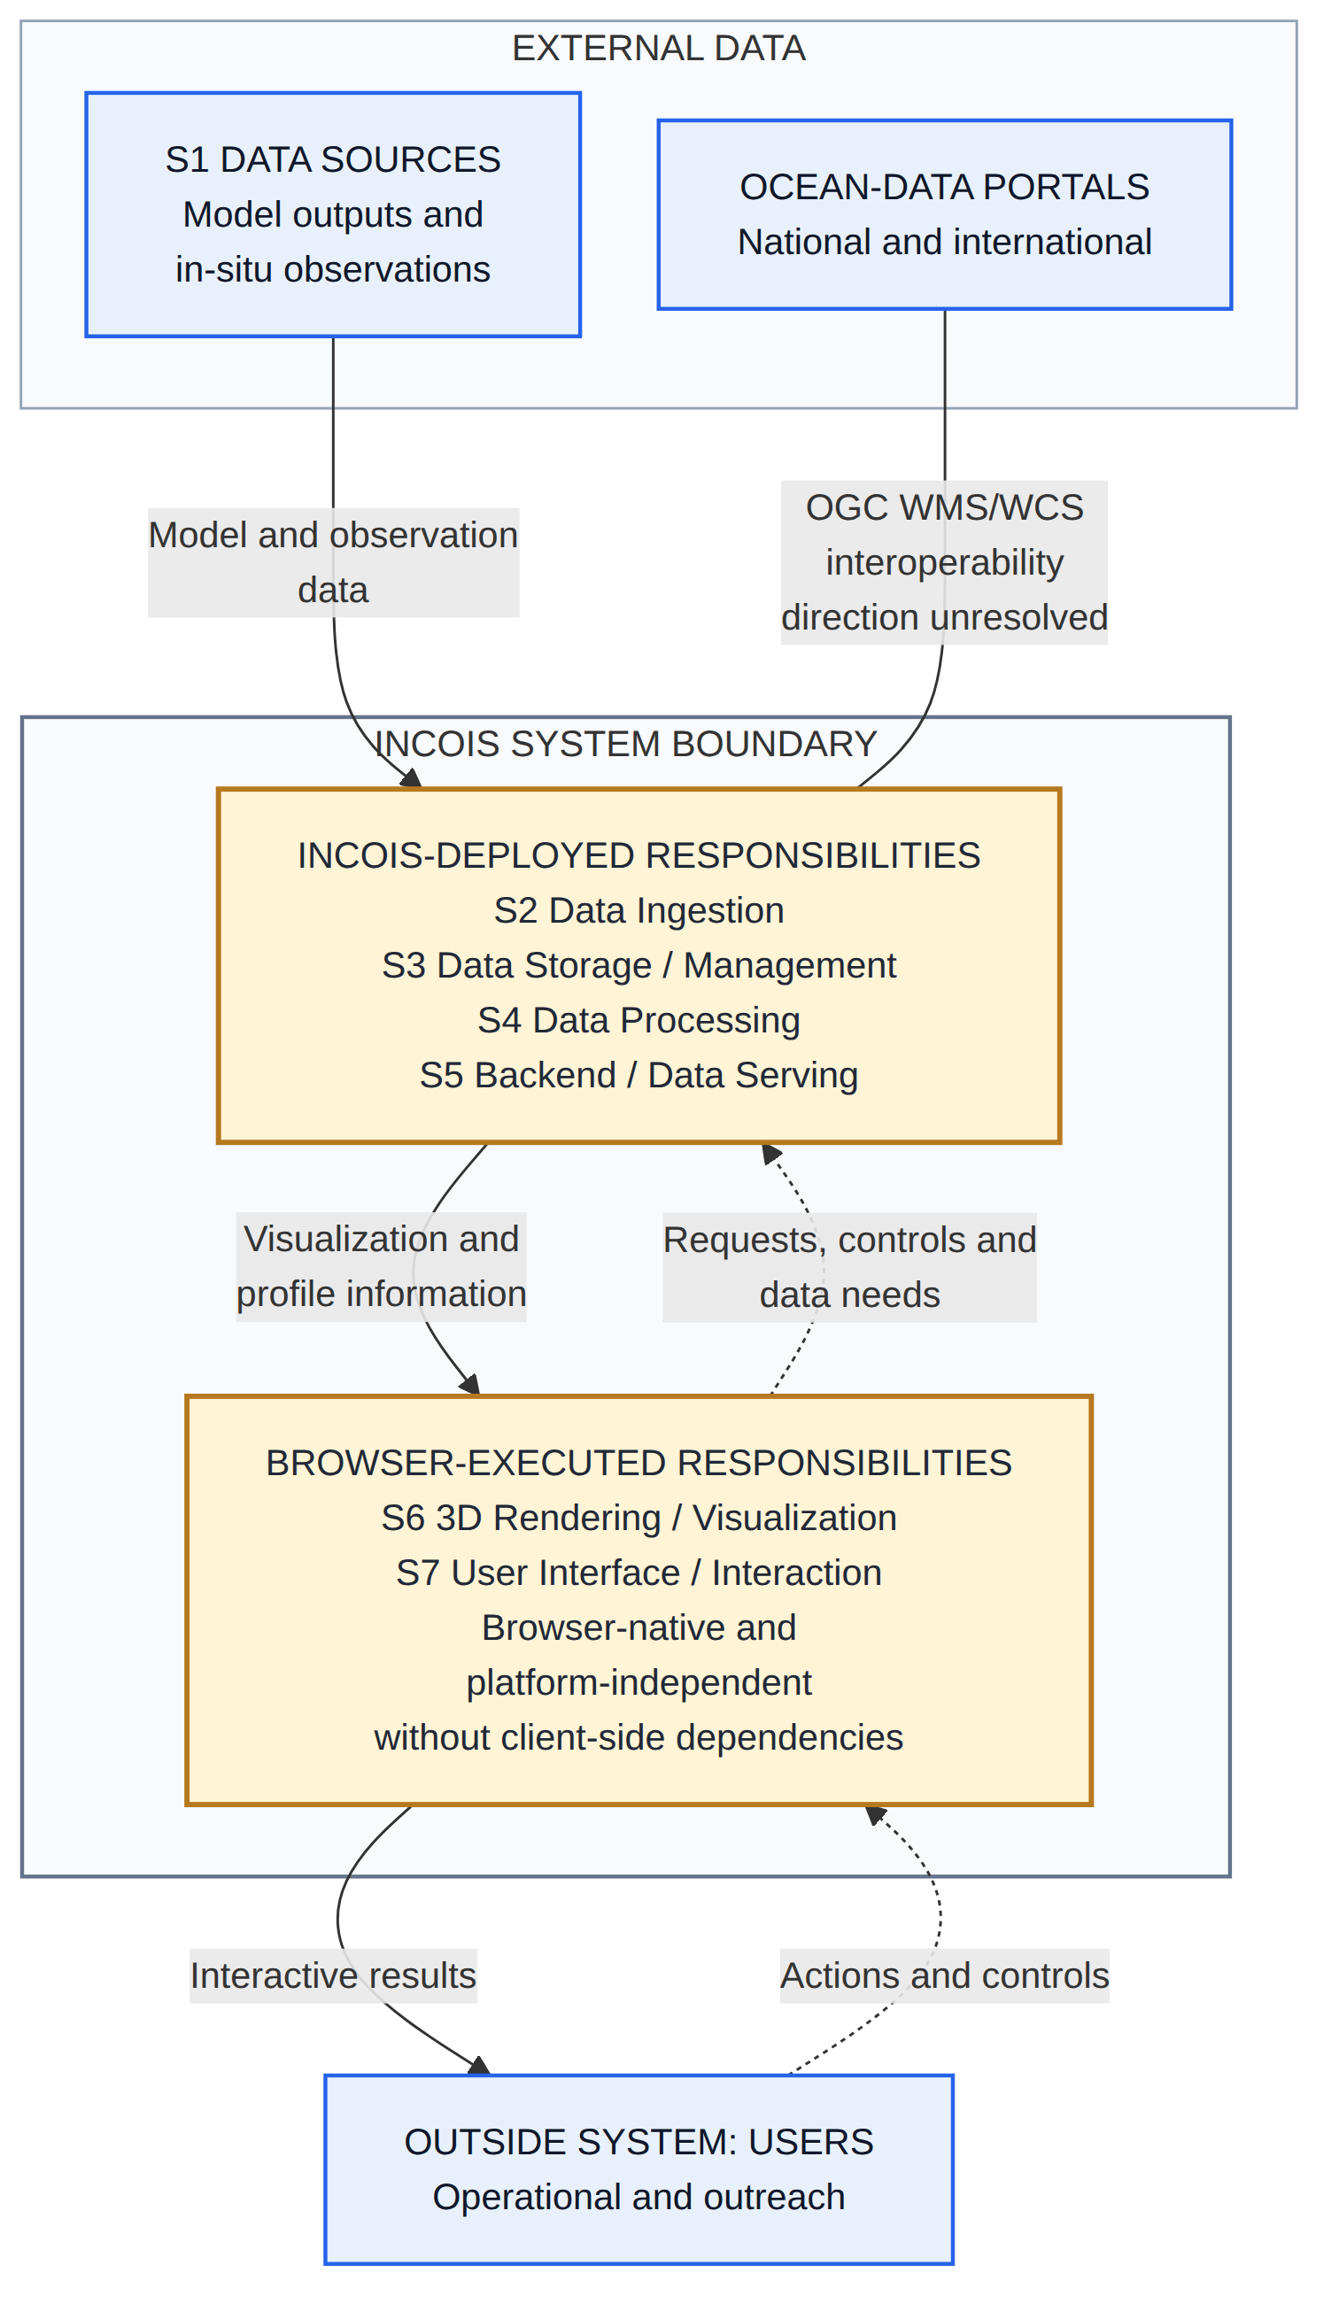
System Boundary
What stays external, what belongs to the INCOIS-deployed platform, and what executes in the browser
INCOIS-deployed responsibilities
S2 Data Ingestion, S3 Data Storage / Management, S4 Data Processing and S5 Backend / Data Serving.
Browser-executed responsibilities
S6 3D Rendering / Visualization and S7 User Interface / Interaction — browser-native and platform-independent, without client-side dependencies.
Boundary note
This is a logical responsibility boundary, not a selected host, service, container or deployment topology. Browser-executed responsibilities remain part of the system.
SRS basis: DIR-001 to DIR-007 · ING-001 to ING-002 · BDA-001 · WEB-001 to WEB-003 · STD-002 to STD-003.

Slide 4
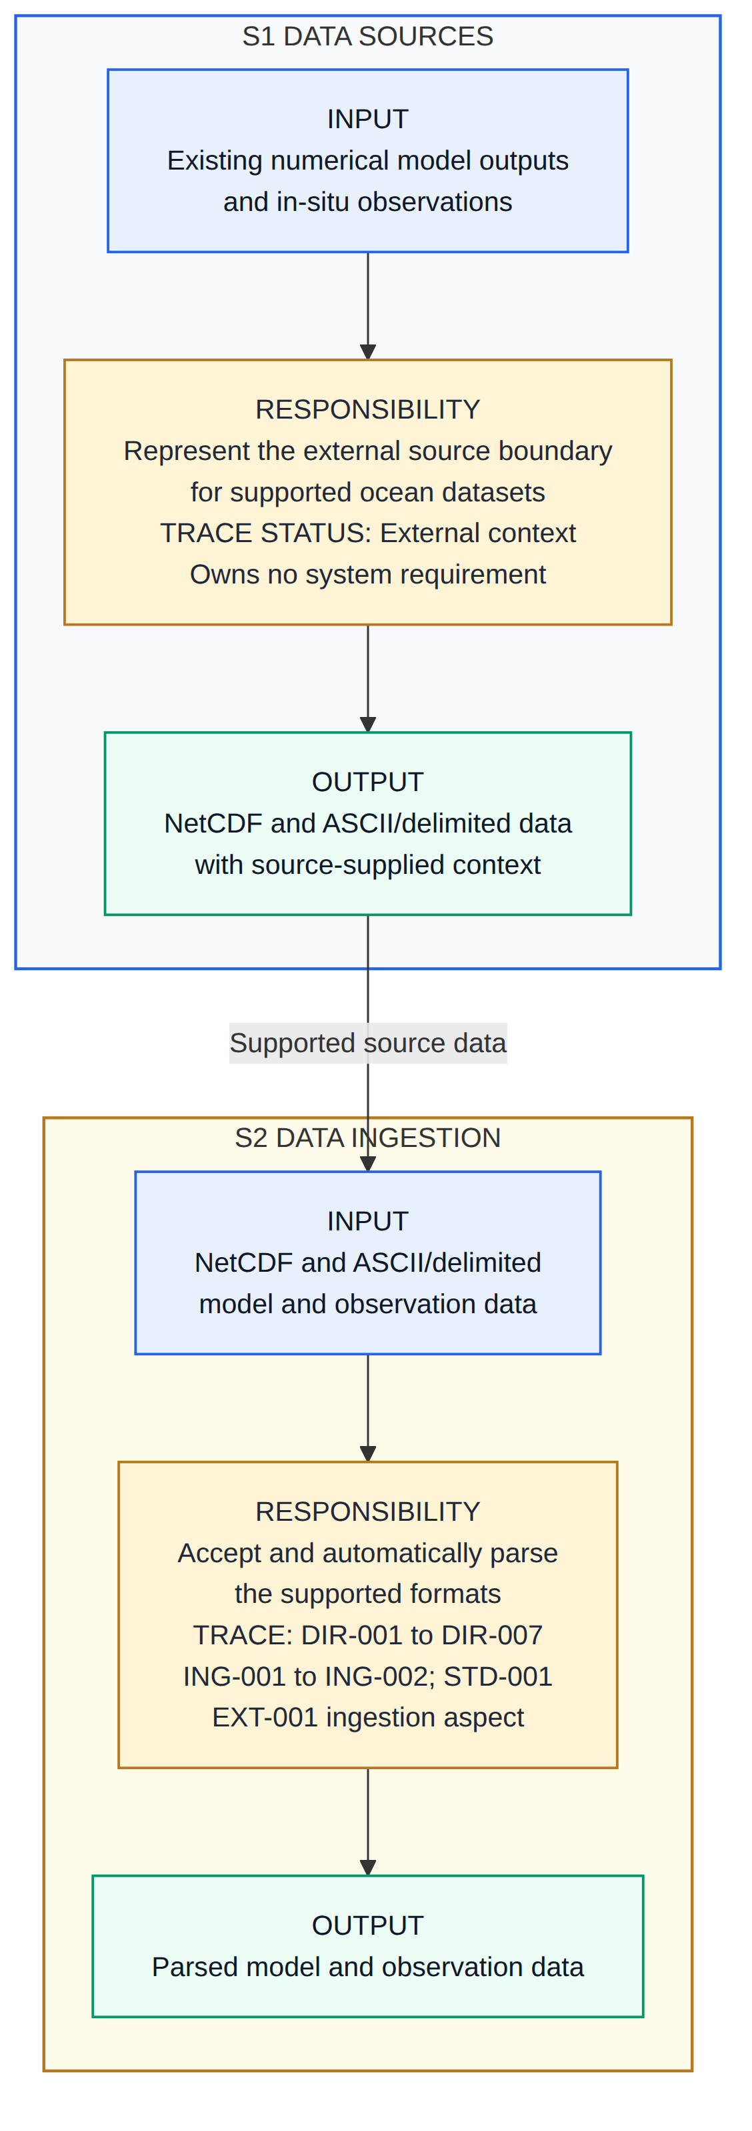
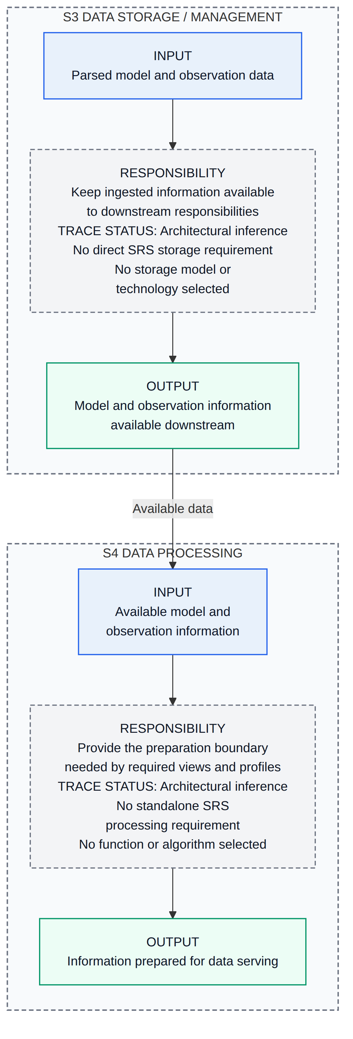
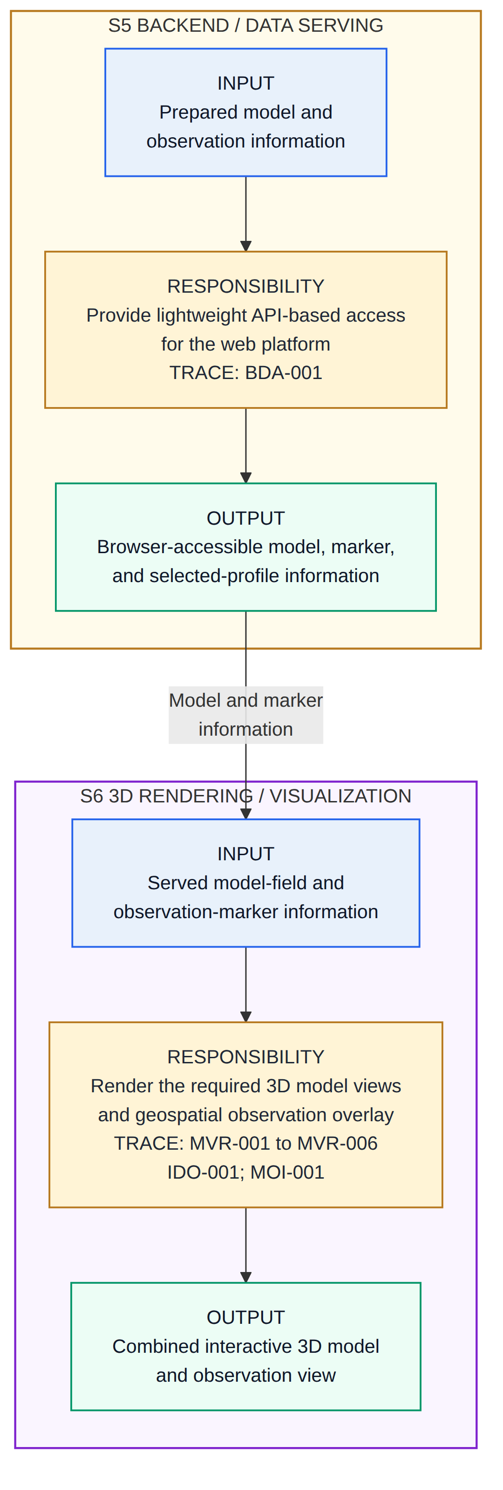
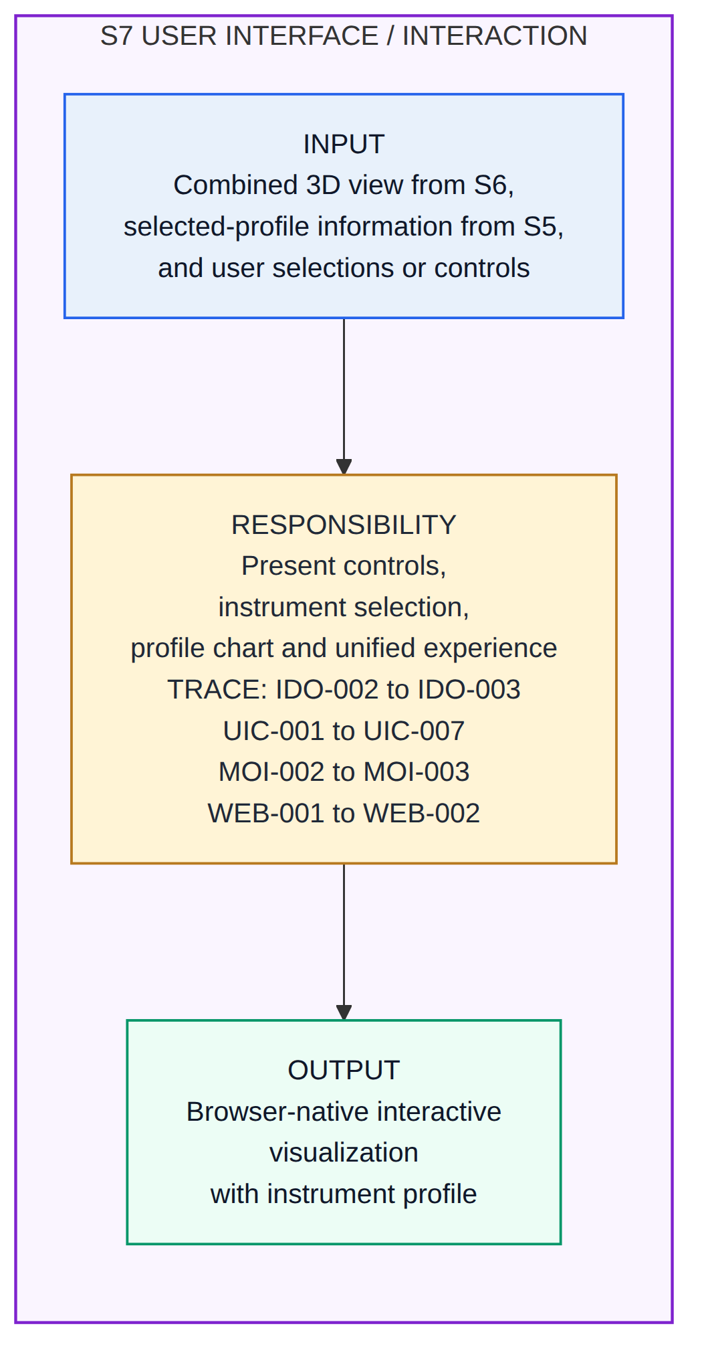
Responsibility Pipeline
Which stage owns each high-level responsibility, and what it must hand onward — the chain is shown in four columns
>
>
>
Parsed data
Prepared information
Combined 3D view
Direct TRACE labels identify SRS requirement ownership. S3 and S4 are marked as inferred enabling boundaries because the SRS defines no standalone storage or processing design. S5 also serves selected-profile information directly to S7, and S7 returns requests and controls to S5.
SRS basis: DIR-001 to DIR-007 · ING-001 to ING-002 · BDA-001 · MVR-001 to MVR-006 · IDO-001 to IDO-003 · UIC-001 to UIC-007 · MOI-001 to MOI-003 · WEB-001 to WEB-003.

Slide 5
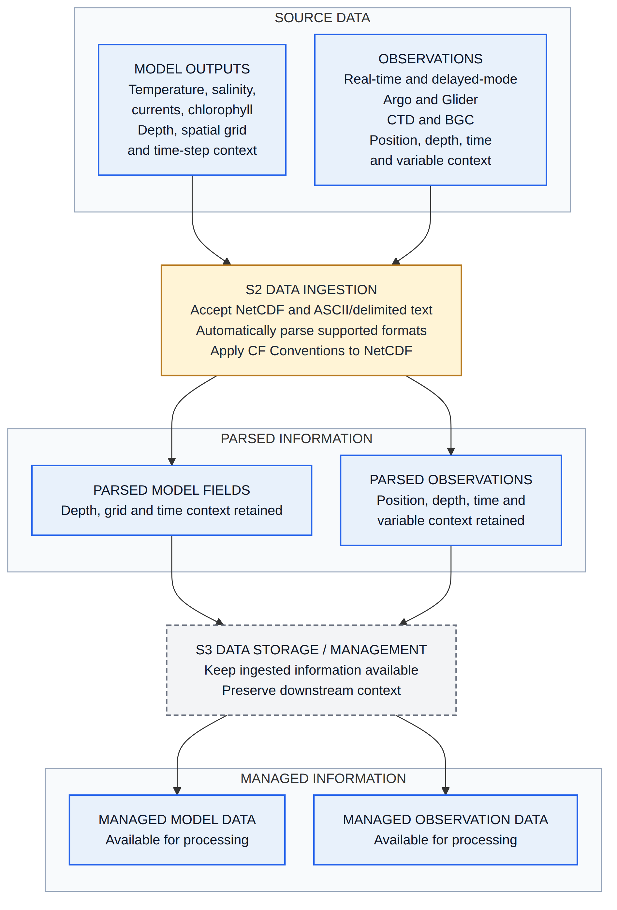
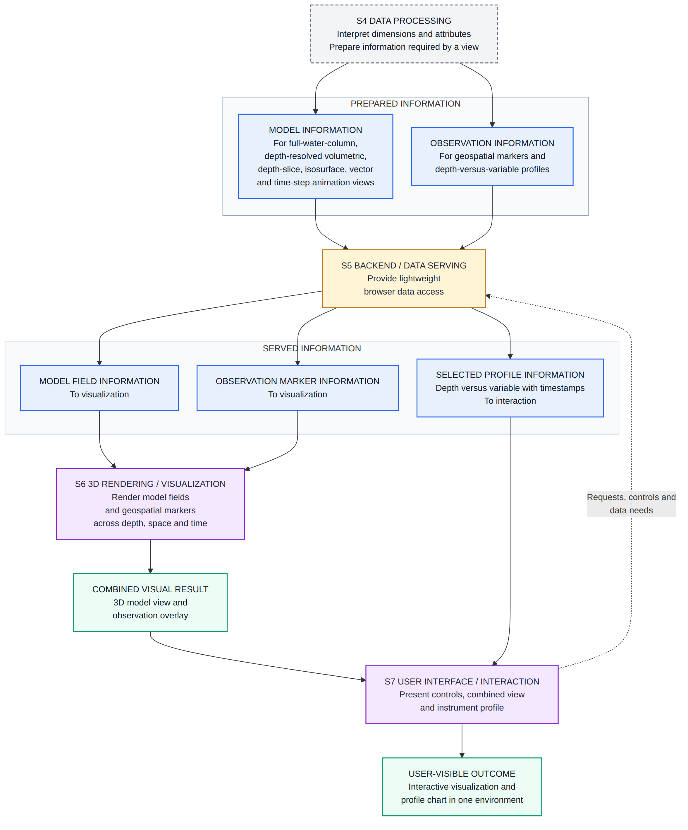
End-to-End Data Flow
How model data and observation data change as they move through the shared responsibilities and reach the user
>
Managed information
to S4
Model and observation information stays distinct through the shared stages and converges at S6 for co-visualization. The selected-profile branch is served from S5 and presented directly through S7.
SRS basis: DIR-001 to DIR-007 · ING-001 to ING-002 · BDA-001 · MVR-001 to MVR-006 · IDO-001 to IDO-003 · MOI-001 to MOI-003 · STD-001.

Slide 6
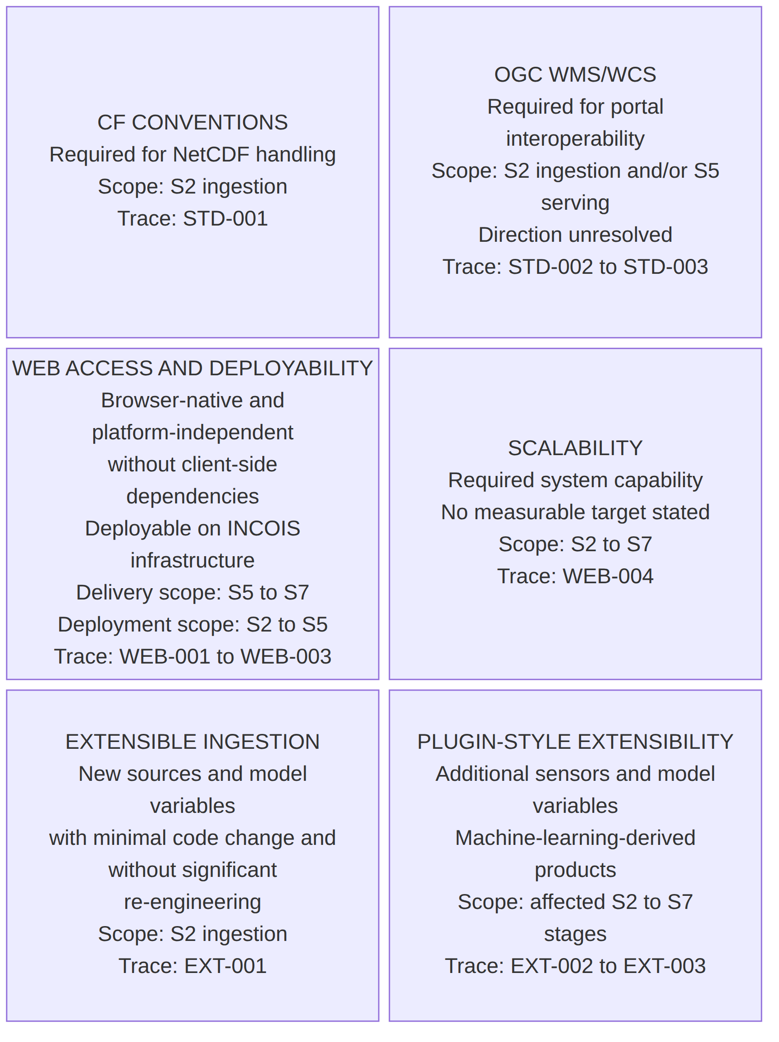
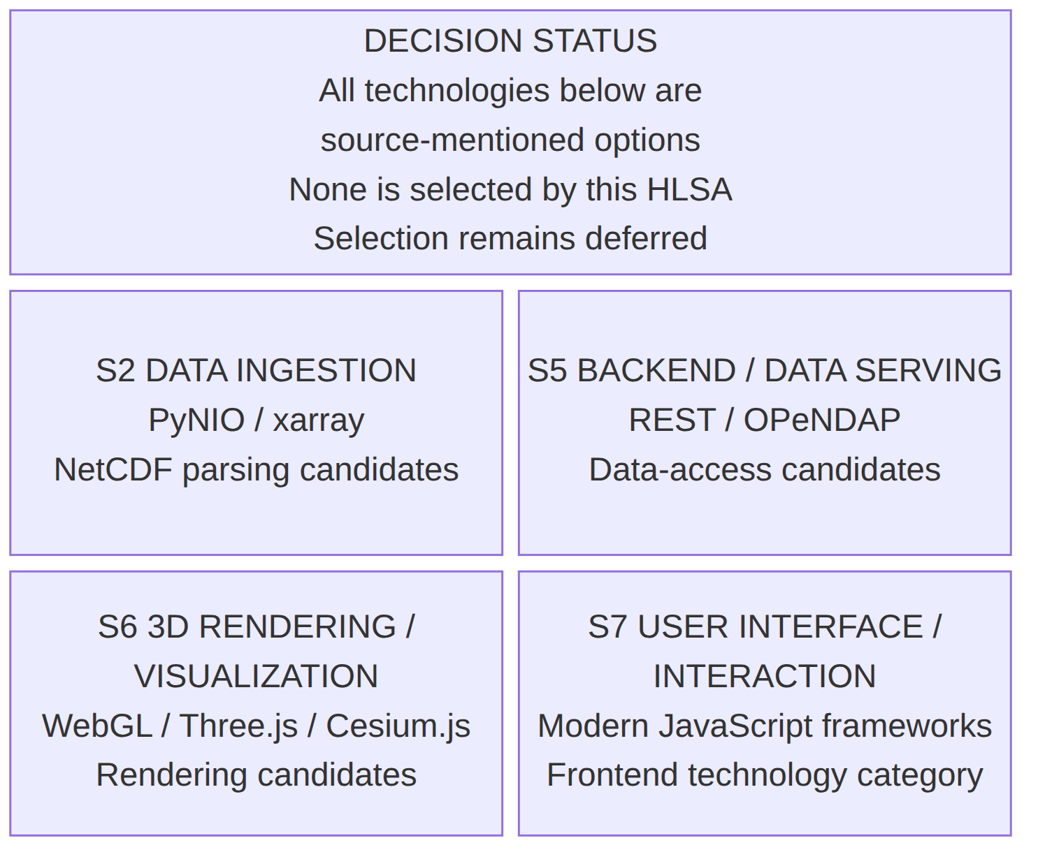
Constraints and Technology Options
Cross-cutting constraints
Source-mentioned technology options — none selected
Constraint note: these retain the required standards and constraints without inventing capacity targets, extension mechanisms or deployment design. Technology note: OGC WMS/WCS and CF Conventions are not shown as suggestions because the SRS requires those standards.
SRS basis: WEB-001 to WEB-004 · EXT-001 to EXT-003 · STD-001 to STD-003.

