Slide 1
XDCR in Couchbase 2.2
XDCR team, ns_server team, ep_engine team

Slide 2
Agenda
XDCR basics
What, why, how
What’s new in 2.2
New XDCR protocol
Per-replication settings
Optimistic XDCR stats
A quick demo
Notes:
Each on of these can determined the number of nodes
Data sets, work load, etc.

Slide 3
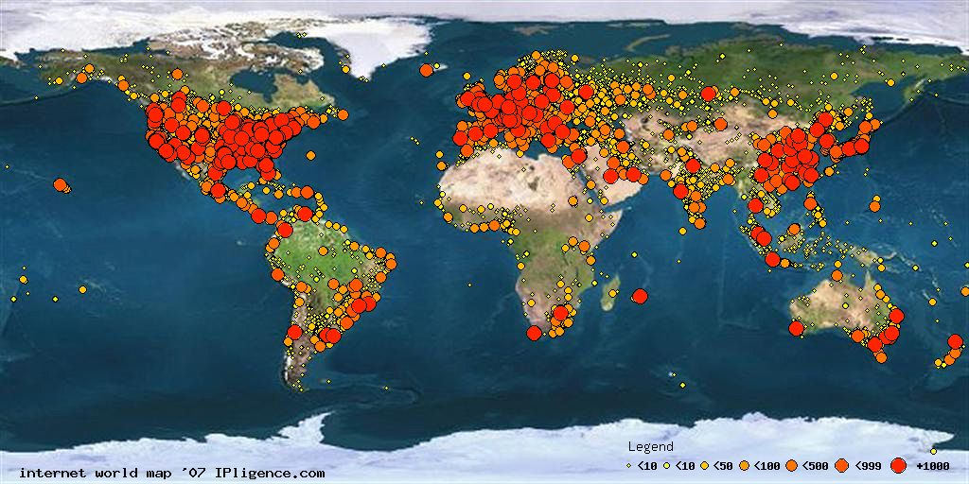

XDCR: Cross Data Center Replication
Europe Data Center
US Data Center
asia Data Center
http://blog.groosy.com/wp-content/uploads/2011/10/internet-map.jpg
Notes:
So what is xdcr, why we need xdcr and how xdcr works
Xdcr is cross data center replication, allow you to replicate data from one data center to another
Why ?
Two reasons, performance and availablility
For example, when you create application on top of cb, you may want to your applicatoin 24 hours 7 days online, and you may want to have your users around the world
Thus you can create multiple data center around the world, the benefity is 1 users can access data at the nearest data center to improve users-experience
Seonc, in case some bad things happen, say the whole datacenter lsost powner, you wont lose your data completely, you have backup datacenter in another place, , after original dc comes back, you can restore the original datacenter the backup data

Slide 4
Cross Data Center Replication – The basics
Introduced since Couchbase 2.0 (Dec. 2012)
Replicate your Couchbase data across clusters
Clusters may be spread across geos
Configured on a per-bucket (per-database) basis
Supports unidirectional and bidirectional operation
Application can read and write from both clusters
Active – Active replication
Replication throughput scales out linearly
Different from intra-cluster replication
Notes:
Here are some basics about xdcr
per bucket basis: you can have multiple buckets on the same clsuters and rcreate replciations on top of each bucket, you can also create multiple replications on the same bucket, to different clusters
Active-active, remember in ccb, in for every key we put it in different places, one on active and you can create some replicas to backup the key in the same cluster
Xdcr is active-active, that means we replicate from one active vbucket to another active vbucket,
Xdcrm if you lookin to xdcr, each vbucket actualy repciate own, once repliation starts there is noc enterialized bottleneck to syncrhouize each vbucket replcation
That means ifyou have enough resouce resource, when ou asddd ne node into lcuster, you seelinear scalble perofrmance.

Slide 5
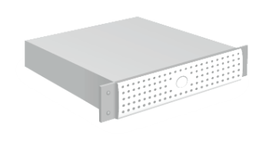
Cross data center replication – Data flow
2
App Server
Doc 1
Couchbase Server Node
3
2
3
Managed Cache
To other node
Replication Queue
Doc 1
Doc 1
Disk Queue
Disk
Doc 1
XDCR Queue
To other cluster
Notes:
1. A set request comes in from the application .
2. Couchbase Server responses back that they key is written
3. Couchbase Server then Replicates the data out to memory in the other nodes
4. At the same time it is put the data into a write que to be persisted to disk

Slide 6
What is new in 2.2?

Slide 7
What’s new in 2.2
Direct replication to remote memcached
Pre-2.2: CAPI protocol
revs_diff, bulk_docs
Translate to memcached operations at destination
2.2: XMem: Memcached binary protocol
getMeta(), setWithMeta(), delWithMeta()
Per-replication settings
Pre-2.2: settings per node basis
Configurable on both UI and using REST APIs
Optimistic XDCR stats
Notes:
What is new
Basically three things,
Direct replciation to memcached. In
pre-2.2, yif you loook into the xdcr, you will see htat data are rpelciated over CAPI protocole, capi means couch api,
We use two CAPI protocl commands, revs_diff , bulcksd-cl, revs_diff means ….
Blucket_docs
Local translation
In .2.2, we skip this step, the source will directly use memcahced protocol

Slide 8
New XDCR Protocol
Direct Replication to Memcached
Transport layer change
Improved replication throughput
Reduced CPU usage at destination side, but not source side
Pipelined memcached operations
No impact to existing
parameters
checkpointting
fault tolerant
statistics
Notes:
A little more about new XDCR protocol
It is completely a data transport layer change, that means we only change way how send data to remote , but xdcr protocl does not change
The reaon is mostly performance, not functional, in pre-2.2 we use CAPI, we talk to erlang code at destianton and translate CPAI protocl tomemache protoocl and send them one-by-one to lcoal memached,
The translation part is CPU expensive, it is a loop I the batch and send them to lcoal memcached and get repsponses, and buildup the batched repsonse
Now we remote this part, we use more effficnet mbp diregtolery and remove erlang code form data path, in our test we observe much better throughput and CPU suage, if you are not bounded by other thingss
9
Since it is a data trasport layer change, it has not impact to many things

Slide 9
Conflict Resolution in Memcached
set(del)WithMeta() can do conflict resolution
New set(del)WithMeta = old set(del)WithMeta + getMeta + conflict resolution
A background fetch is issued if metadata is missing
All in memcached (ep_engine)
XMem mode conflict resolution
Non-optimistic – 2 ops/mutation:
getMeta from destination to source
setWithMeta at destination
Optimistic – 1 op/mutation:
setWithMeta at destination
Notes:
A little more about new XDCR protocol
It is completely a data transport layer change, that means we only change way how send data to remote , but xdcr protocl does not change
The reaon is mostly performance, not functional, in pre-2.2 we use CAPI, we talk to erlang code at destianton and translate CPAI protocl tomemache protoocl and send them one-by-one to lcoal memached,
The translation part is CPU expensive, it is a loop I the batch and send them to lcoal memcached and get repsponses, and buildup the batched repsonse
Now we remote this part, we use more effficnet mbp diregtolery and remove erlang code form data path, in our test we observe much better throughput and CPU suage, if you are not bounded by other thingss
9
Since it is a data trasport layer change, it has not impact to many things

Slide 10
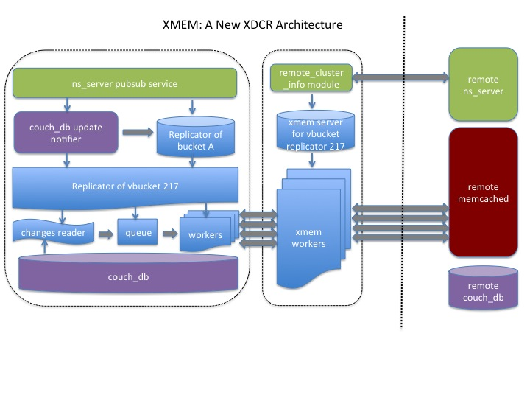
Pre-2.2: Replication over CAPI
CAPI
Notes:
Do not failover a healthy node!

Slide 11
XMem: Replication to Memcached
Notes:
Do not failover a healthy node!

Slide 12
Per-replication XDCR Settings
Better resource management
More current vb replicators for critical replications
Fine-tuned checkpoint interval
Small workload -> longer checkpoint interval
High workload -> smaller checkpoint interval
Elastic Search still uses CAPI mode XDCR
Incompatible with new XMem (version 2)
Concurrent XDCRs can have different protocols:
XDCR1 to ES clsuter uses CAPI (version 1) mode
XDCR2 to regular CB cluster uses Xmem (version 2) mode
Notes:
Do not failover a healthy node!

Slide 13
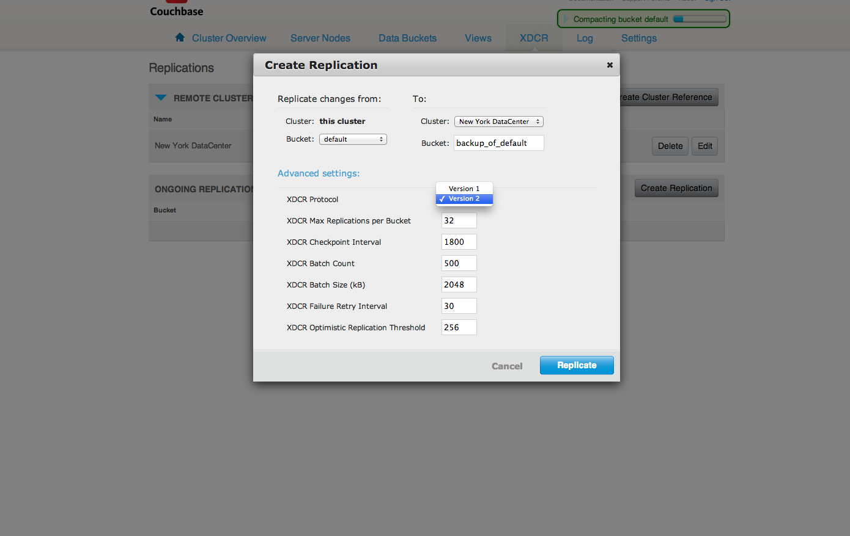
Per-replication XDCR Settings
Notes:
Do not failover a healthy node!

Slide 14
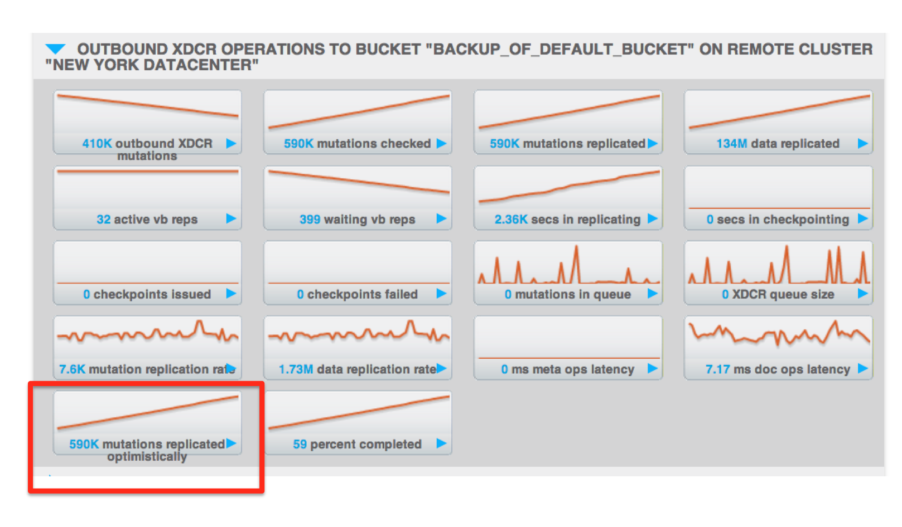
Optimistic XDCR Stats in 2.2
Optimistic XDCR (introduced in 2.1)
Replication without asking for metadata
Optimized for latency, but not bandwidth
Configurable on UI or using REST API
Threshold parameter (default 256 bytes)
Notes:
Do not failover a healthy node!

Slide 15
Couchbase NoSQL Document Database junyi@couchbase.com Thank you!

