Slide 1
PROJECT 1
NFL Restaurant density analysis.
Group 4: Christopher Williams, Eric Farrell, Justin Ying, Francisco J. Perez

Slide 2
Table of contents.
Introduction.
Data request, coding challenges and solutions.
Restaurant analysis in 2 miles radius around the Stadiums.
Restaurant analysis before and after game day.
Restaurants in most popular cities in the US vs most and least popular NFL teams.
Team.

Slide 3
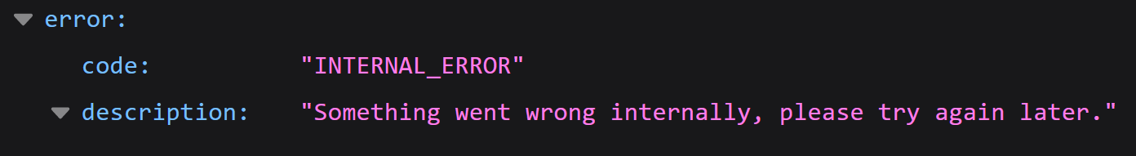
II. Data request and coding challenges.
Yelp API Authentication: API key + Authorization HTTP header value as: “Authorization: Bearer <YOUR ACCESS TOKEN>”.
Data request. Due to the nature of the project (obtaining and analyzing in 2 different timepoints), the response is saved as json files.
Business search endpoint.
Query limit:
This endpoint returns up to 1000 businesses based on the search criteria, although the number of business results to return per response is by default 20 (maximum 50).
Paging the search queries in steps of 20 (using 50 raised more errors) gave us 620 json files.
Some of the json files saved didn’t have any information; this error is only noticed when reading the already saved json files and the only way around it is to continuously request the data until there isn’t any “empty” file.

Slide 4
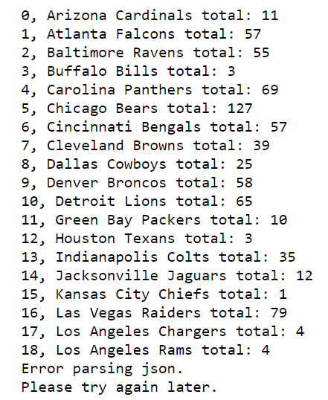
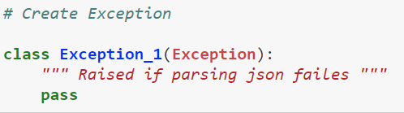
II. Data request, coding challenges and solutions
Some of the query parameters do not exist in the json response Example: some businesses won’t have a price key in the json file, raising errors when trying to read it. Solution, fill the missing information with np.nan.
In order to get around the API errors obtaining data, multiple error exceptions needed to be raised. Example:

Slide 5
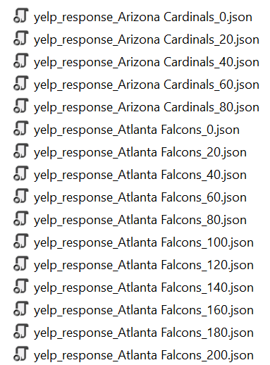
II. Data request and coding challenges.
Data munging:
From 620 json files, clean and format the data for 32 NFL teams.
Identifying (saving) the json file per team.
Read the json files and unify the data requested for each team.
Convert Yelp price format “$, $$, $$$, $$$$” to numbers.
Drop all null and np.nan values.
Data munging method used in this project:
Creation of dictionaries with nested lists and nested tuples as values.

