Slide 1
PROJECT 1
NFL Restaurant density analysis.
Group 4: Christopher Williams, Eric Farrell, Justin Ying, Francisco J. Perez

Slide 2
Table of contents.
Introduction.
Data request and coding challenges.
Restaurant analysis in 2 miles radius around the Stadiums.
Restaurant analysis before and after game day.
Restaurants in most popular cities in the US vs most and least popular NFL teams.
Conclusions.
Team.

Slide 3
I. Introduction.
Hypothesis: We believe the density of restaurants/bars around stadiums amount to a significant percentage of the total restaurants of the country.
Data source:
{Wikipedia} NFL stadiums locations.
{Yelp API} bars & restaurants.
{CSV} US cities dataset.
Questions:
How many restaurants in a 3000 meters radius (approx. 2 miles) are around the stadiums?
How the restaurants (number, type, price, etc.) differ between cities?
How the restaurants reviews compare before game day to the after game day?
How do restaurants/bars score in cities with more popular franchises compare to less popular ones?
Compare restaurants’ ratings between most popular cities (NY, Chicago, Las Vegas, Seattle, San Francisco)
Compare restaurants’ ratings of cities with the most popular teams (Dallas Cowboys, New England Patriots, Pittsburgh Steelers, Green Bay Packers, Seattle Seahawks
Compare restaurants’ ratings of cities with the least popular teams (Jacksonville Jaguars, Tampa Bay Buccaneers, Tennessee Titans, Cincinnati Bengals, Buffalo Bills)

Slide 4
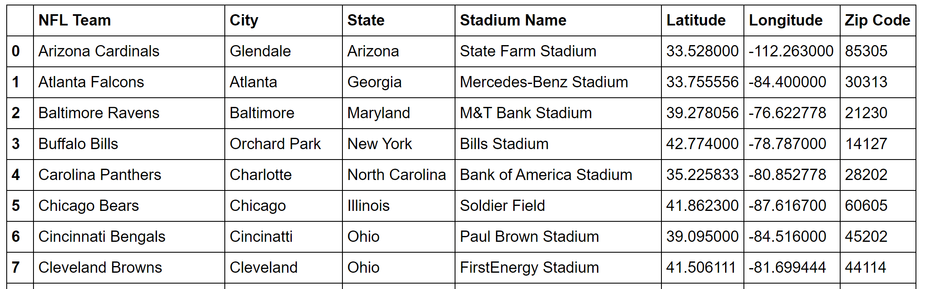
II. Data request and coding challenges.
Data source. Created a csv file with NFL data from Wikipedia and US cities information.
Use Yelp to request data of restaurants in a 3000 meters radius around the NFL Stadiums:
Two different timepoints: Saturday & Monday.
Two different search terms :
General search term: “restaurants”
Search by category: "sportsbars","pubs","wine_bars", "cocktailbars“ (considered as one for our analysis purposes)
Coded to request data based on the day of the week.

Slide 5
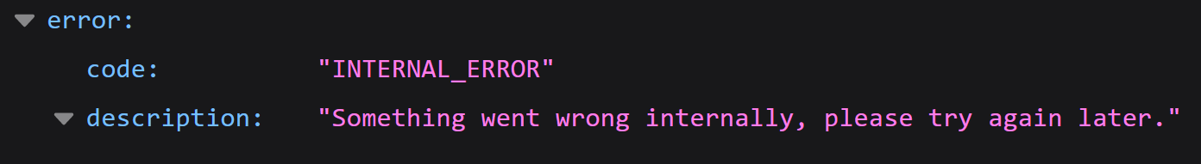
II. Data request and coding challenges.
Yelp API Authentication: API key + Authorization HTTP header value as: “Authorization: Bearer <YOUR ACCESS TOKEN>”.
Data request. Due to the nature of the project (obtaining and analyzing in 2 different timepoints), the response is saved as json files.
Business search endpoint.
Query limit:
This endpoint returns up to 1000 businesses based on the search criteria, although the number of business results to return per response is by default 20 (maximum 50).
Paging the search queries in steps of 20 (using 50 raised more errors) gave us 620 json files per timepoint.
Some of the json files saved didn’t have any information; this error is only noticed when reading the already saved json files and the only way around it is to continuously request the data until there isn’t any “empty” file.

Slide 6
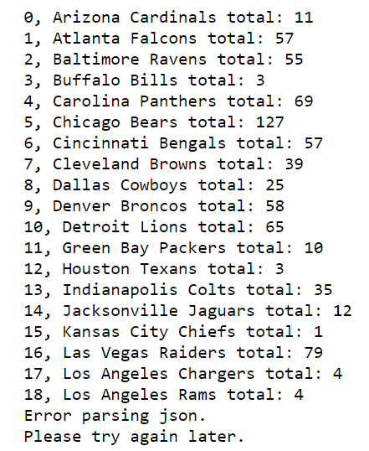
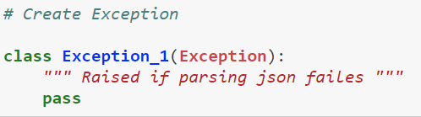
II. Data request, coding challenges and solutions.
Some of the query parameters do not exist in the json response Example: some businesses won’t have a price key in the json file, raising errors when trying to read it. Solution, fill the missing information with np.nan.
In order to get around the API errors obtaining data, multiple error exceptions needed to be raised. Example:

Slide 7
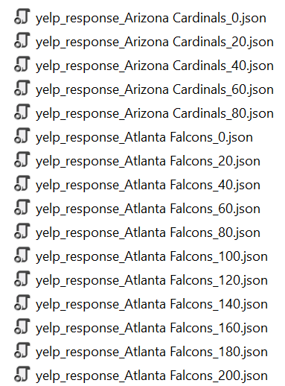
II. Data request and coding challenges.
Data munging:
From 620 json files, clean and format the data for 32 NFL teams.
Identifying (saving) the json file per team.
Read the json files and unify the data requested for each team.
Convert Yelp price format “$, $$, $$$, $$$$” to numbers.
Drop all null and np.nan values.
Data munging method used in this project:
Creation of dictionaries with nested lists and nested tuples as values.

Slide 8
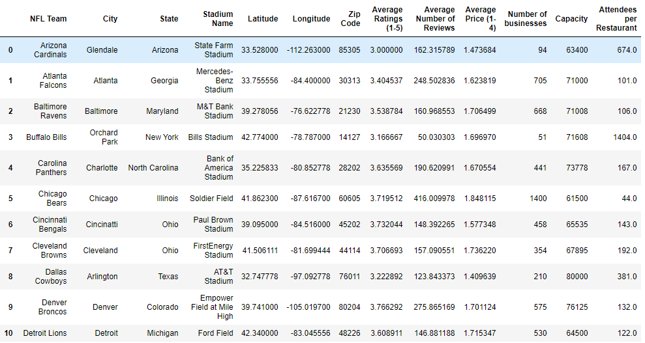
III. Restaurant analysis in 2 miles radius around the Stadiums.

Slide 9
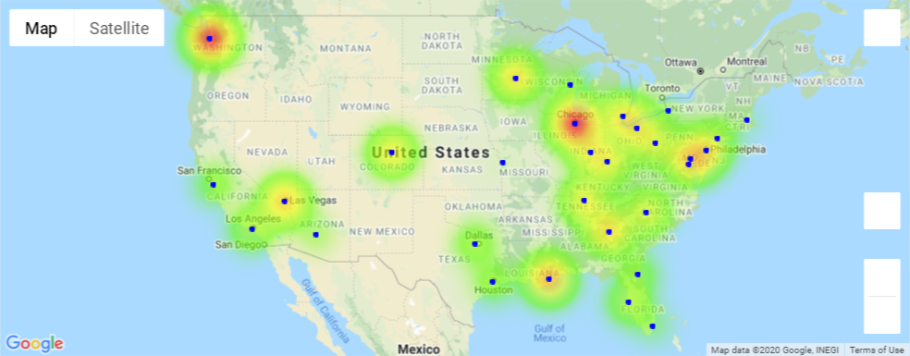
III. Restaurant analysis in 2 miles radius around the Stadiums. - Number of restaurants around each NFL stadium

Slide 10
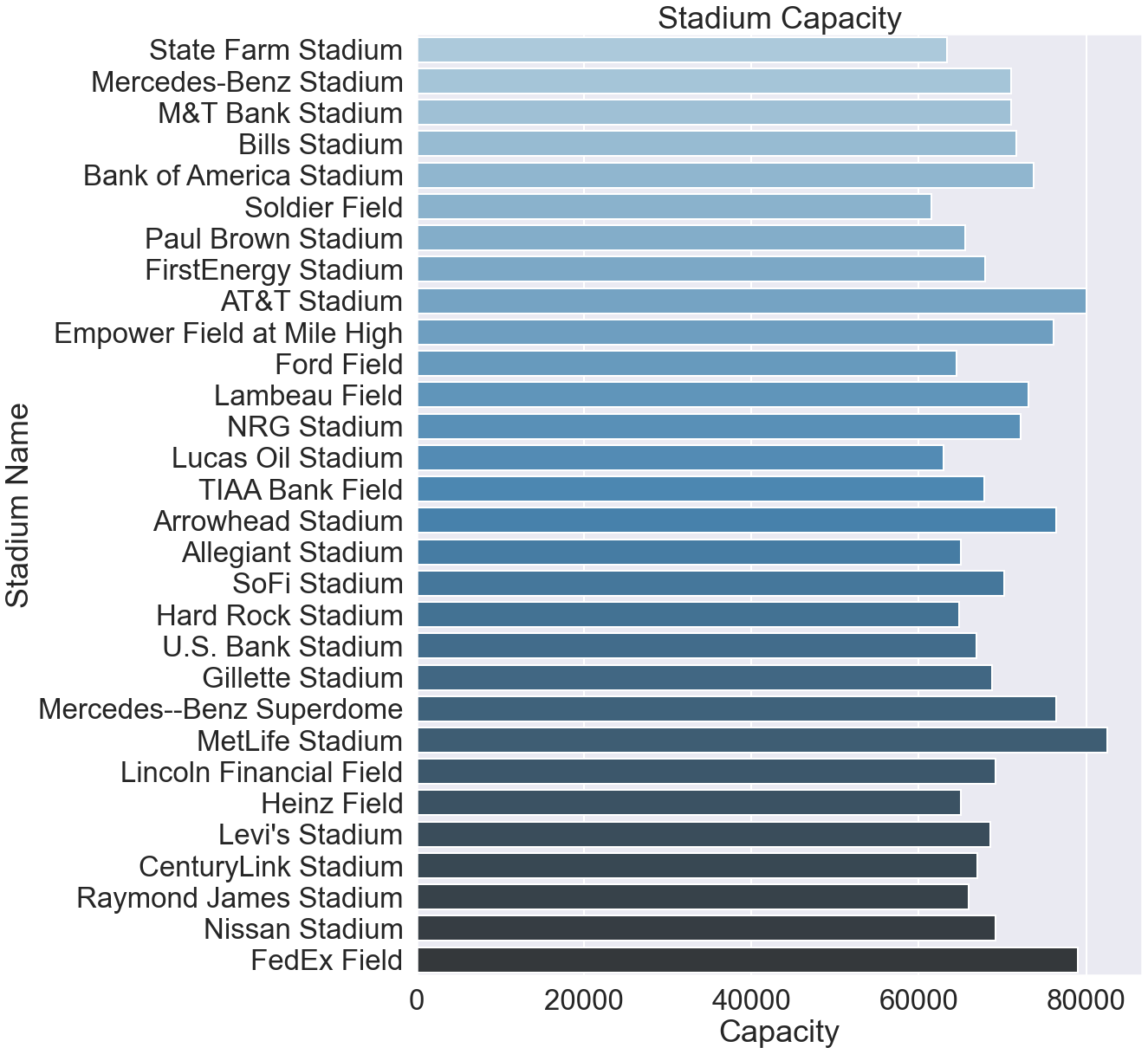
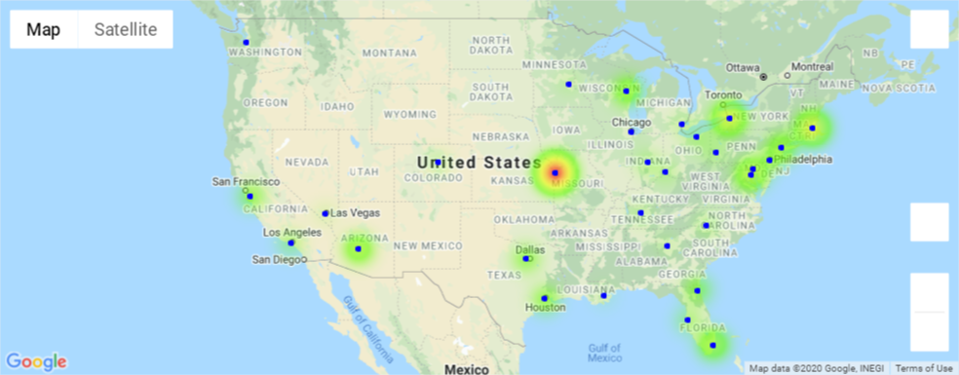
III. Restaurant analysis in 2 miles radius around the Stadiums. - Stadium Capacity and attendees per restaurant.
Not much around Arrowhead Stadium with only 18 restaurants

Slide 11
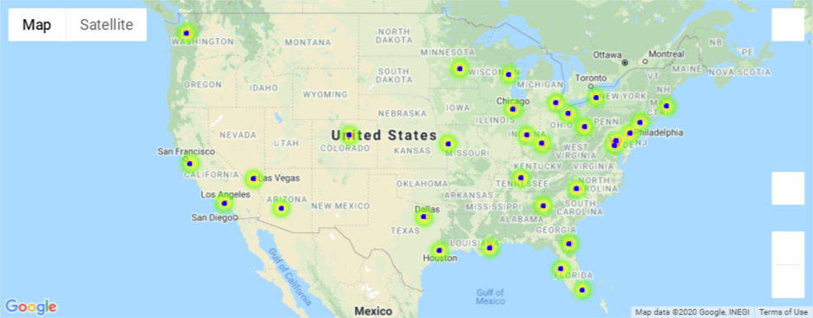
III. Restaurant analysis in 2 miles radius around the Stadiums. - Avg. rating of restaurants around each stadium.

Slide 12
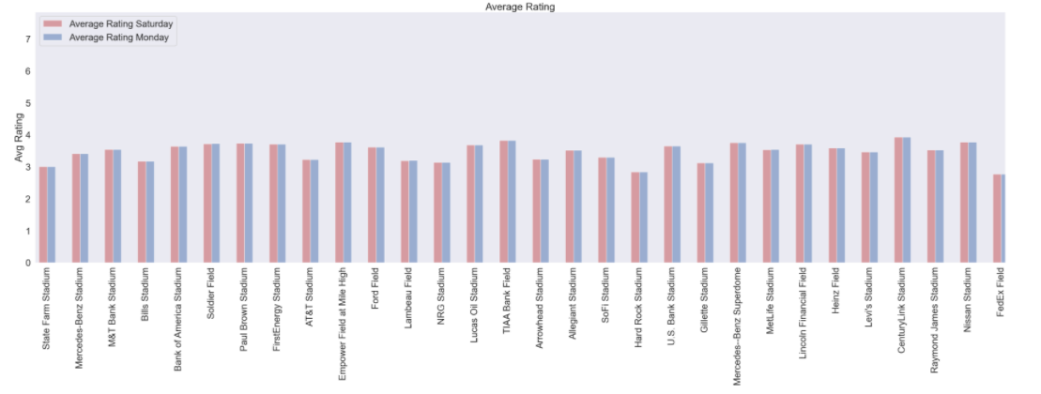

IV. Rating analysis before and after game day.
The Average Rating of 1000 restaurants and the average rating of the them only changed barely for a few stadiums.
Looking at this data over the course of a longer period time for instance a month or year could produce more noticeable results.

Slide 13
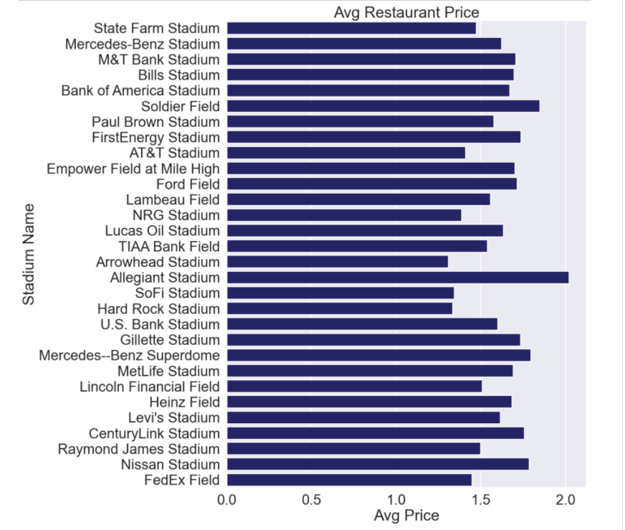
Restaurant Price Scale
The Restaurant Price Scale was represented by “$”. With “$” being the cheapest and “$$$$” being most expensive.
The data shows most teams tend to stay in the lower price range in restaurants around the stadium.
Interesting the most expensive was Allegiant Stadium which is newly built in Las Vegas but has yet to have fans around.

Slide 14
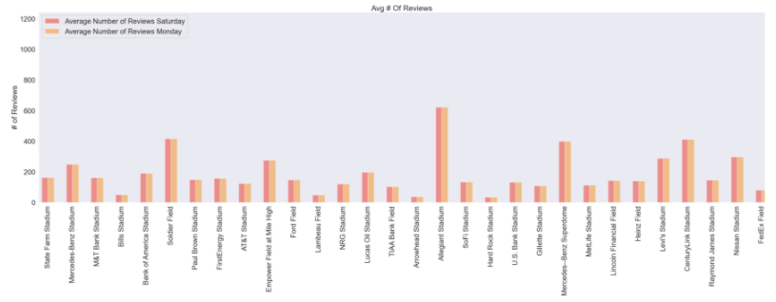
The Average number of Reviews of 1000 restaurants and the average number of the them only changed barely for a few stadiums. One observation is that Allegiant stadium hasn’t had fans but it being in Las Vegas which is popular destination, the numbers could be a little deceiving. Looking at this data over the course of a longer period time for instance a month or year could produce more noticeable results.

Slide 15
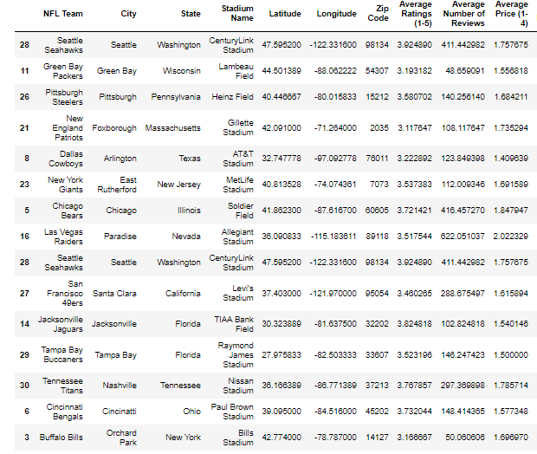
V. Restaurants in most popular cities in the US vs most and least popular NFL teams. - Comparing Restaurants by Team/City Popularity
We compared the data pulled from for the most popular NFL franchises among fans, the most popular cities for people to visit that had NFL teams, and then least popular NFL franchises.
Most Popular Teams:
Dallas Cowboys
New England Patriots
Pittsburgh Steelers
Green Bay Packers
Seattle Seahawks
Most Popular Cities:
New York
Chicago
Las Vegas
Seattle
San Francisco
Least Popular Teams:
Jacksonville Jaguars
Tampa Bay Buccaneers
Tennessee Titans
Cincinnati Bengals
Buffalo Bills

Slide 16
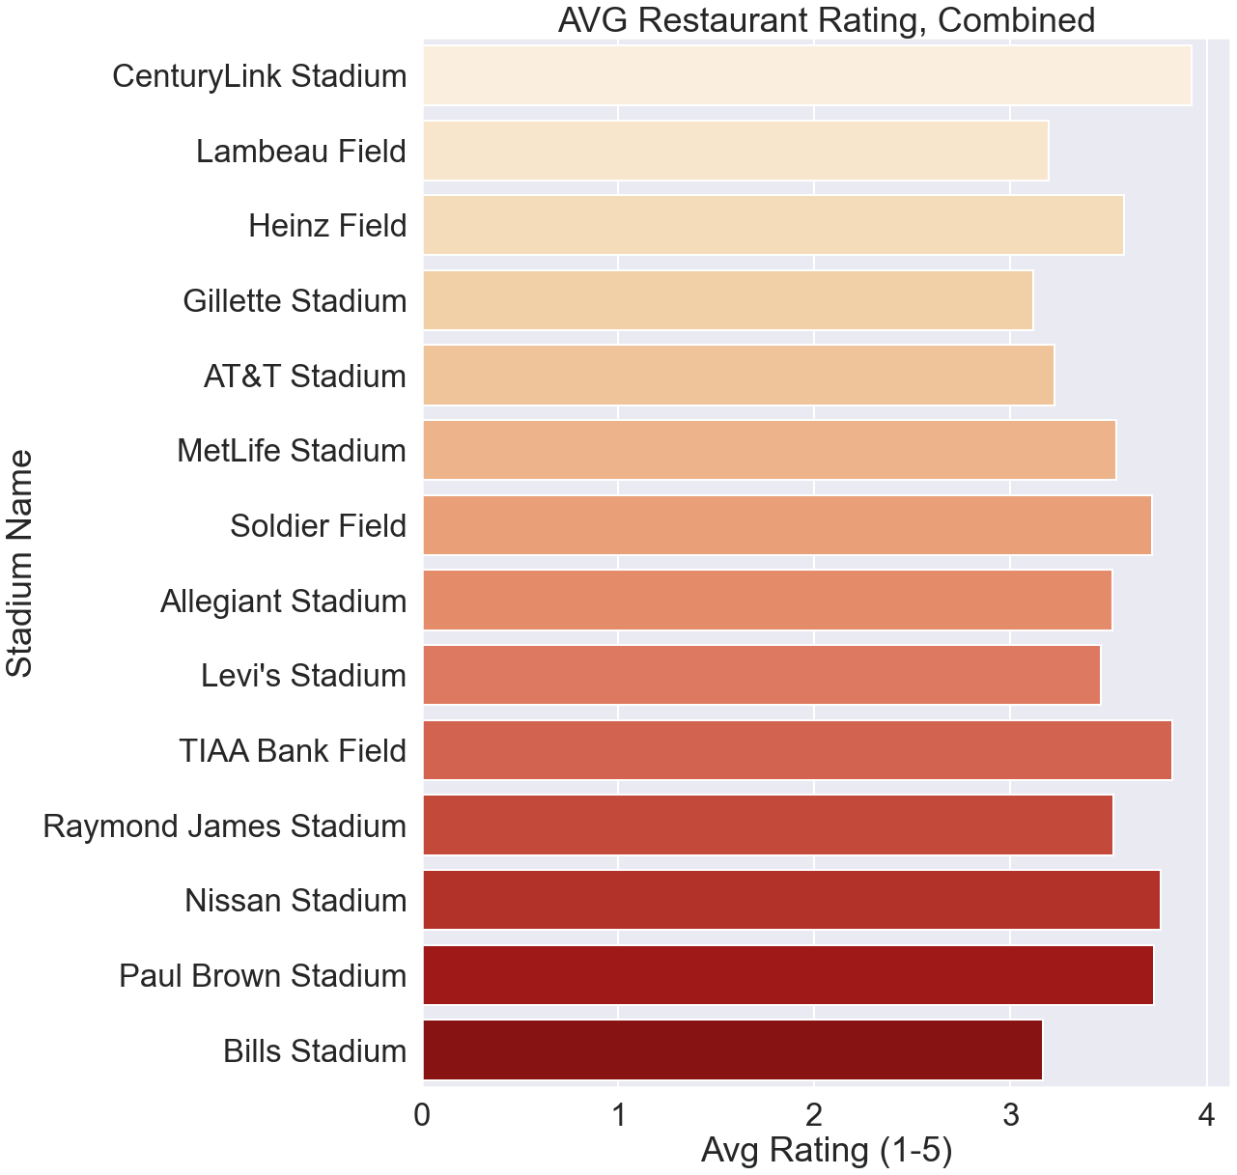
V. Restaurants in most popular cities in the US vs most and least popular NFL teams. - Comparing Ratings by Team/City Popularity
In this chart, we are showing the team’s stadiums and the average restaurant rating that each has in a 3000 meters radius around it.
CenturyLink Stadium (3.92, Seattle Seahawks) has the highest rating while Gillette Stadium (3.12, New England Patriots) had the lowest.
The average rating for each team in this part of the study was 3.55.

Slide 17
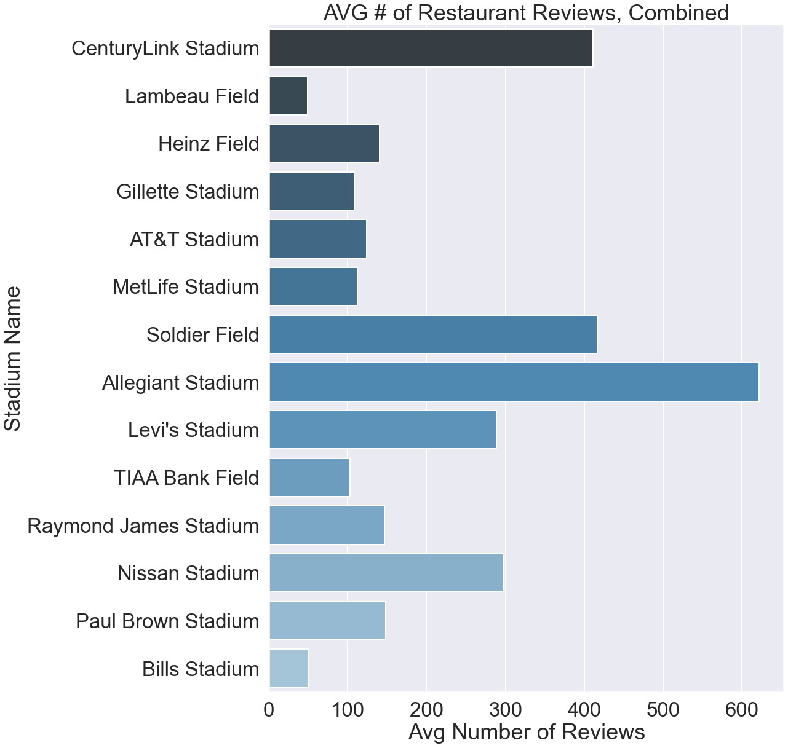
V. Restaurants in most popular cities in the US vs most and least popular NFL teams. -Comparing Number of Reviews by Team/City Popularity
Here is a comparison of the average number of reviews around each stadium.
Allegiant Stadium (Las Vegas), Soldier Field (Chicago), CenturyLink Stadium (Seattle) all had large numbers of reviews left on average.
This could potentially be due to their popularity as tourist spots since all 3 are included in the list of America’s popular travel destinations.

Slide 18
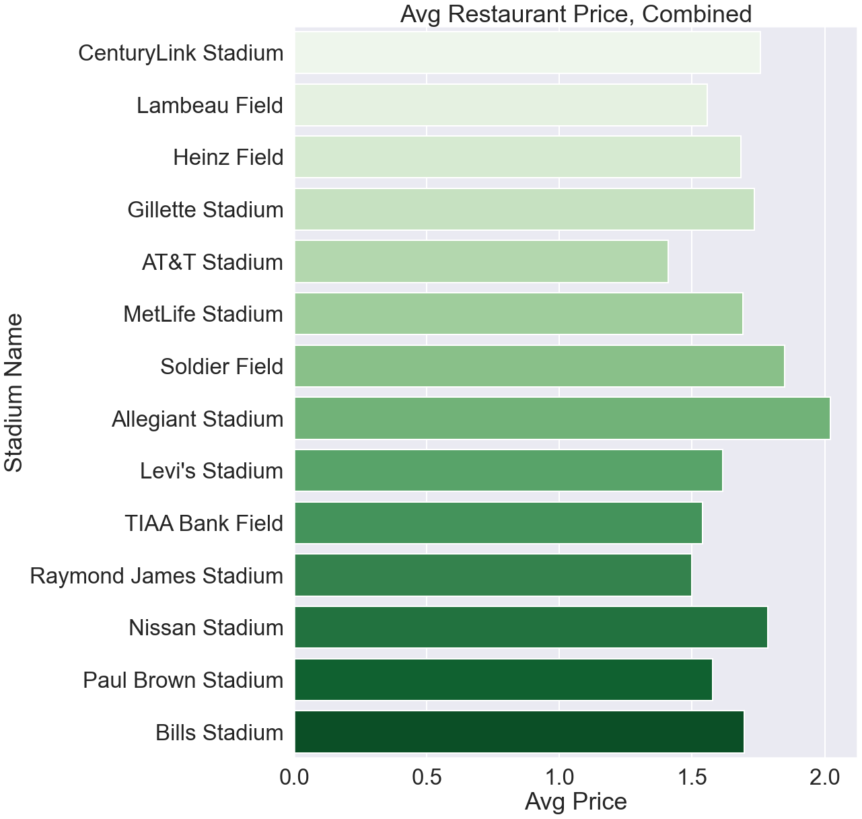
V. Restaurants in most popular cities in the US vs most and least popular NFL teams. - Comparing Price by Team/City Popularity
Yelp has a price system using the dollar sign to signify the average price of a dish at that restaurant.
$ (least expensive) - $$$$ (most expensive)
Based on the results to the right the restaurants around stadiums average between 1.5 and 2.0 $ signs. This means that they are relatively low priced, and we cannot conclude that there is price gouging around stadiums.
Alliegiant Stadium (Las Vegas) has the highest price on average while AT&T (Dallas) has the lowest.
Las Vegas’s high-priced restaurants may be due to the city being a tourist hot spot.

Slide 19
V. Conclusions.
Our initial hypothesis:
The density of restaurants/bars around stadiums amount to a significant percentage of the total restaurants of the country.
According to statistica.com, there are 660,755 restaurants in the US as of spring 2018.
Results: There are more than 12000 restaurants around the NFL Stadiums in a 3000 meters radius. That amounts to a 2% of all restaurants in the USA.

Slide 20
Team
Javier: Gatekeeper, Yelp API (code request, clean and format data, statistics output)
Eric: plotting categories data, question 5.
Justin: plotting summary, question 1.
Chris: plotting Saturday & Monday data, questions 2 & 3

