Slide 1
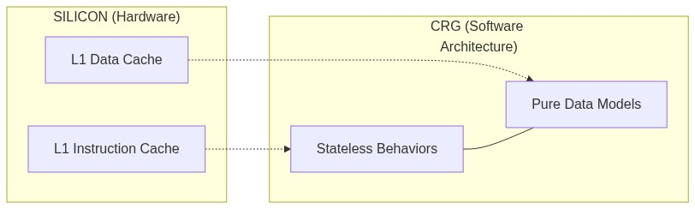
00 - THE HOOK (Hardware-Software Symmetry)
// Hardware Reality: Physical Separation
// L1 Instruction Cache (L1I) <==> Stateless Behaviors
// L1 Data Cache (L1D) <==> Pure Data Models
// The Software Conflict:
struct TraditionalObject {
void Behavior(); // L1I
float Data; // L1D
}; // Forces coupling where hardware demands split.
Notes:
If you look at the silicon of a modern CPU, the Level 1 cache is physically divided in two: the Data Cache (L1D) and the Instruction Cache (L1I). The hardware itself demands a strict separation between state and behavior to reach peak efficiency. Yet, for decades, we have forced them together in our objects. Stateless Behavior Projection is the answer. We stop fighting the hardware. We treat data and logic as two parallel dimensions — mirroring the silicon itself.

Slide 2
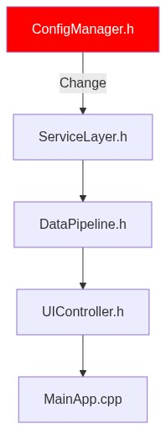
01 - THE COST OF COUPLING (The Build Wall)
// You change this:
struct ConfigManager {
bool b_EnableFeatureX = false; // ← one bool
};
// The compiler punishes everyone:
// config_manager.h -> service_layer.h -> data_pipeline.h -> ui_controller.h
// 217 files recompile. 38 minutes. Every programmer. Every day.
Notes:
You touch a header. One bool. You hit build. 38 minutes later, you're still waiting. That's Include Hell. It doesn't feel like a performance problem; it feels like a morale problem. But it's an architecture problem. Everything is entangled at compile time. CRG cuts that knot: how do you get behaviors to discover each other at link time, with zero shared headers?

Slide 3
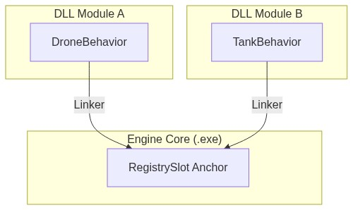
02 - THE INTRUSIVE BACKBONE (NodeList + RegistrySlot)
// RegistrySlot: Anchored definition in engine core
#define CRG_BIND_SLOT(T) template<> T RegistrySlot<T>::s_Value{};
CRG_BIND_SLOT(const BehaviorNode*)
// MODULE A: Zero dependencies on core internals
struct DroneBehavior : NodeList<BehaviorNode, IBehavior> {
void Execute() const override { /* ... */ }
};
static DroneBehavior g_drone; // OS loads DLL, constructor fires.
Notes:
In production, you have modules registering capabilities without the core knowing they exist. CRG_BIND_SLOT anchors the registry in the core, allowing DLLs to resolve to a single address via the linker. Define a struct, instantiate it as a static, and the OS fires the constructor on load. It's a fully functional plugin system obtained for free.

Slide 4
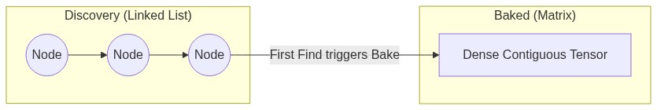
03 - THE BAKING (Taking Back Control)
// DISCOVERY: Linked list traversal (Cache Miss)
for (auto* n = Anchor::s_Value; n; n = n->m_Next) {
if (n->GetID() == modelID) return n;
}
// BAKED: StaticGuard triggers once automatically.
// Flattened into a contiguous matrix.
return s_CapabilityTensor[denseModelID][contextOffset]; // O(1)
Notes:
Static initialization gives us free discovery, but walking a linked list for 100k entities is performance suicide. The Bake solves this: the first time Find() is called, the list is flattened into a dense, contiguous matrix. Lookup becomes a calculation, not a search. We trade dynamic flexibility for static performance.

Slide 5
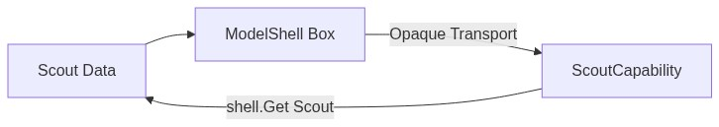
04 - THE OPAQUE TRANSPORT (ModelShell)
class ModelShell {
struct Concept { virtual ModelTypeID GetID() const = 0; };
template<class T> struct Model : Concept { T value; };
alignas(64) std::byte m_SBO[64]; // SBO, Zero heap
public:
template<class T> const T& Get() const {
return static_cast<const Model<T>*>(m_ptr)->value;
}
};
Notes:
ModelShell is a logic-empty shell that carries data and preserves identity across boundaries. The only job is data transport. It uses Small Buffer Optimization (SBO) to ensure zero heap allocation and fits within a cache line. The data recovery via Get<T>() only happens inside the behavior that knows the type.

Slide 6
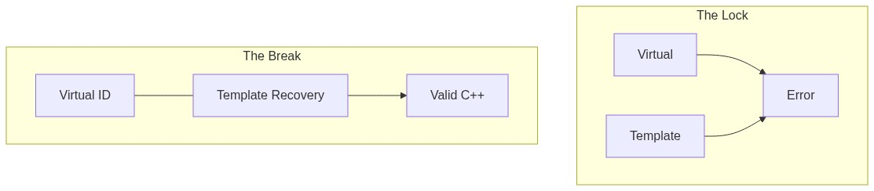
05 - THE VIRTUAL DEADLOCK (Breaking the Lock)
// THE PROBLEM: Virtual + Template = Illegal
struct IShape {
template<class T> virtual T Get() = 0; // compiler error
};
// THE BREAK: Split concerns
struct Concept {
virtual ModelTypeID GetID() const = 0; // Identity
};
template<class T>
const T& Get() const { ... } // Template Data Recovery
Notes:
C++ forbids virtual template methods — the 'Virtual Deadlock'. ModelShell breaks this by splitting the concerns: one virtual method (GetID()) for identity, and a non-virtual template method (Get<T>()) for data recovery. One virtual jump to identify, one static_cast to recover. The lock is broken.

Slide 7
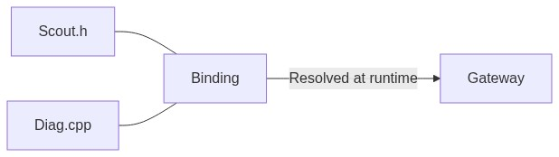
06 - IDENTITY DECOUPLING (The Capability Binding)
// DATA: scout.h (Pure state)
struct Scout { string callsign; int health; };
// LOGIC: diag.cpp (Pure logic)
struct Diagnostic : IDiagnostic {
void Execute(const ModelShell& shell) const { ... }
};
// BINDING: wire.cpp (The wire)
static const CapabilityBinding<Scout, Diagnostic> g_ScoutDiag;
Notes:
Data, Logic, and Binding are orthogonal dimensions that never include each other. The Gateway resolves them at runtime through the baked matrix. You can add a new capability by dropping a new .cpp file with a static binding. We compose systems at link time, not at compile time.

Slide 8
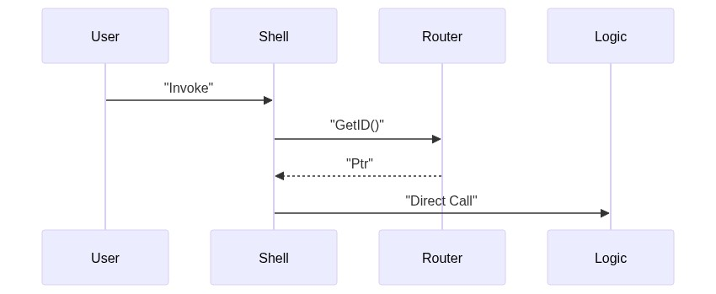
07 - THE OOP ILLUSION (Invoke / TryInvoke)
// Cold Path: Clean OOP syntax
shell.Invoke<&IMovement::Move>(ctx);
// Analyzed at compile-time:
// 1. Extracts Interface (IMovement)
// 2. Validates signature
// 3. One virtual jump + O(1) tensor
// 4. Direct call
Notes:
Invoke and TryInvoke provide an OOP illusion for the cold path. The method pointer is analyzed at compile time to extract the interface and validate the signature. It pays one virtual call to recover the type, then jumps into the tensor. Use it for queries, never in a hot loop.

Slide 9
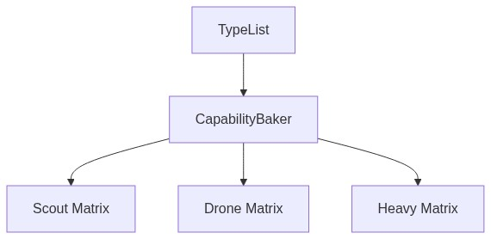
08 - THE BAKER (One Line, N Models)
using AirModels = TypeList<Scout, Drone, Heavy>;
// One line. All models. All capabilities.
static const CapabilityBaker<AirModels, Diag, Tele> g_AirBaker;
Notes:
Manual registration doesn't scale. The Baker fixes this by expanding a TypeList of models across templatized capabilities. One static line generates N entries in the matrix. Group definitions by domain and let the matrix build itself.

Slide 10

09 - THE PRICE OF FREEDOM (O(N) Search)
// Current Find() bottleneck:
for (const auto* node : RouterSlot::s_Value) {
if (node->GetID() == modelID) // comparison
return node->Resolve(iid);
}
Notes:
The Baker is elegant, but Find() is still O(N) over the number of registered models. For 100k entities, this is a bottleneck. We need pure math: compute an offset and jump. But hashes can't be array indices. We need to collapse the sparse ID universe.

Slide 11
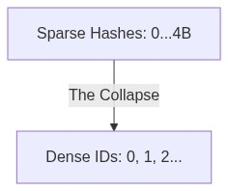
10 - THE ID EXPLOSION (The Sparse Universe)
// typeid().hash_code() is sparse (0 to 4B)
// Scout -> 0x4A1F...
// Drone -> 0x9B3D...
// THE COLLAPSE: DenseTypeID
template<class T>
struct DenseTypeID {
static DenseID Get() {
static DenseID s_id = Counter++; // 0, 1, 2...
return s_id;
}
};
Notes:
ModelTypeIDs are arbitrary hashes scattered across a 4-billion slot space. You can't index an array with them. DenseTypeID collapses this sparse universe into consecutive integers (0, 1, 2...) assigned at startup. Now lookup is one array access.

Slide 12
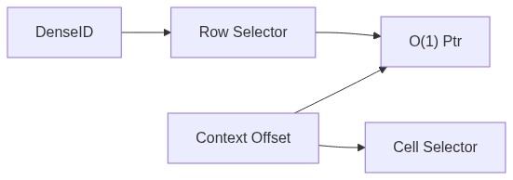
11 - THE DENSE INDEXER (Collapse in Action)
// THE FLAT TENSOR: Rows = DenseID, Columns = Offset
static vector<vector<RouteNode*>> s_Tensor;
// Lookup: two array accesses
return s_Tensor[denseID][offset];
Notes:
DenseID is thread-safe (C++11 static local) and assigned exactly once per type. We build a flat tensor where rows are DenseIDs and columns are context offsets. No loop, no comparison, no hash collision. Finding a capability is now just a question of 'what is the offset?'.

Slide 13
12 - THE HYPERCUBE (N-Dimensional Space)
// Horner's Method: Resolve N-dims into 1 offset
// offset = (State * Zone_count) + Zone
template<class... TAxes>
struct Space {
static constexpr size_t Volume = (EnumTraits<TAxes>::Count * ...);
static size_t ComputeOffset(Args... args) { ... }
};
Notes:
A behavior depends on context axes: State, Zone, Authority. Space encodes these at compile time. ComputeOffset uses Horner's method — one accumulation, no branches. Whether you have one dimension or ten, the lookup cost stays flat: two array accesses. Complexity is free.

Slide 14
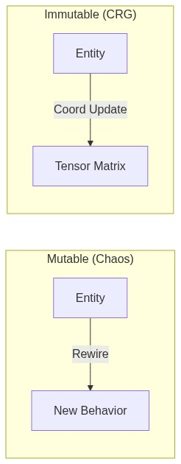
13 - THE CRG CURE (Immutable Topology)
// MUTABLE: Behavior change = structural rewire
behaviors.remove(entity, patrol); // prefetcher loses stream
// CRG: Behavior change = coordinate update
world_state = State::Combat; // matrix: unchanged.
Notes:
In a mutable topology, behavior changes are structural operations that break the CPU prefetcher. In CRG, the matrix is frozen. A behavior transition is just a coordinate update. The memory addresses never change, so the prefetcher never loses its stream. Immutability is a performance guarantee.

Slide 15
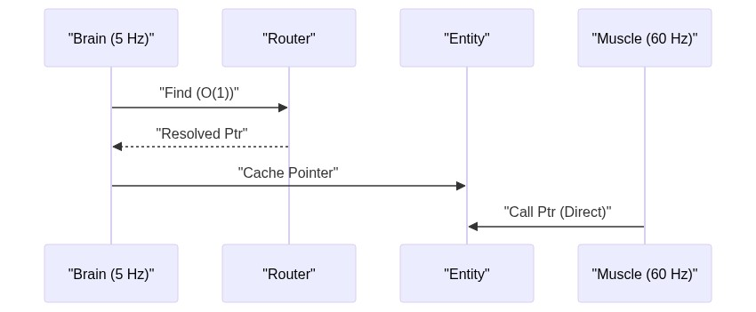
14 - ECS SYMBIOSIS (The Brain & The Muscle)
// THE BRAIN (5 Hz): Decision
cap = Router::Find<Energy>(handle, state, zone);
// THE MUSCLE (60 Hz): Execution
for (auto& [battery, cap] : ecs.View<ActiveCapability>()) {
cap(params); // Direct static call
}
Notes:
ECS manages the data pipeline (Muscle); CRG manages logic projection (Brain). The Brain ticks at 5Hz, makes the decision via O(1) lookup, and caches it in ActiveCapability. The Muscle ticks at 60fps, iterating packed arrays and calling the pointer directly. We are bottlenecked by RAM, not logic.

Slide 16
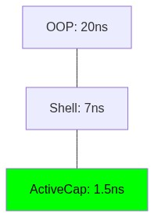
15 - THREE LEVELS (The Performance Ladder)
// Level 1: Classic OOP vtable -> ~20.0 ns
entity.GetBehavior()->Update();
// Level 2: CRG Shell (Cold Path) -> ~7.0 ns
shell.Invoke<&IMovement::Move>();
// Level 3: ActiveCapability (DOD) -> ~1.5 ns
cap(params); // Zero virtual. Direct ptr.
Notes:
Three levels of speed. Level 1: classic OOP vtable dispatch (~20ns). Level 2: CRG Shell Invoke, paying a virtual jump for type erasure (~7ns) — perfect for cold paths. Level 3: ActiveCapability, cached results called directly via function pointer (1.5ns). We've reached the physical hardware limit.

Slide 17
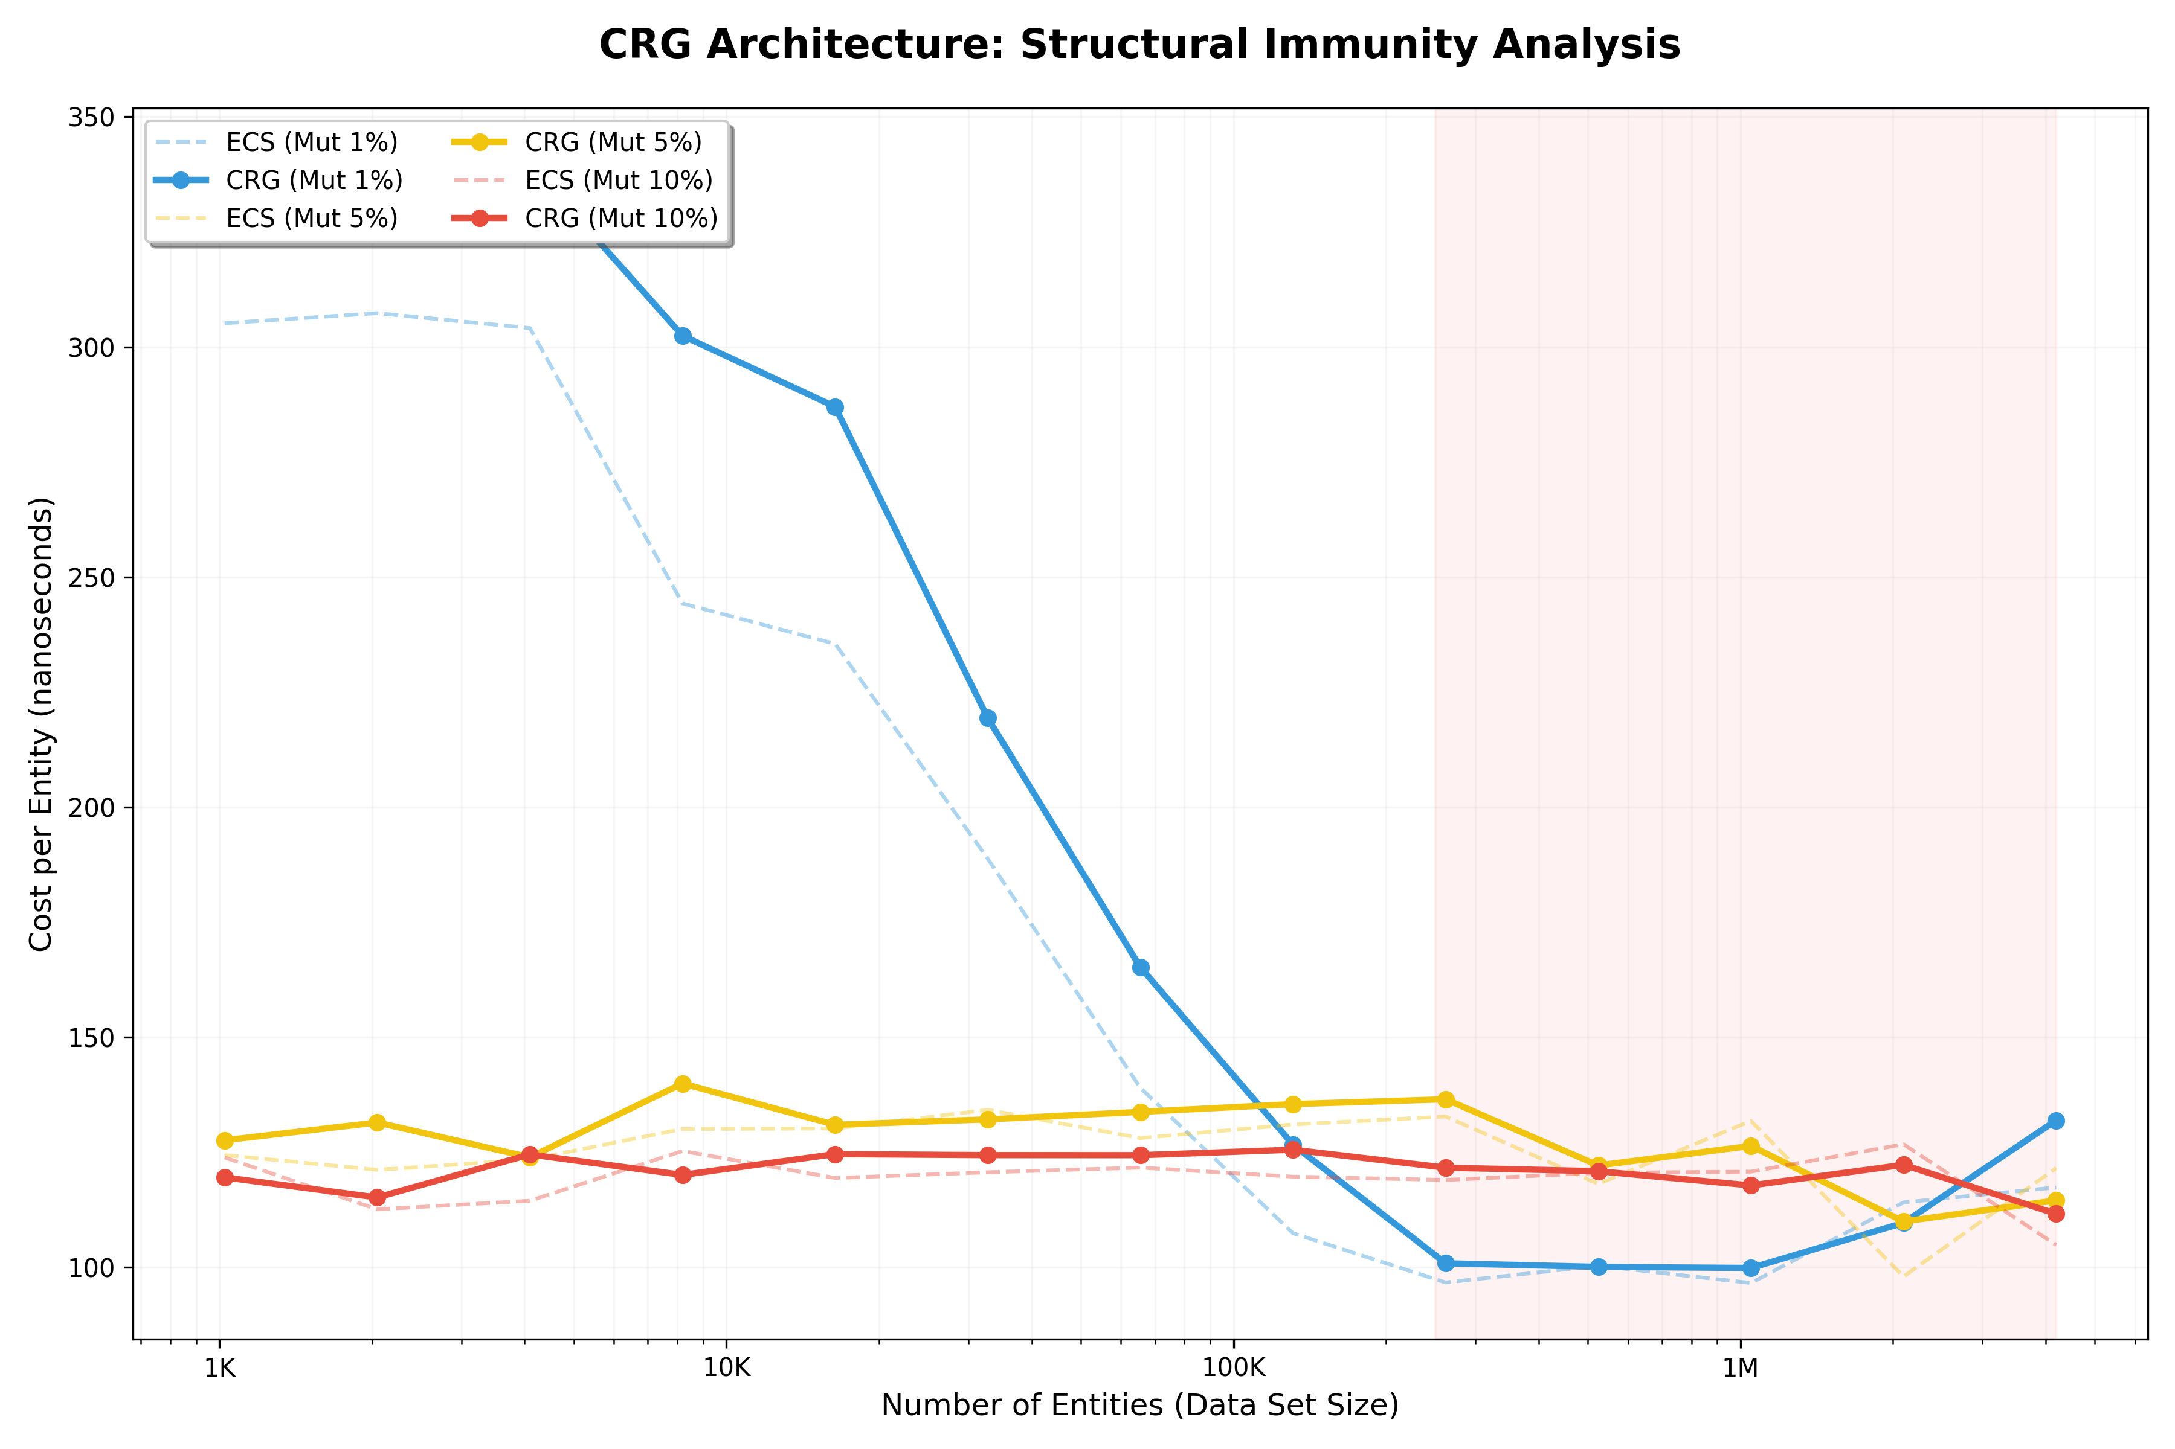

16 - REACHING THE SILICON LIMIT (Benchmarks)
Scan to challenge these results live
Notes:
This is the physical reality of the Memory Wall. At a 10% mutation rate, traditional ECS architectures drop to 19 Gi/s because the CPU is busy moving memory instead of executing logic. CRG sustains over 30 Gi/s because the topology is immutable. Note the QR code on the right: you can scan it now to access the live simulator and verify these performance metrics on your own device during the Q&A.

Slide 18
17 - STRESS TEST SIMULATION (High Volatility)
Scan to challenge these results live
Notes:
In this visual stress test at 50,000 entities, you can see the ECS frame-time (in red) skyrocketing as soon as we introduce behavioral volatility. Every archetype change is a memory copy that destroys cache locality. The green line represents CRG: it remains a flat line because it treats transitions as coordinate updates, not structural rewires. Feel free to use the simulator link to adjust the mutation rate yourself.

Slide 19
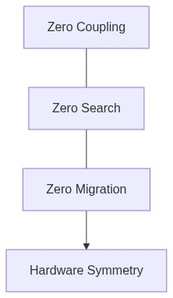
18 - CONCLUSION
// 1. Zero Coupling (Linker)
// 2. Zero Search (Math)
// 3. Zero Migration (Hardware)
// CRG is what happens when you
// stop fighting C++.
Notes:
CRG is a linker-driven dispatch framework for any C++ system needing decoupling and performance. Three guarantees: Zero coupling (modules self-register), Zero search (context is a coordinate), Zero migration (topology is immutable). Stop fighting C++ and the hardware. Give them what they were built for.

