Slide 1
T:O
TokenOptimizer
Two skills that optimise AI token usage in feature development
Compress the PRD · anchor plans to real code · route to the right model — and prove it with A/B evidence.
Hackcelerate — Token Optimisation · 15 Jul 2026

Slide 2
WHY THIS MATTERS
The Problem
• Large, verbose PRDs are fed straight into LLMs — high input-token cost on every call.
• AI plans reference vague or hallucinated file locations — wasted regeneration cycles, low trust.
• Every task, trivial or complex, hits the most expensive model — overspending on simple work.
• No measurable quality baseline — cost cuts risk silently degrading output.
Net effect: rising AI spend, inconsistent quality, and no data-driven way to prove ROI.
TokenOptimizer — Hackcelerate
2

Slide 3
OPTIMISE TOKENS, KEEP QUALITY
The Solution — Two Skills
SKILL 1
PRD Compression
Distils a verbose PRD into dense, structured requirement atoms before it reaches the model — ~67% fewer input tokens, acceptance criteria kept verbatim.
SKILL 2
Anchoring + Routing
Anchors every plan step to a real file:line reference (flagging hallucinations), and routes each task to the cheapest capable model.
TokenOptimizer — Hackcelerate
3

Slide 4
~67% FEWER INPUT TOKENS
Skill 1 · PRD Compression
• Strips boilerplate, framing, hedging and formatting noise.
• Extracts only decision-relevant requirements: goals, constraints, acceptance criteria, non-functional, dependencies, out-of-scope.
• Preserves acceptance criteria verbatim — the build is never checked against a paraphrase.
• Deterministic and fully offline — no API key, no model required.
Result: ~73% smaller PRDs with no loss of decision-critical content.
TokenOptimizer — Hackcelerate
4

Slide 5
GROUNDED OUTPUT, SMART SPEND
Skill 2 · Codebase Anchoring + Model Routing
• Indexes the repo (AST for Python, regex for JS/TS/Java/Go/Ruby/C#) into a file:line symbol table.
• Anchors each plan step to real references; unresolved symbols are flagged as possible hallucinations.
• Classifies task complexity (trivial / standard / complex) with a confidence score.
• Routes trivial → Haiku, standard → Sonnet, complex → Opus; low confidence upgrades toward premium.
Fewer hallucination-driven rework loops + the cheapest capable model per task.
TokenOptimizer — Hackcelerate
5

Slide 6
END-TO-END FLOW
How It Works
Raw PRD
Compress
Anchor plan (file:line)
Route model
LLM call
Metrics + Dashboard
Deterministic and offline-first: every stage works with no API key; a Claude key or local model only improves quality.
TokenOptimizer — Hackcelerate
6

Slide 7
8 A/B TESTS ACROSS 2 BUSINESS UNITS
Validated Results
58%
73%
24.0/25
2,413
Avg cost savings
Avg PRD compression
Avg quality (optimised)
Total tokens saved
Baseline quality averaged 19.5/25 — optimised is equal or higher in every case, at a fraction of the cost.
TokenOptimizer — Hackcelerate
7

Slide 8
25-POINT RUBRIC, PER FEATURE REQUEST
Quality — Baseline vs Optimised
TokenOptimizer — Hackcelerate
8

Slide 9
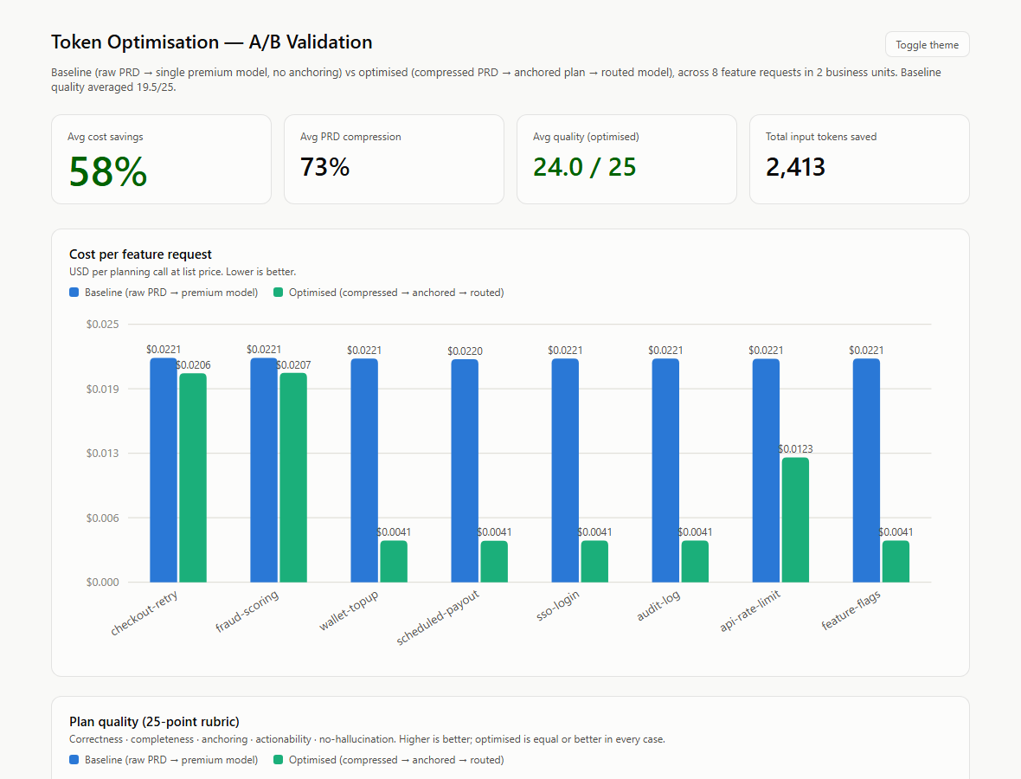
DESKTOP APP · CLI · DASHBOARD · GUIDED DEMO
The Product
Desktop app (3 tabs)
Token Optimizer, Feature-Dev Skills, and a Dashboard with native charts.
CLI (tokenopt)
compress-prd · anchor-plan · route · ab-suite · dashboard.
Guided demo
Help → Guided Demo: an automated tour that runs each feature live.
Skill plugins
Self-contained, independently-maintained packages under skills/ (code + SKILL.md + tests).
In-app A/B validation dashboard
TokenOptimizer — Hackcelerate
9

Slide 10
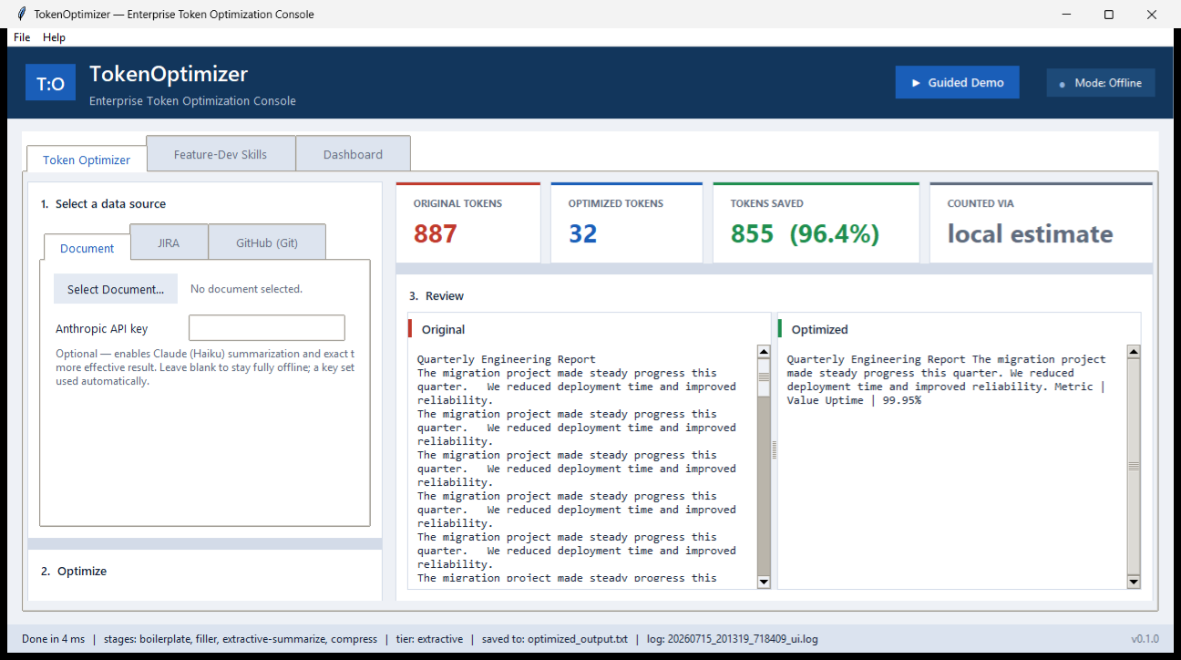
NARRATED WALKTHROUGH OF EVERY FEATURE
Demo Video
A 3:14 narrated video
16 scenes with voice-over and on-screen captions.
Covers every feature
Document / JIRA / GitHub optimization, the offline pipeline, both skills, A/B validation, the dashboard, the guided demo, and the CLI.
Reproducible & offline
Built with scripts/generate_demo_video.py (SAPI voice-over + ffmpeg).
File: docs/TokenOptimizer-Demo.mp4
▶
TokenOptimizer-Demo.mp4 · 3:14 · voice-over
TokenOptimizer — Hackcelerate
10

Slide 11
LAYERED, OFFLINE-FIRST
Architecture
Interfaces
CLI · Desktop UI · Packaged skills
Skills & Evaluation
prd · anchor · router · A/B runner · dashboard
Optimize
reductions · compress · summarize · prefilter · tokens
Integrations
JIRA · GitHub · GitLab · Jenkins · Azure DevOps · documents
Core
config · run_log · llm (client + cache)
TokenOptimizer — Hackcelerate
11

Slide 12
WHY IT SCALES
Business Value
• Direct cost savings of up to ~58% on AI-assisted development spend.
• Validated across 2 business units — extensible to the whole org.
• Higher trust in AI output through verifiable file:line anchoring.
• Data-driven — every claim backed by A/B evidence, not anecdote.
Offline-first: real savings with no API key; better still with Claude or a local model.
TokenOptimizer — Hackcelerate
12

Slide 13
35% cheaper. Equal or better quality.
Validated across 8 A/B tests and 2 business units — ~73% compression, ~58% savings, 24.0/25 quality.
Thank you · TokenOptimizer

