Slide 1
IEEE HACKATHON 2019
Green Peas - Calvin Tantio, Sri Vatsa, Sajjad Ali, Eugene Tan

Slide 2
Education
Scope: Education in Environmental Sustainability
Target audience: Millennial consumers and Gen Z
Aim: Educate customers to make more environmentally sustainable choices

Slide 3
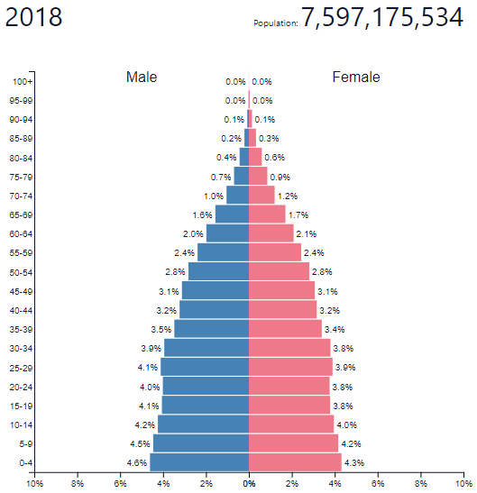
Why Millennials & Gen Z?
Care about the impact of our choices
Unsure of how our choices actually affect the environment
Making up a significant population in the world
M + Z
Image: populationpyramid

Slide 4
Solution
GreenPeas app
Compares the environmental score of different items
Rewards users points for choosing more sustainable options
Plant trees

Slide 5
Solution
GreenPeas app
Focus on furniture for now
Uses Machine learning to compare choices
Generates reward code to earn points
Accumulate points to plant trees overseas

Slide 6
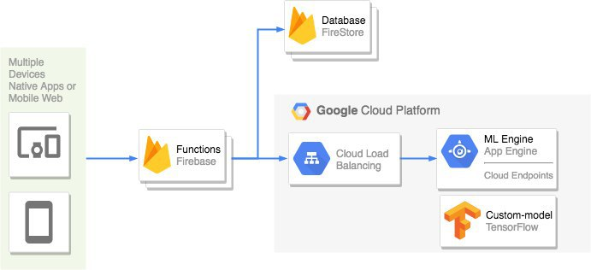
Architecture Diagram

Slide 7
Demo

